Slide 1
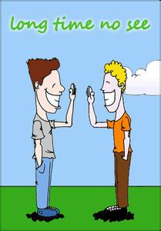
Unit 6
Verbal Communication

Slide 2
Learning Objectives
In this unit, you are to know the differences of verbal communication
between English and Chinese in the following aspects:
1.Forms of address称呼(称谓尊称谦称等)
2.Introduction介绍
3.Greetings打招呼
4.Parting告别
5.Gratitude感谢
6.Invitation邀请
7.Compliments赞扬
8.Apology道歉
9.Making phone calls打电话

Slide 3
Procedures
Warm-up
1
Text Study
2
Practice
3
3
Assignments
4
4

Slide 4

I. Warm-up
Case1:Mr.Eric or Mr. Xin?
What mistakes do the two people make in addressing each other?

Slide 5

Analysis
The case shows the conflict between a Chinese and a native English-speaker on addressing forms.
misunderstanding conflict

Slide 6
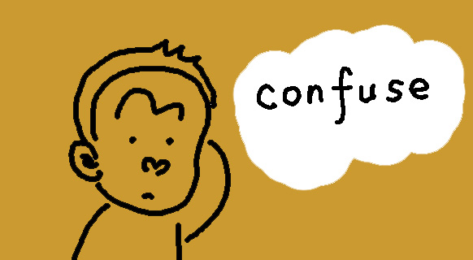
I.Warm-up
Case2:Am I wrong?
Why did the German feel puzzled or surprised when he offered compliments to the Chinese people?

Slide 7
Analysis
The case shows the conflict between Chinese people and Westerners on complimenting.
misunderstanding conflict

Slide 8

II. Text Study
Go over textbooks from pages 73 to 86 and make a comparison of daily verbal communication between English and Chinese.

Slide 9
II. Text Study
In daily verbal communication, there are many
routine ways one must follow in order to maintain
effective cross-cultural communication.
In the following, we are going to compare
different ways of some daily verbal communication
in English and Chinese

Slide 10
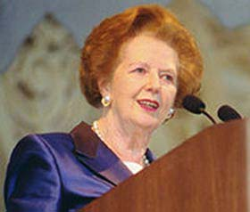
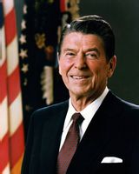
2.1. forms of address
2.1.1.personal names of addressing
a) frequency
English: more often
Chinese: less often
b) formation
English: given name/Christian name+ family name
Most of the English people have three names: first name + middle name+ family
name. British people habitually shorten both their Christian names and middle
names, e.g. M. H. Thatcher；Margaret Hilda Thatcher while American people
only habitually shorten their middle names, e.g. Ronald. W. Reagan: Ronald
Wilson Reagan
Chinese: family name+ given name.

Slide 11
Form of Address
Names:
a surname (family name)/a given name
赵
卫国
Andrew Lewis
surname
given name
given name
surname
collectivism
individualism
primitive society
Xia/Shang Dynasty
Given names came into being before surnames.

Slide 12
2.1.2.titles of addressing
English: smaller number of titles
English-speaking people have only a limited number of titles to be used
before a person’s last name — Doctor, Professor, Judge, Queen, President,
Senator, Governor, Mayor, General, Colonel, Captain队长/船长/机长/舰长/上尉
（陆军）/上校（海军, Father（神父, etc. Dr. Brown, Professor Davis, Queen
Elizabeth, President Roosevelt, General Patten, Father White, etc.
Father, General, Colonel and waiter, boy, conductor can also be used alone.
Chinese: larger number of titles
It is quite common for the Chinese people to use position-linked or
occupation- linked titles (teacher, manager and director) to address people, such
as 李老师、王经理、张主任，but in English, people don’t usually address: Teacher Li, Manager Wang or Director Zhang.

Slide 13
vice, deputy, associate
■ vice, deputy
usually for the titles of administration行政头衔
vice-president (premier, chairman, minister, governor)；deputy-director (secretary, dean, mayor)
■ associate
usually for the titles of academics学术头衔
associate professor副教授
  associate research fellow副研究员
  associate judge副审判长
  associate doctor副主任医师

Slide 14
2.1.3.kinship terms of addressing
English: more general and with fewer kinship terms of addressing
As in Chinese, English kinship terms are usually used to address family
members. They can also be used to address people outside the family, e.g.
Uncle Sam, but generally there are fewer such cases in English than in Chinese. Brother, sister ,grandson, grandpa, grandma, aunt, uncle,, nephew, niece,
cousin, etc.
Brother Joseph or Sister Mary would commonly be understood as referring
to persons belonging to a catholic group or some religious or professional
society.
Chinese: more specific and with more kinship terms of addressing
哥哥/弟弟，姐姐/妹妹，孙子/外孙子，爷爷/外公，奶奶/外婆，伯母/婶/娘/舅妈/姑妈/姨妈，叔叔/伯伯/舅舅/姨夫/姑父，侄子/外甥，侄女/甥女，堂兄（弟）/堂姐(妹)/表姐(妹)，

Slide 15
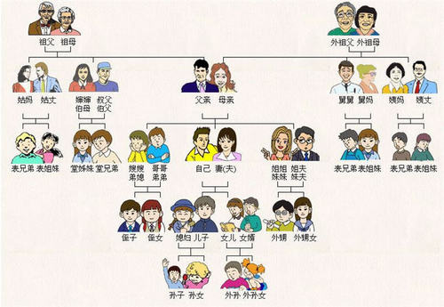

Slide 16
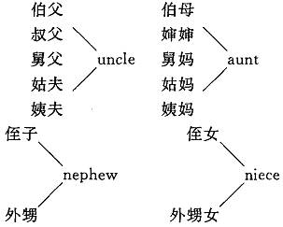
Kinship terms

Slide 17
2.1.4.general terms of addressing
English:
Mr. Mrs. Miss, Ms, Sir, Madam/lady, gentleman
1) “ Mr.” can be used together with full name, surname or titles, e.g. Mr. John Smith, Mr.Smith, Mr. Chairman, Mr. President, Mr. America 2018(2018年美国健美赛冠军)
2) “Mrs.” can be used to address married women, it can be used together with husband’s family name or the married woman’s name, e.g. Mrs. Jones, Mrs. Marry Jones
3) “Miss” can be used alone or together with family names , titles, e.g. “Can you show me the bag, Miss?”, Miss White, Miss England, 2018 (2018年英格兰选美冠军)
4)“Ms” is used before the first name/surname of a married or unmarried woman ( especially when the addresser is not sure whether the addressee is married or not, e.g. Ms White, Ms Mary Green
5)“Sir or Madam” is often used alone to show respect: Good morning, Sir. Yes, Sir, Thank you Madam etc. If “Sir” is followed by full name or Christian name ,it refers to the rank of nobility(爵位),e.g. Sir John White or Sir John. “Madam” can be used together with family name or titles, e.g. Madam Smith, Madam President, Madam Chairman
6) “Lady and Gentleman” can be used together with family name or titles, Lady Smith, Lady President. “Good morning, ladies and gentleman!”
Chinese:
“同志” 、“师傅” 、“老师” 、“老板”、“先生”、“帅哥”、“小姐”、“美女” 。
“先生” in Chinese is not completely equal to “Mr.” or “Sir” as it can also be used to address
respected females, e.g. “宋先生” for “宋庆龄” .

Slide 18
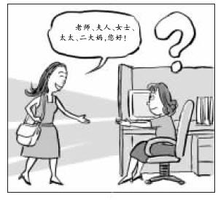
How to address?

Slide 19
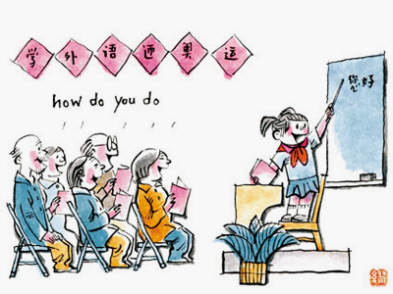
2.1.5.Respecting terms of addressing
English:
His/Her/Your Majesty(陛下), Your Highness(殿下), Your Excellency/Honor (阁下/大人)；
Chinese:
您（的），君，老，公,
e.g. 李君，王老，张公，您老, etc.
There is “你好！”, “您好！”in Chinese, but there is only “How do you do?” in
English

Slide 20
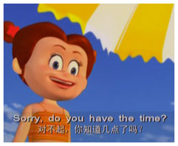
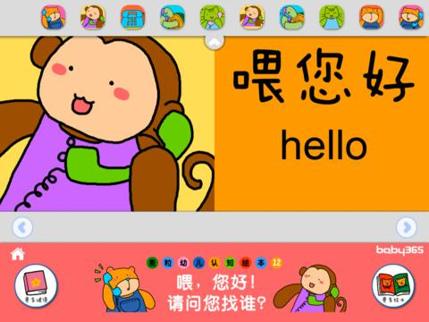
2.1.6. non-naming addressing
In English, people usually use “Hi”、 “Hello”, “Excuse me” , “ Sorry” or “Could you tell me…?” to address a stranger.
While in Chinese, people usually use“喂”, “嗨”，“那个谁” to address a stranger.

Slide 21
2.1.7. Pet Names昵称
English:
1)Elizabeth 伊丽莎白（devoted to God忠于上帝: there are 16 pet names for this pet name. Bess(贝
丝) ,Bessie (贝茜) ,Beth (贝思) ,Betsy (贝特茜) ,Bett] (贝蒂) ,Elsie(茜) ,Elise (艾丽丝) ,Libby (莉比) ,Lisa
(莉莎) ,Liz (莉丝) ,Liza (莉莎) ,Lizzi (莉茜) ,Lil (l) ian (莲) ,Lizzy (莉蕊), Isabel (伊莎贝尔) ,Isabella (伊萨贝
娜)
2)Margaret 玛格丽特(pearl珍珠):Madge , Maggie ,Mamie , Margie, Margot ,
3)Ann 安(elegance优雅): Anita , Annetta , Annie , Anna, Anne, Nancy;
4)Mary 玛丽(suffering痛苦) : Mara , Maria, Marie, Marion, Mariana,
5)Jane 珍妮/简(sympathetic with God同情上帝): Jenny ,Jan, Netti,Joan , Jean, Jeanne
6)William 威廉(will意志) :Bill , Billy , Billie , Will , Willie
7)Alexader 亚力山大(guard for mankind人类的守护者) : Alik , Alec , Alex , Alick
8)Robert 罗伯特(brightness明亮) : Bob , Bobby , Rob , Robin
Chinese
With prefixes “老, 小, 大”etc. e.g. 老章, 小丽, 大刘；
with suffixes: “子, 儿”etc .e.g. 光子, 萍儿, 头儿;
With single names: “蕾、蕾蕾、小蕾， 蕾儿” for “秦蕾”;
4）with double names: ”永波” for “吴永波”;
5）with pet names: “大毛, 小毛”.

Slide 22
2.2. Introduction
Self-introduction
English: usually introducing their own names, titles or ranks
A: I’m John Bush / I’m Mrs. Johnson.
B: How do you do?
A: Hi! I’m John Bush/Hullo! My name is John Bush.
B: How do you do?/Nice to meet you.
Chinese: often asking other’s names or introducing their names (even only their family names)
甲：您贵姓？
乙：免贵姓张。
Introducing others
English: In English-speaking countries, people follow the rule that the respected should be the first to be
Informed (尊者有权先了解情况). They usually introduce males to females, the unmarried to the married,
people of lower status to people of higher status or younger people to elder people.
Chinese: usually introduce people of higher status (especially at meetings or on ceremonies ), elder
people or males first. 把男士介绍给女士； 把未婚女士介绍给已婚女士；把比较次要的
人介绍给同性别的较重要的人；把较年轻的介绍给同性别的较年长者；把儿童介
绍给成年人；
中国人的习惯恰好相反：“先尊后卑”（西方“先卑后尊”）。

Slide 23
2.3. Greetings
The purpose of greeting is to establish or maintain social contact, not to transfer
information, so formulaic expressions are often used
English: less private
Chinese: more private
1)Casual
Hello (AmE., BrE., etc.)
Hi. (AmE.)
Hey (BriE.)
Response : Hello, Hi, Hey
2)With wishes
Good morning (between getting up time and 10.am.)
Good afternoon (between lunch time and 6.pm.)
Good evening. (after 6.pm.)
Response : Good morning /Good afternoon /Good evening.
Merry Christmas. Happy new year!
Response : Merry Christmas. Happy new year!

Slide 24
2.3. Greetings
3)With concerns
How do you do ? ( first meeting)
Response: How do you do ?
How are you?
How are you getting on?
How are things going?
How is everything?
Response: Fine, thanks. And you?
Very well. Not bad, thank you. And you?
4)On weather
Good weather, isn’t it?
Response Oh, yes , it’s a lovely day!

Slide 25
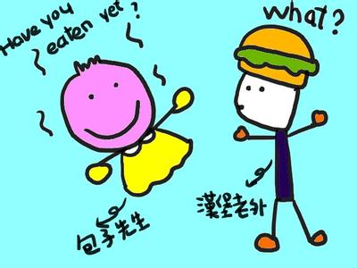
2.3. Greetings
A typical Chinese greeting is literally到哪儿去啊？(Where are you going?) ，干啥去
啊？(What are you going to do?”),吃了吗？(Have you eaten?),忙什么呢？(What are you
busy with?) 出去呀?（Are you going out?) ,上班啊？(Are you going to work? )
Generally, there are more such greetings in Chinese than in English, as in fact, it is not
a genuine question for the Chinese, but only a form of greeting. Yet people in the English-
speaking countries regard such greetings as something private.

Slide 26
Have you had your lunch? / Where are you going?
Chinese
Westerners
normal
offended
A greeting
An invasion of privacy

Slide 27
2.4. parting
English: a small talk for a couple of minutes before departure; see off the guest to a
shorter distances
In English, before leaving, the guest usually has a small talk for a couple of minutes
and then says:
Well, it’s been lovely to see you, but I must be going soon
Thank you for a lovely evening. I won’t hold you any longer
Thank you for a nice dinner. but I must be going now.
Well, I’m afraid I must be leaving now.
In response, the host usually accompanies the guest to the door and say something like:
Thank you for coming. Good-bye/Bye-bye
Response: Good-bye/Bye-bye, So long, See you. See you later,
Chinese: often make an abrupt leaving-taking; see the guest to a longer distances.
In contrast, Chinese guest often stands up suddenly and say:
我走了(I’m leaving now ) ,which seems quite abrupt to English-speaking people.
The guest will move to the door and say:
请留步！ 回吧！再见！
To show respect, the host will see the guest to a longer distance (the building gate, the bus stop or even out of sight) and say something like:
请慢走！请走好！不远送了！有空再来！

Slide 28
2.5. Gratitude
1) Frequency
English: more often;
Chinese: less often
“Thank you” is far more frequently used than “谢谢” in Chinese. It is very
common in America, even between parents and children, husband and wife and
for very small and most ordinary things. So they thank people all day long. For
instance, they will thank the saleswoman after she has attended to them. They
will say “Thank you” to a student who has just answered the question. At home,
the husband will thank his wife when she brings him a glass of water. The wife
will thank her husband if he helps her with her chair.
The traditional Chinese concept holds that it is the duty of the young and
junior to do something for the elderly and the senior, so the latter don’t have to
say thanks. And traditional Chinese customs don’t require people to express
thanks for the small favors that others have done them. But it does not mean
that the Chinese people do not like to thanks others, they have far more ways,
either in different words, or gestures or just with a smile.

Slide 29
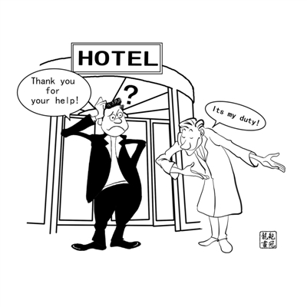
2.5. Gratitude
2) Response
English: You’re welcome, Don’t mention it, That’s all right, With pleasure;
Chinese: 没关系、没什么
Chinese and American cultures have different expressions for thanks and their
responses. Some English expressions for thanks can be confusing to the Chinese people.
a）“This is what I should do” or “It’s my duty to do so” are not responses to thanks in English.
b） “It doesn’t matter” or “Never mind” are not responses to thanks but to apologies “I’m
sorry”,.
Therefore, in the second situation, a native English speaker should find it inappropriate
to respond with “It’s my duty to do so”, which means “You don’t have to thank me. I had no
choice but to do it, because it is my duty, otherwise I would not have done so.” This is, of
course, far from the message the Chinese intends to convey.

Slide 30
2.5. Gratitude
English:
Expressions of gratitude Formulaic Responses
Thanks You’re welcome.
Many thanks. Don’t mention it.
Thank you very much. It’s my pleasure.
It’s very kind of you to give me the help. That’s all right/ That’s okay.
Chinese:
太谢谢你了 甭客气
麻烦您了 没关系。
您受累了 没什么。

Slide 31
2.6.Invitation邀请
When the Chinese people say: “Let’s get together soon”, “I haven’t seen you for a long time. You must come round for dinner sometime” or “It’s good seeing you. I’ll invite you to tea later,” we usually take these statements at our face value. The unwritten “rules” are confusing and create misunderstandings for English-speakers.
In comparison, an American might also say something that sounds like an invitation but that never results in an actual meeting with another person. These statements are just expressions of goodwill rather than genuine invitations. They just indicate that the speaker feels positive towards the other party. For example:

Slide 32
Invitation 1
Kate: It was nice talking to you. I have to run to class.
Alice; OK, maybe we can meet sometime soon.
Kate: Yeah, love to. Why don’t you drop by my house sometime?
Alice: Great. The proper response would simply be “Great, I’d love to very much Gotta go. See ya soon.
The invitation did not result in an appointment and was nothing more than a “polite” expression.” No questions about “when” and “where” should be asked. If ever such questions were raised, the speaker would be embarrassed.

Slide 33
Invitation 2
Kate: Before you leave for your vacation, can we get together and have
lunch?
Alice: Sure. I’d love to.
Kate: How about Friday? Say 12:30 at my place?
Alice: That sounds good. See you then.
In this dialogue a genuine invitation was extended because Kate had a definite plan and a specific time and place in mind. If Kate had said only “Drop by”, Alice probably would not have visited Kate.

Slide 34
2.7.Compliments赞扬
1) Frequency
English: more often; accepting
Chinese: less often; effacing
On the whole, the English-speaking people compliment each other quite
often. Yet the Chinese people are rather cautious about using compliments.
Besides, the English-speaking people tend to accept the compliments whereas
the Chinese tend to efface 降低themselves in words, although they do feel
comfortable about the compliments. They are afraid of being misunderstood for
flattering, which is considered very low and mean act among the Chinese people, e.g.
“That’s a beautiful sweater you’re wearing.”
Correct response: “Thank you. My mother knitted it for me several years
ago.”
Incorrect response: “Oh, no, I’ve had this ugly old thing for years.”

Slide 35

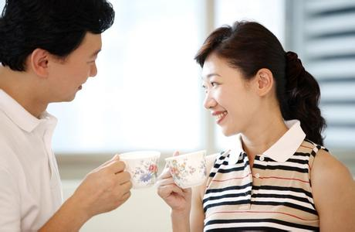
Flirtation？
E: It is common for a man informally to give a woman compliments on her looks or clothing
C: It is taken as a kind of flirtation调情 if a man compliments a woman

Slide 36
Fishing for compliments
a) “Growing flowers is my hobby, but I’m not much good at it” ------
“But these flowers are beautiful.”
“I wish I could do as well !”
b)“ I really know little about the subject.”-----
“Well, I certainly don’t know anybody who knows more than you do!”

Slide 37
2.7.Compliments赞扬
2) Linguistic form
English: The pronoun “I ”is used more often, e.g. “I love it”， “I like it”. While in Chinese, the
compliments often begin with the pronouns “you” or “your”; the overwhelming majority of English
compliments contain one of a highly restricted set of adjectives, adverbs, verbs or responses:
adjectives: nice, good, beautiful, pretty, great, excellent, wonderful, super, terrific, etc
verbs: .like, love, look, is/are
responses :Thanks, thank you, etc.
——I really like your dress.
——Thank you.
——That’s a beautiful necklace.
——It was my grandmother’s. ——I really like your dress.
——Thank you.
Chinese: with various forms
——王姐，你还是那样年轻、漂亮，一点儿也没变样。
——哪里，老了。不能和你比了。
——老师， 您的书法真漂亮。
——献丑了
——是吗？ ——王姐，你还是那样年轻、漂亮，一点儿也没变样。
——哪里，老了。不能和你比了。
——老师， 您的书法真漂亮。
——献丑了
——是吗？

Slide 38
2.8.Apology道歉
Expressions of apology Formulaic Responses
English:
Excuse me. It doesn’t matter.
I’m sorry. Never mind.
I beg your pardon. That’s all right.
I apologize No problem.
Please forgive me for It’s nothing.
Chinese:
对不起。 没事。
不好意思。 不要紧。
请原谅。 没关系。
都怨我。 不用道歉/自责。

Slide 39
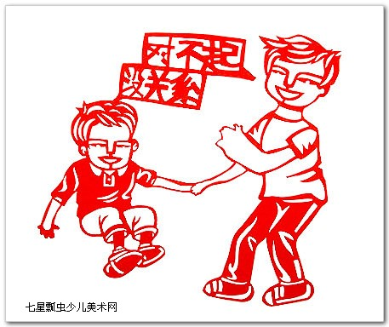
2.8.Apology道歉
In Chinese, “不要紧”、“没关系”can be used as response to many expressions of gratitude as well as apology. However, they are not equal to “It doesn’t matter.” “Never mind”, which are used only as the response to apology in English.

Slide 40

2.9.Making Phone Calls打电话
6.9.1 Phone Calls in English
1）①This is... (speaking.) ②This is 7863469. ③... is here, not “ I’m ...”
2）①Who’s that? ②Who’s speaking (calling), please?, not “Who are you?”
3）Is that ...?, Is that ... speaking (calling)? , not “Are you ...? ”
4）① Hold on, please. ②Just a moment, please. ③ Wait a minute, please.
5）①I’m calling to tell you ... ②I’m calling to ask you ...

Slide 41
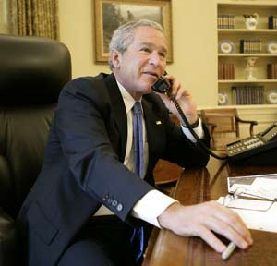
2.9.Making Phone Calls打电话
6）May I speak to Mr. Smith, please? 请找史密斯先生接电话好吗?
Can [Could] I speak to Mr. Smith, please? 请找史密斯先生接电话好吗?
Is Mr. Smith in? 史密斯先生在家吗?
Is Mr. Smith there? 史密斯先生在那儿吗?
7）Sorry, wrong number.
8）There's nobody here by that name.这儿没人叫这个名字。
9）May I take a message for you? 我可以给你带个口信吗?
Could you take a message for me, please? 请给我带个口信吗?
Would you like to leave a message? 你要留个口信吗?
May I leave a message? 我可以留个口信吗?
10）OK， that's all. Bye. 好了，就这样，再见。

Slide 42
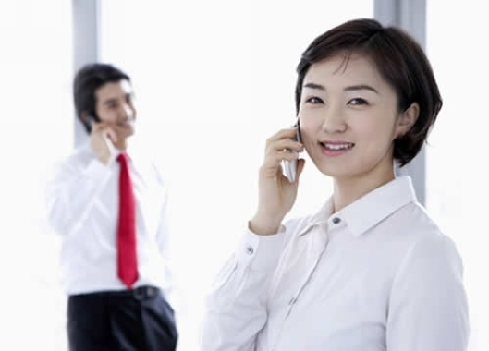
2.9.Making Phone Calls打电话
6.9.2 Phone Calls in Chinese
1）A. 喂，是张老师吗？
B. 我就是，请问你是谁？
A. 张老师，我是李阳啊。
2）A. 喂，你找谁？
B. 我找张老师
A. 我就是，请问你是谁？

Slide 43
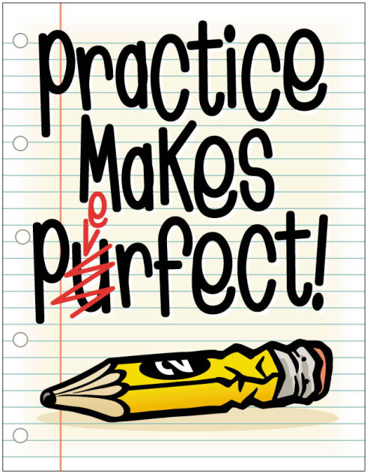
III. Practice

Slide 44
Surname +Title
3.1. Addressing People
Language | Chinese | English
Formal Relationship/ Situation
Neutral Relationship/ Situation
Close Relationship/ Informal Situation
Title +Surname
Surname +Title
Title +Surname
Given Name
Given Name

Slide 45
3.2.Match the following two groups.
vice
director
professor
associate
assistant
manager
deputy
president

Slide 46
3.3. Give as many Chinese references of the following English kinship terms as possible
Grandfather
Granddaughter；
Uncle
Aunt
cousin
Nephew
Brother-in-law
Sister-in-law
（外）祖父、老大爷；
（外）孙女
叔叔、伯伯、舅舅、姑夫、姨夫；
姨妈、姑妈、舅妈、婶婶、伯母
堂兄；表兄；堂弟 表弟；堂姐；堂妹表兄；表妹
侄子、外甥
姐夫、妹夫、大伯字、小叔、内兄、内弟
嫂子、姨子、姑子、弟媳

Slide 47
3.4)What mistakes are made in the following greetings?
Where are you going?你上哪去？
Where have you been?你去哪里啦？
Have you had your meal?吃过了吗？
It’s none of your business.
Pragmatic mistakes!

Slide 48
3.5)Complete the following dialogues
English
A: This is really a nice sweater.
B: I’m glad you like it.
A: You did a good job.
B: Thank you/Thanks.
Chinese:
A: 你的运动衫真漂亮！Your sweater is very good.
B: 我才买了十元钱。I bought it only for ten yuan.
A: 你工作做的真好！You did the job really very well.
B: 这都是集体的力量/还有很多不足。That’s the result of joint efforts./There’s still much room for improvement.

Slide 49
3.6)What do the following two groups of daily verbal communication respond to respectively?
A) It doesn’t matter. 没关系
Never mind. 不要紧
（responses to apology）
B)You’re welcome. 不用谢
It’s my pleasure. 没关系
（responses to gratitude）

Slide 50
3.7)Comprehension Check
All cultures require and value politeness, but the ways in which politeness is achieved may vary significantly.
Addressing forms like “玛莉小姐 Miss Mary”, “布朗Brown” by the Chinese may be a form of cultural compromise.
Ranks in the armed forces like Captain, Colonel can be used as titles.
Westerners can understand what Uncle policeman or P.L.A. Uncle means.
T
T
T
F

Slide 51
Comprehension Check
5. We can address Jason Douglas, who is a lawyer, as Lawyer Douglas.
6. Chinese hospitality toward the Westerners is always greatly appreciated.
7. The Chinese way of showing concern is usually appreciated by the Westerners.
8. “Thank you for coming!” is always the typical expression used by Western hosts when the guests just arrived.
F
F
F
F

Slide 52
3.8)Choose the appropriate answer.
There may be more than one possible answer for each
1.What would you do if you met a woman and you didn’t know if she should be called “Mrs.”, “Miss”, “Ms”?
a) You could use “Ms”.
b) You could try not to use her name.
c) You could check the woman’s left hand to see if she’s married.
2.What would you do if you were introduced to someone and you didn’t know whether or not to shake hands?
a) You could keep your hands in your pockets in order to avoid shaking hands.
b) You could wait and see what the other person does and then you could do the same (shake or not to shake hands).
c) You could be the first person to give your hand.
√
√
√

Slide 53
3.9)Case analysis
A westerner invited a Chinese girl to have lunch and take a tour around the British Parliament. In fact, the girl didn't have the lunch just because when the westerner asked her "Are you hungry?” , the girl answered no. Then they didn't have lunch together. The second time, the girl was invited to a restaurant, when the host asked the same question “Are you hungry?” , she answered “not really”. The host ordered a light meal for her.

Slide 54
The mistake :
In the first situation, the westerner used his question as an invitation. The girl understood it only as a question. According to the Chinese tradition, the man should have invited her to lunch since their appointment was to have lunch first.
In the second situation, the westerner used his question as a question rather than an invitation. According to the Chinese tradition, the man should have ordered plenty of food for the girl.
Conclusion:
The same sentence concealed different intentions. People should try to make sense of what it really means.

Slide 55
3.10)Role-play
(1) Introduce A ( a married woman) to B (a young man) in English and Chinese respectively
(2) make a phone call in English and Chinese respectively

Slide 56
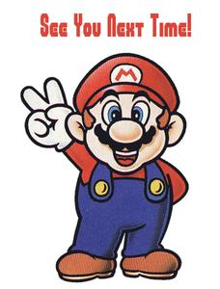
IV. Assignments
1. …
2. Video Watching
Watch Family Album in USA 《走遍美国》Episodes 1-2 and comment on the verbal communication in it.

