Slide 1
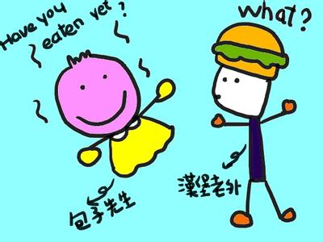
Unit 8
Social Customs and Interactions

Slide 2
Learning Objectives
In this unit, you are to know:
1. some important traditional Chinese and western festivals
2. some important traditional Chinese and western diets
3. attitudes towards friendship and hospitality in the US and
China
4. Chinese and western gift-giving/gift-receiving customs
5. “Lady First” in English-speaking countries
6. conversational topics in China and English-speaking
countries.

Slide 3
Procedures
Warm-up
1
Text Study
2
Practice
3
3
Assignments
4
4

Slide 4
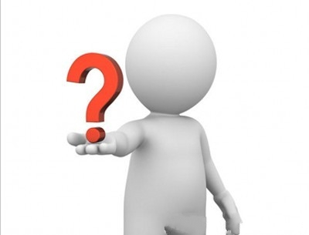
I. Warm-up
Cases1-5
What do all of the five cases reflect?

Slide 5

Analysis
All of the cases show the conflicts between Chinese people and
English –speaking people on social customs and interactions .
misunderstanding conflict

Slide 6
II. Text Study
Go over textbooks from pages 117 to 132 and make a comparison of Social Customs and Interactions between China and western countries.

Slide 7
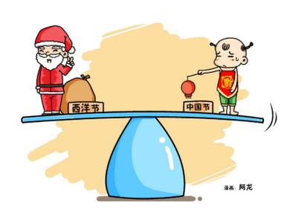
2.1.Traditional Chinese and Western Festivals

Slide 8
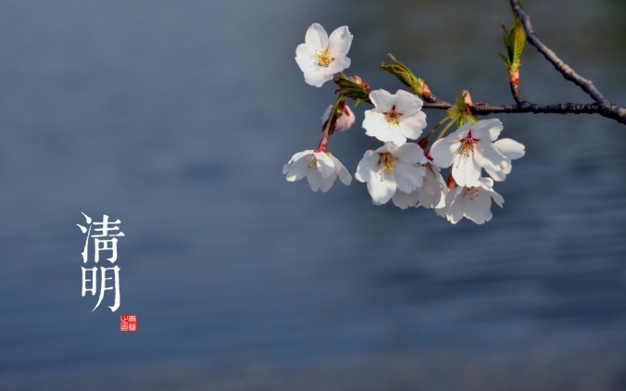
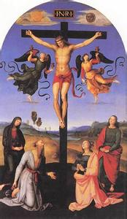
Differences
1) origins
China: mainly from seasons
English-speaking countries: mainly from religions

Slide 9

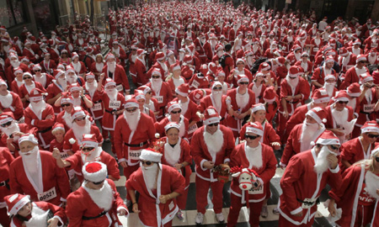
2) customs
China: enjoying food
English-speaking countries: getting pleasure from holding religious activities

Slide 10
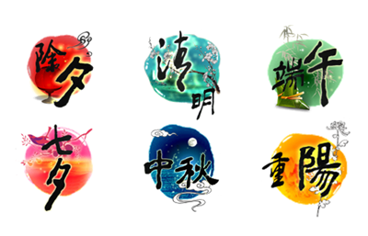
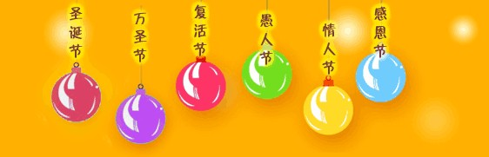
Similarities
1) Expressing people’s wish and love for happy life
2) Expressing people’s love for their sweethearts
3) Lasting continuous celebrations for days
4) Commemorating or celebrating particular figures

Slide 11
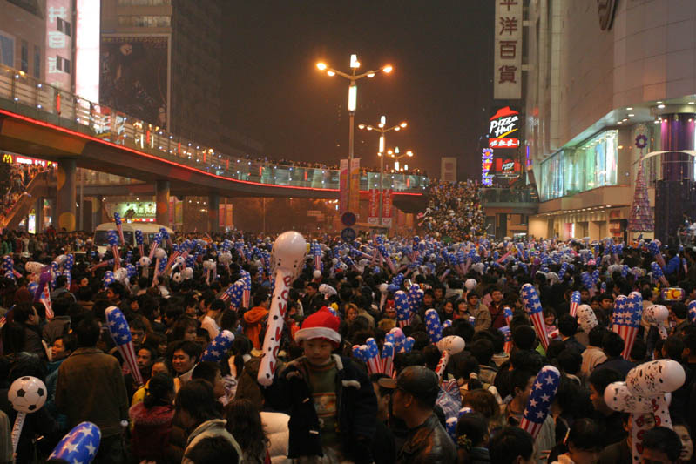
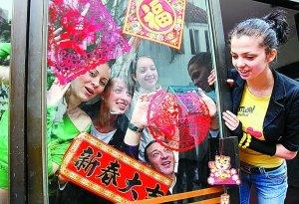
From traditional festivals to global festivals
Chinese people celebrate western festivals
Westerners celebrate Chinese festivals

Slide 12
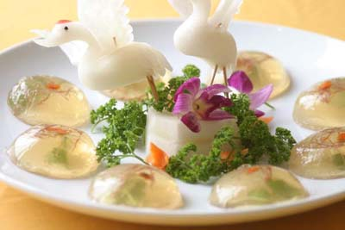

2.2. Traditional Chinese and Western Diets

Slide 13
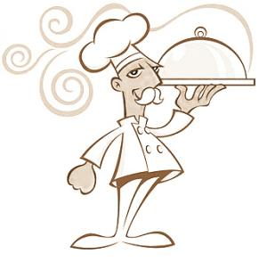
2.2.1. Attitudes towards Diets
1) Dieting first VS means of survival or communication first
2) Complexity (Formality) VS Simplicity/informality
3) Delicacy (flavor) VS balance of nutrition
4) Collectivism VS individualism

Slide 14
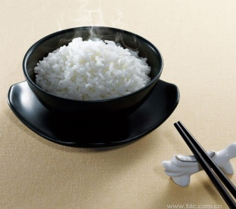
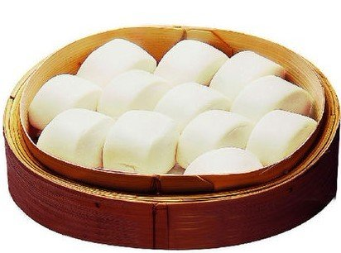
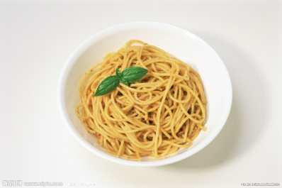
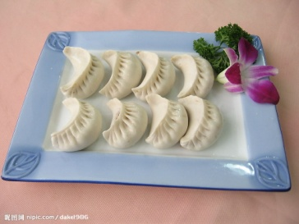
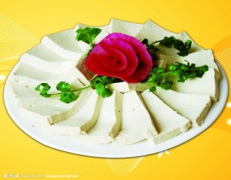
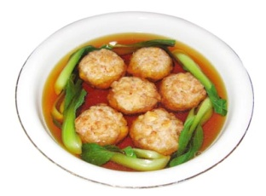
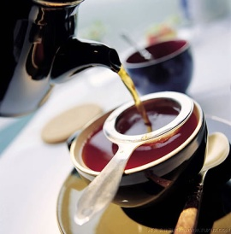
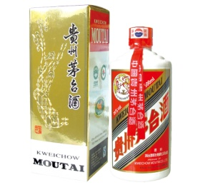
2.2.2. Varieties of Foods and Drinks
China: rice, steamed bread, noodles, dumpling, bean curb, meat balls, tea, Moutai, etc.
.

Slide 15
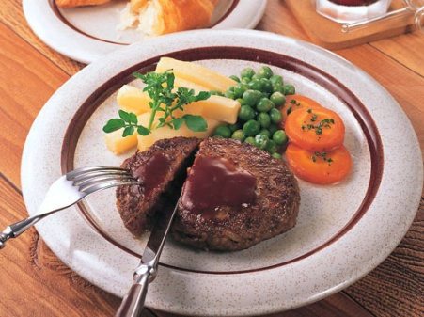
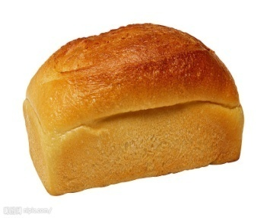
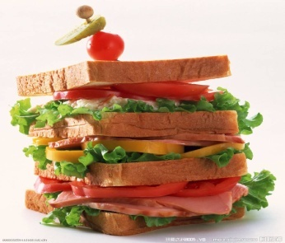
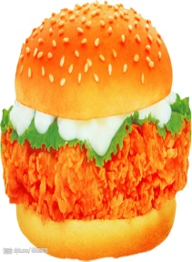
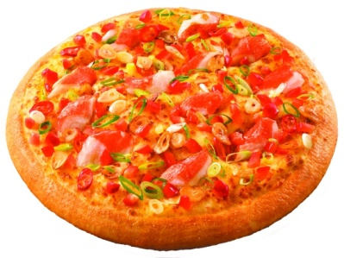
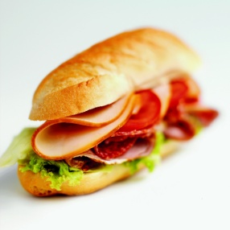
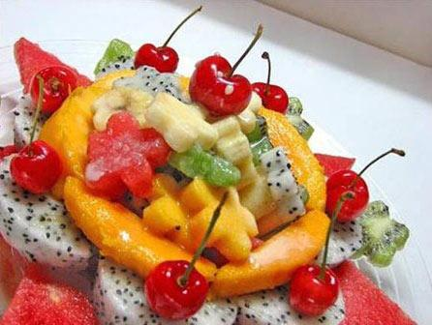
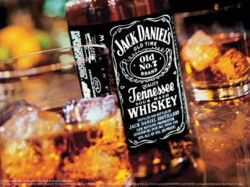
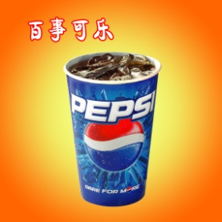
2.2.2. Varieties of Foods and Drinks
Western countries: bread, sandwich, hamburger, pizza, hotdog, pudding, beef,
salad, ham, pie, ice-cream, coffee, milk, Pepsi Cola, wine, brandy, whisky, etc.

Slide 16
2.3. Showing Hospitality at dinner
Chinese | English-speaking people
always refuse offer of drinks or food to demonstrate politeness in seeming not to wish to put their host to any trouble. | always accept or refuse offer of drinks or food very genuinely.
Sometimes an offer is not a real offer but a polite remark. After we say ‘no’, we usually wait for the second and third offer. If the host just brings the food or drink and ignores ‘no’, we will accept it. | Their refusal is accepted as genuine.
press their guests to drink or eat to show their hospitality | don’t press. To press people to have food or drink after they have refused is frowned upon and can cause embarrassments.
far more than can be eaten at the time | relate the meal size more accurately to the people’s appetite
constantly put the best piece of food on the visitor’s plate | leave the guests to help themselves and do not keep urging them to eat more

Slide 17
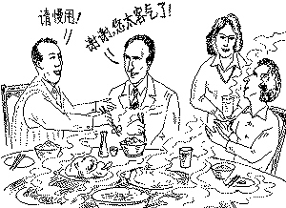
Guests’ Responses to Different Ways of Hospitality
1)A Chinese guest: Can you imagine how many dishes I
had? One – a stew炖菜 with meat and vegetables. The meat was
over done and too hard to eat; green vegetables were no
longer green. They never put food on your plate but just ask
you to help yourself. If you, as a guest, are shy or modest,
waiting for the food to be put on your plate, you will remain
half-starved.
2)An English guest: Each time a new dish arrived his
parents would lean over and load my plate with tasty morsels美味.
As they had taken all the trouble to cook it I just had to
polish it off. As soon as my plate was empty they would put
more on. Of course, I felt duty-bound to eat that too.

Slide 18
3)Twelve Cups of Tea
When I first went to Hong Kong, I had no idea about Chinese tea-drinking and found myself caught in a very awkward situation. I visited a Chinese family and was immediately given a cup of tea. I was not thirsty and I did not particularly like that type of tea, but out of politeness I finished the cup. But the more I drank, the more I was given. I kept insisting that I did not want any more, but the host took no notice. I drank about twelve cups of tea that afternoon! The host must have thought I was very greedy, but I did not know how to avoid getting more tea poured.

Slide 19
2.4.Attitudes Towards Friendship in the US and China
Chinese Friendship | US Friendship
Affective | Instrumental
Friend in need患难之交 | Friend in fair weather need 顺境之友
Totalization of a person | Compartmentalization of a person
Deep commitment and obligation | No deep commitment and obligation
High degree of familiarity | Low degree of familiarity
Interdependence | independence
Solid, stable and long-lasting | Vulnerable, unstable and short-lived
Small circles, few in number | Big circles, large in number
Centered around affectivity | Centered around activity
Offer friends specific advice to solve problems | Help friends to find out the solutions to problems
Friends of the same gender | Friends of both genders
.

Slide 20

2.5. Attitudes Towards Gift-sending/Gift-receiving in China and English –speaking countries
Ways of Sending Gifts
China English –speaking countries
Many people send gifts without wrapping them, and if they wrap them, they usually tell the receiver what is inside. | People usually wrap the gifts and do not tell the receiver what is inside.
Expensive gifts are welcome. | Expensive gifts are not appropriate.
Fruit is a common one to bring with when visiting a family. | Gifts or fruit are thought of as only appropriate of visits to the people who are ill.
Gifts with such taboos as 钟（终）, 伞（散）or乌龟（王八） should be avoided | Gifts with such unlucky number as 13 should be avoided
Numbers of gifts suggest good luck. So one bottle of wine is unusual. | One bottle of wine is quite enough , two are also welcome but unusual and not expected.

Slide 21
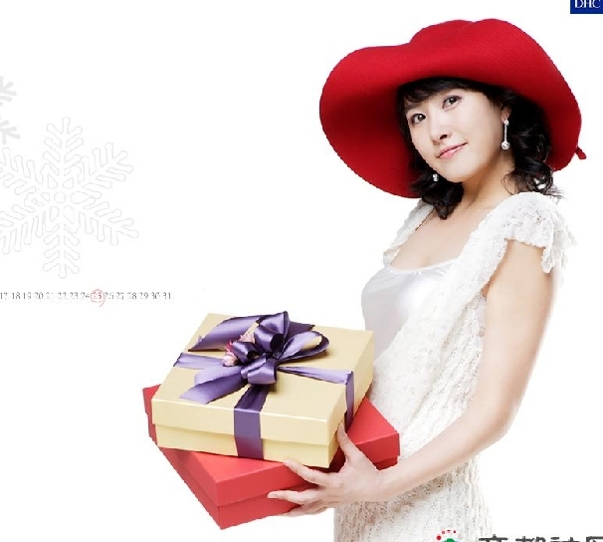
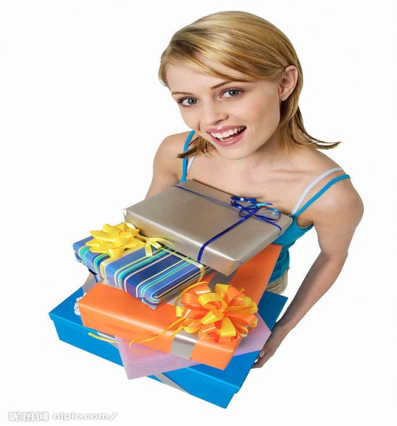
2.5. Attitudes Towards Gift-sending/Gift-receiving in China and English –speaking countries
Ways of Receiving Gifts
China | English-speaking countries
Higher authorities may receive gifts from their subordinates | Higher authorities do not usually receive gifts from their subordinates
Tend to open the gifts after the visitors have left. If you open the gift as soon as it is given, you might embarrass the person who gives you the gift and you might be thought greedy. | It is regarded as polite to open gifts as soon as they are given to express appreciation. It is impolite to just say thank you and put the gift away in a corner.

Slide 22

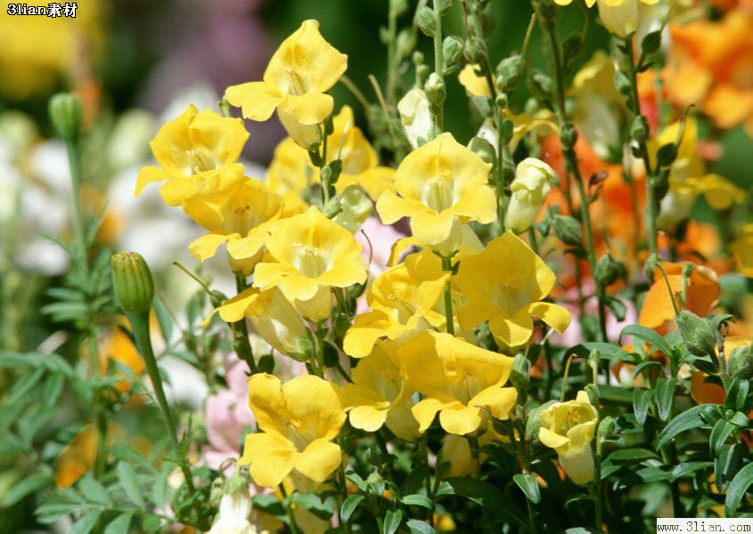
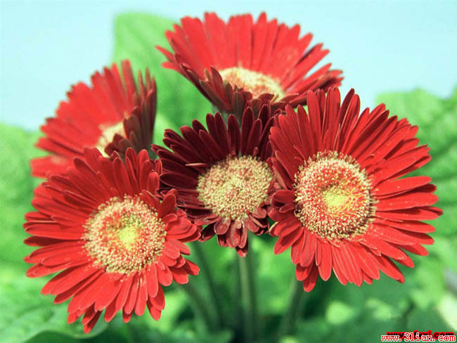
Gifts
Flowers occupy a uniquely acceptable place in the spectrum of gifts. The transitory nature of cut flowers makes them an ideal present: They cannot be mistaken for a bribe, and can be given on a regular basis. However, flowers also have specific cultural associations which differ in each country.
There are two typical situations in which flowers can be useful to business people. One is to help establish a good relationship with a secretary. The other is when an executive is invited to someone's house. It is still more customary - all over the world - to give flowers to women rather than men, who in most cultures only receive flowers when ill.

Slide 23
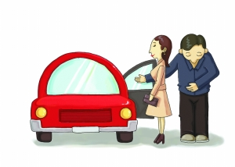
2.6. “ Lady First “ in English –speaking countries
“Lady First” , a symbol of modern civilization and good manner, is regarded as one of
the most important etiquettes or custom in social activities in western countries. People must
follow the rules concerned in cross-cultural communication.
The sources of the etiquette of “Lady First” may come from:
1) Christianity
2)the Knight spirit of Middle Ages in Europe.
“Lady First” means that women can enjoy certain privileges and should be given priorities
in various social situations and treated with both reverence and respect.
Usually, when interacting with a lady, a man should:
open the door for a lady;
escort a lady to the door of her home after a date and make sure she is safely within the
confines of her home;
let a lady walk ahead into a car or a restaurant;
assist a lady with her chair when she gets up or sits down if a man takes the lady out for
dinner;
help a lady put on her coat when necessary;
walk or cross the street on the side which is closer to the traffic;
let a lady decide whether to shake hand with you or not;
let ladies leave out of danger first if accidents or something urgent
happens;
pardon a lady if she makes any careless mistakes, etc.

Slide 24
现代交际场合遵循“女士优先”礼仪具体表现
1.走路和进出门时女士先行；
2.下楼时男子要走在前面保护女子，上楼时男子走在后面给予保护；
3.男士陪女士在街上走时,男士主动为女士提拿东西并走在靠马路的一侧,以确保女
子不受车辆伤害；
4.进出门、上下电梯或汽车时,男子主动为女子开门,给予照顾并让其先行;
5.进出门时,男子主动协助女士脱下或穿上外衣;
6.进餐时,男子主动站到女士背后,为其推拉椅子,帮她们坐好;
7.在会场和公共车辆上,男子主动给女子让座;照相时,让女子坐在前排正中央;
8.同乘电梯时男士必须脱帽;
9.男士想抽烟或开窗之前,要先征求女士意见;
10.遇到女士时, 男宾应先向女主人问好；
11.男子介绍给女子,未婚女子介绍给已婚女子时(如果未婚的女士明显地年长,则将
已婚的年轻女士介绍给年长的未婚女士)。只有英国的王子例外,介绍时要把女士向
他引见 。
12.男士 、女士初次相识时,是否握手要由女士决定,并由女士采取主动。在室内介
绍客人相识时,男子（除年纪过大者以外）都必须起立,其他女士只在被介绍给男主
人或比自己年长许多的男性老人时才起立,其他时候则不必站立。

Slide 25
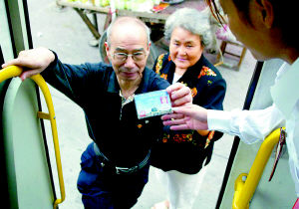
"Senior First" , a traditional virtue in China, is observed throughout the
country. It means people should show reference and esteem to the elders and the
superiors .
The Women’s position in China has been raised highly since the May 4th
Movement, but even so, there is still a long way to go in the liberation of
women. Compared with the western “ Lady First ”, there is still much
difference.
When confronting "Senior First" and “ Lady First ”,The Chinese people
will usually put the former first. While in the west, when a respected old
gentleman dines with a young lady, it is the lady who is to be served, which
is just the opposite in a Chinese situation.

Slide 26

2.7. Conversational topics
In cross-cultural communication, one nation should know what topics they
can share talking about and what topics they should avoid talking about.
Otherwise, they will run into conflicts or in an embarrassing situation.

Slide 27
2.7.1.Topics which are acceptable
both to English-speaking people and Chinese people
1.hobbies业余爱好
2.entertainments娱乐
3.traveling/spending holidays旅游/度假
4.weather天气
5.houses&cars房子与车子
6.work工作
7.national or local news 国内外新闻

Slide 28
2.7.1.Topics which are acceptable
to the Chinese people but unacceptable to English-speaking people
1.age年龄
It is generally regarded as impolite to ask people their age, This is particularly true of woman when she is over thirty. So a direct question like “How old are you ?” should be avoided. Otherwise, you would make others unhappy and yourself in an awkward situation.
2.marriage婚姻状况
It is not strange to see some people never marry at all, others marry late, some marry but do not want to have children, and some marry but divorce. So it is wise not to ask questions like “Are you married?”, “How many children have you got?”. Of course, you can ask general questions like “Have you got a large family?” or “Is your family with you here in China?”

Slide 29
3.health健康状况
When sick, people in the English –speaking countries will feel
offended at being given such pieces of advice :
“Drink plenty of water”,
“Put on more clothes”
because to these independent people, such advice is with
protective and parental overtones, and they are being treated like
children.
Instead, the following expressions of concern are preferable:
Look after yourself.
I do hope you’ll be feeling better soon.
Have you been to the doctor?
Try and get some rest
Besides, such expressions should also be avoided:
Why are you looking so thin?
You have had a tiring journey. So you must be tired. Lie down and
have a rest.
These expressions imply someone is not strong enough

Slide 30
4.Salary/price价格
People’s salary is regarded as extremely personal and private in
the English –speaking countries. Even family members do not ask
about each other’s salary. It is better to avoid questions like “How
much do you own?”
Although people in the English –speaking countries may talk
about price in general, it is not appropriate ask someone directly
how much they paid for something. If you really want to know the
price , it can only be approached indirectly.
5.religion/politics宗教信仰/政治问题
People in the English –speaking countries are sensitive to the
topics concerning religion or politics , so in cross-cultural
communication, we should try not to ask such questions as “Do you
go to church?”, “ Why did you vote for…?” , or we will look for
unnecessary conflicts, debates or embarrassments.

Slide 31
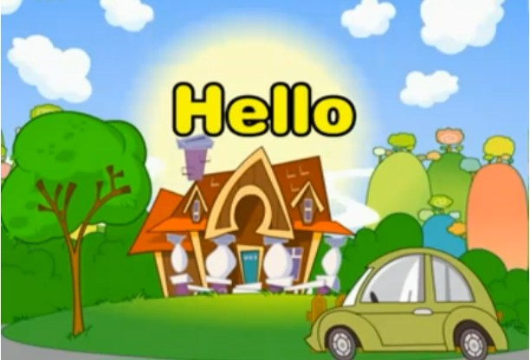
III. Practice
.

Slide 32
1. Translate the following Chinese and Western foods and drinks into English or Chinese
Chinese foods and drinks | Western foods and drinks
米饭 rice | Toast 土司/烤面包
蛋炒饭 | hamburger
春卷 | hotdog
煎饼 | sandwich
包子 | French fries
馄饨 | pudding
阳春面 | spaghetti
火锅 | beefsteak
豆芽 | Roast turkey
北京烤鸭 | Roast mutton
红烧肉 | sardine
龙井 Longjing | instant coffee
茅台 Maotai | 威士忌 whisky
egg fried rice
汉堡包
spring roll
热狗
pancake
三明治
meatbun
炸薯条
wonton
布丁
plain noddle
意大利面条
firepot
牛排
beansprouts
烤火鸡
Beijing roast duck
烤羊肉
red-cooked pork
沙丁鱼
速溶咖啡

Slide 33
2. Case Study
.
While I was studying in America, I met an American classmate named Jimmy. One day I was eager to buy a book, but I did not have enough money, so I borrowed three dollars from him. Before he lent me the three dollars, Jimmy asked me three times, “Are you sure you will return the money to me?” Four days later, he kept reminding me about the loan until I paid him back the money.
Interestingly enough, weeks later he borrowed $30 from me and said he would pay me back in a week. After one month, there was no sign of the money so I reminded him. To my surprise, he said, “I’m sorry, why didn’t you remind me earlier?” and returned the money instantly.

Slide 34
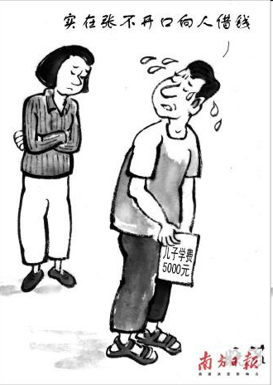
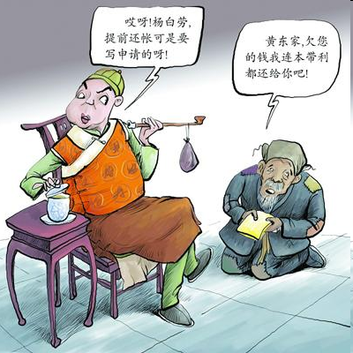
Questions and Answers
Question 1:
If you were “I” in this case,
how would you adjust yourself?
Question 2:
What’s the response of the American
if you are generous and say:
“Don’t mention it again. You don’t
have to pay me back.”

Slide 35
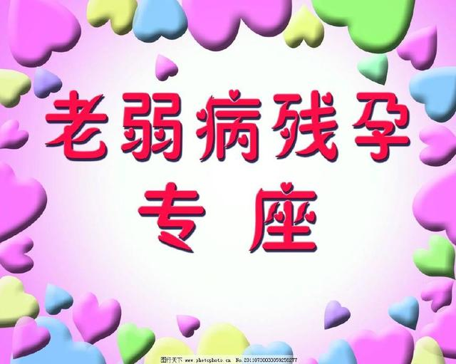
4. Discuss the following Questions
1) Besides “ Seniors First ”, who else may be given the first priority in China?
In China, such people as the weak, the sick, the disabled, the pregnant, the
Infants, higher authorities or model people may also enjoy privileges.

Slide 36
2) How is "First Lady" different from "Lady First" ?
"First Lady" refers to the wife of the president in U.S.
3) Why do women prefer Chairperson, businessperson, police or cop... instead of Chairman, businessman, policeman ...?
Because they want to get rid of sexual discrimination in language.

Slide 37
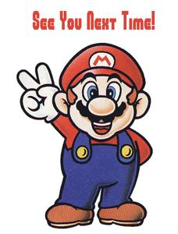
IV. Assignments
1.Have you ever celebrated any western festivals or enjoyed any
western foods or drinks? If yes, how or what ?
2.List some more festivals and popular foods or drinks in China
and English-speaking countries.
3.Video Watching

