Slide 1

Unit 4
Cultural Values

Slide 2
Learning Objectives
In this unit, you are to know:
1. the definition, types, importance and characteristics of cultural values
2. the six fundamental cultural values in China and English-speaking countries
3. some specific cultural values reflected in English and Chinese languages

Slide 3
Procedures
Warm-up
1
Text Study
2
Practice
3
3
Assignments
4
4

Slide 4

I. Warm-up
Case 1Showing Concern
Why wouldn’t the professor appear happy on hearing what Wang Lin said?

Slide 5

Analysis
The case shows the conflict between China and the West on such cultural values as being young and independent.
misunderstanding conflict

Slide 6

I. Warm-up
Case2 The Privacy of the Page
Why didn’t Simon feel happy with Chen Feng?

Slide 7
Analysis
The case shows the conflict between China and the West
on such cultural values as privacy.
misunderstanding conflict

Slide 8
II. Text Study
Go over textbooks from pages 47 to 53
and try to answer the following questions.
1. What are the definition, types and characteristics of cultural values?
2. What are the six fundamental cultural values in China and English-speaking countries
3.What are some specific cultural values reflected in English and Chinese languages?

Slide 9
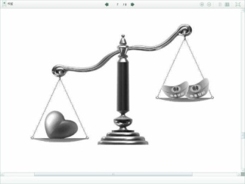
2.1.Definition
Cultural values are: "one's principles or standards: one's judgment of what is
valuable or important in life." ——Concise Oxford Dictionary.
Cultural values can be defined as people’s principles, standards or judgment of what
is valuable or important in life. It determines people’s beliefs and attitudes, guiding
people how to communicate.
Cultural values are the core of intercultural communication. People can not conduct
intercultural communication effectively without understanding the differences in cultural
values.
People from different cultural groups not only differ in the way they perceive the
world but also in their judgment about what is right and wrong, appropriate and
inappropriate, beautiful and ugly, valuable and worthless. The system of criteria for
conduct and evaluation is the value system of a culture, which contains a set of highly
organized and interrelated values that function as the desired objectives or goals of that
culture.
A cultural value may manifest itself in the mode of behavior or in the end-state of life
of its people. By understanding the values of a cultural group, we can better appreciate
the behavior of its members and make more accurate interpretations and predictions
about what they do and say in interpersonal communication.

Slide 10

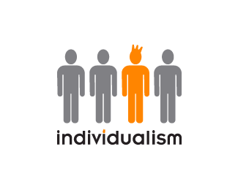
2.2.Types
Universal cultural values 一般(普遍)价值观： values that are common to all
human beings. For instance, the desire to live a happy life is a universal value.
everybody wants to have a happy life.
Specific cultural values 特殊价值观：values that apply only to a particular
group of people (a particular culture). For example, individualism is a culture-
specific value, not all cultures uphold individualism. As a matter of fact, most of
the cultures in the world belong to collectivism in nature.

Slide 11
2.3.Characteristics
1) Values are generally normative（规范化的）
Cultural values tell us what is good and bad, what is right and wrong, what is true and false, what is positive and negative.
2)Values are hidden看不见
Values are formed in people’s mind, they can not see them, nor are they always aware of them, yet they do follow these values to behave.
3)Values are interrelated 相互影响的
Values may influence with each other. One value may lead to the formation of another, e.g. collectivism may lead to the formation of “ filial piety 孝顺” and, individualism may lead to the formation of “privacy”.

Slide 12
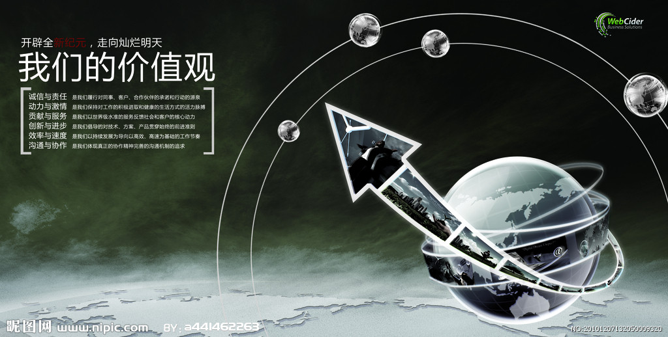
2.3.Characteristics
4)Values are learned可学得的
Values can be learned from people around: family, school, social groups, and
so on. Once learned , they tend to be stable and govern people’s beliefs, attitudes,
ideas or behaviors.
5)Values are changeable 可变的
Values change like cultures, but at a slower pace than such forms of culture
as dress, food, etc.

Slide 13

2.4. A Comparative Study of Cultural values
between China and English-speaking countries
Cultures are both similar and different and as the difference are where misunderstanding
and even conflicts may arise when peoples of different cultural backgrounds meet and
communicate, the following will deal with some of the most important differences of
values between China and English-speaking countries.

Slide 14
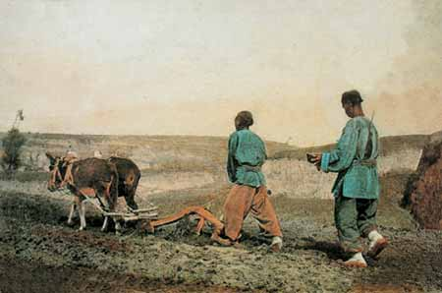
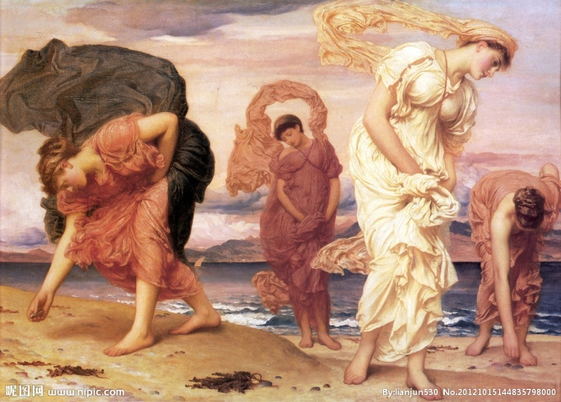
总体而言，西方传统价值观念以个人主义为基点,以幸福主义为目标,以科学主义和法治主义为调控手段。中国传统价值观念以整体主义为基点,以禁欲主义为目标,以德性主义和人治主义为调控手段。
在农业文化和海洋文化的基础上, 东西方分别形成了以下价值观：天人合一与天人相分、群体主义取向与个人主义取向、求稳与求变、做人与做事、过去取向与未来取向、自由支配时间与严格遵守时间。

Slide 15
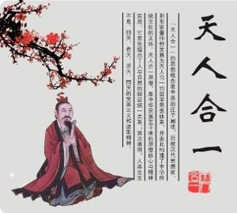
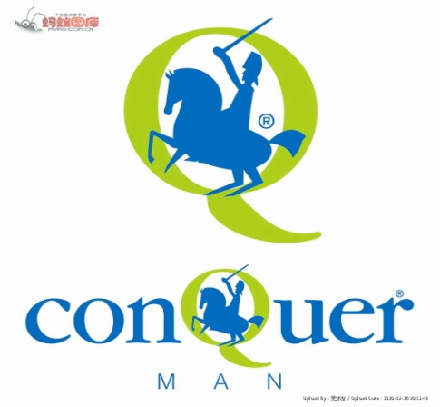
2.4.1.Oneness Between Man and Nature vs Dividedness Between Man and Nature
天人合一与天人相分
Traditionally, the Chinese attitudes towards universe or nature is Oneness Between
Man and Nature. Which means man should be obedient to nature, or should be in
harmony with nature. With this idea, the Chinese people tend to seek for wholeness,
generality in thinking patterns or language use. While from past to present, the western
people’s attitudes towards universe or nature Is Dividedness Between Man and Nature,
which means man and nature are incompatible and the former should try to conquer the
latter. With this idea, the western people tend to analyze and be logical in thinking
patterns or language use. The different attitudes towards universe or nature determine the
national traits and communicative behaviors, including communicative styles, speech
action, pragmatic rules and discourse structures as well.

Slide 16

2.4.2.Group Orientation vs Individualism Orientation
群体主义取向与个人主义取向
Oneness Between Man and Nature will naturally lead to Group Orientation which
means people should always put others first and be willing to sacrifice oneself when
necessary. With this attitude, the Chinese people like to rely on others, lacking self-
competitiveness. It influences such communicative styles as being polite, respecting
others and disgracing oneself greatly. Such values as harmony, interdependence, humility,
face-saving courtesy, group loyalty are typical cultural values of collectivism. Chinese
collectivism has been labeled as “we” cultures.
Compared with the Chinese people, the westerners, especially the Americans,
Worship individualism. Thus, in English language dictionaries, there are more than 100
compound words with “self” as prefix, such as self-control, self-confidence, self-
dependence, self-esteem自我认为, self-reliance, self-respect, etc. You can imagine how
important individualism is in American people.! The western individualism has naturally
been labeled as “I” cultures. Such values as privacy, independence, equality, fairness,
competition are the direct product of individualism, They are regarded as something legal,
reasonable, and what people need most.

Slide 17
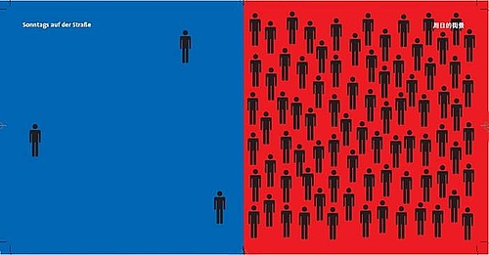
Collectivist and Individual Culture
Collectivist Culture
The culture places
little value on
individual identity and
great value on group
identity.
Going one's own
way is not valued;
uniformity and
conformity are stressed.
Individual Culture
The culture tends
to define themselves
by the extent to which they are different from,
rather than similar to other. People are encouraged to display self-confidence and
assertiveness,disclosure of personal thoughts and feelings

Slide 18
Collectivism | Individualism
“WE” culture | “I” culture
openly speaking one’s mind appears distasteful | open discussion of disagreement are valued forms of talk
open expression risks face-losing | seek the notice of others; affirm their uniqueness
the right to privacy in the sense of freedom is not recognized | guarding privacy; valuing freedom to do and think whatever they choose
one’s business is also the business of the group; friends should be concerned with each other’s personal matters | live life guided only by principles such as equality and noninterference

Slide 19
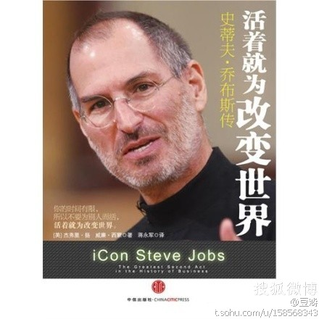
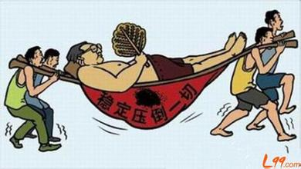
2.4.3. seeking stability vs Seeking change
求稳与求变
Having been under the influence of Confucianism for a long time, the Chinese
people tend to seek stability by being loyal, going middle-way. They think stability is
the prerequisite for development. Without stability, there would be no unity, let alone
development, so in Chinese there are: “知足长乐”, “安分守己”,“循规蹈矩”, “相安无
事”, etc.
The Americans think everything in the world should be changeable, so in their life
they are full of inventiveness and always seek change. To them, change, development,
progress, improvement, future mean the same, without change, there would be no progress
or future.

Slide 20
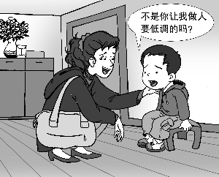

2.4.4. Being vs Doing
做人与做事
It has been the traditional Chinese culture for thousands of years that man should be
obedient to nature, one’s mind should be in harmony with surroundings, “清静无为”, “修
身养性” has been sought for. The Chinese people have put more stress on “what a man
should be” than on “what a man should do”. “Modesty(谦虚)”, “kind(宽容)”, “reserved(含
蓄)” has been regarded as important means to cultivate one’s personality. In their language
use, they avoid being aggressive, tend to talk less or even just keep silent.
People in the English-speaking countries prefer doing something than being somebody.
They put more stress on outward behavior or action, they like competing or taking risks.
They hope to realize their values by actions, by conquering nature, so they are known as
talkativeness in their interpersonal communication

Slide 21
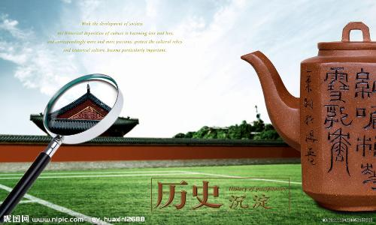
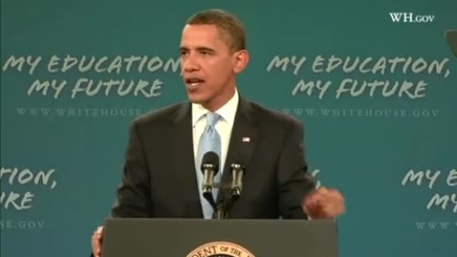
2.4.5 Past Orientation vs Future Orientation
过去取向与未来取向
People in the east and west have different attitudes towards time orientation.
The Chinese people like to look backwards while people in the west like to look
Forward. Both Confucianism and Taoism propose returning to nature, returning
to the past. The Chinese people value tradition and experience. As a Chinese
proverb advises, “Consider the past and you will know the present. ”. They
respect their ancestors, the elders and teachers.
To the westerners,” retuning to the past” means” retuning to the original sins
(原罪)，most Americans have put great faith in the future. Part of the reasons
may come from the Protestant religion of the Puritans, the first English people to
live in America. So it is hopeless to go backwards. Besides, they are not so
satisfied with the present life (although the present life is happy) they do not
believe fate. they believe the future life will be happier. So they do not tend to be
obedient (循规蹈矩)or respect their ancestors, the elders and teachers as much
as the Chinese people do.

Slide 22
2.4.6 Master to Time vs Slave to Time
自由支配时间/严格遵守时间
Different cultures have different ways to use time. Hall put it into two categories: Mono-chronic Time System and Poly-chronic Time System .
The former regards time as a line with both beginning and ending that can be divided, but can not be repeated. It emphasizes schedules, segmentation, and promptness (being punctual).The latter regards time as something separate, several things happening at once. Those who follow Poly-chronic Time System may do different things at the same time. Generally, people in the east take Poly-chronic Time System while people in the west take Mono-chronicTime System. Comparatively speaking, the Chinese people are masters to time, they use time more freely and elastically. In their such daily life as shopping, making telephone calls, chatting, they always seem to be leisurely, To a large degree, people in the west are slaves to time. They take activities strictly according to schedule, seeming dominated by an” iron hand”, which determines what to be done and what not to be done., what should be done first what should be done later.

Slide 23
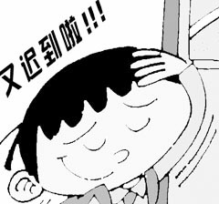

2.4.6 Master to Time vs Slave to Time
自由支配时间/严格遵守时间
What we should bear in mind is that all these analysis about the cultural values are relative, not extreme, changing, not static.

Slide 24
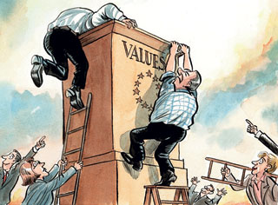
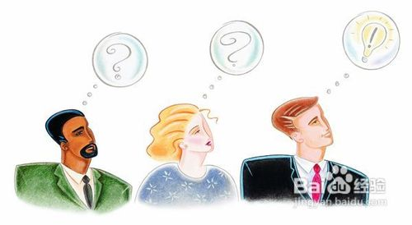
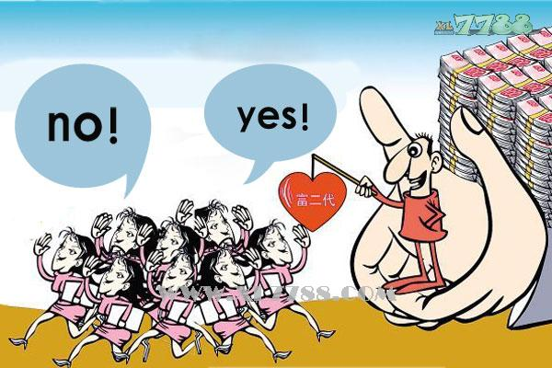
2.5. Some Specific Cultural Values Reflected in English and Chinese Languages

Slide 25
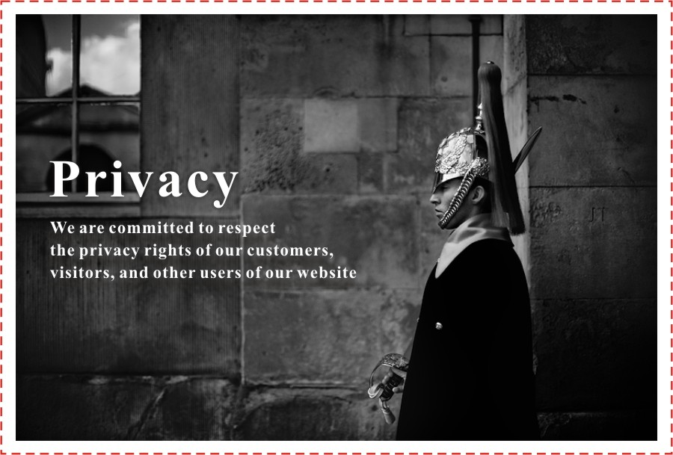

2.5. 1. A man’s home is his castle——privacy
Americans assume that people “need some time to themselves” or “some time alone”
to think about things or recover their spent psychological energy.
If the parents can afford it, each child will have his or her own bedroom. Having
one’s own bedroom, even as an infant, imbues people with the notion that they’re entitled
to a place of their own where they can be by themselves and keep their possessions.
Americans assume that people have their “private thoughts” that might never be
shared with anyone. Doctors, lawyers, psychiatrists, and others have rules governing
“confidentiality” that are intended to prevent information about their clients’ personal
situations from becoming known to others

Slide 26
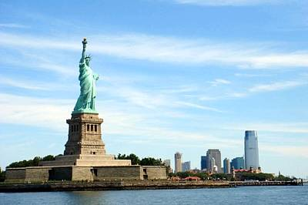
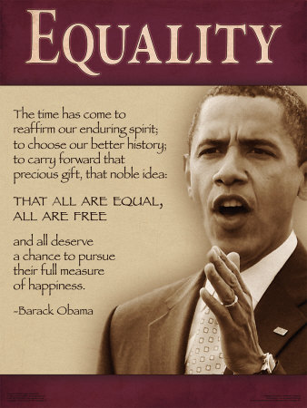
2.5.2.All people are created equal——equality
We hold these truths to be self-evident, that all men are created equal, that they are endowed by their Creator with certain unalienable rights, that among these are life, liberty and the pursuit of happiness. —— “Declaration of Independence” （1776）

Slide 27

2.5.3.Time is money——efficiency
Originated in USA

Slide 28
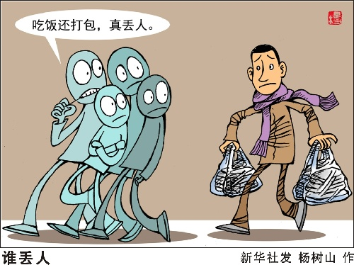
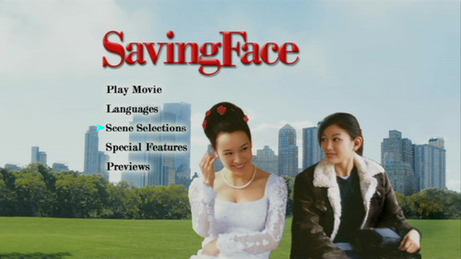
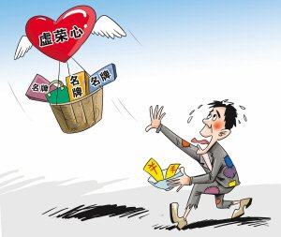
2.5.4.树有皮，人有脸——face
“Face” is extremely important in Asian societies, especially in China. What
does “face” refer to?
In the oriental value system, “face” refers to an individual’s pride, dignity,
honor, and even identity.
From the Chinese origin, two expressions (namely, losing and saving face)
are universally used in English, such as :
1) I lost a lot of face by being unable to answer this question.
2) This saved me a great deal of face.
In Singapore and Malaysian English, there are a lot more expressions related
to face such as those below:
1)They started quarrelling …. I don’t know where to hide my face.
2) How can you do that to me? I really got no face now.
3)You must go to his son’s wedding dinner. You must give his face.

Slide 29
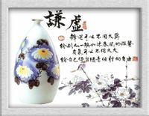
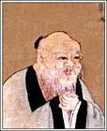

2.5.5.请问您贵姓?——谦卑
谦虚使人进步，骄傲使人落后——谦虚
“May I have you name?” and “Modesty makes you progress; conceitedness makes you lag behind” respectively reflects the Chinese cultural values: humility and modesty.

Slide 30
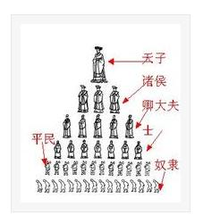
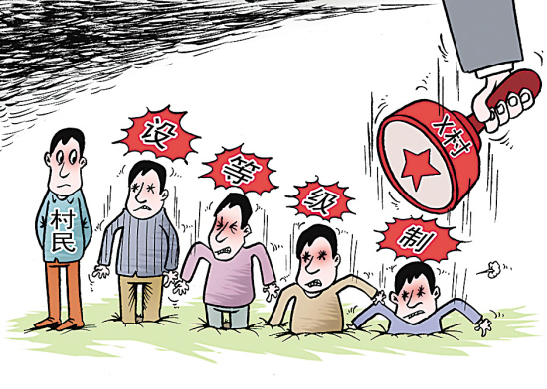
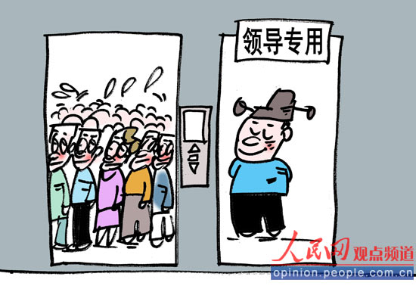
2.5.6.君臣父子，上下有序——hierarchy
“Let the ruler be a ruler, the subject a subject, the father a father, the son a son” is the feudalistic thought which has prevailed in China for thousands of years.

Slide 31
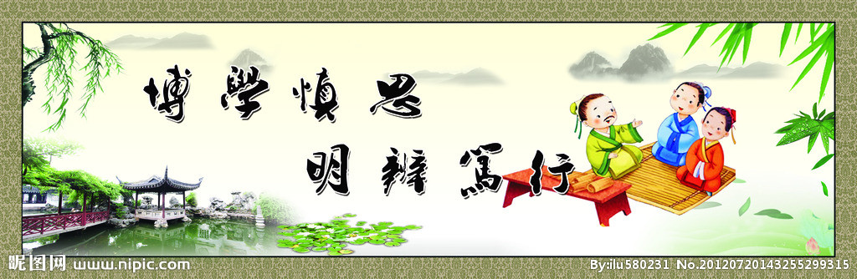
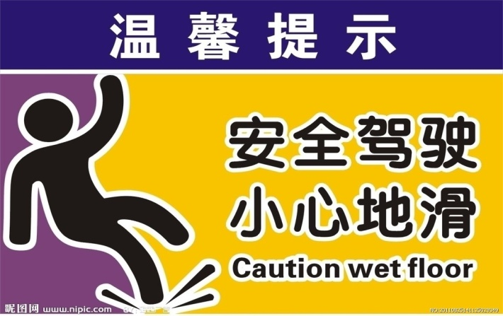
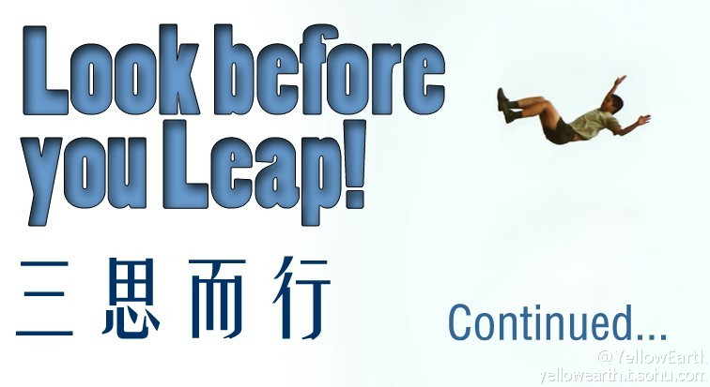
2.5.7.慎思，三思而行；Look before you leap——caution

Slide 32
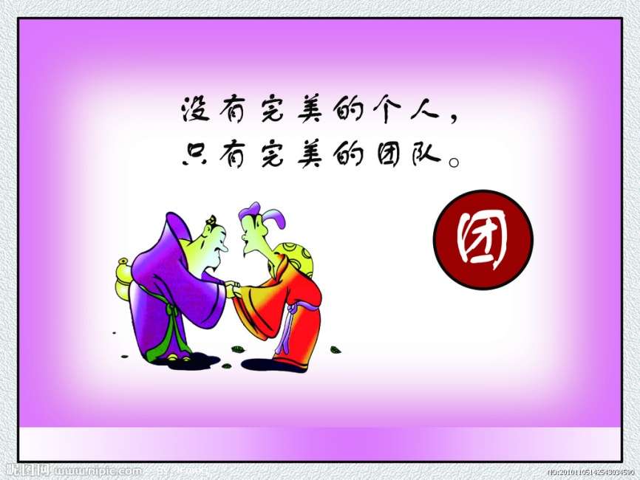
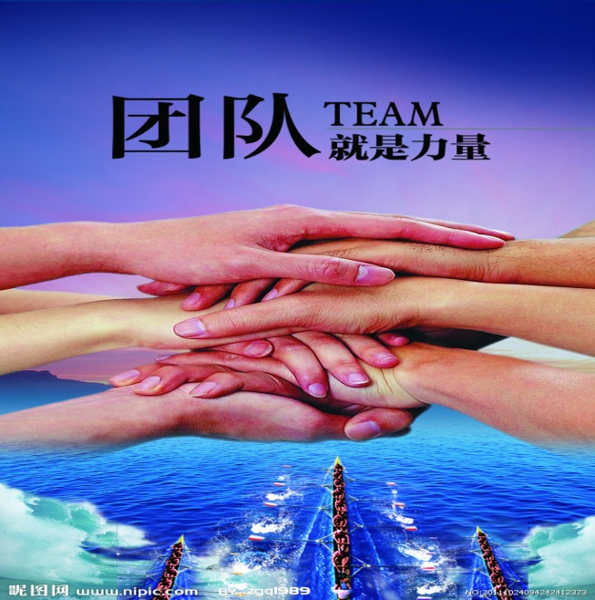
2.5.8.众人拾柴火焰高；Unity is power——unity

Slide 33

III. Practice

Slide 34

3.1. Question for discussion
1. What are the functions of cultural values?
2. What cultural values do you carry with you?
3. In English, “ I ” is always capitalized and given names are put before family names, what cultural value do they reflect?
4.What are the advantages and disadvantages of Chinese and western
cultural values?
5. How have the Chinese and western cultural values changed?

Slide 35
3.2.List as many typical cultural values as possible in English-speaking countries and China
Individualism
Independence
Self-reliance
Privacy
Hard work
Competitiveness
adventure
Collectivism
Interdependency
Filial piety
Face
Hard work
Modesty
humility

Slide 36
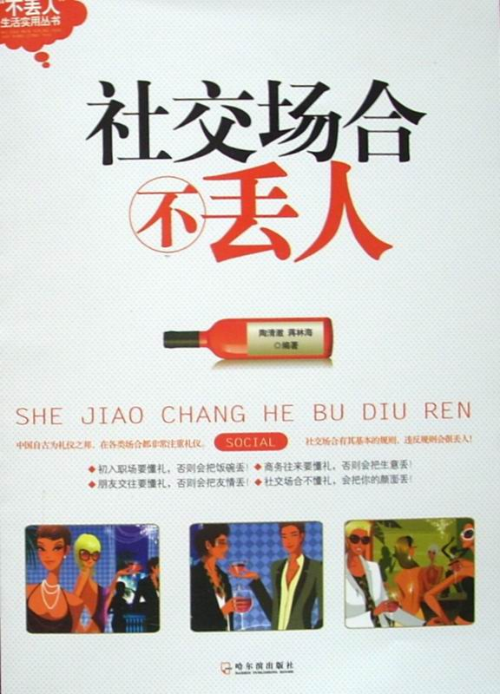
3.3.List as many expressions in Chinese as possible
which are concerned with “ face”
丢脸， 长脸 ，不要脸，没脸见人， 脸皮厚， 体面，
给面子， 留点面子， 要面子，看我的面子……

Slide 37
3.4.Try to translate the following Chinese into English
1) 如海道：“天缘凑巧”：因贱荆去世，都中家岳母念及小女无人依傍，…”
“What a lucky coincidence!” exclaimed Ju-hai. “Since my wife’s death my mother-in-law in the capital has been worried because my daughter has no one to bring her up. …”
2) 欢迎贵国代表团到我校参观。
Welcome your country delegation to visit our school.

Slide 38

3.5.Complete the following task.
People have different views about privacy. What kinds of personal information
are you willing to share with others? What kinds of personal information do you
believe in keeping private?
Read the personal information column in the chart below. How do you feel
about each item? Rate your feelings from 1 to 5, with 1 being “ not very
Private” , with 5 being “very private”. Circle the number that best represents the
degree of privacy you prefer. Be ready to discuss your reasoning

Slide 39
degree of privacy | not very private ——very private
My phone number | 1 2 3 4 5
My religion | 1 2 3 4 5
My bank account number | 1 2 3 4 5
My favorite color | 1 2 3 4 5
My feelings | 1 2 3 4 5
My marital status | 1 2 3 4 5
weight | 1 2 3 4 5
My home country | 1 2 3 4 5
My health | 1 2 3 4 5
My income | 1 2 3 4 5

Slide 40
3.6.Analyze the following case
Asked by her daughter who had married an American, a Chinese old lady went to America to look after her grand-child. Elle fell seriously ill one day and was sent to hospital. She needed an operation. Hospitalisation expenses are high in Amerca. What’s more, the old lady had no medical insurance. The husband said to her wife: “We could not afford the expenses.” Extremely surprised and angry, the wife told him that she would save her mother even at the cost of her own life. 《美国价值观》—— 一个中国学者的探讨 朱永涛 p.6
What is the Possible cause of the quarrel?
different value standard
Chinese value: It’s the children’s obligation to try their best to help their parents, especially when their parents are in trouble. — filial piety
American value: It’s up to the father-in-law, not the daughter, not to speak of him, the son-in-law, to pay for the medicine.

Slide 41
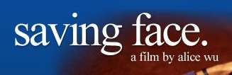
IV. Assignments
1. Do some of the exercises in Unit 4.
2. Video Watching: Watch the film “ Saving Face” and comment on the
National cultural values reflected in it.

Slide 42


