Slide 1

Unit 9
Intercultural Business Negotiations

Slide 2
Learning Objectives
In this unit, you are to know:
1. the definition of business negotiation and the intercultural business negotiations;
2.the characteristics, context, principles and criteria of business negotiations;
3.the cultural factors affecting intercultural business negotiations;
4.the differences of styles of business negotiations between East and West.

Slide 3
Procedures
Warm-up
1
Text Study
2
Practice
3
3
Assignments
4
4

Slide 4

I. Warm-up
What do the two cases reflect？

Slide 5

Analysis
The two cases reflect the cultural differences between U.S. and Japan: U.S. is a country of low-context culture while Japan is a country of high-context culture.
Negotiation!

Slide 6

II. Text Study
Go over textbooks from pages 140 to 149 and learn about
how to deal with intercultural business negotiation.

Slide 7
With the trend of economic globalization and integration,
intercultural business negotiation is becoming more and
more important in the international trade, and at the same
time, international negotiators are meeting more and more
challenges of cultural impact on international business
negotiation.

Slide 8

2.1. Negotiation
2.1.1.Definition
Negotiation and business involves hard work.
Negotiation means discussions through which relevant parties can reach an agreement
to satisfy their needs and achieve coordinate relations.
Negotiation is the process of discussion by which two or more parties aim to reach
a mutually acceptable agreement
Negotiating across borders is more complex because of the number of stakeholders
involved.

Slide 9
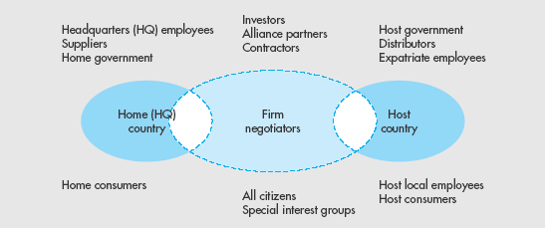
Stakeholders
Notes:
This slide illustrates the different stakeholders involved in global negotiations.

Slide 10

2.1.2. Characteristics
1. Negotiation is dynamic, transitory and directive, trying to persuade your counterpart to understand or accept your proposals;
2. There must be interrelations and conflicts in opinions, interests and even behavior patterns, conveying and exchanging information through logical thinking and relevant suitable expressions;
3. Negotiation is a process of adjusting needs and finally reaching agreement;
4. There must be the bottom line of interest for each party, which negotiators get from negotiation determined by their company, their negotiating strategy and relevant environmental factors;
5. Negotiation is science as well as art.

Slide 11
2.1.3. Contents
the four Cs：
common interest, conflicting interests, compromise, and criteria.
1) Common interest considers that both parties in the negotiation share, have, or
want something that the other party has or does.
2) Conflicting interests include payment, distribution, profits, contractual
responsibilities, and quality.
3) Compromise includes areas of disagreement. Although a win-win negotiated
settlement would be best for both parties, the compromises that are negotiated may
not produce that result.
4) Criteria include the conditions under which the negotiations take place.

Slide 12
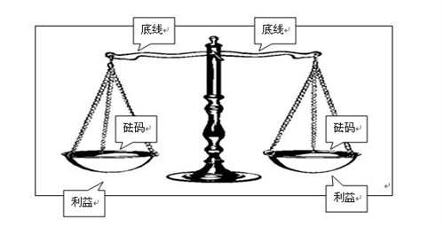
2.1.4. Principles
If negotiators want to succeed in negotiation, they should obey some important
principles:
1. try to expand their general interests during the whole process of negotiation;
2.to be skillful at creating open, fair and just competitive situation;
3. make objectives clear and compromise at suitable time while attacking;
4.hold on to the principle of equality and reciprocity;
5. stick to objective criteria independent from personal emotions;
6. try to put forward proposals beneficial to both;
7.Stress their interests, not standing point;
8. Separate personal affairs from what to be negotiated.

Slide 13
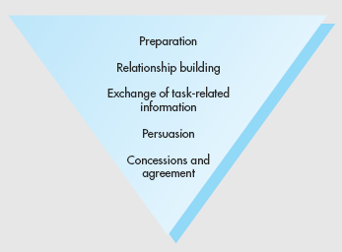
2.1.5. Process

Slide 14
Preparation
Negotiators must familiarize themselves with
  The entire context and background of their counterparts
  The specific subjects to be negotiated
  Differences in culture, language, and environment
Negotiators must have an understanding of their own negotiating style
Negotiators should find out as much as possible about
  The kinds of demands that might be made
  The composition of the opposing team
  The relative authority that the members possess
Develop a profile of their counterparts
Consider different variables during this process as well

Slide 15
Relationship building – taking time to build mutual trust before starting business discussions
  May require go-betweens
  Be prepared to wait for the other party to start business negotiations
Exchanging task related information – during this stage each side makes a presentation and states its position, normally followed by a question-and-answer session
  Role reversal: showing an understanding of the other party’s viewpoint and needs
Notes:
This slide highlights steps two and three in the negotiation process. During relationship building many non-task events (social events, tours, and ceremonies) take place so that the parties can get to know one another.
Once stage three begins the parties begin to present their positions and discussion follow so that a mutually beneficial solution can be found. Negotiators should focus not only on presenting their situation and needs but also on showing an understanding of their opponents’ viewpoint. Focusing on the entire situation confronting each party encourages the negotiators to assess a wider range of alternatives for resolution, rather than limiting themselves to their preconceived, static positions. Researchers suggest that to be most effective, negotiators should prepare for meetings by practicing role reversal.

Slide 16
Persuasion – during this stage both parties try to persuade the other to accept more of their position while giving up some of their own; there are recognizable tactics for this stage
  Stressful tactics
Concessions and Agreements – at this point each side will make various concessions so that an agreement can be reached and signed
Notes:
This slide highlights the final two stages in the negotiation process. Follow the hyperlink to the persuasion tactics.
Well-prepared negotiators are aware of various concession strategies and have decided ahead of time what their own concession strategy will be. Familiar with the typical initial positions that various parties are likely to take, they know that the Russians and the Chinese generally open their bargaining with extreme positions, asking for more than they hope to gain, whereas the Swedes usually start with what they are prepared to accept. Research in the United States indicates that better end results are attained by starting with extreme positions. With this approach, the process of reaching an agreement involves careful timing of the disclosure information and of concessions. Most people who have studied negotiations believe that negotiators should disclose only the information that is necessary at a given point and that they should try to obtain information piece by piece to get the whole picture gradually without giving away their goals or concession strategy.

Slide 17
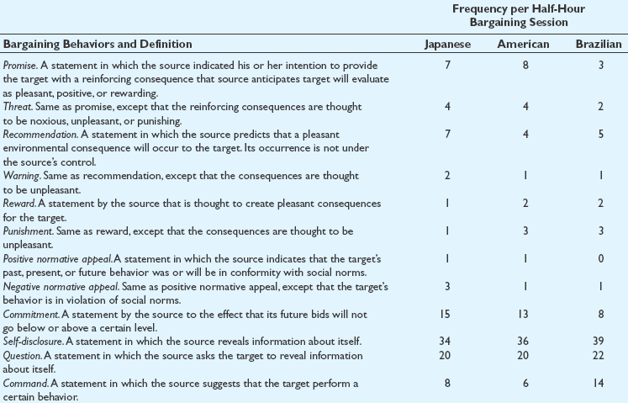
Persuasion Tactics

Slide 18
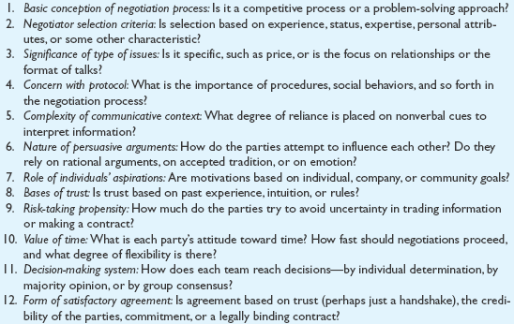
Twelve Variables in the Negotiation Process

Slide 19
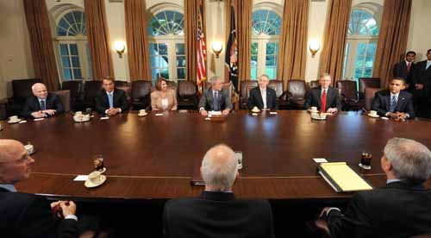
2.2. Intercultural Business Negotiation
2.2.1. Definition
Intercultural business negotiation can be defined as the discussions of common
and conflicting interests in terms of business between people of different cultural
backgrounds who work to reach an agreement of mutual benefit.

Slide 20
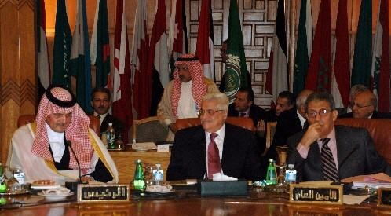
2.2.2. Factors Affecting Intercultural Business Negotiation
1) Negotiating Atmosphere
2) Communication style
3) Uncertainty Avoidance
4) Decision-Making System
5) Power Distance
6) Personal attitude
7) View of Time
8) Protocol
9) Form of Agreement

Slide 21
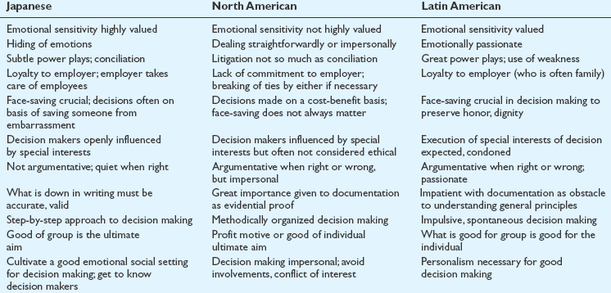
2.2.3. A Comparison of Business Negotiation Styles Between East and West
Understanding Negotiation Styles(1)

Slide 22
2.2.3. A Comparison of Business Negotiation Styles Between East and West
1) Americans:
Americans tend to convey warmth, sincerity, confidence and positiveness in their
communication. They are always ready to engage in bargaining, or compromise in
the negotiation process. Negotiators from the United States tend to assume that
English will be spoken in the sessions. They tend to be more interested in logical
arguments. They may employ threats, warnings and continual pushiness, even if
their counterparts are signaling “no”. Americans tend to express their ideas bluntly
silence being perceived as uncomfortable and indicative of trouble.
For North Americans, negotiations are businesslike; their factual appeals are
based on what they believe is objective information, presented with the assumption
that it is understood by the other side on a logical basis.

Slide 23
2.2.3. A Comparison of Business Negotiation Styles Between East and West
2)The British:
The British employ a negotiating style similar to that of Americans, but more
silence is utilized and they are less egalitarian. The British negotiators are regarded
as kind, friendly, sociable, agreeable, flexible and responsive.
3)The French:
The French frequently employ “no” communication and often insist on the use of
their own language in negotiation settings. They are confrontational and competitive.
4)The Germans:
German negotiators do not tend to compromise and are generally clear, firm, and
assertive in their expression.
5)The Russians:
The Russians employ axiomatic appeals – that is, their appeals are based on the
ideals generally accepted in their society.

Slide 24
2.2.3. A Comparison of Business Negotiation Styles Between East and West
6)The Chinese:
The Chinese do not wish to openly confront conflict and therefore will shun any
proposal- counter- proposal style of negotiating. The Chinese must not be forced to
withdraw from a stand if that might result in a possible loss of face. Chinese
negotiators make concessions slowly and refrain from small talk. They do not accept
hypothetical examples.
7)The Japanese;
The Japanese desire smoothness in their transactions. They encourage covert,
fragmented expression. They also employ necessary silence in the process of
negotiations, and their communication is more frequently positive than expressive of
“no’s” and commands. The Japanese polite behaviors are considered among the
least aggressive negotiators.
8)The Arabs:
The Arabs use affective appeals based on emotions and subjective feelings.

Slide 25
2.2.4. Management of Intercultural Business Negotiations
Successful management of intercultural business negotiations
requires the negotiator:
  To gain specific knowledge of the parties in the upcoming meeting
  To prepare accordingly to adjust to and control the situation
  To be innovative
A problem solving approach is essential to successful
cross-cultural negotiation.Treat everyone with respect, avoid
making anyone feel uncomfortable, don’t criticize or blame
others in a personal way such that they lose face.
Notes:
Skillful global managers must assess many factors when managing negotiations. They must understand the position of the other parties in regard to their goals—whether national or corporate—and whether these goals are represented by principles or specific details. They should have the ability to recognize the relative importance attached to completing the task versus developing interpersonal relationships. Managers also must know the composition of the teams involved, the power allotted to the members, and the extent of the teams’ preparation. In addition, they must grasp the significance of personal trust in the relationship.

Slide 26
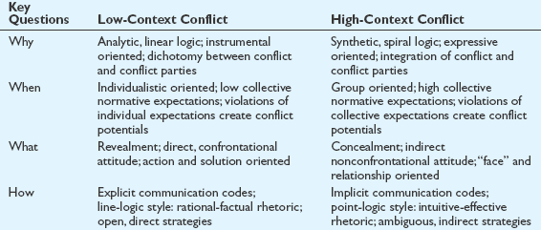
1)Managing Conflict
Notes:
Much of the negotiation process is fraught with conflict—explicit or implicit—and such conflict can often lead to a standoff, or a lose–lose situation. This is regrettable, not only because of the situation at hand, but also because it probably will shut off future opportunities for deals between the parties. Much of the cause of such conflict can be found in cultural differences between the parties—in their expectations, in their behaviors, and particularly in their communication styles.

Slide 27
2)Decision -making
Stages in the Rational Decision Making Model
  Defining the problem
  Gathering and analyzing relevant data
  Considering alternative solutions
  Deciding on the best solution
  Implementing the decision
Notes:
Negotiation actually represents the outcome of a series of small and large decisions. The decisions include those made by each party before actual negotiations start. The decisions include incremental decisions, made during the negotiation process, on how to react and proceed, when to concede, and on what to agree or disagree. Negotiation can thus be seen as a series of explicit and implicit decisions, and the subjects of negotiation and decision making become interdependent. Generally these decisions are made by using the rational decision making model.

Slide 28
3)Cultural Variables Affecting Decision -making
Objective (basing decisions on rationality) versus subjective (basing decisions on emotions) approach
Risk tolerance
Locus of control – internal (negotiators in control of events), or external negotiators have little control over events)

Slide 29
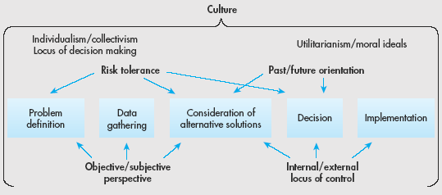
Cultural Variables Affecting Decision -making

Slide 30
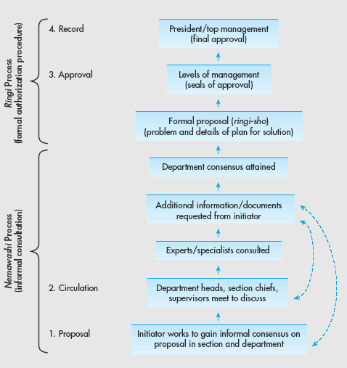
4)Decision -making in Japan
Notes:
Having an understanding of the Japanese decision making process is vital for any manager that will be working within this country. This understanding will come from having an understanding that the Japan’s national culture is one that is based on relationships, and team work. It is this culture of collectivism and shared responsibility that underlies the Japanese ringi system of decision making. In the ringi system, the process works from the bottom up. Americans are used to a centralized system, where major decisions are made by upper-level managers in a top-down approach typical of individualistic societies. The Japanese process, however, is dispersed throughout the organization, relying on group consensus. The ringi system is cumbersome and very time-consuming prior to the implementation stage, although implementation is facilitated because of the widespread awareness of and support for the proposal already gained throughout the organization. However, its slow progress is problematic when decisions are time-sensitive. This process is the opposite of the Americans’ top-down decisions, which are made quite rapidly and without consultation, but which then take some time to implement because unforeseen practical or support problems often arise.

Slide 31
5)Negotiating with the Chinese people(1)
The Chinese people think in terms of process that
has no culmination. Americans think in terms of concrete
solutions to specific problems. . . . The Chinese people’s
approach is impersonal, patient and aloof . . .To
Americans, Chinese leaders seem polite but aloof and
condescending. To the Chinese people, Americans appear
erratic and somewhat frivolous.
—Henry Kissinger,
Newsweek, May, 2001

Slide 32
Negotiating with the Chinese people (2)
Business people have two major areas of conflict when negotiating with the Chinese
  Amount of detail about product characteristics
  Apparent insincerity about reaching an agreement
Chinese negotiation process is affected by three cultural norms
  Politeness and emotional restraint
  Emphasis on social obligations
  Belief in the interconnection of work, family, and friendship

Slide 33
Negotiating with the Chinese (3)
Tips to foreigners conducting business in China
  Practice patience
  Accept prolonged periods of stalemate
  Refrain from exaggerated expectations
  Discount Chinese rhetoric about future prospects
  Expect the Chinese to try to manipulate by shaming
  Resist the temptation to believe that difficulties are your fault
  Try to understand Chinese cultural traits
Notes:
The Chinese are among the toughest negotiators in the world. American managers must anticipate various tactics, such as their delaying techniques and their avoidance of direct, specific answers: Both ploys are used to exploit the known impatience of Americans. The Chinese frequently try to put pressure on Americans by “shaming” them, thereby implying that the Americans are trying to renege on the friendship—the basis of the implicit contract. Whereas Westerners come to negotiations with specific and segmented goals and find it easy to compromise, the Chinese are reluctant to negotiate details. They find it difficult to compromise and trade because they have entered negotiations with a broader vision of achieving development goals for China, and they are offended when Westerners don’t internalize those goals.

Slide 34

III. Practice
.

Slide 35

1. How do you understand the following statement?
Negotiators from the United States are by nature very individualistic, their
attitude towards making a decision on export would be “anything is permitted
unless it is restricted by the state”. While in another culture, the attitude might be
“nothing is permitted unless it is initiated by the state”.
Cultural values are reflected in intercultural business negotiation

Slide 36

2. How do the following statements characterize U.S. negotiation styles?
Expressing individualism
1) I can understand this by myself.
2) Please call me Steve.
3) Pardon my French.
4) Let’s get to the point.
5) Speak up! What do you think?
6) Let’s put our cards on the table.
7) A deal is a deal.
8) One thing at a time.
Being informal
Excusing profanity
Being efficient
Avoiding silence
Wishing for honesty
Expecting to honor an agreement
Expecting to separate issues and settle them one at a time.

Slide 37
4. Q’s & A’s
Why Is Mr. Green So Angry?
A Chinese software company wanted to cooperate with an American software company,
so they invited the American company to China to have a negotiator. The latter was very
interested in this invitation because they all knew that nowadays China is the would-be
largest market in the world. So, the American company sent three persons of which Mr.
Green was the group leader to China. On the other hand, Mr. Wang, as the group leader of a
team made up of fifteen people, was in charge of the matter for this Chinese company.
When finally Mr. Wang saw Mr. Green at the airport, he smiled, “ You must be very tired!”
Mr. Green was somewhat puzzled, but he did not pay much attention to that. Then, when
they arrived at the hotel, Mr. Wang treated Mr. Green a big dinner. Mr. Green was at a loss
when he saw that so much food was served. “That is impossible to eat out all that food”, said
Mr. Green. But Mr. Wang said, “ I’m very sorry that we just prepare some poor food, I hope
you don’t mind”. Mr. Green was totally puzzled, “ who said that China is a developing country
and Chinese are poor? If the poor live this way, there must be no God!” He also considered
Mr. Wang as a false guy for apologizing for this big dinner.
On the next day when Mr. Green suggested that they should begin the negotiation. Mr.
Wang just laughed, “ There is no need to hurry, after all, and you three come to China for the
first time, so just see around our city for several days. First enjoy yourselves, and the talk
about business. Would that be all right?”

Slide 38
4. Q’s & A’s
But Mr. Green was a little unpleased, If we don’t begin our negotiation, what on earth we come to China?”
“ I know that our business is negotiation, but we also hope that you can enjoyyourselves, we can start our negotiation several days later”, said Mr. Wang.
“ Business is business, we really appreciate your good will, but we come to
China not for ourselves, but for the company”, said Mr. Green.
Mr. Wang was a little embarrassed hearing this. But finally they begin their negotiation. When they all seated themselves, Mr. Green felt very strange, hejust couldn’t understand the Chinese company sent so many persons to this negotiation, after all, this is just a negiation, niot a fight.
After Mr. Wang in troduced all his members to Mr. Green, the latter finally found out that these persons included sales manager, technician and some other similar people, “ I can’t see why these people come”, thought M Green. Then he introduced his members to Mr. Wang, “ this is my secretary, and this is the lawyer of our company.” When hearing the word “ lawyer”, all Chinese people present somewhat disappointed and angry. Mr. Wang froze his smiling, totally had no idea what to say. “Why lawyer? It’s just like caculating family property in preparing for the divorce at the time when we are just beginning to fall in love”,thought Mr. Wang.
Why Mr. Green Is So Angry?

Slide 39
4. Qs & As
‘
During the negotiation, Mr. Green advanced several articles, but every time, Mr. Wang would just say, “ Oh, that’s very good, but I have to talk with my boss.” Mr. Green was very unpleasant, for he couldn’t understand why the company sent Mr. Wang if he couldn’t make any decisions. What’s worse, sometimes Mr. Wang would give some puzzled answers, like “ I can fully understand this, but I am afraid there are many problems about this, it’s very complex”.
“ Then what are the problems”, asked MR. Green. This made Mr. Wang embarrassed and he just kept silent.
At last, MR. Green couldn’t help his angry anymore, “ I don’t think that you company really wanted to cooperate with our company!”
Mr. Wang also felt very angry, but he just said, “ Take it easy, in fact, we do want to cooperate with you, but see that things are complex.”
Mr. Green was so angry to these cloudy words that he accidentally felt down the seat. All the Chinese present smiled and asked, “ A re you OK?” Mr. Green said nothing and left the room for he thought he was not respected.
The next day he left China with his members.
Why Mr. Green Is So Angry?

Slide 40
Questions for discussion:
1) Why did Mr. Green felt kind of puzzled when he heard Mr. Wang say “ you must be very tired” at the airport.
2) Why did the Chinese people serve their foreign counterparts such a big dinner? How did Mr. Green think of it?
3) When Mr. Green introduced his lawyer at the negotiation table, why did the Chinese people feel very uncomfortable?
4) Why did Mr. Green think that the Chinese company was unwilling to cooperate with his company?

Slide 41

IV. Assignments

Slide 42

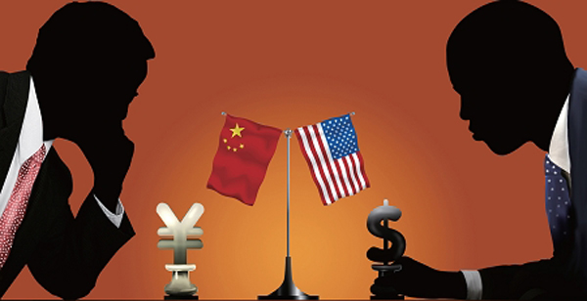
1. Intercultural business negotiation styles vary
from culture to culture. What are the primary
differences between Chinese negotiators and their
American counterparts? What are the underlying
reasons for their potential conflicts?

Slide 43
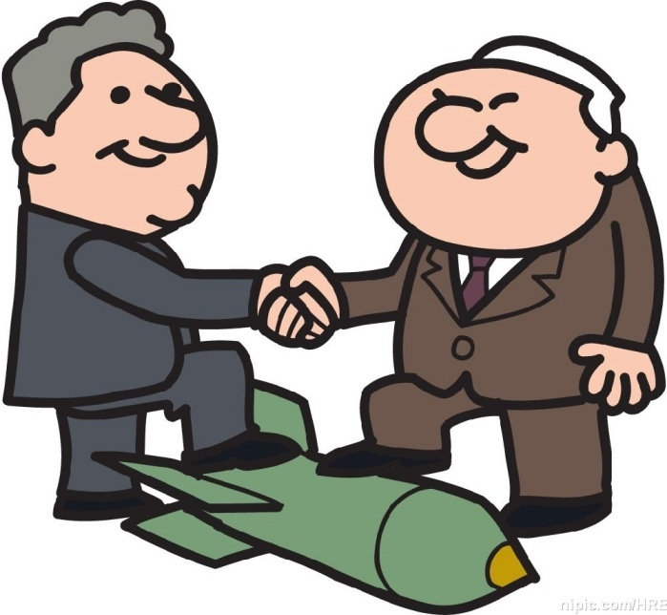
2. Select a case from mess media that discusses a
negotiation session between members of two or
more cultures. Analyze the situation by deciding
why the negotiation is successful or why it failed.

Slide 44

3. Video-watching:

