Slide 1
Solve FGVC based on Vision Transformer
Shiyu Chen, Jingyun Huang and Zijian Lin
2023.6.18

Slide 2
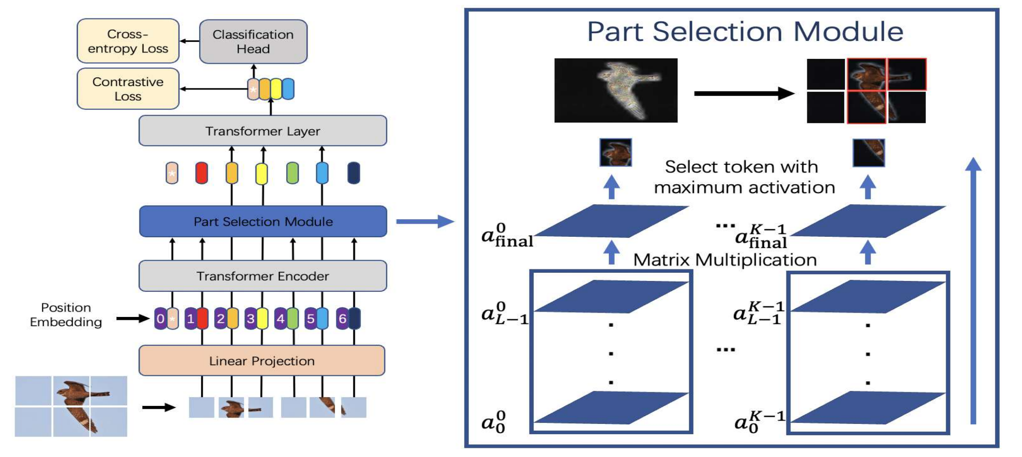
TransFG: A Transformer Architecture for Fine-Grained Recognition --Dec 1 2021
https://github.com/TACJu/TransFG

Slide 3
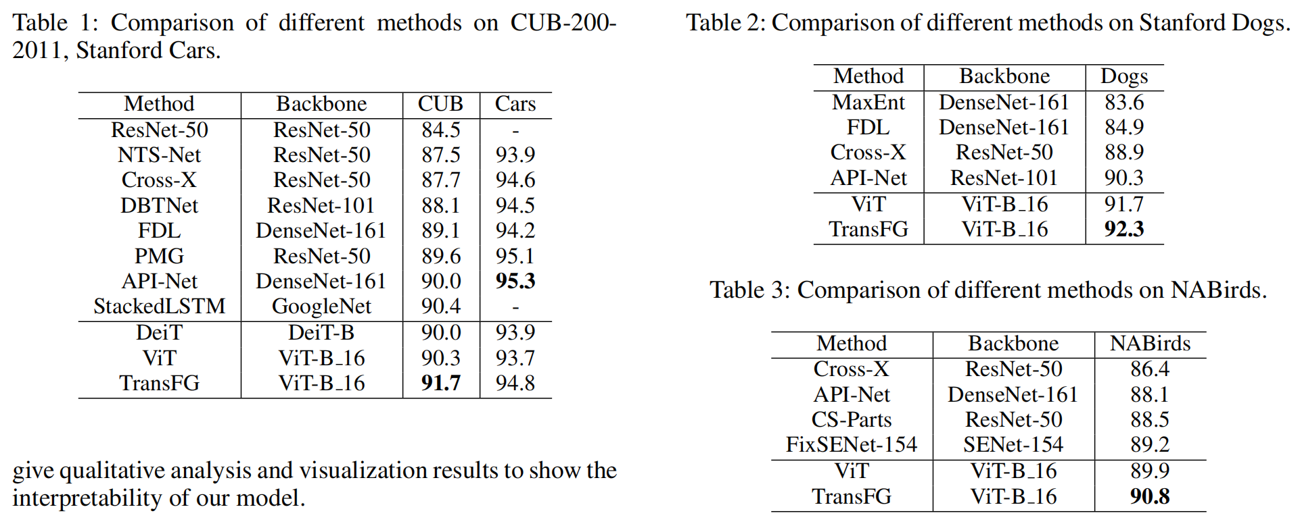
TransFG: A Transformer Architecture for Fine-Grained Recognition --Dec 1 2021
https://github.com/TACJu/TransFG

Slide 4
Model structure: ViT
Image Sequentialization
Segmentation: Preprocessing the input image into a sequence of flattened patches.
Patch Embedding
(1)Mapping: map the vectorized patches into a latent D-dimensional embedding space using a trainable linear projection.
(2)Pass through transformer

Slide 5
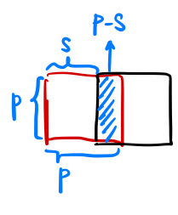
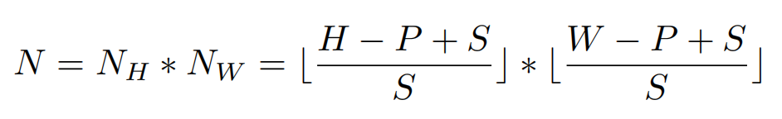
Model structure: ViT
Image Sequentialization
Segmentation: Preprocessing the input image into a sequence of flattened patches.
Input : H*W
Patch: P
Step: S
Why overlapping?

Slide 6


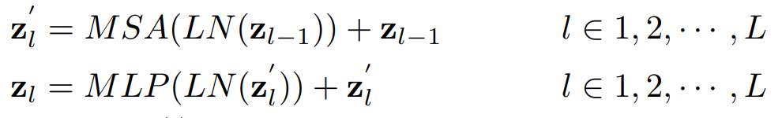

Patch Embedding
Map patch into latent D-dimensional embedding space, E is the patch embedding projection
ViT exploits the first token of the last encoder layer as the representation of the global feature
is the encoded image representation
Forward embeddings to a classifier head to obtain the final classification results without considering the potential information stored in the rest of the tokens

Slide 7
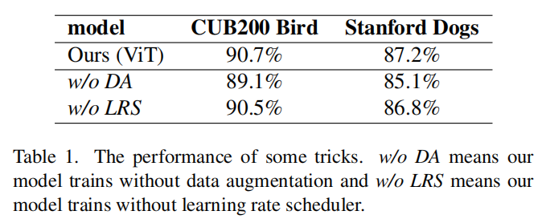
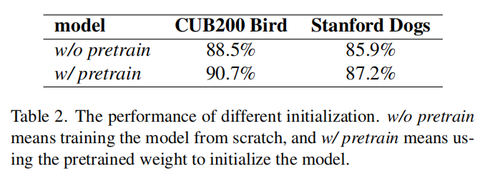
Training tricks

Slide 8
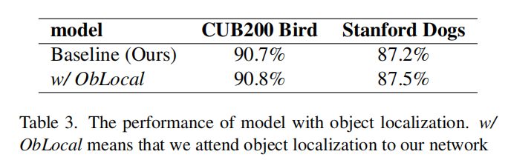
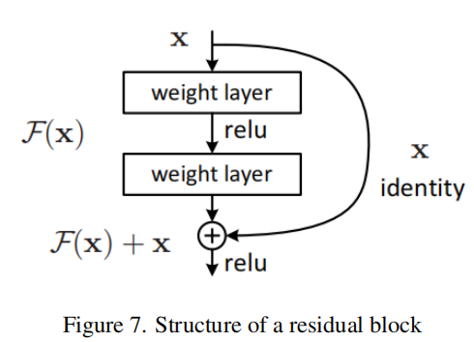
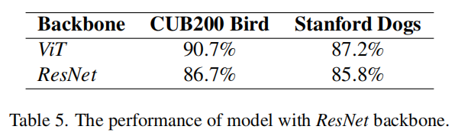
Object Localization
Based on R-CNN：
CNN backbone: ResNet

Slide 9
ViT model backbone vs. CNN backbone
Self-attention:
ViT models use self-attention to learn relationships between different parts of the input image, while CNNs rely on local filters and convolutions. This gives ViTs the ability to capture long-range dependencies that CNNs may miss.
Translation invariance:
CNNs are translation invariant by design due to the convolutional filters. ViTs do not inherently have this property and need positional embeddings to maintain location information.
Sensitivity to input size:
ViTs generally require input images of a fixed size, while CNNs can handle a range of input sizes.

