Slide 2
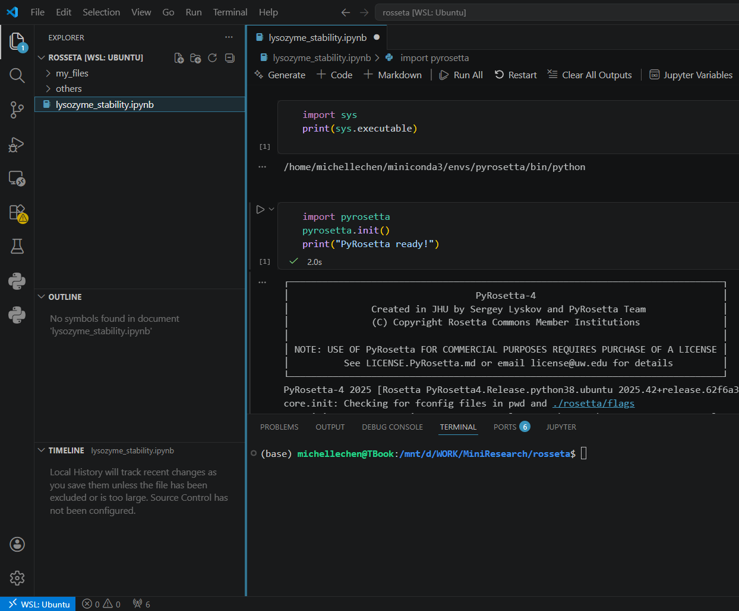
Explorer Panel
Editor
Activity Bar
Integrated Terminal
Status Bar

Slide 3
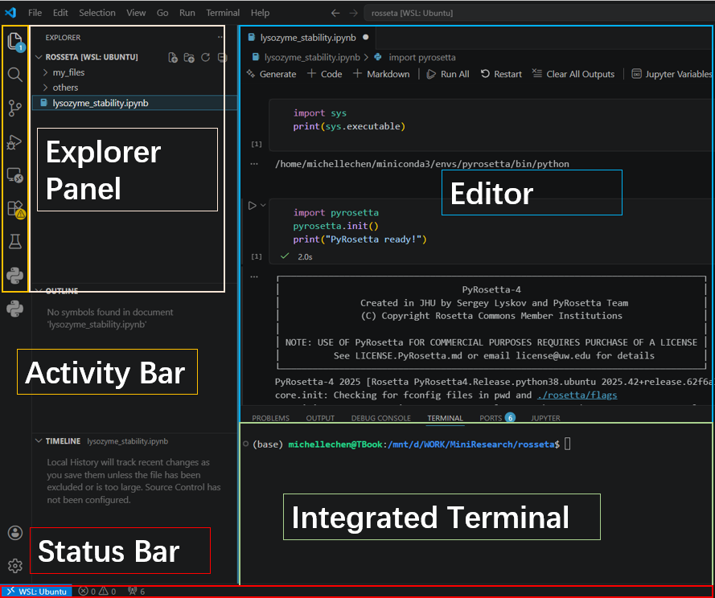

Slide 4
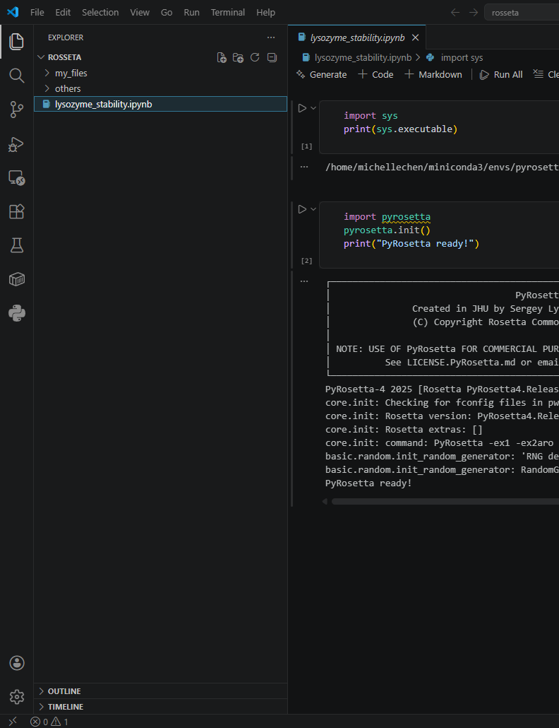
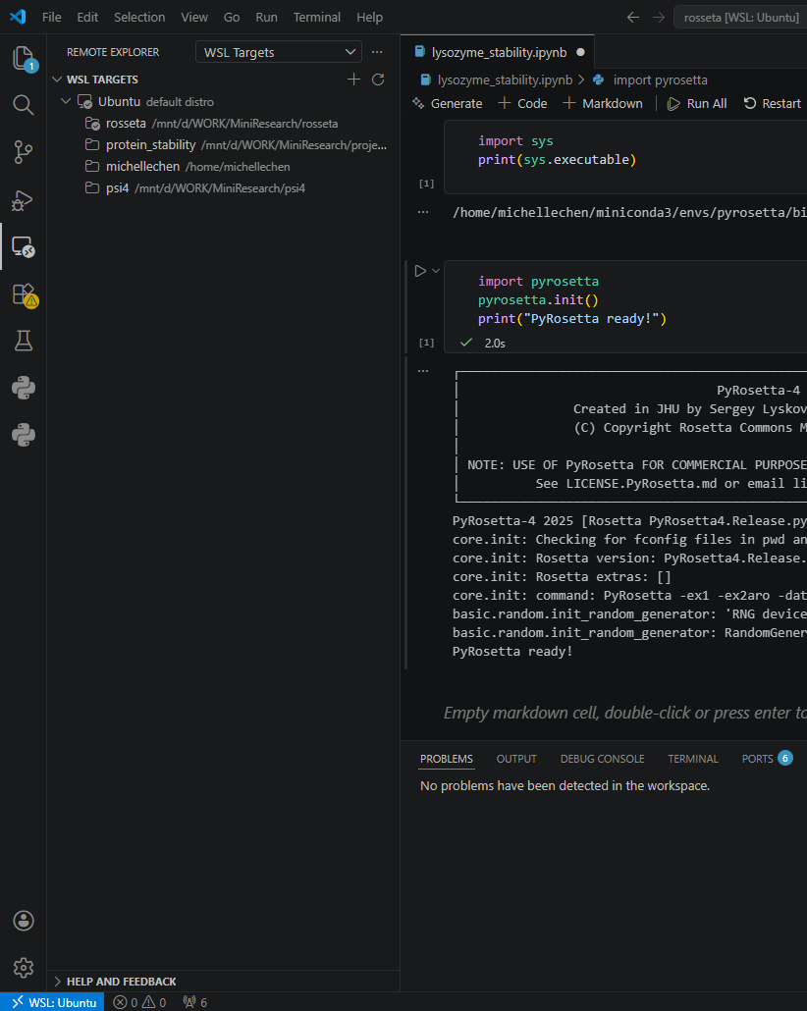
Explore Panel
shows your files and folders
Remote Explorer
manages your WSL connection
Extensions
browse and install extensions
Activity Bar

Slide 5
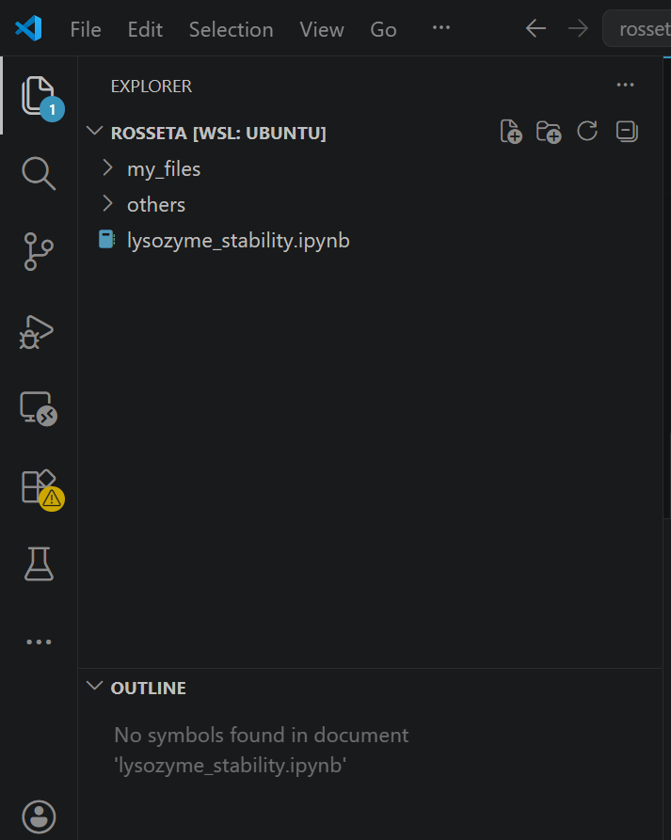
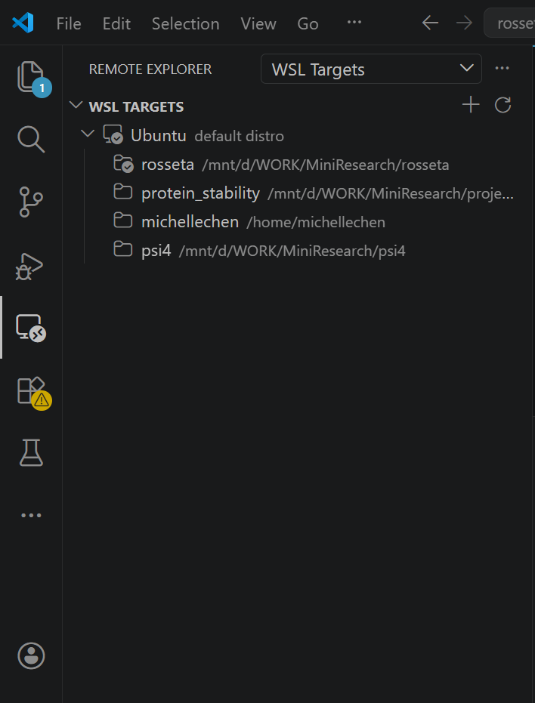
Explore Panel
shows your files and folders
Remote Explorer
manages your WSL connection
Extensions
browse and install extensions
Activity Bar

Slide 6
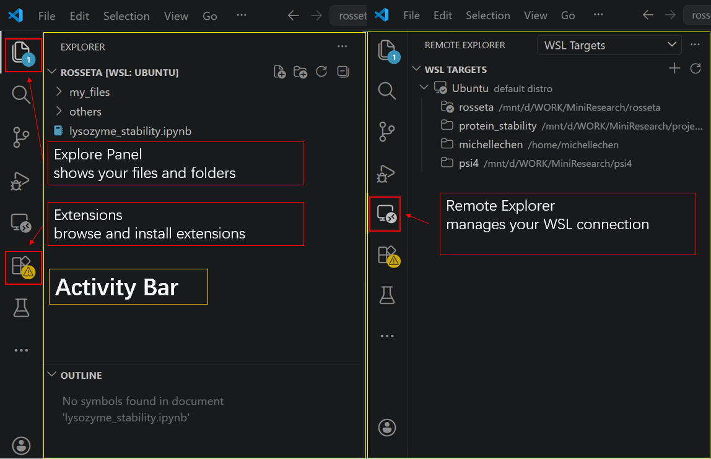

Slide 7
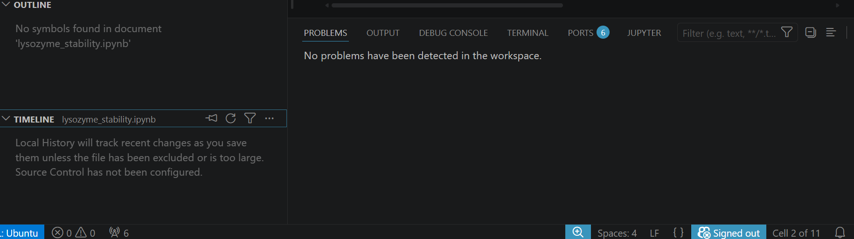
Output can be checked here
Problem can be checked here
You can show or hide this part by clicking this button

Slide 8
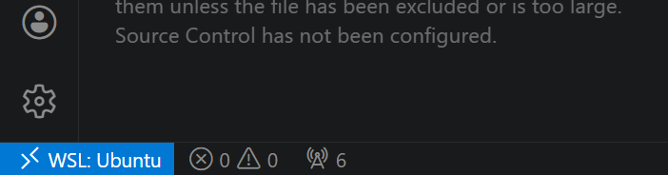
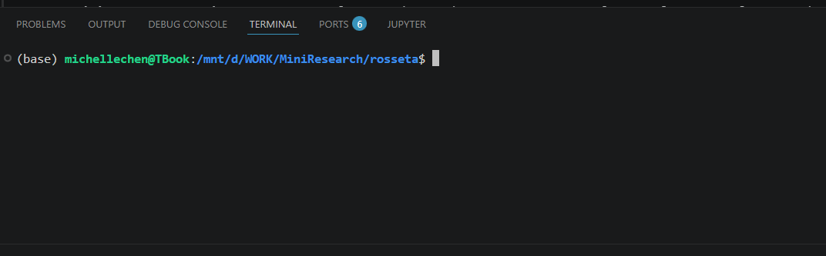

Slide 9
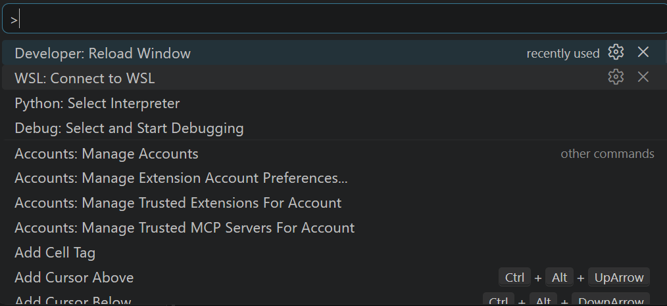
Ctrl + Shift + P
Command Pallets

Slide 10
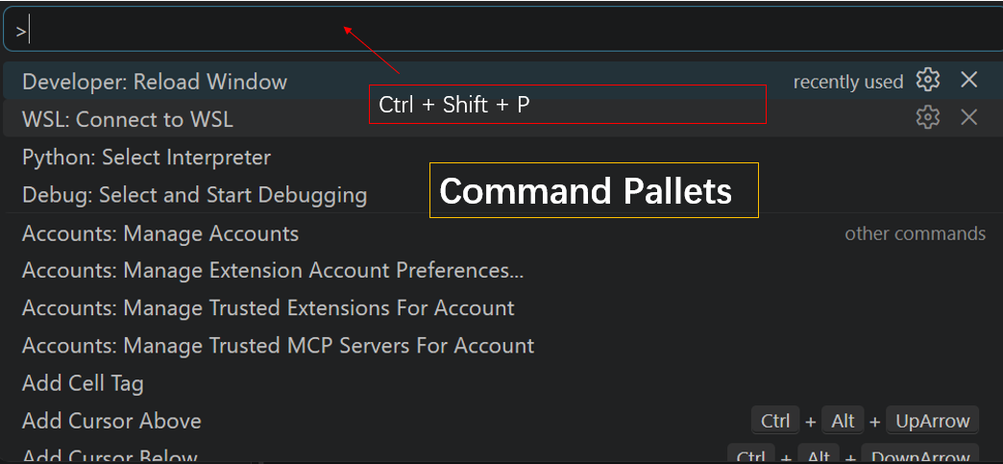

Slide 11
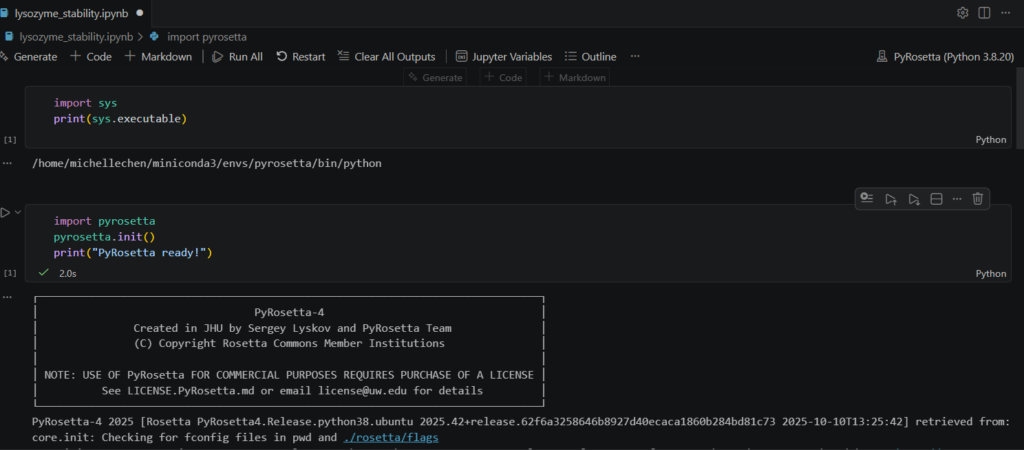

Slide 12
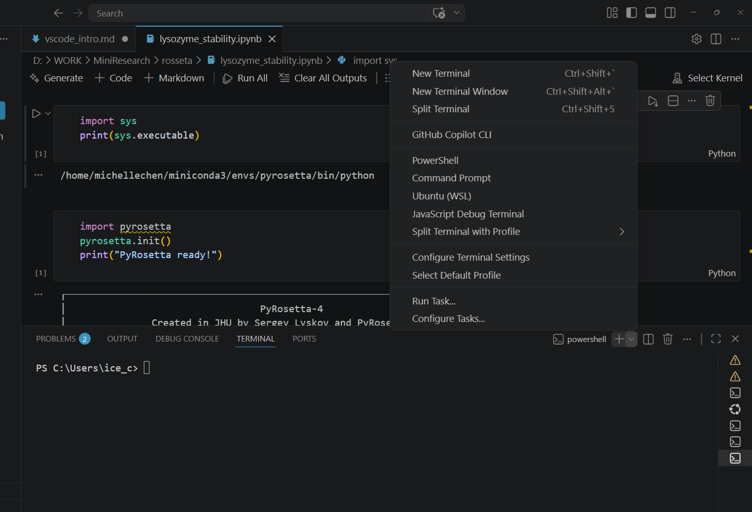
Press the Dropdown Arrow

Slide 13
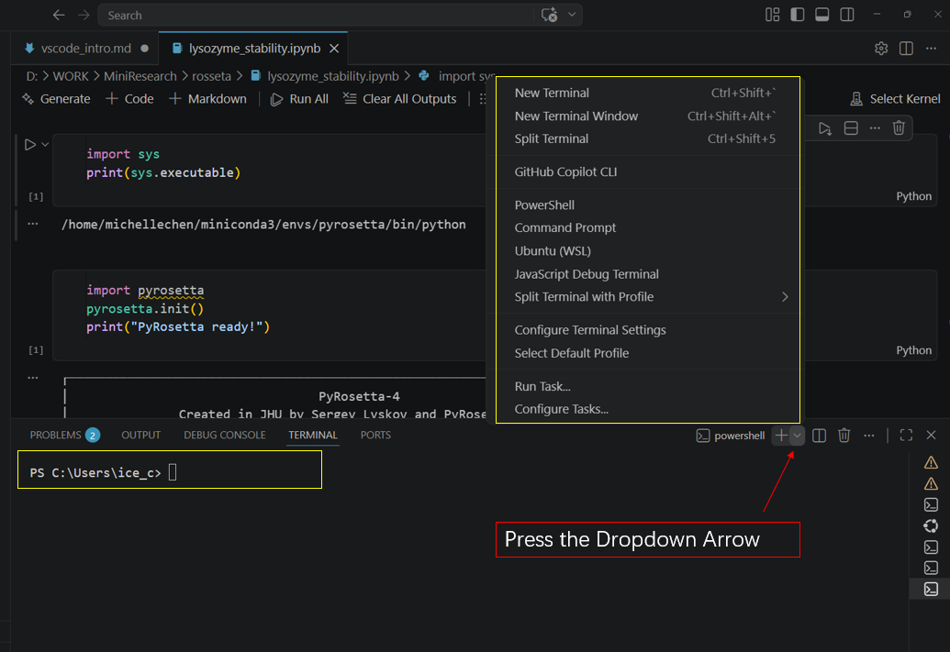

Slide 14
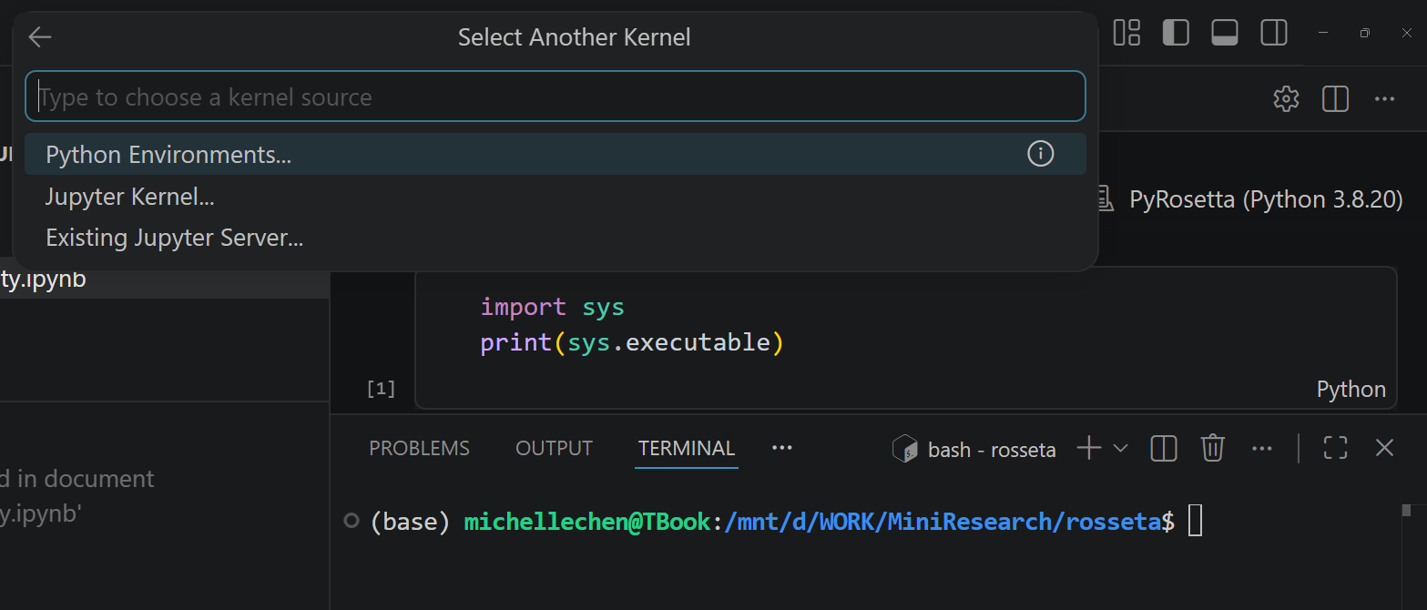

Slide 15
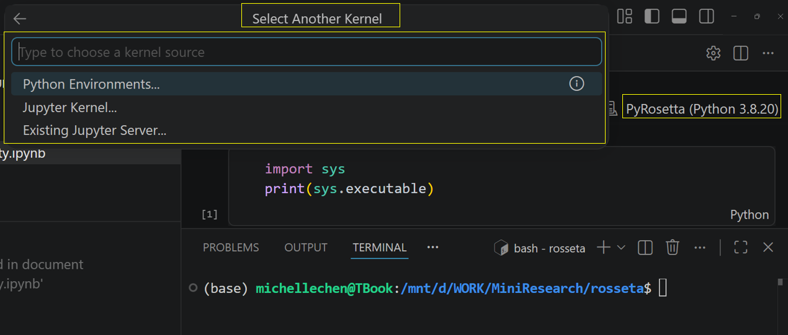

Slide 16
