Slide 1
NACK格式

Slide 2
一、NACK格式
1、RTCP RTPFB Common Header
2、NACK FCI 3、抓包
二、WebRTC接收NACK的过程 1、接收Nack的调用栈
2、Call::DeliverPacket
3、RTCP包的判断
4、RTCPReceiver::IncomingPacket
5、ParseCompoundPacket
6、PacketInformation 上一个函数处理后返回数据结构

Slide 3
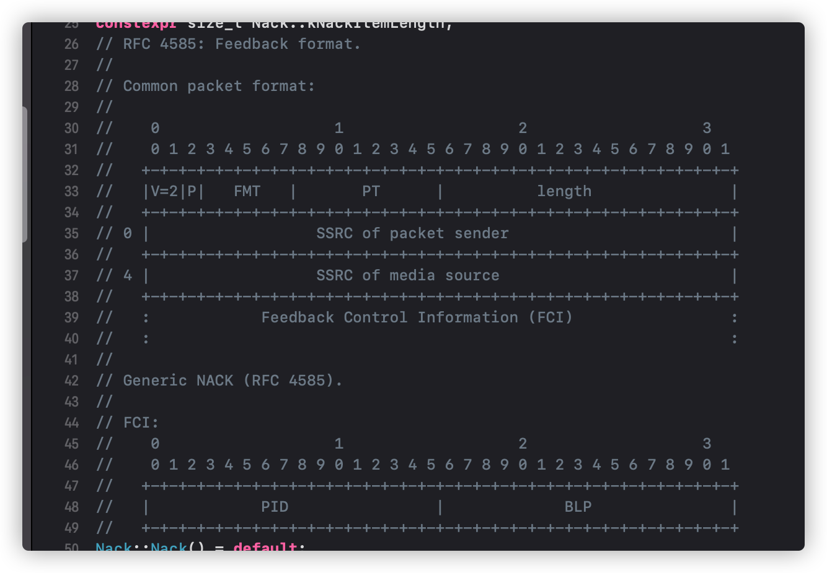
RTCP RTPFB Common Header
moudle/rtp_rtcp/rtcp_packet/nack.*

Slide 4
NACK FCI
1、PID（Packet ID），丢包的起始位置的Sequence Number
2、BLP（bitmask of following lost packets），丢失包后面的丢包掩码
3、相关文档： https://datatracker.ietf.org/doc/rfc4585/

Slide 5
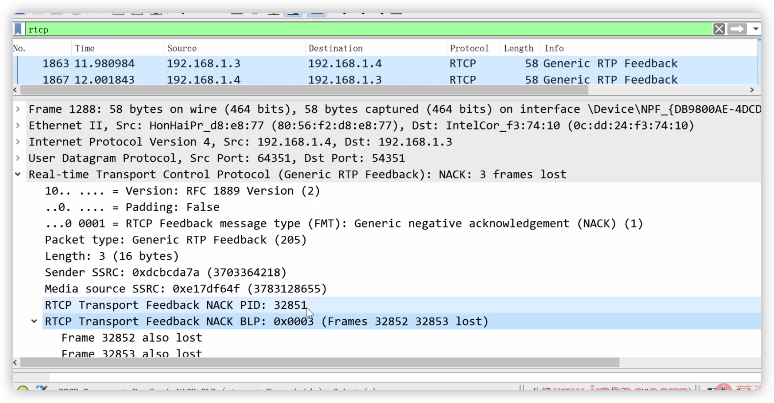
抓包

Slide 6
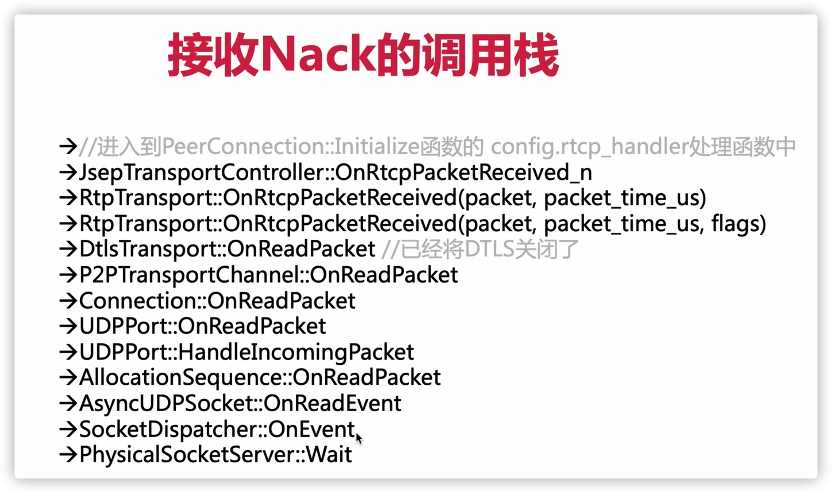
WebRTC接收NACK的过程

Slide 7
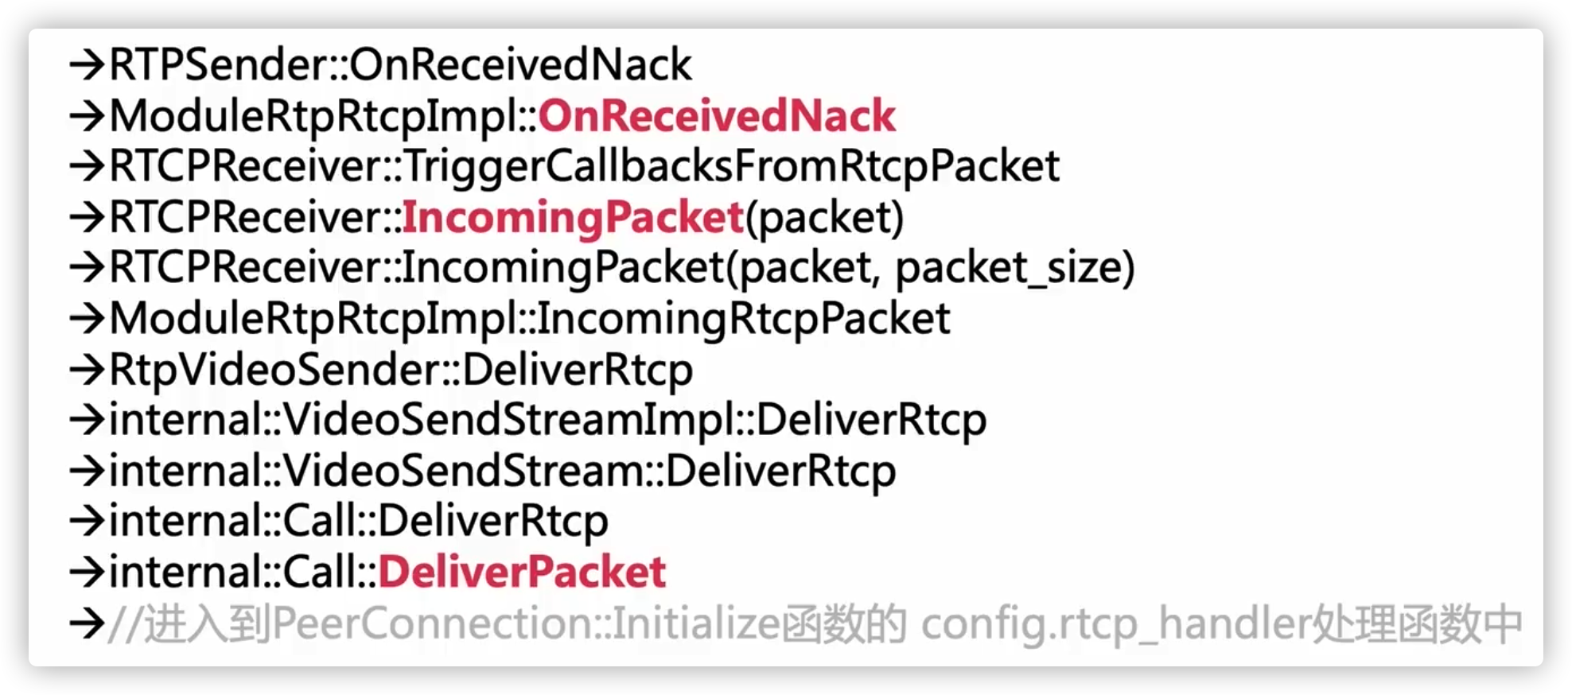
接收Nack的调用栈

Slide 8
Call::DeliverPacket
PacketReceiver::DeliveryStatus Call::DeliverPacket(
MediaType media_type,
rtc::CopyOnWriteBuffer packet,
int64_t packet_time_us) {
if (IsRtcpPacket(packet)) {
RTC_DCHECK_RUN_ON(network_thread_);
DeliverRtcp(media_type, std::move(packet));
return DELIVERY_OK;
}
RTC_DCHECK_RUN_ON(worker_thread_);
return DeliverRtp(media_type, std::move(packet), packet_time_us);
}

Slide 9
RTCP包的判断
在modules/rtp_rtcp/source目录下
查看rtp_utility.cc（M74版本）（m94版本 rtp_util.cc）
基本思路是根据PT类型来判断是否是RTCP包
constexpr uint8_t kRtpVersion = 2;
constexpr size_t kMinRtpPacketLen = 12;
constexpr size_t kMinRtcpPacketLen = 4;
bool HasCorrectRtpVersion(rtc::ArrayView<const uint8_t> packet) {
return packet[0] >> 6 == kRtpVersion;
}
bool IsRtcpPacket(rtc::ArrayView<const uint8_t> packet) {
return packet.size() >= kMinRtcpPacketLen && HasCorrectRtpVersion(packet) &&
PayloadTypeIsReservedForRtcp(packet[1] & 0x7F);
}

Slide 10
RTCPReceiver::IncomingPacket
void RTCPReceiver::IncomingPacket(rtc::ArrayView<const uint8_t> packet) {
if (packet.empty()) {
RTC_LOG(LS_WARNING) << "Incoming empty RTCP packet";
return;
}
PacketInformation packet_information;
// 联合包 解析第一个包
if (!ParseCompoundPacket(packet, &packet_information))
return;
TriggerCallbacksFromRtcpPacket(packet_information);
}

Slide 11
ParseCompoundPacket
bool RTCPReceiver::ParseCompoundPacket(rtc::ArrayView<const uint8_t> packet,
PacketInformation* packet_information) {
MutexLock lock(&rtcp_receiver_lock_);
CommonHeader rtcp_block;
for (const uint8_t* next_block = packet.begin(); next_block != packet.end();
next_block = rtcp_block.NextPacket()) { // 读取一个RTCP包
ptrdiff_t remaining_blocks_size = packet.end() - next_block;
RTC_DCHECK_GT(remaining_blocks_size, 0);
if (!rtcp_block.Parse(next_block, remaining_blocks_size)) { //出错了 ！！！
if (next_block == packet.begin()) {
// Failed to parse 1st header, nothing was extracted from this packet.
RTC_LOG(LS_WARNING) << "Incoming invalid RTCP packet";
return false;
}
++num_skipped_packets_;
break;
}
if (packet_type_counter_.first_packet_time_ms == -1)
packet_type_counter_.first_packet_time_ms = clock_->TimeInMilliseconds();
switch (rtcp_block.type()) {
case rtcp::SenderReport::kPacketType:
HandleSenderReport(rtcp_block, packet_information);
break;
case rtcp::ReceiverReport::kPacketType:
HandleReceiverReport(rtcp_block, packet_information);
break;
case rtcp::Sdes::kPacketType:
HandleSdes(rtcp_block, packet_information);
break;
case rtcp::ExtendedReports::kPacketType:
HandleXr(rtcp_block, packet_information);
break;
case rtcp::Bye::kPacketType:
HandleBye(rtcp_block);
break;
case rtcp::App::kPacketType:
HandleApp(rtcp_block, packet_information);
break;
case rtcp::Rtpfb::kPacketType:
switch (rtcp_block.fmt()) {
case rtcp::Nack::kFeedbackMessageType:
HandleNack(rtcp_block, packet_information);
break;
case rtcp::Tmmbr::kFeedbackMessageType:
HandleTmmbr(rtcp_block, packet_information);
break;
case rtcp::Tmmbn::kFeedbackMessageType:
HandleTmmbn(rtcp_block, packet_information);
break;
case rtcp::RapidResyncRequest::kFeedbackMessageType:
HandleSrReq(rtcp_block, packet_information);
break;
case rtcp::TransportFeedback::kFeedbackMessageType:
HandleTransportFeedback(rtcp_block, packet_information);
break;
default:
++num_skipped_packets_;
break;
}
break;
case rtcp::Psfb::kPacketType:
switch (rtcp_block.fmt()) {
case rtcp::Pli::kFeedbackMessageType:
HandlePli(rtcp_block, packet_information);
break;
case rtcp::Fir::kFeedbackMessageType:
HandleFir(rtcp_block, packet_information);
break;
case rtcp::Psfb::kAfbMessageType:
HandlePsfbApp(rtcp_block, packet_information);
break;
default:
++num_skipped_packets_;
break;
}
break;
default:
++num_skipped_packets_;
break;
}
}
if (packet_type_counter_observer_) {
packet_type_counter_observer_->RtcpPacketTypesCounterUpdated(
main_ssrc_, packet_type_counter_);
}
if (num_skipped_packets_ > 0) {
const int64_t now_ms = clock_->TimeInMilliseconds();
if (now_ms - last_skipped_packets_warning_ms_ >= kMaxWarningLogIntervalMs) {
last_skipped_packets_warning_ms_ = now_ms;
RTC_LOG(LS_WARNING)
<< num_skipped_packets_
<< " RTCP blocks were skipped due to being malformed or of "
"unrecognized/unsupported type, during the past "
<< (kMaxWarningLogIntervalMs / 1000) << " second period.";
}
}
return true;
}

Slide 12
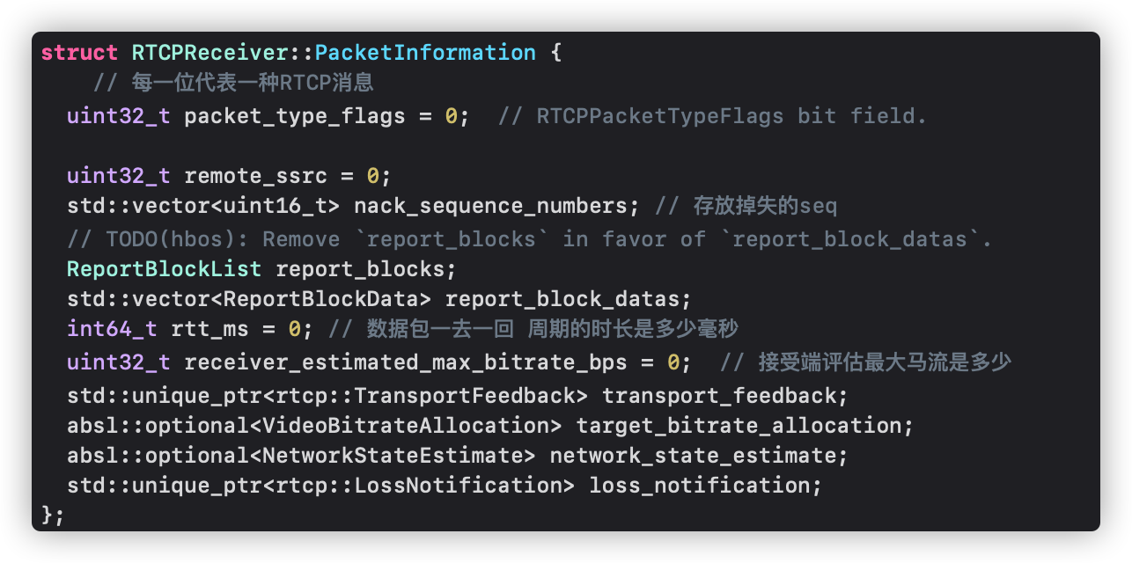
PacketInformation 上一个函数处理后返回数据结构

Slide 13
RTX协议

Slide 14
关于RTX要知道的几点信息
RTX包有自己的SSRC
RTX包有自己的payload type
RTX包是按自己的Sequence Number来排序
收到RTX包后，如何判断它重传的是哪个包？

Slide 15
如何找到RTX包？
找到Offer/Answer的SDP
从SDP中找到RTX的SSRC
通过WireShark抓包，并过出RTX的SSRC

Slide 16
如何知道充传的是哪儿包？

Slide 17
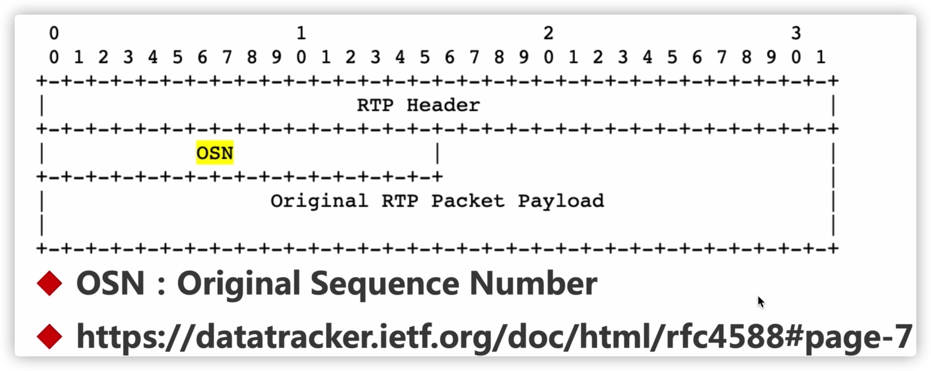
RTX协议

