Slide 1
Association between Housing Instability and Hypertension-Associated Emergency Department Visits
Steve Chen
NRSG 741

Slide 2
Background
The number of hypertension-associated emergency department visits has increased tremendously
Between 2006 and 2012, increased by 29.9% (Vijayaraghavan et al., 2012)
These unnecessary emergency department visits could be avoided with better hypertension management
Housing instability is a major barrier to hypertension management
Poor medication adherence, blood pressure monitoring, clinic attendance

Slide 3
Research Question
How does housing instability affect hypertension-associated emergency department utilization?

Slide 4
Methods
Dataset: Health Center Patient Survey
Nationally representative dataset of safety net clinic patients
Descriptive analyses and logistic regression

Slide 5
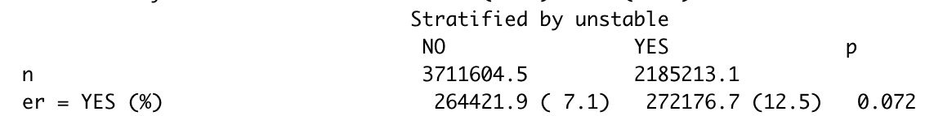
Results
5.9 million adults diagnosed with hypertension who seek care at safety net clinics
37.1% report unstable housing
More likely to be younger, poorer
Overall, 9.1% report hypertension-associated ED visit
12.5% among those with unstable housing vs. 7.1% among those with stable housing

Slide 6
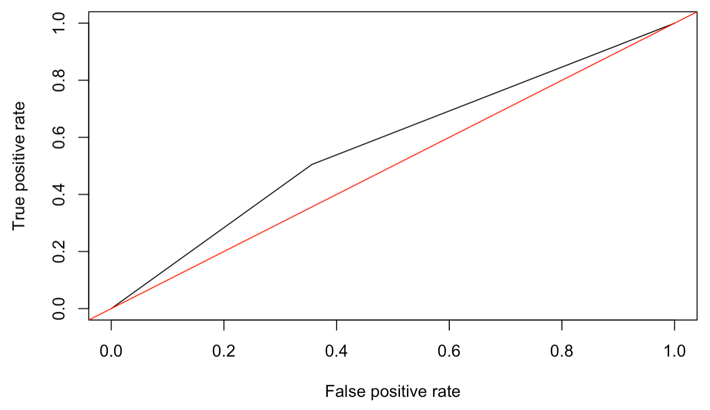
Results
 | Coefficient Estimate | OR Estimate | Standard Error | P-value
Reduced model | 0.6178 | 1.8548 | 0.2314 | 0.0753
Full model | 0.3784 | 1.4599 | 0.3965 | 0.3400
AUC: 0.574

Slide 7
Conclusions
No statistically distinguishable association between unstable housing and hypertension-related ER visits
OR: 1.45, p = 0.34
Context:
Previous literature also did not find any broad association between the two variables, only some evidence in particular subpopulations (Vijayaraghavan et al., 2012)
Association observed among other chronic diseases (Berkowitz et al., 2018)

Slide 8
References
Berkowitz, SA, Kalkhoran, S, Edwards, ST, Essien, UR & Baggett, TP (2018). Unstable housing and diabetes-related emergency department visits and hospitalization: a nationally representative study of safety-net clinic patients. Diabetes Care, 41, 933-939.
Vijayaraghavan, M, Kushel, MB, Vittinghoff, E, Kertesz, S, Jacobs, D, Lewis, CE, Sidney, S & Bibbins-Domingo, K (2012). Housing instability and incident hypertension in the CARDIA cohort. Journal of Urban Health, 90(3), 427-441.

