Slide 1
Java Collection

Slide 2
Generics:
The Java Generics programming is introduced in J2SE 5 to deal with type-safe objects.
Before generics, we can store any type of objects in collection i.e. non-generic. Now generics, forces the java programmer to store specific type of objects.

Slide 3
Advantage of Java Generics
There are mainly 3 advantages of generics. They are as follows:
1) Type-safety : We can hold only a single type of objects in generics. It doesn’t allow to store other objects.
2) Type casting is not required: There is no need to typecast the object.
Before Generics, we need to type cast.
List list = new ArrayList();
list.add("hello");
String s = (String) list.get(0);//typecasting
After Generics, we don't need to typecast the object.
List<String> list = new ArrayList<String>();
list.add("hello");
String s = list.get(0);
3) Compile-Time Checking: It is checked at compile time so problem will not occur at runtime. The good programming strategy says it is far better to handle the problem at compile time than runtime.
List<String> list = new ArrayList<String>();
list.add("hello");
list.add(32);//Compile Time Error

Slide 4
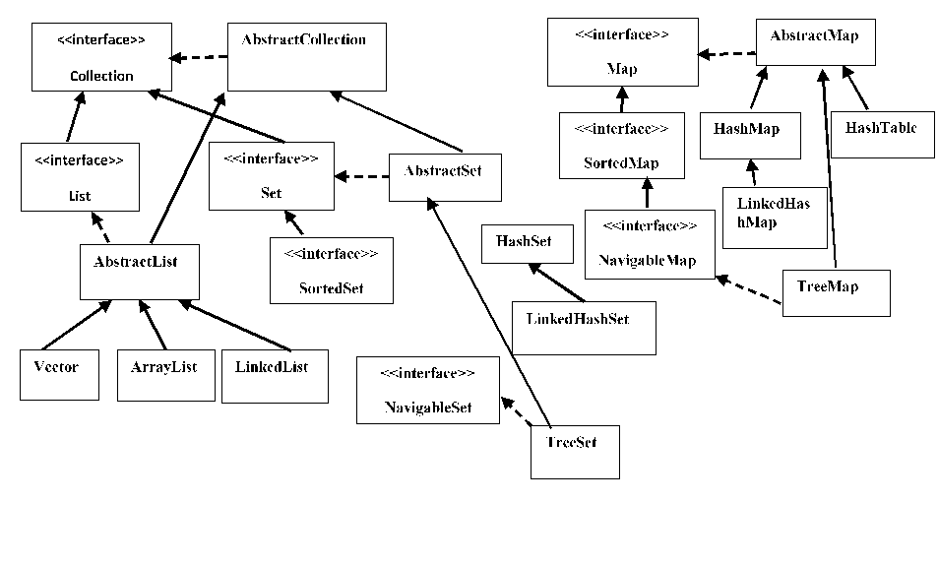

Slide 5
Interface | Hash Table | Resizable Array | Balanced Tree | Linked List | Hash Table + Linked List
Set | HashSet |  | TreeSet |  | LinkedHashSet
List |  | ArrayList |  | LinkedList
Deque |  | ArrayDeque |  | LinkedList
Map | HashMap |  | TreeMap |  | LinkedHashMap

Slide 6
ArrayList:
The important points about Java ArrayList class are:
Java ArrayList class can contain duplicate elements.
Java ArrayList class maintains insertion order.
Java ArrayList class is non synchronized.
Java ArrayList allows random access because array works at the index basis.
In Java ArrayList class, manipulation is slow because a lot of shifting needs to be occurred if any element is removed from the array list.

Slide 7
LinkedList:
The important points about Java LinkedList are:
Java LinkedList class can contain duplicate elements.
Java LinkedList class maintains insertion order.
Java LinkedList class is non synchronized.
In Java LinkedList class, manipulation is fast because no shifting needs to be occurred.
Java LinkedList class can be used as list, stack or queue.

Slide 8
TreeMap:
The important points about Java TreeMap class are:
A TreeMap contains values based on the key. It implements the NavigableMap interface and extends AbstractMap class.
It contains only unique elements.
It cannot have null key but can have multiple null values.
It is same as HashMap instead maintains ascending order.

Slide 9
HashMap:
The important points about Java HashMap class are:
A HashMap contains values based on the key.
It contains only unique elements.
It may have one null key and multiple null values.
It maintains no order.

Slide 10
LinkedHashMap:
The important points about Java LinkedHashMap class are:
A LinkedHashMap contains values based on the key.
It contains only unique elements.
It may have one null key and multiple null values.
It is same as HashMap instead maintains insertion order.

Slide 11
HashSet
The important points about Java HashSet class are:
HashSet stores the elements by using a mechanism called hashing.
HashSet contains unique elements only.

Slide 12
LinkedHashSet
The important points about Java LinkedHashSet class are:
Contains unique elements only like HashSet.
Provides all optional set operations, and permits null elements.
Maintains insertion order.

Slide 13
TreeSet
The important points about Java TreeSet class are:
Contains unique elements only like HashSet.
Access and retrieval times are quiet fast.
Maintains ascending order.

Slide 14
Vector
Vector implements a dynamic array. It is similar to ArrayList, but with two differences:
Vector is synchronized.
Vector contains many legacy methods that are not part of the collections framework.

Slide 15
HashTable
The important points about Java Hashtable class are:
A Hashtable is an array of list. Each list is known as a bucket. The position of bucket is identified by calling the hashcode() method. A Hashtable contains values based on the key.
It contains only unique elements.
It may have not have any null key or value.
It is synchronized.

Slide 16
java.util.collections
Java collection class is used exclusively with static methods that operate on or return collections. It inherits Object class.The important points about Java Collections class are:
Java Collections class supports the polymorphic algorithms that operate on collections.
Java Collections class throws a NullPointerException if the collections or class objects provided to them are null.

Slide 17
Iterator:
Iterator Pattern is used "to access the elements of an aggregate object sequentially without exposing its underlying implementation".
The Iterator pattern is also known as Cursor.

Slide 18
Java Enum:
Enum in java is a data type that contains fixed set of constants.
It can be used for days of the week (SUNDAY, MONDAY, TUESDAY, WEDNESDAY, THURSDAY, FRIDAY and SATURDAY) , directions (NORTH, SOUTH, EAST and WEST) etc. The java enum constants are static and final implicitly. It is available from JDK 1.5.
Java Enums can be thought of as classes that have fixed set of constants.
Java Enum Cont…
enum improves type safety
enum can be easily used in switch
enum can be traversed
enum can have fields, constructors and methods
enum may implement many interfaces but cannot extend any class because it internally extends Enum class

