Slide 1
Java Exception Handling

Slide 2
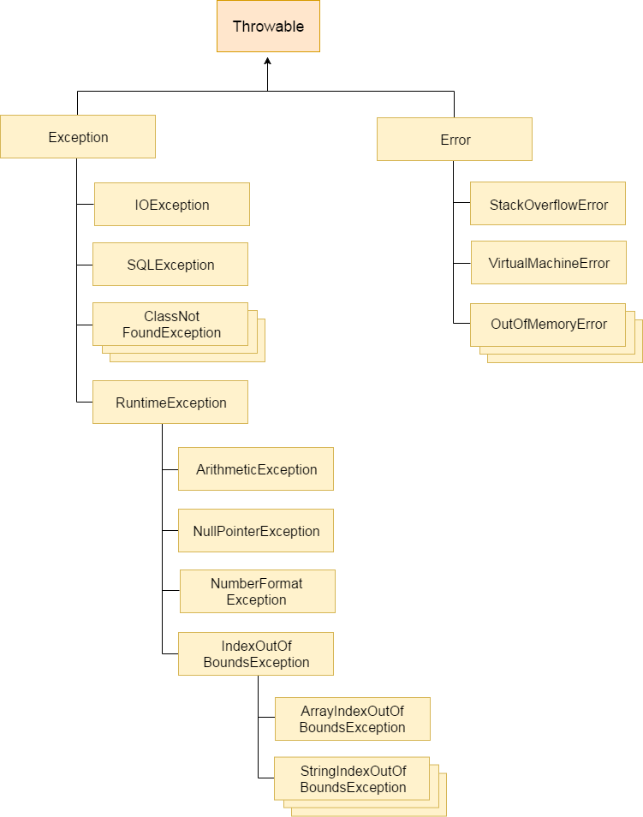

Slide 3
Types of Exception
There are mainly two types of exceptions: checked and unchecked where error is considered as unchecked exception. The sun microsystem says there are three types of exceptions:
Checked Exception
Unchecked Exception
Error

Slide 4
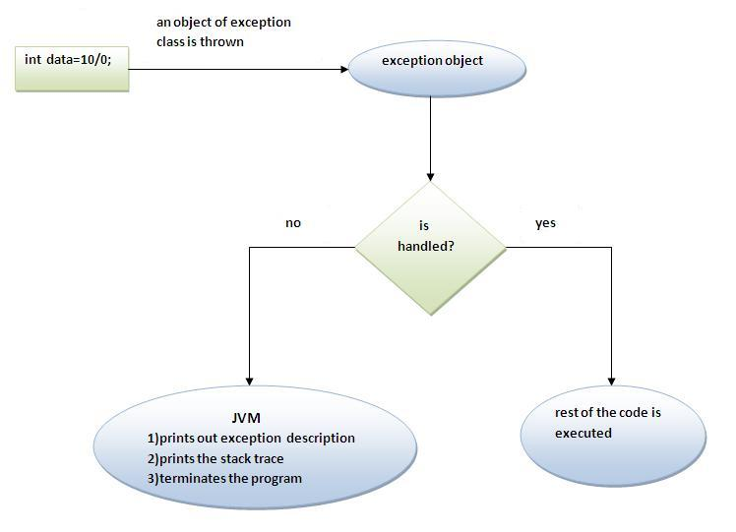
Exception Handling Mechanism

Slide 5
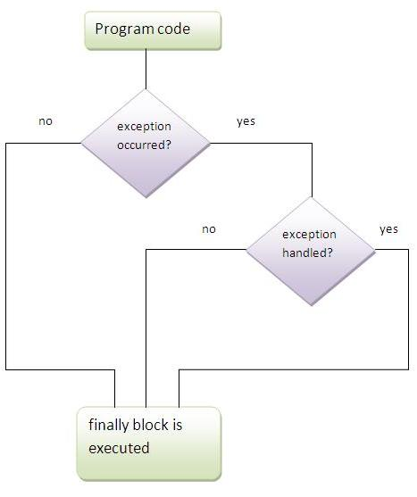
Try-catch
Try-finally
Try-catch-finally

Slide 6
throw

Slide 7
Throws - The Java throws keyword is used to declare an exception.

Slide 8
Exception Propagation

