Slide 1
Multithreading

Slide 2
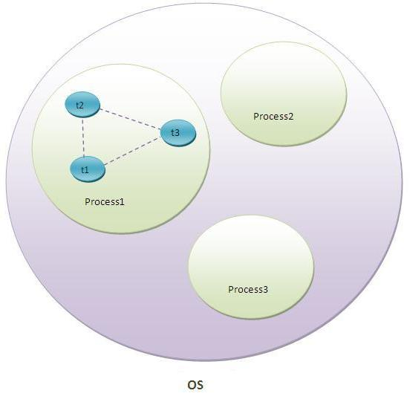

Slide 3
Multitasking:
1. Process based Multitasking – Multiprocessing.
2. Thread based Multitasking – Multithreading.

Slide 4
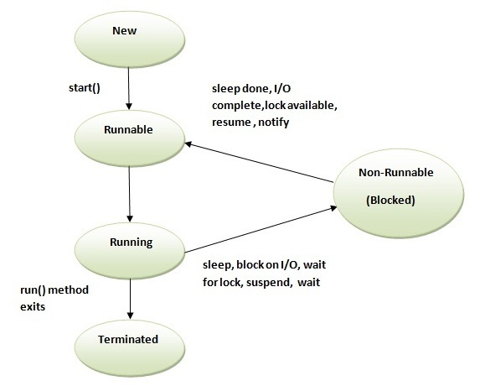
Thread Life Cycle

Slide 5
How to create threads?
There are two ways to create a thread:
- By extending Thread class.
- By implementing Runnable interface.

Slide 6
getName(),setName(String) and getId() method.

Slide 7
currentThread() method.

Slide 8
Daemon Thread:
->The sole purpose of the daemon thread is that it provides services to user thread for background supporting task. If there is no user thread, why should JVM keep running this thread. That is why JVM terminates the daemon thread if there is no user thread.
->The java.lang.Thread class provides two methods for java daemon thread.
No. | Method | Description
1) | public void setDaemon(boolean status) | is used to mark the current thread as daemon thread or user thread.
2) | public boolean isDaemon() | is used to check that current is daemon.

Slide 9
Threadpool

Slide 10
Threadgroup
-Java provides a convenient way to group multiple threads in a single object. In such way, we can suspend, resume or interrupt group of threads by a single method call.

Slide 11
Single Task-Multiple Threads

Slide 12
Multiple tasks – Multiple Threads

Slide 13
GC
- unreferenced objects
- finalize() – Object class
- static void gc() - System class

Slide 14
Java Runtime class
-Java Runtime class is used to interact with java runtime environment.
-The Runtime.getRuntime() method returns the singleton instance of Runtime class.

