Slide 1
Multithreading

Slide 2
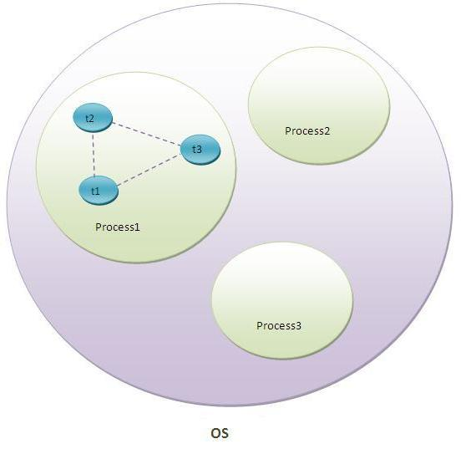

Slide 3
Multitasking:
1. Process based Multitasking – Multiprocessing.
2. Thread based Multitasking – Multithreading.

Slide 4
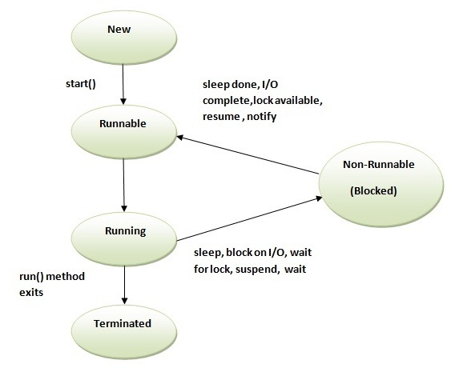
Thread Life Cycle

Slide 5
How to create threads?
There are two ways to create a thread:
- By extending Thread class.
- By implementing Runnable interface.

Slide 6
getName(),setName(String) and getId() method.

Slide 7
currentThread() method.

Slide 8
Daemon Thread:
->The sole purpose of the daemon thread is that it provides services to user thread for background supporting task. If there is no user thread, why should JVM keep running this thread. That is why JVM terminates the daemon thread if there is no user thread.
->The java.lang.Thread class provides two methods for java daemon thread.
No. | Method | Description
1) | public void setDaemon(boolean status) | is used to mark the current thread as daemon thread or user thread.
2) | public boolean isDaemon() | is used to check that current is daemon.

