Slide 2


Data
ProQuest TDM Studio
- TDM Studio leverages the power of a library’s content to help researchers make new connections and uncover career-defining outcomes.
Wall Street Journal
- an American business-focused, English-language international daily newspaper based in New York City
-It is regarded as a newspaper of record, particularly in terms of business and financial news.
- News data from 2019/12 – 2021/11

Slide 3




Large-scale computing Methods
Python Multiprocessing
- Parse 90000+ xml files into DataFrame
Dask
- Dask DataFrame for DataFrame manipulation and calculation word embeddings
- Read all xml files
Joblib
- Topic modeling
-‘Dask’ backend
Gensim
- Word2Vec
- Indicate #workers for multicores

Slide 4
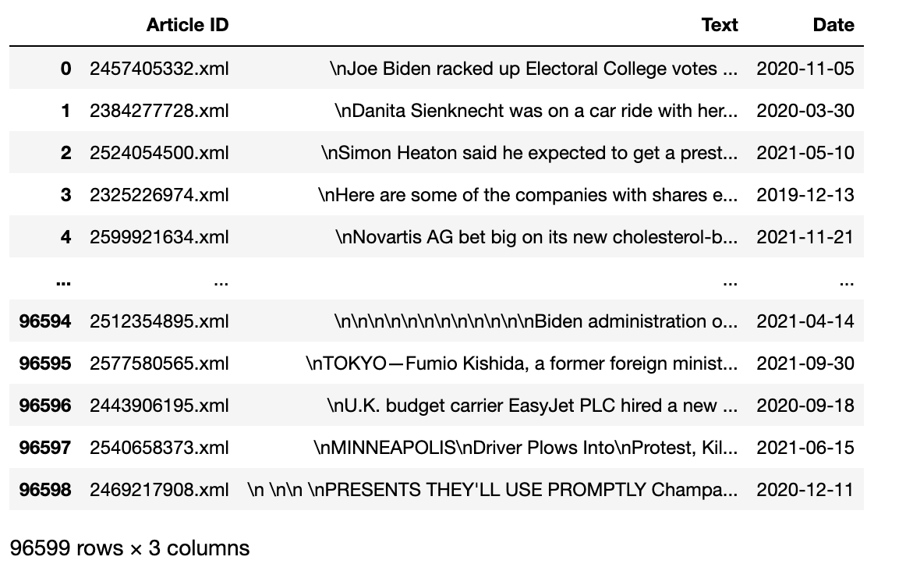
Multiprocessing Pool
- Parse the xml Files into Data Frame
- Create the function for parsing, create a pool object, then call the function using that pool object to run multiprocessing.

Slide 5
Topic Modeling
- Perform Topic Modeling on 2021/09 data for illustration.
- Use scikit-learn CountVectorizer for tokenization and vocabulary creation
- Use the sklearn.decomposition.NMF for topic modeling, which is believed to be more coherent than the LDA models.

Slide 6
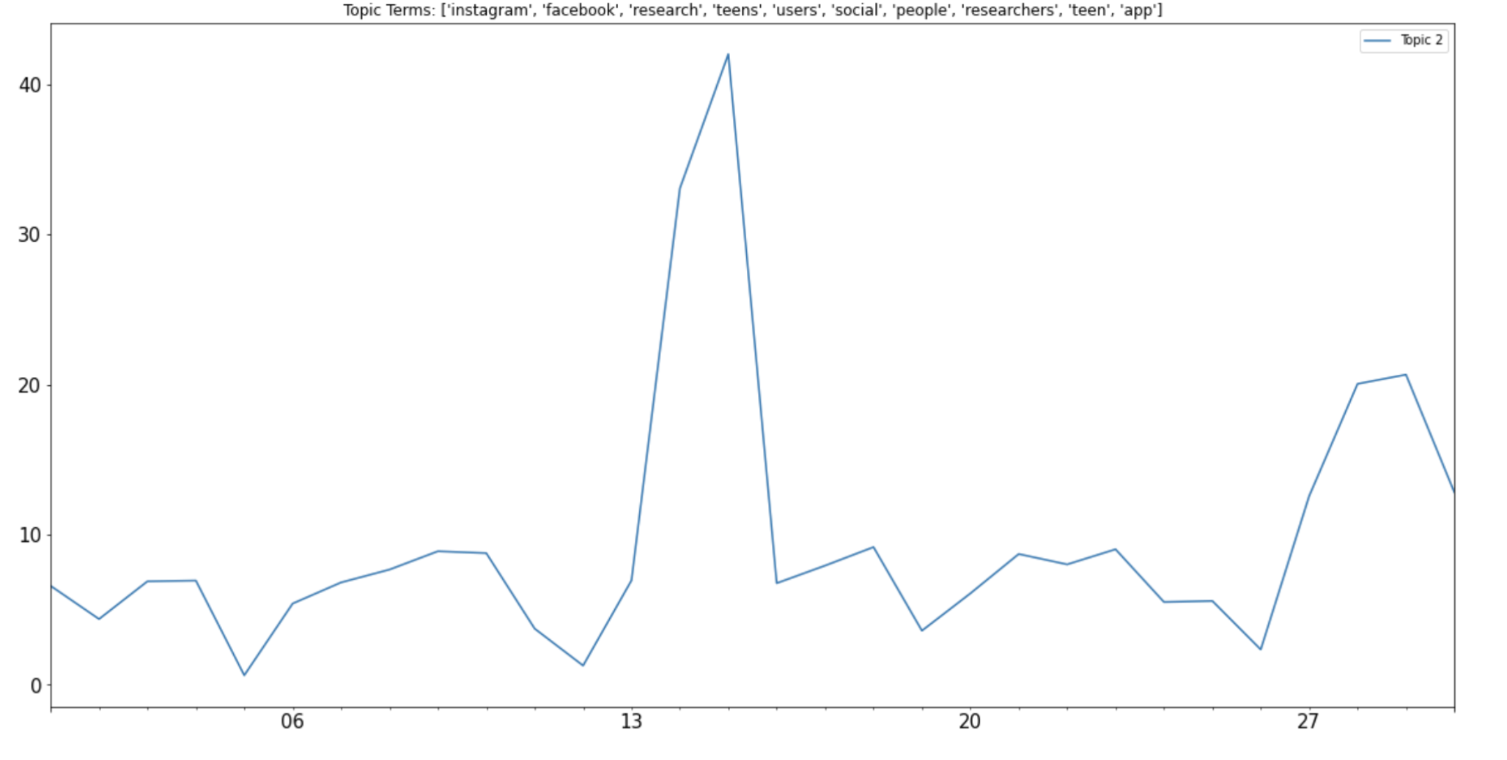
Topic modeling – Results1
- Tokens such as Instagram, Facebook, teen and teens.
- This infers that teens' use of social media is a heated topic during the middle of the month.

Slide 7
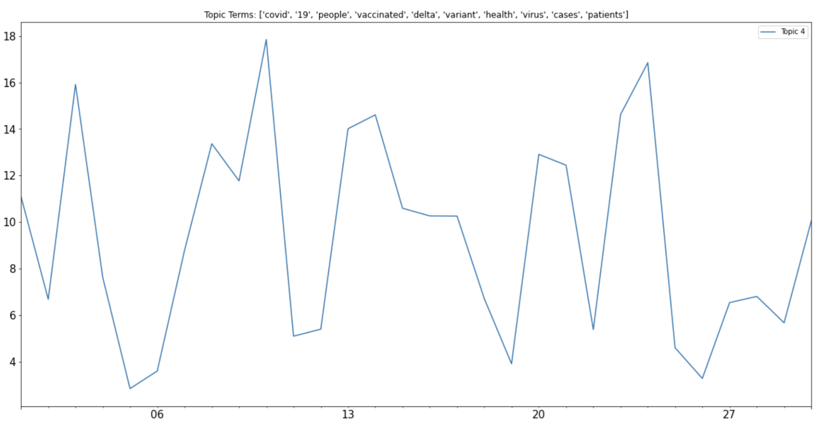
Topic modeling – Results2
Unsurprisingly, the topic related to Covid-19 is frequently mentioned, with the special concern on Delta variation.

Slide 8
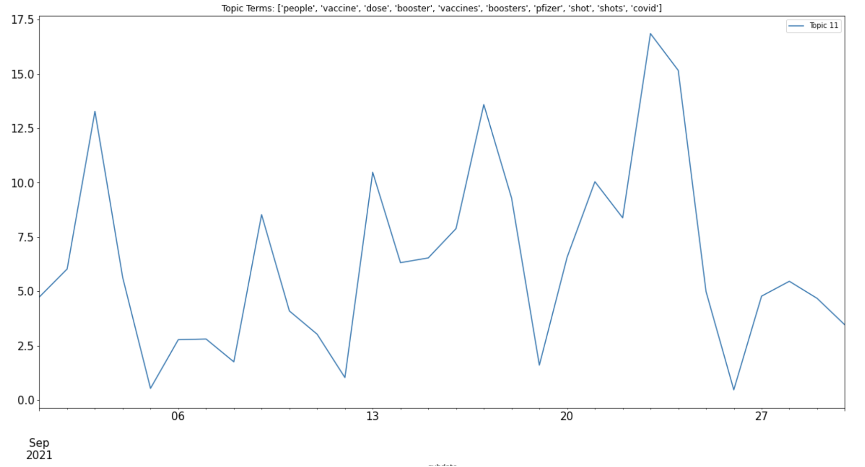
Topic modeling – Results3
Topic 11 also shows that vaccines are regraded as an efficient way to prevent Covid, and people were considering getting boosted shots to deal with the changing nature of the Covid virus.

Slide 9
Thank you!
T

