Slide 1
The Determinants of Analyst Forecast Revisions
Exploratory analysis through Word embeddings and Topic Modeling
Zixu Chen, Tian Chen
MACSS Program
University of Chicago

Slide 2
Social Science Question- Explaining Analyst Forecast Revision
……
T
T+1m
T+2m
T+nm
T+24m (2-year ahead EPS forecast)
How?
Monthly News
Research question: what are the determinants for analysts to make forecast revisions for two-year-ahead EPS estimates?
as an ocean of news come in during the monthly interval, the value-relevant information embedded in this unstructured datasets are of vital importance.

Slide 3
Research Design and Workflow
Propose hypothesis about possible determinants of analyst forecast revisions using evidence from relevant literatures.
Collect dynamic news data on Wall Street Journal from ProQuest text and data mining (TDM) studios.
Get the xml file content, parse the files and convert data of different months into DataFrame using MultiProcessing Pool.
Build topic modeling models: use Scikit-learn CountVecterizer to produce term-document matrix and use Scikit-learn NMF model to train the topic modeling, parallelizing using joblib and Dask in the backend.
Train dynamic monthly word-embedding models using rolling monthly data in the most recent two years using Word2Vec and Dask DataFrame, extracting the cultural dimensions that are relevant to analyst forecast revisions.

Slide 4


Data
ProQuest TDM Studio
- Text and Data mining Studio run on AWS.
- We utilize its text content and Sagemaker notebooks for data analysis.
Wall Street Journal
- an American business-focused, English-language international daily newspaper based in New York City
- It is regarded as a newspaper of record, particularly in terms of business and financial news.
- News data from 2019/12 – 2021/11; 90,000+ articles

Slide 5




Large-scale computing Methods
Python Multiprocessing
- Parse 90000+ xml files into DataFrame
Dask
Dask DataFrame for DataFrame manipulation and calculation in word embeddings
- Read xml files
Joblib
- Topic modeling
-‘Dask’ backend
Gensim
- Word2Vec
- Indicate #workers for multicores

Slide 6
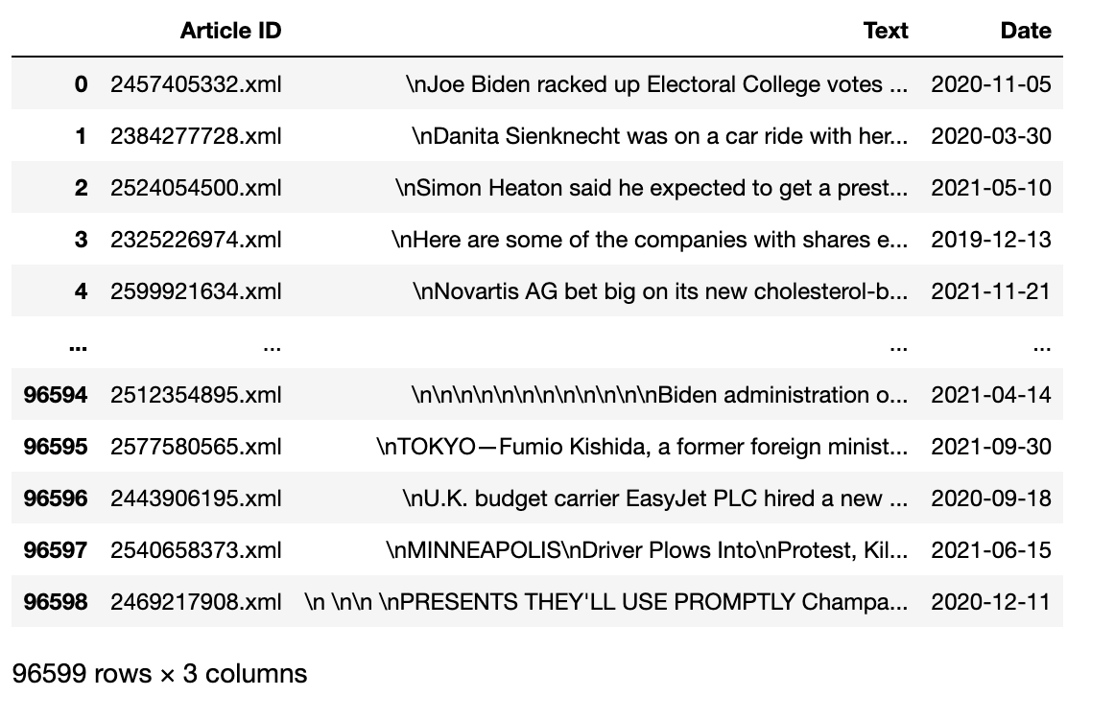
Multiprocessing Pool
- Parse the xml Files into Data Frame
- Create the function for parsing, create a pool object, then call the function using that pool object to run multiprocessing.

Slide 7
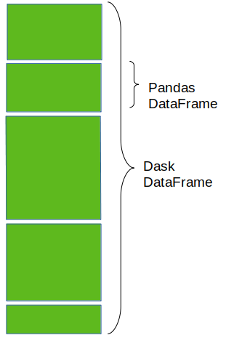
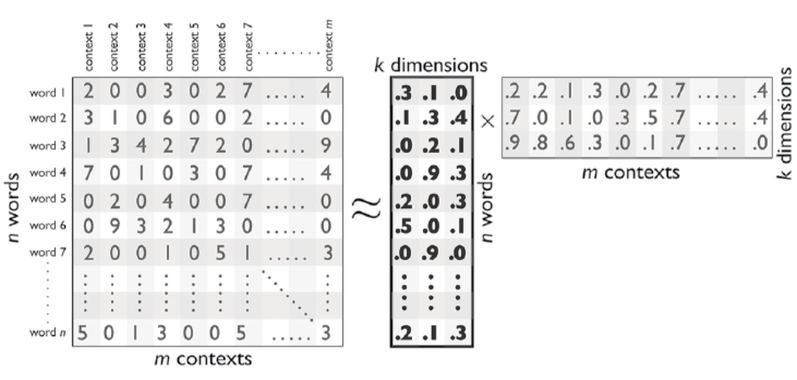
Word Embedding Models : Word2Vec
Word-embedding models input large collections of digitalized text and output a high-dimensional vector-space model.
Word2Vec, which uses a shallow, two-layered neural network architecture which optimizes the prediction of words based on shared contexts with other words.
Use Gensim‘s Word2Vec Model with built-in paralleling option
Use Dask DataFrame managing parallelization

Slide 8
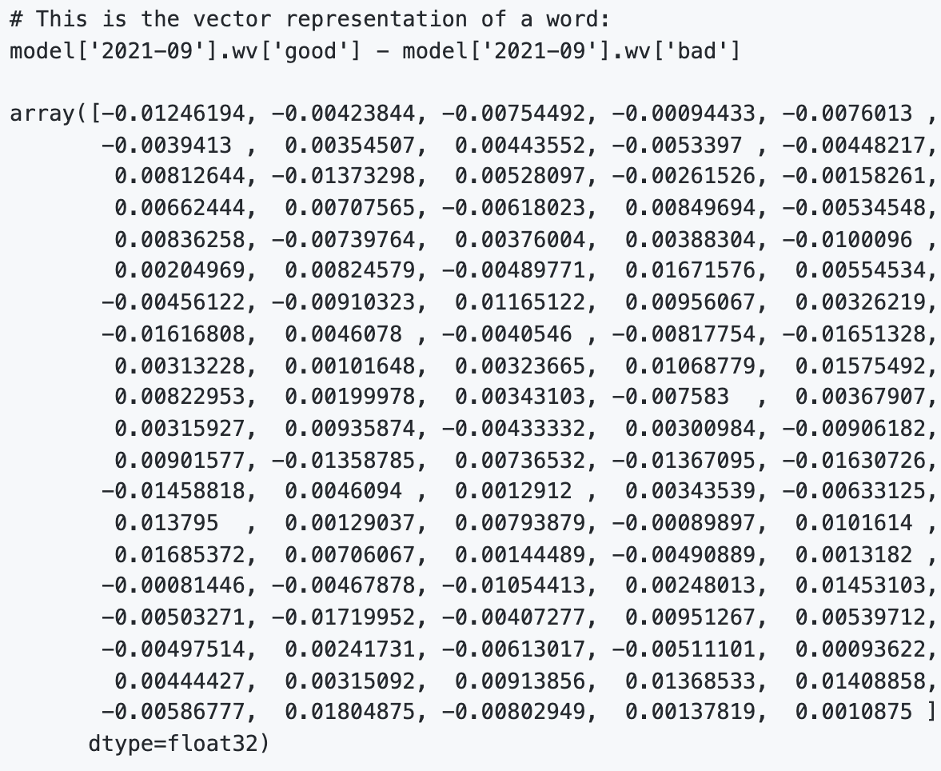
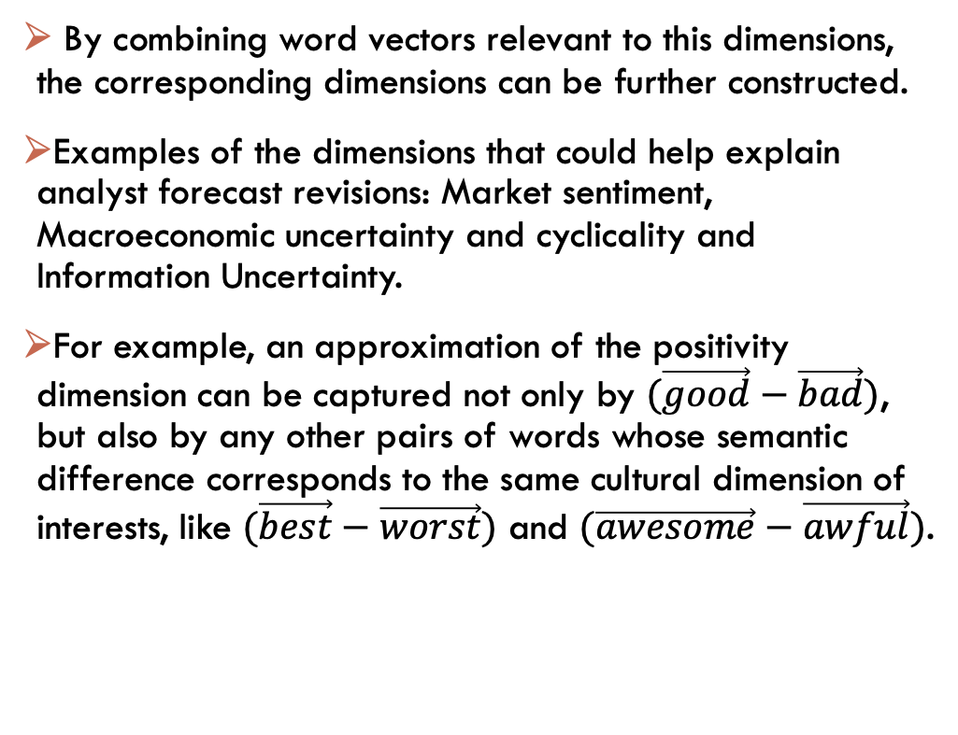
Identifying Cultural Dimensions
By combining word vectors relevant to this dimensions, the corresponding dimensions can be further constructed.
Examples of the dimensions that could help explain analyst forecast revisions: Market sentiment, Macroeconomic uncertainty and cyclicality and Information Uncertainty.
For example, an approximation of the positivity dimension can be captured not only by $(\vec{good}−\vec{bad})$, but also by any other pairs of words whose semantic difference corresponds to the same cultural dimension of interests, like $(\vec{best}−\vec{worst})$ and $(\vec{awesome}−\vec{awful})$.

Slide 9
Topic Modeling
- Perform Topic Modeling on 2021/09 data for illustration
- Use scikit-learn CountVectorizer to produce token-documentation matrix
- Use the sklearn.decomposition.NMF for topic modeling, which is believed to be more coherent than the LDA models

Slide 10
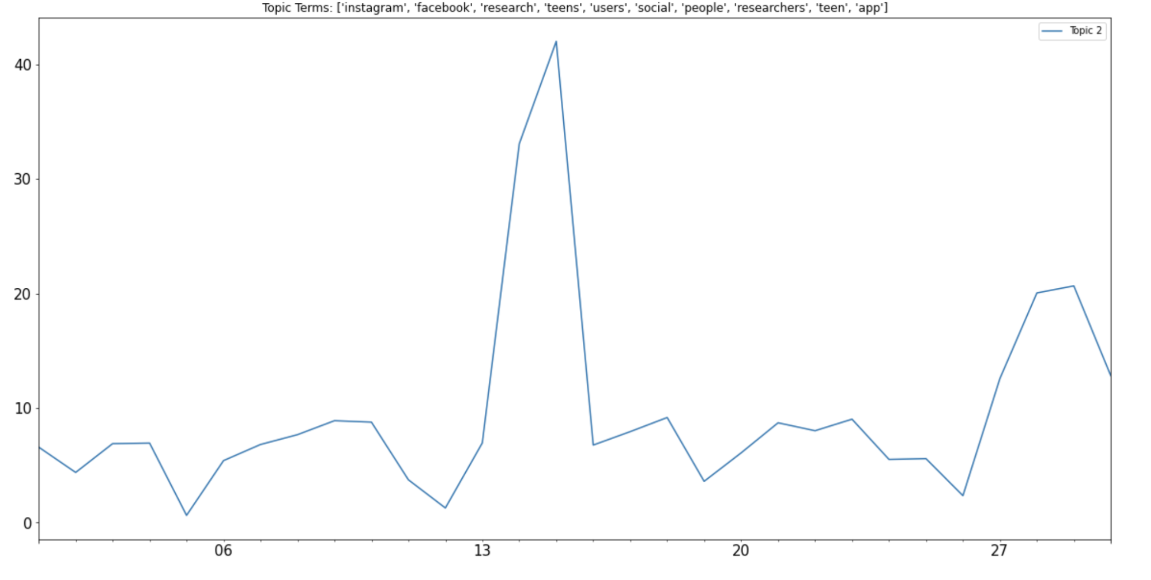
Topic modeling – Results1
- Tokens such as Instagram, Facebook, teen and teens.
- This infers that teens' use of social media is a heated topic during the middle of the month.

Slide 11
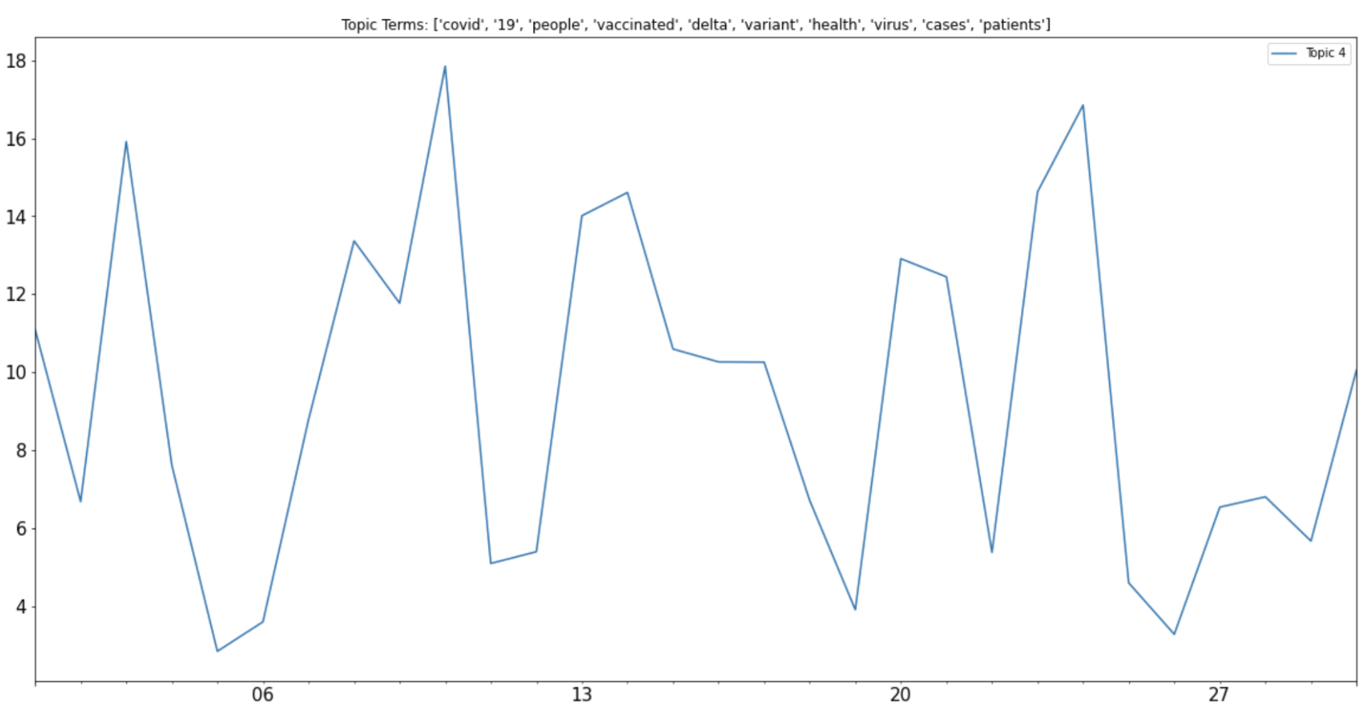
Topic modeling – Results2
Unsurprisingly, the topic related to Covid-19 is frequently mentioned, with the special concern on Delta variation.

Slide 12
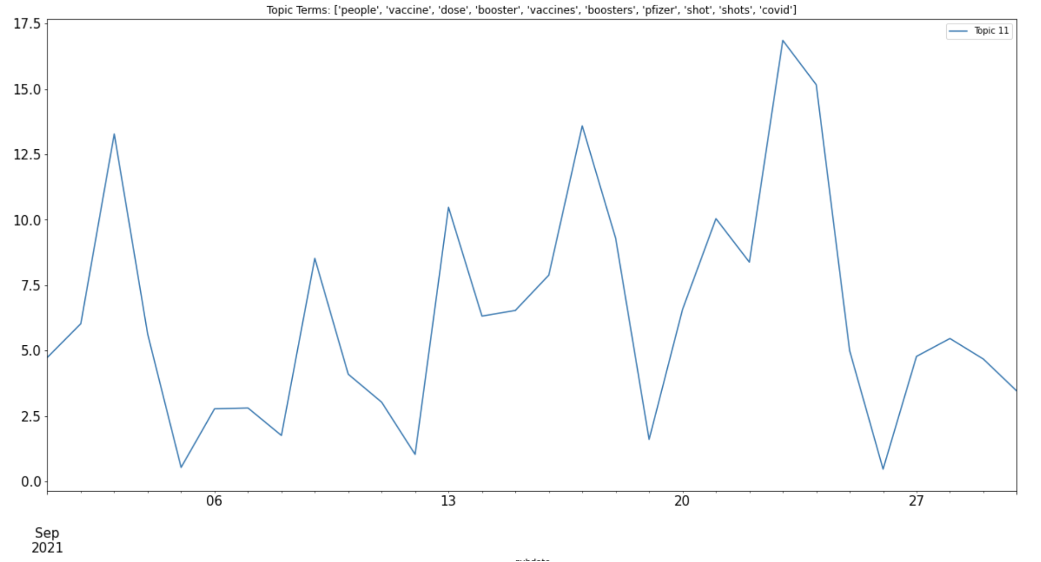
Topic modeling – Results3
Topic 11 also shows that vaccines are regraded as an efficient way to prevent Covid, and people were considering getting booster shots to deal with the changing nature of the Covid virus.

Slide 13
Thank you!
We especially thank our dear Jon, and Brandon from TDM studio for their help on this project!

