Slide 1

SpringBoot Application

Slide 2
Contents
1
What’s SpringBoot?
3
Auto-configuration
2
Restful Api
4
Unit-test

Slide 3
Overview Spring Boot makes it easy to create stand-alone, production-grade Spring based Applications that you can "just run"
Create stand-alone Spring applications
Embed Tomcat, Jetty or Undertow directly (no need to deploy WAR files)
Provide opinionated 'starter' dependencies to simplify your build configuration
Automatically configure Spring and 3rd party libraries whenever possible
Provide production-ready features such as metrics, health checks and externalized configuration
Absolutely no code generation and no requirement for XML configuration

Slide 4
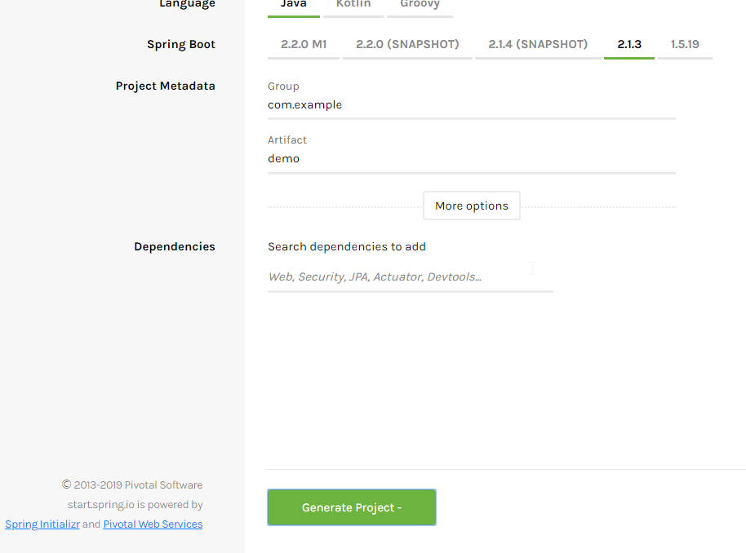
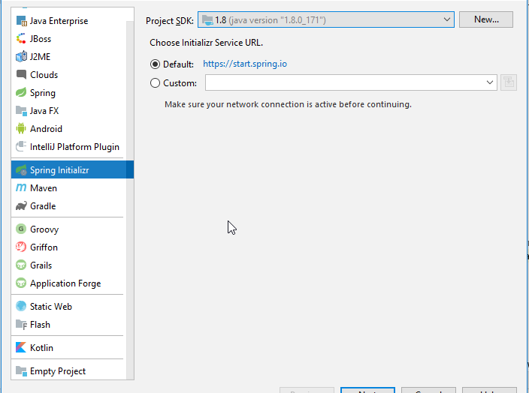
Spring Boot Quick Start

Slide 5

What is Restful API?t

