Slide 1
On Time or Not?
Predicting Delivery Delays on Brazil’s largest e-commerce platform, Olist
Chentong Hao
December 12th, 2025
Data Science Institute
https://github.com/chentonghao/Midterm
Notes:
Hi everyone, I’m Chentong Hao from Data Science Institute,.
My project is about predicting delivery delays on Brazil’s largest e-commerce platform, Olist.

Slide 2
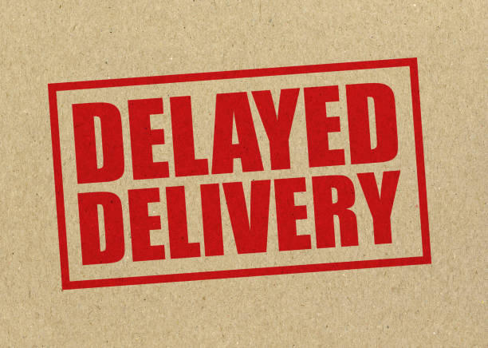

1 Recap
Problem Definition:
Predict whether an e-commerce order will be delivered on time.
🤯
Type of Task: Binary Classification
Target: is_late
1 → Delivered after estimated date
0 → Delivered on time
Data Set
Source: Olist — Brazil’s largest e-commerce platform
Public release on Kaggle (Olist data-sharing initiative)
Real transactional records from 2016–2018 (100k in total)
Each row = one real order
Notes:
This is a binary classification problem, and my target variable is is_late.
The dataset was publicly released on Kaggle .
The data contains over 100k real transactional records ,
with each row representing one actual order placed on the platform.

Slide 3
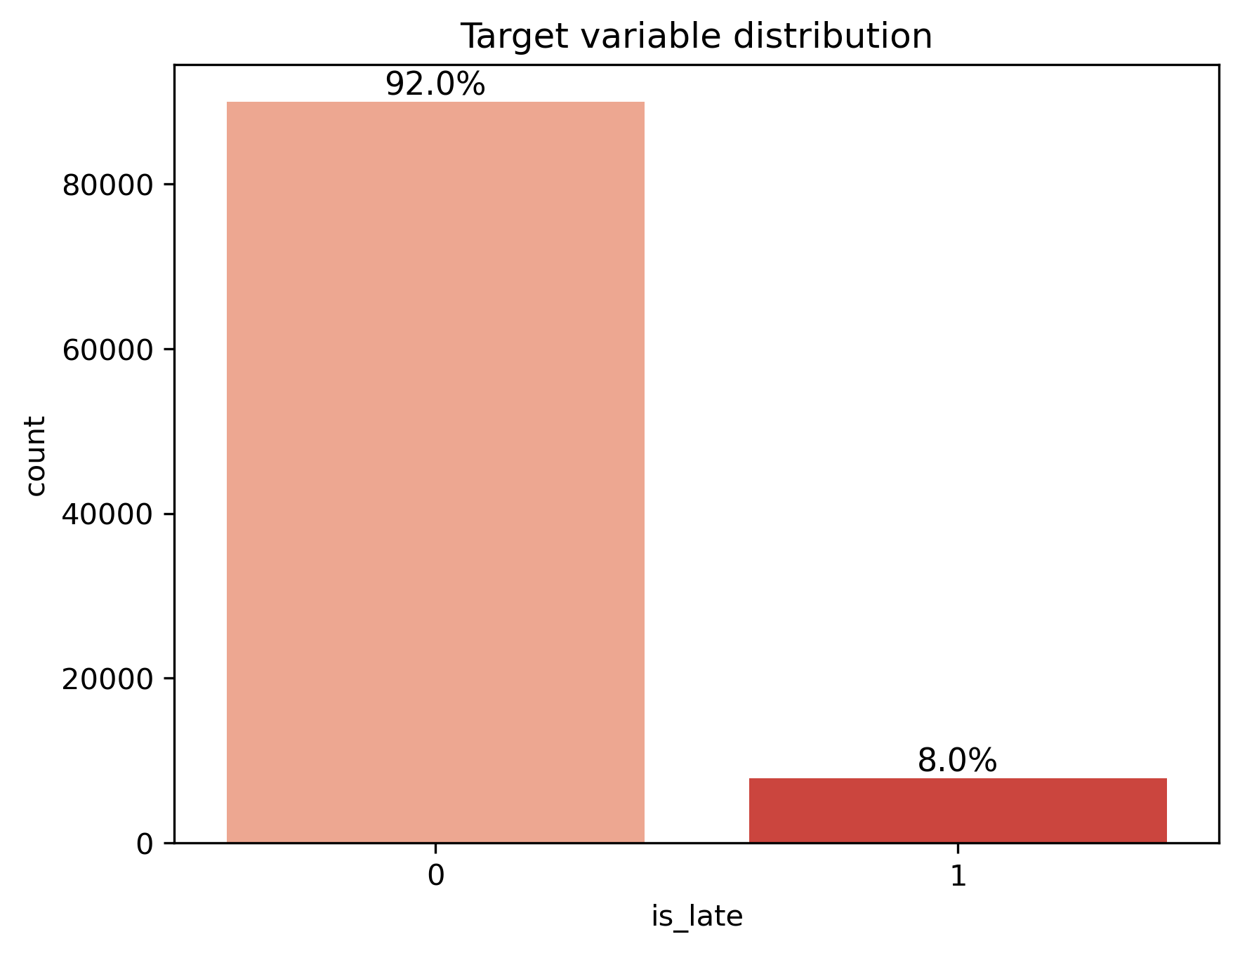
1 Recap
The most important EDA conclusion:
Strong class imbalance！
Categorical Features
OneHotEncoder
Pattern submodel approach
One missing column:
seller_avg_score_past
Full-feature models
(with seller_avg_score_past)
Numerical & Linear Ordinal Features
StandardScaler
Reduced-feature models
(without seller_avg_score_past)
Temporal Features
Cyclic encoding
Notes:
as the EDA shows, my dataset is extremely imbalanced so I addressed this issue later in the modeling process.This figure summarizes my preprocessing and missing-value strategy. I have three feature types: categorical, numerical/ordinal, and temporal, which go through One-Hot Encoding, StandardScaler, and cyclic encoding.The only missing field is seller_avg_score_past, so I train two submodels: one using rows where it exists and one reduced-feature model where it is missing.

Slide 4
2 Cross Validation
Use repeated simple train60% / val20% / test20% splits (3 runs with different seeds) .
Use stratify to preserve class balance in every split.
Model | Hyperparameters (Search Space)
KNN | n_neighbors: {3, 5, 11, 21}; weights: {“uniform”, “distance”}; p: {1, 2}
SVM | C: {0.1, 1, 10}; kernel: {“linear”,“rbf”}; gamma: {“scale”,“auto”}; class_weight: {“balanced”}
Logistic Regression | C: {0.01, 0.1, 1, 10}; penalty: {“l1”,“l2”}; class_weight: {“balanced”}; solver: {“liblinear”}
Decision Tree | max_depth: {3, 5, 10}; min_samples_split: {2, 10, 50}; min_samples_leaf: {1, 5, 20}; criterion: {“gini”,“entropy”}; class_weight: {“balanced”}
XGBoost | learning_rate: {0.01, 0.03}; max_depth: {1, 3, 10}; reg_alpha: {0, 1e−2, 1e−1, 1, 10}; reg_lambda: {0, 1e−2, 1e−1, 1, 10}; subsample: {0.66}; colsample_bytree: {0.9}; scale_pos_weight: {8, 12}; n_estimators: {5000}
Notes:
For cross validation,I use repeated stratified 60/20/20 splits for train/validation/test across 3 random seeds. I chose this setup because the dataset is large enough for simple splits, the target is highly imbalanced so stratification is essential.
Across the models, I tune the main capacity and regularization settings: for KNN I adjust how many neighbors it considers and what distance metric it uses; for SVM I tune C, gamma, and the kernel; for logistic regression I tune the strength of regularization and whether it uses L1 or L2; for the decision tree I tune its depth and how many samples are required to split; and for XGBoost I tune learning rate, max depth, L1 and L2 penalties, sampling rates, and the class-imbalance parameter.
Because the dataset is highly imbalanced, the key hyperparameters are the weight-related ones: SVM, logistic regression, and the decision tree use class_weight, while XGBoost uses scale_pos_weight to up-weight late deliveries.

Slide 5
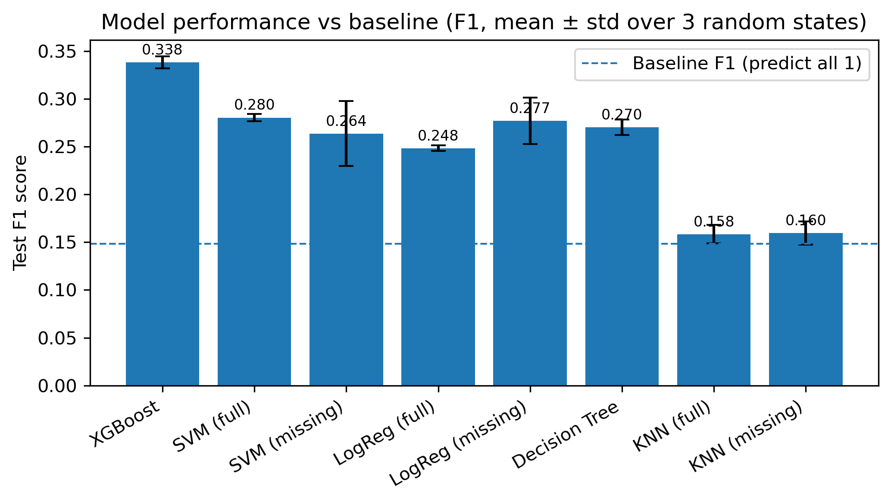
Results slide(s) (10 points)
Calculate the baseline scores of your evaluation metric. Describe the test scores of each algorithm you tried (plot means and standard deviations). How do your scores compare to a simple baseline model? Inspect your model (e.g., confusion matrix, scatter plot of the true vs predicted values in regression, global/local feature importances). Describe what steps you took to make your model interpretable. What did you learn?
3 Results - Model Performance
Notes:
For results, I compare against a simple baseline that always predicts ‘late’ (F1 ≈ 0.15), and all of my models perform better than this. XGBoost is clearly the best, with a mean test F1 around 0.34 ± 0.01, because it can capture nonlinear patterns and feature interactions, handle the strong class imbalance via scale_pos_weight, and use early stopping to control model complexity.
KNN performs worst, with F1 only around 0.16. Thus suggests a simple distance-based method struggles in this high-dimensional, one-hot encoded and imbalanced setting.
Overall, this comparison shows that tree-based boosting is the most suitable model for my late-delivery problem, while every non-trivial model still improves meaningfully over the naive baselines.

Slide 6
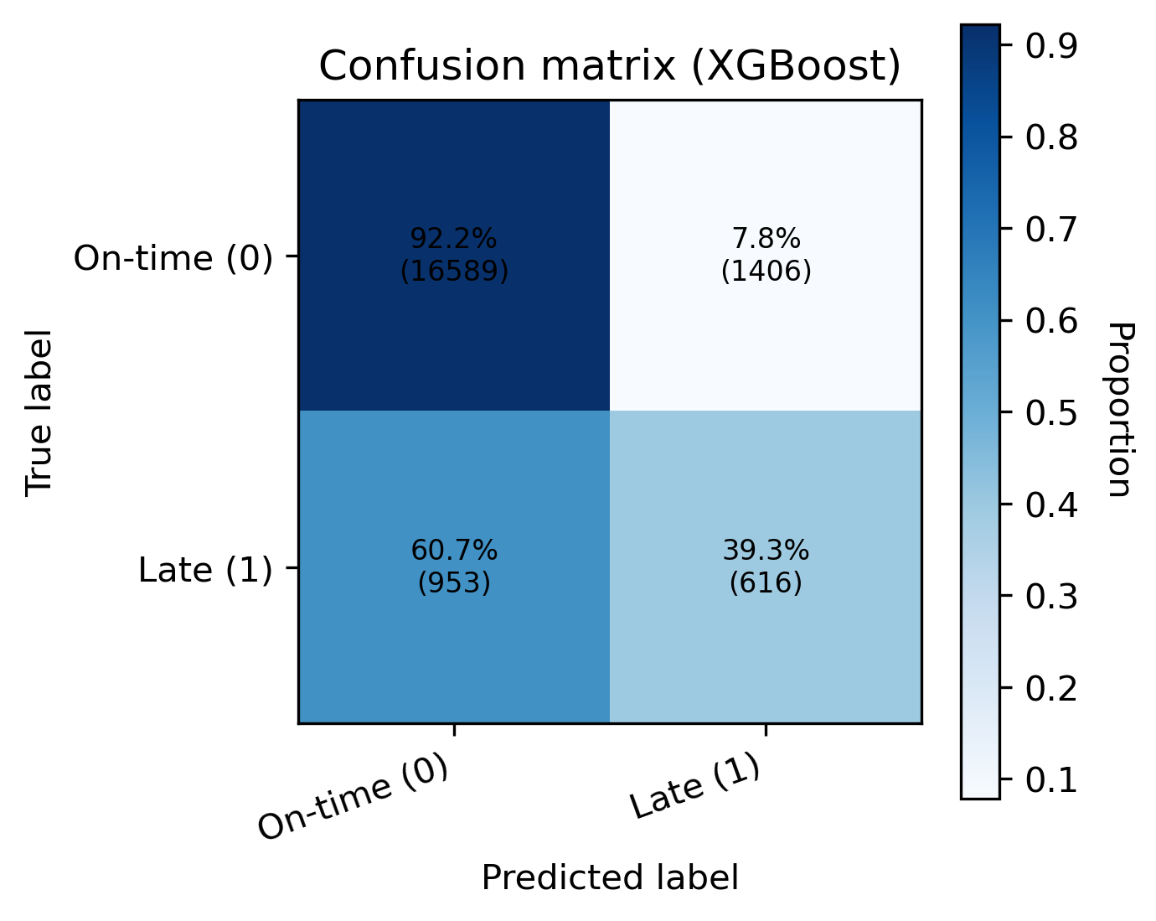
3 Results - Confusion Matrix
Excellent performance on majority class:
92% of on-time orders correctly predicted
Meaningful detection of minority class:
39% of late deliveries identified (baseline = 0%)
Still challenging due to strong class imbalance:
61% of late orders misclassified as on-time
Notes:
The confusion matrix helps show what the model is getting right and wrong. It classifies about 92% of on-time orders correctly, which is expected for the majority class. For late deliveries, it detects about 39% — a clear improvement over the baseline (0%), though many late cases are still missed because the problem is highly imbalanced.

Slide 7
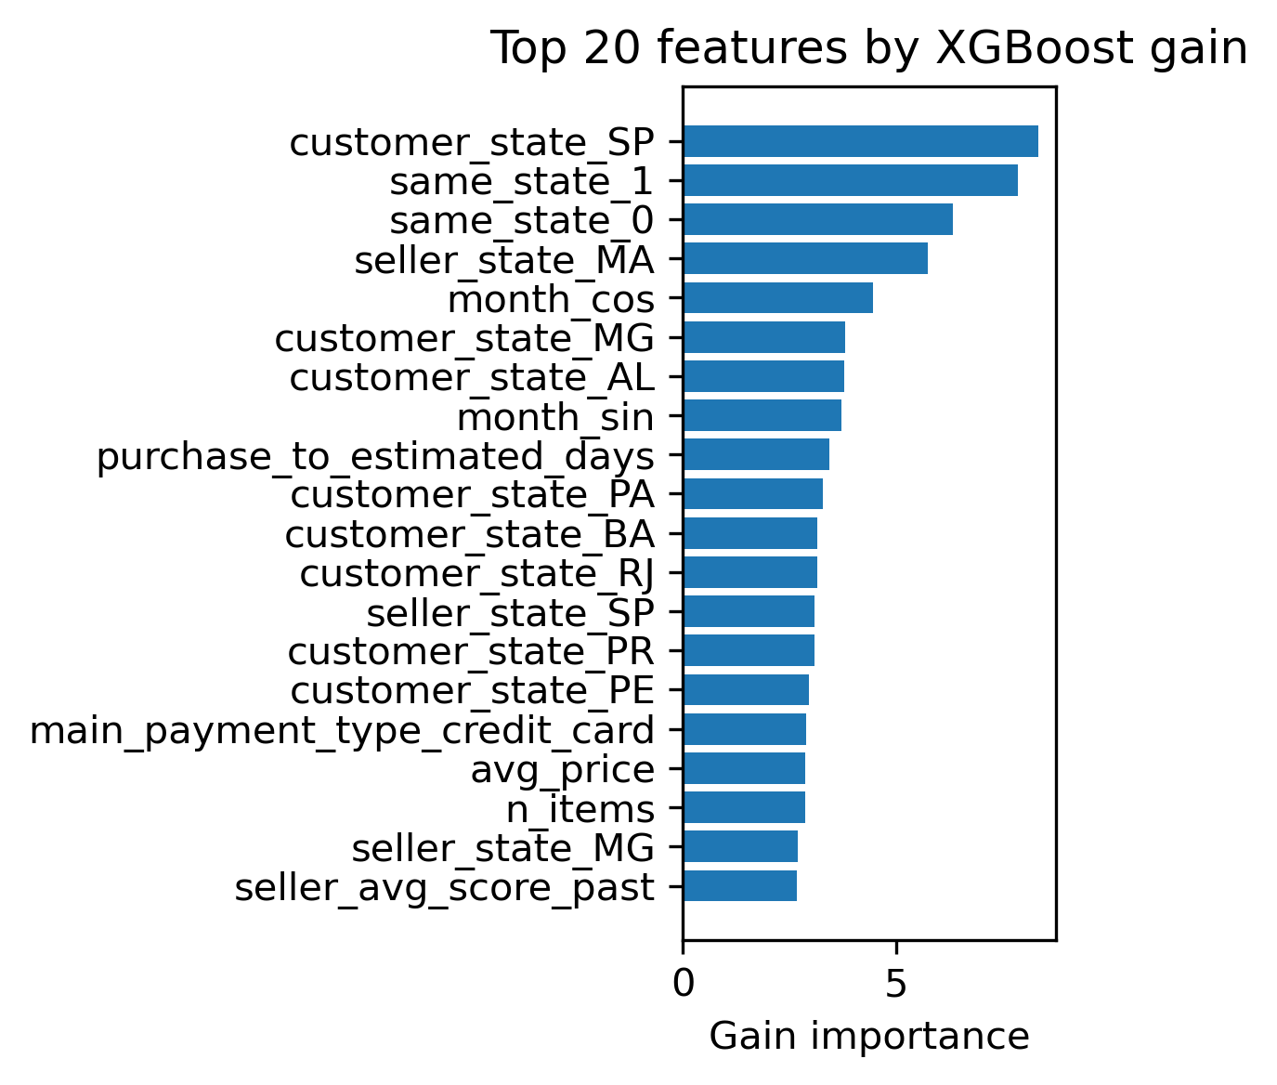
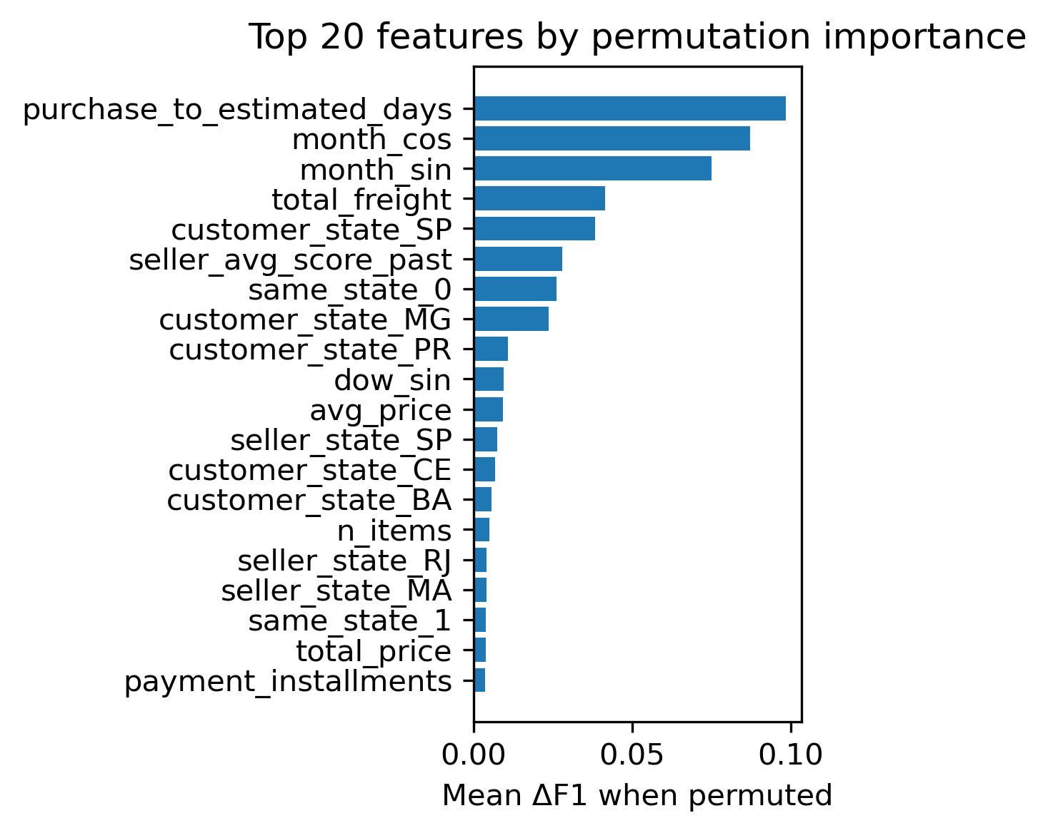
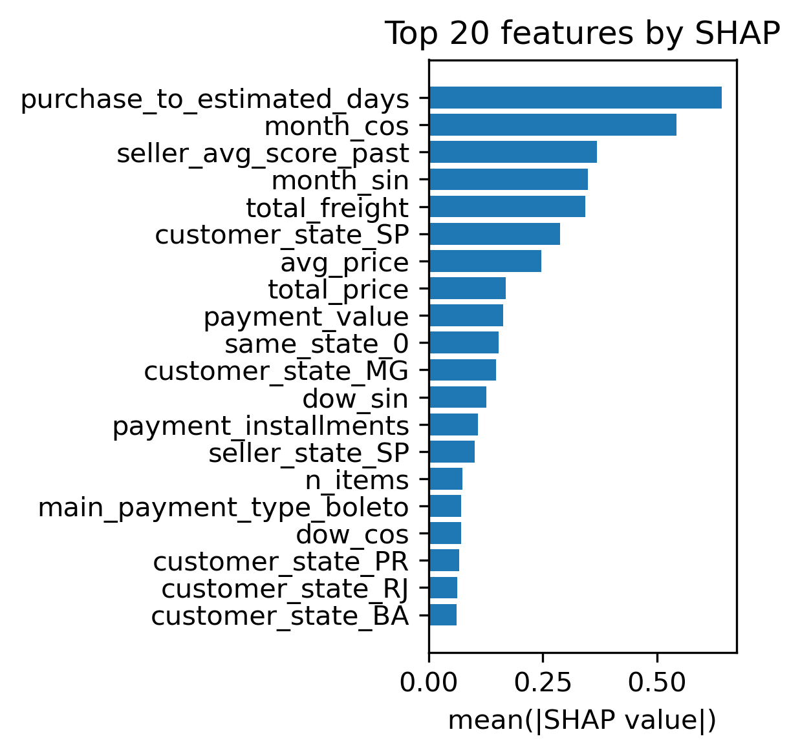
3 Results - Global Feature Importance
Even though these methods measure importance in very different ways, they all highlight the same patterns:
purchase_to_estimated_days — how early the customer placed the order
cyclic time features like month_sin and month_cos
and geographical features such as customer_state_SP, same_state_0, and seller/buyer state combinations
Notes:
Now I tet to identify the important features, I compare three global importance methods for my best XGBoost model: gain, permutation importance, and SHAP.
Even though they use very different definitions, they consistently highlight the same key features: purchase_to_estimated_days, the cyclic time features and the customer–seller state indicators.
This agreement suggests the model is picking up real, stable patterns: late deliveries are mostly driven by how tight the delivery window is, the time of year, and how far the package has to travel.

Slide 8
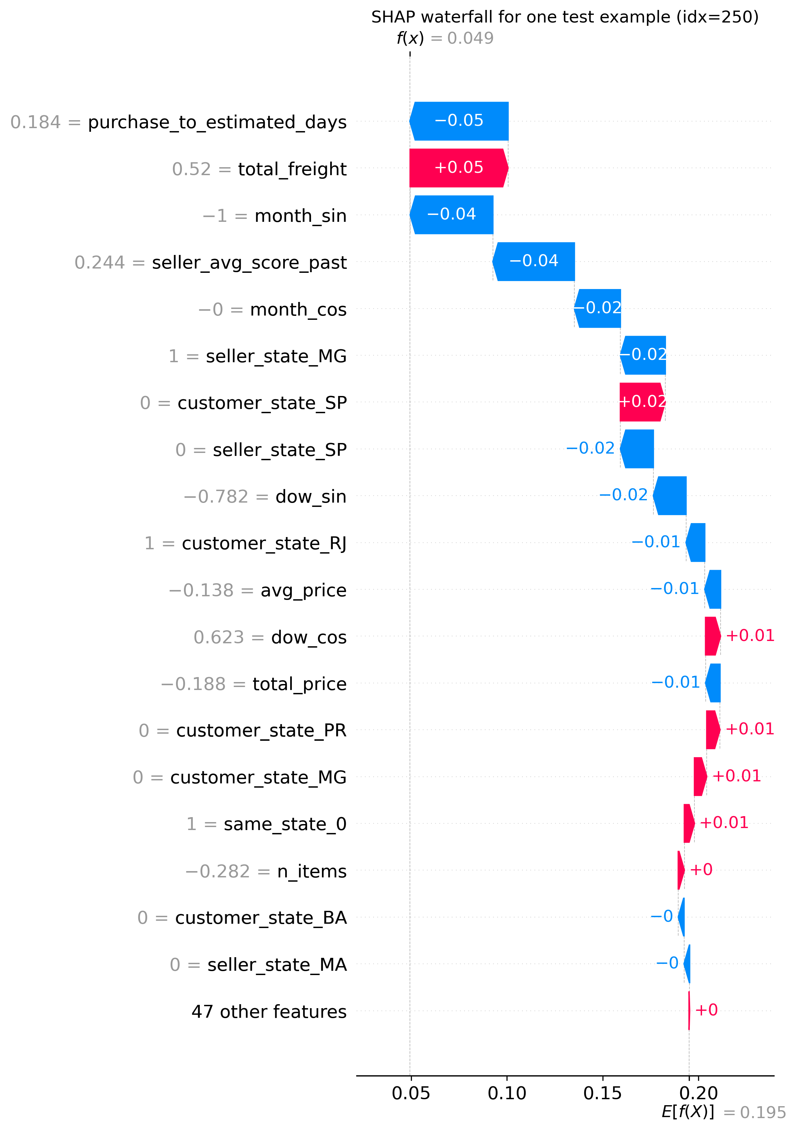
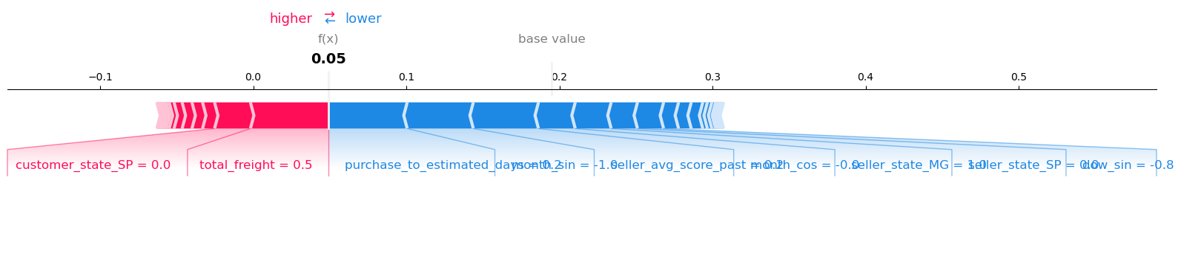
3 Results - Local Feature Importance
Too crowded Try waterfall plot instead:
Prediction for this order: 4.9% late (lower than the dataset average 19.5%)
A few features dominate the decision:
purchase_to_estimated_days
total_freight
temporal features (month_sin, month_cos)
seller_avg_score_past
Most other features contribute almost 0, because this order looks “typical”
Notes:
For local explanations, the force plot was hard to read, so I use a SHAP waterfall plot instead.
This example order has a low predicted late-delivery probability (~4.9%).
A few features clearly push the risk down — ordering well before the estimated date, moderate freight cost, seasonal signals, and a good seller score — while most other features have SHAP values near zero, meaning the order looks otherwise very typical.

Slide 9
3 Results - Outlook
Richer features
(data limitations)
Handling class imbalance more aggressively
Improving interpretability
Only public Olist fields.
Missing operational signals.
Missing context signals.
Try more advanced resampling.
Macro F1 as evaluation matrix
Explore imbalance-robust models.
Translate SHAP patterns into business rules
Add complementary plots
Notes:
“For outlook, I see three directions.
First, richer features – today we only use public Olist fields, but internal operational and context data could greatly boost accuracy.
Second, handling class imbalance more aggressively – with better resampling and imbalance-robust models.
Third, improving interpretability – turning SHAP patterns into simple business rules and adding a few complementary plots for non-technical users.”

Slide 10
Q&A

