Slide 1
On Time or Not?
Predicting Delivery Delays in Brazil’s Olist Marketplace
Chentong Hao
Data Science Institute, Brown University
https://github.com/chentonghao/Midterm
October 24, 2025

Slide 2


1 Problem Introduction
🤯
Have you ever ordered something online, checked the tracking page five times a day,and still wondered — “Why hasn’t my package arrived yet ???”
Problem Definition:
Predict whether an e-commerce order will be delivered on time.
Why It Matters:
Delivery punctuality → key to customer satisfaction
Late orders → harm seller reputation
Accurate delay prediction → optimize logistics operations
Type of Task: Binary Classification
Target: is_late
1 → Delivered after estimated date
0 → Delivered on time

Slide 3


2 Dataset
Source: Olist — Brazil’s largest e-commerce platform
Public release on Kaggle (Olist data-sharing initiative)
Real transactional records from 2016–2018
Each row = one real order
Three challenges:
Large: over 100k orders and multiple linked tables.
Non-iid : multiple orders come from the same customers
Some tables contain missing values.

Slide 4
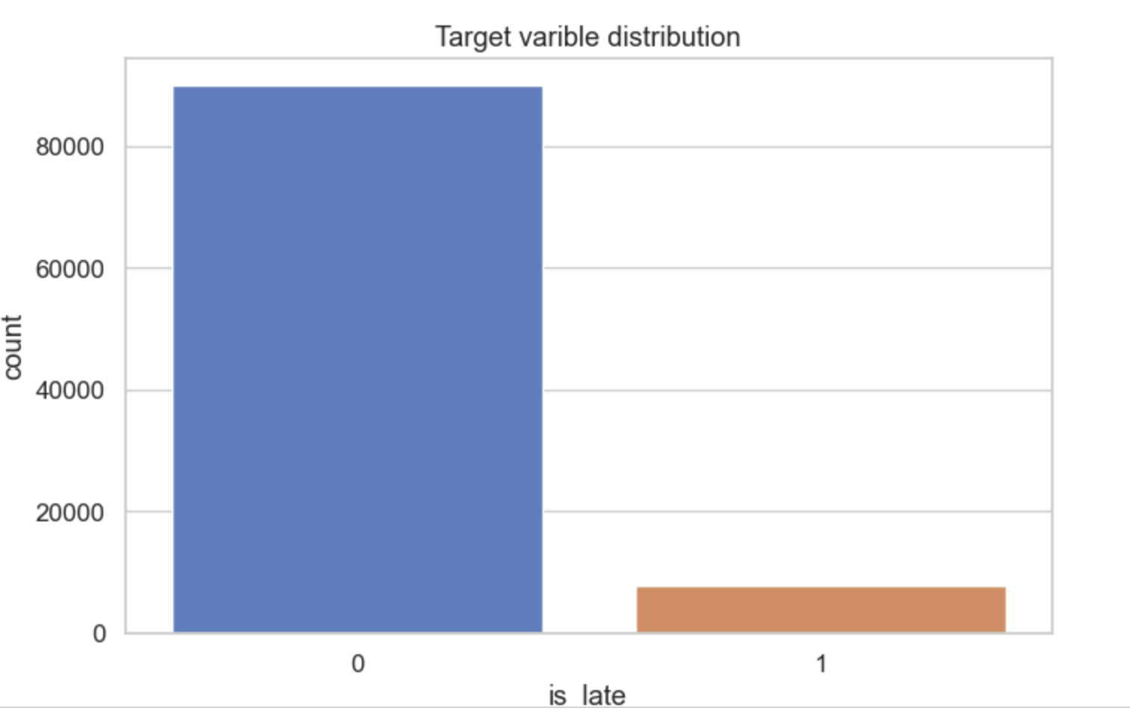
3 EDA
A strong class imbalance

Slide 5
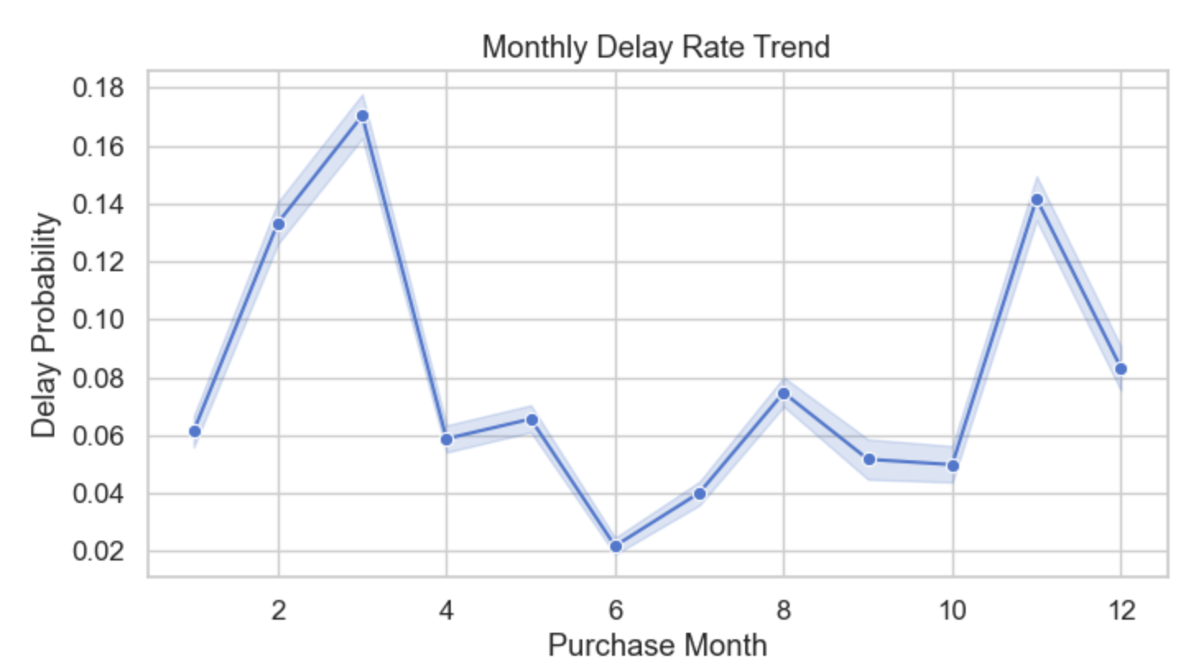
3 EDA
Delay peaks in March–April
Lowest delay around June
Second spike in November
Holiday Possible cause?

Slide 6
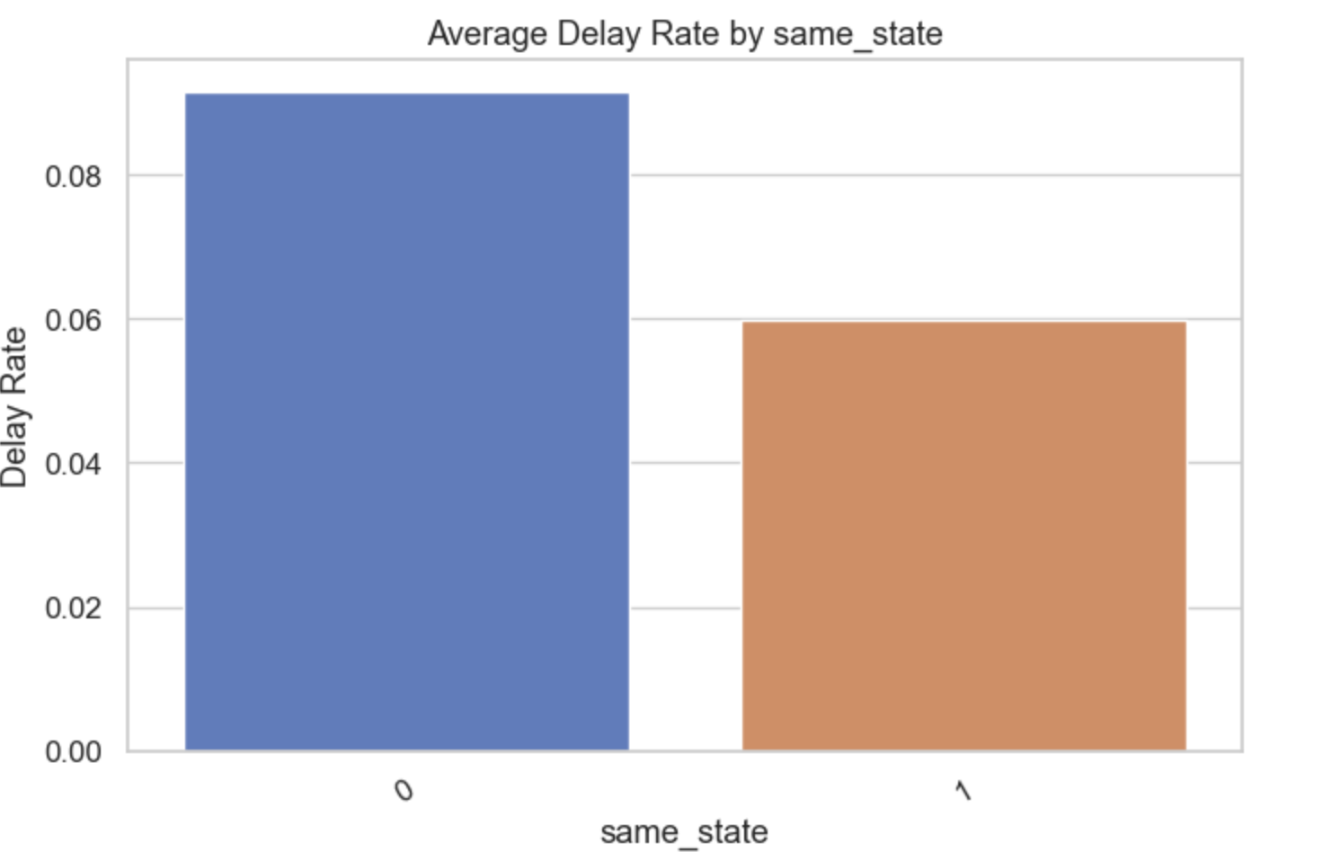
3 EDA
Cross-state orders → higher delay rate
Same-state orders → fewer delays
Shipping distance likely main factor

Slide 7
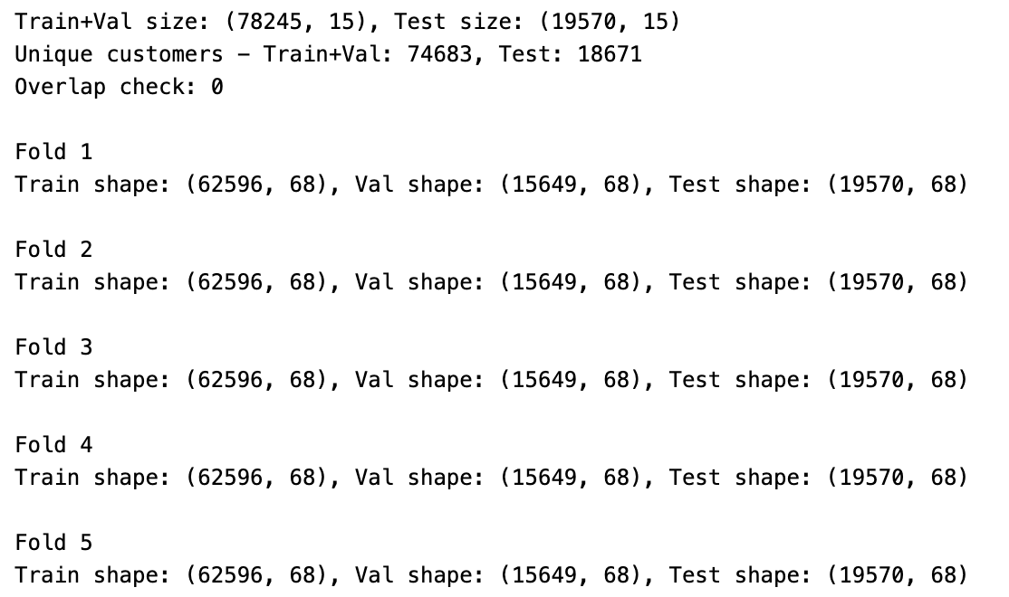
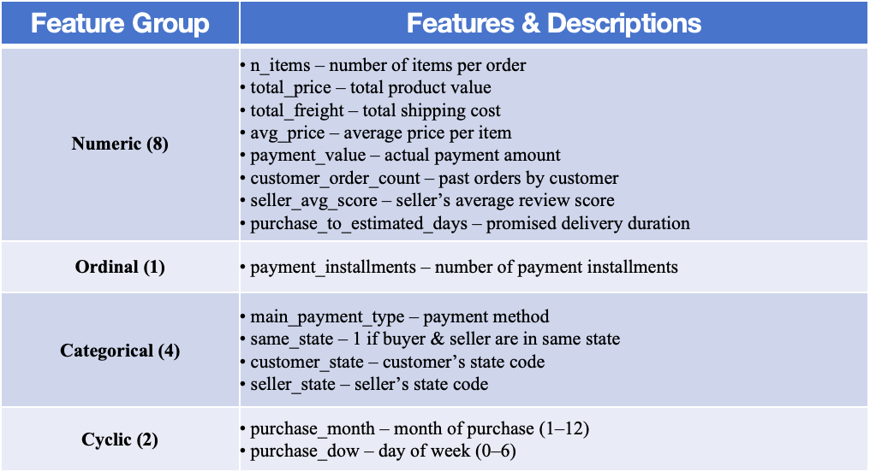
4 Splitting and Preprocessing
Splitting:
Grouped by customer_unique_id to avoid data leakage
Used GroupShuffleSplit (80% train+val / 20% test)
Within train+val: 5-fold GroupKFold for cross-validation
Preprocessing:
StandardScaler → numerical & linear ordinal features
OneHotEncoder → categorical features (payment_type, state)
Cyclic encoding → temporal features (month, day_of_week)
Very few missing entries (<0.1%) → drop
Feature Group | Features & Descriptions
Numeric (8) | • n_items – number of items per order • total_price – total product value • total_freight – total shipping cost • avg_price – average price per item • payment_value – actual payment amount • customer_order_count – past orders by customer • seller_avg_score – seller’s average review score • purchase_to_estimated_days – promised delivery duration
Ordinal (1) | • payment_installments – number of payment installments
Categorical (4) | • main_payment_type – payment method • same_state – 1 if buyer & seller are in same state • customer_state – customer’s state code • seller_state – seller’s state code
Cyclic (2) | • purchase_month – month of purchase (1–12) • purchase_dow – day of week (0–6)

