Slide 1
SMART CLASSROOM IOT NETWORK FOR MONITORING STUDENT MENTAL WELL-BEING AND BEHAVIOR

Slide 2
INTRODUCTION
Modern classrooms are evolving into technology-rich environments. However, current smart classroom solutions often overlook student well-being, privacy, and network efficiency.
This project proposes a Smart Classroom IoT Network that integrates: Environmental sensing
Behavioral analytics Adaptive networking Decentralized security
Designed for resource-constrained educational settings, the system aims to support both academic success and mental wellness.

Slide 3
RESEARCH QUESTIONS
IoT Networks: How can adaptive multi-protocol IoT networks improve classroom monitoring?
Edge AI: How can edge AI ensure privacy while analyzing student behavior?
SDN: How does SDN enhance performance and engagement in smart classrooms?
Blockchain: How can decentralized security frameworks protect sensitive educational data?
OBJECTIVES
Design a multi-protocol IoT network for environmental and attendance monitoring. Implement edge AI for real-time behavioral analysis.
Optimize classroom network performance using SDN.
Ensure secure access control using blockchain and AI-based anomaly detection.

Slide 4
RESEARCH GAP
 | Project Component | Smart IoT Classroom Systems (Yağanoğlu et al. 2023, Dai et al. 2023) | Microsoft Teams Education Insights (2020- 2023) | Google Classroom Analytics (2023-2025) | Traditional Network Management Systems (2020-2024) | Our Smart Classroom IoT Network
 | Adaptive IoT Environmental & Attendance Monitoring | Partial Basic environmental monitoring (temp, CO₂) but no adaptive networking or RL optimization | No environmental sensing capabilities | No environmental sensing capabilities | No IoT sensor integration | Multi-protocol adaptive mesh network with RL optimization, integrated environmental-attendance correlation
 | Privacy-Preserving Edge AI Behavioral Analysis | No behavioral analysis capabilities | Cloud-based processing, no privacy guarantees, basic engagement metrics only | Cloud-based processing, assignment tracking only, no behavioral analysis | No AI or behavioral analysis features | Complete edge-based multi-modal analysis with mathematical privacy guarantees
 | AI-Driven Network Optimization for Education | Basic network connectivity, no intelligent QoS management | Basic Standard network protocols, no educational app prioritization | Basic Standard network protocols, no intelligent optimization | Partial Traditional QoS but no AI-driven educational context awareness | AI-driven SDN with dynamic educational app prioritization, contextual network slicing
 | Blockchain Zero Trust Security with AI Anomaly Detection | Traditional security protocols, no blockchain integration | Basic Standard enterprise security, centralized authentication | Basic Standard enterprise security, centralized authentication | Partial Traditional network security, no blockchain or AI-driven threat detection | Integrated blockchain-SDN architecture with AI- powered real-time anomaly detection and decentralized access control

Slide 5
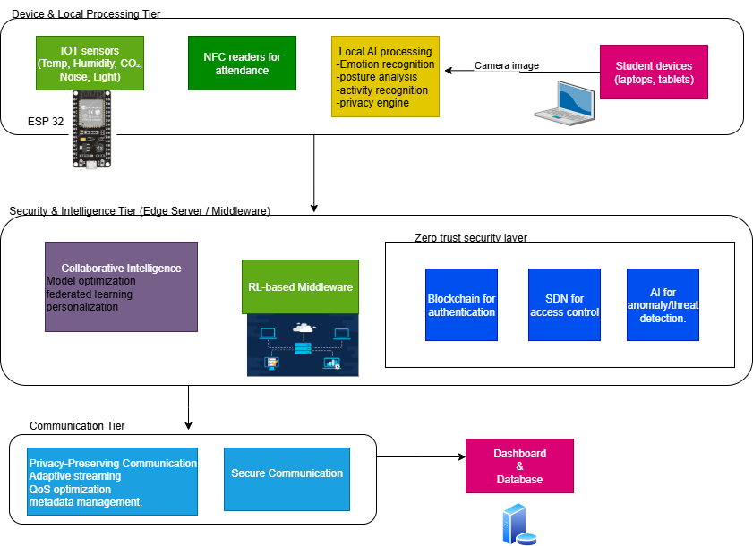

System Diagram

Slide 6

PRIVACY-PRESERVING EDGE AI BEHAVIORAL ANALYSIS
Specialzation: Computer Systems and Network Engineering
IT22073228 | D.W.A.I. Abeynayake | 25-26J-024

Slide 7
PRIVACY-PRESERVING EDGE AI BEHAVIORAL ANALYSIS
RESEARCH GAP
Current behavioral analysis systems (Microsoft Teams Analytics, Google Classroom Analytics) transmit raw biometric data to cloud servers for processing, creating fundamental privacy vulnerabilities Existing research by Liu (2024) and Zhang et al. (2020) achieves high emotion recognition accuracy but requires continuous video streaming to external servers, violating student privacy
No existing solutions combine emotion, posture, and activity detection with local processing capabilities specifically designed for educational contexts
OUR SOLUTION
Our system performs all AI analysis locally on student laptops using built-in cameras - no sensitive biometric data ever transmitted
Implements differential privacy mechanisms with mathematical privacy guarantees for behavioral metadata sharing
Dynamic privacy budget (ε) automatically adjusts based on real-time network bandwidth — a mechanism not found in any existing system
PROBLEM IDENTIFICATION
What methods can perform real-time behavioral analysis (emotion, posture, activity) on student devices while ensuring no sensitive biometric data leaves the device?
What are the limitations of current educational AI systems regarding privacy preservation and edge computing capabilities?
IT22073228 | D.W.A.I. Abeynayake | 25-26J-024

Slide 8
PRIVACY-PRESERVING EDGE AI BEHAVIORAL ANALYSIS
TECHNOLOGIES & EVALUATION
KEY DOMAINS OF KNOWLEDGE UTILIZED
Machine Learning & Computer Vision Privacy-Preserving AI
Edge Computing & Model Optimization
USED TECHNOLOGIES
TensorFlow Lite 2.8+
DeepFace (emotion detection) OpenCV (video processing) diffprivlib (differential privacy implementation)
MediaPipe (posture detection) psutil (bandwidth monitoring)
DATA AVAILABILITY & ETHICAL CLEARANCE
FER2013 dataset for emotion recognition with classroom-specific augmentation
University IRB approval for classroom validation studies with student consent
FERPA compliance through local processing and differential privacy - no biometric data storage or transmission
HOW TO EVALUATE
Multi-modal behavioral analysis accuracy Privacy preservation verification Membership inference
IT22073228 | D.W.A.I. Abeynayake | 25-26J-024

Slide 9
PRIVACY-PRESERVING EDGE AI BEHAVIORAL ANALYSIS
EXPECTED OUTPUTS
Real-time individual behavioral analysis (emotion, posture, activity classification) processed locally on each student device
Anonymous aggregated classroom insights for educators through privacy-preserving metadata sharing Live lecturer dashboard reflecting classroom engagement state within 2.1 seconds via WebSocket
ETHICAL CONSIDERATIONS
Complete local processing Mathematical privacy guarantees Student autonomy
No surveillance Regulatory compliance
NETWORK PERFORMANCE
Bandwidth: 0.20 Kbps vs 72 Mbps (358,293× reduction) Works on low-bandwidth connections (2G/3G compatible) Latency: 2.1s end-to-end (detection → dashboard) Scalability: <1 Mbps for 100 students (vs 400 Mbps for video) Reliability: 100% offline capability, 0% data loss risk Efficiency: 1-2 packets/min vs 600+ packets/min (video)
IT22073228 | D.W.A.I. Abeynayake | 25-26J-024

Slide 10
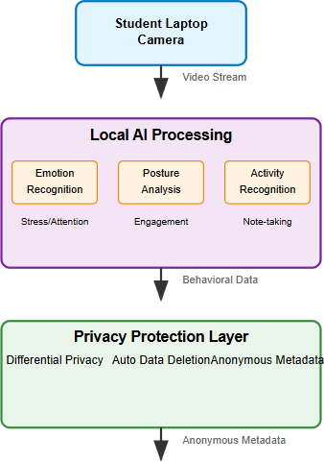
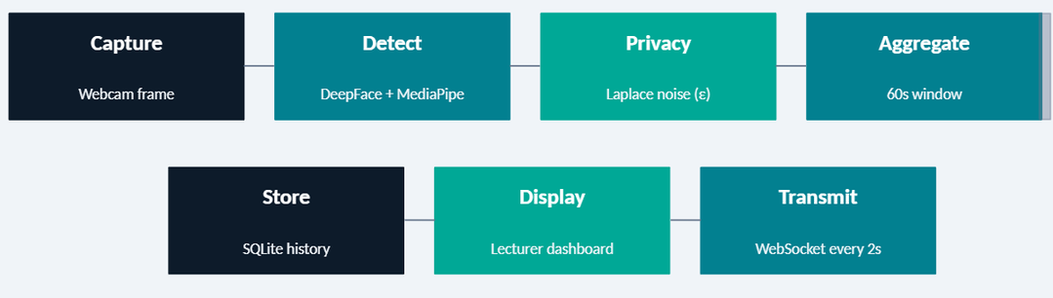
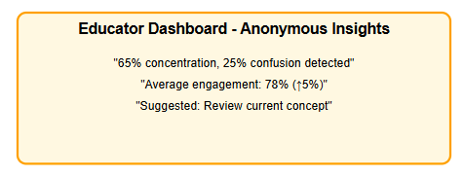
PRIVACY-PRESERVING EDGE AI BEHAVIORAL ANALYSIS
SYSTEM OVERVIEW
REAL WORLD SCENARIO
During a 90-minute IT undergraduate lecture, 25 students run the privacy-preserving analytics on their laptops. When the instructor explains distributed systems, the aggregated dashboard shows 68% engagement with 15% showing confusion indicators. The instructor pauses to clarify, improving engagement to 82%
- all while protecting individual student privacy with ε=1.3 Differential Privacy.
All AI processing stays on the student device — only anonymous metadata leaves
IT22073228 | D.W.A.I. Abeynayake | 25-26J-024

Slide 11
PRIVACY-PRESERVING EDGE AI BEHAVIORAL ANALYSIS
DYNAMIC DIFFERENTIAL PRIVACY
Below 100 Kbps → ε = 0.3 (maximum privacy) 100–500 Kbps → ε = 1.0
500–1000 Kbps → ε = 2.5
Above 1000 Kbps → ε = 5.0 (most accurate)
NETWORKING LAYER
The protocol is WebSocket, implemented using Flask-SocketIO on the server side and python-socketio on the student client. Every 2 seconds, the student client emits a packet to the server. The packet is roughly 200–400 bytes — compare that to a single raw 720p video frame which is around 900KB. Your system uses over 99.9% less bandwidth than streaming video would. For 100 students simultaneously, your system needs under 1 Mbps total. Raw video streaming for the same 100 students would require around 400 Mbps.
When the server receives a student update, it immediately pushes a full classroom snapshot to the lecturer's browser. The end-to-end latency from webcam frame to dashboard update is approximately 2.1 seconds.
DASHBOARD FUNCTIONS
Current dominant emotion Posture score
Current ε value (so the lecturer can see how private the data currently is) Bandwidth quality badge (POOR / FAIR / GOOD / EXCELLENT)
Card colour: green for happy, amber for neutral, red for negative emotions
IT22073228 | D.W.A.I. Abeynayake | 25-26J-024

Slide 12

ADAPTIVE IOT ENVIRONMENTAL & ATTENDANCE MONITORING WITH REINFORCEMENT LEARNING MIDDLEWARE
Specialzation: Computer Systems and Network Engineering (CSNE)
IT22132000 | S.S Bamunuarachchi | 25-26J-024

Slide 13
ADAPTIVE IOT ENVIRONMENTAL & ATTENDANCE MONITORING WITH REINFORCEMENT LEARNING MIDDLEWARE
Problem, Motivation & Research Gap
Why it Matters
Poor classroom environments can lead to:
Reduced student focus Increased stress levels Inaccurate attendance tracking Lower learning effectiveness
Many university classrooms lack real-time monitoring of environmental conditions and automated attendance systems.
Stakeholders
Primary users: Students and lecturers Secondary users: University IT administrators
Decision makers: University management and academic departments
Research Gap
Existing classroom monitoring solutions:
Monitor environmental conditions OR attendance separately
Are static and non-adaptive
Do not use intelligent learning-based systems to adapt classroom conditions.
Observed Issue
Classrooms often experience:
High temperature and humidity Poor air quality (CO₂ levels) Excessive noise levels
Manual or inefficient attendance tracking
These factors reduce student concentration and engagement during lectures.
Main Objective
Design and implement a Smart Classroom IoT system that monitors environmental conditions and student attendance in real-time and supports adaptive optimization using Reinforcement Learning middleware.
IT22132000 | S.S Bamunuarachchi | 25-26J-024

Slide 14
ADAPTIVE IOT ENVIRONMENTAL & ATTENDANCE MONITORING WITH REINFORCEMENT LEARNING MIDDLEWARE
Proposed Creative Solution
Solution Summary
An IoT-based Smart Classroom monitoring system that collects environmental and attendance data and enables intelligent adaptive classroom management using Reinforcement Learning middleware.
Key Features Delivered
FR1 – Environmental Monitoring Temperature monitoring Humidity monitoring
Noise level monitoring
CO₂ / air quality monitoring FR2 – Smart Attendance System NFC/RFID based attendance Automatic attendance logging
Integration with student management system FR3 – Real-time Monitoring Dashboard
MERN stack web dashboard Displays environmental data
Shows attendance logs and analytics
Non-Functional Focus
Performance: Real-time data streaming Security: Secure REST API communication Usability: User-friendly dashboard for lecturers
Reliability: Continuous monitoring using IoT devices
Completed:
ESP32 sensor integration NFC attendance system Backend APIs
MERN dashboard
Reinforcement Learning middleware integration
IT22132000 | S.S Bamunuarachchi | 25-26J-024

Slide 15
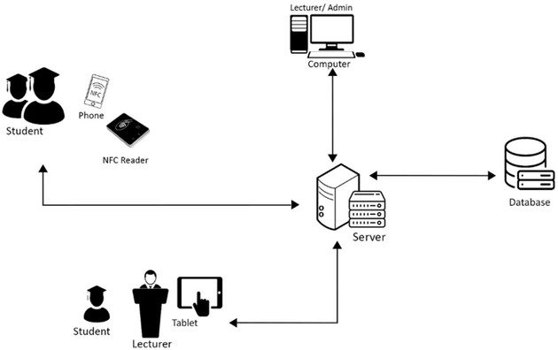
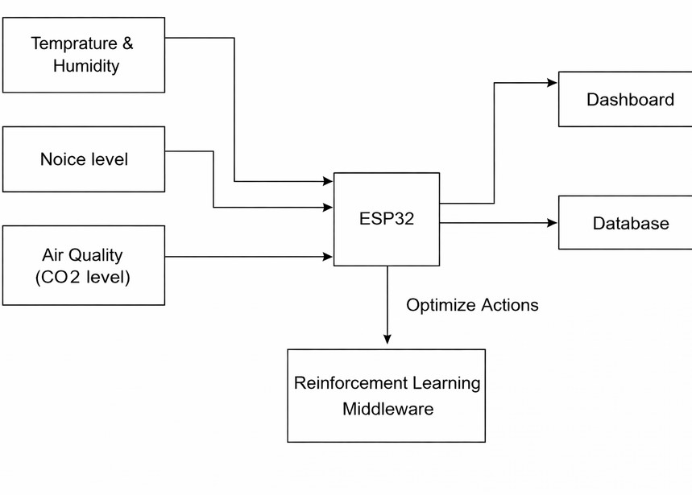
ADAPTIVE IOT ENVIRONMENTAL & ATTENDANCE MONITORING WITH REINFORCEMENT LEARNING MIDDLEWARE
Example architecture flow:
Sensors → ESP32 → WiFi → Backend Server → Database → Dashboard
↓
RL Middleware
Component A – IoT Sensor Layer
DHT22 temperature & humidity sensor Noise sensor
CO₂ / air quality sensor
Component B – Edge Device
ESP32 microcontroller
Collects sensor data and sends to server
Component C – Backend & Middleware
Node.js API server
Reinforcement Learning middleware Data processing services
Component D – Application Layer
MERN stack dashboard Student management system MongoDB database
Integration Points
REST APIs
JSON data format
Wi-Fi communication from ESP32 MongoDB database storage
Deployment Setup
Backend deployed on server/cloud ESP32 connects via Wi-Fi
Dashboard accessed via web browse
IT22132000 | S.S Bamunuarachchi | 25-26J-024

Slide 16
ADAPTIVE IOT ENVIRONMENTAL & ATTENDANCE MONITORING WITH REINFORCEMENT LEARNING MIDDLEWARE
Target Users / Market Universities Schools
Smart campus infrastructure providers Educational technology companies
Value Proposition This system provides:
Combined environment monitoring + attendance tracking Real-time classroom analytics
AI-based adaptive classroom optimization Low-cost IoT implementation
Adoption Plan / Next Steps
Pilot deployment in selected classrooms Collect environmental and attendance data
Implement Reinforcement Learning optimization Expand deployment across campus classrooms
IT22132000 | S.S Bamunuarachchi | 25-26J-024

Slide 17
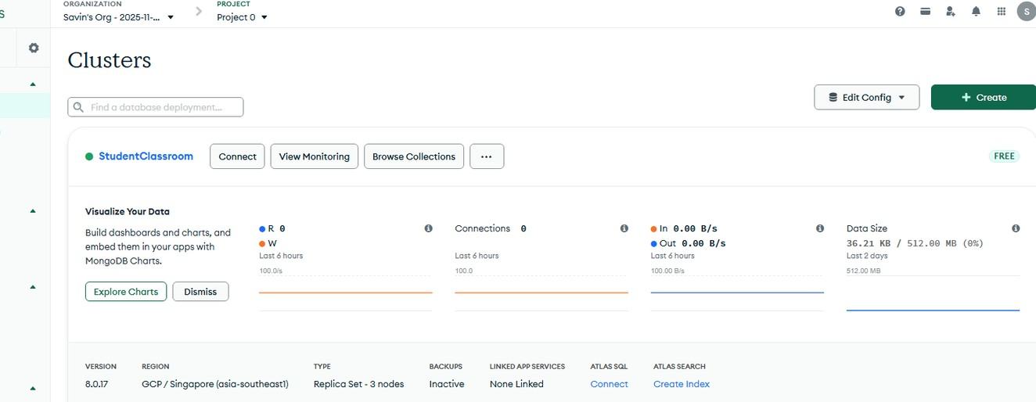
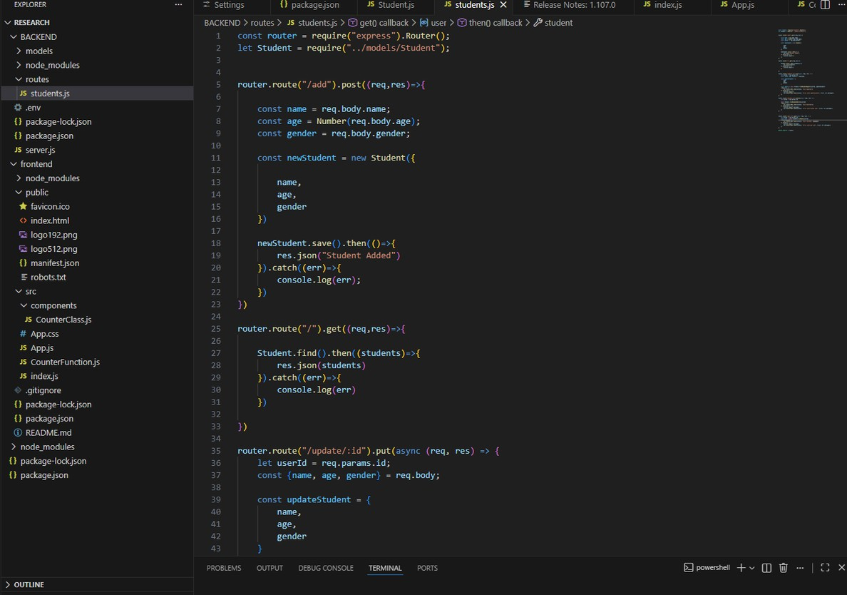
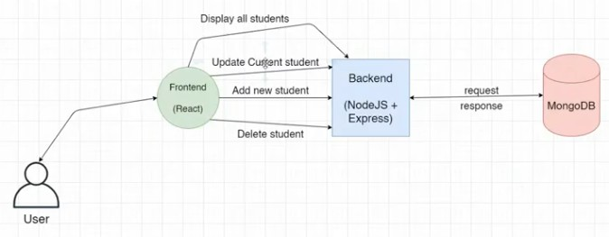
ADAPTIVE IOT ENVIRONMENTAL & ATTENDANCE MONITORING WITH
REINFORCEMENT LEARNING MIDDLEWARE
Student management system
IT22132000 | S.S Bamunuarachchi | 25-26J-024

Slide 18
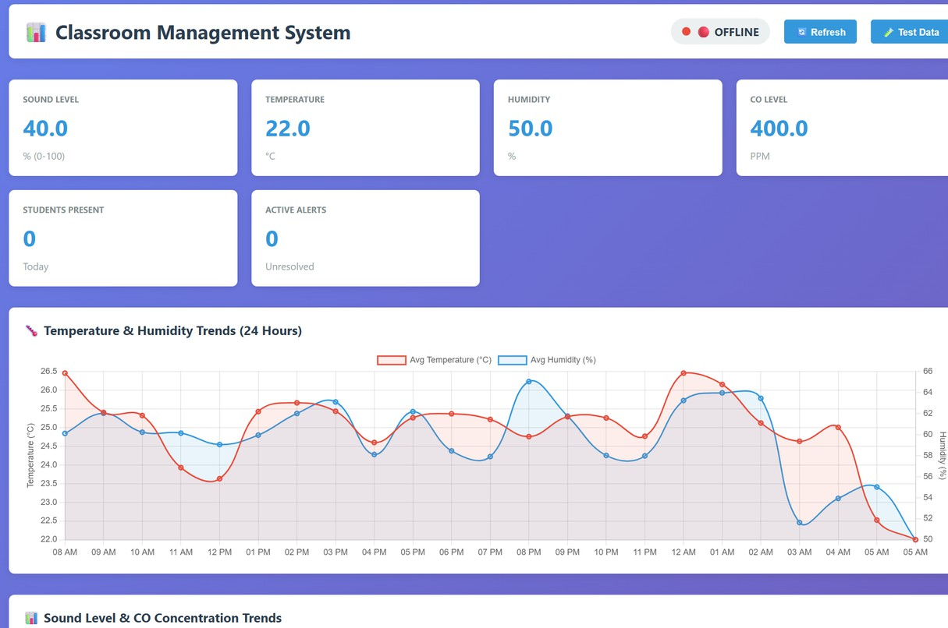
ADAPTIVE IOT ENVIRONMENTAL & ATTENDANCE MONITORING WITH REINFORCEMENT LEARNING MIDDLEWARE
Demo Flow
Step 1 – Sensor Monitoring
Display real-time temperature, humidity, noise, and air quality data. Step 2 – NFC Attendance
Student taps RFID/NFC card.
Attendance automatically recorded in database.
Step 3 – Dashboard Visualization
Show real-time environmental metrics. Display attendance records and analytics.
IT22132000 | S.S Bamunuarachchi | 25-26J-024

Slide 19


SDN- enabled classroom network optimizer.
Specialization : Computer Systems and Network Engineering
IT22078278 | A. V. G. H. H. Karunathilake | 25-26J-024

Slide 20

SDN – Enabled classroom network optimizer
Bandwidth congestion stalls the modern digital classroom
Equal Degradation: Modern education relies heavily on bandwidth-intensive tools (LMS, Zoom, GitHub). Legacy networks treat all traffic equally, causing learning applications to suffer severe degradation during peak congestion.
The HTTPS Blinding Problem: Traditional network management relies on Deep Packet Inspection (DPI). HTTPS encryption makes payload inspection impossible without violating user privacy.
The Gap: A lack of intelligent, privacy-preserving network optimization specifically designed for resource-constrained educational environments.
IT22078278 | A. V. G. H. H. Karunathilake | 25-26J-024

Slide 21
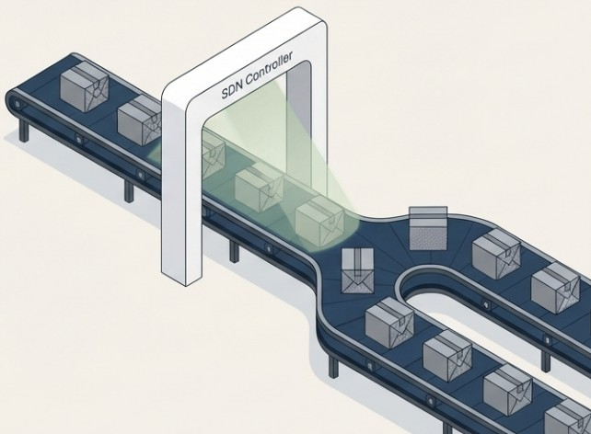

SDN – Enabled classroom network optimizer
Research Objective: To design and evaluate
an SDN-based network
optimizer priority
that during
guarantees congestion privacy.
academic
without compromising student
Proposed Solution: An application-aware Software-Defined Networking (SDN) controller equipped with a machine learning engine. Instead of binary allow/block filtering, the system dynamically enforces Quality of Service (QoS) policies to prioritize educational traffic and shape non-academic bandwidth usage.
IT22078278 | A. V. G. H. H. Karunathilake | 25-26J-024

Slide 22
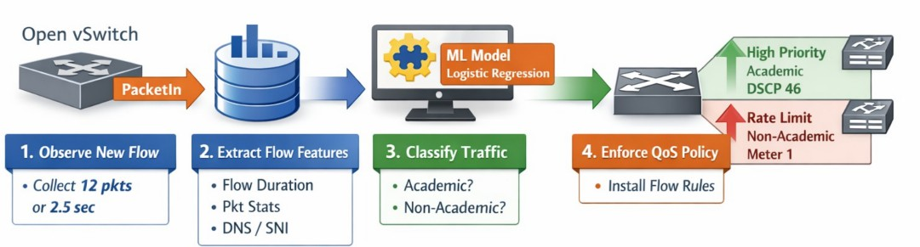
SDN – Enabled classroom network optimizer
Privacy-Preserving Classification: The system completely avoids payload decryption. It
Early-Decision Enforcement: The controller does not monitor the entire session. It heavily observes only the first 12 packets or a 2.5-second window.
classifies traffic based entirely on plaintext
metadata (DNS query names, TLS SNI hostnames) and statistical flow features (packet sizes, inter-arrival times, byte ratios).
A lightweight Logistic Regression model executes
extremely fast inference (<1ms latency) based on these early statistics.
Once classified, rules are pushed to the data plane, minimising control-plane overhead.
IT22078278 | A. V. G. H. H. Karunathilake | 25-26J-024

Slide 23
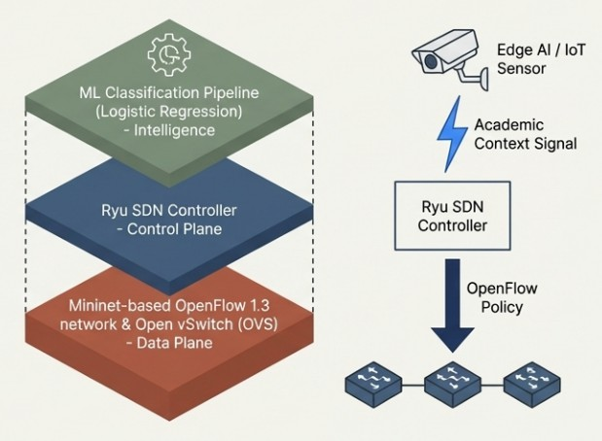
SDN – Enabled classroom network optimizer
Building the foundational SDN architecture
Data Plane: A Mininet-based OpenFlow 1.3 network utilizing Open vSwitch (OVS) for hardware-level packet forwarding.
Control Plane: The Ryu SDN controller managing the network state and executing routing logic.
Intelligence: An integrated ML classification pipeline (scikit-learn/joblib) running logistic regression to evaluate flow statistics.
External Integration: The architecture features logical data interfaces designed to accept external classroom context (e.g., Edge AI/IoT sensor signals) and instantly convert them into dynamic OpenFlow policies.
IT22078278 | A. V. G. H. H. Karunathilake | 25-26J-024

Slide 24
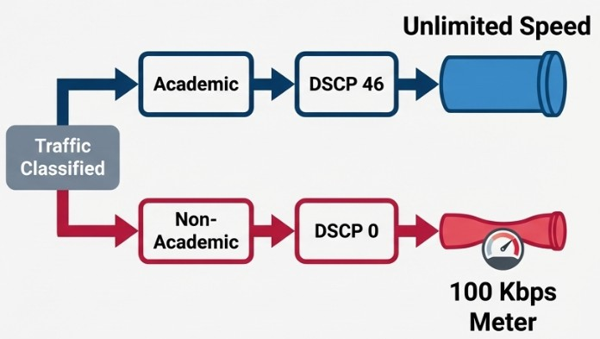
SDN – Enabled classroom network optimizer
Enforcing Quality of Service through prioritisation, not blocking
Rather than deploying a static web filter, the controller implements granular QoS differentiation:
Academic Traffic (High Priority): Marked with DSCP 46 (Expedited Forwarding). Granted unrestricted forwarding at full network speed to ensure zero latency for learning tools.
Non-Academic Traffic (Throttled): Marked with DSCP 0 (Best Effort). Attached to OpenFlow meters that strictly rate-limit the flow to 100 Kbps.
This strategy effectively chokes distracting traffic to preserve critical bandwidth, providing a more realistic and manageable network environment than binary blocking.
IT22078278 | A. V. G. H. H. Karunathilake | 25-26J-024

Slide 25
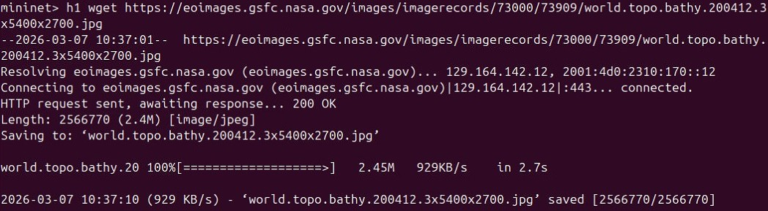
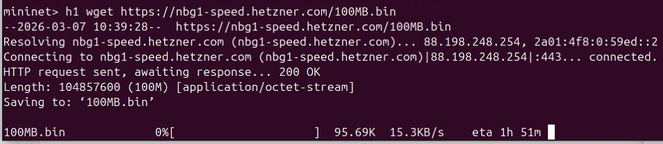
SDN – Enabled classroom network optimizer
Verifying dynamic enforcement at the terminal level
The integrated system demonstrates stable execution and objective-aligned results in a live control-plane environment:
Real-time Feature Extraction: The system reliably isolates the 12-packet observation window and extracts statistical features per flow.
Live ML Classification: Terminal logs validate instantaneous classification decisions (academic vs. non-academic) using the pre-trained .joblib model.
Dynamic Rule Installation: OpenFlow flow rules, including specific DSCP marking and meter execution, are successfully installed in the OVS switch, proving the bridge between the ML decision and data-plane enforcement.
IT22078278 | A. V. G. H. H. Karunathilake | 25-26J-024

Slide 26
SDN – Enabled classroom network optimizer
SDN-optimized routing drastically improves academic throughput under congestion.
IT22078278 | A. V. G. H. H. Karunathilake | 25-26J-024

Slide 27
SDN – Enabled classroom network optimizer
Deployment Extension & Scalability Validation
Current System Status:
The SDN-enabled classroom network optimizer has been fully implemented and tested in a controlled SDN test environment.
The main objectives of this component have been achieved, including privacy-preserving traffic classification, early decision enforcement, and QoS-based prioritization of academic traffic during congestion.
Planned Extensions:
As a next step, the same SDN control logic can be deployed on physical OpenFlow-capable switches to evaluate hardware-level performance under larger and more realistic network loads.
Longer classroom-style trials can be carried out to observe sustained network behavior during real student usage over extended periods.
Traffic labeling mechanisms can be further refined to handle shared CDN and cloud-hosted services, improving classification robustness in complex real-world scenarios.
IT22078278 | A. V. G. H. H. Karunathilake | 25-26J-024

Slide 28





DECENTRALIZED ZERO TRUST NETWORK ACCESS WITH AI SECURITY
Specialzation: Computer Systems and Network Engineering
IT22365132 | C.B Gunasena | 25-26J-024

Slide 29
Decentralized Zero Trust Network Access
with AI Security
Knowledge Gap or Problem Definition: Centralized authentication in educational IoT vulnerable to single-point failures and cyberattacks; 80% cloud-dependent, increasing latency by 50% and privacy risks for student data.
Shortcomings of Existing Systems: Traditional systems lack offline resilience and tamper-proof auth; unable to handle dynamic threats like DDoS effectively.
Our Solution: Integrates customized Hyperledger Fabric for decentralized, tamper-proof authentication, Ryu SDN for dynamic access policies with 30% latency reduction, and Xgboost algorithm for >95% accuracy in AI anomaly
detection.
IT22365132 | C.B Gunasena | 25-26J-024

Slide 30
Decentralized Zero Trust Network Access
with AI Security
Domains:
Cybersecurity: Implements Zero Trust model for continuous device verification, ensuring no implicit trust in network entities. Network Security: Focuses on real-time anomaly detection and threat mitigation to secure IoT traffic flows.
Blockchain Applications: Leverages distributed ledger technology for robust, decentralized device management in IoT ecosystems.
Specific Technologies:
Hyperledger Fabric: Edge deployment with <1GB RAM usage and 95% faster transactions than Ethereum.
Ryu SDN: Employs OpenFlow 1.3 with IDS capabilities for intelligent traffic management.
Xgboost: Leverages LiteRT (2025 update) for micro-edge AI, trained on CICIDS2017 dataset with custom neural networks
IT22365132 | C.B Gunasena | 25-26J-024

Slide 31
Decentralized Zero Trust Network Access with AI Security
Progress Milestones: MAC-Based Blockchain Authentication
Blockchain Backend: A functional Python/Flask ledger with SHA-256 block linking to maintain a "Single Source of Truth" for device status (active vs revoked).
Network Orchestration: Successfully established the Table-Miss flow rule, ensuring all unknown traffic in the Smart Classroom is redirected to the controller for scrutiny.
Dynamic Rule Injection: Verified that OFPFlowMod messages are only triggered for devices verified by the blockchain ledger.
Implementation Environment:
SDN Controller: Ryu (OpenFlow v1.3).
Switching: Open vSwitch (OVS) running on a Linux-based edge gateway.
Ledger: Localized Blockchain node for low-latency identity verification (<2ms query time).
IT22365132 | C.B Gunasena | 25-26J-024

Slide 32
Decentralized Zero Trust Network Access with AI Security
Implementation: Bridging Blockchain with SDN Enforcement
Ryu-Blockchain Middleware: Developed a custom Ryu application that intercepts the OpenFlow Packet-In event. It extracts the eth.src (MAC address) and performs a real-time REST API call to the Blockchain /check endpoint.
Zero Trust Enforcement Logic: * Implicit Deny: If the API returns authorized: False, the controller ignores the packet, effectively dropping it at the switch level.
Conditional Trust: Only upon a True response from the ledger does the controller calculate the output port and install a flow entry.
Flow Persistence: Authorized flows are installed with an idle_timeout=60. This ensures that if a device stops communicating, its permission is revoked from the switch's fast-path memory, requiring a re-authentication check.
IT22365132 | C.B Gunasena | 25-26J-024

Slide 33
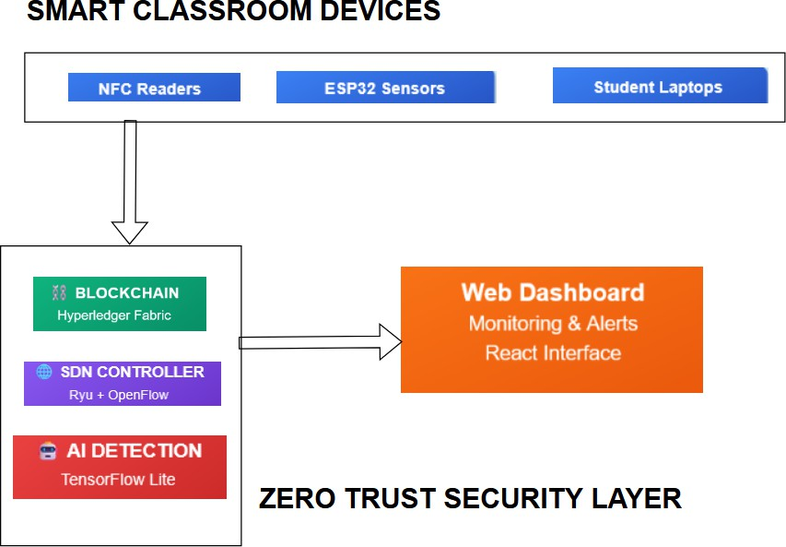
Decentralized Zero Trust Network Access
with AI Security
- System Overview: Personal laptop/edge device hosts Fabric (cryptographic auth), Ryu (policy enforcement), TensorFlow Lite (flow monitoring); offline logs sync.
- Real-World Scenario: Dashboard activation; devices register/authenticate via blockchain; SDN prioritizes apps/ blocks threats; AI alerts on anomalies—secure monitoring in low-budget classrooms.
IT22365132 | C.B Gunasena | 25-26J-024

Slide 34
COMMERCIALIZATION
Investment/Cost & Recovery: ~LKR 70,000 total (labor: 4 students' effort; material: LKR 50,000 for hardware). Recover via LKR 10,000/year subscriptions, ROI in 2 years from 50 adoptions.
Target Market/Customer Profile: Developing edtech market (USD 94B in 2025, growing to 186B by 2035); customers: Budget-conscious schools/ administrators needing secure IoT.
Value Proposition/IPR: Affordable privacy-focused monitoring; open-source core with proprietary modules.

Slide 35
CONCLUSION
We propose a Smart Classroom IoT Network that ensures privacy, security, and adaptability.
The system focuses on both academic support and student well-being.
Our solution is innovative, affordable, and practical for resource-limited educational environments.

Slide 36
THANK YOU

