Slide 1
SMART CLASSROOM IOT NETWORK FOR MONITORING STUDENT MENTAL WELL-BEING AND BEHAVIOR

Slide 2
INTRODUCTION
Modern classrooms are evolving into technology-rich environments. However, current smart classroom solutions often overlook student well-being, privacy, and network efficiency.
This project proposes a Smart Classroom IoT Network that integrates: Environmental sensing
Behavioral analytics Adaptive networking Decentralized security
Designed for resource-constrained educational settings, the system aims to support both academic success and mental wellness.

Slide 3
RESEARCH QUESTIONS
IoT Networks: How can adaptive multi-protocol IoT networks improve classroom monitoring?
Edge AI: How can edge AI ensure privacy while analyzing student behavior?
SDN: How does SDN enhance performance and engagement in smart classrooms?
Blockchain: How can decentralized security frameworks protect sensitive educational data?
OBJECTIVES
Design a multi-protocol IoT network for environmental and attendance monitoring. Implement edge AI for real-time behavioral analysis.
Optimize classroom network performance using SDN.
Ensure secure access control using blockchain and AI-based anomaly detection.

Slide 4
RESEARCH GAP
Smart IoT Classroom Systems (Yağanoğlu et al.
2023, Dai et al. 2023)
Microsoft Teams Education Insights (2020-
2023)
Google Classroom Analytics (2023-2025)
Traditional Network Management Systems (2020-2024)
Our Smart Classroom IoT Network
Project Component
Partial Basic environmental monitoring (temp, CO₂) but no adaptive networking or RL optimization
Multi-protocol adaptive mesh network with RL optimization, integrated
environmental-attendance correlation
Adaptive IoT Environmental & Attendance Monitoring
No environmental sensing capabilities
No environmental sensing capabilities
No IoT sensor integration
Cloud-based processing, no privacy
guarantees, basic engagement metrics only
Cloud-based processing, assignment
tracking only, no behavioral analysis
Complete edge-based multi-modal analysis with
mathematical privacy guarantees
Privacy-Preserving Edge AI Behavioral Analysis
No behavioral analysis capabilities
No AI or behavioral analysis features
AI-driven SDN with dynamic educational app prioritization, contextual network slicing, and smart
caching
AI-Driven Network Optimization for Education
Basic network connectivity, no intelligent
QoS management
Basic Standard network protocols, no educational app prioritization
Basic Standard network protocols, no intelligent optimization
Partial Traditional QoS but no AI-driven educational context awareness
Integrated blockchain- SDN architecture with AI-
powered real-time anomaly detection and decentralized access control
Blockchain Zero Trust Security with AI Anomaly Detection
Traditional security protocols, no blockchain
integration
Basic Standard enterprise security, centralized authentication
Basic Standard enterprise security, centralized authentication
Partial Traditional network security, no blockchain or AI-driven threat detection

Slide 5
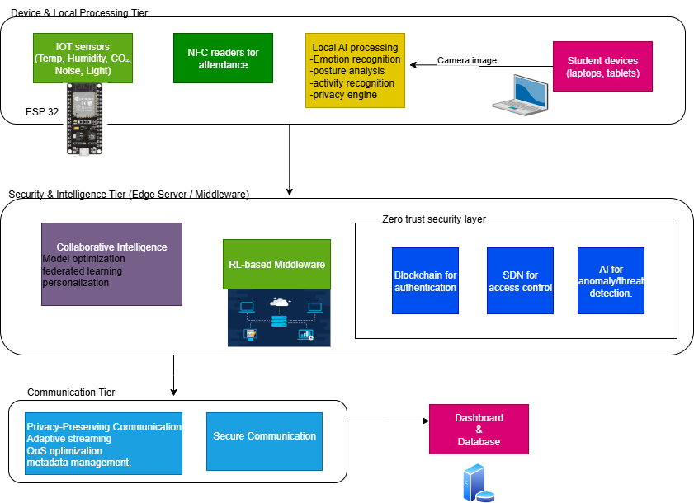

System Diagram

Slide 6

PRIVACY-PRESERVING EDGE AI BEHAVIORAL ANALYSIS
Specialzation: Computer Systems and Network Engineering
IT22073228 | D.W.A.I. Abeynayake | 25-26J-024

Slide 7
PRIVACY-PRESERVING EDGE AI BEHAVIORAL ANALYSIS
RESEARCH GAP
Current behavioral analysis systems (Microsoft Teams Analytics, Google Classroom Analytics) transmit raw biometric data to cloud servers for processing, creating fundamental privacy vulnerabilities Existing research by Liu (2024) and Zhang et al. (2020) achieves high emotion recognition accuracy but requires continuous video streaming to external servers, violating student privacy
No existing solutions combine emotion, posture, and activity detection with local processing capabilities specifically designed for educational contexts
OUR SOLUTION
Our system performs all AI analysis locally on student laptops using built-in cameras - no sensitive biometric data ever transmitted
Implements differential privacy mechanisms with mathematical privacy guarantees for behavioral metadata sharing
PROBLEM IDENTIFICATION
What methods can perform real-time behavioral analysis (emotion, posture, activity) on student devices while ensuring no sensitive biometric data leaves the device?
What are the limitations of current educational AI systems regarding privacy preservation and edge computing capabilities?
IT22073228 | D.W.A.I. Abeynayake | 25-26J-024

Slide 8
PRIVACY-PRESERVING EDGE AI BEHAVIORAL ANALYSIS
TECHNOLOGIES & EVALUATION
KEY DOMAINS OF KNOWLEDGE UTILIZED
Machine Learning & Computer Vision Privacy-Preserving AI
Edge Computing & Model Optimization
USED TECHNOLOGIES
TensorFlow Lite 2.8+
DeepFace (emotion detection) OpenCV (video processing) diffprivlib (differential privacy implementation)
DATA AVAILABILITY & ETHICAL CLEARANCE
FER2013 dataset for emotion recognition with classroom-specific augmentation
University IRB approval for classroom validation studies with student consent
FERPA compliance through local processing and differential privacy - no biometric data storage or transmission
HOW TO EVALUATE
Multi-modal behavioral analysis accuracy Privacy preservation verification Membership inference
IT22073228 | D.W.A.I. Abeynayake | 25-26J-024

Slide 9
PRIVACY-PRESERVING EDGE AI BEHAVIORAL ANALYSIS
EXPECTED OUTPUTS
Real-time individual behavioral analysis (emotion, posture, activity classification) processed locally on each student device
Anonymous aggregated classroom insights for educators through privacy-preserving metadata sharing
ETHICAL CONSIDERATIONS
Complete local processing Mathematical privacy guarantees Student autonomy
No surveillance Regulatory compliance
NETWORK PERFORMANCE
Bandwidth: 0.20 Kbps vs 72 Mbps (358,293× reduction) Works on low-bandwidth connections (2G/3G compatible)
Latency: 2.1s end-to-end (detection → dashboard) Scalability: <1 Mbps for 100 students (vs 400 Mbps for video) Reliability: 100% offline capability, 0% data loss risk Efficiency: 1-2 packets/min vs 600+ packets/min (video)
IT22073228 | D.W.A.I. Abeynayake | 25-26J-024

Slide 10
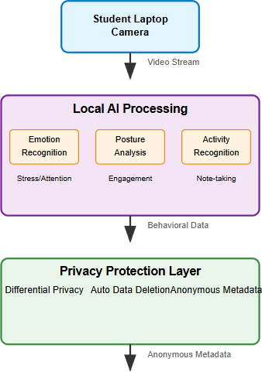
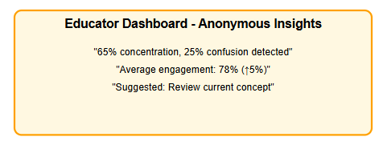
PRIVACY-PRESERVING EDGE AI BEHAVIORAL ANALYSIS
SYSTEM OVERVIEW
REAL WORLD SCENARIO
During a 90-minute IT undergraduate lecture, 25 students run the privacy-preserving analytics on their laptops. When the instructor explains distributed systems, the aggregated dashboard shows 68% engagement with 15% showing confusion indicators. The instructor pauses to clarify, improving engagement to 82%
- all while protecting individual student privacy with ε=1.3 Differential Privacy.
IT22073228 | D.W.A.I. Abeynayake | 25-26J-024

Slide 11

ADAPTIVE IOT ENVIRONMENTAL & ATTENDANCE MONITORING WITH REINFORCEMENT LEARNING MIDDLEWARE
Specialzation: Computer Systems and Network Engineering (CSNE)
IT22132000 | S.S Bamunuarachchi | 25-26J-024

Slide 12
ADAPTIVE IOT ENVIRONMENTAL & ATTENDANCE MONITORING WITH REINFORCEMENT LEARNING MIDDLEWARE
Problem Definition
Traditional classrooms lack real-time awareness of student comfort & engagement Poor environmental conditions negatively affect:
Concentration Stress levels
Attendance behavior Existing systems are static, not adaptive
Research Gap:
Lack of intelligent IoT-based classroom systems that: Combine environment + attendance
Adapt conditions automatically using learning-based middleware
Objectives
Design an IoT-based environmental monitoring system Implement student attendance tracking infrastructure Develop a backend student management system
Prepare data flow for Reinforcement Learning–based adaptation Enable real-time data acquisition using ESP32
IT22132000 | S.S Bamunuarachchi | 25-26J-024

Slide 13
ADAPTIVE IOT ENVIRONMENTAL & ATTENDANCE MONITORING WITH REINFORCEMENT LEARNING MIDDLEWARE
Proposed Creative Solution
IoT & Embedded Systems : Environmental monitoring Sensor networks, Actuators.
Networking & Middleware : Reinforcement learning for multi-protocol IoT (Wi-Fi, BLE, Zigbee).
Database & Identity : Student management system with attendance tracking from MERN stack.
Technologies Utilized
Sensors: DHT22/Si7021 (Temp & Humidity), MH-Z19B (CO₂), MEMS Mic (Noise), LDR/TSL2591 (Light).
Communication: Wi-Fi, BLE, Zigbee.
Middleware: RL (Deep Q-Learning / Policy Gradient)
Attendance: NFC Reader (PN532/RC522).
IT22132000 | S.S Bamunuarachchi | 25-26J-024

Slide 14
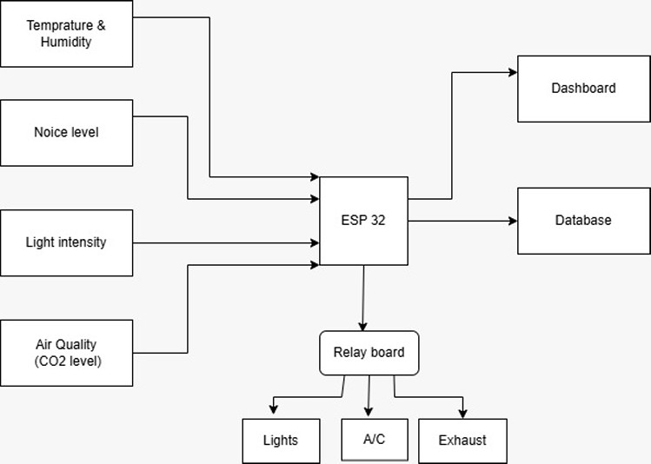
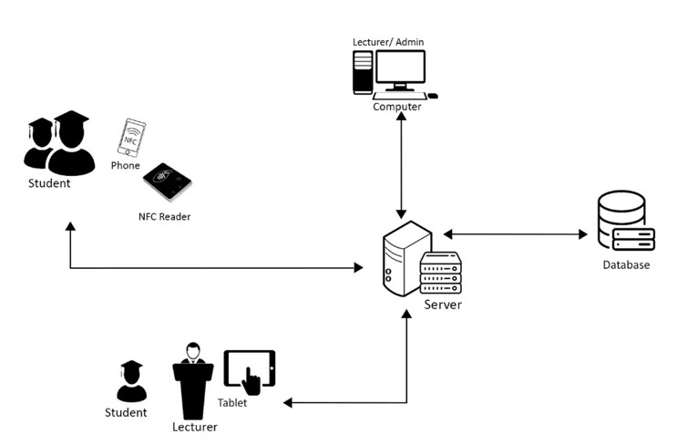
ADAPTIVE IOT ENVIRONMENTAL & ATTENDANCE MONITORING WITH REINFORCEMENT LEARNING MIDDLEWARE
IT22132000 | S.S Bamunuarachchi | 25-26J-024

Slide 15
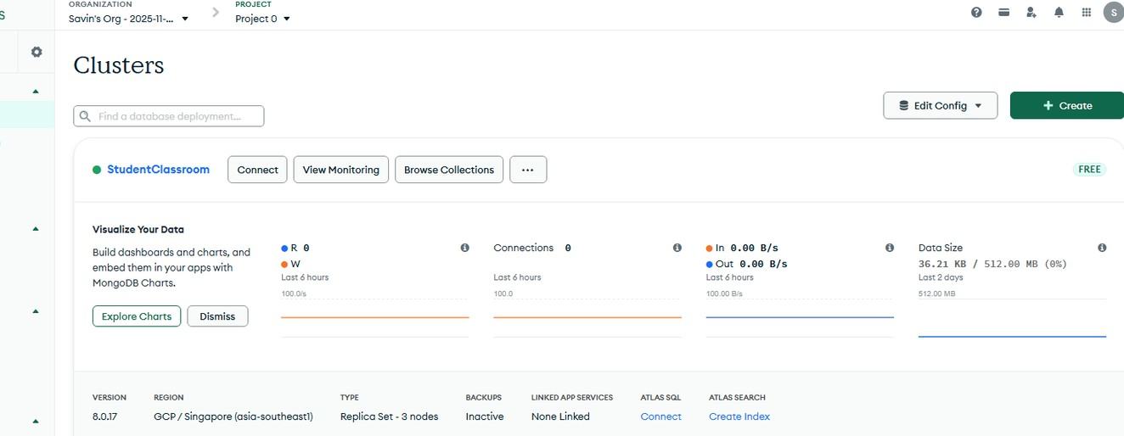
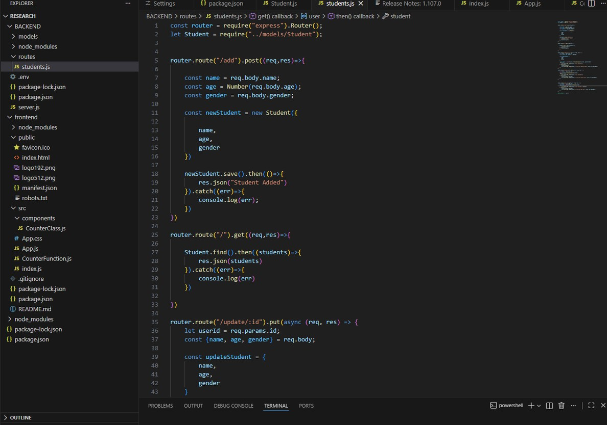
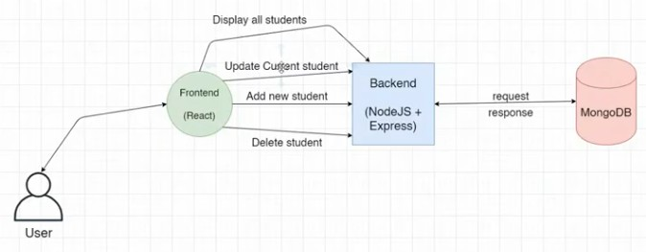
ADAPTIVE IOT ENVIRONMENTAL & ATTENDANCE MONITORING WITH
REINFORCEMENT LEARNING MIDDLEWARE
Student management system
IT22132000 | S.S Bamunuarachchi | 25-26J-024

Slide 16
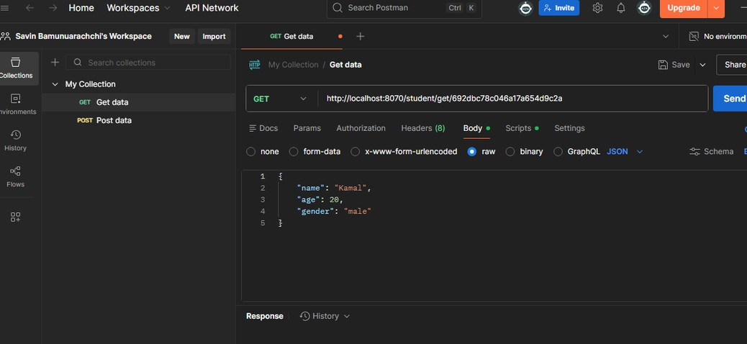
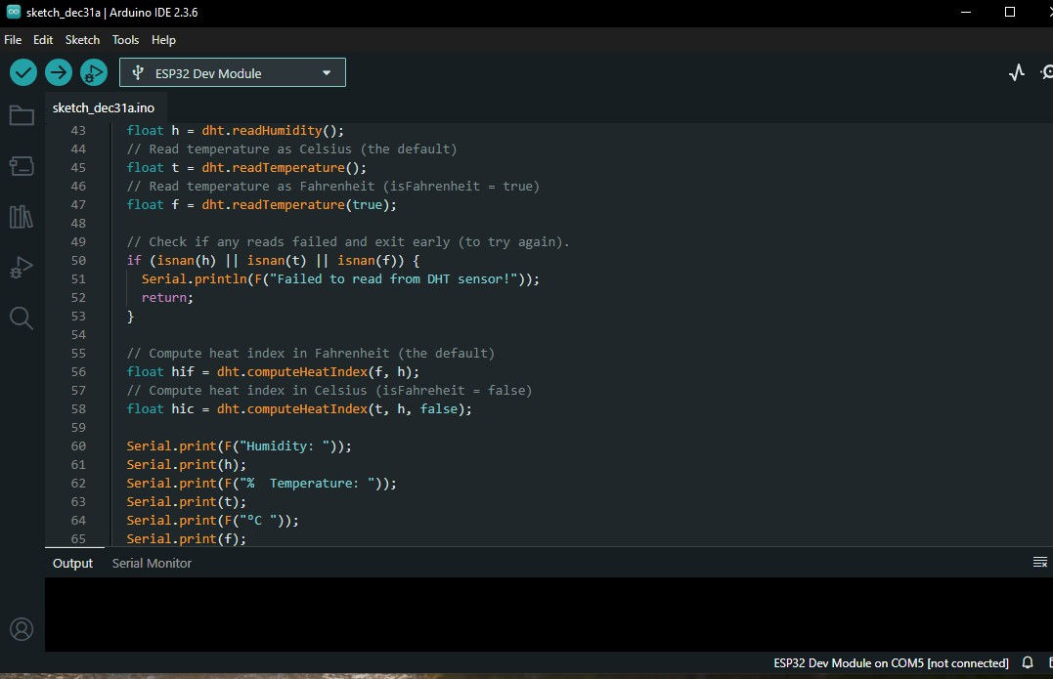
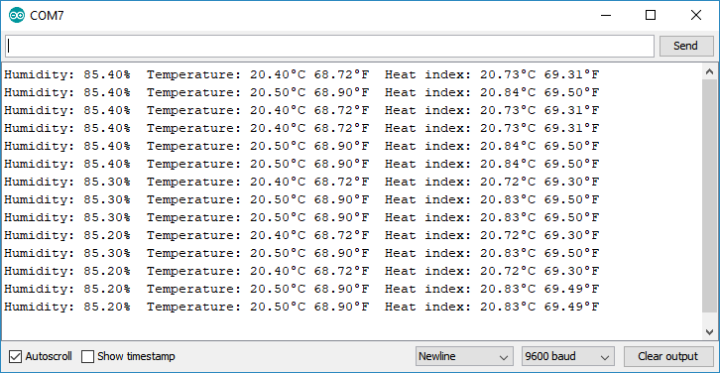
IOT embedded sensors

Slide 17


SDN- enabled classroom network optimizer.
Specialization : Computer Systems and Network Engineering
IT22078278 | A. V. G. H. H. Karunathilake | 25-26J-024

Slide 18
SDN – Enabled classroom network optimizer
Knowledge Gap:
Traditional classroom networks treat all traffic equally, causing poor performance for educational tools.
No integration with classroom context or student engagement data.
Shortcomings of Existing Systems:
Lack of traffic prioritization for learning apps.
No dynamic bandwidth allocation based on classroom activity. No offline support or local caching.
No integration with IoT-based behavioral monitoring.
Creative Solution:
An SDN controller that uses ML to classify and prioritize traffic. Dynamic QoS policies based on real-time classroom context.
Local caching of educational content.
Offline-first SDN controller with ML-based traffic classification and dynamic flow control..
IT22078278 | A. V. G. H. H. Karunathilake | 25-26J-024

Slide 19
SDN – Enabled classroom network optimizer
How the Solution Addresses the Sub-Problem Implements Ryu SDN controller on Ubuntu with Open vSwitch bridge.
Uses ML model to classify traffic (academic vs non-academic) based on port, packet size, and packet rate.
Enforces real-time flow rules: academic traffic allowed, non-academic blocked or throttled.
User Requirements Addressed
Stable connectivity for educational apps (Zoom, GitHub, LMS).
Reduced congestion during lectures and coding sessions.
Design Excellence / Contribution Novel integration of SDN + ML for classroom-specific QoS.
Offline-first architecture using local gateway (no cloud dependency).
Cost-effective deployment using existing hardware (laptop + AP).
User Feedback
Planned surveys with students and educators after prototype testing
IT22078278 | A. V. G. H. H. Karunathilake | 25-26J-024

Slide 20
SDN – Enabled classroom network optimizer
Evaluation:
Data & Ethics:
Classification Accuracy: Target ≥ 95% QoS Improvement: ≥ 30% faster response for educational apps Bandwidth Optimization: Prioritization reduces congestion during peak usage.
No personal data stored; only traffic metadata analyzed.
Privacy preserved through local processing.
IT22078278 | A. V. G. H. H. Karunathilake | 25-26J-024

Slide 21
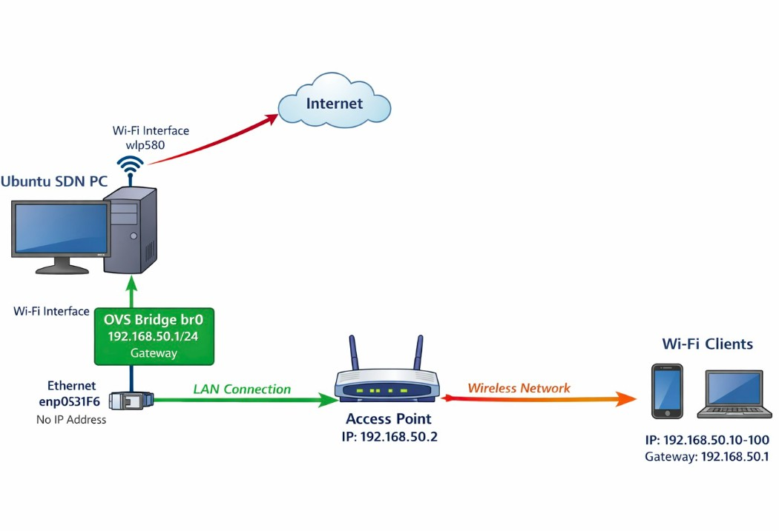

SDN – Enabled classroom network optimizer
Use Case
During coding sessions, GitHub and IDE traffic prioritized.
Video conferencing tools (Zoom/Teams) get bandwidth during presentations.
Non-academic traffic (social media, streaming) blocked.
IT22078278 | A. V. G. H. H. Karunathilake | 25-26J-024

Slide 22





DECENTRALIZED ZERO TRUST NETWORK ACCESS WITH AI SECURITY
Specialzation: Computer Systems and Network Engineering
IT22365132 | C.B Gunasena | 25-26J-024

Slide 23
Decentralized Zero Trust Network Access
with AI Security
Knowledge Gap or Problem Definition: Centralized authentication in educational IoT vulnerable to single-point failures and cyberattacks; 80% cloud-dependent, increasing latency by 50% and privacy risks for student data.
Shortcomings of Existing Systems: Traditional systems lack offline resilience and tamper-proof auth; unable to handle dynamic threats like DDoS effectively.
Our Solution: Integrates customized Hyperledger Fabric for decentralized, tamper-proof authentication, Ryu SDN for dynamic access policies with 30% latency reduction, and TensorFlow Lite for >95% accuracy in AI anomaly detection.
IT22365132 | C.B Gunasena | 25-26J-024

Slide 24
Decentralized Zero Trust Network Access
with AI Security
Domains:
Cybersecurity: Implements Zero Trust model for continuous device verification, ensuring no implicit trust in network entities. Network Security: Focuses on real-time anomaly detection and threat mitigation to secure IoT traffic flows.
Blockchain Applications: Leverages distributed ledger technology for robust, decentralized device management in IoT ecosystems.
Specific Technologies:
Hyperledger Fabric: Edge deployment with <1GB RAM usage and 95% faster transactions than Ethereum.
Ryu SDN: Employs OpenFlow 1.3 with IDS capabilities for intelligent traffic management.
Xgboost: Leverages LiteRT (2025 update) for micro-edge AI, trained on CICIDS2017 dataset with custom neural networks
IT22365132 | C.B Gunasena | 25-26J-024

Slide 25
Decentralized Zero Trust Network Access with AI Security
Progress Milestones: MAC-Based Blockchain Authentication
Blockchain Backend: A functional Python/Flask ledger with SHA-256 block linking to maintain a "Single Source of Truth" for device status (active vs revoked).
Network Orchestration: Successfully established the Table-Miss flow rule, ensuring all unknown traffic in the Smart Classroom is redirected to the controller for scrutiny.
Dynamic Rule Injection: Verified that OFPFlowMod messages are only triggered for devices verified by the blockchain ledger.
Implementation Environment:
SDN Controller: Ryu (OpenFlow v1.3).
Switching: Open vSwitch (OVS) running on a Linux-based edge gateway.
Ledger: Localized Blockchain node for low-latency identity verification (<2ms query time).
IT22365132 | C.B Gunasena | 25-26J-024

Slide 26
Decentralized Zero Trust Network Access with AI Security
Implementation: Bridging Blockchain with SDN Enforcement
Ryu-Blockchain Middleware: Developed a custom Ryu application that intercepts the OpenFlow Packet-In event. It extracts the eth.src (MAC address) and performs a real-time REST API call to the Blockchain /check endpoint.
Zero Trust Enforcement Logic: * Implicit Deny: If the API returns authorized: False, the controller ignores the packet, effectively dropping it at the switch level.
Conditional Trust: Only upon a True response from the ledger does the controller calculate the output port and install a flow entry.
Flow Persistence: Authorized flows are installed with an idle_timeout=60. This ensures that if a device stops communicating, its permission is revoked from the switch's fast-path memory, requiring a re- authentication check.
IT22365132 | C.B Gunasena | 25-26J-024

Slide 27
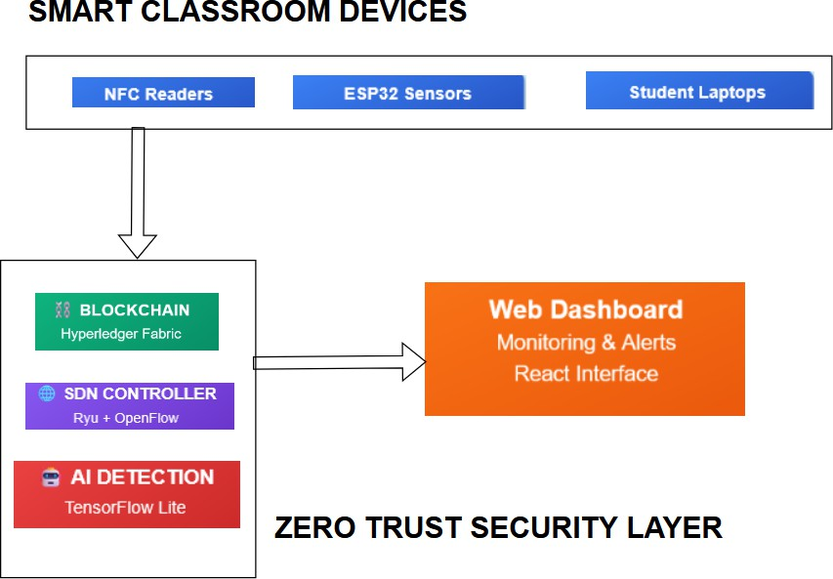
Decentralized Zero Trust Network Access
with AI Security
- System Overview: Personal laptop/edge device hosts Fabric (cryptographic auth), Ryu (policy enforcement), TensorFlow Lite (flow monitoring); offline logs sync.
- Real-World Scenario: Dashboard activation; devices register/authenticate via blockchain; SDN prioritizes apps/ blocks threats; AI alerts on anomalies—secure monitoring in low-budget classrooms.
IT22365132 | C.B Gunasena | 25-26J-024

Slide 28
COMMERCIALIZATION
Investment/Cost & Recovery: ~LKR 70,000 total (labor: 4 students' effort; material: LKR 50,000 for hardware). Recover via LKR 10,000/year subscriptions, ROI in 2 years from 50 adoptions.
Target Market/Customer Profile: Developing edtech market (USD 94B in 2025, growing to 186B by 2035); customers: Budget-conscious schools/ administrators needing secure IoT.
Value Proposition/IPR: Affordable privacy-focused monitoring; open- source core with proprietary modules.

Slide 29
CONCLUSION
We propose a Smart Classroom IoT Network that ensures privacy, security, and adaptability.
The system focuses on both academic support and student well-being.
Our solution is innovative, affordable, and practical for resource-limited educational environments.

Slide 30
THANK YOU

