Slide 1
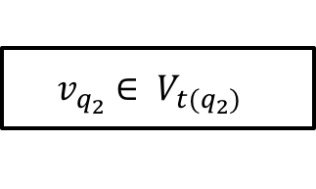
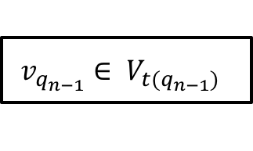
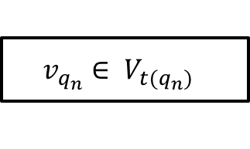
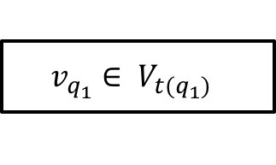
$$v_{q_{1}}∈ V_{t(q_{1})}$$
$$v_{q_{n}}∈ V_{t(q_{n})}$$
Web Service
$$v_{q_{2}}∈ V_{t(q_{2})}$$
$$v_{q_{n−1}}∈ V_{t(q_{n−1})}$$

Slide 2

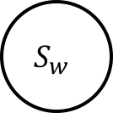
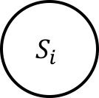
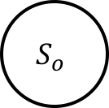




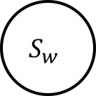
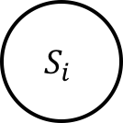
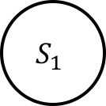
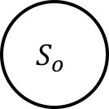
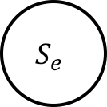




Functionality Model
$$S_{i}$$
$$i$$
$$S_{w}$$
$$[w_{1}]f_{1}$$
$$S_{1}$$
$$[w_{2}]f_{2}$$
$$[w_{n}]f_{n}$$
$$S_{o}$$
$$o$$
$$S_{e}$$
Abstract Functionality Model
$$S_{i}$$
$$i$$
$$S_{w}$$
$$Computation$$
$$S_{o}$$
$$o$$
Updated Functionality Model
$$I, φ$$
Web Service
$$O, ψ$$

Slide 3


$$I, (φ)$$
Web Service
$$O, (ψ)$$

Slide 4
Stage 1: Goal Specification
Goal
Business Process
Composite Service
Stage 2: Service Discovery
Stage 4: Service Execution
Search Query
Service Registry
Process Instance
Stage 5: Service Maintenance
and Monitoring
Service Candidates
Classes
Stage 3: Service Selection

