Slide 1
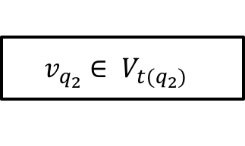
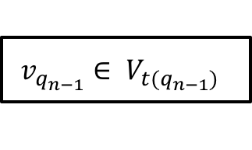
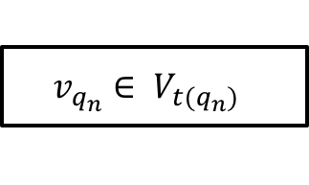
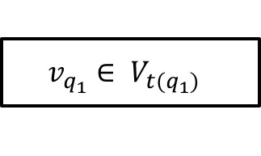
$$v_{q_{1}}∈ V_{t(q_{1})}$$
$$v_{q_{n}}∈ V_{t(q_{n})}$$
Web Service
$$v_{q_{2}}∈ V_{t(q_{2})}$$
$$v_{q_{n−1}}∈ V_{t(q_{n−1})}$$

Slide 2

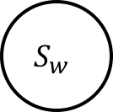
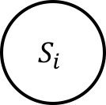
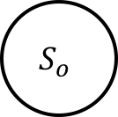




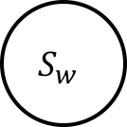
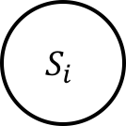
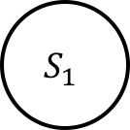
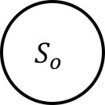
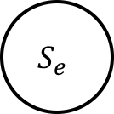




Functionality Model
$$S_{i}$$
$$i$$
$$S_{w}$$
$$[w_{1}]f_{1}$$
$$S_{1}$$
$$[w_{2}]f_{2}$$
$$[w_{n}]f_{n}$$
$$S_{o}$$
$$o$$
$$S_{e}$$
Abstract Functionality Model
$$S_{i}$$
$$i$$
$$S_{w}$$
$$Computation$$
$$S_{o}$$
$$o$$
Updated Functionality Model
$$I, φ$$
Web Service
$$O, ψ$$

Slide 3


$$I, (φ)$$
Web Service
$$O, (ψ)$$

Slide 4
Stage 1: Service Request
Goal
Business Process
Composite Service
Stage 2: Service Discovery
Stage 4: Service Execution
Search Query
Service Registry
Process Instance
Stage 5: Service Maintenance
and Monitoring
Service Candidates
Classes
Stage 3: Service Selection

Slide 5
Web Service Composition
Web service composition (WSC) : a composition of web services to meet a more complex task.
Hotel Reservation
ConferenceCity
Input:
TravelDepartureDate
TravelReturnDate
HomeCity
ConferenceCity
ArrivalDate
HotelReservation
Flight Information
Output:
BusTicket,
FlightTicket, HotelReservation
StreetMap
Bus Service
Generate Map
Fig.1 An example of traveling agency service
Notes:
Now why we need service composition ?
Since one atomic web service could not satisfy or fully satisfy users' complex requirements, web services are composed together to meet more sophisticated meet a more complex requirement.
This slide shows a popular web service composition example from travel domain, In this scenario, the agency provide services of booking flights, accommodation and bus for users.
The inputs are gathered from customers, and the outputs are expected to be returned.
We begin by executing the FlightBooking Service and GenerateMap Service, the FilightInformation serevice books the flights and determines the arrival date. Then, we use the arrival date together with the other given data, we can book the hotel and bus. Together, these three services produce all required outputs.

Slide 6
Functional Properties of WSC
Valid functionalities
Satisfaction on the inputs of all involved services
Required outputs is a subset of output of all involved services
Semantic matchmaking quality
How perfect does the provided inputs match the required outputs
Input:
ConferenceCity
$I:$ $MappedLocation$
Generate Map
$$O:\text{StreetMap}$$
Output:
StreetMap
$$Instance−of \left(MappedLocation, Location\right),Instance−of \left(ConferenceCity, City\right) and City ⊑Location$$
Fig.2 An example of one component service from traveling agency service
Notes:
From the previous example, two features are addressed in its functional properties.
One is the Valid functionalities, another is Semantic matchmaking quality.
In the first feature, all inputs of involved services must be satisfied for the execution of service composition. Meanwhile, the required outputs of service composition is a a subset of outputs of all involved web services
The second feature is the quality of the matchmaking, it answers how perfect does the provided inputs match the required outputs
One component service from previous example, a generateMap service requires inputs MappedLocation and producing output StreetMap. However, MappedLocation is not provided, only ConferenceCity is provided satisfying the relationship here. We can see that ConferenceCity is less preferable compared to MappedLocation. Therefore, Semantic matchmaking quality between ConferenceCity and MappedLocation is relatively lower. \end{itemize}

Slide 7


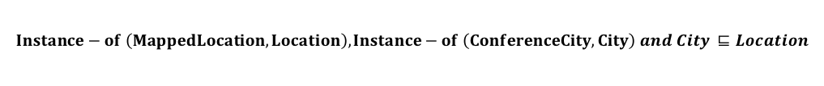
Functional Properties of WSC
Input:
ConferenceCity
$I:$ $MappedLocation$
Generate Map
$$O:\text{StreetMap}$$
Output:
StreetMap
$$Instance−of \left(MappedLocation, Location\right),Instance−of \left(ConferenceCity, City\right) and City ⊑Location$$
Fig.2 An example of one component service from traveling agency service
Notes:
From the previous example, two features are addressed in its functional properties.
One is the Valid functionalities, another is Semantic matchmaking quality.
In the first feature, all inputs of involved services must be satisfied for the execution of service composition. Meanwhile, the required outputs of service composition is a a subset of outputs of all involved web services
The second feature is the quality of the matchmaking, it answers how perfect does the provided inputs match the required outputs
One component service from previous example, a generateMap service requires inputs MappedLocation and producing output StreetMap. However, MappedLocation is not provided, only ConferenceCity is provided satisfying the relationship here. We can see that ConferenceCity is less preferable compared to MappedLocation. Therefore, Semantic matchmaking quality between ConferenceCity and MappedLocation is relatively lower. \end{itemize}

Slide 8


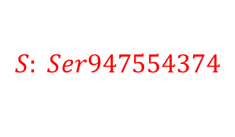







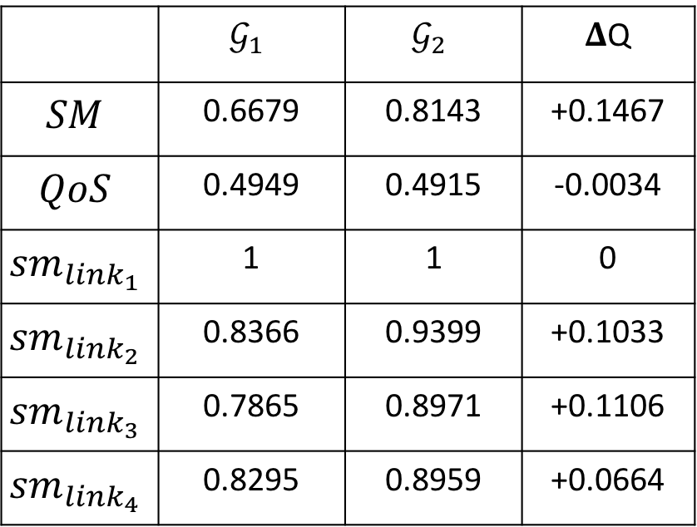





(1) ${WG}_{1}$
Start
(3)
 | $$𝒢_{1}$$ | $$𝒢_{2}$$ | 𝚫Q
$$SM$$ | 0.6679 | 0.8143 | +0.1467
$$QoS$$ | 0.4949 | 0.4915 | -0.0034
$${sm}_{{link}_{1}}$$ | 1 | 1 | 0
$${sm}_{{link}_{2}}$$ | 0.8366 | 0.9399 | +0.1033
$${sm}_{{link}_{3}}$$ | 0.7865 | 0.8971 | +0.1106
$${sm}_{{link}_{4}}$$ | 0.8295 | 0.8959 | +0.0664
link1
serv1779102626
serv1570805927
serv46573851
serv1086418840
serv2124625285
serv669825442
serv254870550
link2
serv185438317
link3
serv1016986607
serv1640238160
link4
End
$$\text{Con}\text{1140910860}$$
(2) ${WG}_{2}$
(4)
Start
link1
$$\text{Con}\text{2113572083}$$
serv1779102626
$$I_{s}:Inst658772240$$
serv1570805927
serv739257675
serv254870550
$$S:End$$
serv1086418840
serv2124625285
serv669825442
$$\text{Con}\text{865430433}$$
$$\text{Con}\text{933224122}$$
link2
serv878122141
$$\text{Con}\text{103314376}$$
$$\text{Con}\text{1277108237}$$
link3
serv1016986607
serv947554374
$$O_{s}:Inst795998200$$
$$S: Ser947554374$$
$\text{Con}\text{2}\text{037585}$750
link4
End
$$O_{s:}:Inst582785907$$
$$S:Ser\text{1640238160}$$

