Slide 1
NLP Final Project Report VAE based sentiment analysis
Chen-Wei Chang

Slide 2
Outline
01
Motivation
02
Related work : VAE
03
Overview
04
Experiment
05
Conclusion

Slide 3

Motivation
我真的很生氣你
你真的很白目
Embedding Space (by BERT)
Latent Space (Arousal、Valence)
他是我的偶像
我很崇拜他

Slide 4
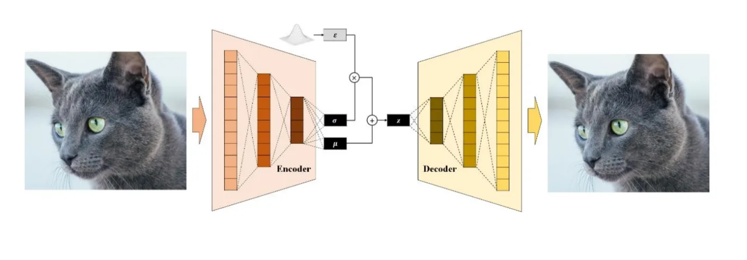
Auto-Encoding Variational Bayes
Related work : VAE
Notes:
Fine-tuning is the process of adjusting the parameters of a pre-trained large language model to a specific task or domain. Although pre-trained language models like GPT possess vast language knowledge, they lack specialization in specific areas. Fine-tuning addresses this limitation by allowing the model to learn from domain-specific data to make it more accurate and effective for targeted applications.

Slide 5
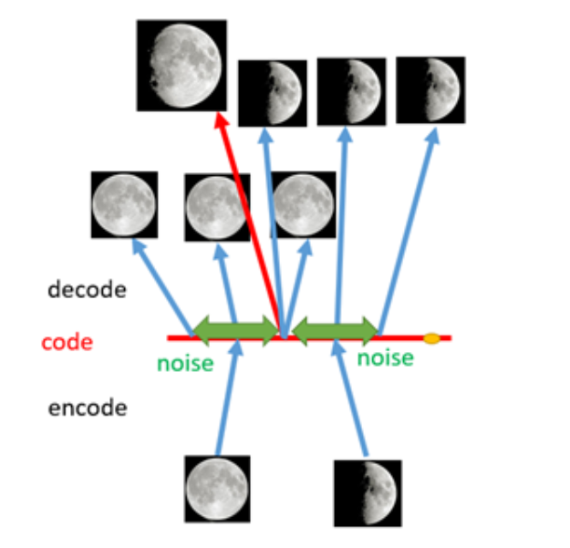
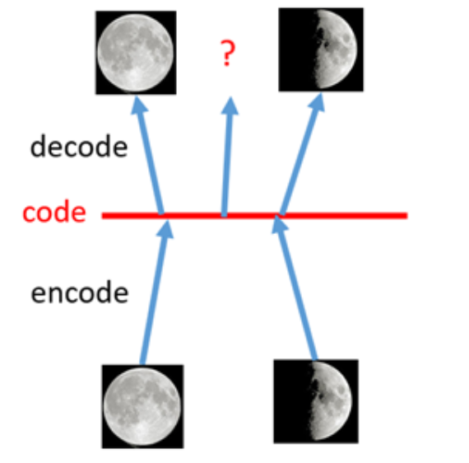
Advantage of VAE
Related work
AutoEncoder
VAE

Slide 6
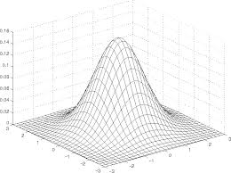










Overall framework
Overview
Input
Ouput
Valence$μ$
Arousal$μ$
Encoder
$$+$$
$$z$$
Decoder
Valence$σ$
Category
$$×$$
Category
A$rousal σ$
Valence$ε$
Embedding
By Bert
A$rousal ε$

Slide 7
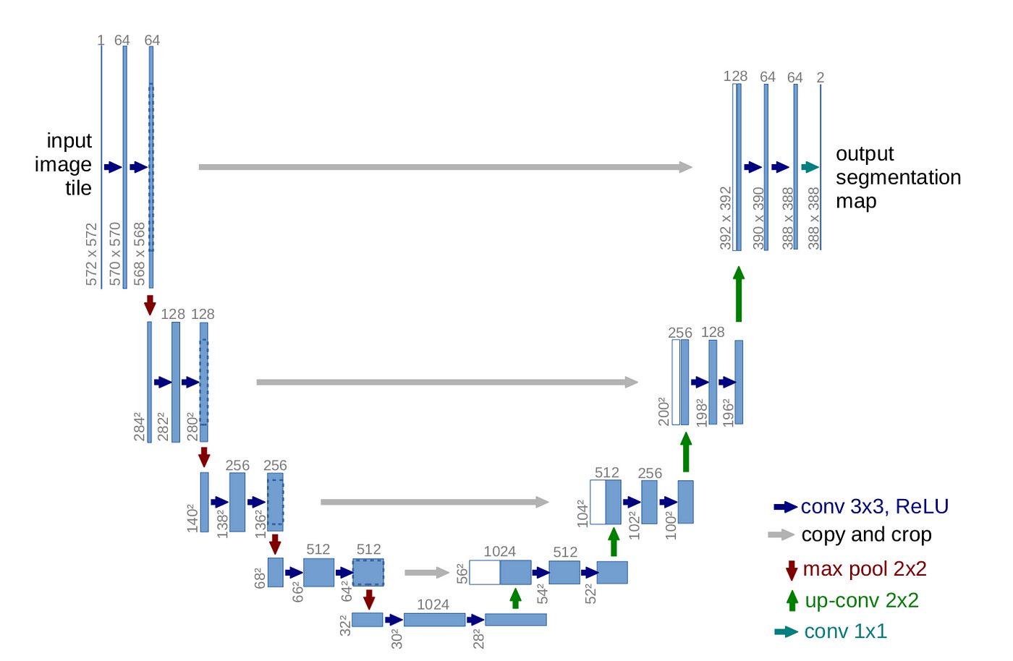
Encoder-Decoder Architecture : Base on U-Net
Overview

Slide 8





Loss
Overview
(1)
(2)
(3)
(4)
(5)

Slide 9
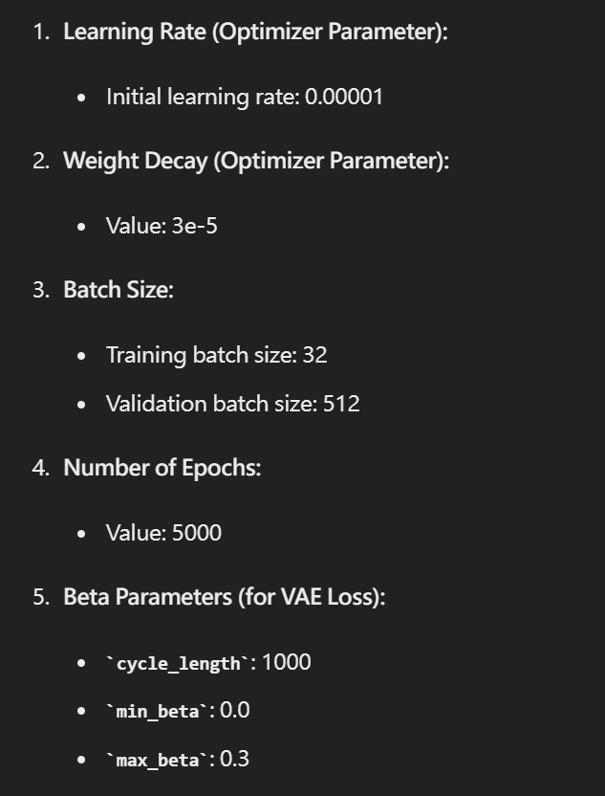
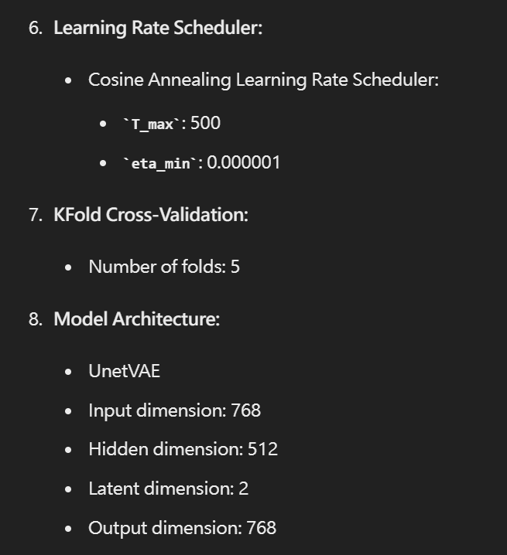
Hyperparameter
Experiment

Slide 10
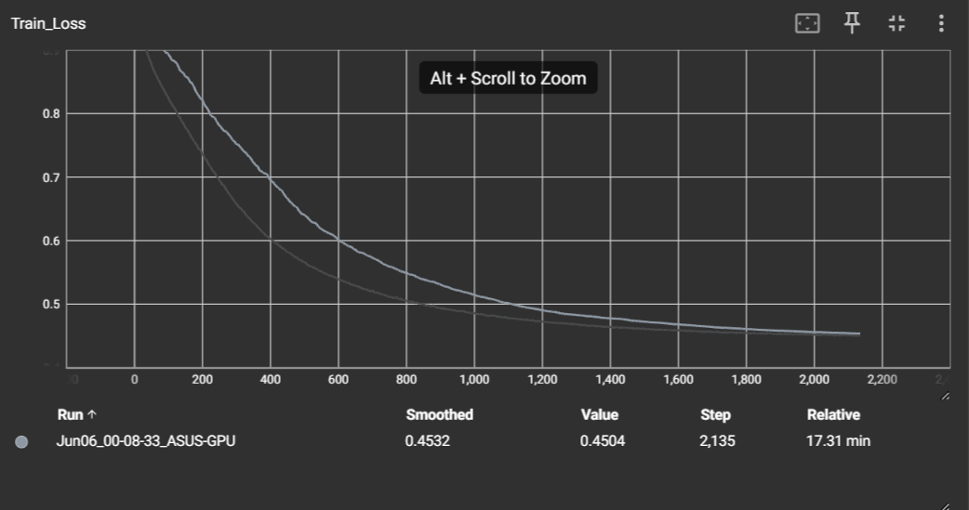
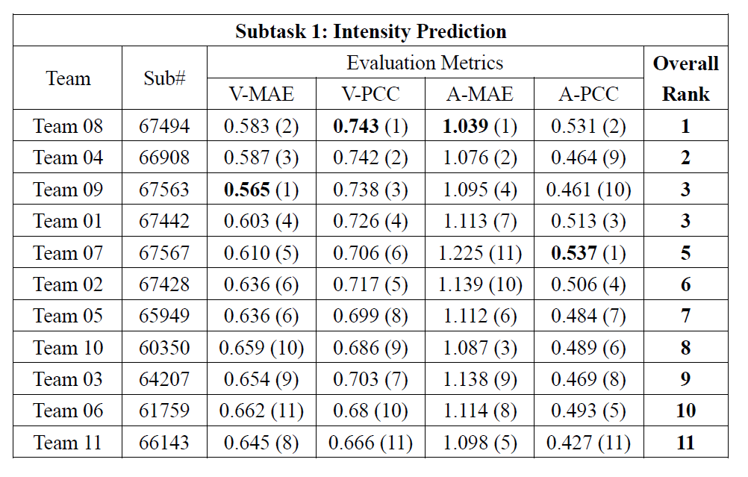
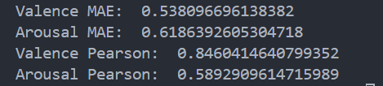
Results analysis
Experiment

Slide 11
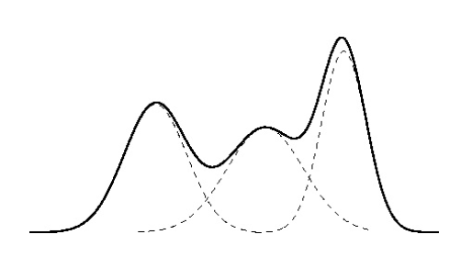
Conclusion
Feature work
Can’t capture important feature from input data : InfoVAE add an additional term based on mutual information between the latent variables and the input data. This encourages the model to learn latent representations that retain more information about the input data.
The simple Gaussian assumption is to easy : Instead of assuming a simple Gaussian distribution for the latent variables . Maybe we can use flexible distributions like Gaussian Mixture Models.
Fine tuning bert.
Notes:
它們分別觀察了in-distribution (ID) 以及out-of-distribution (OOD)，這兩個distribution 分別代表著算術推理以及常識推理的distribution，在常識推理中training dataset是從所有的常識推理的datasets的datasets所組成的，在算數推理中，training dataset只由GSM8K跟AQuA組成，透過研究的結果我們可以發現透過in-distribution這樣的方式來微調較小規模的LLM，能夠達到不輸ChatGPT的效能。而out-of-distribution我們可以看到透過像LoRA這樣的方式進行微調，也可以達到不錯的效果，證明在這種out-of-distribution的微調方式下，微調較小規模的LLM是可行的，不過對於像GSM8K跟AQuA這種比較複雜問題的datasets，微調的效果跟ChatGPT相比，還是有肉眼可見的差異，因此在這種複雜的數學問題上的表現優化，應該是未來一個很重要的研究方向。

