Slide 1
“5G” timeline in 3GPP
3GPP TSG RAN #67
Shanghai, China
Mar 9–12, 2015
Dino Flore
TSG-RAN Chairman
Balazs Bertenyi
TSG-SA Chairman

Slide 2
Outline
Introduction
IMT 2020, “5G” and other useful clarifications
Tentative timeline for RAN
Conclusions
Tentative timeline for RAN and SA

Slide 3
Introduction
This presentation is an initial attempt to draw a timeline for the work on “5G” in 3GPP
The proposed timeline is tentative and may be revisited at later time

Slide 4
IMT 2020, “5G” and other useful clarifications

Slide 5
On IMT 2020
ITU-R finally agreed the workplan for IMT 2020, reported in the Annex of this presentation for your convenience
Like for past generations, it is assumed that 3GPP will submit a candidate technology for IMT 2020
RAN will lead the 3GPP submission process to ITU-R, with ITU-R AH being responsible for the actual submissions and coordination with other TSGs, if needed
So we need to start planning to make sure that we will have a timely submission to IMT 2020

Slide 6
On “5G” (1)
The IMT 2020 effort kicks off a broader discussion to define next generation cellular technology, aka “5G”
What this means in practice is that, when the discussion starts, RAN will *import* the relevant IMT 2020 requirements and then may add its own requirements on top of that

Slide 7
On “5G” (2)
Like for previous generations, RAN should probably not explicitly use the term “5G” during the actual work
“5G” will remain a marketing term that companies will use as they see fit (like it was the case for “4G”)
So - to the disappointment of some - this may be one of the last times we use the term “5G” explicitly ☺

Slide 8
On the new radio for “5G” (1)
From ongoing discussions it is clear that a new radio will be part of “5G”
What is yet not clear is the exact scope and requirements of such new radio, which will have to be agreed by RAN
Depending on the exact scope and requirements of the new radio, a new system/architecture may be needed as well
  Which will then have to be developed in close cooperation with the System groups, as it was done for past generations
  Note: that a new system/architecture may also be needed because of new service requirements established by the System groups. More on this later …

Slide 9
On the new radio for “5G” (2)
So, what name should we use in the future for the new radio (and possibly new system)?
In the last generation, the name of the new radio was *randomly* generated --- remember how “LTE” came to be ☺
This time it may be wise to involve 3GPP Marcomm Officer and companies in a more explicit name selection process
It would be good to settle on the name of the new radio by the time the work starts (and we start documenting things about it)

Slide 10
Initial timeline for “5G” in RAN

Slide 11
Key constraints
IMT 2020 submission deadlines
  Initial technology submission
    Deadline: Jun. 2019 (5D #32)
    Expected input: high-level description of the technology¹
  Detailed specification submission
    Deadline: Oct. 2020 (5D #36)
    Expected input: actual stage-3 specifications
  As clarified by the ITU-R AH, 3GPP should submit the final specs at the 5D meeting in Feb 2020, based on functionally frozen specs by Dec 2019
Start of the “5G” work shall not impact Rel-13 work and schedule
  ¹ Sufficient description to allow third parties to evaluate the technology against IMT 2020 requirements

Slide 12
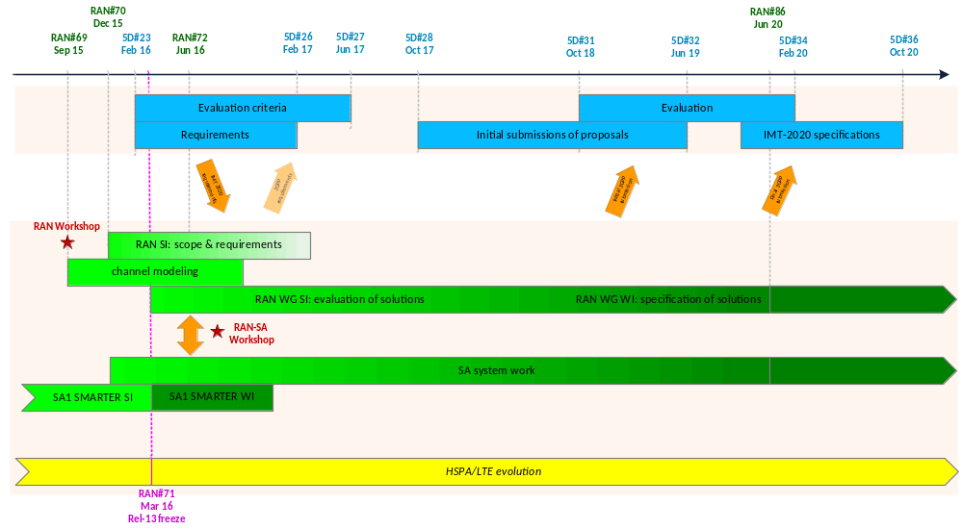
“5G” timeline in 3GPP

Slide 13
On the RAN SI (1)
Discussion should start in RAN to establish the key radio requirements & scope of the work - For such discussion a RAN SI could be opened in Dec. 2015
The bulk of the requirements should be agreed in the first 6 months of the RAN discussion to guide the work in the WGs
  But the RAN SI can remain formally open until the corresponding ITU-R task is closed (for this reason the RAN SI is shown as a fading block in the timeline diagram)
As mentioned earlier, RAN may add its won requirements on top of the relevant IMT 2020 requirements
  While this did not happen in the past, it is also possible for RAN to provide ITU-R with feedback on IMT 2020 requirements or evaluation framework

Slide 14
On the RAN SI (2)
In line with the earlier recommendation the SI should not contain the term “5G” (at least not in the Title, Objectives & TR)
  One possibility would be to talk more generically about “next generation radio technology”
The SI top level objective could be to define usecases and requirements for next generation radio technology
As part of the above goal, the SI should then clearly identify & document:
  Requirements needed for IMT 2020
  Scope / usecases / requirements for the new radio
The above so that later
  => A. is used by the ITU-R AH to drive the IMT 2020 submission to ITU-R (which may include LTE
  => B. is used by the WGs to drive the design of the new radio (in parallel to the LTE evolution)

Slide 15
RAN Workshop
Before the approval of the RAN SI, it would be beneficial to have a workshop where companies can share their views on next generation radio technology
After some discussion in RAN it was decided to have the workshop on Thursday and Friday of the week of RAN#69
  Exceptionally RAN#69 will run from Mon to Wed
  Given the compressed schedule, RAN#69 will not discuss new proposals on core features, beyond existing items that are moving from study to normative phase

Slide 16
Work in the RAN WGs
Discussion could tentatively start in the WGs in Mar. 2016, when Rel-13 is scheduled to freeze
If Rel-13 is delayed, then the start of the discussion in the WGs may also be delayed, unless it is decided to have additional parallel sessions in the WGs

Slide 17
Operation above 6 GHz (1)
From the ongoing discussions, it is clear that the “5G” work will include operation above 6 GHz
Because of that, it is also clear that some channel modeling effort will be required in RAN
Various channel modeling efforts are ongoing in the industry and RAN may want to leverage the work done by some of them
How much needs to be developed by RAN vs. imported from external organizations is TBD and should be discussed further by companies

Slide 18
Operation above 6 GHz (2)
As channel modeling can take time, it would be good that the work is started a bit earlier to have sufficient progress by the time we discuss next generation radio technologies in the WGs
Not to impact the Rel-13 work the task can be done in a ad-hoc / parallel session
The tentative proposal is that a channel modelling task is started in Sep. 2015, with the following understanding:
  In Q4-15 RAN will identify the key bands of interest above 6 GHz
  From Q1-16 the actual channel modelling discussion will start in a new parallel / ad-hoc session of RAN1
    The amount of time per week that will be dedicated to the task is TBD; it was also noted that we should try to avoid overlap with 3D-MIMO discussions

Slide 19
“5G” timeline in RAN (cont’d)
No further assumptions are made at this stage on the exact schedule of the technical work beyond the ITU-R deadlines for initial and specification submission
In particular no assumptions are made on:
  Schedule for the transition from SI phase to WI phase in the WGs
  Exact timing of Rel-14, Rel-15, Rel-16 etc…
  When & in which release there will be the first generation of “5G” specs and what will be in it
Ideally we should converge on the above open issues by the time the work starts in the WGs, so companies have more time to discuss and converge
  By that time, the discussion on the exact content and phasing of the technical work will also benefit from a better understanding on the scope and requirements
Given the above, the technical work is currently represented in the timeline chart as a SI (bright green) turning at some point into a WI (dark green)

Slide 20
Coordination between RAN and SA
As mentioned earlier, a new system/architecture may be needed for “5G” as well and will have to be developed in closed cooperation with the System groups
  So a tentative SA2 container should be planned so that the technical work starts around the same time in RAN WGs and SA2 for the architectural work related to the new radio
In particular, once the discussion moves to the WGs, the definition of the new system/architecture will be based on two potential streams of requirements
  Radio requirements established by RAN
  Service/System requirements established by SA1/SA2
    This discussion has already started in SA1 with the SMARTER SI
To establish a clear worksplit between WGs on system/architecture aspects we could have a joint workshop between RAN and SA (or the relevant WGs) in H2 2016
  In any case it is anticipated that SA2 will have a critical role in reconciling requirements from #1 and #2 and in making sure that there will be a coherent and consistent architecture/system

Slide 21
System aspects (SA)
Handling of ‘5G’ related work on system aspects is subject to the regular 3GPP procedures (WI/SI approval, etc…)
SA1 input is invited to the RAN workshop in Sept/2015 to present an overview on their service requirements work
Heads ups for further inter-TSG coordination
  Tentatively plan a container in SA2 from H2-16 for the possible architecture work related to the new radio
  Tentatively plan a RAN-SA workshop in H2-16 on the architecture evolution when both radio and service/system requirements will be available

Slide 22
Conclusions
The document presents a tentative 3GPP timeline for the work on “5G”
At this stage, the proposal is more defined regarding when & how to start the work in RAN and the IMT 2020 submission deadlines …
…But it makes no assumptions on what will happen in between, as more discussion and convergence is needed among companies on that
In the short term (2015) the proposed timeline will lead to the following events:
  Sep. 2015, RAN workshop
  Sep. 2015, approval of SI on channel modeling*
    With work starting in RAN1 only from Q1-16
  Dec. 2015, approval of RAN SI on scope & requirements*
* Subject to the regular approval process

Slide 23
ANNEX

Slide 24
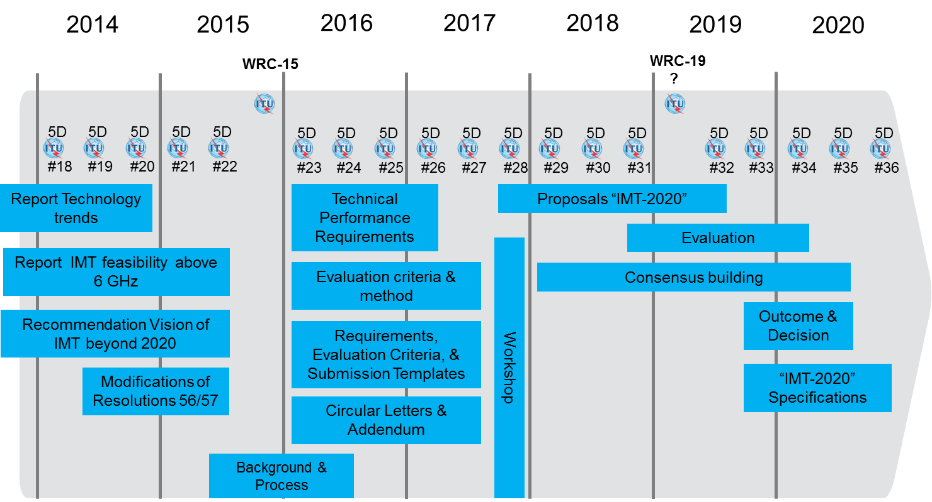
Workplan for IMT-2020

