Slide 1



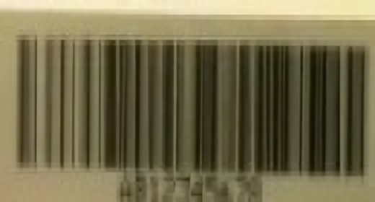

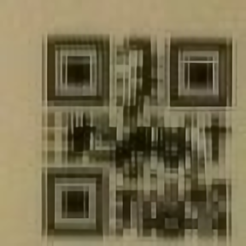
Works | Inputs | Outputs | Note
SwinIR |  |  | ICCV 2023 Sử dụng kiến trúc Transformer Cơ chế tập trung

Slide 2

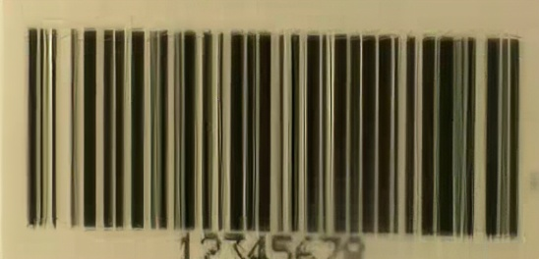

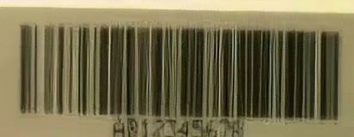

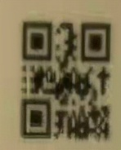
Works | Inputs | Outputs | Note
ESRGAN |  |  | - ECCV2018 Workshops - Enhanced SRGAN. Champion PIRM Challenge on Perceptual Super-Resolution. - 15th European Conference on Computer Vision, September 8 – 14, 2018

Slide 3
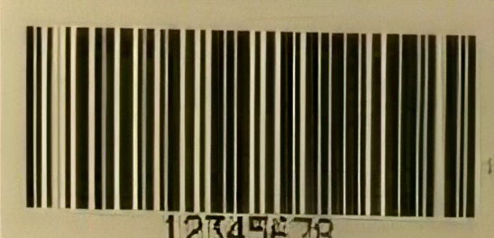
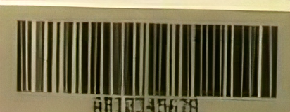
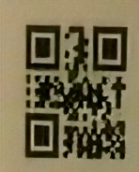
Works | Inputs | Outputs | Note
RealSR |  |  | Real-World Super-Resolution via Kernel Estimation and Noise Injection (Xiaozhong Ji, Yun Cao, Ying Tai, Chengjie Wang, Jilin Li, and Feiyue Huang) The winner of CVPR NTIRE 2020 Challenge on Real-World Super-Resolution in both tracks. Real-World SuperResolution via Kernel Estimation and Noise Injection

Slide 4

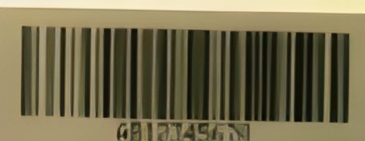
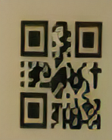
Works | Inputs | Outputs | Note
BSRGAN |  |  | Designing a Practical Degradation Model for Deep Blind Image Super-Resolution (ICCV, 2021) (PyTorch) - We released the training code! (Kai Zhang, Jingyun Liang, Luc Van Gool, Radu Timofte - Computer Vision Lab, ETH Zurich, Switzerland)

Slide 5
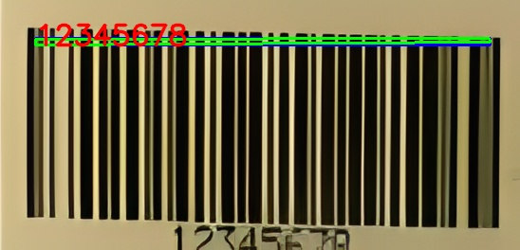
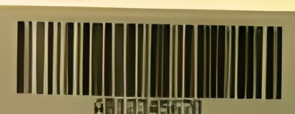
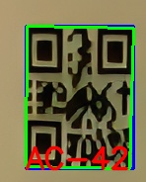
Works | Inputs | Outputs | Note
REAL-ESRGAN |  |  | - Năm 2021

