Slide 1
Readme – motion correction
registration_ver4
Edit by Wun-Ci Chen, Kai-Chun Jhan
2024/06/21

Slide 2
1. System requirements
Our environment
Windows 10
Matlab R2021b
CPU 11th Gen Intel Core
This code has been tested on our environment and Matlab R2020b.
No non-standard software required.

Slide 3
2. Installation guide
Please refer to the following URL for MATLAB installation instructions.
https://www.mathworks.com/help/install/install-products.html
Typically, installing MATLAB on a "normal" desktop computer takes around 30 minutes to 1 hour.
Typically, installing our code takes less than one minute.

Slide 4
3. Demo
Perform motion correction using auxiliary corrected data (denoised, cropped, etc.), then apply the parameters back to the original data.
Running the program with demo data on a normal computer should complete within five minutes.

Slide 5
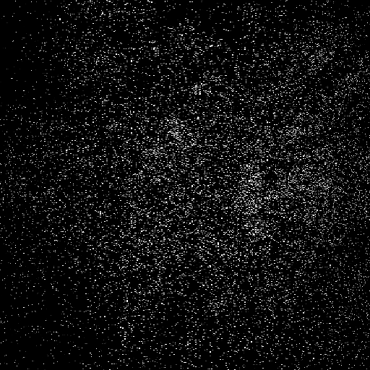
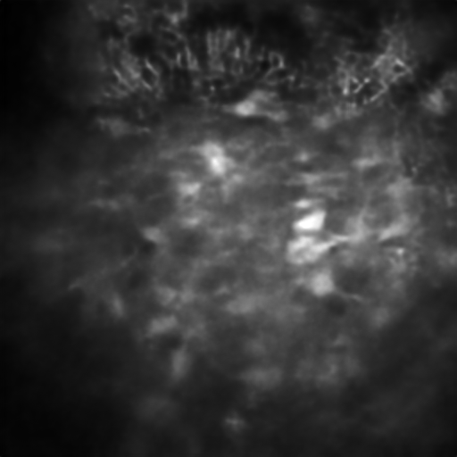
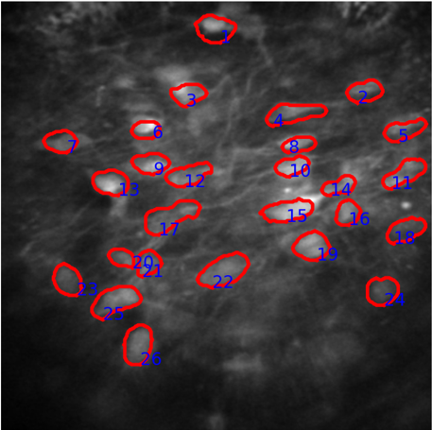


3. Demo
Denoised data
Motion correction
transform matrix
Functional raw data
1
0
0
DeepCAD-RT
y
0
1
0
t
$$t_{x}$$
$$t_{y}$$
1
x
Apply
expected output
After motion correction:
U-Net cell segmentation
We use the DeepCAD-RT algorithm to obtain denoised images.
https://github.com/cabooster/DeepCAD-RT

Slide 6
4. Instructions for use

Slide 7


Folder organization
Run (user defined)
img
ABCDE (user defined)
img_auxiliary
img_raw
singletrial_auxiliary
singletrial_raw
aligntrial_auxiliary
aligntrial_raw
img_trial

Slide 8
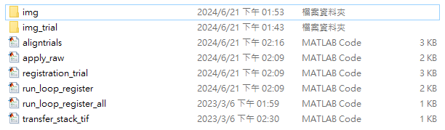
Example
Run (user defined)
Store all the code and create two folders named "img" and "img_trial".

Slide 9

Example
img
Under the newly created "img" folder, create folders named after each data ID
(note: naming order may vary).

Slide 10

Example
ABCDE (user defined)
Inside each group's folder, create 2 folders as shown in the attached image.
In the "img_raw" folder, place raw data for this group (multiple channels can be placed at once).
In the "img_auxiliary" folder, place auxiliary corrected data for this group.
Data format must be in 3D stack (x-y-t).
* Multiple channels must be acquired simultaneously with identical displacements in time.

Slide 11
img_trial
Go back to the top-level "img_trial" folder created earlier, and place the first registered TIFF image (or any cropped image that aids in mutual alignment of each group) for each registered group inside.
Note: The TIFF files placed must be named the same as the folders in the third level (i.e., the names of each group's folder).

Slide 12
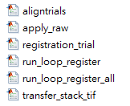
Program description
Cross-correction between different groups
Single-group registration

Slide 13
Folder arrangement for all
Folder structure "run" (users can change the name):
Place all program files ("p files") here.
run/img
Place all subfolders containing images to be processed under "img".
run/img/ABCDE/img_raw(or img_auxiliary)
Organize images for processing under either "img_raw" or "img_auxiliary ".
run/img/ABCDE/singletrial_raw(or singletrial_auxiliary)
Results from processing a single group will correspondingly be stored here.
run/img/ABCDE/aligntrial_raw(or aligntrial_auxiliary)
Final aligned results from all groups will be stored here.
run/img_trial
Copy the first TIFF file (or cropped image) from each registered group here, for alignment purposes.

Slide 14
Execution method and workflow
The parameter for executing `run_loop_register_all`:
True: Adjust image contrast before applying registration parameters.
False: Apply motion correction without adjusting image contrast.
run_loop_register_all(false):
Execute this function to perform registration for each single group.
This will generate registration results in each group's "singletrial" folder.
aligntrials:
Run this step to align all groups.
It aligns all groups based on the first trial's registration results.
registration_trial:
Execute this function in MATLAB. MATLAB will prompt for which trial to adjust ("Which trial?").
Input a number equal to or greater than 2 to specify which trial to adjust.
The first trial in alphabetical order serves as the baseline for alignment (1).
Subsequent trials are numbered sequentially starting from 2.

