Slide 1
E-Books-Classify-System
From Muse-Master
Presenter:杨光 曾仲

Slide 2
Contents
1
Project Proposal
2
Kick Off
3
Software Requirement Specification
4
Software Design Specification
www.themegallery.com
Company Logo

Slide 3
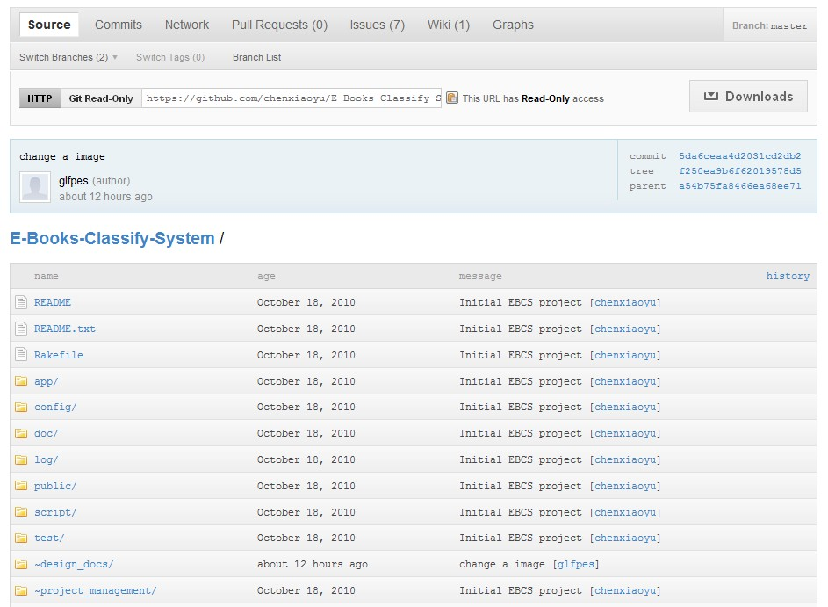
Part1.Project Proposal:
Project Name
项目名:独善其身，简称 EBCS（ E-Books-Classify-System ），目前整个组的工作完成如下：
www.themegallery.com
Company Logo

Slide 4
Part1.Project Proposal: Basic Functional Presentation
我们的项目在3种状态下有不同的功能
1.用户未联网，可以手动管理自己的本地资源，给自己本地书籍分类管理。
2.用户联网，但未登陆，可以根据书名等关键词搜索服务器上的文档，并可以下载和在线阅读。
3.用户联网，登陆，可以搜索其他用户，添加好友，并可以下载或阅读好友public权限的书。
www.themegallery.com
Company Logo

Slide 5
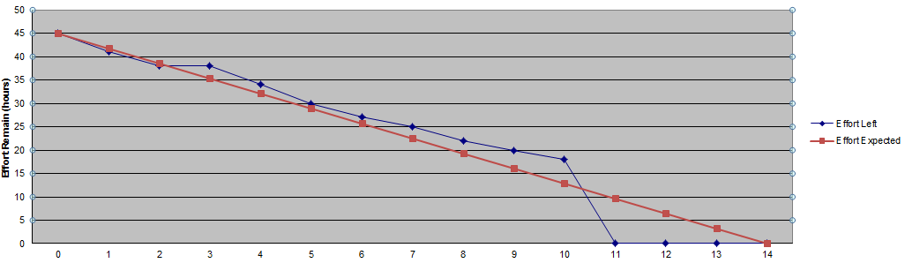
Part1.Project Proposal:
Developing Status Of Now
项目
 |  |  |  | Sprint 1. Make a simple post only blog
 |  |  |  |  |  |  |  |  |  |  | days in sprint / effort left
Story ID | Issue ID | Status | Assignee | Story/task | 0 | 1 | 2 | 3 | 4 | 5 | 6 | 7 | 8 | 9 | 10 | 11 | 12 | 13 | 14
 |  |  |  | Effort Experted (hours) | 45 | 42 | 39 | 35 | 32 | 29 | 26 | 23 | 19 | 16 | 13 | 9.6 | 6 | 3 | 0
 |  |  |  | Effort Left (hours) | 45 | 41 | 38 | 38 | 34 | 30 | 27 | 25 | 22 | 20 | 18 | 0 | 0 | 0 | 0
1 |  |  |  | GUI Implementation
 | SSB-1 | Done | Yang, Li | GUI Framework architecture | 45 | 41 | 38 | 38 | 34 | 30 | 27 | 25 | 22 | 20 | 18 | 0 | 0 | 0 | 0
 | SSB-2 | Pending | Zeng, Wu | GUI Panel Design
2 |  |  |  | Create foreground application
 | SSB-4 | Pending | Yang Zeng | Lists implementation | 0
 | SSB-5 | Pending | Li ,Wu | Check and debug Lists
3 |  |  |  | Project Review
 | SSB-6 | Pending | Chen | Documents for Meeting on Thursday night
 | SSB-7 | Pending | Hu | Plan documents for next step
4
www.themegallery.com
Company Logo

Slide 6
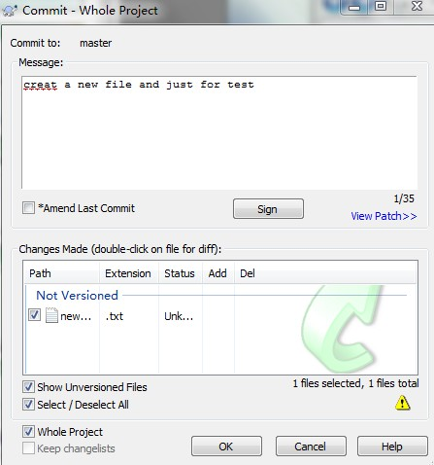
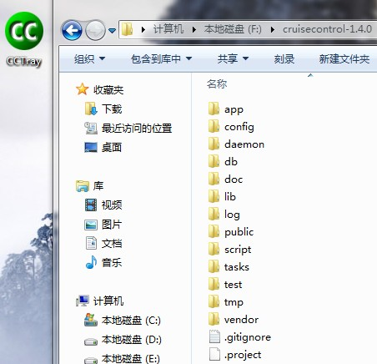
Part2.Project Kick Off
经过整个组艰辛的奋斗，终于将项目配置环境设置好
cctray和cruisecontrol
上传工具TortoiseGit
www.themegallery.com
Company Logo

Slide 7
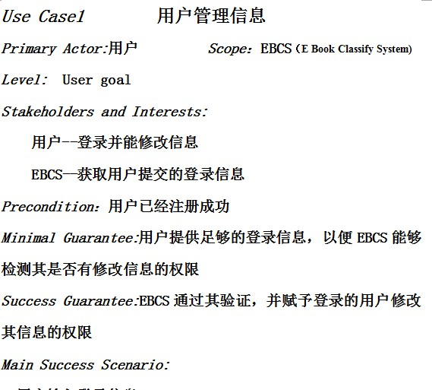
Part3.SRS I -- USE CASE
One Usecase
www.themegallery.com
Company Logo

Slide 8
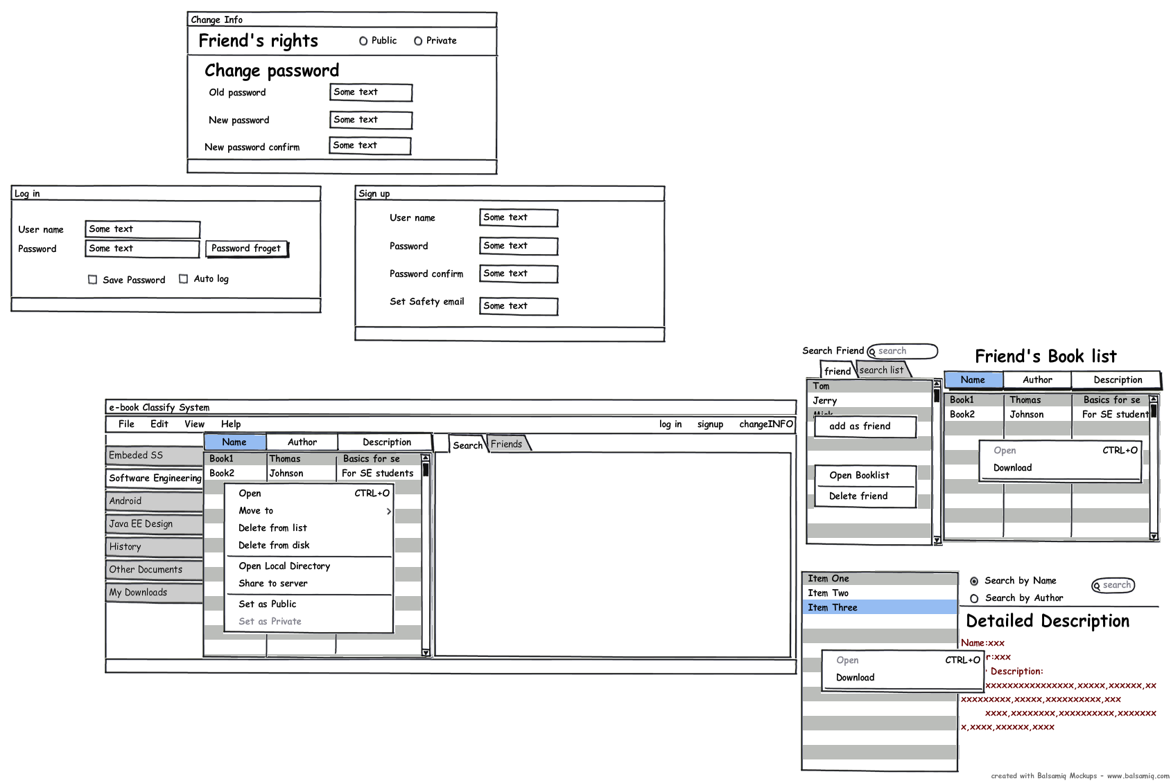
Part3.
SRS II -- UIPrototype
uiprototype：One graph
www.themegallery.com
Company Logo

Slide 9
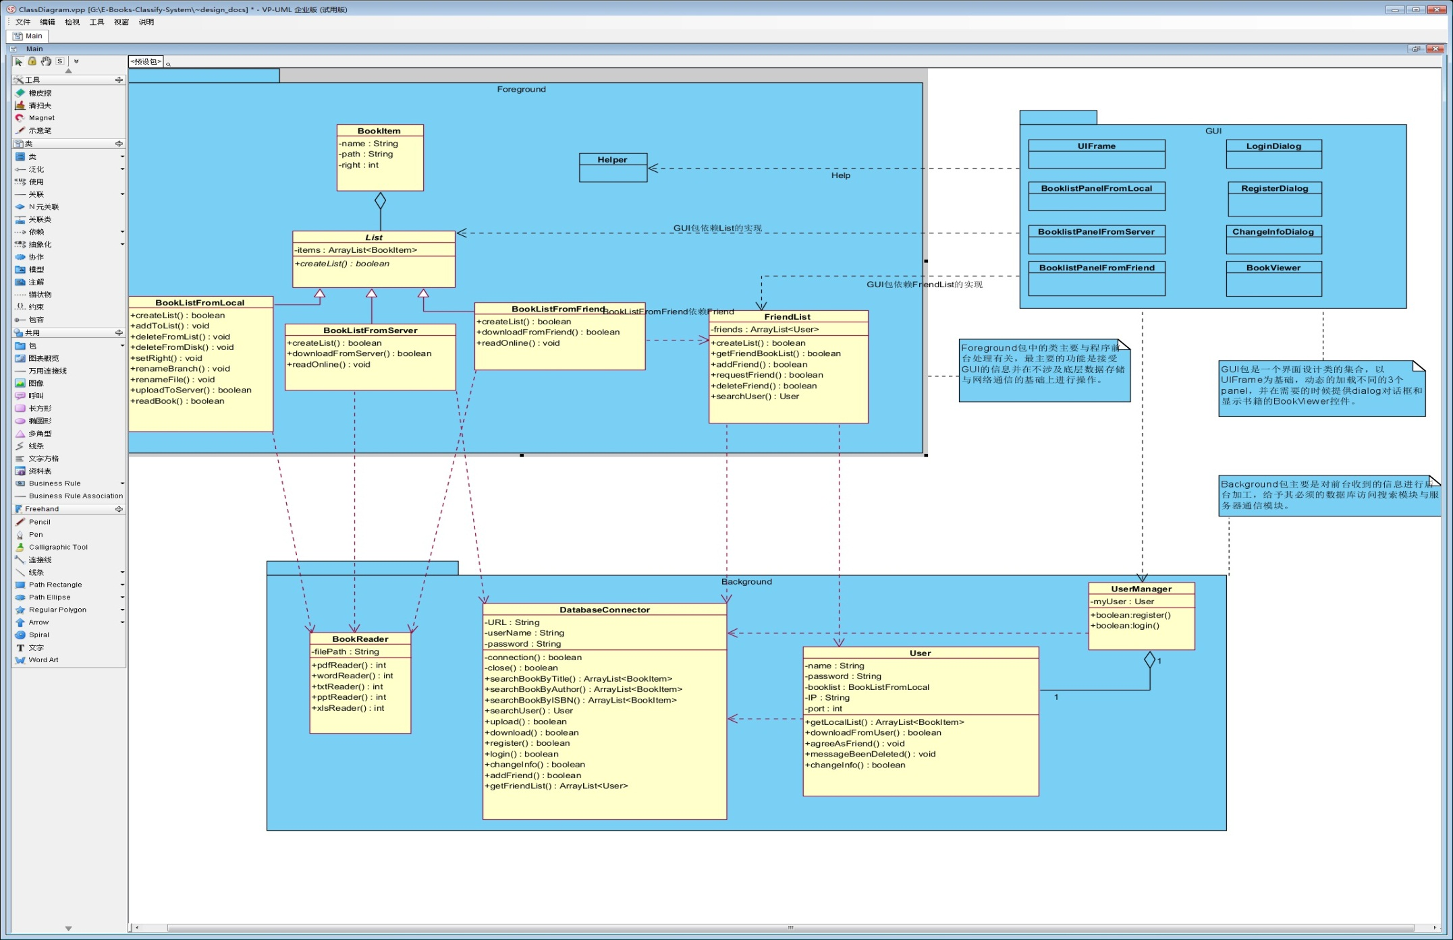
Part4.SDS I -- Class Diagram
www.themegallery.com
Company Logo

Slide 10
Q&A
From Muse-Master

Slide 11
Thank You !
From Muse-Master

