Slide 1
计算数学基础
第1章
沈复民
fumin.shen@gmail.com
电子科技大学 计算机科学与工程学院

Slide 2
Chapter 1 Eigenvalues, Eigenvectors, and Similarity
1.0 Introduction
1.1 The eigenvalues-eigenvector equation
1.2 The characteristic polynomial and algebraic multiplicity
1.3 Similarity
1.4 Left and right eigenvectors and geometric multiplicity

Slide 3
1.0 Introduction

Slide 4
In the initial section of each chapter, we motivate some key issues discussed in the chapter with examples of how they arise, either conceptually or in applications.

Slide 5
1.0 Introduction

Slide 6
1.0.1 Change of basis and similarity
If B is a given basis of a vector space V, if T is a given linear transformation on V , and if A = _{B} [ T ] _{B} is the B basis representation of T , the set of all possible basis representations of T is
{ _{B} ₁ [ I ] _{B} _{B} [ T ] _{B} _{B} [ I ] _{B} ₁ : B ₁ is a basis of V }
= { S ⁻ ¹ A S : S ∈ M_{n} (F) is invertible }
This is just the set of all matrices that are similar to the given matrix A .
Similar but not identical matrices are therefore just different basis representations of a single linear transformation .

Slide 7
1.0.1 Change of basis and similarity
One would expect similar matrices to share many important properties — at least, those properties that are intrinsic to the underlying linear transformation — and this is an important theme in linear algebra.

Slide 8
1.0.1 Change of basis and similarity
It is often useful to step back from a question about a given matrix to a question about some intrinsic property of the linear transformation of which the matrix is only one of many possible representations.

Slide 9
1.0.1 Change of basis and similarity
Similarity
Key Concept

Slide 10
1.0.2 Constrained extrema and eigenvalues
Nonzero vectors x such that Ax is a scalar multiple of x play a major role in analyzing the structure of a matrix or linear transformation.

Slide 11
1.0.2 Constrained extrema and eigenvalues
Eigenvector & Eigenvalue
Key Concept

Slide 12
1. 1 The eigenvalue-eigenvector equation
1.1.1 Notation
A matrix A ∈ M_{n} can be thought of as a linear transformation from C^{n} into C^{n}, namely,
A : x → Ax (1.1.1)
But it is also useful to think of it as an array of numbers.
The interplay between these two concepts of A, and what the array of numbers tells us about the linear transformation, is a central theme of matrix analysis and a key to applications.

Slide 13
1. 1 The eigenvalue-eigenvector equation
1.1.1 Notation
A fundamental concept in matrix analysis is the set of eigenvalues of a square complex matrix.

Slide 14
1. 1 The eigenvalue-eigenvector equation
Definition 1.1.2
Let A ∈ M_{n} . If a scalar λ and a nonzero vector x satisfy the equation
Ax = λx , x ∈ C^{n} , x ≠ 0 , λ ∈ C (1.1.3)
then λ is called an eigenvalue of A and x is called an eigenvector of A associated with λ . The pair λ , x is an eigenpair for A .
The scalar λ and the vector x in the preceding definition occur inextricably as a pair. It is a key element of the definition that an eigenvector can never be the zero vector .

Slide 15
1. 1 The eigenvalue-eigenvector equation
Definition 1.1.4
The spectrum of A∈ M_{n} is the set of all λ ∈ C that are eigenvalues of A ; we denote this set by σ (A) .

Slide 16
1. 1 The eigenvalue-eigenvector equation
Even if they had no other importance, eigenvalues and eigenvectors would be interesting algebraically: according to (1.1.3) , the eigenvectors are just those nonzero vectors such that multiplication by the matrix A is the same as multiplication by the scalar λ .

Slide 17
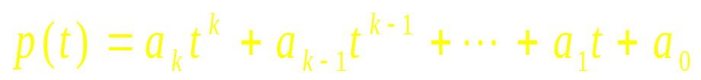
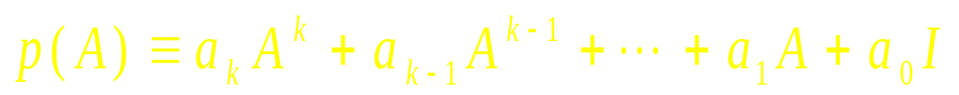
1. 1 The eigenvalue-eigenvector equation
a_{k} ≠ 0

Slide 18

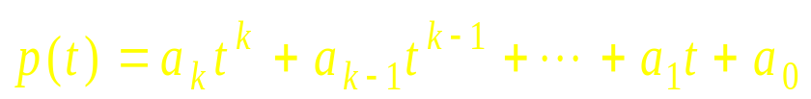
1. 1 The eigenvalue-eigenvector equation
The fundamental theorem of algebra ( Appendix C ) A polynomial of degree n ≥ 1 with complex coefficients has, counting multiplicities, exactly n roots among the complex numbers.

Slide 19


1. 1 The eigenvalue-eigenvector equation

Slide 20
1. 1 The eigenvalue-eigenvector equation
The eigenvalues of p(A) are linked to the eigenvalues of A in a simple way .

Slide 21
1. 1 The eigenvalue-eigenvector equation
Theorem 1.1.6
Let p(t) be a given polynomial of degree k . If λ , x is is an eigenvalue-eigenvector pair of A ∈ M_{n} , then p(λ) , x is an eigenvalue-eigenvector pair of p(A). Conversely, if k ≥ 1 and if μ is an eigenvalue of p(A), then there is some eigenvalue λ of A such that μ = p(λ) .

Slide 22
1. 1 The eigenvalue-eigenvector equation
Observation 1.1.7
A matrix A ∈ M_{n} is singular if and only if 0 ∈ σ (A) .

Slide 23
1. 1 The eigenvalue-eigenvector equation
Observation 1.1.8
Let A ∈ M_{n} and λ , μ ∈ C be given . Then λ ∈ σ (A) if and only if λ + μ ∈ σ ( A + μ I ) .

Slide 24
1. 1 The eigenvalue-eigenvector equation
We are now prepared to make a very important observation : every complex matrix has a nonempty spectrum , that is , for each A ∈ M_{n} , there is some scalar λ ∈ C and some nonzero x ∈ C^{n} such that Ax = λx .

Slide 25
1. 1 The eigenvalue-eigenvector equation
Theorem 1.1.9
Let A ∈ M_{n} be given . Then A has an eigenvalue . In fact , for each given nonzero y ∈ C^{n} , there is a polynomial g (t) of degree at most n − 1 such that g (A) y is an eigenvector of A .

Slide 26
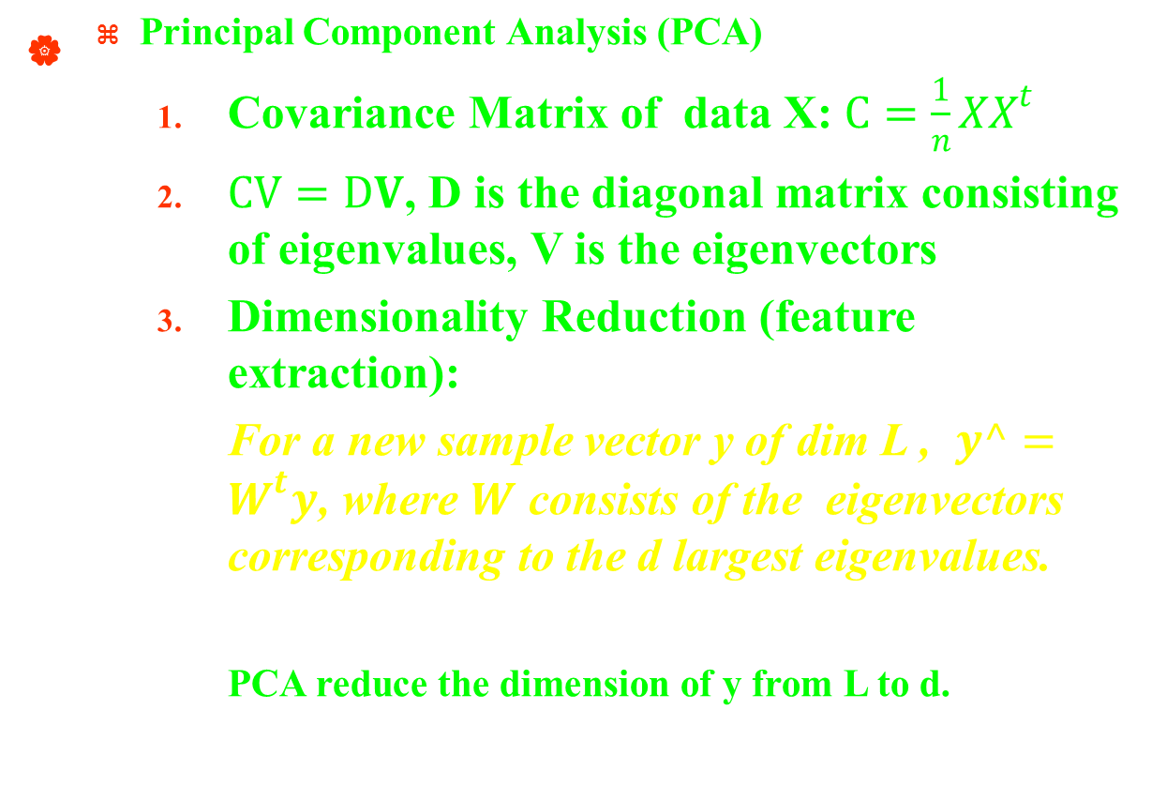
Applications of eigenvalue-eigenvector

Slide 27

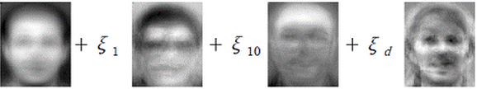
PCA for Face recognition
Input face
Average face
Eigen face 1
…
Eigen face d

Slide 28
1. 2 The characteristic polynomial and algebraic multiplicity
How many eigenvalues does a square complex matrix have?
How may they be characterized in a systematic way?

Slide 29
1. 2 The characteristic polynomial and algebraic multiplicity
Rewrite the eigenvalue-eigenvector equation (1.1.3) as
(λ I − A) x = 0, x ≠ 0 (1.2.1)
Thus, λ ∈σ (A) if and only if λ I − A is singular, that is, if and only if
det (λ I - A) = 0 (1.2.2)

Slide 30
1. 2 The characteristic polynomial and algebraic multiplicity
Definition 1.2.3
Thought of as a formal polynomial in t , the characteristic polynomial of A ∈ M_{n} is
p_{A} ( t ) = det ( t I − A )
We refer to the equation p_{A} ( t ) = 0 as the characteristic equation of A .

Slide 31
1. 2 The characteristic polynomial and algebraic multiplicity
Observation 1.2.4
The characteristic polynomial of each A = [ a_{ij} ]∈ M_{n} has degree n and p_{A} ( t ) = t ^{n} − ( trA ) t ^{n−1} + … + (−1) ^{n} det A . Moreover , p_{A} (λ) = 0 if and only if λ ∈σ (A) , so σ (A) contains at most n complex numbers .

Slide 32
1. 2 The characteristic polynomial and algebraic multiplicity
Definition 1.2.5
Let A ∈M_{n} . The multiplicity of an eigenvalue λ of A is its multiplicity as a zero of the characteristic polynomial p_{A} (t) . For clarity , we sometimes refer to the multiplicity of an eigenvalue as its algebraic multiplicity .

Slide 33
1. 2 The characteristic polynomial and algebraic multiplicity
We can now say without qualification that each matrix A ∈ M_{n} has exactly n eigenvalues among the complex numbers ; the trace and determinant of A are the sum and product , respectively, of its eigenvalues . If A is real , some or all of its eigenvalues might not be real .

Slide 34
1. 2 The characteristic polynomial and algebraic multiplicity
We may list the eigenvalues of A ∈ M_{n} as
λ ₁ , λ ₂ , … , λ _{n}
where the ordering is arbitrary and we repeat eigenvalues according to multiplicity. Then we know that
p _{A} ( t ) = ( t − λ ₁ ) ( t − λ ₂ ) … ( t −λ _{n} )

Slide 35
1. 2 The characteristic polynomial and algebraic multiplicity
Since we now know that each n-by-n complex matrix has finitely many eigenvalues , we may make the following definition .

Slide 36
1. 2 The characteristic polynomial and algebraic multiplicity
Definition 1.2.9
Let A ∈M_{n} . The spectral radius of A is ρ (A) = max { |λ| : λ ∈ σ (A) } .

Slide 37
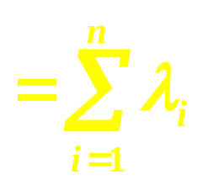
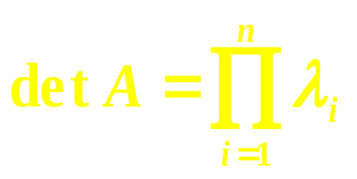
1. 2 The characteristic polynomial and algebraic multiplicity
Sometimes the structure of a matrix make the characteristic polynomial easy to calculate .
tr A

Slide 38
1. 2 The characteristic polynomial and algebraic multiplicity
The next theorem shows that a singular complex matrix can always be shifted slightly to become nonsingular. This important fact often permits us to use continuity arguments to deduce results about singular matrices from properties of nonsingular matrices.

Slide 39
1. 2 The characteristic polynomial and algebraic multiplicity
Theorem 1.2.17
Let A ∈ M_{n} . There is some δ > 0 such that A + ε I is nonsingular whenever ε ∈ C and 0 < |ε | < δ .

Slide 40
1. 2 The characteristic polynomial and algebraic multiplicity
Theorem 1.2.18
Let A ∈ M_{n} and suppose that λ ∈ σ (A) has algebraic multiplicity k . Then rank ( A − λ I ) ≥ n − k with equality for k = 1 .

Slide 41
1.3 Similarity

Slide 42
1. 3 Similarity
We know that a similarity transformation of a matrix in M_{n} corresponds to representing its underlying linear transformation on C^{n} in another basis .
Thus , studying similarity can be thought of as studying properties that are intrinsic to one linear transformation or the properties that are common to all its basis representations .

Slide 43
1.0.1 Change of basis and similarity
If B is a given basis of a vector space V, if T is a given linear transformation on V , and if A = _{B} [ T ] _{B} is the B basis representation of T , the set of all possible basis representations of T is
{ _{B} ₁ [ I ] _{B} _{B} [ T ] _{B} _{B} [ I ] _{B} ₁ : B ₁ is a basis of V }
= { S ⁻ ¹ A S : S ∈ M_{n} (F) is invertible }
This is just the set of all matrices that are similar to the given matrix A .
_{B} ₁ [ T ] _{B} ₁
Similar but not identical matrices are therefore just different basis representations of a single linear transformation .

Slide 44
1. 3 Similarity
Definition 1.3.1
Let A , B ∈ M_{n} be given . We say that B is similar to A if there exists a nonsingular matrix S ∈ M_{n} such that
B = S ⁻ ¹AS
The transformation A → S ⁻ ¹ A S is called a similarity transformation by the similarity matrix S . We say that B is permutation similar to A if there is a permutation matrix P such that B = P ^{T}AP .
The relation “B is similar to A” is sometimes abbreviated B ∼ A .

Slide 45
1. 3 Similarity
Observation 1.3.2
Similarity is an equivalence relation on M_{n} ; that is , similarity is
(a) reflexive: A ∼ A ;
(b) symmetric: B ∼ A implies A ∼ B ; and
(c) transitive: C ∼ B and B ∼ A imply C ∼ A .
Exercise . Verify Observation 1.3.2 .

Slide 46
1. 3 Similarity
Like any equivalence relation , similarity partitions the set M_{n} into disjoint equivalence classes . Each equivalence class is the set of all matrices in M_{n} similar to a given matrix, a representative of the class.
All matrices in an equivalence class are similar , and matrices in different classes are not similar .

Slide 47
1. 3 Similarity
The crucial observation is that matrices in an similarity class share many important properties .
Some of these are mentioned here ; a complete description of the similarity invariants (e.g., Jordan canonical form) is in Chapter 3.

Slide 48
1. 3 Similarity
Theorem 1.3.3
Let A , B ∈ M_{n} . If B is similar to A , then A and B have the same characteristic polynomial .
Proof ?????

Slide 49
1. 3 Similarity
Corollary 1.3.4
Let A , B ∈ M_{n} and suppose that A is similar to B , then
(a) A and B have the same eigenvalues .
(b) If B is a diagonal matrix , its main diagonal entries are the eigenvalues of A .
(c) B = 0 ( a diagonal matrix ) if and only if A = 0 .
(d) B = I ( a diagonal matrix ) if and only if A = I .

Slide 50
1. 3 Similarity
Having the same eigenvalues is a necessary but not sufficient condition for similarity .

Slide 51
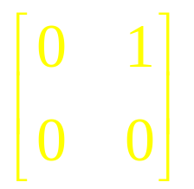

1. 3 Similarity
Example 1.3.5
Consider
and
which have the same eigenvalues but are not similar ( why not ? ) .

Slide 52
Exercise
The determinant, trace, and rank are similarity invariants.
det S ⁻ ¹AS = det A
tr S ⁻ ¹AS = tr A
rank S ⁻ ¹AS = rank A

Slide 53
1. 3 Similarity
Since diagonal matrices are especially simple and have very nice properties , we would like to know which matrices are similar to diagonal matrices .

Slide 54
1. 3 Similarity
Definition 1.3.6
If A ∈ M_{n} is similar to a diagonal matrix , then A is said to be diagonalizable .

Slide 55
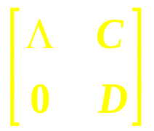
Theorem 1.3.7
Let A ∈ M_{n} be given. Then A is similar to a block matrix of the form
, Λ = diag (λ₁ , … , λ_{k}) , D ∈ M_{n − k} , 1 ≤ k < n (1.3.7.1)
if and only if there are k linearly independent vectors in C^{n} , each of which is an eigenvector of A . The matrix A is diagonalizable if and only if there are n linearly independent vectors , each of which is an eigenvector of A .
If x ⁽¹⁾ , … , x ^{( n )} are linearly independent eigenvectors of A and if S = [ x ⁽¹⁾ , … , x ^{( n )} ] , then S ⁻¹ A S is a diagonal matrix .
If A is similar to a matrix of the form (1.3.7.1) , then the diagonal entries of Λ are eigenvalues of A .
If A is similar to a diagonal matrix Λ , then the diagonal entries of Λ are all of the eigenvalues of A .

Slide 56
1. 3 Similarity
Diagonalizability is assured if all the eigenvalues are distinct. The basis for this fact is the following important lemma about some of the eigenvalues.
Lemma 1.3.8
Let λ ₁ , … , λ_{k} be k ≥ 2 distinct eigenvalues of A ∈ M_{n} ( that is , λ_{i} ≠ λ_{j} if i ≠ j and 1 ≤ i , j ≤ k ) and suppose that x ^{( i )} is an eigenvector associated with λ _{i} for each i = 1 , … , k . Then the vectors x ⁽¹⁾ , … , x ^{( k )} are linearly independent .

Slide 57
1. 3 Similarity
Theorem 1.3.9
If A ∈ M _{n} have n distinct eigenvalues, then A is diagonalizable.
Lemma 1.3.8
Theorem 1.3.7

Slide 58
1. 3 Similarity
Having distinct eigenvalues is sufficient for diagonalizability , but of course , its is not necessary .

Slide 59
1. 3 Similarity
In general , matrices A , B ∈ M_{n} do not commute , but if A and B are both diagonal , they always commute .
The latter observation can be generalized somewhat; the following lemma is helpful in this regard :

Slide 60
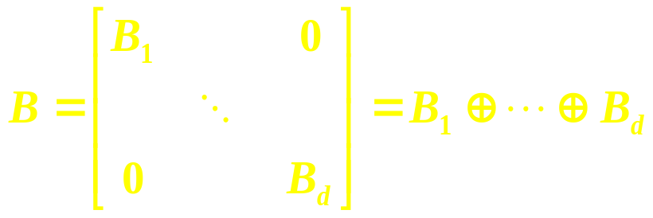
1. 3 Similarity
Lemma 1.3.10
Let B₁ ∈ M_{n1} , … , B_{d} ∈ M_{nd} be given and let B be the direct sum
Then B is diagonalizable if and only if each of B₁ , … , B_{d} is diagonalizable .

Slide 61
1. 3 Similarity
Definition 1.3.11
Two matrices A , B ∈ M_{n} are said to be simultaneously diagonalizable if there is a single nonsingular matrix S ∈ M_{n} such that S ⁻¹ A S and S ⁻¹ B S are both diagonal .

Slide 62
1. 3 Similarity
Theorem 1.3.12
Let A , B ∈ M_{n} be diagonalizable. Then A and B commute if and only if they are simultaneously diagonalizable.

Slide 63
1. 3 Similarity
We want to have a version of Theorem 1.3.12 involving arbitrarily many commuting diagonalizable matrices .
Central to our investigation is the notion of an invariant subspace and the companion notion of a block triangular matrix .

Slide 64
1. 3 Similarity
Definition 1.3.16
A family F ⊆ M_{n} of matrices is a nonempty finite or infinite set of matrices; A commuting family is a family of matrices in which every pair of matrices commutes.
For a given A ∈ M_{n} , a subspace W ⊆ C^{n} is A-invariant if Aw ∈ W for every w ∈ W. A subspace W ⊆ C^{n} is trivial if either W = {0} or W = C^{n} ; otherwise, it is nontrivial.
For a given family F ⊆ M_{n} , a subspace W ⊆ M_{n} is F-invariant if W is A-invariant for each A ∈ F . A given family F ⊆ M_{n} is reducible if some nontrivial subspace of C^{n} is F-invariant; otherwise, F is irreducible.

Slide 65
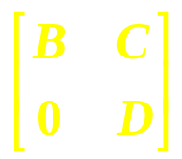
1. 3 Similarity
S ⁻¹ A S = , B ∈ M_{k} , 1 ≤ k ≤ n − 1 (1.3.17)
Observation 1.3.18
Suppose that n ≥ 2. A given A ∈ M_{n} is similar to a block triangular matrix of the form (1.3.17) if and only if some nontrivial subspace of C^{n} is A-invariant. Moreover, if W ⊆ C^{n} is a nonzero A-invariant subspace, then some vector in W is an eigenvector of A.
A given family F ⊆ M_{n} is reducible if and only if there is some k ∈ {2 , … , n − 1} and a nonsingular S ∈ M_{n} such that S ⁻ ¹AS has the form (1.3.17) for every A ∈ F .

Slide 66
1. 3 Similarity
Observation 1.3.18
Invariant Subspace
Block Triangular Matrix

Slide 67
1. 3 Similarity
The following lemma is at the heart of many subsequent results .

Slide 68
1. 3 Similarity
Theorem 1.3.19
Let F ⊂ M_{n} be a commuting family. Then some nonzero vector in C^{n} is an eigenvector of every A ∈ F .

Slide 69
1. 3 Similarity
The next result shows that Theorem 1.3.12 can be extended to arbitrary commuting families of diagonalizable matrices .

Slide 70
1. 3 Similarity
Definition 1.3.20
A family F ⊂ M_{n} is said to be simultaneously diagonalizable if there is a single nonsingular matrix S ∈ M_{n} such that S ⁻¹ A S is diagonal for every A ∈ F .

Slide 71
1. 3 Similarity
Theorem 1.3.21
Let F ⊂ M_{n} be a family of diagonalizable matrices . Then F is a commuting family if and only if it is a simultaneously diagonalizable family . Moreover , for any given A₀ ∈ F and for any given ordering λ₁ , … , λ_{n} of the eigenvalues of A₀ , there is a nonsingular S ∈ M_{n} such that S ⁻ ¹ A₀ S = diag ( λ₁ , … , λ_{n} ) and S ⁻ ¹ B S is diagonal for every B ∈ F .

Slide 72
1. 3 Similarity
Theorem 1.3.21
Let F ⊂ M_{n} be a family of diagonalizable matrices . Then F is a commuting family if and only if it is a simultaneously diagonalizable family .
Theorem 1.3.12 Let A , B ∈ M_{n} be diagonalizable. Then A and B commute if and only if they are simultaneously diagonalizable.

Slide 73
1. 3 Similarity
Remarks
We defer two important issues until Chapter 3:
(1) Given A , B ∈ M_{n} , how can we determine if A is similar to B ? This is a motivation for canonical forms under similarity .
(2) How can we tell if a given matrix A ∈ M_{n} is diagonalizable without knowing its eigenvectors ?

Slide 74
1. 3 Similarity
Although AB and BA need not be the same ( and need not be the same size even when both products are defined ), their eigenvalues are as much the same as possible. Indeed, if A and B are both square, then AB and BA have exactly the same eigenvalues.

Slide 75
1. 3 Similarity
Theorem 1.3.22
Suppose that A ∈ M_{m, n} and B ∈ M_{n, m} with m ≤ n . Then the n eigenvalues of BA are the m eigenvalues of AB together with n − m zeroes ; that is , p_{BA} (t) = t ^{n − m} p_{AB} (t) . If m = n and at least one of A or B is nonsingular , then AB and BA are similar .

Slide 76
1. 3 Similarity
Our final theorem about similarity shows that the only relationship between the eigenvalues and main diagonal entries of a complex matrix is that their respective sums be equal .

Slide 77
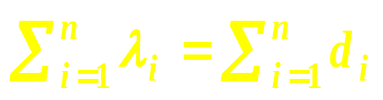
1. 3 Similarity
Theorem 1.3.31 (Mirsky)
Let an integer n ≥ 2 and complex scalars λ₁ , … , λ_{n} and d₁ , … , d_{n} be given . There is an A ∈ M_{n} with eigenvalues λ₁ , … , λ_{n} and main diagonal entries d₁ , … , d_{n} if and only if . If λ₁ , … , λ_{n} and d₁ , … , d_{n} are all real and have the same sums , there is an A ∈ M_{n}(R) with eigenvalues λ₁ , … , λ_{n} and main diagonal entries d₁ , … , d_{n} .

Slide 78
1.4 Left and right eigenvectors and geometric multiplicity

Slide 79
1. 4 Left and right eigenvectors and geometric multiplicity
The eigenvectors of a matrix are important not only for their role in diagonalization but also for their utility in a variety of applications .

Slide 80
1. 4 Left and right eigenvectors and geometric multiplicity
Observation 1.4.1
Let A ∈ M _{n} .
(a) The eigenvalues of A and A ^{T} are the same .
(b) The eigenvalues of A ∗ are the complex conjugates
of the eigenvalues of A .

Slide 81
1. 4 Left and right eigenvectors and geometric multiplicity
Definition 1.4.2
Let A ∈ M_{n} . For a given λ ∈ σ (A) , the set of all vectors x ∈ C^{n} satisfying A x = λ x is called the eigenspace of A associated with the eigenvalue λ .
Every nonzero element of this eigenspace is an eigenvector of A associated with λ .

Slide 82
1. 4 Left and right eigenvectors and geometric multiplicity
Definition 1.4.3
Let A ∈ M_{n} and let λ be an eigenvalue of A . The dimension of the eigenspace of A associated with λ is the geometric multiplicity of λ . The multiplicity of λ as a zero of the characteristic polynomial of A is the algebraic multiplicity of λ .
If the term multiplicity is used without qualification in reference to λ , it means the algebraic multiplicity . We say that λ is simple if its algebraic multiplicity is 1 ; it is semisimple if its algebraic and geometric multiplicities are equal .

Slide 83
1. 4 Left and right eigenvectors and geometric multiplicity
The algebraic multiplicity of an eigenvalue is greater than or equal to its geometric multiplicity.
The geometric multiplicity of an eigenvalue is less than or equal to its algebraic multiplicity.

Slide 84
1. 4 Left and right eigenvectors and geometric multiplicity
Definition 1.4.4
Let A ∈ M_{n} . We say that A is defective if the geometric multiplicity of some eigenvalue of A is strictly less than its algebraic multiplicity .
If the geometric multiplicity of each eigenvalue of A is the same as its algebraic multiplicity , we say that A is nondefective .
If each eigenvalue of A has geometric multiplicity 1 , we say that A is nonderogatory ; otherwise , it is derogatory .

Slide 85
1. 4 Left and right eigenvectors and geometric multiplicity
A matrix is diagonalizable if and only if it is nondefective . It has distinct eigenvalues if and only if it is nonderogatory and nondefective .

Slide 86
1. 4 Left and right eigenvectors and geometric multiplicity
Definition 1.4.6
A nonzero vector y ∈ C^{n} is a left eigenvector of A ∈ M_{n} associated with an eigenvalue λ of A if
y ∗ A = λ y ∗
If necessary for clarity , we refer to the vector x in (1.1.3) as a right eigenvector .
when the context does not require distinction , we continue to call x an eigenvector .

Slide 87
1. 4 Left and right eigenvectors and geometric multiplicity
Theorem 1.4.7
Let A ∈ M_{n} , nonzero vectors x , y ∈ C^{n} , and scalars λ , μ ∈ C be given . Suppose that Ax = λx and y∗A = μ y∗ . If λ ≠ μ , then y∗x = 0 .
The principle of biorthogonality

Slide 88
1. 4 Left and right eigenvectors and geometric multiplicity
The eigenvalues of a matrix are unchanged by similarity ; its eigenvectors transform under similarity in a simple way .

Slide 89
1. 4 Left and right eigenvectors and geometric multiplicity
Theorem 1.4.9
Let A , B ∈ M_{n} and suppose that B = S ⁻ ¹ A S for some nonsingular S .
(a) If x ∈ C^{n} is a right eigenvector of B associated with an eigenvalue
λ , then Sx is a right eigenvector of A associated with λ .
(b) If y ∈ C^{n} is a left eigenvector of B associated with λ , then S ^{− ∗} y is
a left eigenvector of A associated with λ .

Slide 90
Exercises & Problems
Page 45. Exercise 1
Page 45. Exercise 3
Page 47. Exercise 1
Page 48. Problem 5
Page 48. Problem 6
Page 48. Problem 7
Page 55. Problem 1
Page 55. Problem 2
Page 60. Exercise 1
Page 61. Exercise 1
Page 62. Exercise 2
Page 62. Exercise 3
Page 69. Problem 5
Page 70. Problem 9

