Slide 1
计算数学基础
第2章
沈复民
fumin.shen@gmail.com
电子科技大学 计算机科学与工程学院

Slide 2
Chapter 2 Unitary Similarity and Unitary Equivalence
2.0 Introduction
2.1 Unitary matrices and the QR factorization
2.2 Unitary similarity
2.3 Unitary and real orthogonal triangularizations
2.4 Consequences of Schur’s triangularization theorem
2.5 Normal matrices
2.6 Unitary equivalence and the singular value decomposition
2.7 The CS decomposition

Slide 3
1. 3 Similarity
Definition 1.3.1
Let A , B ∈ M_{n} be given . We say that B is similar to A if there exists a nonsingular matrix S ∈ M_{n} such that
B = S ⁻ ¹AS
The transformation A → S ⁻ ¹ A S is called a similarity transformation by the similarity matrix S .
S ⁻ ¹ = S ∗
The relation “B is similar to A” is sometimes abbreviated B ∼ A .

Slide 4
2. 0 Introduction
Similarity via a unitary matrix U , A → U ∗AU, is not only conceptually simpler than general similarity (the conjugate transpose is much easier to compute than the inverse ) , but it also has superior stability properties in numerical computations .

Slide 5
2. 0 Introduction
The transformation A → S ∗AS , in which S is nonsingular but not necessarily unitary, is called ∗congruence; we study it in Chapter 4.
For A ∈ M_{n , m} , the transformation A → UAV, in which U ∈ M_{m} and V ∈ M_{n} are both unitary, is called unitary equivalence.

Slide 6
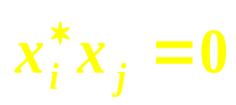
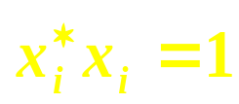
2. 1 Unitary matrices and the QR factorization
Definition 2.1.1
A list of vectors x₁ , … , x_{k} ∈ C^{n} is orthogonal if for all i ≠ j , i , j ∈ {1, … , k}. If, in addition, for all i = 1, … , k (that is, the vectors are normalized), then the list is orthonormal.

Slide 7
2. 1 Unitary matrices and the QR factorization
Theorem 2.1.2
Every orthonormal list of vectors in C^{n} is linearly independent.

Slide 8
2. 1 Unitary matrices and the QR factorization
A linearly independent list need not be orthonormal , of course, but one can apply the Gram-Schmidt orthonormalization procedure (0.6.4) to it and obtain an orthonormal list with the same span .

Slide 9
Definition 2.1.3
U ∗ = U ⁻ ¹
A matrix U ∈ M_{n} (C) is unitary if U ∗ U = I . A matrix U ∈ M_{n} (R) is real orthogonal if U ^{T} U = I .

Slide 10
Definition
A matrix U ∈ M_{n} is said to be unitary if U ∗ U = I . If, in addition, U ∈ M_{n} (R) , U is said to be real orthogonal .
A matrix A ∈ M_{n} is said to be Hermitian if A∗ = A . If, in addition, A ∈ M_{n} (R) , A is said to be symmetric .
A matrix A ∈ M_{n} is said to be normal if A∗A = AA∗ , that is , if A commutes with its Hermitian adjoint .

Slide 11
7. 1 Definitions and properties
A Hermitian matrix A ∈ M_{n} is positive definite if
x∗Ax > 0 for all nonzero x ∈ C^{n} . (7.1.1a)
It is positive semidefinite if
x∗Ax ≥ 0 for all nonzero x ∈ C^{n} . (7.1.1b)
Implicit in these definitions is the fact that if A is Hermitian , then x∗Ax is real for all x ∈ C^{n} ; see (4.1.3) . Conversely , if A ∈ M_{n} and x∗Ax is real for all x ∈ C^{n} , then A is Hermitian , so assuming that A is Hermitian in the preceding definitions , while customary , is actually superfluous ; see (4.1.4) .

Slide 12
7. 2 Characterizations and properties
Theorem 7.2.1
A Hermitian matrix is positive semidefinite if and only if all of its eigenvalues are nonnegative . It is positive definite if and only if all of its eigenvalues are positive .

Slide 13
Chapters 2 , 4 , and 7
Several Classes of Matrices
Chapters 7
Positive (semi)definite matrix
Chapters 2
Chapters 4
Unitary matrix
Hermitian matrix
Normal matrix
Chapters 2

Slide 14
7. 2 Characterizations and properties
The unitary matrices in M_{n} form a remarkable and important set. We list some of the basic equivalent conditions for U to be unitary in (2.1.4).

Slide 15
Theorem 2.1.4
If U ∈ M_{n} , the following are equivalent:
(a) U is unitary . ( U ∗ U = I )
(b) U is nonsingular and U ∗ = U ⁻ ¹ .
(c) U U ∗ = I .
(d) U ∗ is unitary .
(e) The columns of U are orthonormal .
(f) The rows of U are orthonormal .
(g) For all x ∈ C^{n} , || x ||₂ = || Ux ||₂ , that is , x and Ux have
the same Euclidean norm .

Slide 16
2. 1 Unitary matrices and the QR factorization
Definition 2.1.5
A linear transformation T : C^{n} → C^{m} is called a Euclidean isometry if ||x||₂ = ||Tx||₂ for all x ∈ C^{n}. Theorem 2.1.4 says that a square complex matrix U ∈ M_{n} is a Euclidean isometry (via U : x → Ux) if and only if it is unitary .

Slide 17
2. 1 Unitary matrices and the QR factorization
Observation 2.1.6
If U, V ∈ M_{n} are unitary (respectively, real orthogonal), then the UV is also unitary (respectively, real orthogonal).
Theorem 2.1.4 (b)

Slide 18
2. 1 Unitary matrices and the QR factorization
Observation 2.1.7
The set of unitary (respectively, real orthogonal) matrices in M_{n} forms a group .
This group is generally referred to as the n-by-n unitary (respectively, real orthogonal) group, a subgroup of GL (n , C) (0.5).

Slide 19
0.5 Nonsingularity
The nonsingular matrices in M_{n} (F) form a group , the general linear group , often denoted by
GL ( n , F )
F = C
GL ( n , C )

Slide 20
2. 1 Unitary matrices and the QR factorization
Notions of “convergence” and “limit” of a sequence of matrices are presented precisely in Chapter 5 .

Slide 21
2. 1 Unitary matrices and the QR factorization
Lemma 2.1.8 (The Selection Principle for Unitary Matrices)
Let U₁ , U₂ , …∈ M_{n} be a given infinite sequence of unitary matrices. There exists an infinite subsequence U_{k1} , U_{k2} , … , 1 ≤ k₁ < k₂ < … , such that all of the entries of U_{ki} converge ( as sequences of complex numbers ) to the entries of a unitary matrix as i → ∞ .

Slide 22
2. 1 Unitary matrices and the QR factorization
A unitary matrix U has the property that U ⁻ ¹ equals U ∗ . One way to generalize the notion of a unitary matrix is to require that U ⁻ ¹ be similar to U ∗ .
The set of such matrices is easily characterized as the range of the mapping A → A ⁻ ¹ A ∗ for all nonsingular A ∈ M_{n} .

Slide 23
2. 1 Unitary matrices and the QR factorization
Theorem 2.1.9
Let A ∈ M_{n} be nonsingular . Then A ⁻ ¹ is similar to A ∗ if and only if there is a nonsingular matrix B ∈ M_{n} such that A = B ⁻ ¹ B ∗ .
A ⁻ ¹ is similar to A ∗
A ∈ { B ⁻ ¹ B ∗ , B ∈ M_{n} is a nonsingular matrix }

Slide 24
2. 1 Unitary matrices and the QR factorization
If a unitary matrix is presented as a 2-by-2 block matrix, then the ranks of its off-diagonal blocks are equal ; the ranks of its diagonal blocks are related by a simple formula .

Slide 25
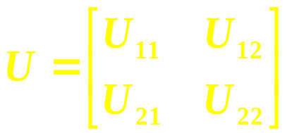
2. 1 Unitary matrices and the QR factorization
Lemma 2.1.10
Let a unitary matrix U ∈ M_{n} be partitioned as , in
which U₁₁ ∈ M_{k} . Then rank U₁₂ = rank U₂₁ and rank U₂₂ = rank U₁₁ + n − 2k . In particular , U₁₂ = 0 if and only if U₂₁ = 0 , in which case U₁₁ and U₂₂ are unitary .

Slide 26
2. 1 Unitary matrices and the QR factorization
Plane rotations and Householder matrices are special (and very simple) unitary matrices that play an important role in establishing some basic matrix factorizations.

Slide 27
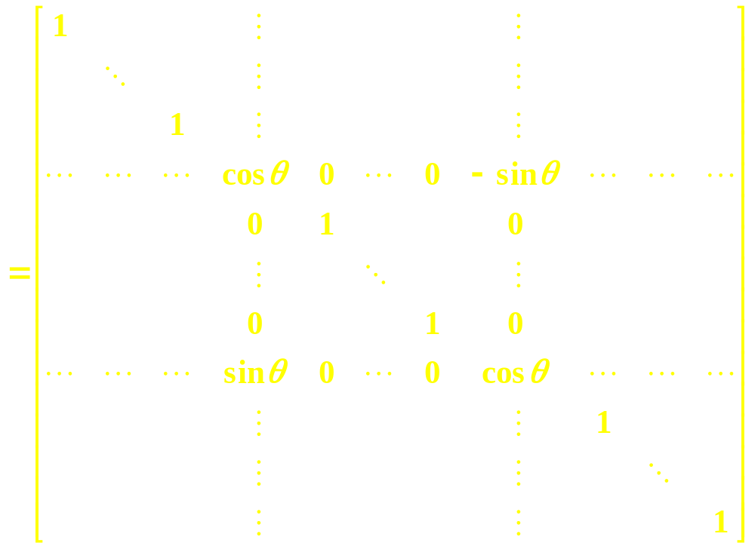
Example 2.1.11. Plane rotations . Let 1 ≤ i < j ≤ n and let
row i
U ( θ ; i , j )
row j
column i
column j
denote the result of replace the i , i and j , j entries of the n-by-n identity matrix by cos θ , replacing its i , j entry by − sin θ and replacing its j , i entry by sin θ . The matrix U ( θ ; i , j ) is called a plane rotation or Givens rotation .

Slide 28
2. 1 Unitary matrices and the QR factorization
Exercise
Verify that U ( θ ; i , j ) ∈ M_{n} (R) is real orthogonal for any pair of indices i , j with 1 ≤ i < j ≤ n and any parameter θ ∈ [ 0 , 2π ) .

Slide 29
2. 1 Unitary matrices and the QR factorization
The matrix U ( θ ; i , j ) carries out a rotation ( through an angle θ ) in the i , j coordinate plane of R^{n} .

Slide 30
Example 2.1.12. Householder matrices
Let w ∈ C^{n} be a nonzero vector . The Householder matrix U_{w} ∈ M_{n} is defined by U_{w} = I − 2(w∗w) ⁻ ¹ww∗ . If w is a unit vector , then U_{w} = I − 2ww∗ .

Slide 31
2. 1 Unitary matrices and the QR factorization
Exercise
Show that a Householder matrix U_{w} is both unitary and Hermitian, so U_{w}⁻ ¹ = U_{w} .

Slide 32
2. 1 Unitary matrices and the QR factorization
Exercise
Show that a Householder matrix U_{w} acts as the identity on the complementary subspace w ⊥ and that it acts as a reflection on the one-dimensional subspace spanned by w ; that is , U_{w} x = x if x ⊥ w and U_{w} w = − w .

Slide 33
2. 1 Unitary matrices and the QR factorization
The following QR factorization of a complex or real matrix is of considerable theoretical and computational importance.

Slide 34
Theorem 2.1.14 (QR factorization) Let A ∈ M_{n , m} be given .
(a) If n ≥ m , there is a Q ∈ M_{n , m} with orthonormal columns and
an upper triangular R ∈ M_{m} with nonnegative main diagonal
entries such that A = QR .
(b) If rank A = m , then the factors Q and R in (a) are uniquely
determined and the main diagonal entries of R are positive .
(c) If m = n , then the factor Q in (a) is unitary .
(d) There is a unitary Q ∈ M_{n} and an upper triangular R ∈ M_{n , m}
with nonnegative diagonal entries such that A = QR .
(e) If A is real , then the factors Q and R in (a) , (b) , (c) , and (d)
may be taken to be real .

Slide 35
QR factorization and QR algorithm
A popular numerical method for calculating eigenvalues ( under some assumptions) is called the QR algorithm. It is based on the QR factorization.

Slide 36
QR factorization and QR algorithm
QR algorithm
Let A₀ ∈ M_{n} be given . Write A₀ = Q₀ R₀ , where Q₀ and R₀ are as guaranteed in Theorem 2.1.14 , and define A₁ = R₀ Q₀ . Again, write A₁ =Q₁ R₁ , with Q₁ unitary and R₁ upper triangular , and continue . In general, factor A_{k} = Q_{k} R_{k} and define A_{k + 1} = R_{k} Q_{k} .

Slide 37
Exercise
Show that each A_{k} produced by the QR algorithm is unitarily similar to A₀ , k = 1, 2, … .
Q_{k} A_{k + 1}
=
Q_{k} R_{k} Q_{k}
=
A_{k} Q_{k}
Q_{k} A_{k + 1} = A_{k} Q_{k}
A_{k + 1} = Q_{k}∗ A_{k} Q_{k}

Slide 38
QR factorization and QR algorithm
Under certain circumstances ( for example, if all the eigenvalues of A₀ have distinct absolute values ) , the QR iterates A_{k} will converge to an upper triangular matrix as k → ∞ . Since this upper triangular matrix is unitarily equivalent to A₀ , the eigenvalues of A₀ are revealed .

Slide 39
2. 1 Unitary matrices and the QR factorization
An important geometrical fact is that any two lists containing equal numbers of orthonormal vectors are related via a unitary transformation.

Slide 40
2. 1 Unitary matrices and the QR factorization
Theorem 2.1.18
If X = [ x₁ … x_{k} ]∈ M_{n, k} and Y = [ y₁ … y_{k} ] ∈ M_{n, k} have orthonormal columns , then there is a unitary U ∈ M_{n} such that Y = UX . If X and Y are real , then U may be taken to be real .

Slide 41
2. 1 Unitary matrices and the QR factorization
Problems
1. If U ∈ M_{n} is unitary, show that | det U | = 1 .
2. Let U ∈ M_{n} be unitary and let λ be a given eigenvalue of U .
Show that (a) | λ | = 1 and (b) x is a (right) eigenvector of U
associated with λ if and only if x is a left eigenvector of U
associated with λ .
–
9. If U ∈ M_{n} is unitary, show that U , U ^{T} , and U ∗ are all unitary.
12. Show that if A ∈ M_{n} is similar to a unitary matrix, then A ⁻ ¹ is
similar to A ∗ .

Slide 42
2. 2 Unitary similarity
Since U ∗ = U ⁻ ¹ for a unitary U , the transformation on M_{n} given by A → U ∗AU is a similarity transformation if U is unitary . This special type of similarity is called unitary similarity .

Slide 43
2. 2 Unitary similarity
Definition 2.2.1
Let A , B ∈ M_{n} be given .
We say that A is unitarily similar to B if there is a unitary U ∈ M_{n} such that A = UBU ∗ . If U may be taken to be real ( and hence is real orthogonal ) , then A is said to be ( real ) orthogonally similar to B.
We say that A is unitarily diagonalizable if it is unitarily similar to a diagonal matrix; A is real orthogonally diagonalizable if it is real orthogonally similar to a diagonal matrix.

Slide 44
2. 2 Unitary similarity
Exercise
Show that unitary similarity is an equivalence relation .

Slide 45
1. 3 Similarity
Theorem 1.3.3
Let A , B ∈ M_{n} . If B is similar to A , then A and B have the same characteristic polynomial .

Slide 46
1. 3 Similarity
Corollary 1.3.4
Let A , B ∈ M_{n} and suppose that A is similar to B , then
(a) A and B have the same eigenvalues .
(b) If B is a diagonal matrix , its main diagonal entries are the eigenvalues of A .
(c) B = 0 ( a diagonal matrix ) if and only if A = 0 .
(d) B = I ( a diagonal matrix ) if and only if A = I .

Slide 47
The determinant, trace, and rank are similarity invariants.
det S ⁻ ¹AS = det A
tr S ⁻ ¹AS = tr A
rank S ⁻ ¹AS = rank A

Slide 48
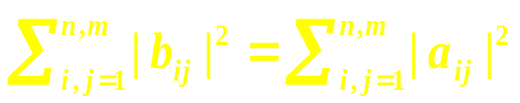
2. 2 Unitary similarity
Theorem 2.2.2
Let U ∈ M_{n} and V ∈ M_{m} be unitary , let A = [a_{ij}] ∈ M_{n, m} and B = [b_{ij}]
∈ M_{n, m} , and suppose that A = UBV . Then .
In particular , this identity is satisfied if m = n and V = U ∗ , that is ,
if A is unitarily similar to B .
tr B∗B = tr A∗A

Slide 49
Theorem 2.2.2 says that tr A∗A is unitary similarity invariant .

Slide 50
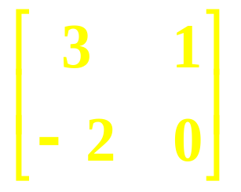
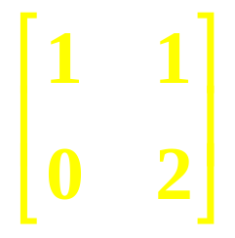
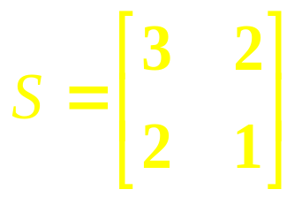
2. 2 Unitary similarity
Exercise
Show that the matrices
and
are similar but not unitarily similar .

Slide 51
1. 3 Similarity
Definition 1.3.1
Let A , B ∈ M_{n} be given . We say that B is similar to A if there exists a nonsingular matrix S ∈ M_{n} such that
B = S ⁻ ¹AS
The transformation A → S ⁻ ¹ A S is called a similarity transformation by the similarity matrix S .
S ⁻ ¹ = S ∗
The relation “B is similar to A” is sometimes abbreviated B ∼ A .

Slide 52
2. 2 Unitary similarity
Unitary similarity implies similarity but not conversely . The unitary similarity equivalence relation partitions M_{n} into finer equivalence classes than the similarity equivalence relation .
Unitary similarity, like similarity, corresponds to a change of basis , but of a special type – it corresponds to a change from one orthonormal basis to another .

Slide 53
2. 2 Unitary similarity
Theorem 2.2.2
Let U ∈ M_{n} and V ∈ M_{m} be unitary , let A = [a_{ij}] ∈ M_{n, m} and B = [b_{ij}]
∈ M_{n, m} , and suppose that A = UBV . Then .
In particular , this identity is satisfied if m = n and V = U ∗ , that is ,
if A is unitarily similar to B .
tr B∗B = tr A∗A

Slide 54
Chapter 2 Unitary Similarity and Unitary Equivalence
2.0 Introduction
2.1 Unitary matrices and the QR factorization
2.2 Unitary similarity
2.3 Unitary and real orthogonal triangularizations
2.4 Consequences of Schur’s triangularization theorem
2.5 Normal matrices
2.6 Unitary equivalence and the singular value decomposition
2.7 The CS decomposition

Slide 55
2. 3 Unitary and real orthogonal triangularizations
Perhaps the most fundamentally useful fact of elementary matrix theory is a theorem attributed to Issai Schur : Any square complex matrix A is unitarily similar to a triangular matrix whose diagonal entries are the eigenvalues of A , in any prescribed order .

Slide 56
Theorem 2.3.1 ( Schur form : Schur triangularization )
Let A ∈ M_{n} have eigenvalues λ₁ , … , λ_{n} in any prescribed order and let x ∈ C^{n} be a unit vector such that Ax = λ₁x .
(a) There is a unitary U = { x , u₂ … u_{n} } ∈ M_{n} such that
U ∗AU = T = [ t_{i j} ]
is upper triangular with diagonal entries t_{i i} = λ_{i} , i = 1, … , n .
(b) If A ∈ M_{n} (R) has only real eigenvalues , then x may be chosen to
be real and there is a real orthogonal Q = { x q₂ … q_{n} } ∈ M_{n} (R)
such that
Q^{T}AQ = T = [ t_{ij} ]
is upper triangular with diagonal entries t_{ii} = λ_{i} , i = 1, … , n .

Slide 57
2. 3 Unitary and real orthogonal triangularizations
Note that neither the unitary matrix U nor the upper triangular matrix T of Theorem 2.3.1 is unique . Not only may the diagonal entries of T (the eigenvalues of A ) appear in any order , but also the unitarily similar upper triangular matrices may appear very different above the diagonal .

Slide 58
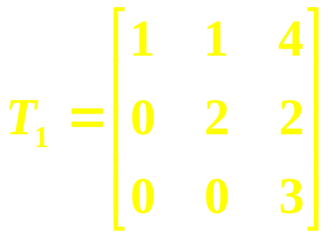
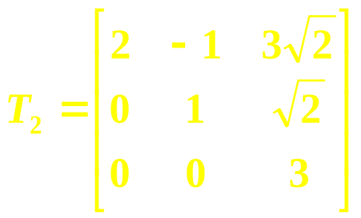
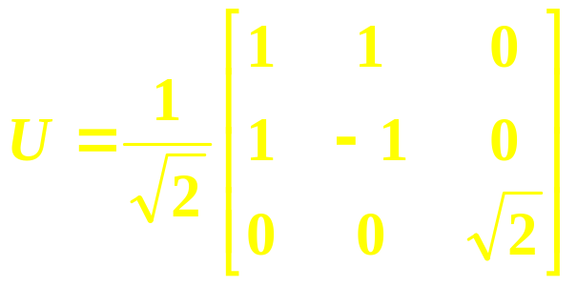
Example 2.3.2
If the eignevalues of A are reordered and the corresponding upper triangularization ( 2.3.1 ) is performed , the entries of T above the main diagonal can be different . Consider
,
,
.
Verify that U is unitary and T₂ = UT₁U∗ .

Slide 59
2. 3 Unitary and real orthogonal triangularizations
There is a useful extension of (2.3.1) : A commuting family of complex matrices can be reduced simultaneously to upper triangular form by a single unitary similarity .

Slide 60
2. 3 Unitary and real orthogonal triangularizations
Theorem 2.3.3
Let F ⊆ M_{n} be a nonempty commuting family . There is a unitary U ∈ M_{n} such that U ∗AU is upper triangular for every A ∈ F .

Slide 61
2. 3 Unitary and real orthogonal triangularizations
If a real matrix A has any non-real eigenvalues , there is no hope of reducing it to a upper triangular form T by a real similarity because some main diagonal entries of T (eigenvalues of A) would be non-real . However , we can always reduce A to a real upper quasitriangular form T by a real orthogonal similarity ; conjugate pairs of non-real eigenvaules are associated with 2-by-2 blocks .

Slide 62
0.9.4 Block triangular matrices
A block upper triangular matrix in which all the diagonal blocks are 1-by-1 or 2-by-2 is said to be upper quasitriangular. A matrix is lower quasitriangular if its transpose is upper quasitriangular ; it is quasitriangular if it is either upper quasitriangular or lower quasitriangular. A matrix that is both upper quasitriangular and lower quasitriangular is said to be quasidiagonal .

Slide 63
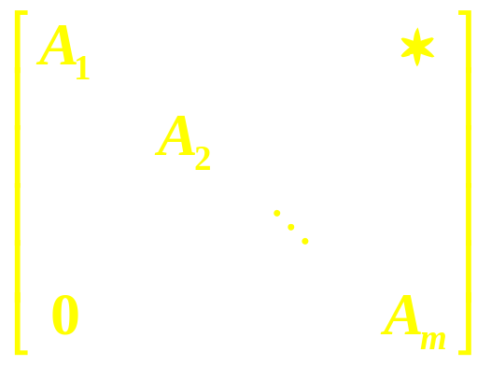
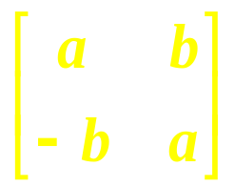
Theorem 2.3.4 ( Real Schur form ) Let A ∈ M_{n} (R) be given .
(a) There is a real nonsingular S ∈ M_{n} (R) such that S ⁻ ¹AS is a real upper quasitriangular matrix
, each A_{i} is 1-by-1 or 2-by-2
(2.3.5)
with the following properties : (i) its 1-by-1 diagonal blocks display the real eignevalues of A ; (ii) each of its 2-by-2 diagonal blocks has a special form that displays a conjugate pair of non-real eigenvalues of A :
(iii) its diagonal blocks are completely determined by the eigenvalues of A ; they may be appear in any prescribed order .
, a , b ∈ R , b > 0 , and a ± ib are eigenvalues of A .
(2.3.5a)

Slide 64
Theorem 2.3.4 ( Real Schur form ) Let A ∈ M_{n} (R) be given .
(b) There is a real orthogonal Q ∈ M_{n} (R) such that Q ^{T}AQ is a real upper quasitriangular matrix with the following properties :
(i) Its 1-by-1 diagonal blocks display the real eignevalues of A ;
(ii) Each of its 2-by-2 diagonal blocks has a conjugate pair of non-real ei-genvalues (but no special form) ;
(iii) The ordering of its diagonal blocks may be prescribed in the following sense: If the real eigenvalues and conjugate pairs of non-real eigenvlues of A are listed in a prescribed order , then the real eigenvalues and conjugate pairs of non-real eigenvalues of the respective diagonal blocks A₁ , … , A_{m} of Q^{T}AQ are in the same order .

Slide 65
2. 3 Unitary and real orthogonal triangularizations
There is a commuting families version of Theorem 2.3.4 : A commuting family of real matrices may be reduced simultaneously to a common upper quasitriangular form by a single real orthogonal similarity .

Slide 66
2. 3 Unitary and real orthogonal triangularizations
Problem
6. Let A, B ∈ M_{n} be given, and suppose A and B are simultaneously
similar to upper triangular matrices; that is, S ⁻ ¹ AS and S ⁻¹ BS
are both upper triangular for some nonsingular S ∈ M_{n} . Show
that every eigenvalues of AB − BA must be zero.

Slide 67
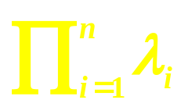
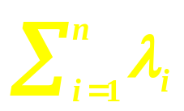
2. 4 Consequences of Schur’s triangularization theorem
2.4.1 The trace and determinant
Use (2.3.1) to show that if A ∈ M_{n} has eigenvalues λ₁ , … , λ_{n} , counting multiplicity, then
det A = and tr A = .

Slide 68
Theorem 2.3.1 ( Schur form : Schur triangularization )
Let A ∈ M_{n} have eigenvalues λ₁ , … , λ_{n} in any prescribed order and let x ∈ C^{n} be a unit vector such that Ax = λ₁x .
(a) There is a unitary U = { x , u₂ … u_{n} } ∈ M_{n} such that
U ∗AU = T = [ t_{i j} ]
is upper triangular with diagonal entries t_{i i} = λ_{i} , i = 1, … , n .
(b) If A ∈ M_{n} (R) has only real eigenvalues , then x may be chosen to
be real and there is a real orthogonal Q = { x q₂ … q_{n} } ∈ M_{n} (R)
such that
Q^{T}AQ = T = [ t_{ij} ]
is upper triangular with diagonal entries t_{ii} = λ_{i} , i = 1, … , n .

Slide 69
2. 4 Consequences of Schur’s triangularization theorem
2.4.3 The Caley-Hamilton theorem
The fact that every square complex matrix satisfies its own characteristic equation follows from Schur’s theorem and an observation about multiplication of triangular matrices with special patterns of zero entries .

Slide 70


2. 4 Consequences of Schur’s triangularization theorem
Lemma 2.4.3.1
Suppose that R = [r_{ij}] and T = [t_{ij}] ∈ M_{n} are upper triangular and that r_{i j} = 0 , 1 ≤ i , j ≤ k < n , and t _{k + 1 , k + 1} = 0 . Let S = = RT . Then , 1 ≤ i , j ≤ k + 1 .

Slide 71
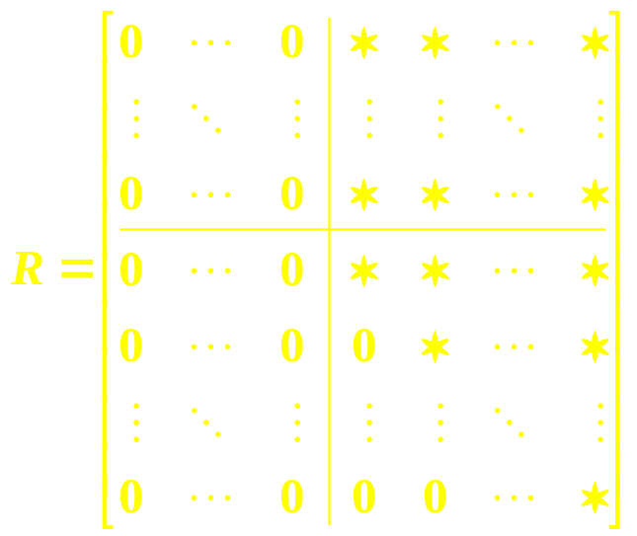
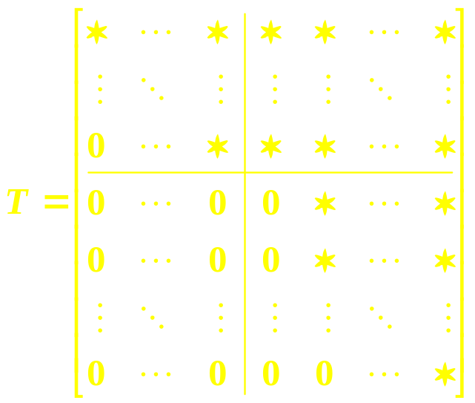
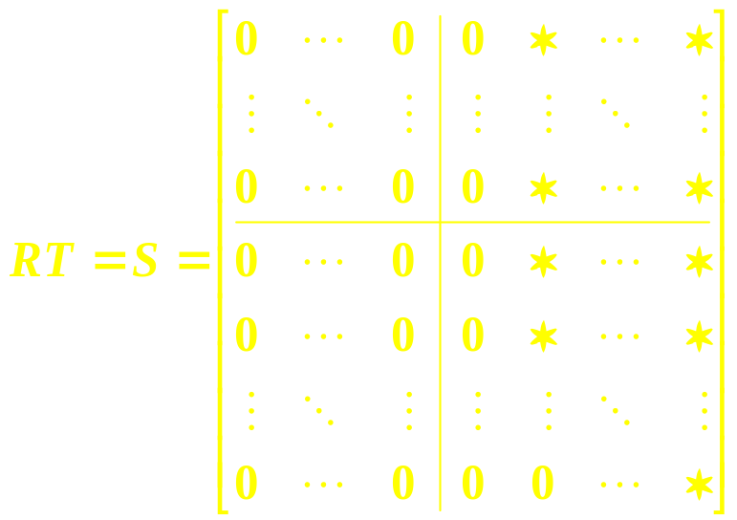
2. 4 Consequences of Schur’s triangularization theorem
Lemma 2.4.3.1
k
k + 1
k
k + 1
k + 1
k + 1

Slide 72
2. 4 Consequences of Schur’s triangularization theorem
Theorem 2.4.3.2 (Cayley-Hamilton)
Let p_{A} (t) be the characteristic polynomial of A ∈ M_{n} . Then
p _{A} (A) = 0

Slide 73
2. 4 Consequences of Schur’s triangularization theorem
Exercise
What is wrong with the following argument ? “ Since p_{A} ( λ_{i} ) = 0 for every eigenvalue λ_{i} of A ∈ M_{n} , and since the eigenvalues of p_{A} (A) are p_{A} ( λ₁ ) ,…, p_{A} ( λ_{n} ) , all eigenvalues of p_{A}(A) are 0 . Therefore , p_{A}(A) = 0 . ”
It is a common mistaken argument for the Cayley-Hamilton theorem . Given an example to illustrate the fallacy in the argument .
P. 58 Example 1.3.5 & P. 118 Example 2.4.8.4

Slide 74
2. 4 Consequences of Schur’s triangularization theorem
Exercise
What is wrong with the following argument ?
“ Since p_{A} (t) = det ( t I − A ) , we have p_{A} (A) = det (AI − A) = det (A − A) = det 0 = 0 . Therefore , p_{A} (A) = 0 . ”
The scalar polynomial p_{A} (t) is first computed as p_{A} (t) = det ( t I − A) , and one then forms the matrix p_{A} (A) from the characteristic polynomial .

Slide 75
2. 4 Consequences of Schur’s triangularization theorem
Theorem 2.4.3.2 (Cayley-Hamilton)
Let p_{A} (t) be the characteristic polynomial of A ∈ M_{n} . Then
p _{A} (A) = 0

Slide 76
2. 4 Consequences of Schur’s triangularization theorem
Theorem 2.4.3.2 (Cayley-Hamilton)
The Cayley-Hamilton theorem is often paraphrased as “ every square matrix satisfies its own characteristic equation (1.2.3)”, but this must be understood carefully : The scalar polynomial p_{A}(t) is first computed as p_{A}(t) = det(tI − A); one then computes the matrix p_{A}(A) by substituting t → A .

Slide 77
2. 4 Consequences of Schur’s triangularization theorem
Theorem 2.4.3.2 (Cayley-Hamilton)
One important use of the Cayley-Hamilton theorem is to write powers A^{k} of A ∈ M_{n} , for k ≥ n , as linear combinations of I , A , A² , … , A^{n − 1} .

Slide 78
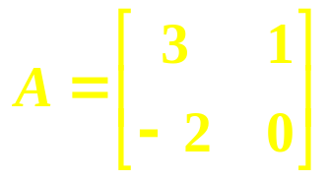



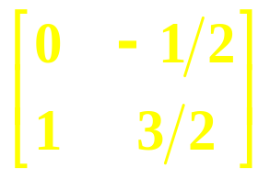






Example 2.4.3.3
Let
Then p_{A} (t) = t ² − 3t + 2 , so A² − 3A + 2I = 0 . Thus , A² = 3A − 2I ; A³ = A(A²) = 3A² − 2A = 3(3A − 2I ) − 2A = 7A − 6I ; A⁴ = 7A² − 6A = 15A − 14I , and so on . We can also express negative powers of the nonsingular matrix A as linear combinations of A and I. Write
A² − 3A + 2I = 0
as
2I = − A² + 3A = A ( − A + 3I ) , or I = A [ ( − A + 3I ) ] .
Thus ,
A ⁻ ¹ = − A + I = ,
A ⁻ ² = (− A + I ) ² = A² − A + I = (3A − 2I) − A + I
= − A + I ,
and so on .

Slide 79
2. 4 Consequences of Schur’s triangularization theorem
Corollary 2.4.3.4
Suppose A ∈ M_{n} is nonsingular and let p_{A}(t) = t ^{n} + a_{n − 1} t ^{n − 1} +…+ a₁ t + a₀ . Let q(t) = − ( t ^{n − 1} + a _{n − 1} t ^{n − 2} +…+ a₂ t + a₁ ) / a₀ . Then A ⁻ ¹ = q(A) is a polynomial in A .

Slide 80
2. 4 Consequences of Schur’s triangularization theorem
Exercise
If A , B ∈ M_{n} are similar and g(t) is any given polynomial , show that g(A) is similar to g(B) , and that any polynomial equation satisfied by A is satisfied by B .
Given some thought to the converse : Satisfaction of the same polynomial equations implies similarity - true or false ?

Slide 81
2. 4 Consequences of Schur’s triangularization theorem
Example 2.4.3.5
We have shown that each A ∈ M_{n} satisfies a polynomial equation of degree n , for example , its characteristic equation . It is possible for A ∈ M_{n} to satisfy a polynomial equation of degree less than n , however .

Slide 82
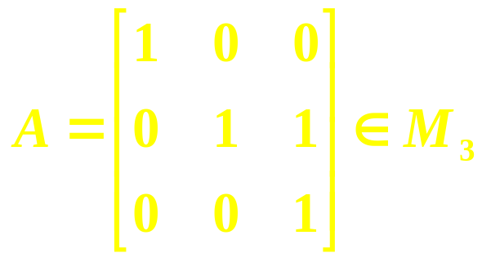
2. 4 Consequences of Schur’s triangularization theorem
Example 2.4.3.5
Consider
The characteristic polynomial is p_{A}(t) = (t − 1) ³ and indeed (A − I) ³ = 0 . But (A − I) ² = 0 so A satisfies a polynomial equation of degree 2 .

Slide 83
2. 4 Consequences of Schur’s triangularization theorem
2.4.4 Sylvester’s theorem on linear matrix equations
The equation AX − XA = 0 associated with commutativity is a special case of the linear matrix equation AX − XB = C , often called Sylvester’s equation. The following theorem gives a necessary and sufficient condition for Sylvester’s equation to have a unique solution X for every given C .

Slide 84
2. 4 Consequences of Schur’s triangularization theorem
Theorem 2.4.4.1 ( Sylvester )
Let A ∈ M_{n} and B ∈ M_{m} be given . The equation AX − XB = C has a unique solution X ∈ M_{n , m} for each given C ∈ M_{n , m} if and only if σ (A) ∩ σ (B) = ∅ , that is , if and only if A and B have no eigenvalue in common . In particular , if σ (A) ∩ σ (B) = ∅ then the only X such that AX − XB = 0 is X = 0 . If A and B are real , then AX − XB = C has a unique solution X ∈ M_{n , m} (R) for each given C ∈ M _{n , m} (R) .

Slide 85
2. 4 Consequences of Schur’s triangularization theorem
2.4.5 Uniqueness in Schur’s triangularization theorem
A matrix identity of the form AX = XB is known as an intertwining relation .
The commutativity equation AB = BA is perhaps the most familiar intertwining relation ; other examples are the anti-commutativity equation AB = − BA , AB = BA^{T} , AB = BA , and AB = BA∗ .
–

Slide 86
2. 4 Consequences of Schur’s triangularization theorem
2.4.5 Uniqueness in Schur’s triangularization theorem
For given A ∈ M_{n} , an upper triangular form T described in (2.3.1) that can be achieved by unitary similarity need not be unique . That is, different upper triangular matrices with the same main diagonals can be unitarily similar .
Under certain assumptions ?
Theorem 2.4.5.1

Slide 87
2. 4 Consequences of Schur’s triangularization theorem
2.4.6 Every square matrix is block diagonalizable
The following application and extension of Schur’s triangularization theorem (2.3.1) is an important step toward the Jordan canonical form, we discuss in the next chapter .

Slide 88
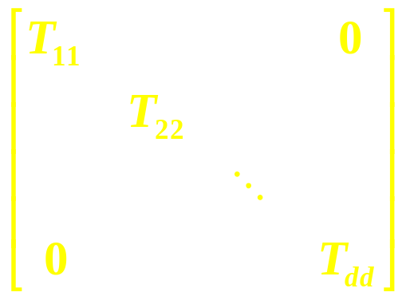
2. 4 Consequences of Schur’s triangularization theorem
2.4.6 Every square matrix is block diagonalizable
Theorem 2.4.6.1
Let the distinct eigenvalues of A ∈ M_{n} be λ₁ , … , λ_{d} , with respective multiplicities n₁ , … n_{d} . Then A is similar to
If A ∈ M_{n} (R) and if all the eigenvalues of A are real , then the same result holds , and the similarity matrix may be taken to be real .

Slide 89
2. 4 Consequences of Schur’s triangularization theorem
2.4.7 Every square matrix is almost diagonalizable
Another use of Schur’s result is to make it clear that every square complex matrix is “ almost diagonalizable ” in two possible inter-pretations of the phrase :
The first says that arbitrarily close to a given matrix , there is a diagonalizable matrix .
The second says that any given matrix is similar to an upper triangular matrix whose off-diagonal entries are arbitrary small .

Slide 90
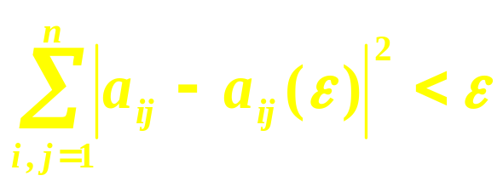
2. 4 Consequences of Schur’s triangularization theorem
Theorem 2.4.7.1
Let A = [a_{ij}] ∈ M_{n} . For each ε > 0 , there exists a matrix A(ε) = [ a_{ij}(ε) ] ∈ M_{n} that has n distinct eigenvalues (and is therefore diagonalizable) and is such that
P. 60 Theorem 1.3.9

Slide 91
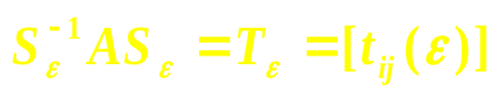
2. 4 Consequences of Schur’s triangularization theorem
Theorem 2.4.7.2
Let A ∈ M_{n} . For each ε > 0 there is a nonsingular matrix S_{ε} ∈ M_{n} such that
is upper triangular and | t_{ij} (ε ) | < ε for all i , j ∈ {1 , … , n} such that i < j .

Slide 92
2. 4 Consequences of Schur’s triangularization theorem
2.4.8 Commuting families and simultaneous triangularization
We now use the commuting families version (2.3.3) of Schur’s theorem to show that the eigenvalues “ add ” and “ multiply ” — in some order — for commuting matrices.
Theorem 2.3.3 Let F ⊆ M_{n} be a nonempty commuting family. There is a unitary U∈ M_{n} such that U ∗AU is upper triangular for every A ∈ F .

Slide 93
2. 4 Consequences of Schur’s triangularization theorem
Theorem 2.4.8.1
Suppose that A , B ∈ M_{n} commute . Then there is an ordering α₁ , … , α_{n} of the eigenvalues of A and an ordering β₁ , … , β_{n} of the eigenvalues of B such that the eigenvalues of A + B are α₁ + β₁ , α₂ + β₂ , … , α_{n} + β_{n} and the eigenvalues of AB are α₁β₁ , α₂β₂ , … , α_{n}β_{n} . In particular , σ (A + B) ⊆ σ (A) + σ (B) , σ (AB) ⊆ σ (A) σ (B) .

Slide 94
2. 4 Consequences of Schur’s triangularization theorem
σ (A + B) ⊆ σ (A) + σ (B) if A and B commute.
√
σ (A + B) = σ (A) + σ (B) if A and B commute?
σ (A + B) ⊇ σ (A) + σ (B) if A and B commute.
×

Slide 95
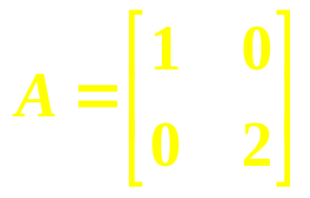
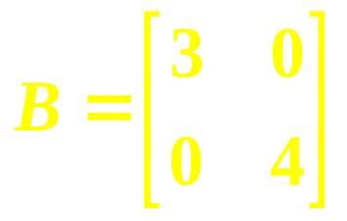
2. 4 Consequences of Schur’s triangularization theorem
Example 2.4.8.2
Even if A and B commute , not every sum of their respective eigenvalues need be an eigenvalue of A + B . Consider
Since 1 + 4 = 5 ∉ {4 , 6} = σ (A + B) , we see that σ (A + B) is contained in , but is not equal to , σ (A) + σ (B) .
and
Thus, σ (A+B) is contained in, but is not generally equal to, σ (A) + σ (B) when A and B commute.

Slide 96
2. 4 Consequences of Schur’s triangularization theorem
σ (A + B) ⊆ σ (A) + σ (B) if A and B commute.

Slide 97
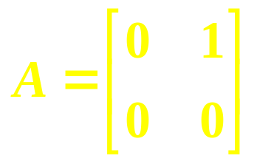
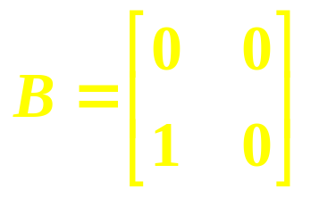
2. 4 Consequences of Schur’s triangularization theorem
Example 2.4.8.3
If A and B do not commute , it is difficult to say how σ (A + B) is related to σ (A) and σ (B) . In particular, σ (A + B) need not be contained in σ (A) + σ (B) . Let
Then σ (A + B) = { − 1, 1 } , while σ (A) = σ (B) = { 0 } .
and

Slide 98
2. 4 Consequences of Schur’s triangularization theorem
σ (A + B) ⊆ σ (A) + σ (B) if A and B commute.
A and B commute if σ (A + B) ⊆ σ (A) + σ (B).
×

Slide 99
2. 4 Consequences of Schur’s triangularization theorem
Example 2.4.8.4
Is there a converse of (2.4.8.1) ? If the eigenvalues of A and B add , in some order , must A and B commute ? The answer is no , even if the eigenvalues of α A and β B add , in some order , for all scalar α and β. This is an interesting phenomenon, and the characterization of such pairs of matrices is an unsolved problem !

Slide 100
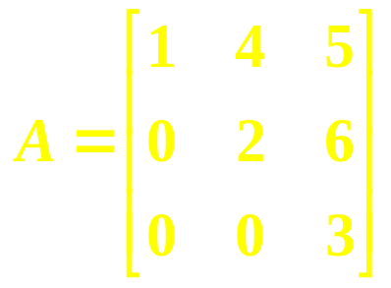
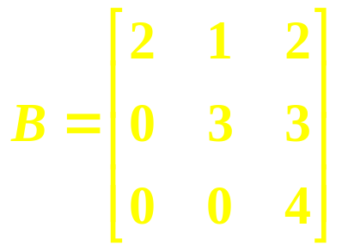
2. 4 Consequences of Schur’s triangularization theorem
Example
Let
The eigenvalues add, but A and B do not commute . Clearly , simultaneous upper triangularizability is sufficient for the additivity of eigenvalues , but it, too, is not necessary. And, of course, upper triangular matrices need not commute.
A + B
and
{3, 5, 7}
{1, 2, 3}
{2, 3, 4}

Slide 101
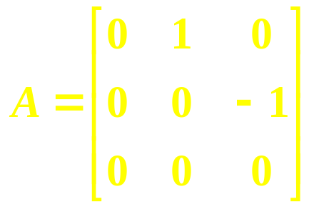
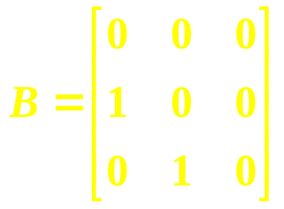
2.4.14 Example
Consider the noncommuting matrices
and
for which σ (A) = σ (B) = {0}. Moreover, p_{α A+β B} (t ) = t ³, so σ (α A+β B) = {0} for all α , β ∈ C and the eigenvalues add .
If A and B were simultaneously upper triangularizable, the proof of (2.4.8.1) shows that the eigenvalues of AB would be products , in some order , of the eigenvalues of A and B . However , σ (AB) = {− 1, 0, 1} is not contained in σ (A) ⋅ σ (B) = {0} , so A and B are not simultaneously triangularizable .

Slide 102
2. 4 Consequences of Schur’s triangularization theorem
Corollary 2.4.8.5
Suppose that A, B ∈ M_{n} commute, σ (A) = { α₁ , … , α _{d1} }, and σ (B) = { β₁ , … , β _{d2} }. If α _{i} ≠ − β _{j} for all i , j , then A + B is nonsingular .

Slide 103
2. 4 Consequences of Schur’s triangularization theorem
Exercise
Verify (2.4.8.5) using (2.4.8.1) .

Slide 104
2. 4 Consequences of Schur’s triangularization theorem
For complex matrices , simultaneous triangularization and simultaneous unitary triangularization are equal concepts .

Slide 105
2. 4 Consequences of Schur’s triangularization theorem
Theorem 2.4.8.6
Let A₁ , … , A_{m} ∈ M_{n} be given. There is a nonsingular S ∈ M_{n} such that S ⁻ ¹A_{i} S is upper triangular for all i = 1 , … , m if and only if there is a unitary U ∈ M_{n} such that U ∗A_{i} U is upper triangular for all i = 1, … , m .

Slide 106
2. 4 Consequences of Schur’s triangularization theorem
2.4.10 Eigenvalues of a rank-one perturbation
It is often useful to know that any one eigenvalue of a matrix can be shifted arbitrarily by a rank-one perturbation , without disturbing the rest of the eigenvalues .

Slide 107
2. 4 Consequences of Schur’s triangularization theorem
Theorem 2.4.10.1 ( A. Brauer )
Suppose that A ∈ M_{n} has eigenvalues λ , λ₂ , … , λ_{n} , and let x be a nonzero vector such that Ax = λx . Then for any v ∈ C^{n} the eigenvalues of A + xv ∗ are λ + v ∗ x , λ₁ , … λ_{n} .

Slide 108
Problems
2. Why is the rank of an upper triangular matrix at least as large as the number of its nonzero main diagonal entries?
4. Let A , B ∈ M_{n} and suppose that A commutes with B. If A is non-singular , deduce that B commutes with A ⁻ ¹ .
11. Let A, B ∈ M_{n} be given and consider their commutator C = AB − BA . Show that tr C = 0 .

Slide 109
Chapter 2 Unitary Similarity and Unitary Equivalence
2.0 Introduction
2.1 Unitary matrices and the QR factorization
2.2 Unitary similarity
2.3 Unitary and real orthogonal triangularizations
2.4 Consequences of Schur’s triangularization theorem
2.5 Normal matrices
2.6 Unitary equivalence and the singular value decomposition
2.7 The CS decomposition

Slide 110
2. 5 Normal matrices
The class of normal matrices, which arises naturally in the context of unitary similarity , is important throughout matrix analysis ; it includes the unitary, Hermitian, skew Hermitian, real orthogonal, real symmetric, and real skew-symmetric matrices .

Slide 111
2. 5 Normal matrices
Definition 2.5.1
A matrix A ∈ M_{n} is normal if AA∗ = A∗A , that is , if A commutes with its conjugate transpose .

Slide 112
2. 5 Normal matrices
Exercise
If A ∈ M_{n} is normal and α ∈ C , show that α A is normal .
The class of normal matrices of a given size is closed under multiplication by complex scalars .

Slide 113
2. 5 Normal matrices
Exercise
If A ∈ M_{n} is normal , and if B is unitarily similar to A , show that B is normal .
The class of normal matrices of a given size is closed under unitary similarity .

Slide 114
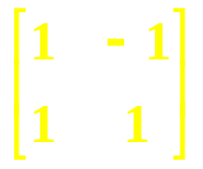
2. 5 Normal matrices
Examples
(a) Since U ∗U = I = UU ∗ if U is unitary, all unitary matrices are normal.
(b) Since A∗A = AA∗ trivially if A∗ = A , all Hermitian matrices are normal.
(c) If A ∈ M_{n} is such that A∗ = − A , A is called skew-Hermitian . In this event,
A∗A = − A² = AA∗ , so that all skew-Hermitian matrices are also normal.
(d) A = is normal, but it does not fall into any of the above categories.

Slide 115
2. 1 Unitary matrices and the QR factorization
Lemma 2.1.10
Let a unitary matrix U ∈ M_{n} be partitioned as , in
which U₁₁ ∈ M_{k} . Then rank U₁₂ = rank U₂₁ and rank U₂₂ = rank U₁₁ + n − 2k . In particular , U₁₂ = 0 if and only if U₂₁ = 0 , in which case U₁₁ and U₂₂ are unitary .

Slide 116
2. 5 Normal matrices
There is something special not only about zero rows or columns of a normal matrix , but also about certain zero blocks .

Slide 117
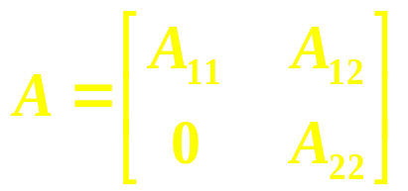
2. 1 Unitary matrices and the QR factorization
Lemma 2.5.2
Let A ∈ M_{n} be partitioned as , in which A₁₁ and A₂₂
are square . Then A is normal if and only if A₁₁ and A₂₂ are normal and A₁₂ = 0 .
A block upper triangular matrix is normal if and only if each of its off-diagonal blocks is zero and each of its diagonal blocks is normal;
In particular , an upper triangular matrix is normal if and only if it is diagonal .

Slide 118
2. 5 Normal matrices
We next catalog the most fundamental facts about normal matrices . The equivalence of (a) and (b) in the following theorem is often called the spectral theorem for normal matrices .

Slide 119
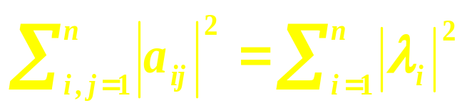
2. 5 Normal matrices
Theorem 2.5.3
Let A = [ a_{ij} ] ∈ M_{n} has eigenvalues λ₁ , … , λ_{n} , the following statements are equivalent :
(a) A is normal .
(b) A is unitarily diagonalizable .
(c) .
(d) A has n orthonormal eigenvectors .
The Spectral Theorem
for Normal Matrices

Slide 120
2. 5 Normal matrices
A representation of a normal matrix A ∈ M_{n} as A = UΛU ∗ , in which U is unitary and Λ is diagonal , is called a spectral decomposition of A .

Slide 121
2. 5 Normal matrices
Theorem 2.5.4.
Two normal matrices are unitarily similar if and only if they have the same eigenvalues .

Slide 122
2. 5 Normal matrices
We next note that commuting normal matrices may be simultaneously unitarily diagonalized .

Slide 123
2. 5 Normal matrices
Theorem 2.5.5
Let N ⊆ M_{n} be a nonempty family of normal matrices . Then N is commuting family if and only if it is a simultaneously unitarily diagonalizable family .

Slide 124
2. 5 Normal matrices
Application of Theorem 2.5.3 to the special case of Hermitian matrices yields a fundamental result called the spectral theorem for Hermitian matrices .

Slide 125
2. 5 Normal matrices
Theorem 2.5.6
Let A ∈ M_{n} be Hermitian and have eigenvalues λ₁ , … , λ_{n} . Let Λ = diag ( λ₁ , … , λ_{n} ) . Then
(a) λ₁ , … , λ_{n} are real .
(b) A is unitarily diagonalizable .
(c) There is a unitary U ∈ M_{n} such that A = U Λ U ∗ .

Slide 126
Theorem 1.3.7.
Let A ∈ M_{n} be given . Then A is diagonalizable if and only if there are n linearly independent vectors , each of which is an eigenvector of A .

Slide 127
Theorem 1.3.9
If A ∈ M_{n} have n distinct eigenvalues, then A is diagonalizable.

Slide 128
Theorem 2.5.3 (d)
A basis of eigenvectors (in fact , an orthonormal basis) is structurally guaranteed.
Why ?

Slide 129
This is one reason why Hermitian and normal matrices are so important and have such pleasant properties .

Slide 130
2. 4 Consequences of Schur’s triangularization theorem
2.4.5 Uniqueness in Schur’s triangularization theorem
A matrix identity of the form AX = XB is known as an intertwining relation .
The commutativity equation AB = BA is perhaps the most familiar intertwining relation ; other examples are the anti-commutativity equation AB = − BA , AB = BA^{T} , AB = BA , and AB = BA∗ .
–

Slide 131
If A , B ∈ M_{n} are normal (either complex or real) and satisfy an intertwining relation , the Fuglede-Putnam theorem says that A∗ and B∗ satisfy the same intertwining relation .

Slide 132
2. 5 Normal matrices
Theorem 2.5.16 ( Fuglede − Putnam )
Let A ∈ M_{n} and B ∈ M_{m} be normal and let X ∈ M_{n , m} be given . Then AX = XB if and only if A ∗X =X B ∗ .

Slide 133
2. 5 Normal matrices
Problems
1. Show that A ∈ M_{n} is normal if and only if (Ax)∗(Ax) = (A∗x)∗(A∗x) for
all x ∈ C^{n} , that is , ||Ax||₂ = ||A∗x||₂ for all x ∈ C^{n} .
2. Show that a normal matrix is unitary if and only if all its eigenvalues
have absolute value 1 .
3. Show that a normal matrix is Hermitian if and only if all its eigenvalues
are real .

Slide 134
2. 5 Normal matrices
Problems
4. Show that a normal matrix is skew Hermitian if and only if all its
eigenvalues are pure imaginary (have real part equal to 0).
5. If A ∈ M _{n} is skew Hermitian (respectively Hermitian), show that
iA is Hermitian (respectively skew Hermitian).
6. Show that A ∈ M _{n} is normal if and only if it commutes with some
normal matrix with distinct eigenvalues .

Slide 135
2. 6 Unitary equivalence and the singular value decomposition

Slide 136
2. 6 Unitary equivalence and the singular value decomposition
For A ∈ M_{n , m} , the transformation A → UAV, in which U ∈ M_{m} and V ∈ M_{n} are both unitary , is called unitary equivalence .

Slide 137
2. 6 Unitary equivalence and the singular value decomposition
To ensure that we can reduce A , B ∈ M_{n} to upper triangular form by the same unitary similarity , some condition (commutativity, for example) must be imposed on them .
However, we can reduce any two given matrices to upper triangular form by the same unitary equivalence .

Slide 138
2. 6 Unitary equivalence and the singular value decomposition
Theorem 2.6.1
Let A , B ∈ M_{n} . There are unitary V, W ∈ M_{n} such that A = V T_{A} W ∗ , B = V T_{B} W ∗ , and both T_{A} and T_{B} are upper triangular . If B is nonsingular , the main diagonal entries of T_{B}⁻¹ T_{A} are the eigenvalues of B ⁻ ¹ A .

Slide 139
2. 6 Unitary equivalence and the singular value decomposition
Theorem 2.6.2
Let A , B ∈ M_{n} (R) . There are real orthogonal V, W ∈ M_{n} such that A = V T_{A} W ^{T} , B = V T_{B} W ^{T} , T_{A} is real and upper quasitriangular , and T_{B} is real and upper triangular .

Slide 140
2. 6 Unitary equivalence and the singular value decomposition
Although only square matrices that are normal can be diagonalized by unitary similarity , any complex matrix can be diagonalized by unitary equivalence .
Singular Value Decomposition (SVD)

Slide 141
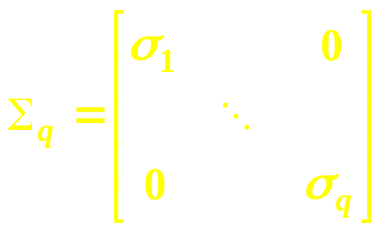
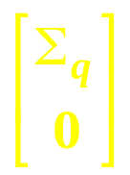
Theorem 2.6.3 ( Singular value decomposition ) Let A ∈ M_{n , m} be given , let q = min { m , n } , and suppose that rank A = r .
(a) There are unitary matrices V ∈ M_{n} and W ∈ M_{m} , and a square
diagonal matrix
such that σ₁ ≥ σ₂ ≥ … ≥ σ_{r} > 0 = σ_{r + 1} = … = σ_{q} and A = V ΣW ∗ ,
in which
Σ = Σ_{q} if m = n ,
Σ = [ Σ_{q} 0 ] ∈ M_{n , m} if m > n , and
Σ = ∈ M_{n , m} if n > m .
(2.6.3.1)

Slide 142
2. 6 Unitary equivalence and the singular value decomposition
Theorem 2.6.3 ( Singular value decomposition )
(b) The parameters σ₁ , … , σ_{r} are the positive square roots of the
decreasingly ordered nonzero eigenvalues of AA∗, which are the
same as the decreasingly ordered nonzero eigenvalues of A∗A .

Slide 143
2. 6 Unitary equivalence and the singular value decomposition
Theorem 2.6.3 ( Singular value decomposition )
The diagonal entries of the matrix Σ in (2.6.3.2) ( that is , the scalars σ₁ , … , σ_{q} that are the diagonal entries of the square matrix Σ_{q} ) are the singular values of A .

Slide 144
2. 6 Unitary equivalence and the singular value decomposition
Theorem 2.6.3 ( Singular value decomposition )
The singular values decomposition ( SVD ) is a very important tool in matrix analysis , with myriad applications in engineering , numerical computation , statistics , image compression , and many other areas ; for more details , see Chapter 7 and Chapter 3 of Horn and Johnson (1991) .

Slide 145
2. 7 The CS decomposition

Slide 146
2. 7 The CS decomposition
The CS decomposition is a canonical form for partitioned unitary matrices under partitioned unitary equivalence .

Slide 147
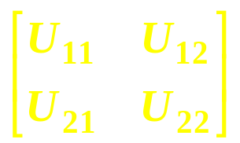
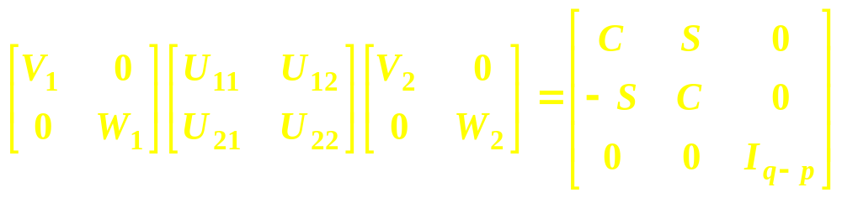

Theorem 2.7.1 ( CS decomposition )
Let p , q , and n be given integers with 1< p ≤ q < n and p + q = n .
Let U = ∈ M_{n} be unitary , with U₁₁ ∈ M_{p} and U₂₂ ∈ M_{q} .
There are unitary V₁ , W₁ ∈ M_{p} and V₂ , W₂ ∈ M_{q} such that
(2.7.1.2)
in which C = diag (σ₁ , … , σ_{p} ) , σ₁ ≥ … ≥ σ_{p} are nonincreasingly ordered singular values of U₁₁ and S = diag .

Slide 148
2. 7 The CS decomposition
The CS decomposition is a widely useful tool , notably in problems involving distances and angles between subspaces .

Slide 149
Exercises & Problems
Page 84. Exercise 2
Page 85. Exercise 2
Page 91. Problem 1
Page 91. Problem 2
Page 92. Problem 9
Page 92. Problem 12
Page 94. Exercise 1
Page 118. Exercise 1
Page 126. Problem 11
Page 131. Exercise 2
Page 132. Exercise 2
Page 132. Exercise 4
Page 132. Exercise 5
Page 141. Problem 2
Page 141. Problem 3
Page 141. Problem 4
Page 141. Problem 5

