Slide 1


Case Study of Skatteetaten
Traffic Analysis
CHENXING LI
2021.01.26

Slide 2

INTRODUCTION
DATASET
Telephone traffic reports to Skatteetaten for december 2020.
438 observations and 43 variables.
Goal
To have a total concept for the traffic situation.
To improve the quality and efficiency of customer service
3

Slide 3
1
Best day to call
2
Call volum over one month
3
An overview of the queues
4
More analysis ideas

Slide 4
Best Day To Call
PART 1

Slide 5
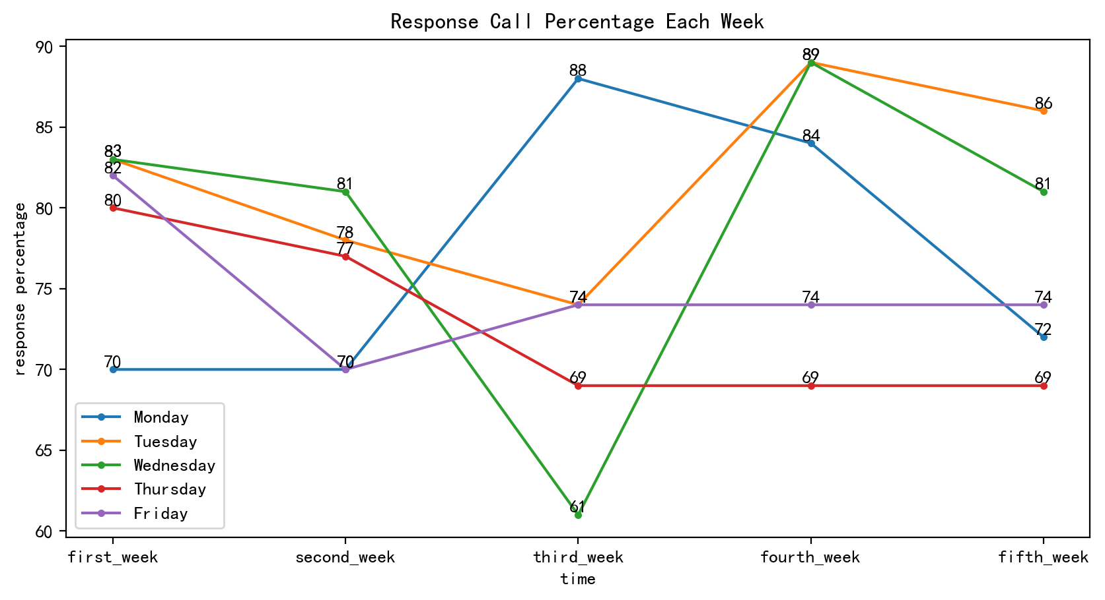
Response Call Percentage Each Week
Response call percentage in week 4 is higher than other weekdays.
Respose call percentage on Monday and Wednesday are unstable.
Week 3 stands out

Slide 6
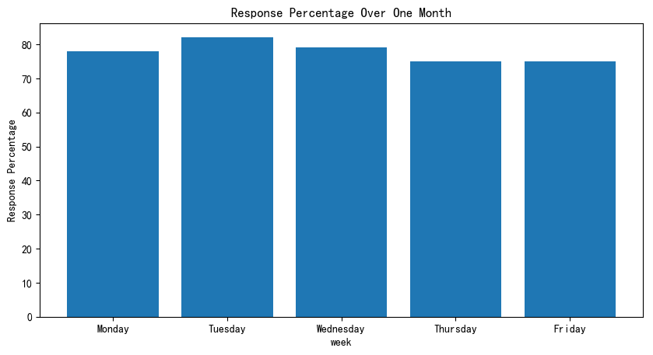
Response Call Percentage On Week Day over the month
Most weekdays : 70% -80%
Tuesday: little higher response
percentage

Slide 7
Call volum over one month
PART 2

Slide 8
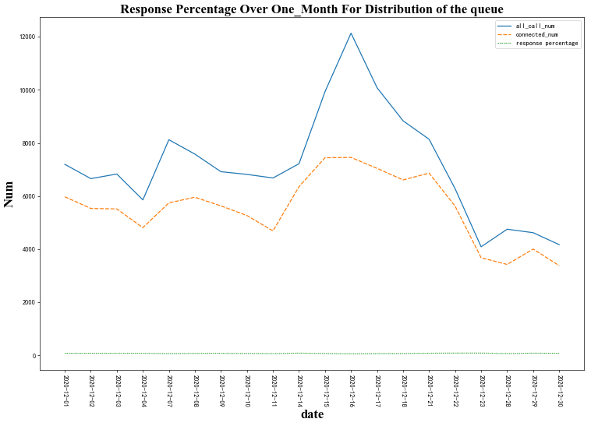
Response Call Percentage On Week Day over the month
when the call number reaches round 8000 or more a day, the ability of answering calls is restricted. Even the call number is at the peak of 12000, the ability of answering calls is still below 8000 per day.

Slide 9
An overview of the queues
PART 3

Slide 10
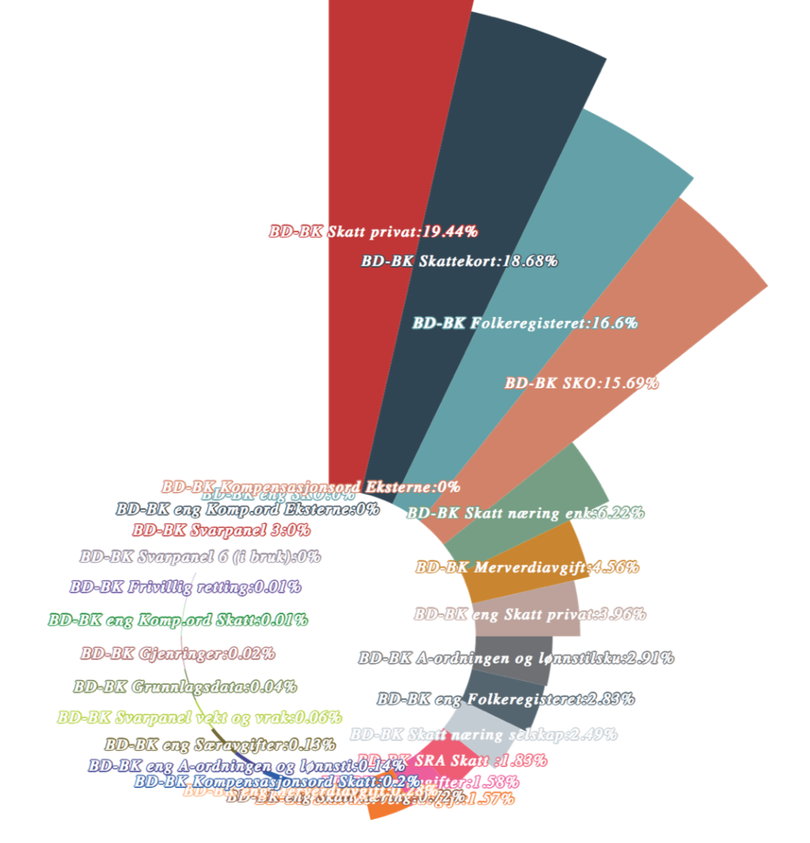
The percentage of incoming call number of different queue
Top four queue with call number:
Queues with no call
BD-BK Skatt privat
BD-BK Skattekort
BD-BK Folkeregistert
BD-BK SKO
BD-BK Svarpanel 3
BD-BK Kompensasjonsord Eksterne
BD_BK eng Komp-ord Eksterne
BD-BK eng SKO
BD-BK Svarpanel 6(i bruk)

Slide 11
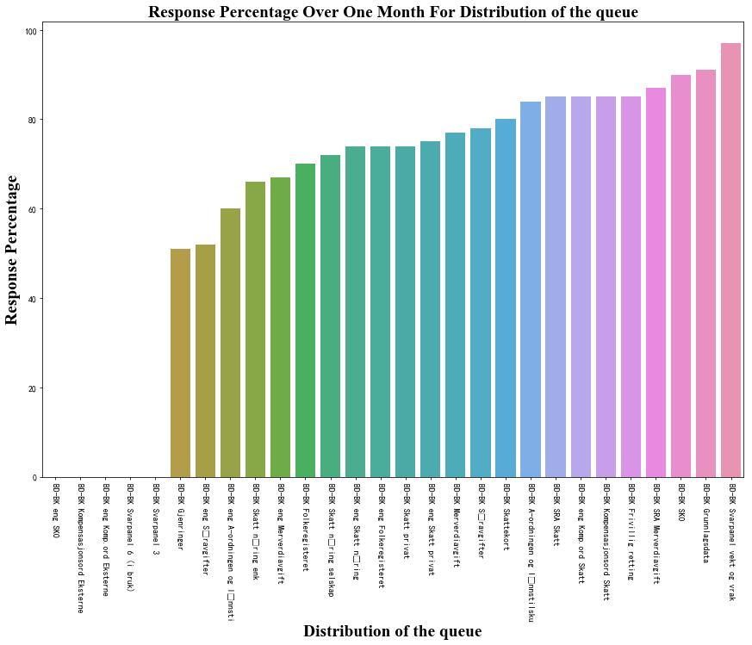
The percentage of call response of different queue
“BD-BK Svarpanel vekt og vrak ” has the highest Response Percentage, more than 95%
“Gjenringer” and “BD_BK end særavgiffter” has around 50% response percentage.

Slide 12
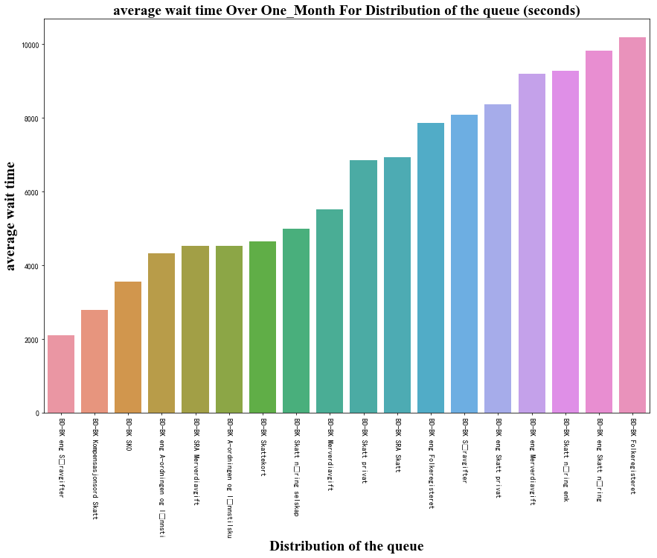
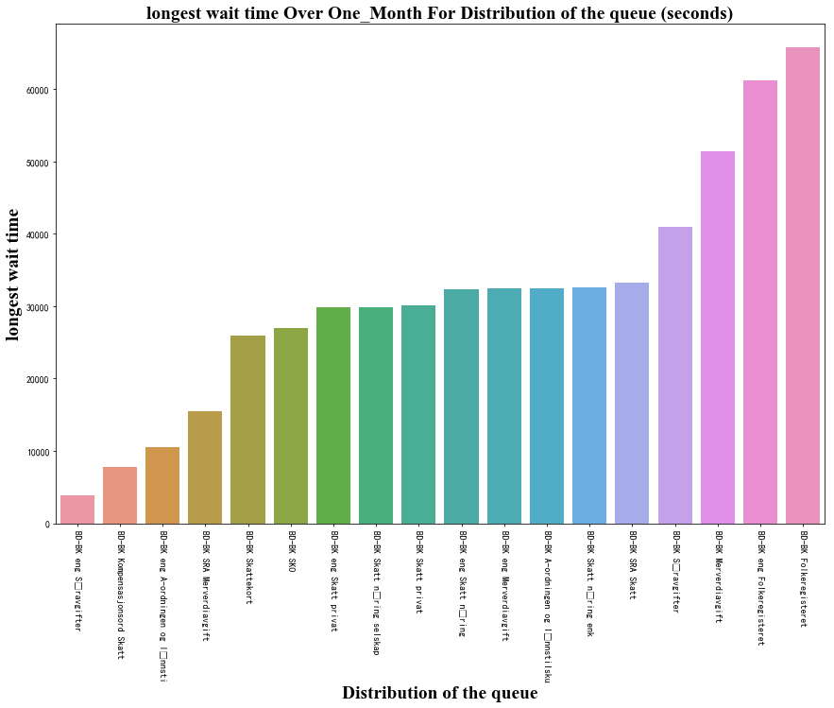
The wait time and hang up time while waiting

Slide 13
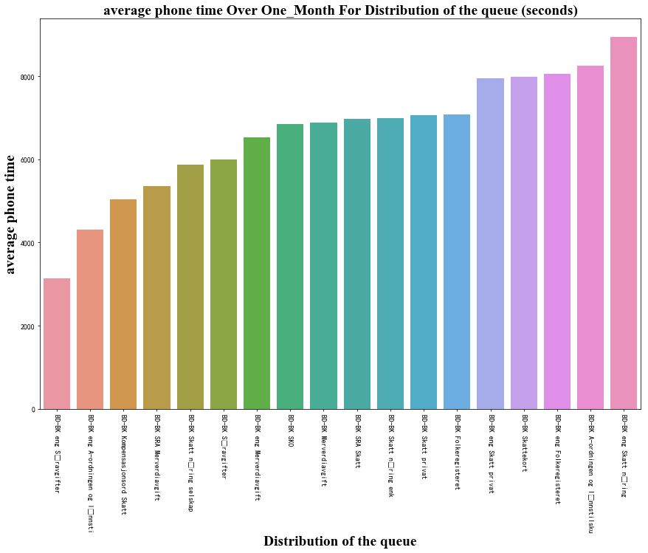
Average talk time of different queue over one month
“BD-BK Folkeregisteret” ranked sixth place
“ eng skatt næring” has the langest average phone time

Slide 14
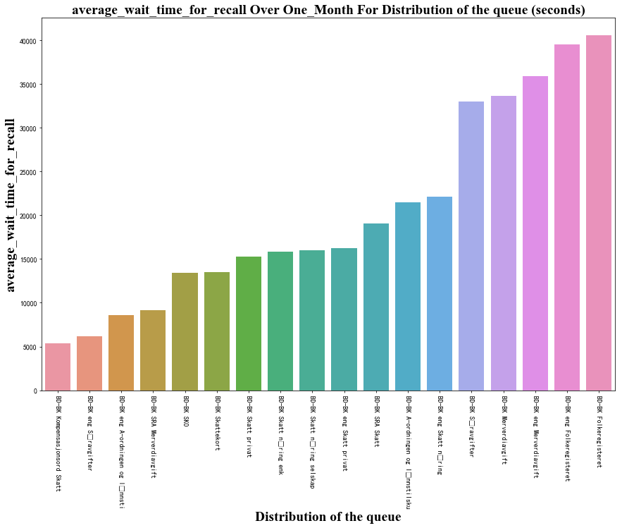
Average waiting time for recall
how long does it take to call back on different queue?

Slide 15

More analysis ideas
Restriction: dataset is too small.
Furture work:
predict next year
the number of incoming calls.
response persent.
waiting time for answering calls for the different queues

Slide 16
Interview case of Skatteetaten
Thank you
CHENXING LI
2021.01.26

