Slide 1
计算系统概论第一次习题课
ta1ly@mail.ustc.edu.cn
2023.10.21

Slide 2
HW1

Slide 3
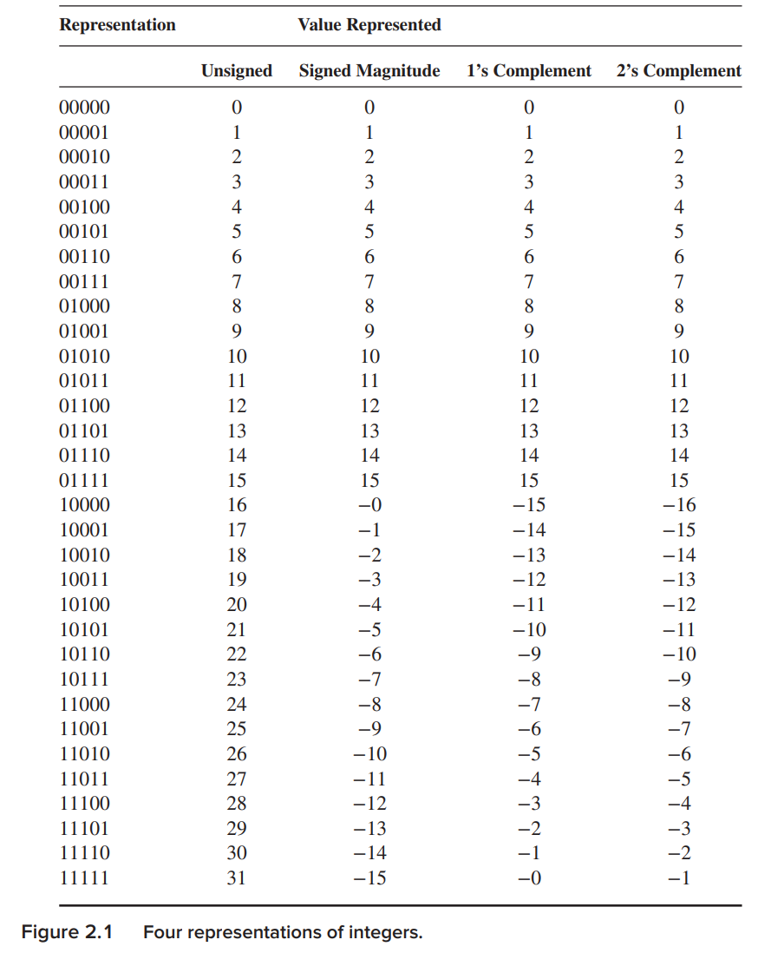
T2 T3 原码和补码
N 位 2 进制补码总共能表示 2^{N} 个不同的数值，表示的范围为 -2^{N-1} 到 2^{N-1} – 1
指数是N-1 不是 N
N 位 2 进制原码总共能表示 2^{N} - 1 个不同的数值，表示的范围为 -2^{N-1} + 1到 2^{N-1} – 1 （正负0）

Slide 4


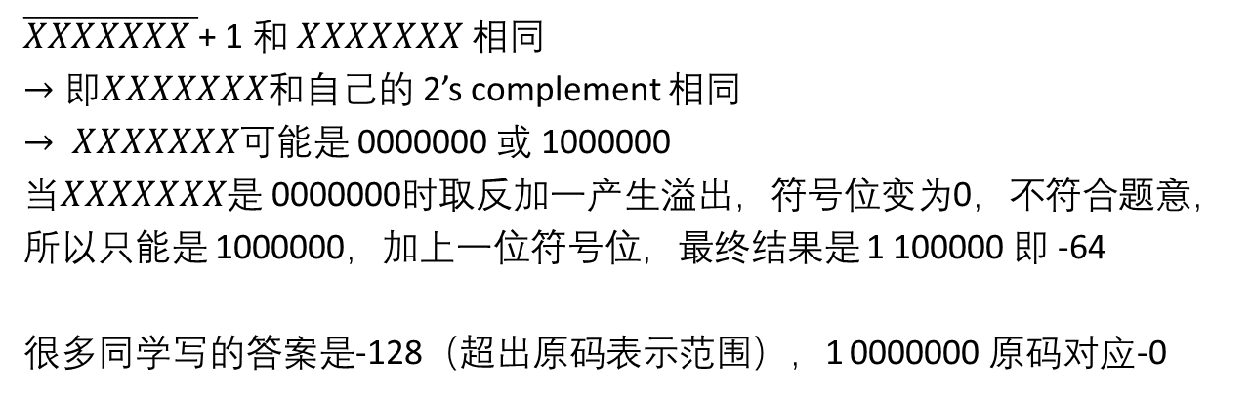

T2 T3 原码和补码
负数的原码
1 XXXXXXX
符号位
数值位
对应的相反数
0 $XXXXXXX$
取反
1 $\overline{XXXXXXX}$
加一得到补码
1 $\overline{XXXXXXX }$+ 1
$\overline{XXXXXXX }$+ 1 和 $XXXXXXX$ 相同
$→即XXXXXXX$和$自己$的 2’s complement 相同
$→ XXXXXXX$可能是 0000000 或 1000000
当$XXXXXXX$是 0000000时取反加一产生溢出，符号位变为0，不符合题意，所以只能是 1000000，加上一位符号位，最终结果是 1 100000 即 -64
很多同学写的答案是-128（超出原码表示范围），1 0000000 原码对应-0

Slide 5
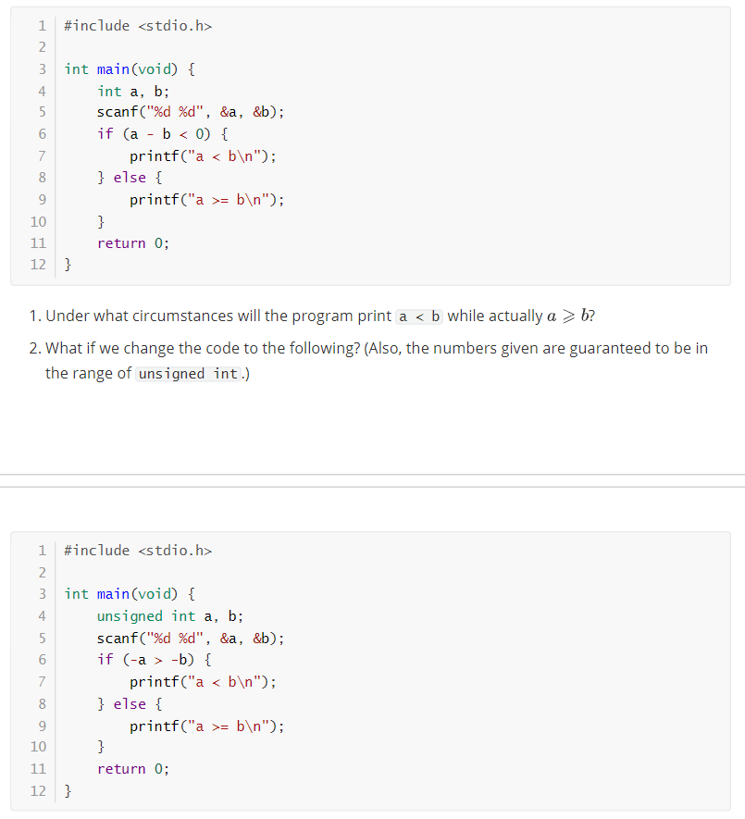
T4 溢出和比较语句
两个有符号数相减
实际结果为负数，但计算结果大于0，说明发生负溢出
实际结果为正数，但计算结果小于0，说明发生正溢出
32-bit 补码的表达范围 -2³¹ ~ 2³¹ – 1
负溢出时 说明 a – b < -2³¹ 正溢出时 说明 a – b > 2³¹ – 1
题目中 Under what circumstances will the program print a < b while actually a ≥ b? 说明这里发生了正溢出

Slide 6
T4 溢出和比较语句
无符号数取相反数，同样是取反加一，得到 “2’s complement”
无符号数视角下，N-bit的a和其补码相加得到2^{N}，所以-a对应的是2³²-a
但对于0而言，他的补码发生了进位，所以对应的是0
当b ≠ 0时，-a 与 -b 比较的是2³²-a 和 2³²-b，结果仍然保序
当b=0，a≠0时，出现 a<b，但此时由于a是无符号数所以一定大于0，出错

Slide 7
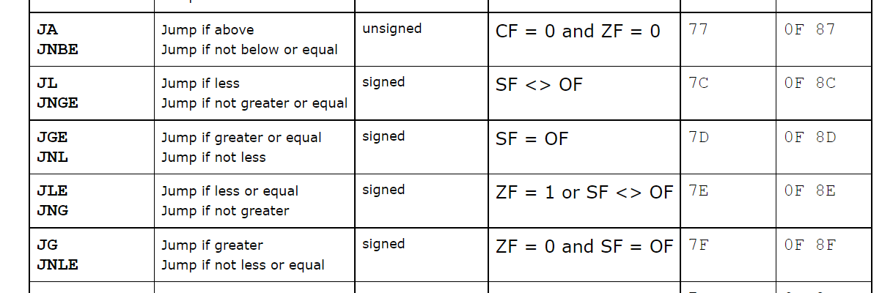
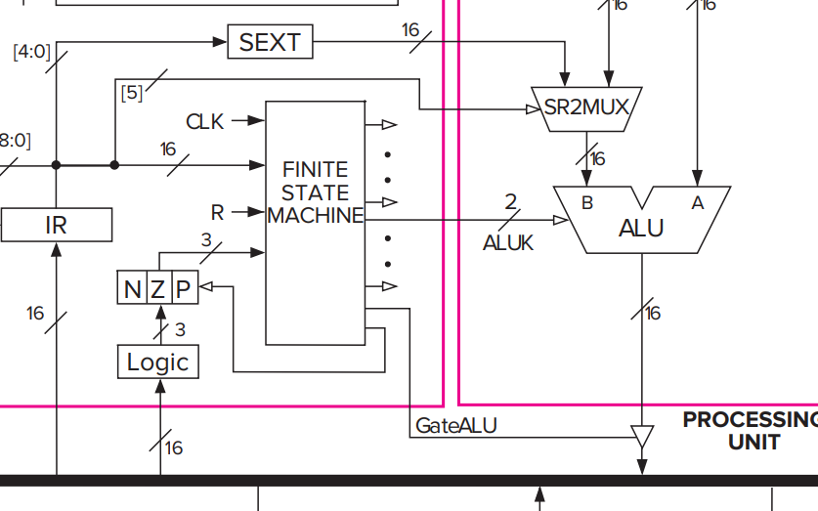
T4 溢出和比较语句
CMP Source1, Source2
temp = Source1 - SignExtend(Source2);
ModifyStatusFlags(); // Set CF, OF, SF, ZF, AF, and PF flags
无符号数
有符号数
CF - carry flag
ZF - zero flags
SF - sign flag
OF - overflow flag
LC3 中的flag

Slide 8
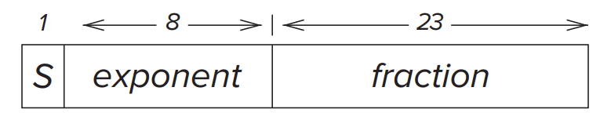
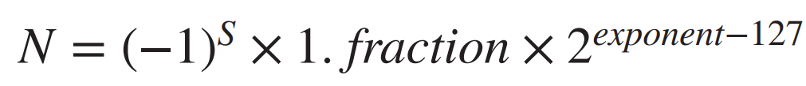


T6 浮点数格式
(a). What is the smallest number that can be represented using the IEEE 32-bit Floating Point standard?
(b). What is the smallest positive number that can be represented using the IEEE 32-bit Floating Point standard?
Normalized Form
Infinities
0/1 11111111 00000000000000000000000
Subnormal Numbers

Slide 9
T6 浮点数格式
(a). What is the smallest number that can be represented using the IEEE 32-bit Floating Point standard?
(b). What is the smallest positive number that can be represented using the IEEE 32-bit Floating Point standard?
(a). Binary float 1 11111110 11111111111111111111111
Value -(2-2⁻²³) x 2¹²⁷
(b). Binary float 0 00000000 00000000000000000000001
Value 2⁻²³ x 2⁻¹²⁶ = 2⁻¹⁴⁹
错误情况： 1. 没有分清楚subnormal和normal
2. 给出了inf的情况
注意一些陷阱，比如largest negative number（最靠近0的负数）

Slide 10
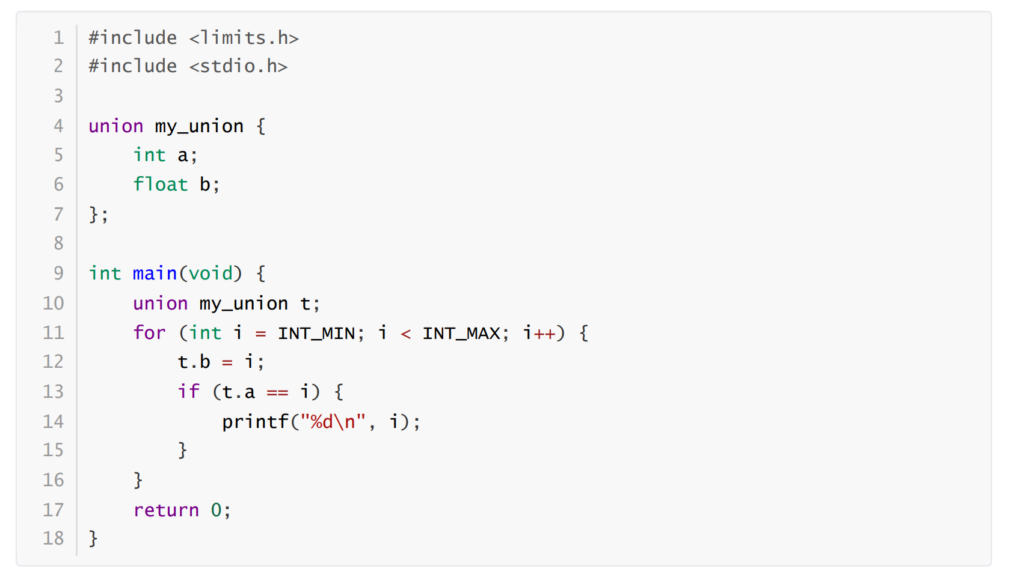
T7 整型与浮点型转化
超出float精度范围时，取近似值
利用union将同一块内存映射到不同的数据类型视图（union中所有的属性都是对同一个二进制数据的解读）

Slide 11
HW2

Slide 12
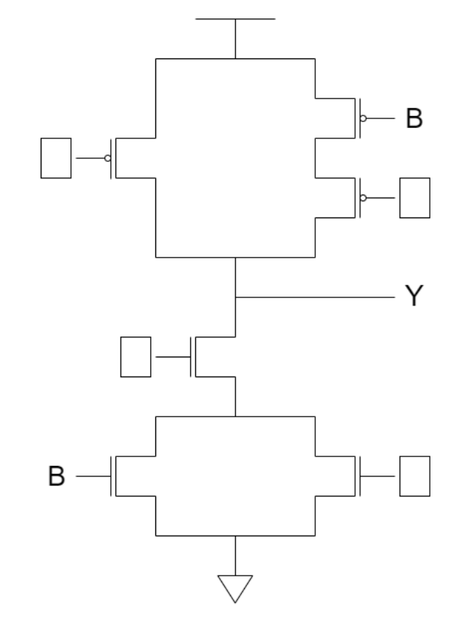
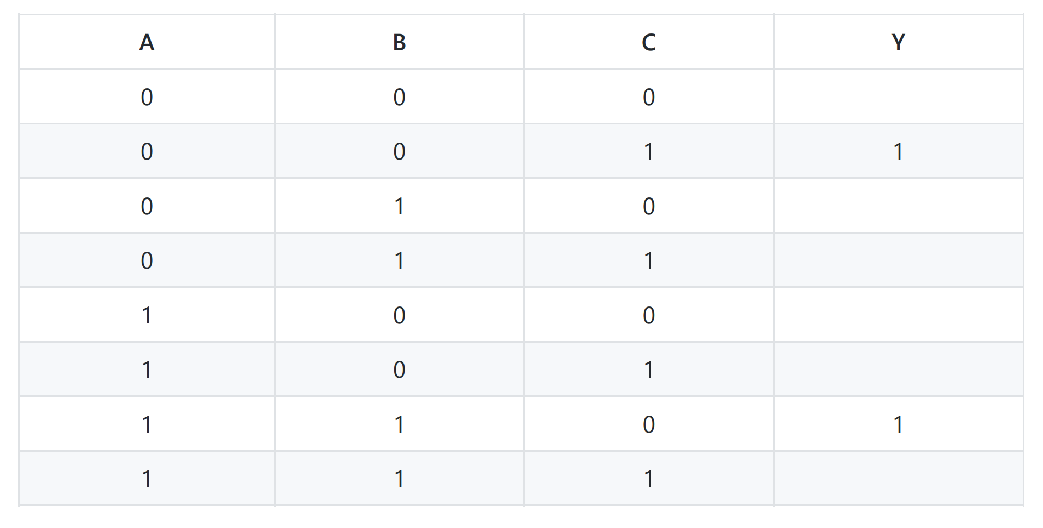
T1 补全逻辑电路与真值表
The transistor circuit shown below produces the accompanying truth table. The inputs to some of the gates of the transistors are not specified. Also, the outputs for some of the input combinations of the truth table are not specified. Complete both specifications. i.e., all transistors will have their gates properly labeled with either A, B, or C, and all rows of the truth table will have a 0 or 1 specified as the output.
1
C
2
3
C
4
1：C
3：C

Slide 13
T1 补全逻辑电路与真值表
The transistor circuit shown below produces the accompanying truth table. The inputs to some of the gates of the transistors are not specified. Also, the outputs for some of the input combinations of the truth table are not specified. Complete both specifications. i.e., all transistors will have their gates properly labeled with either A, B, or C, and all rows of the truth table will have a 0 or 1 specified as the output.
1
C
A / B
2
2： A or B
3
C
4
A / B
4：A or B

Slide 14
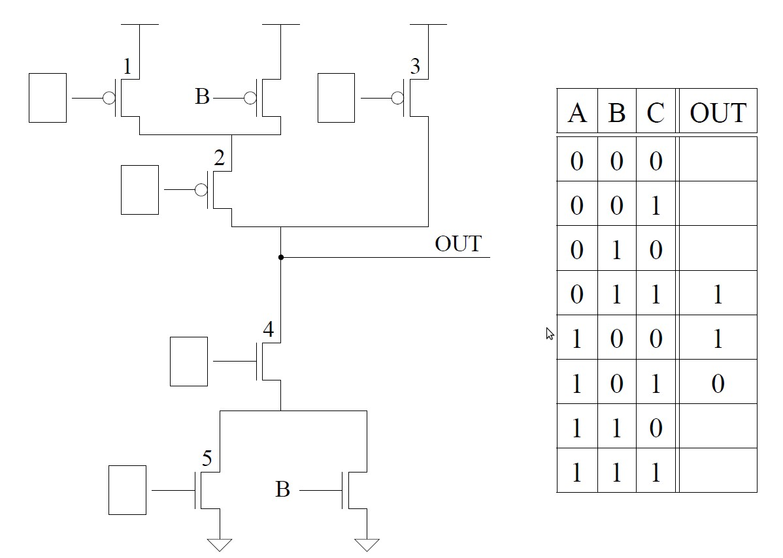
T1 补全逻辑电路与真值表
The transistor circuit shown below produces the accompanying truth table. The inputs to some of the gates of the transistors are not specified. Also, the outputs for some of the input combinations of the truth table are not specified. Complete both specifications. i.e., all transistors will have their gates properly labeled with either A, B, or C, and all rows of the truth table will have a 0 or 1 specified as the output.
4：A
5：B or C
A
5：C
5：A or C
C

Slide 15
T1 补全逻辑电路与真值表
The transistor circuit shown below produces the accompanying truth table. The inputs to some of the gates of the transistors are not specified. Also, the outputs for some of the input combinations of the truth table are not specified. Complete both specifications. i.e., all transistors will have their gates properly labeled with either A, B, or C, and all rows of the truth table will have a 0 or 1 specified as the output.
A
A
1,2：A or 3：A
A
若1,2为A 则 3为C
C

Slide 16
T1 补全逻辑电路与真值表
The transistor circuit shown below produces the accompanying truth table. The inputs to some of the gates of the transistors are not specified. Also, the outputs for some of the input combinations of the truth table are not specified. Complete both specifications. i.e., all transistors will have their gates properly labeled with either A, B, or C, and all rows of the truth table will have a 0 or 1 specified as the output.
A
C
A
A
？
C

Slide 17
T1 补全逻辑电路与真值表
The transistor circuit shown below produces the accompanying truth table. The inputs to some of the gates of the transistors are not specified. Also, the outputs for some of the input combinations of the truth table are not specified. Complete both specifications. i.e., all transistors will have their gates properly labeled with either A, B, or C, and all rows of the truth table will have a 0 or 1 specified as the output.
A
A
2：C，1：A/B
C

Slide 18
T1 补全逻辑电路与真值表
The transistor circuit shown below produces the accompanying truth table. The inputs to some of the gates of the transistors are not specified. Also, the outputs for some of the input combinations of the truth table are not specified. Complete both specifications. i.e., all transistors will have their gates properly labeled with either A, B, or C, and all rows of the truth table will have a 0 or 1 specified as the output.
A/B
A
1
C
1
1
先根据已有真值表找到确定的label
不确定的代入真值表找矛盾。
A
0
C
0

Slide 19
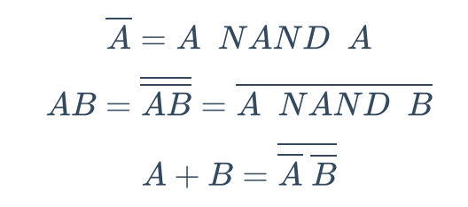
T2 NAND的逻辑完备性
教材Chapter 3.3.5 逻辑完备性定义：可以组合产生任意真值表
一个基本的逻辑完备集 {AND, OR, NOT}
给定逻辑门，只需要能够分别表示出 AND, OR, NOT即可说明逻辑完备
首先用与非门表示非门
再用非门和与非门表示与门
最后用与门和非门表示或门
这就说明与门，或门，非门都可以用与非门表示，而与门，或门，非门可以组合出任意电路，是逻辑完 备的，因此与非门也是逻辑完备的

Slide 20

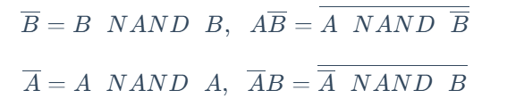
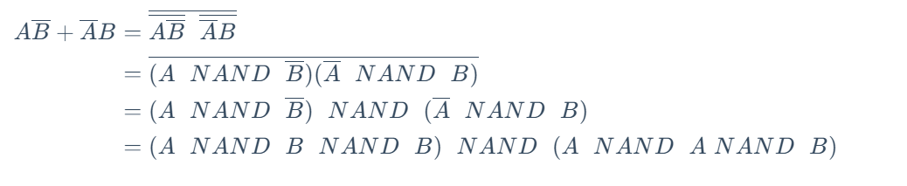
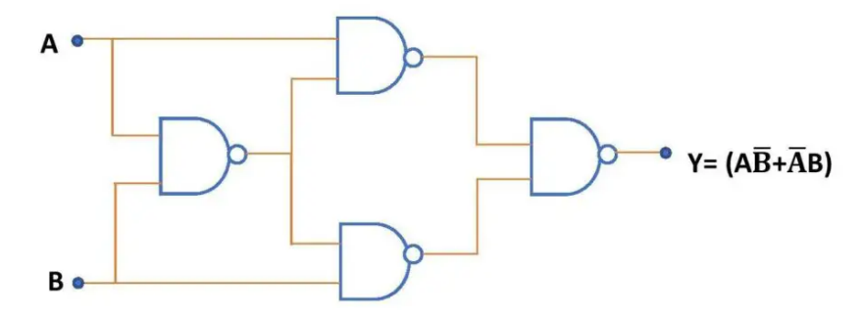
T5 与非门实现异或门
利用T2逻辑完备性
异或的表达式
实现电路

Slide 21
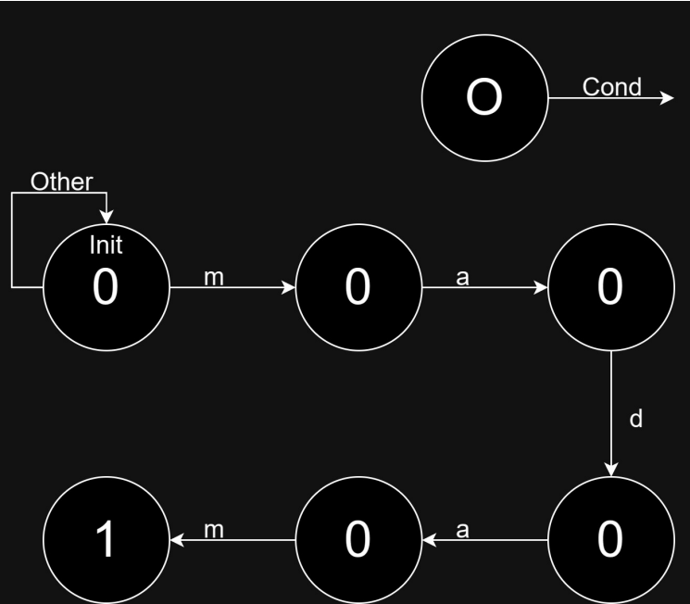
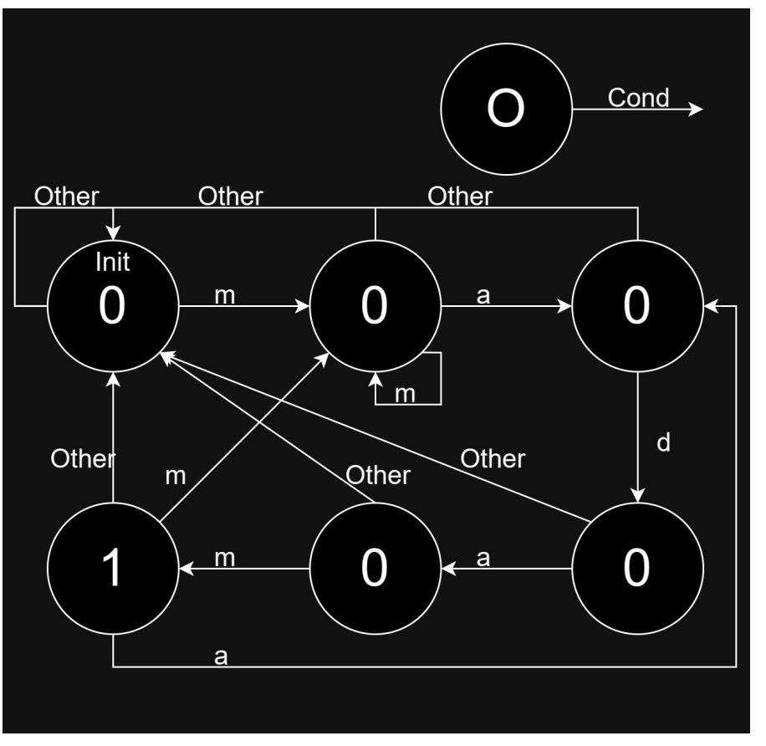
T7 状态机和状态数
Here's an incomplete FSM that, when pattern madam occurs, produces an output 1 . For example, given string madamadam , it'll produce 000010001 .
1. Complete the state diagram.

Slide 22

T7 状态机和状态数
2. Tell the minimum number of latches that are needed in order to implement this FSM. ( If this state machine is implemented with a sequential logic circuit how many state variables will be needed? Recall, the number of state variables is the same as the number of bits needed to represent all of the states.)
6个状态，2² < 6 $≤$ 2³ , 3bit即可表示出所有的状态
N个状态需要的bit数为 $\left\lceil \log{N}\right\rceil$(N>1)
DFA的等价条件：
（1）一致性条件：状态s和t必须同时为接受状态和不接受状态。（是否属于终止状态集） （2）蔓延性条件：对于所有输入符号，状态s和t必须转换到等价状态里。
DFA的最小化(不是本课程需要掌握的内容，感兴趣的同学看群文件）

Slide 23
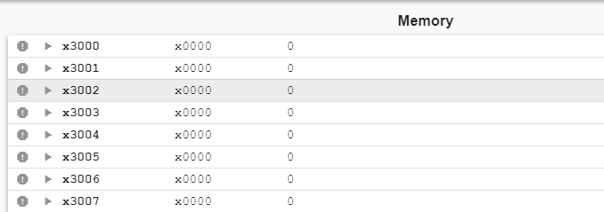
T8 T9 地址空间和寻址能力
There is a memory that needs a bit to represent its address, and its addressability is bit.
How much is the memory's address space at most?
How many bits can the memory store at most?
教材Chapter 3.5
Address Space：地址的数量
Addressability： 每个内存地址里存储数据量
内存大小 = 内存中地址的数量 x 每个地址存储的位数
a bits 地址空间 可以表示2ª个有效地址
b bits 寻址能力 表示每个地址对应 b bit 存储空间
总共能存储 2ªxb bit 信息

Slide 24
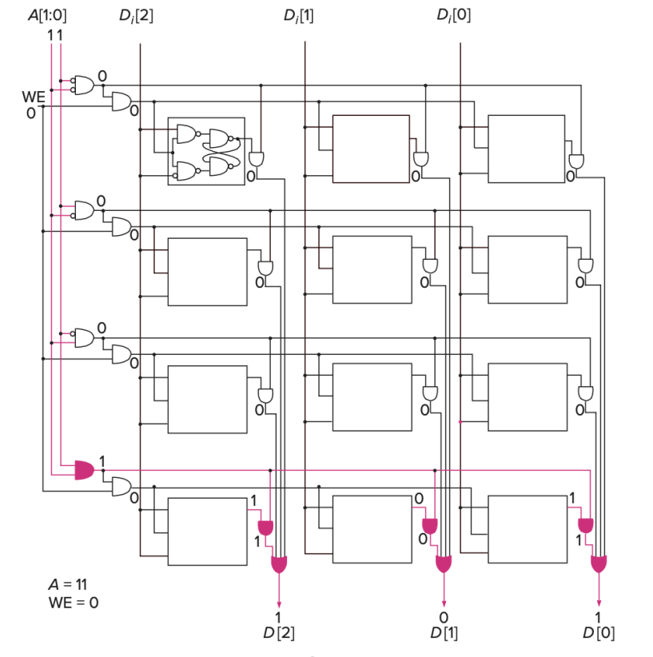
T8 T9 地址空间和寻址能力
地址线：地址有多少位，对应地址空间的大小
数据线：有几位就说明一块内存里存储的数据有几位
一个地址对应的内存块

Slide 25
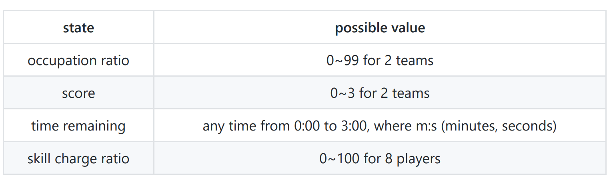
T10 状态空间
In a land occupation competition participated by 2 teams, with 4 players in each team, we need to keep track of the following information on the scoreboard.
1. What is the minimum number of bits that we need to use to store the state required?
N=(100 ∗ 100 ∗ 4 ∗ 4 ∗ 181 ∗ 100 ⁸)， 需要$\left\lceil \log{N}\right\rceil =78$ bit

Slide 26
T10 状态空间
In a land occupation competition participated by 2 teams, with 4 players in each team, we need to keep track of the following information on the scoreboard.
100 - 7bits
4 - 2bits
m(0-3) - 2bits
s(0-59) - 6bits
100 - 7bits
2. Suppose we make four separate logic circuits for each line of the four elements on the scoreboard, how many bits would it then take to store the state of the scoreboard?
(7bits * 2) + (2bits * 2) + (2bits + 6bits) + (7bits * 8) = 82bits

