Slide 1

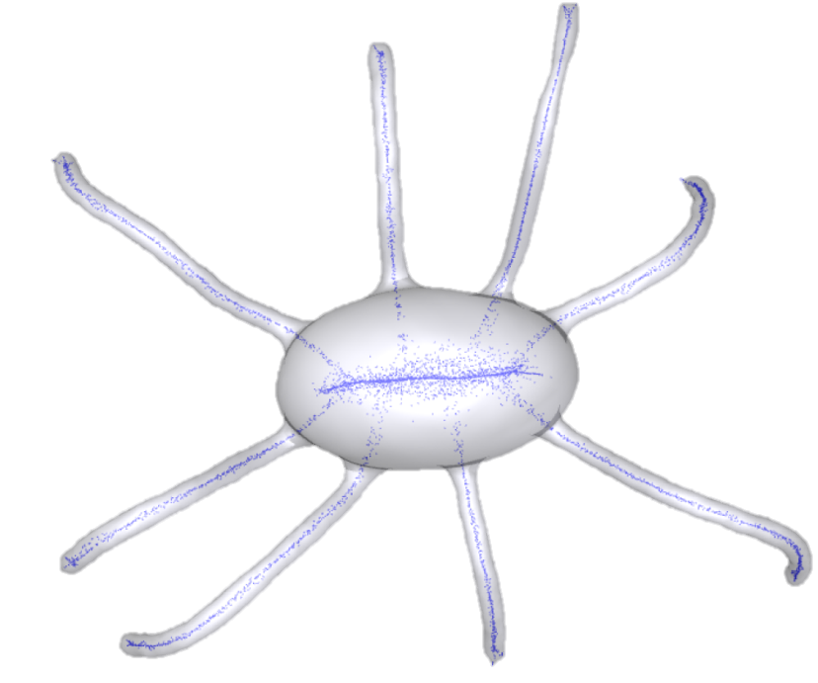
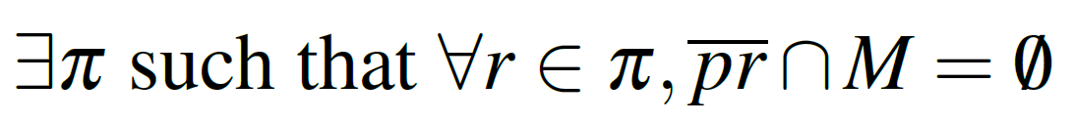
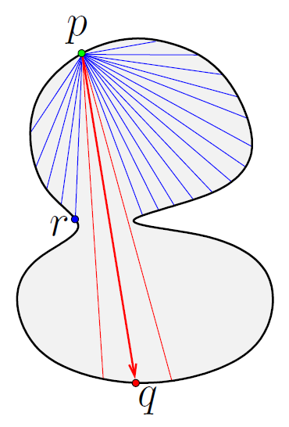
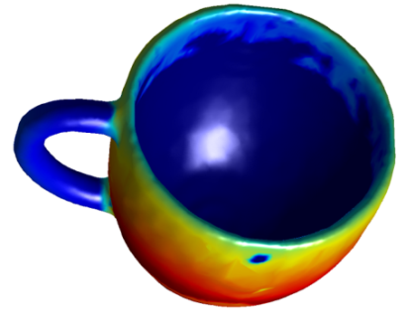
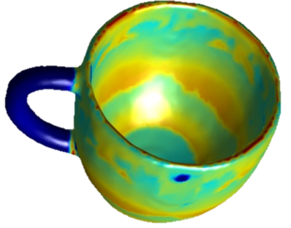
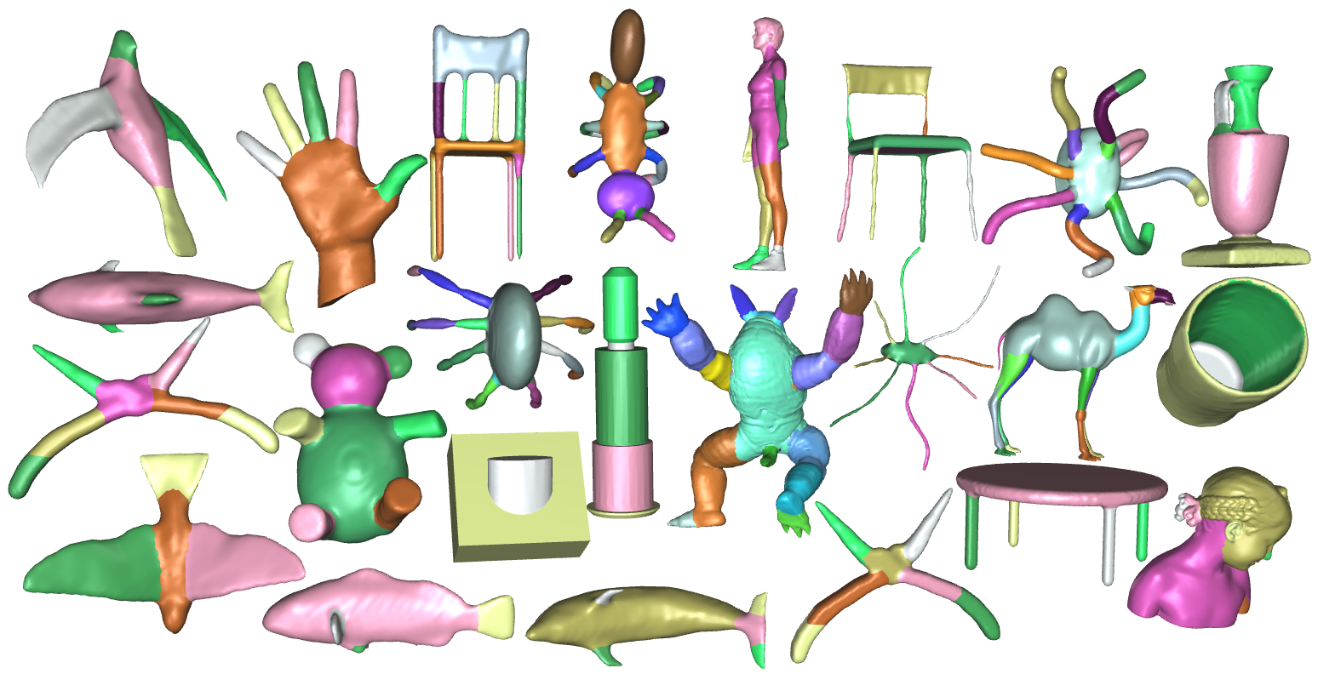
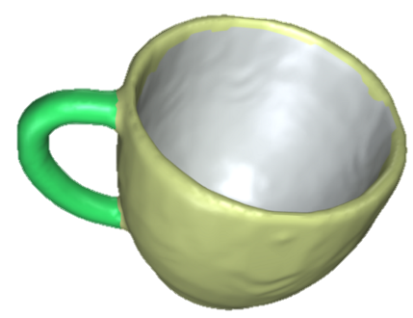
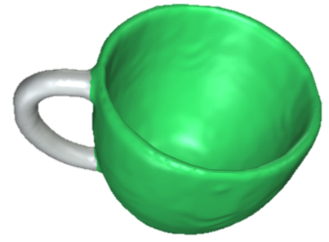
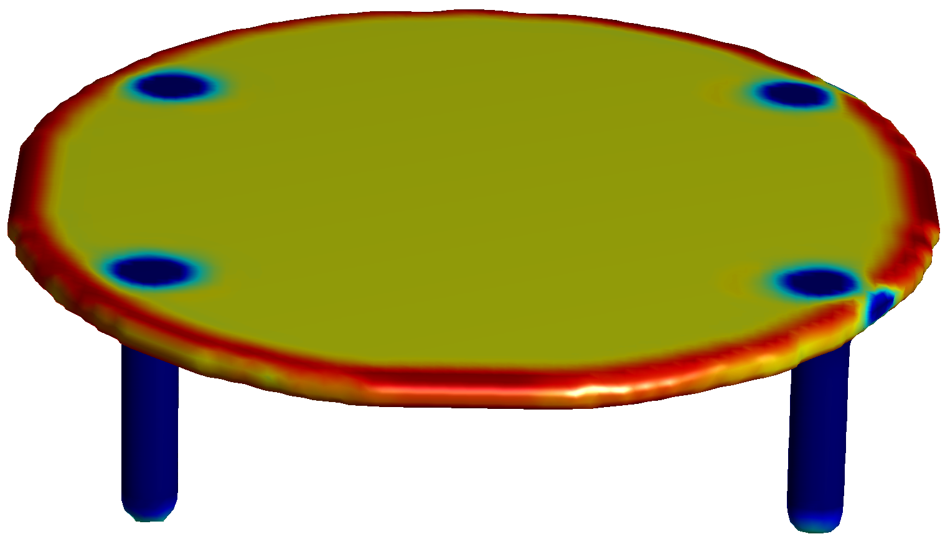
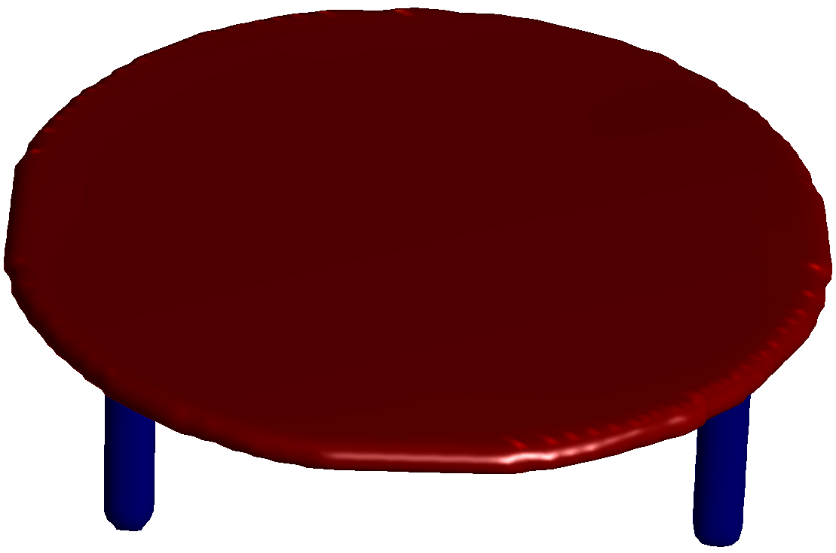
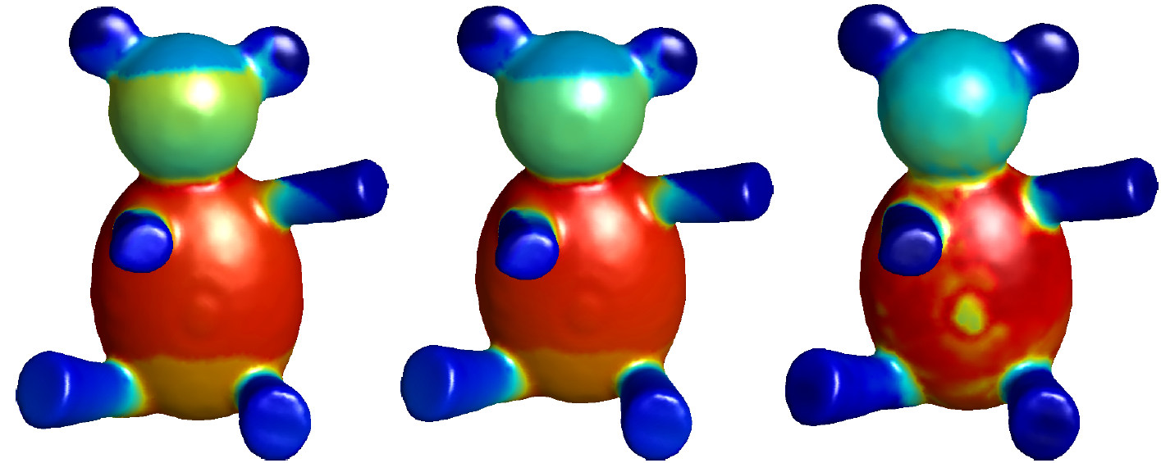
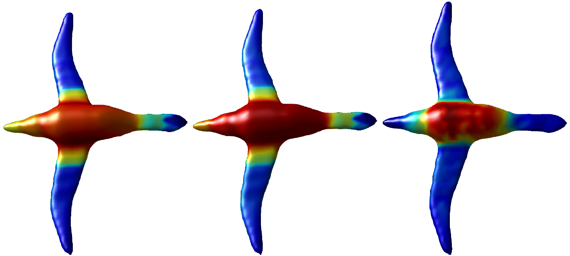
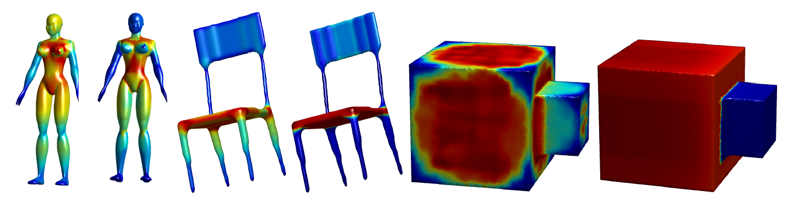
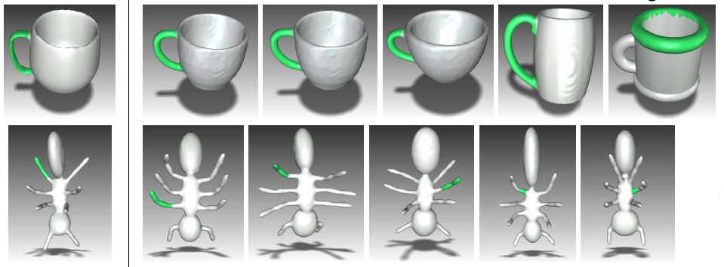

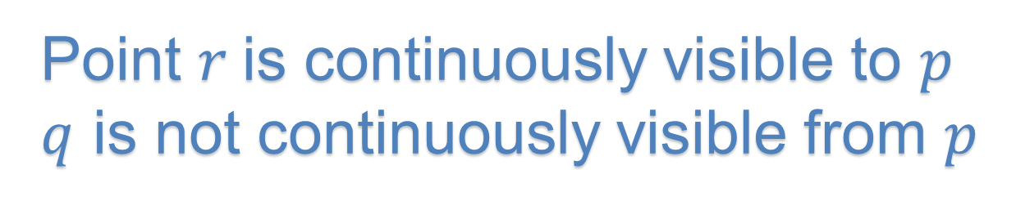
Continuous Visibility Feature Guilin Liu, Yotam Gingold, and Jyh-Ming Lien
project webpage
http://masc.cs.gmu.edu/wiki/CVF
What is Continuous Visibility
CVF variants
Average CVF
send ray in $p$’s counter-normal direction and intersect at $t$
avg_CVF($p$) = (CVF($p$) + CVF($t$))/2
Strong CVF
need to be mutual continuously visible CV($p$, $q$) && CV($q$, $p$)
Good for?
Weak CVF
CV($p$, $q$) = true if length of invisible parts $πw$ for $p$ and $πv$ for $q$are both smaller than $τ$
$$max⁡(||πw||, ||πv||) < τ$$
Good for? tolerating surface noise and ??
Applications
Shape segmentation
Part-based Shape Retrieval
Vertex $q$is continuously visible to $p$, CV($p$, $q$)=true if and only if:
Skeleton extraction
 | SDF | CVF | avg CVF | weak CVF | strong CVF
RI | 0.18 | 0.17 | 0.15 | 0.16 | 0.16
where π is is a geodesic path connecting p to q
What are these numbers?
Point $r$is continuously visible to $p$
$q$ is not continuously visible from $p$
evaluated on Princeton Seg. Benchmark (400 models?)
Smaller RI means better matching
original CVF
average CVF
Define continuously Visible region
for a vertex
segmentation
Explain what is the color code below…
segmentation
Shape diameter function
SDF
Continuous visibility feature
CVF
original CVF strong CVF weak CVF
For each model, left – SDF (shape diameter function); right -- CVF

