Slide 1

MIPI Introduction
billy

Slide 2
MIPI Introduction
Contents
  What is MIPI?
  D-PHY construction features
  MIPI data transmission
  DSI&CSI application

Slide 3
MIPI Introduction
MIPI：
  Mobile Industry Processor Interface
    MIPI Alliance is a collaboration of mobile industry leaders.
    Objective to promote open standards for interfaces to mobile application processors.
  MIPI Spec：
    DCS—Display Command Set
    DBI--Display Bus Interface
    DPI--Display Pixel Interface
    DSI--Display Serial Interface
    CSI--Camera Serial Interface
    D-PHY

Slide 4
MIPI Introduction
MIPI Features
  Low power
    Dynamic adjustable low-power consumption (LP) and high speed (HS) data model and low signal swing 。
  High speed
    Each channel can reach to 500~1000Mbps
  Low cost PHY
  EMI

Slide 5
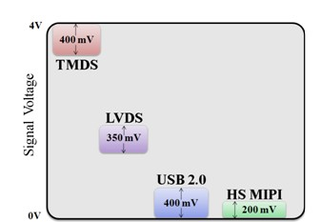
MIPI Introduction
MIPI compare to other differential signal swing.
    TMDS: Transition Minimized Differential signal
    LVDS: Low-Voltage Differential Signaling

Slide 6
D-PHY
D-PHY (Physical Layer) ：
  D-PHY provide the DSI (display serial interface) and CSI (camera serial interface) in the physical definition.
  D-PHY describes the source synchronous high speed(HS), low power consumption (LP) of the physical layer.
  D-PHY data transfer rate is not fixed, 500 ~1000 Mbit/s.
PHY Configuration：
  A clock channel
  One or more data channels

Slide 7
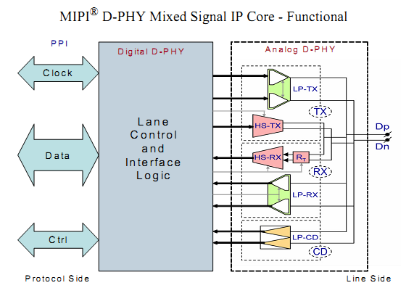
D-PHY

Slide 8
D-PHY
3 types main channels：
  Single-track clock
  Single-track data channel
  Duplex data channel
Transfer mode：
  Low power signal mode-LP
  High speed signal mode-the HS

Slide 9
D-PHY
  Low power signal mode-LP
    10Mbps
    Asynchronous transfer
    Single signal
    (0V~1.2V)
  High speed signal mode-the HS
    80Mbps～1Gbps
    Synchronous transfer
    Differential signal
    (100mV~300mV)

Slide 10
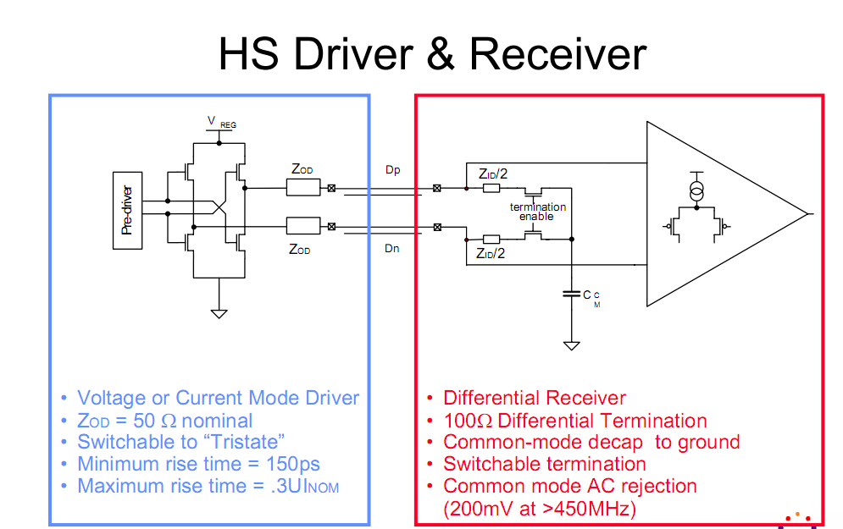

Slide 11
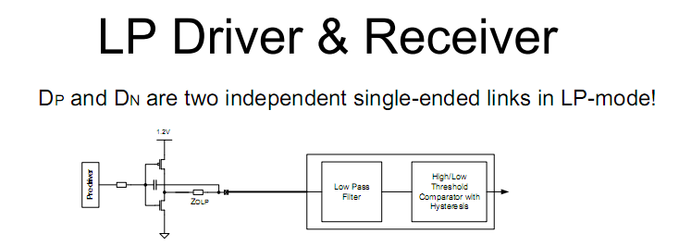

Slide 12
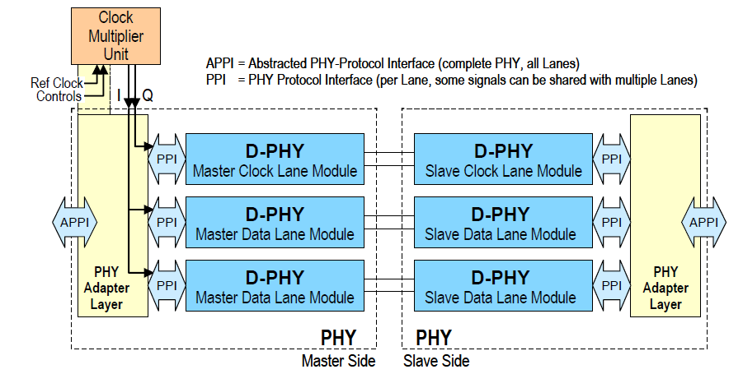
Two Data Lane PHY Configuration

Slide 13
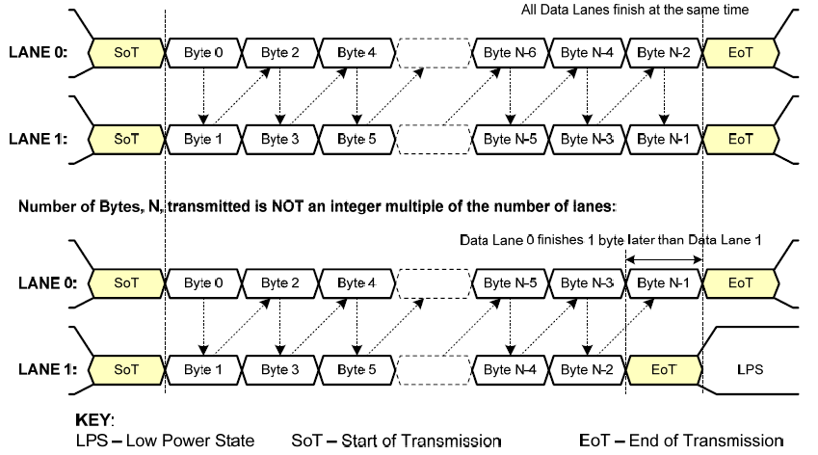
Two Data Lanes HS Transmission Example

Slide 14
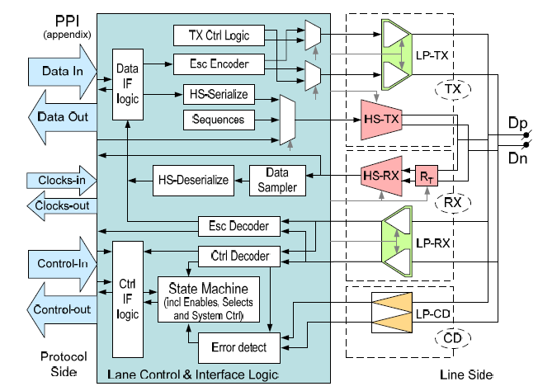
Universal Lane Module Architecture

Slide 15
MIPI Data transmission
Transfer mode ：
  High speed mode --800Mbps(Differential signal)
  Low power mode—10Mbps (Single signal)
    In the LP mode Lane0 only to return to the data
The type of data packets：
  Short Packet：4 bytes (Fixed length)
  Long Packet：6~65541 bytes (Variable length)

Slide 16
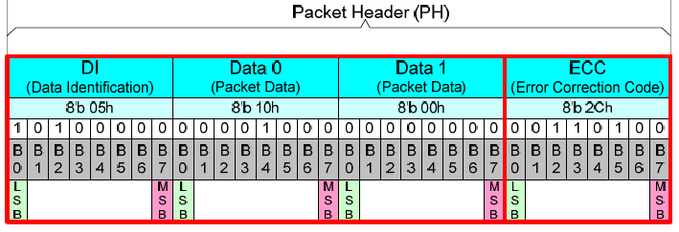
Short Packet Structure
Packet Header (4 bytes)
  Data Identifier (DI) * 1byte: Contains the Virtual Channel[7:6] and Data Type[5:0].
  Packet Data * 2byte: Data for transfer, length is fixed at two bytes .
  Error Correction Code (ECC) * 1byte: Allows single-bit errors to be corrected and 2-bit errors to be detected.
Example
Notes:
通道位[7:6] 和Data Type[5:0]
纠错码（验证数据完整性）

Slide 17
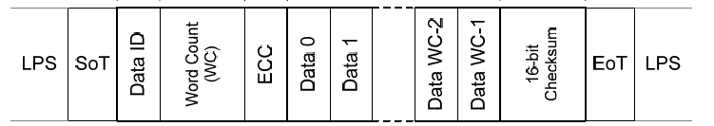
Long Packet Structure
Packet Header (4 bytes)
  Data Identifier (DI) * 1byte: Contains the Virtual Channel[7:6] and Data Type[5:0].
  Word Count (WC) * 2byte: Data for transfer, length is fixed at two bytes .
  Error Correction Code (ECC) * 1byte: Allows single-bit errors to be corrected and 2-bit errors to be detected.
Data Payload (0~65535 bytes)
  Max size=2^16。
Packet Footer (2 bytes)： Checksum
  If the payload has length 0, then the Checksum calculation results in FFFFh
  If the Checksum isn’t calculated, the Checksum value is 0000h
Packet Size
  4 + (0~65535) + 2 = 6 ~ 65541 bytes

Slide 18


Data Transmission Way
Separate Transmissions
Separate Transmissions
KEY:
  LPS – Low Power State SP – Short Packet
  SoT – Start of Transmission LgP – Long Packet
  EoT – End of Transmission

Slide 19
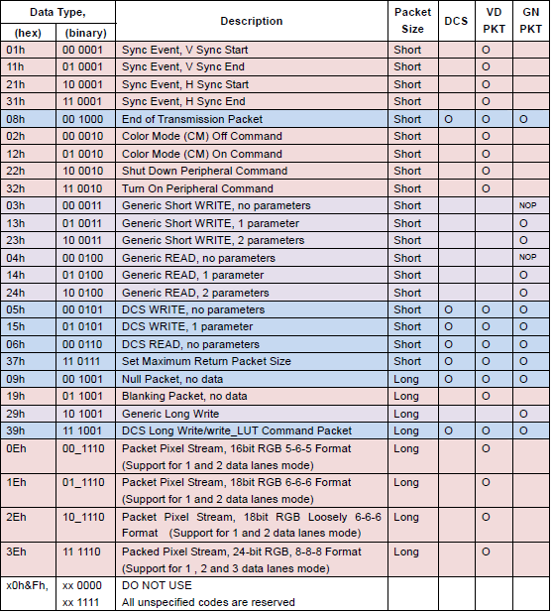
Data Types for Processor-sourced Packets

Slide 20
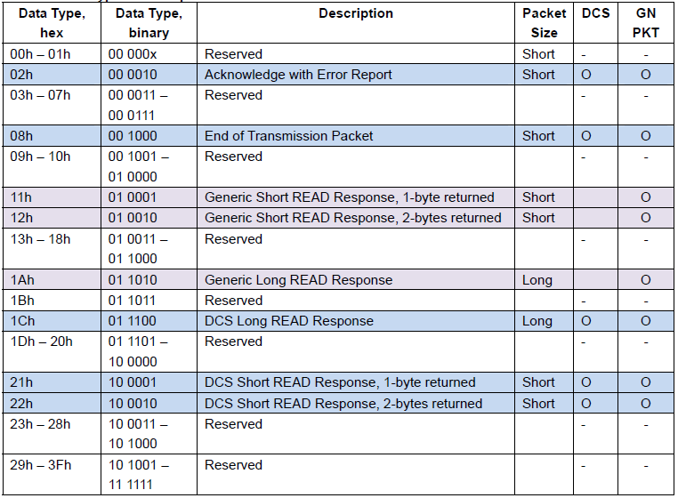
Peripheral-to-Processor LP Transmissions

Slide 21
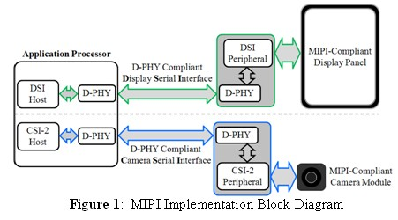
MIPI Application
DSI &CSI typical application

Slide 22
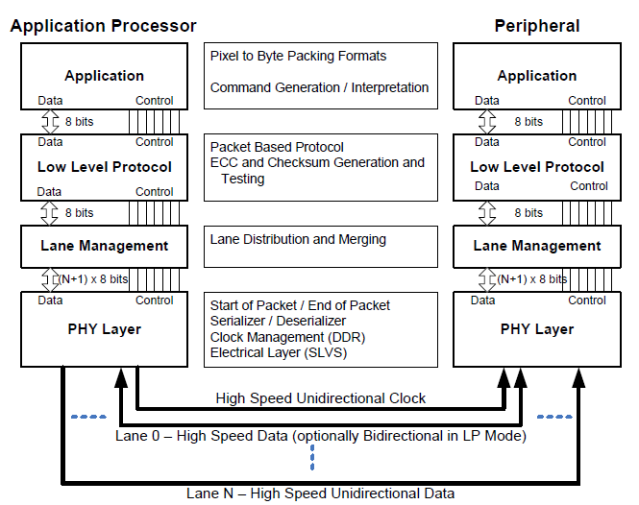
MIPI Application
DCS
DSI
D-PHY

Slide 23
Thanks！

