Slide 1

Further Sketching for Influence Maximization
2022.12.16
Xiaolong CHEN
PhD in Data Science and Analytics
Notes:
I am Xiaolong CHEN from DSA Thrust. My supervisor is Prof. TANG Jing. The title of my project is Further Sketching for Influence Maximization.

Slide 2
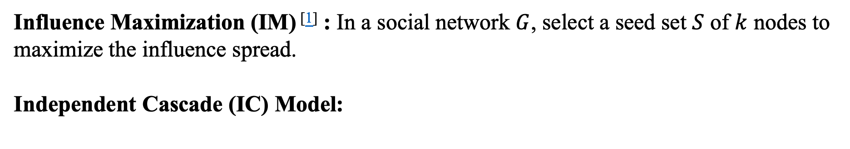
Introduction & Preliminaries
Influence Maximization (IM) ^{[1]} : In a social network $G$, select a seed set $S$ of $k$ nodes to maximize the influence spread.
Independent Cascade (IC) Model:
A
A
0.6
0.3
0.8
D
D
B
C
B
0.5
C
0.2
0.9
G
G
E
0.2
E
0.6
0.4
F
F
0.3
H
H
Fig. 1 Illustration of IC model
Notes:
First let‘s introduce the problem. For influence maximization, given a social graph G, we want to select a seed set S of k nodes to maximize the influence spread.
But how do the nodes influence others. We will focus on the diffusion model called Independent Cascade, which has been mentioned in the course. Every edge is attached with a probability that the target node can be activated by the source node.
The influence propagation goes as follows. At first, we will select a set of nodes to be active, which is called seed set.
Then, the nodes in the seed set will activate their neighbors with certain probability.
At the next timestamp, the newly activated nodes will continue such a process until no new node is activated. Every active node can attempt to influence others only once.
Actually, this is an NP-hard algorithmic problem.

Slide 3
Introduction & Preliminaries
Reverse Influence Sampling^{[2]}
A
A
D
D
B
B
C
C
G
G
E
E
Reverse Reachable
set
F
F
H
H
Fig. 2 Illustration of Reverse Reachable sets
Notes:
In 2014, Borgs’s group put forward the idea of reverse sampling, with near-linear time complexity. First we introduce reverse reachable set. From a node, we simulate the IC process reversely. That is to say, we propagate the influence against the directed edges. The activated nodes comprise a reverse reachable set, which we will call a RR set.

Slide 4

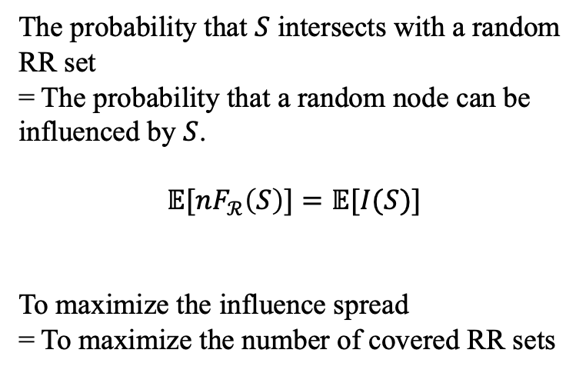
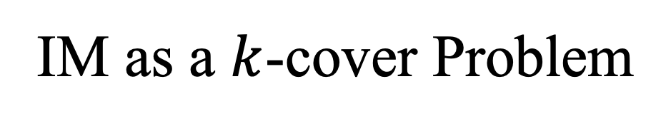
IM as a $k$-cover Problem
Nodes
The probability that $S$ intersects with a random RR set
= The probability that a random node can be influenced by $S$.
$$𝔼[nF_{ℛ}\left(S\right)]=𝔼[I(S)]$$
To maximize the influence spread
= To maximize the number of covered RR sets
RR sets
A
A
D
D
B
B
C
C
G
E
G
E
F
F
H
H
Fig. 3 IM as a $k$-cover problem
Notes:
The key observation is that The probability that the seed set S intersects with a random RR set is equal to the probability that a random node can be influenced by $S$.
In other words, the more influential a node is, the more RR sets it will appear in. Then this problem can be formulated as a maximum coverage problem.
Here is a key conversion.
Consider every node as a set and every RR set as an element. Finding the node set that intersects with most RR sets is equivalent to finding k sets that covers most elements, which is exactly the k cover problem.

Slide 5
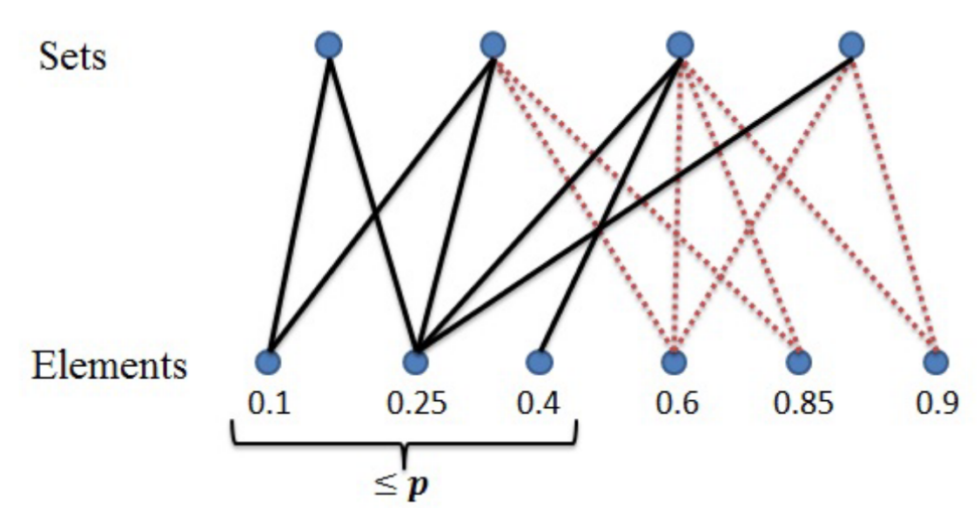
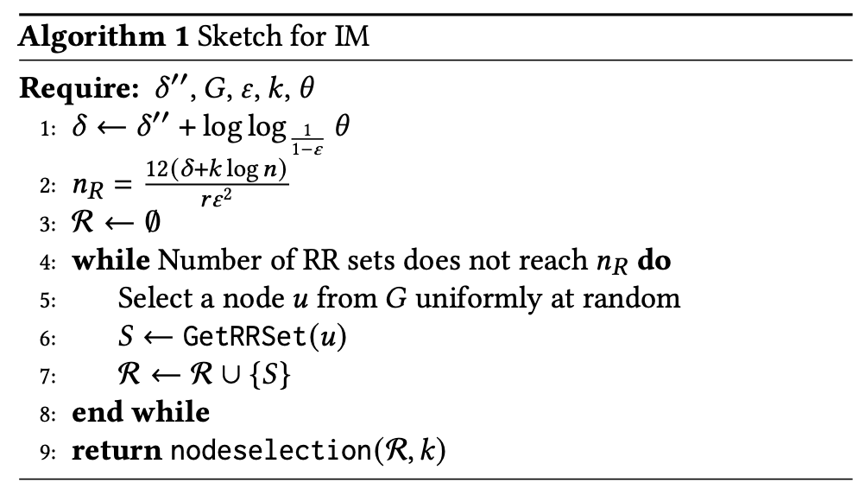
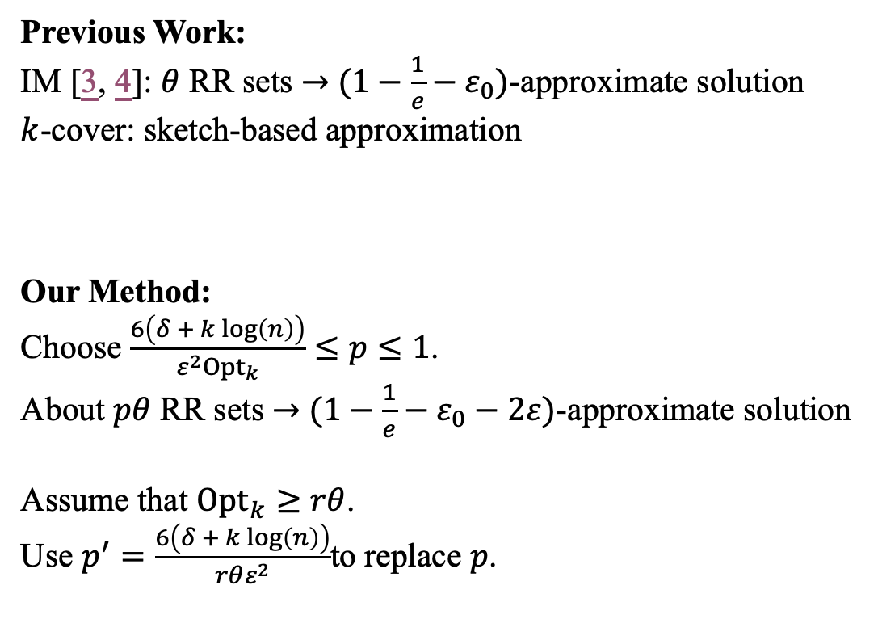

Method
Previous Work:
IM [3, 4]: $θ$ RR sets $→$ $(1−\frac{1}{e}−ε_{0})$-approximate solution
$k$-cover: sketch-based approximation
Our Method:
Choose $\frac{6\left(δ + k log\left(n\right)\right)}{{ε^{2}Opt}_{k}}≤p≤1$.
About $pθ$ RR sets $→$ $(1−\frac{1}{e}−ε_{0}−2ε)$-approximate solution
Assume that ${Opt}_{k}≥rθ$.
Use $p^{′}=\frac{6\left(δ + k log\left(n\right)\right)}{rθε^{2}}$to replace $p$.
Fig. 4 Sketch for $k$-cover
Notes:
A previous work propose that using theta RR sets can give a (1-1/e-\eps_0) approximate solution. Here theta has a complicated formulation, but I dont show it here. We just need to know, there is a theta giving an approximation solution.
Another work studies k-cover problem and proposed that by setting a proper probability p and randomly throwing the elements with p can give an approximate solution for the k-cover problem.
By utilizing this idea in the context of influence maximization, we can further reduce the number of sampling that we need to give a solution with a certain guarantee. But notice that the probability here contains the optimal solution, which we don’t know beforehand. So we assume at least a certain fraction r of elements will be covered. Then we can use this probability to bound the number of RR sets.

Slide 6
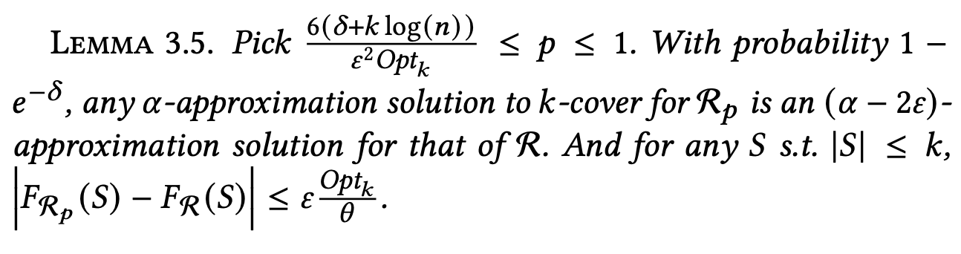
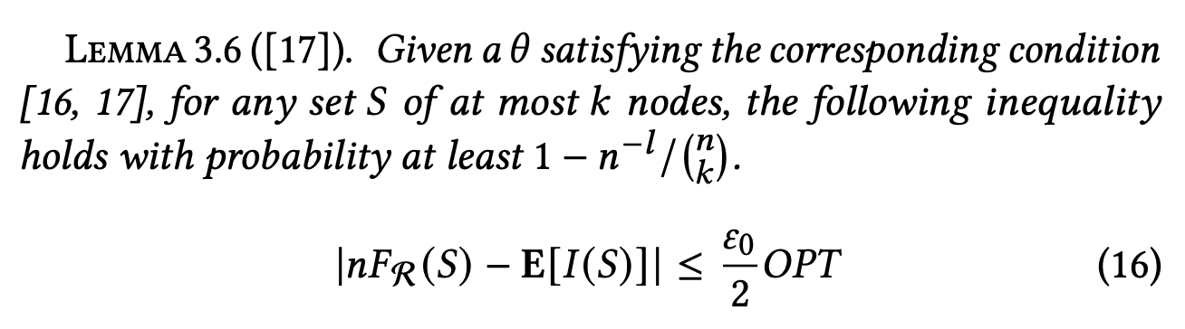
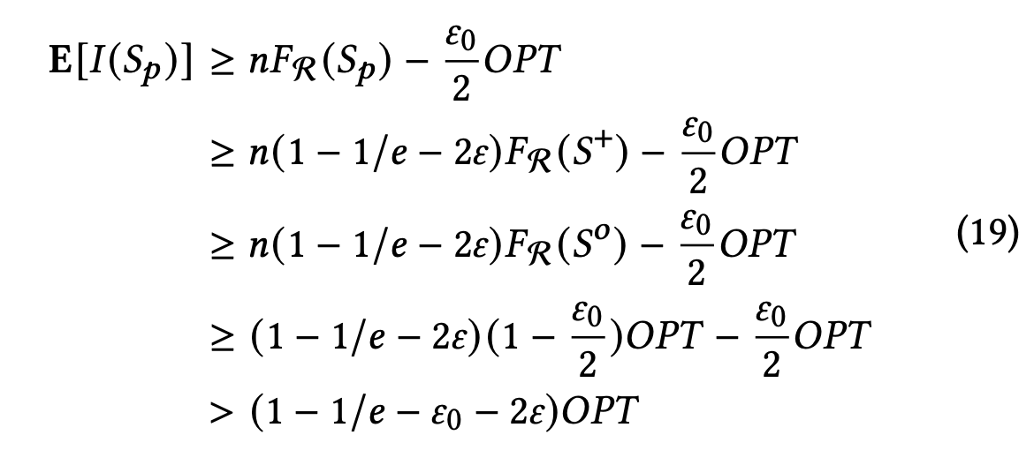
Some Proofs
Notes:
Actually the key contribution focuses on the theoretical part.
Here are some of the core lemmas. I consider this is somehow boring and cannot be covered in this presentation. So I will skip it.

Slide 7
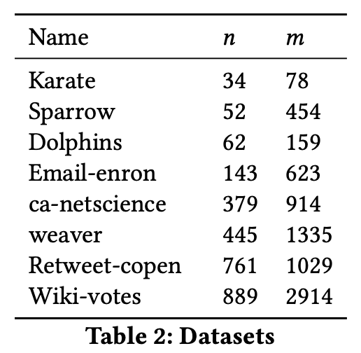
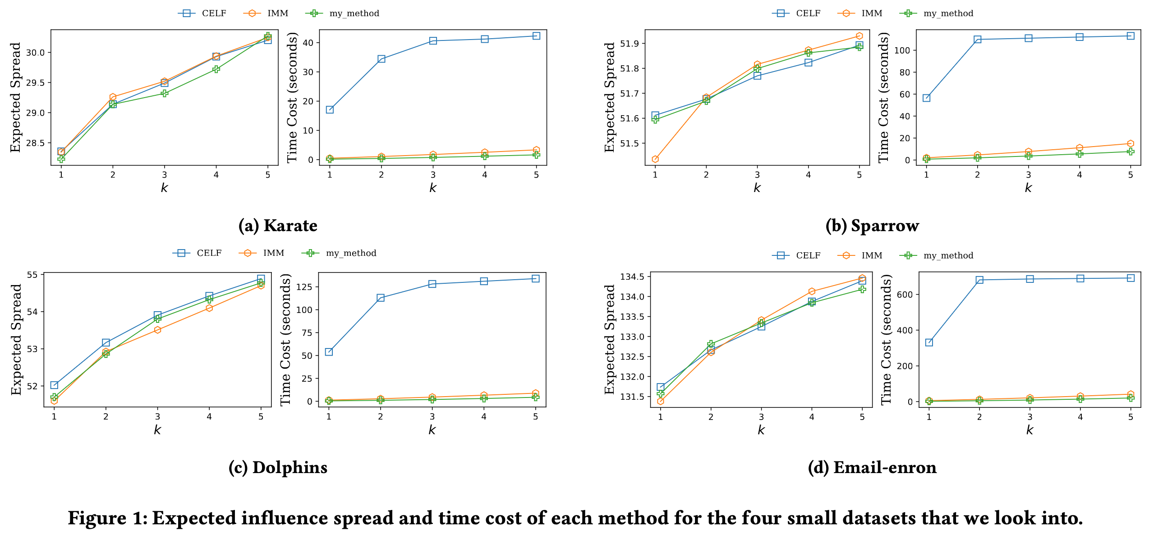
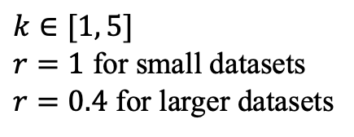
Results
$$k∈[1, 5]$$
$r=1$ for small datasets
$r=0.4$ for larger datasets
Notes:
åThen we go to the experiment result. These are the datasets used in this project.
We set r equal to 1 for small datasets and 0.4 for relatively larger datasets.
For the first four smaller datasets we implement three methods.
The figure on the right hand side illustrates the results. We can see that our methods can return relatively good results with slight improvement on the time complexity.

Slide 8
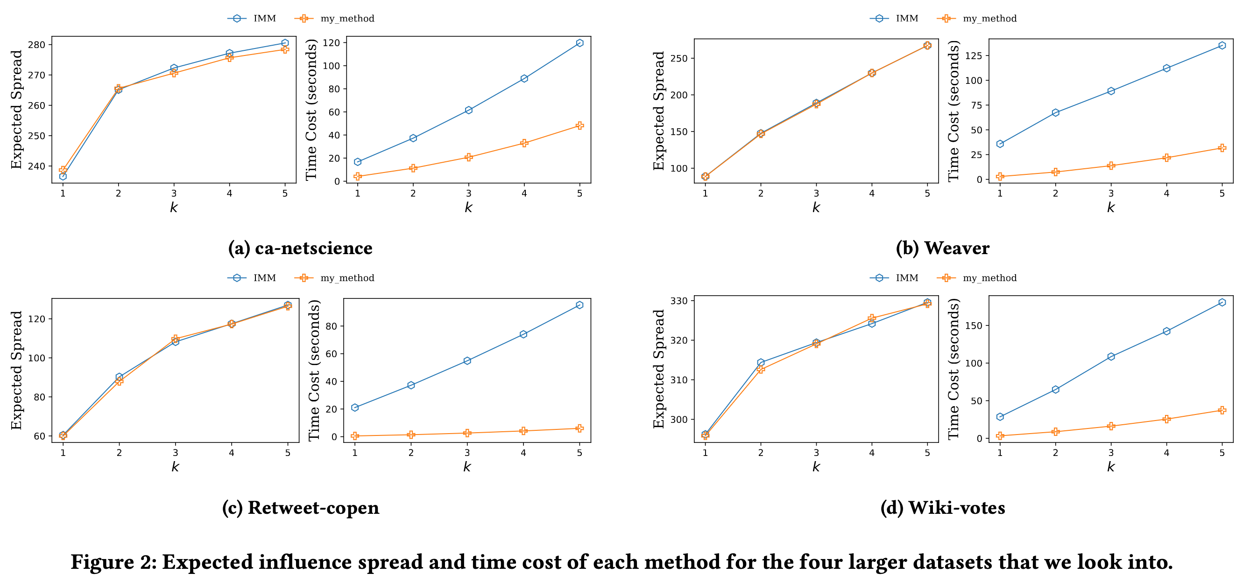
Results
Notes:
For relatively larger datasets, we only implement the sota method and our method. We can see that the improvement on the time complexity is more obvious and still returns good results.

Slide 9
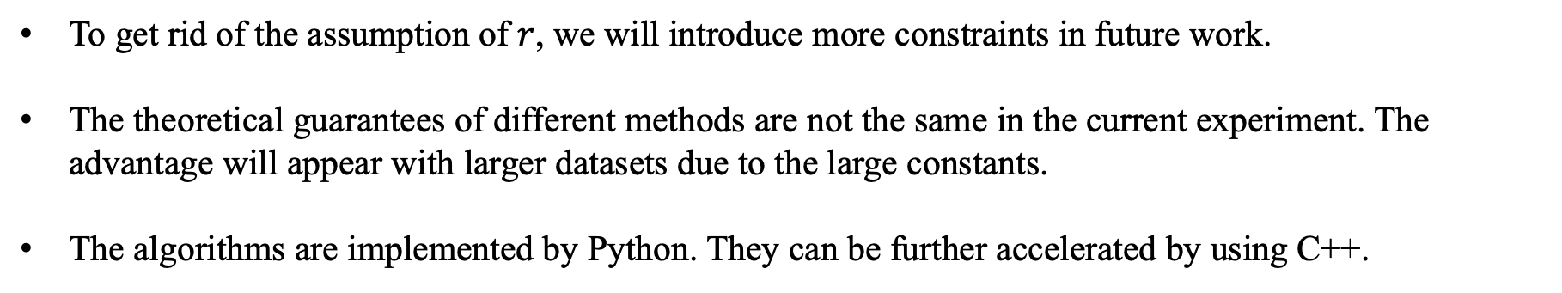
Clarifications
To get rid of the assumption of $r$, we will introduce more constraints in future work.
The theoretical guarantees of different methods are not the same in the current experiment. The advantage will appear with larger datasets due to the large constants.
The algorithms are implemented by Python. They can be further accelerated by using C++.
Notes:
Finally I want to clarify something.

Slide 10
Reference
[1] Kempe, D., Kleinberg, J., & Tardos, É. (2003, August). Maximizing the spread of influence through a social network. In Proceedings of the ninth ACM SIGKDD international conference on Knowledge discovery and data mining (pp. 137-146).
[2] Borgs, C., Brautbar, M., Chayes, J., & Lucier, B. (2014, January). Maximizing social influence in nearly optimal time. In Proceedings of the twenty-fifth annual ACM-SIAM symposium on Discrete algorithms (pp. 946-957). Society for Industrial and Applied Mathematics.
[3] Tang, Y., Xiao, X., & Shi, Y. (2014, June). Influence maximization: Near-optimal time complexity meets practical efficiency. In Proceedings of the 2014 ACM SIGMOD international conference on Management of data (pp. 75-86).
[4] Tang, Y., Shi, Y., & Xiao, X. (2015, May). Influence maximization in near-linear time: A martingale approach. In Proceedings of the 2015 ACM SIGMOD international conference on management of data (pp. 1539-1554).

Slide 11
Thanks!
Q & A

