Slide 1

Further Sketching for Influence Maximization
2022.12.15
Xiaolong CHEN
PhD in Data Science and Analytics
Code and report are available in the github repository: https://github.com/chenxlong3/iota5001_proj
Notes:
I am Xiaolong CHEN from DSA Thrust. The title of my data science project is on the failure of centrality measures in Influence Maximization. The code and report are in my github repository. If you guys are interested, pls refer to that.

Slide 2
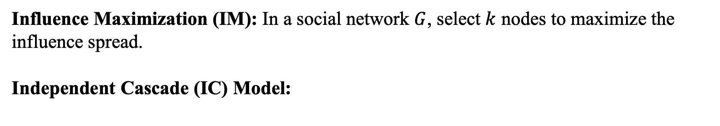
Introduction & Preliminaries
Influence Maximization (IM): In a social network $G$, select $k$ nodes to maximize the influence spread.
Independent Cascade (IC) Model:
A
A
0.6
0.3
0.8
D
D
B
C
B
0.5
C
0.2
0.9
G
G
E
0.2
E
0.6
0.4
F
F
0.3
H
H
Notes:
First let‘s introduce the problem. For influence maximization, given a social graph G, we want to select k nodes to maximize the influence spread. But how do the nodes influence others. We will focus on the diffusion model called Independent Cascade. Every edge is attached with a probability that the target node can be activated by the source node. I will tell you how the influence propagation goes. At first, we will select a set of nodes to be active, which is called seed set. Then, the nodes in the seed set will activate their neighbors with certain probability. At the next timestamp, the newly activated nodes will continue such a process until no new node is activated. Every active node can attempt to influence others only once. Actually, this is an NP-hard algorithmic problem. But from the course we know that centrality measures can reflect social influence to some extent. So what if we just use centrality ranking to select nodes? Such a kind of idea raises a number of questions. Let’s dive into them.

Slide 3
Introduction & Preliminaries
Reverse Influence Sampling^{[3]}
A
A
D
D
B
B
C
C
G
G
E
E
F
F
H
H
Notes:
The first question is how do those centrality measures perform in the IM problem compared to others?
If they fail to return a good result, what are the reasons?
What kinds of network structure features can affect the performance of such methods?
Before starting to solve these questions. I’ll quickly go through the algorithms used in this project.

Slide 4
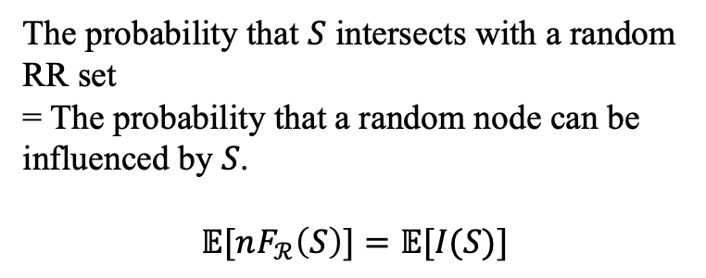
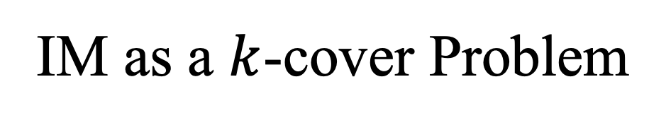
IM as a $k$-cover Problem
The probability that $S$ intersects with a random RR set
= The probability that a random node can be influenced by $S$.
$$𝔼[nF_{ℛ}\left(S\right)]=𝔼[I(S)]$$
Nodes
RR sets
A
A
D
D
B
B
C
C
G
E
G
E
F
F
H
H
Notes:
The first one is Monte-Carlo Greedy. We select the node with the highest influence increment in each iteration. But how do we estimate the influence spread? We just simulate the influence propagation process for a large number of times.
CELF makes use of the submodularity of the influence function to reduce useless computation. Just think it as the MC-greedy + Early Termination.

Slide 5
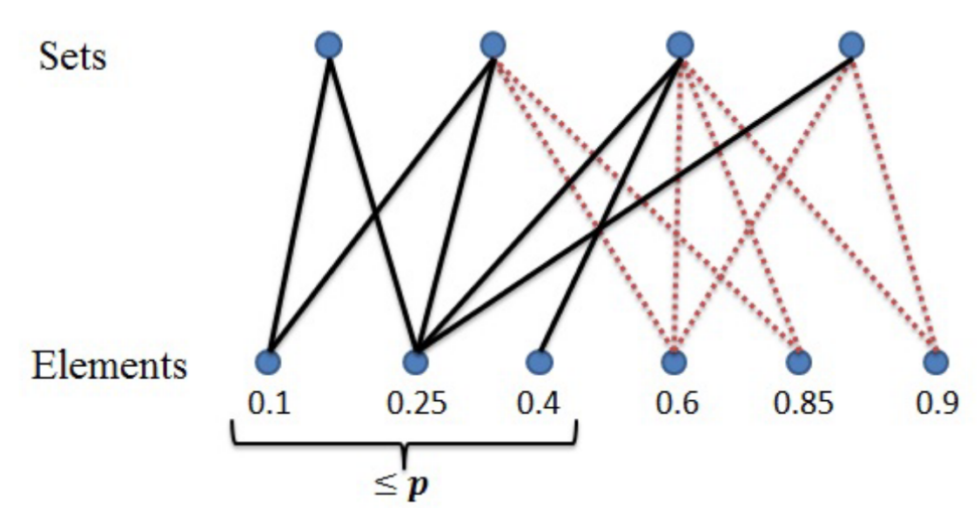
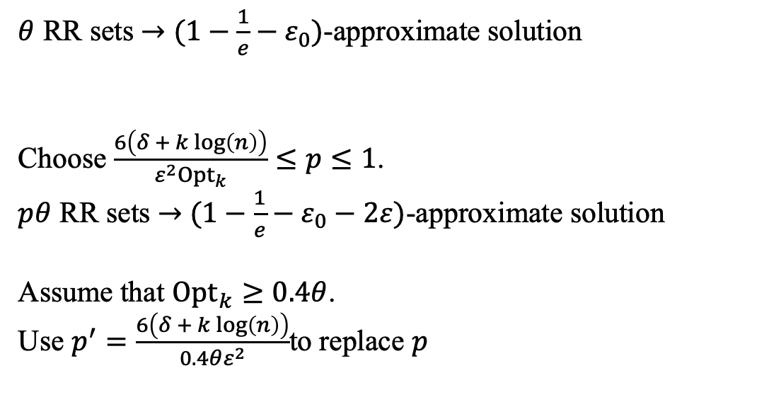
Method
$θ$ RR sets $→$ $(1−\frac{1}{e}−ε_{0})$-approximate solution
Choose $\frac{6\left(δ + k log\left(n\right)\right)}{{ε^{2}Opt}_{k}}≤p≤1$.
$pθ$ RR sets $→$ $(1−\frac{1}{e}−ε_{0}−2ε)$-approximate solution
Assume that ${Opt}_{k}≥0.4θ$.
Use $p^{′}=\frac{6\left(δ + k log\left(n\right)\right)}{0.4θε^{2}}$to replace $p$
Notes:
The first one is Monte-Carlo Greedy. We select the node with the highest influence increment in each iteration. But how do we estimate the influence spread? We just simulate the influence propagation process for a large number of times.
CELF makes use of the submodularity of the influence function to reduce useless computation. Just think it as the MC-greedy + Early Termination.

Slide 6
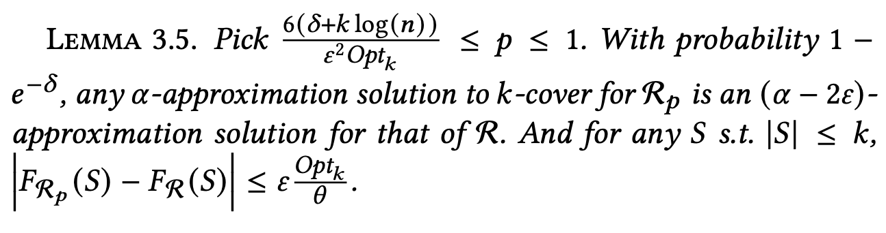
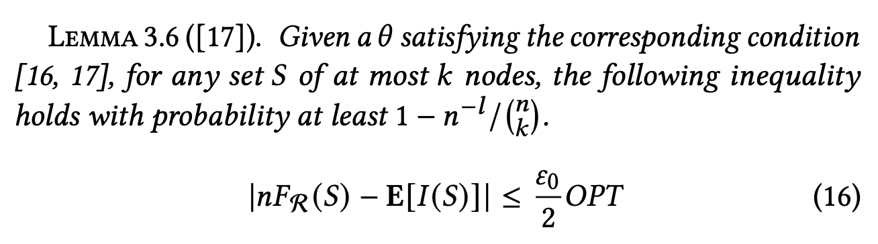
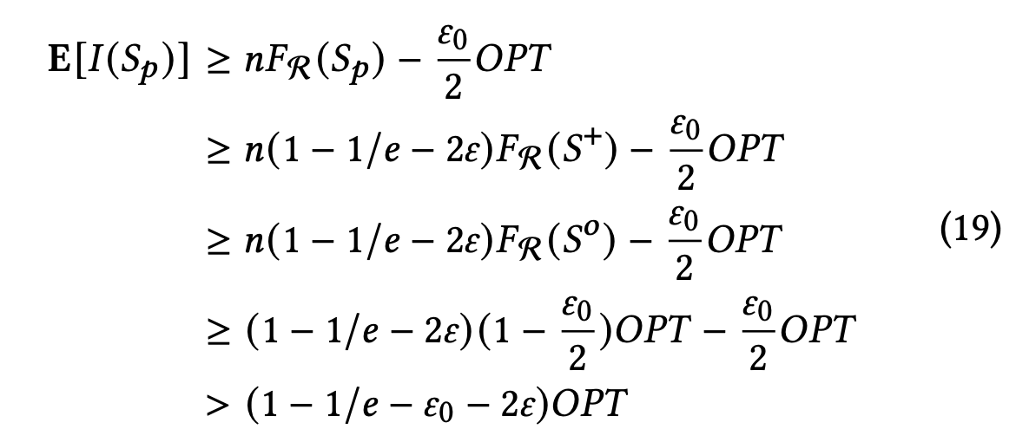
Proofs
Notes:
The first one is Monte-Carlo Greedy. We select the node with the highest influence increment in each iteration. But how do we estimate the influence spread? We just simulate the influence propagation process for a large number of times.
CELF makes use of the submodularity of the influence function to reduce useless computation. Just think it as the MC-greedy + Early Termination.

Slide 7
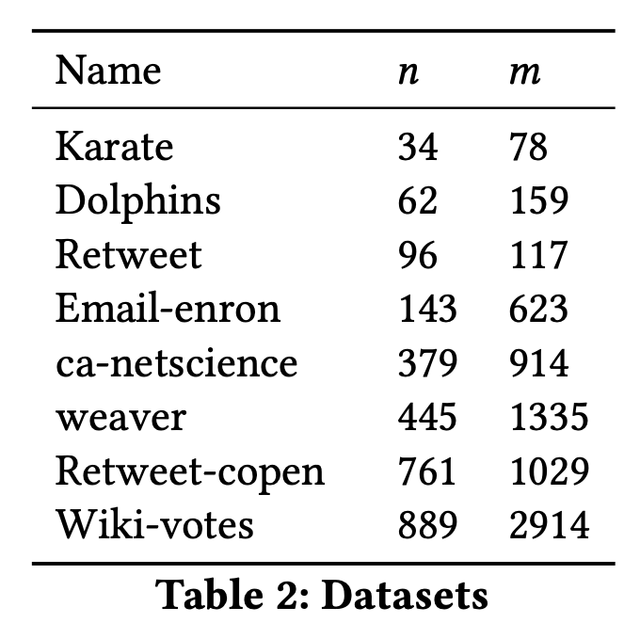
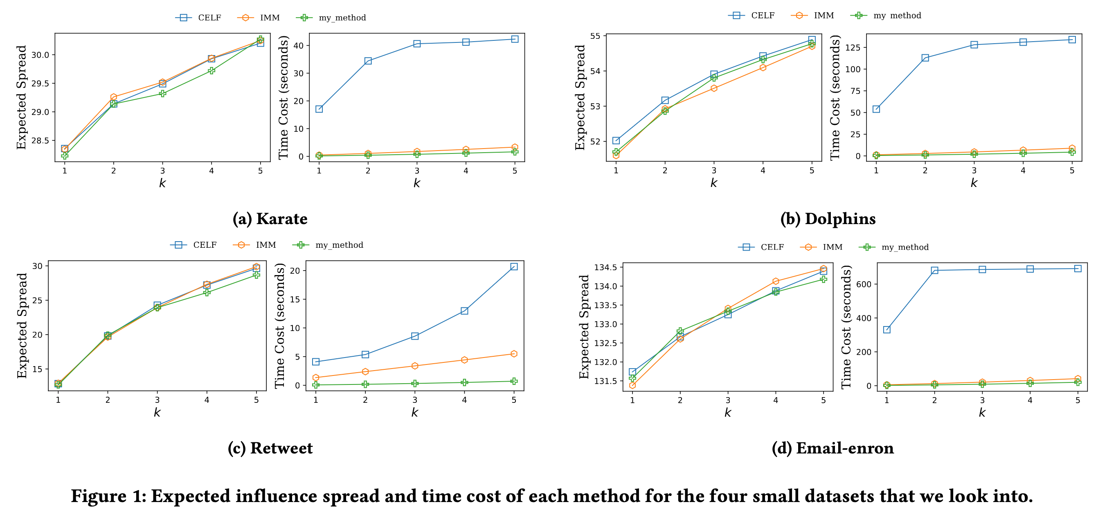
Results
Notes:
These are the datasets used in this project. The figure on the right hand side illustrates the results. We can see that sota is sota. RIS is both effective and efficient. However, centrality ranking-based methods are not very stable, sometimes they perform well, like Hens and Sparrows. But they fail most of the time.

Slide 8
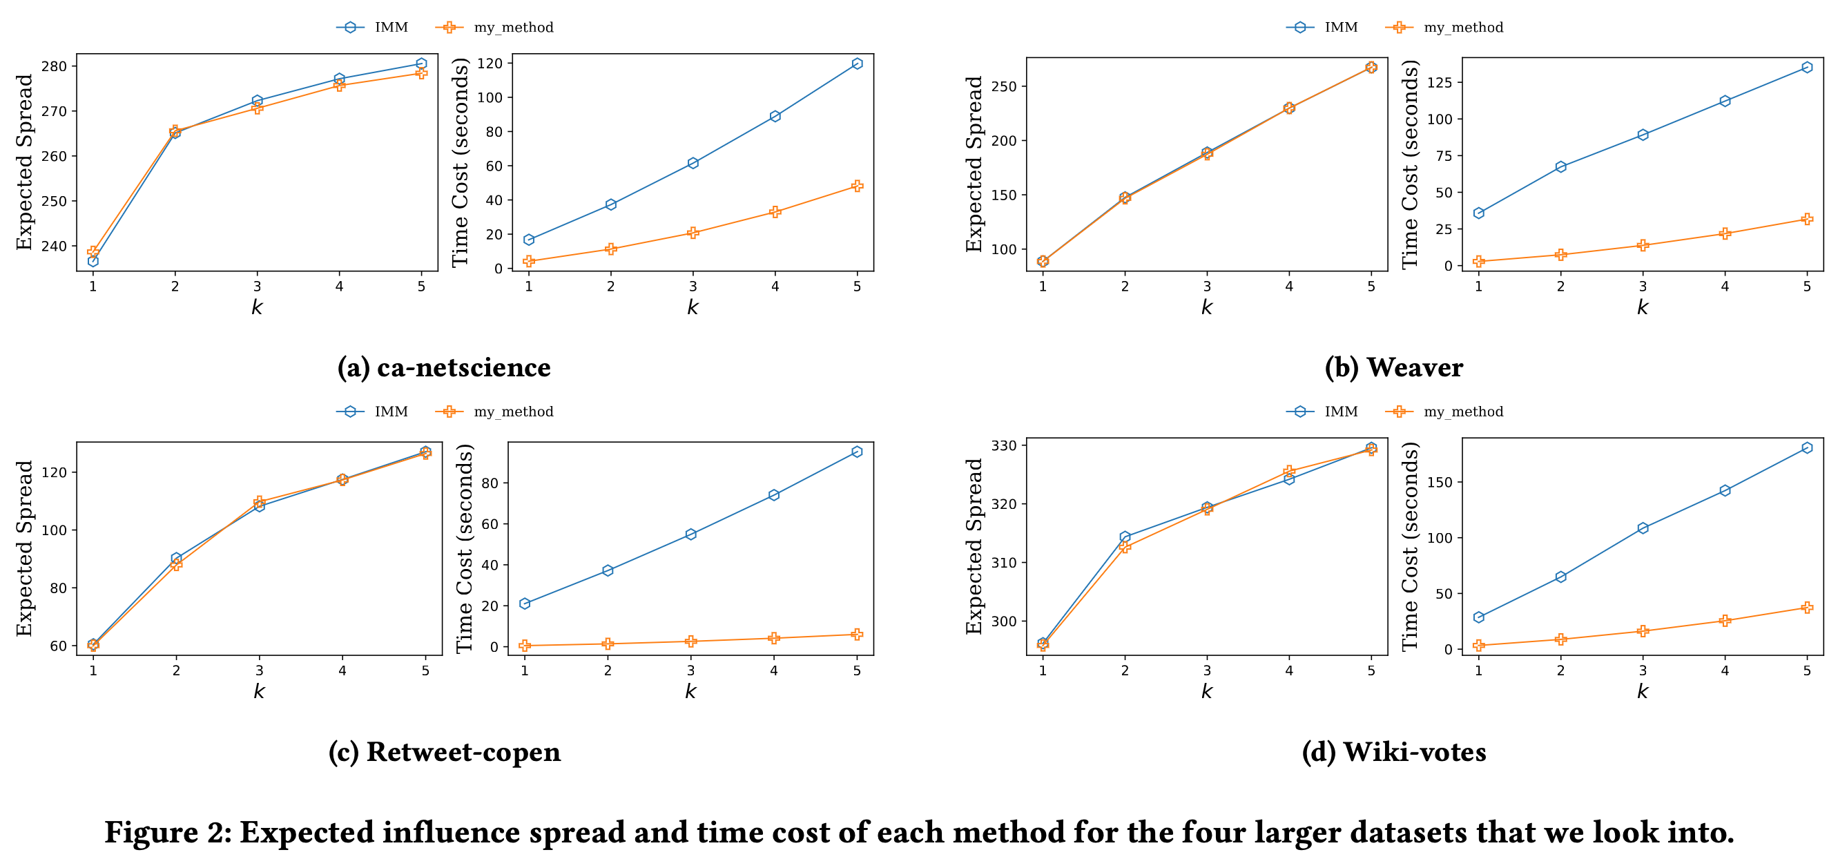
Results
Notes:
These are the datasets used in this project. The figure on the right hand side illustrates the results. We can see that sota is sota. RIS is both effective and efficient. However, centrality ranking-based methods are not very stable, sometimes they perform well, like Hens and Sparrows. But they fail most of the time.

Slide 9
Reference
[1] Kempe, D., Kleinberg, J., & Tardos, É. (2003, August). Maximizing the spread of influence through a social network. In Proceedings of the ninth ACM SIGKDD international conference on Knowledge discovery and data mining (pp. 137-146).
[2] Leskovec, J., Krause, A., Guestrin, C., Faloutsos, C., VanBriesen, J., & Glance, N. (2007, August). Cost-effective outbreak detection in networks. In Proceedings of the 13th ACM SIGKDD international conference on Knowledge discovery and data mining (pp. 420-429).
[3] Borgs, C., Brautbar, M., Chayes, J., & Lucier, B. (2014, January). Maximizing social influence in nearly optimal time. In Proceedings of the twenty-fifth annual ACM-SIAM symposium on Discrete algorithms (pp. 946-957). Society for Industrial and Applied Mathematics.
[4] Freeman, L. C. (1978). Centrality in social networks conceptual clarification. Social networks, 1(3), 215-239.
[5] Page, L., Brin, S., Motwani, R., & Winograd, T. (1999). The PageRank citation ranking: Bringing order to the web. Stanford InfoLab.

Slide 10
Thanks!
Q & A

