Slide 1

On the Failure of Centrality Measures in Influence Maximization
2022.11.30
Xiaolong CHEN
PhD in Data Science and Analytics
Code and report are available in the github repository: https://github.com/chenxlong3/iota5001_proj
Notes:
I am Xiaolong CHEN from DSA Thrust. The title of my data science project is on the failure of centrality measures in Influence Maximization. The code and report are in my github repository. If you guys are interested, pls refer to that.

Slide 2
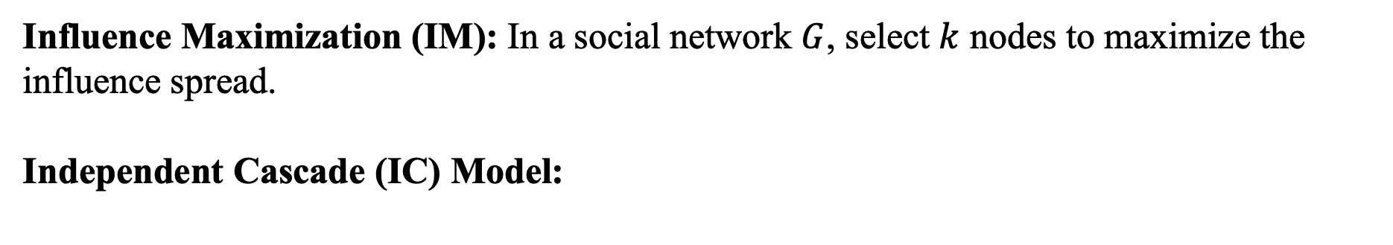
Introduction & Preliminaries
Influence Maximization (IM): In a social network $G$, select $k$ nodes to maximize the influence spread.
Independent Cascade (IC) Model:
A
A
0.6
0.3
0.8
D
D
B
C
B
0.5
C
0.2
0.9
G
G
E
0.2
E
0.6
0.4
F
F
0.3
H
H
Notes:
First let‘s introduce the problem. For influence maximization, given a social graph G, we want to select k nodes to maximize the influence spread. But how do the nodes influence others. We will focus on the diffusion model called Independent Cascade. Every edge is attached with a probability that the target node can be activated by the source node. I will tell you how the influence propagation goes. At first, we will select a set of nodes to be active, which is called seed set. Then, the nodes in the seed set will activate their neighbors with certain probability. At the next timestamp, the newly activated nodes will continue such a process until no new node is activated. Every active node can attempt to influence others only once. Actually, this is an NP-hard algorithmic problem. But from the course we know that centrality measures can reflect social influence to some extent. So what if we just use centrality ranking to select nodes? Such a kind of idea raises a number of questions. Let’s dive into them.

Slide 3
Research Questions
RQ1: How do common centrality measures (Degree, Betweenness, PageRank) perform in the IM problem compared to other methods?
RQ2: If these centrality measures fail to return a good result, what are the reasons accounting for the failure of using centrality ranking for Influence Maximization?
RQ3: What structure features of the graph can affect the performance of those centrality ranking-based methods?
Notes:
The first question is how do those centrality measures perform in the IM problem compared to others?
If they fail to return a good result, what are the reasons?
What kinds of network structure features can affect the performance of such methods?
Before starting to solve these questions. I’ll quickly go through the algorithms used in this project.

Slide 4
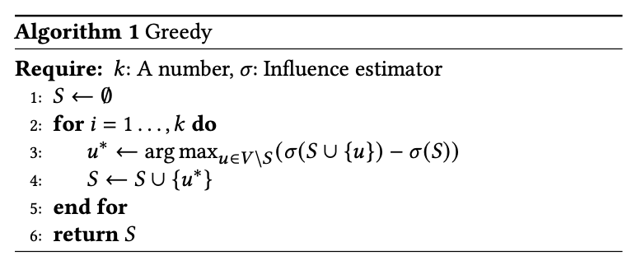
Algorithms
Monte-Carlo Greedy^{[1]}
Cost Effective Lazy Forward (CELF)^{[2]}
MC-greedy + Early Termination
Notes:
The first one is Monte-Carlo Greedy. We select the node with the highest influence increment in each iteration. But how do we estimate the influence spread? We just simulate the influence propagation process for a large number of times.
CELF makes use of the submodularity of the influence function to reduce useless computation. Just think it as the MC-greedy + Early Termination.

Slide 5
Algorithms
Reverse Influence Sampling^{[3]}
A
A
D
D
B
B
C
C
G
G
E
E
F
F
H
H
Centrality Ranking (Outdegree, Betweenness^{[4]}, PageRank^{[5]})
Notes:
The third one is Reverse Influence Sampling. The key idea is that influential nodes have a higher chance to appear in the reverse reachable sets of other nodes. Try to understand reverse reachable. For example, the RR set for D is ABC. For G, it’s ABCD. Oh we find ABC frequently appearing. So we will select ABC here. Don’t worry if you don’t understand. Consider it as a state of the art method. And finally, we use centrality ranking. The centrality measures we use here are outdegree, betweenness and page rank. Now I am able to introduce the methodology.

Slide 6
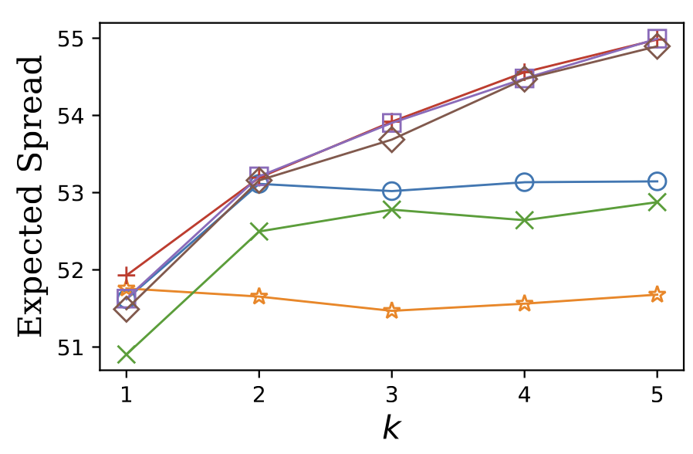
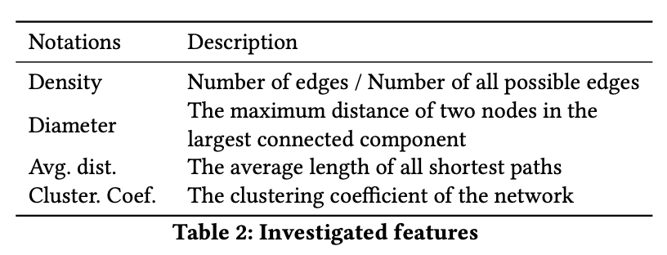

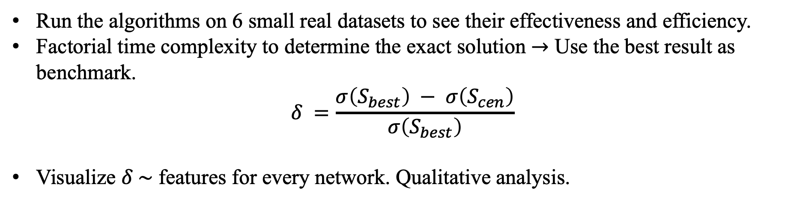
Methodology
Run the algorithms on 6 small real datasets to see their effectiveness and efficiency.
Factorial time complexity to determine the exact solution $→$ Use the best result as benchmark.
$$δ =\frac{σ\left(S_{best}\right) − σ\left(S_{cen}\right)}{σ\left(S_{best}\right)}$$
Visualize $δ \sim$ features for every network. Qualitative analysis.
Spoiler!
$$δ$$
Notes:
Run the algorithms!
Compute the performance of the centrality ranking – based methods. We propose to use this metric, delta. To make the formula here more intuitive, there is a spoiler. Delta basically measures the gap here.
Finally, we will visualize delta and these four basic network features, trying to find some patterns.

Slide 7
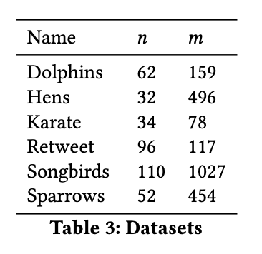
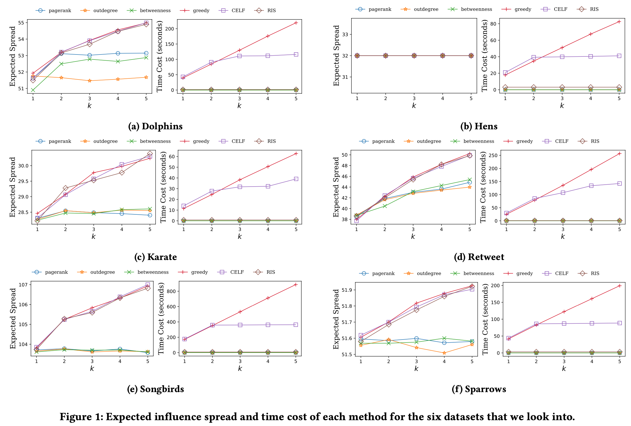
Results
Notes:
These are the datasets used in this project. The figure on the right hand side illustrates the results. We can see that sota is sota. RIS is both effective and efficient. However, centrality ranking-based methods are not very stable, sometimes they perform well, like Hens and Sparrows. But they fail most of the time.

Slide 8
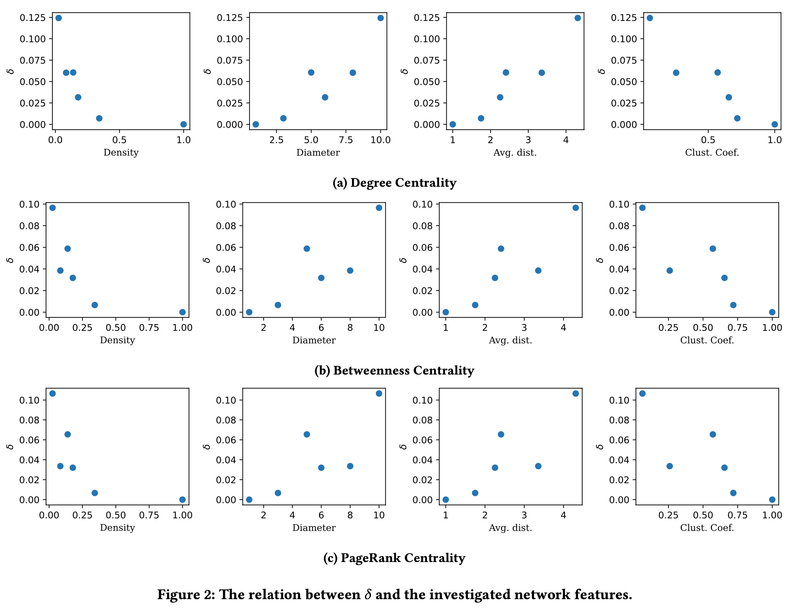
Results
Notes:
By computing delta and visualization, we have this figure. All three centrality measures have similar patterns on the relation between delta and the investigated network features. The first column of figures reveal that their performance may have positive correlation with graph density. But the correlations between the performance and other features are not so obvious. Now we are able to answer the research questions.

Slide 9
Answers to RQs
RQ1: Centrality ranking-based methods are not stable. Fail most of the time.
RQ2: These methods simply consider the influence spread as a linear combination of the influence spread of every individual node in the seed set, not considering influence overlap.
RQ3: Performance has positive correlation with graph density. Other features not so obvious.

Slide 10
Limitations
Due to the limitation of the computation resource and programming language, this project only uses small datasets.
Only four network features are considered here. Hopefully if we consider more features, some interesting patterns can appear.
The number of datasets is not enough for us to carry out meaningful quantitative analysis. We can consider using man-made random graphs in further study.

Slide 11
Reference
[1] Kempe, D., Kleinberg, J., & Tardos, É. (2003, August). Maximizing the spread of influence through a social network. In Proceedings of the ninth ACM SIGKDD international conference on Knowledge discovery and data mining (pp. 137-146).
[2] Leskovec, J., Krause, A., Guestrin, C., Faloutsos, C., VanBriesen, J., & Glance, N. (2007, August). Cost-effective outbreak detection in networks. In Proceedings of the 13th ACM SIGKDD international conference on Knowledge discovery and data mining (pp. 420-429).
[3] Borgs, C., Brautbar, M., Chayes, J., & Lucier, B. (2014, January). Maximizing social influence in nearly optimal time. In Proceedings of the twenty-fifth annual ACM-SIAM symposium on Discrete algorithms (pp. 946-957). Society for Industrial and Applied Mathematics.
[4] Freeman, L. C. (1978). Centrality in social networks conceptual clarification. Social networks, 1(3), 215-239.
[5] Page, L., Brin, S., Motwani, R., & Winograd, T. (1999). The PageRank citation ranking: Bringing order to the web. Stanford InfoLab.

Slide 12
Thanks!
Q & A

