Slide 1
And Potential Usage in Football Betting
Data Analytics Platform for Stock Broker
Prepared by Xu, Chen
03 12 2019

Slide 2
Self-Introduction
Background
The Brokerage Business
Architecture of Data Platform
Data Warehouse
Computation Engine
User Interface
Use Case in Football Betting

Slide 3
Self-Introduction
Work Experience
2018 – 2019 Credit Suisse, Hong Kong
Data Scientist (Prime brokerage)
2017 – 2018 Ortus Capital LLC, Hong Kong
Quant Researcher (China CTA)
2014 – 2016 Jefferies Investment Advisors, NY, US
Quant Researcher (US equity and futures stats arb)
2012 – 2014 WorldQuant LLC, CT, US
Quant developer/Software engineer (Stats arb)
Education & Certificates
2005 – 2012 Ph.D in Physics, University of Delaware
2016 Chartered Financial Analyst

Slide 4
Background
Quant
Model
Trader
Research
Data
Market
Data
Features of Systematic Trading
Structured data and defined pipelines
Modular production (data, model, test, exec, etc.)
Minimum human intervention
Pre-defined risk control methodology
Difficulties Facing Business
Big data (structure, size, location, format, etc.)
Complex and dynamic decision-making process
Alternative model evaluation metrics
Needs to turn data into insights
Valid.

Slide 5
Stock Brokerage Business
Inventory Management
Offer liquidity and provide locates
Minimize stock holdings
Maximize revenues from commissions, dividends, tax, etc.
Central Risk Trading
Execute internal and external orders
Maximize P&L by order internalization
Market-making trading

Slide 6
Architecture of Data Platform
Source → Data warehouse
Data warehouse
/\
I
\/
Computation Engine
Interfaces → Traders
Trader 1
Trader 2
Interface 1
Interface 2
Interface 3
Data Warehouse
Computation
Inventory
&
Pricing
Market Data
Order Flow

Slide 7
Data Warehouse
Data Storage
High frequency: KDB+q
Low frequency: PostgreSQL
Research: KDB, HDF5 or CSV
Data Acquisition
SQL/NoSQL
HDFS (Spark)
Socket
Kafka API
Restful API
Excel
Data Warehouse
PostgreSQL
SQL
Mongo
KDB
Binary
Python
C++

Slide 8
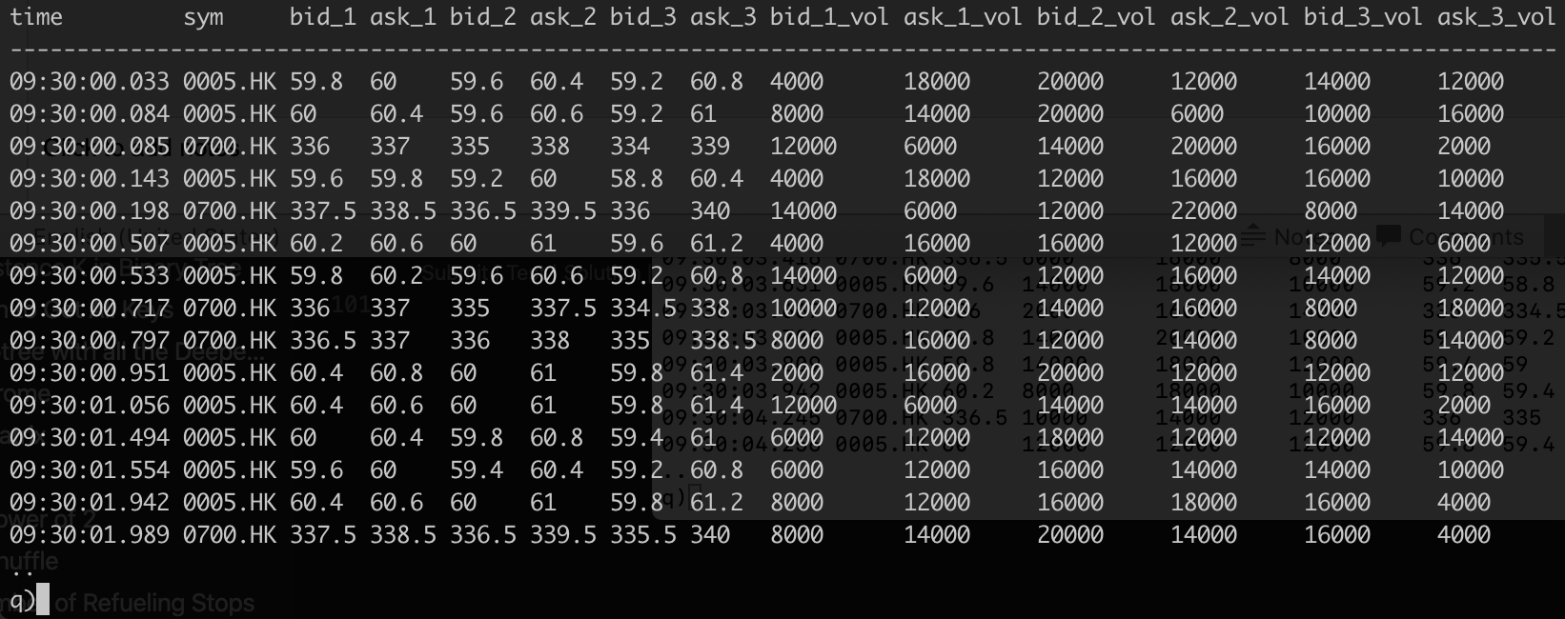
Data Warehouse – KDB Market Data (Simulated)

Slide 9
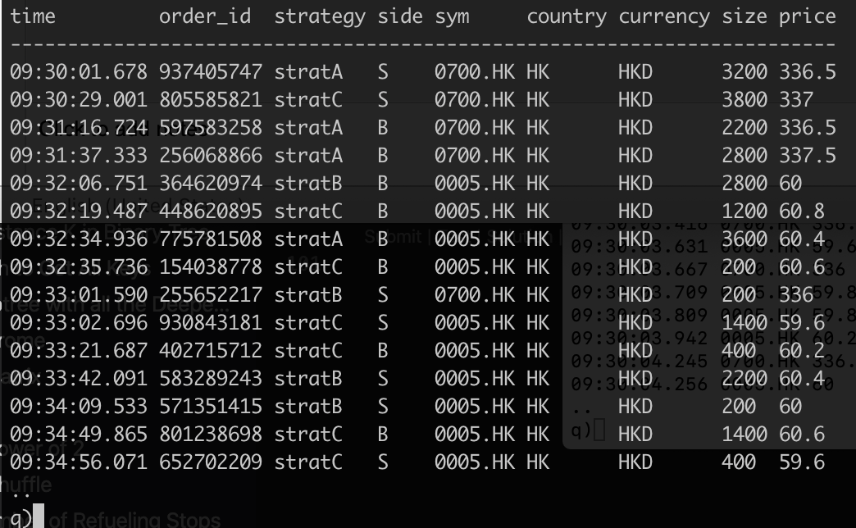
Data Warehouse – Firm Order Flow (Simulated)

Slide 10
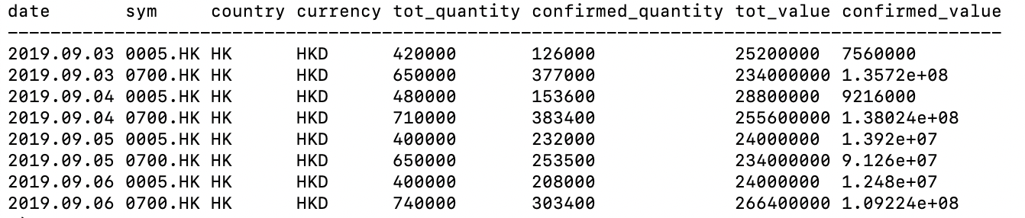
Data Warehouse – Stock Locates (Simulated)

Slide 11
Data Warehouse – Summary
One Data
Initialization
Update
Recovery

Slide 12
Computation Engine
Data
Monitor
Forecast
Report
Price

Slide 13
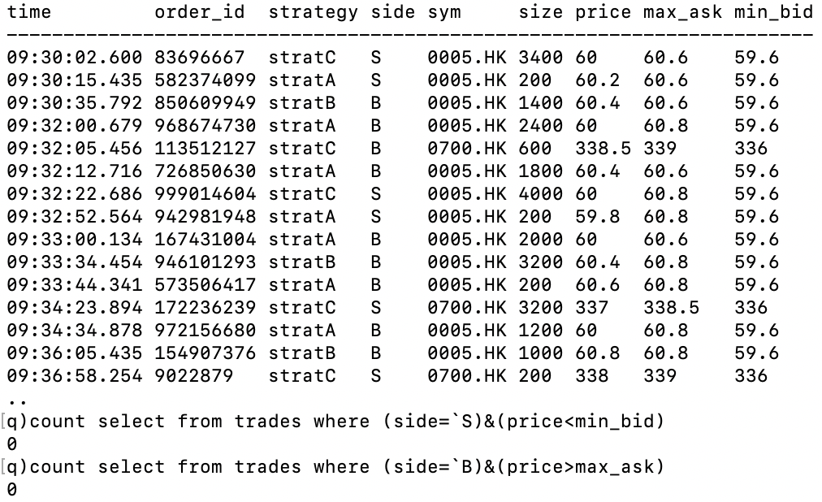
Computation Engine – (Best Execution)

Slide 14
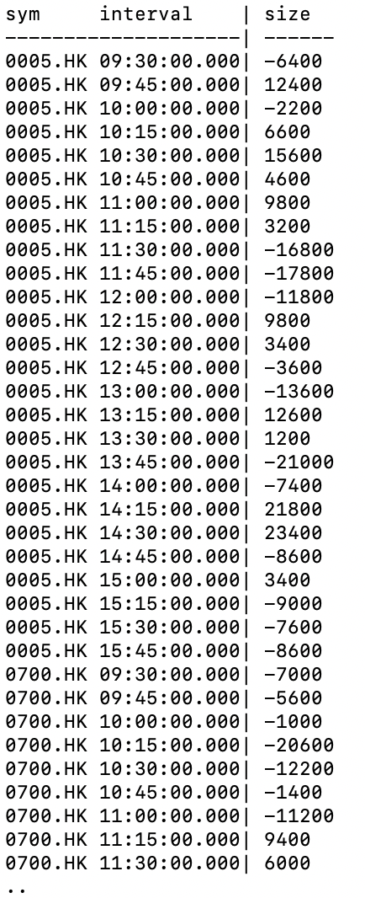
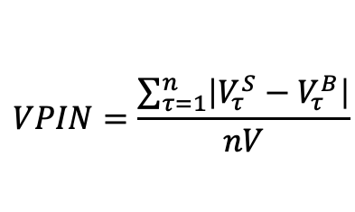
Computation Engine – (Informed Trading)
$$VPIN=\frac{\sum_{τ=1}^{n}{\left|V_{τ}^{S}−V_{τ}^{B}\right|}}{nV}$$

Slide 15
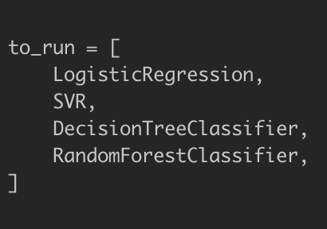
Computation Engine – (ML Risk Forecast)
Features
Stock return (1d, 3d, 5d, 20d, 60d)
Stock volatility (1d, 3d, 5d, 20, 60d)
Trading volume (3d, 10d, 20d, 60d)
Stock availability
Used availability
Commission rate and change
Labels
Trading volume drops over 2xstd in one week against 20 average
Caveat:
Train: 3 years Imbalance
Test: 1 year Non-std

Slide 16
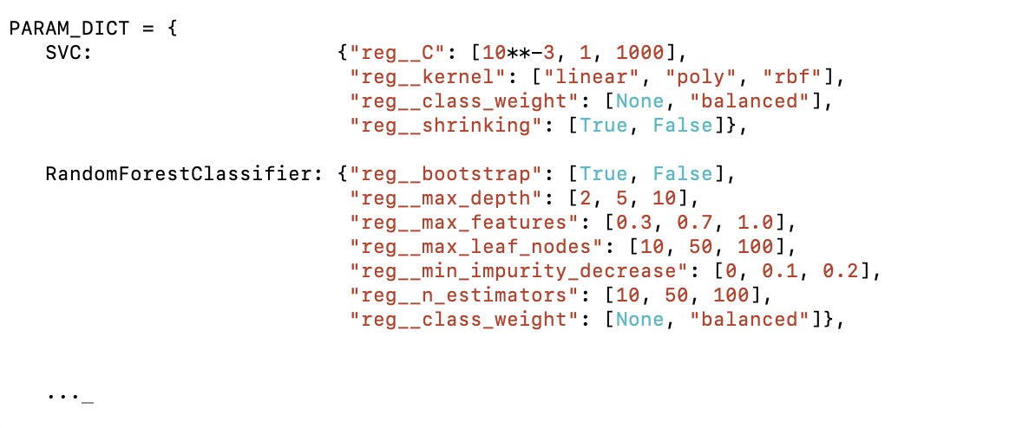
Computation Engine – (ML Risk Forecast)
Evaluation Metrics: Confusion Matrix, Precision, Recall, ROC curve, etc.

Slide 17
Interfaces
Metabase
Easy to use, friendly interface, beautiful graphs
Plotly Dash
Flexible with python code
Superset
Powerful with SQL

Slide 18
Headline
Pie Chart Title
on two lines if necessary

Slide 19
Headline
Bar Chart Title
on two lines if necessary

