Slide 1
High Performance Detection of Strongly Connected Components in Sparse Graphs on GPUs
Pingfan Li, Xuhao Chen, Jie Shen, Jianbin Fang, Tao Tang, Canqun Yang
National University of Defense Technology
Notes:
Good afternoon everyone. Thanks for coming. My name is Xuhao Chen. I am from National University of Defense Technology. My talk is xxx.

Slide 2
Overview
Background and Motivation
Parallel SCC Detection
Existing GPU SCC Detection
Design and Implementation Details
Hybrid Method (Two-Phase)
Exploiting Parallelism in Phase-2
Customizing Graph Traversal
Evaluation
Conclusion
Notes:
In this talk, we will first introduce the background and motivation. We will introduce the previously proposed parallel SCC detection algorithm.
And also the existing GPU SCC detection implementation. We will show the limitation of this implementation.
Then we describe our proposed design and implementation details. We propose the hybrid method in a two-phase algorithm framework.
In each phase, the hybrid method applies different parallelism strategies according to the characteristics of each phase.
We will show how we increase parallelism in Phase-2, and optimize graph traversal operation in both phases.
Next we illustrate some experimental results, and finally concludes.

Slide 3
Overview
Background and Motivation
Design and Implementation Details
Evaluation
Conclusion

Slide 4









Graph Processing on GPUs
SCC detection is one of the most important graph algorithms
Notes:
In recent years, analytics and knowledge extraction on graph data structures have become areas of great interest.
Applications of graph algorithms include social networks, web and big data analysis, recommender systems and so on.
Due to the huge amount of data to process, graph algorithms take quite a lot of time.
Modern datacenters use massively parallel accelerators, such as GPUs, to speedup these algorithms.
SCC Detection is one of the important graph algorithms.

Slide 5
Strongly Connected Components (SCC)
What is a Strongly Connected Component?
trivial-SCC and nontrivial-SCC
SCC Detection/Decomposition
Tarjan’s algorithm: DFS-based, hard to parallelize
Applications
Web and social network analysis
Formal verification and reinforcement learning
Mesh refinement and scientific computing
1
3
6
7
2
4
5
8
In a directed graph, an SCC is a maximally connected subgraph with a path in both directions between any two nodes
Notes:
A graph is said to be strongly connected if every vertex is reachable from every other vertex.
The strongly connected components components of an directed graph form a partition into subgraphs that are themselves strongly connected.
Datasets contain millions to billions of nodes and billions of edges, which implies that SCC on large graphs will take a long time!

Slide 6
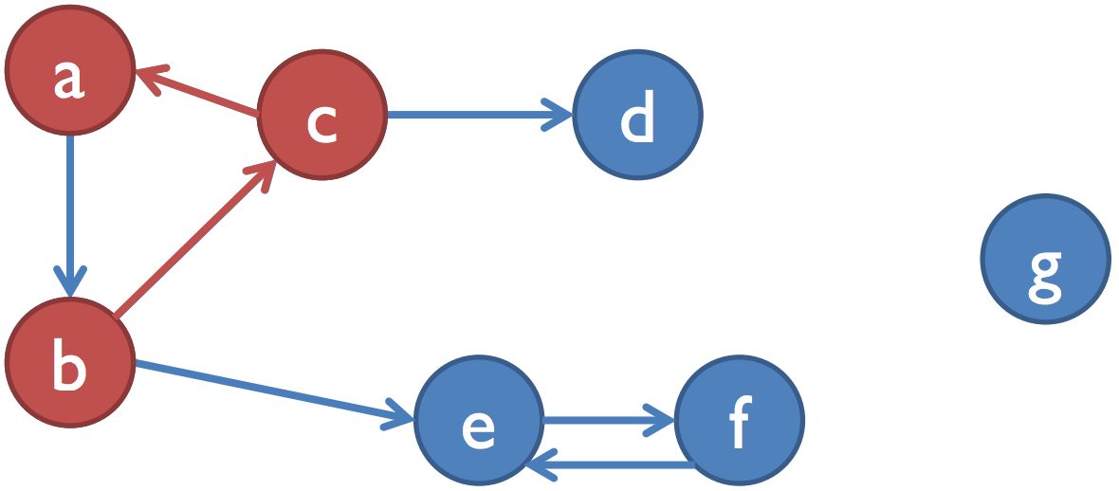
Parallel SCC Detection
Forward-Backward-Trim (FB-Trim) parallel algorithm
FB: Recursive application of reachability^{[1]}
Trim: Removal of trivial SCCs^{[2]}
[1] Fleischer et al. On Identifying Strongly Connected Components in Parallel. In IPDPS Workshops, 2000
[2] McLendon et al. Finding Strongly Connected Components in Distributed Graphs. In JPDC, 2005
Notes:
Transpose graph

Slide 7
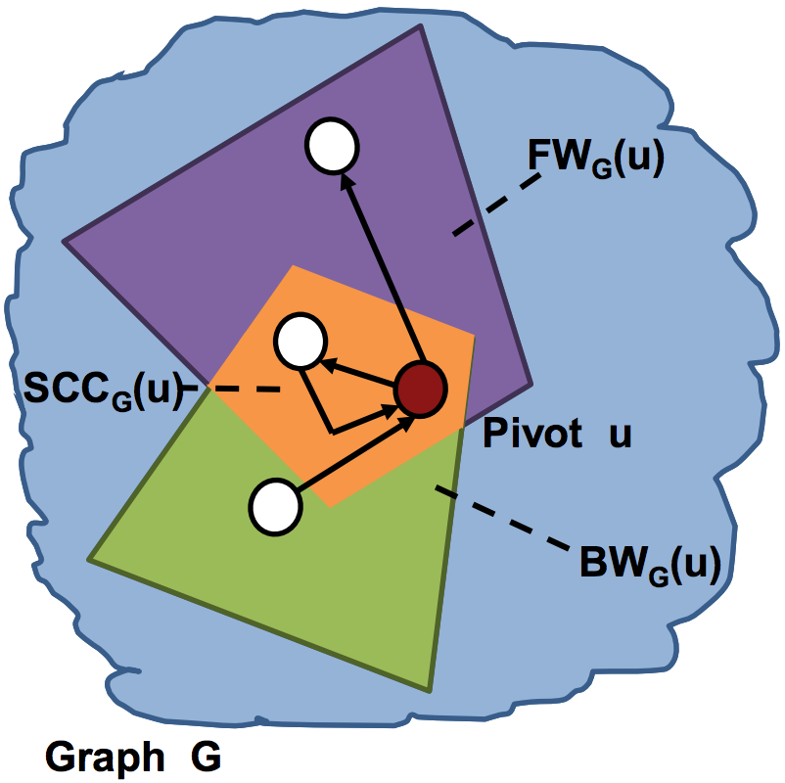
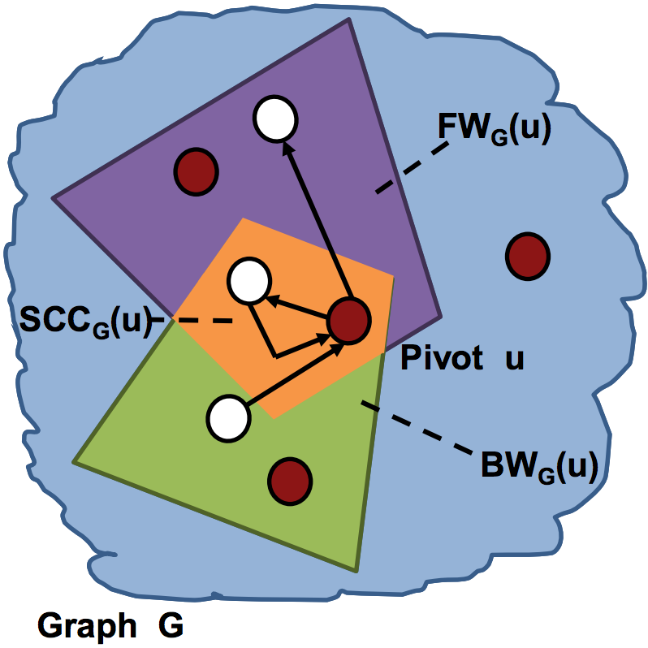
Forward-Backward
Four partitions
𝐹𝑊_{𝐺}(𝑖) ∩ 𝐵𝑊_{𝐺}(𝑖) [SCC]
𝐹𝑊_{𝐺}(𝑖) \ 𝐵𝑊_{𝐺}(𝑖)
𝐵𝑊_{𝐺}(𝑖) \ 𝐹𝑊_{𝐺}(𝑖)
𝑉 \ 𝐹𝑊_{𝐺}(𝑖) ∪ 𝐵𝑊_{𝐺}(𝑖)
Figures are duplicated for Hong’s SC’13 paper

Slide 8
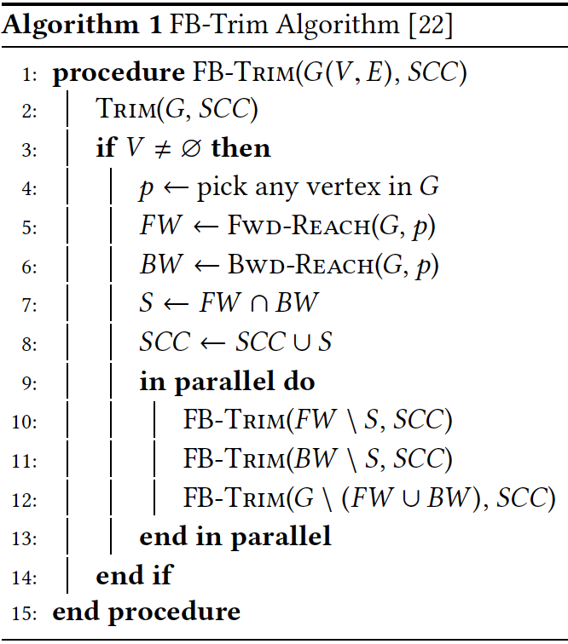
Apply iterative Trim step
Choose ANY vertex in the graph
Calculate
FW & BW reachable sets
Recursively apply algorithm to each partition
New SCC is intersection of FW & BW reachable sets

Slide 9
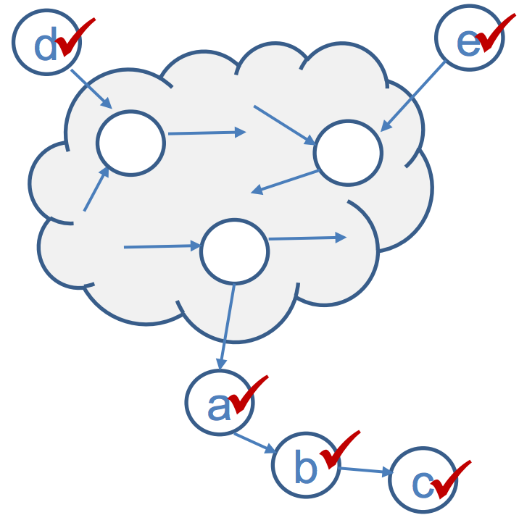
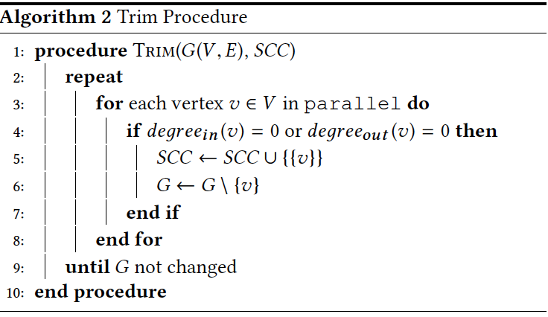
Trimming
Identify trivial SCCs (size 1) by looking only at the number of neighbors
If the vertex has in-degree=0 or out-degree=0, it is a size 1 SCC
Repeat iteratively
The figure is duplicated for Hong’s SC’13 paper
Notes:
We can identify trivial SCCs (size 1) by looking only at the number of neighbors, that is, if the vertex has no incoming edges or no outgoing edges, it is a size 1 SCC.
It’s easy to implement Trimming in parallel

Slide 10
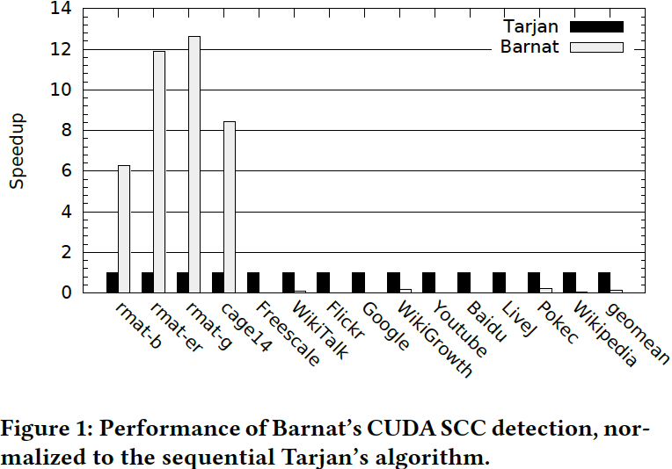
GPU SCC Detection
Barnat et al. implemented the FB-Trim algorithm using CUDA^{[1,2]}
[1] Jiri Barnat et al., Computing Strongly Connected Components in Parallel on CUDA. In IPDPS 2011
[2] Bc Miroslav Stuhl. Computing Strongly Connected Components with CUDA. 2013.

Slide 11
Overview
Background and Motivation
Design and Implementation Details
Evaluation
Conclusion

Slide 12
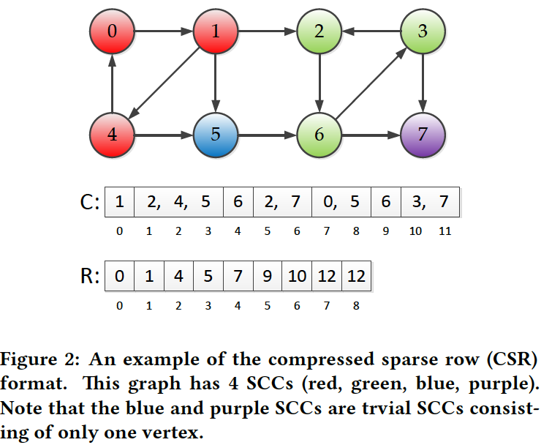
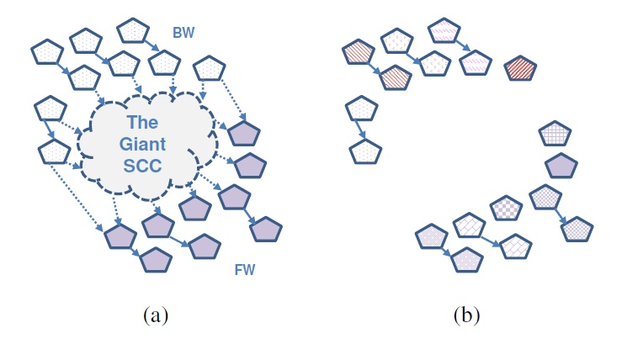
Challenges of GPU SCC Detection
Load imbalance and random memory accesses
Limited parallelism due to data irregularity
This figure is duplicated From Hong’s SC’13 paper

Slide 13
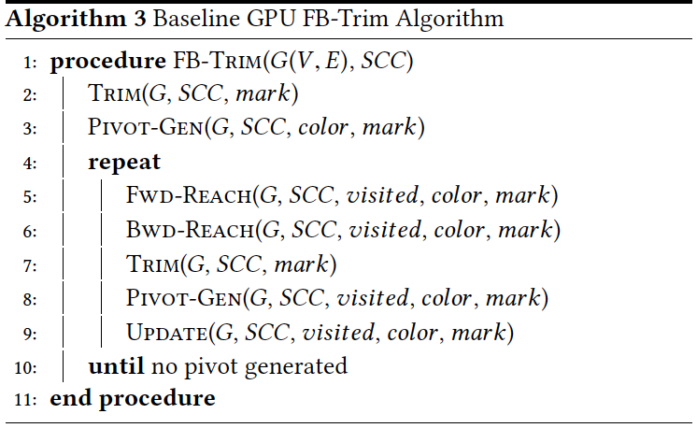
Baseline Design
Apply iterative
Trim step
Calculate
FW & BW reachable sets
Choose the first pivot
Choose pivots in parallel
New SCC is intersection of FW & BW reachable sets
Apply iterative
Trim step

Slide 14
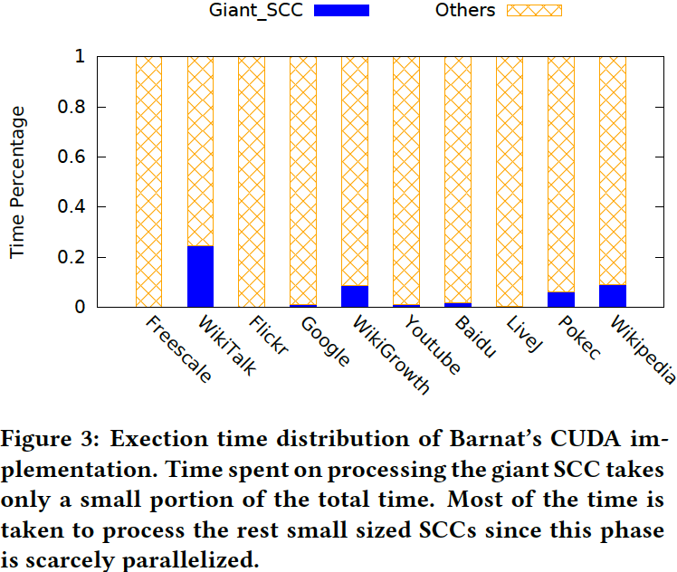
Hybrid Method
Two Phases
Phase-1: Detect the single giant SCC
Phase-2: Detect the rest small SCCs
Hybrid method
Apply different parallelism strategies in different algorithm phases

Slide 15
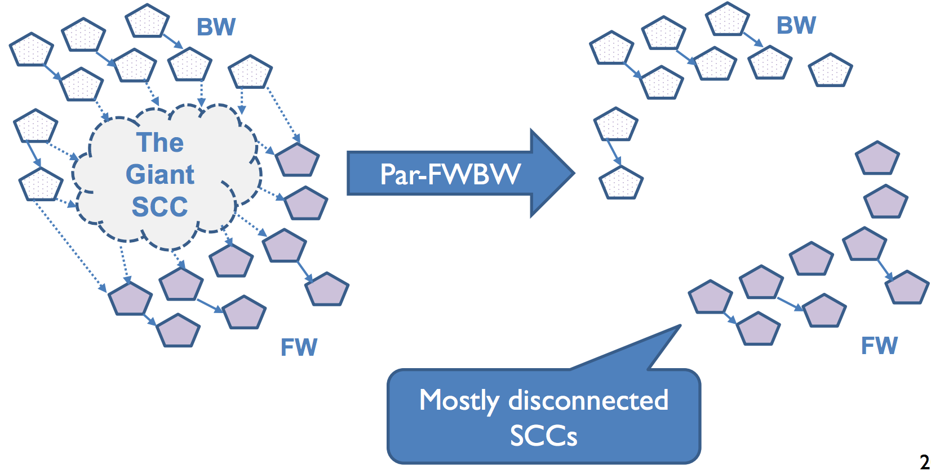
Exploiting Parallelism in Phase-2
Insufficient tasks in Phase-2

Slide 16
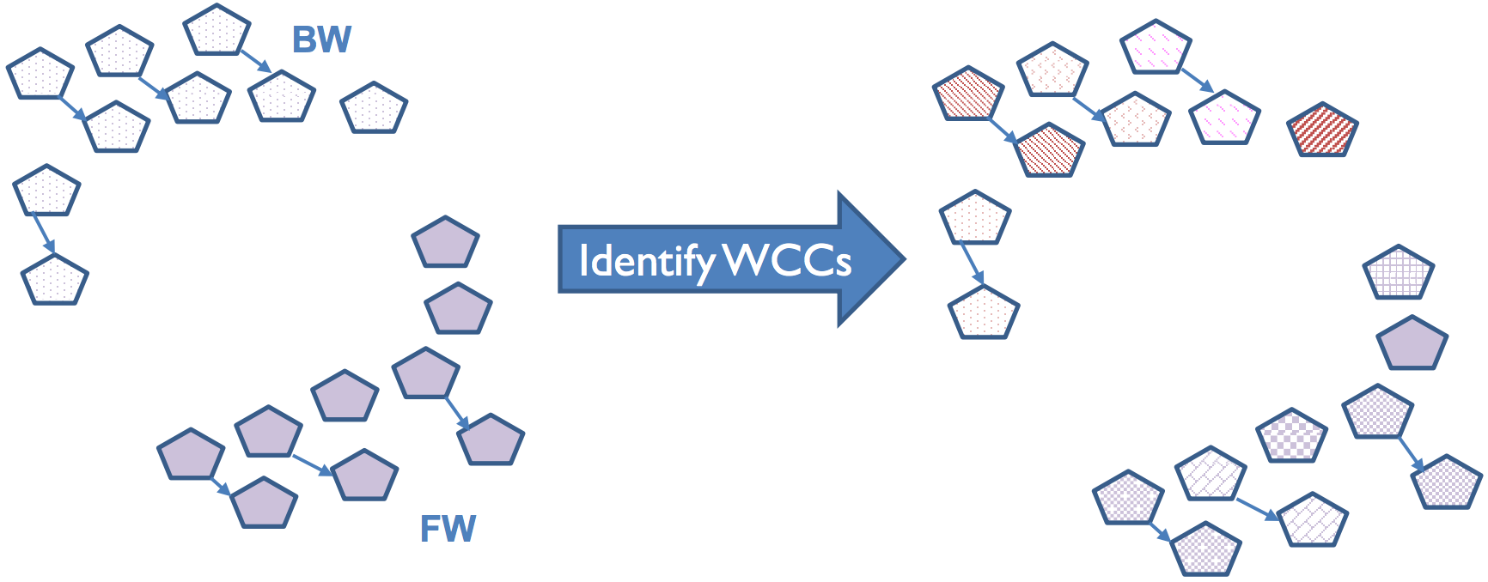
WCC Method
Significantly increases parallelism in FB step
Hong et al. proposed a WCC method^{[1]} for CPU SCC detection
[1] Sungpack Hong et al., On Fast Parallel Detection of Strongly Connected Components (SCC) in Small-world Graphs. In SC 2013.
Notes:
Now each WCC is a separate parallel task.

Slide 17
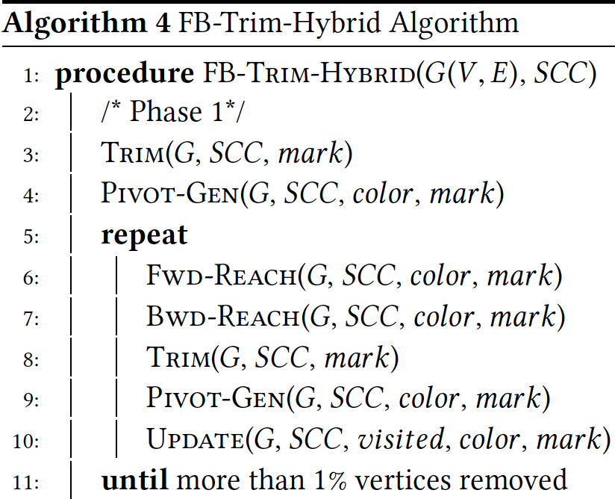
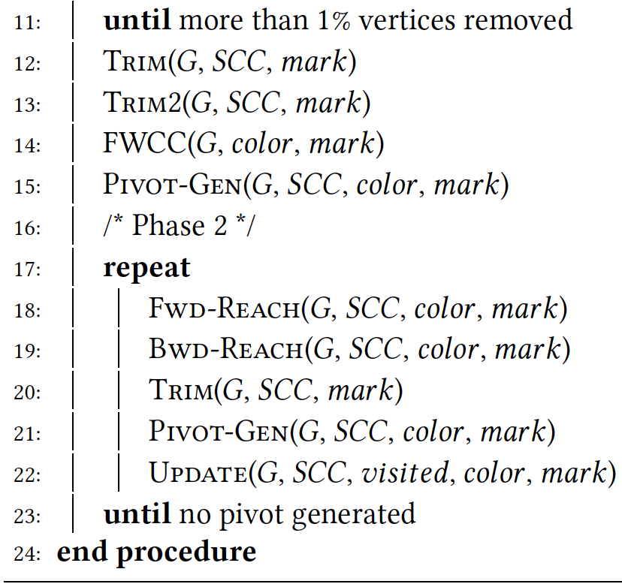
FB-Trim-Hybrid Algorithm on GPUs

Slide 18
Customizing Graph Traversal
Graph traversal (BFS) is the major operation
GPU BFS implementations
Mapping strategies: topology-driven vs. data-driven
Dynamic load balancing
Hybrid method: pick the best implementation for each phase

Slide 19
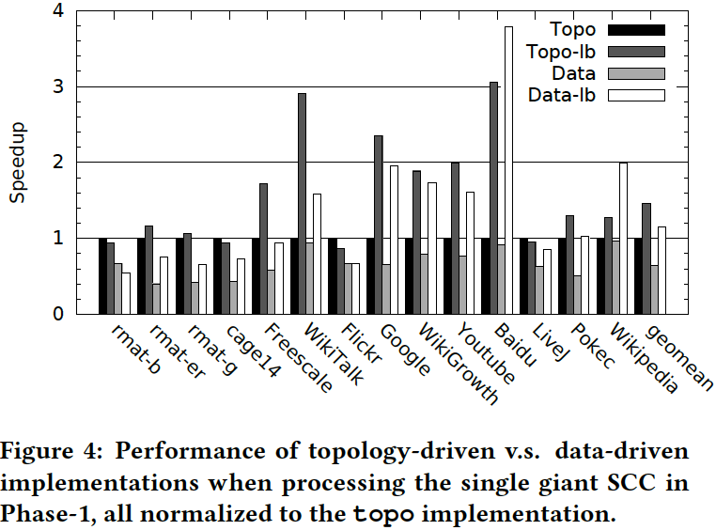
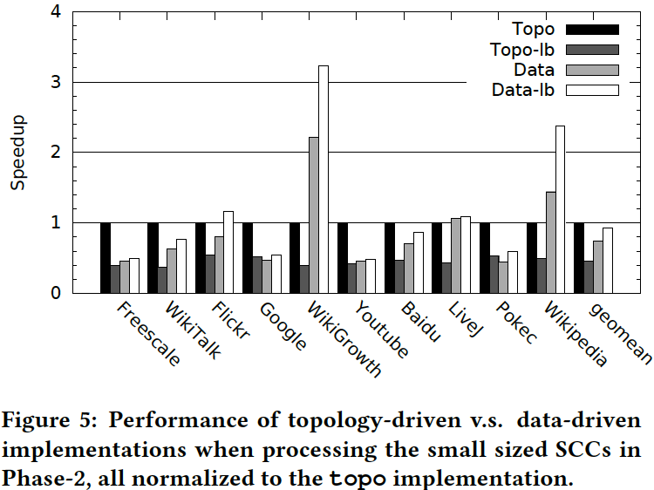
Topology vs. Data Driven Implementations
q

Slide 20
Overview
Background and Motivation
Design and Implementation Details
Evaluation
Conclusion

Slide 21
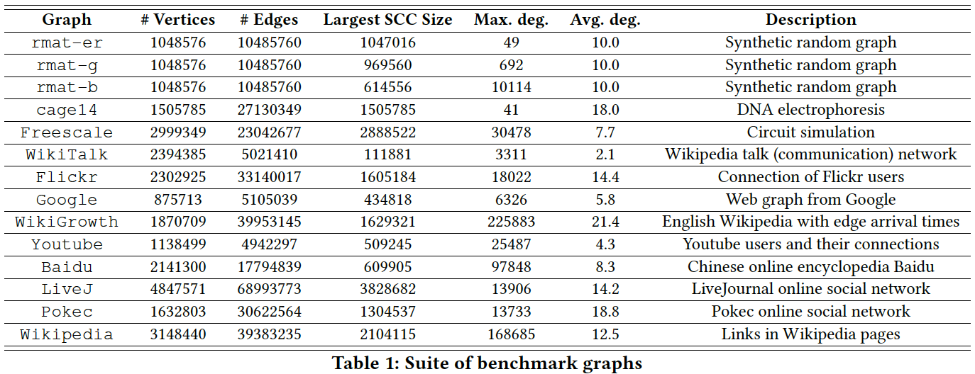
Benchmarks

Slide 22
Experiment Setup
Implementations for comparison:
(1) Tarjan: Tarjan’s serial algorithm,
(2) OpenMP: Hong’s OpenMP implementation,
(3) Barnat: Barnat’s CUDA implementation,
(4) Hybrid: our proposed GPU implementation FB-Trim-Hybrid.
NVIDIA K20c GPU with CUDA Toolkit 7.5 release
Tarjan and OpenMP on Intel Xeon E5 2670 2.60 GHz CPU with 8 cores
16 threads launched for OpenMP since it is the best performing configuration

Slide 23
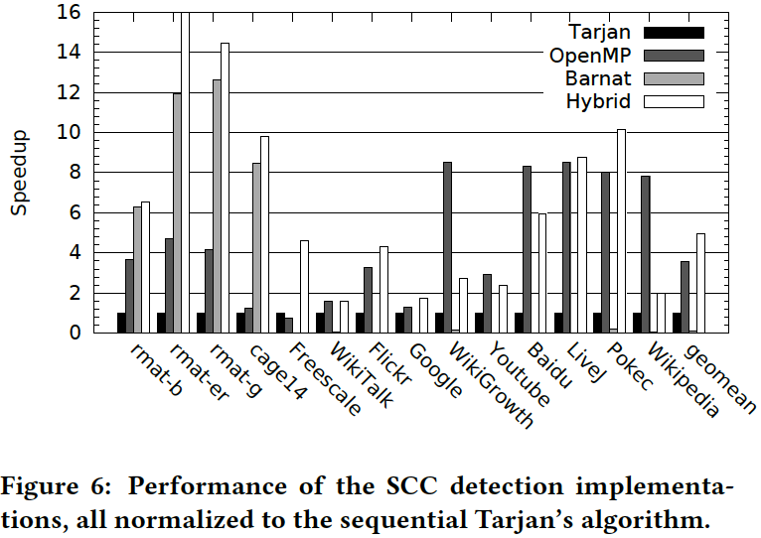
Performance

Slide 24
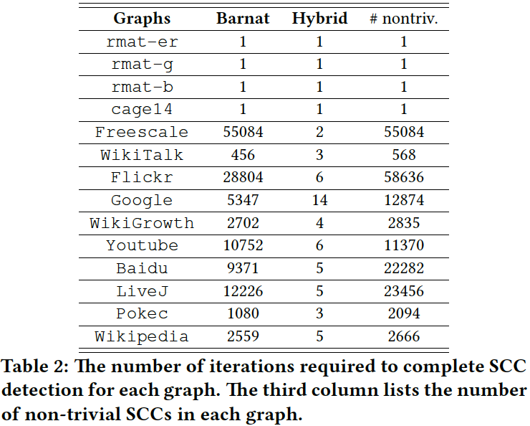
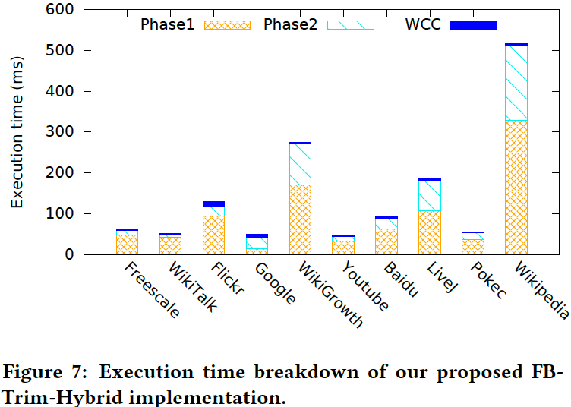
Execution time breakdown

Slide 25
Overview
Background and Motivation
Design and Implementation Details
Evaluation
Conclusion

Slide 26
Conclusion
Existing GPU SCC detection shows limited performance
Limited parallelism in Phase-2
Straightforward BFS strategy
We propose FB-Trim-Hybrid to overcome the limitations
Employ the WCC method in CPU SCC detection to increase parallelism
Customize BFS strategies for different algorithm phases
Our method significantly outperforms previous GPU implementations

Slide 27
Thank You! Q&A

Slide 28
Backup Slides

Slide 29
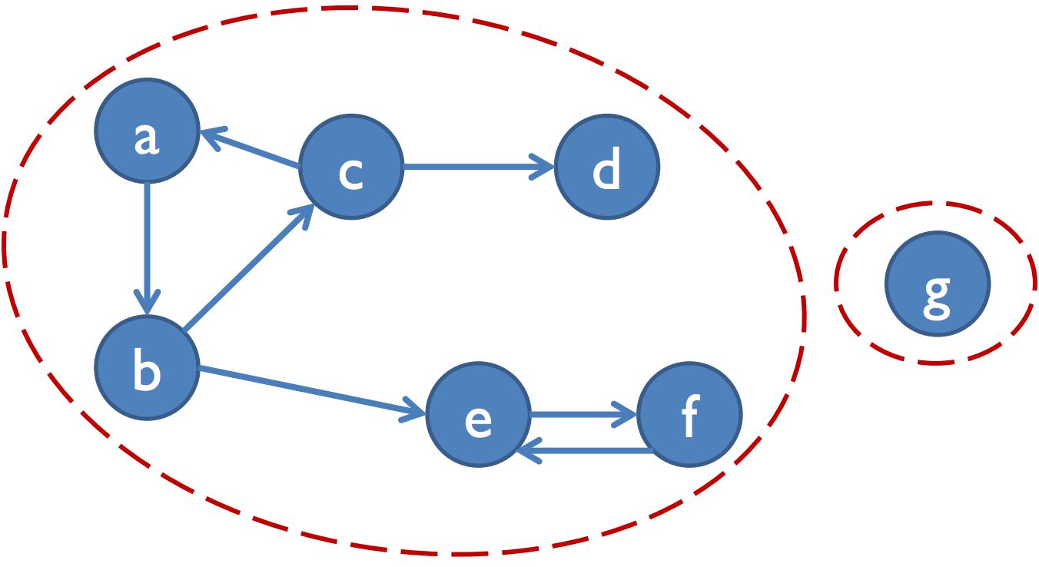
Weakly Connected Components (WCC)
In a directed graph, a WCC is a maximally connected subgraph with a path in one direction between any two nodes

Slide 30
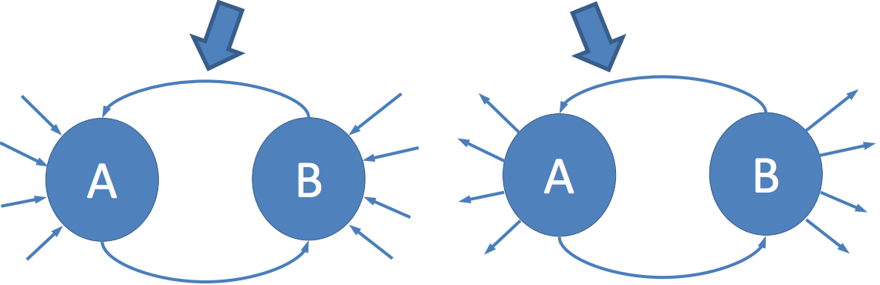
Trim2
Parallel detection of a subset of size-2 SCCs
Tight loop between nodes A and B
No other outgoing (or incoming) edges from A and B
Apply only once rather than iteratively
Higher computational cost than Trim
Reduces execution time of WCC step by up to 50%

Slide 31
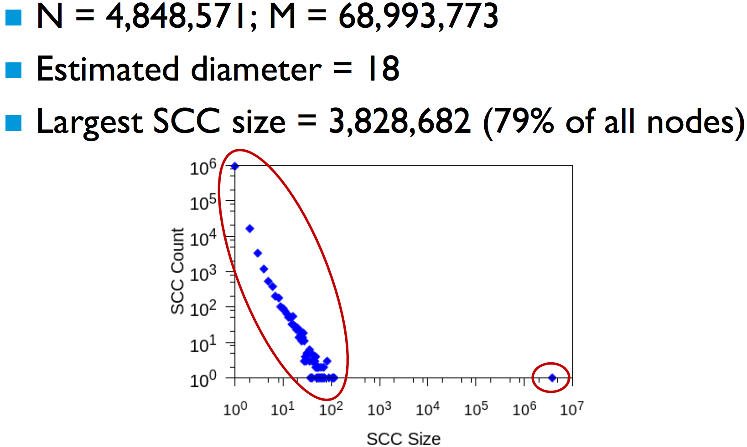
Example Small-World Graph: LiveJournal

Slide 32
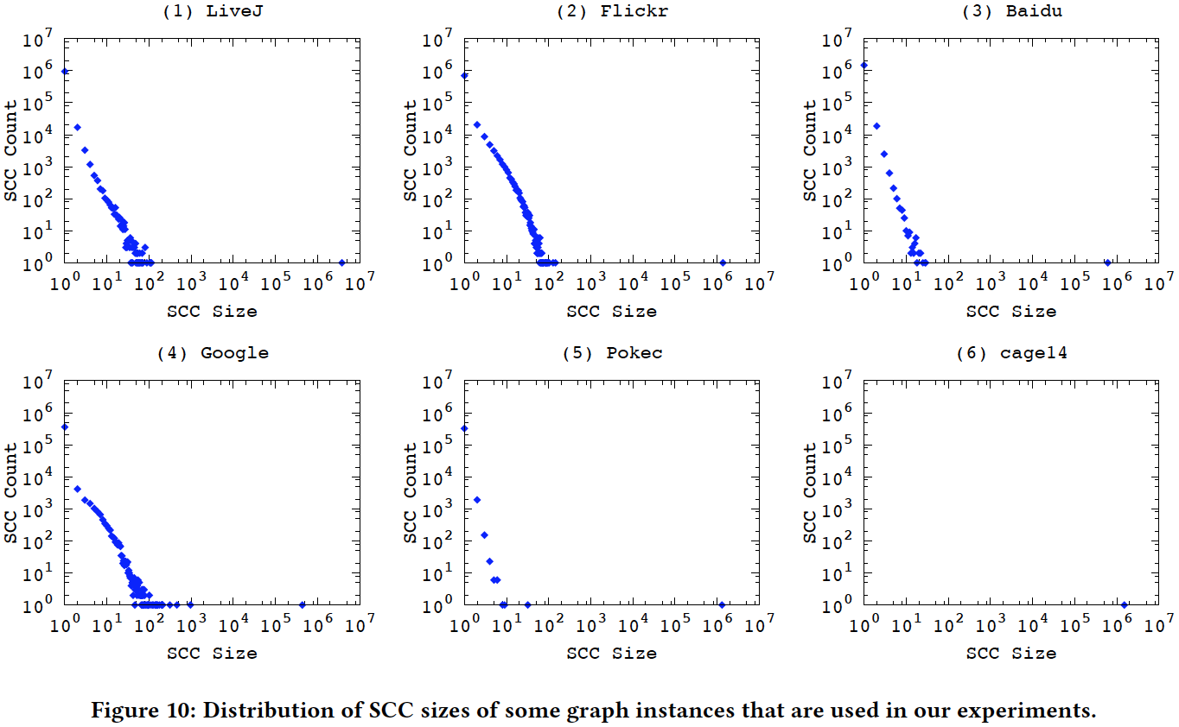
Distribution of SCC sizes

Slide 33
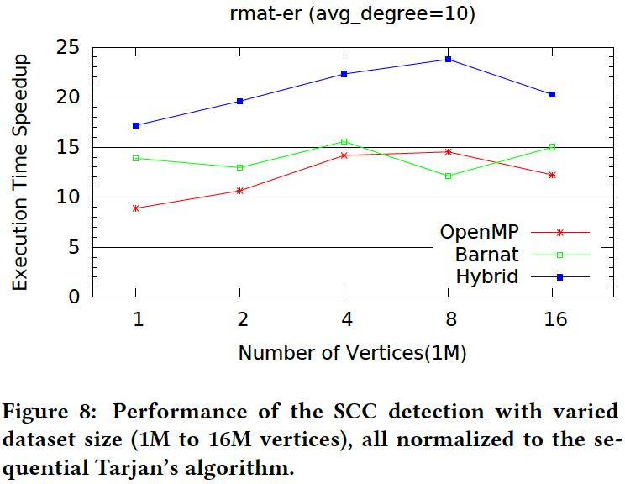
Sensitivity to Input Scale

Slide 34
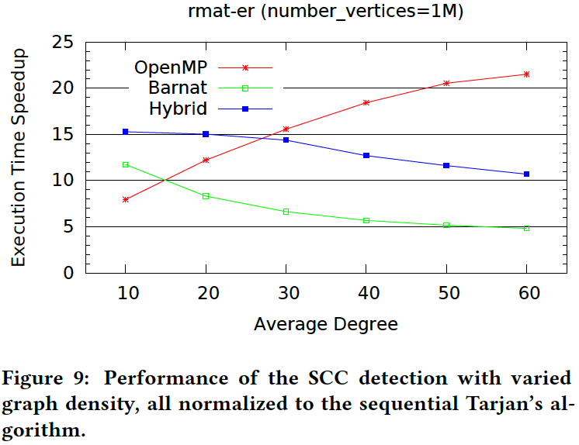
Sensitivity to Density

