Slide 1

Architecting Energy-efficient STT-RAM Based Register File on GPGPUs via Delta Compression
Hang Zhang, Xuhao Chen, Nong Xiao, Fang Liu
State Key Laboratory of High Performance Computing,
College of Computer,
National University of Defense Technology, China

Slide 2
Overview
Background
Motivation
Design Details
Experimental Evaluation
Conclusion

Slide 3
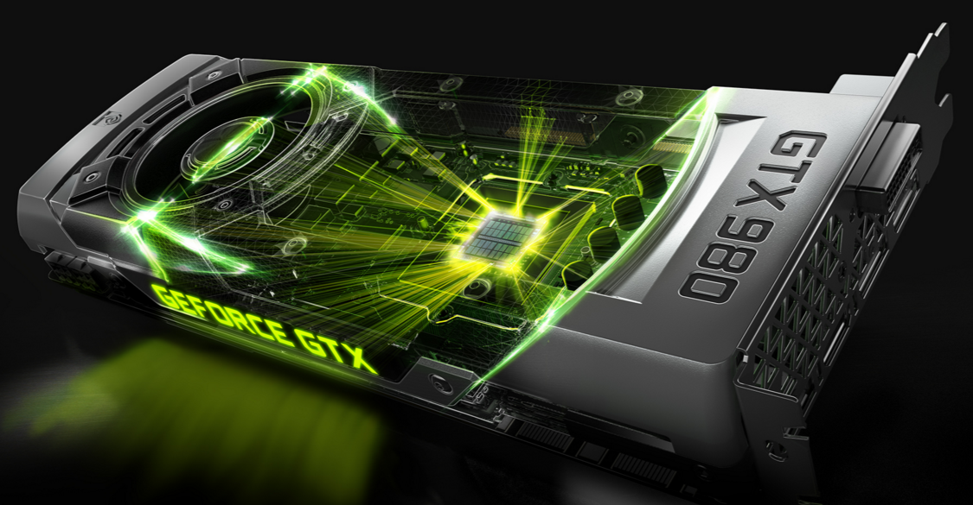

The Processing Engine in Big Data Era
GPGPU (General Purpose Graphic Processing Unit) has been widely employed
Deep Learning
Datacenter
Supercomputer
However, energy-efficiency of GPUs become critical
NVIDIA Tesla K80, 300W
Core i7-980X Extreme Edition, 130W
DOE supercomputer, 20MW
“We also implemented a distributed version of AlphaGo that exploited multiple machines, 40 search threads, 1,202 CPUs and 176 GPUs” – Nature, 2016

Slide 4
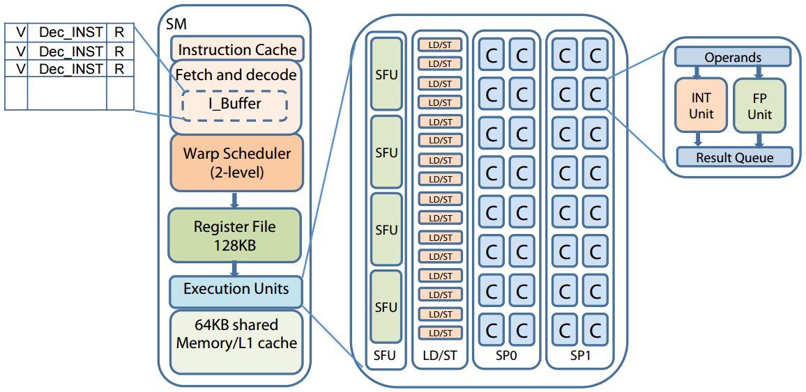
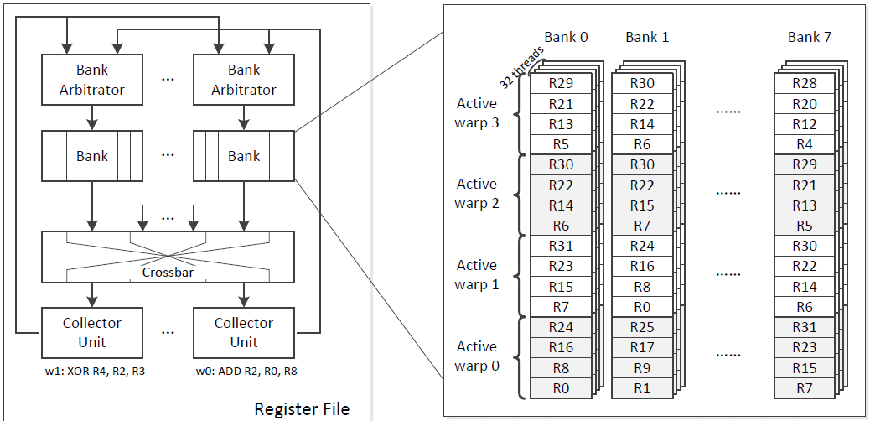
GPGPU Architecture (GTX 480)

Slide 5
GPU Architecture
SIMT architecture: Single Instruction Multiple Threads
thousands of threads running together
threads operates on different data
hiding long memory access latency
Register file with large capacity
save the contexts of threads
512KB per SM (streaming multiprocessor) on NVIDIA K80
constrain how many threads concurrently running
A register read/write operation from a warp
32 threads / warp
32 * 32 bit = 1024 bit

Slide 6
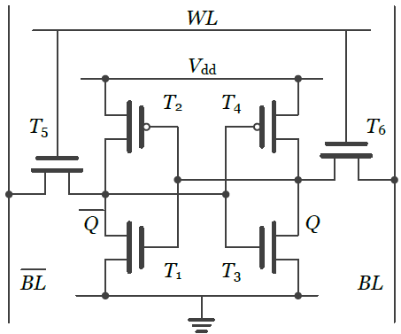
SRAM is the bottleneck
Energy-efficiency of the register file
conventionally built with high leakage SRAM
consume a great portion of GPU total Energy, 15-20%
Impediment for scaling up GPUs in future generation
High Leakage SRAM
high leakage power consumption
escalated leakage power as technology scales
low density, e.g. 137F²
6T SRAM

Slide 7
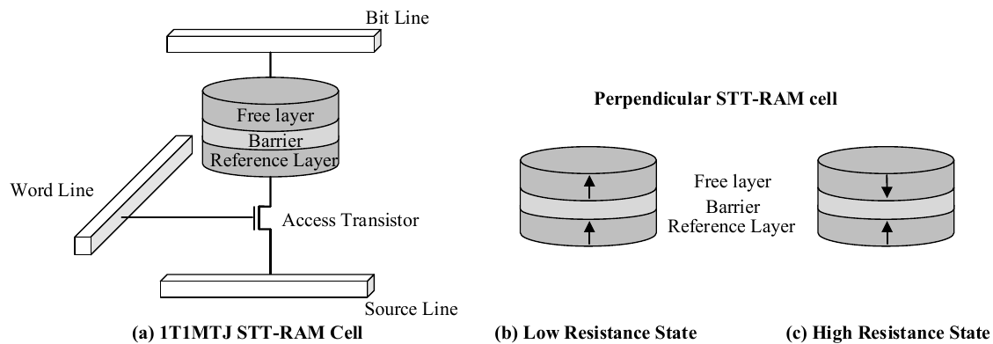
To combat SRAM leakage
STT-RAM (Spin Transfer Torque magnetic RAM)
near zero leakage power
high density, 6-37 F²
good scalability, 1x nm
good endurance, 10^15
Building STT-RAM GPU Register File
R.F. and shared memory [HPCA’13], distributed buffer[DAC’15] , MLC STT-RAM [ASP-DAC’15]
Achieve near-zero Leakage
However, writing STT-RAM cells becomes a problem
high write energy consumption
long write latency

Slide 8
Design Goal
Prior proposals still suffer from
performance degradation
high dynamic energy consumption
Our goal
leverage value similarity in SIMT architecture
propose a lightweight compression framework to mitigate STT-RAM writes
redesign a centralized write buffer for better utilization

Slide 9
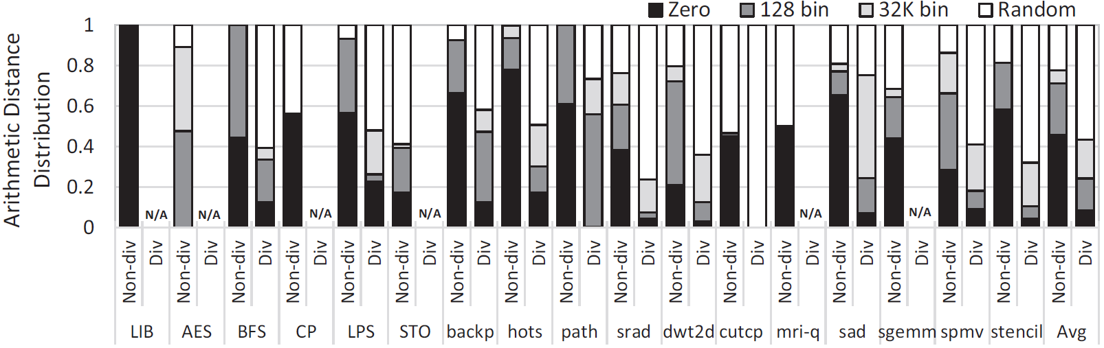
Register Value Similarity
Value similarity between successive register requests
many thread-specific local variables, threadID
some local variables are assigned similar
input data arrays has a very narrow dynamic range
Register value similarity profiling
1. 79% of the registers are categorized as not random
during non-divergent execution phase
2. Compression algorithm can be effective
ISCA’15 Warped-compression: enabling power efficient GPUs through register compression

Slide 10
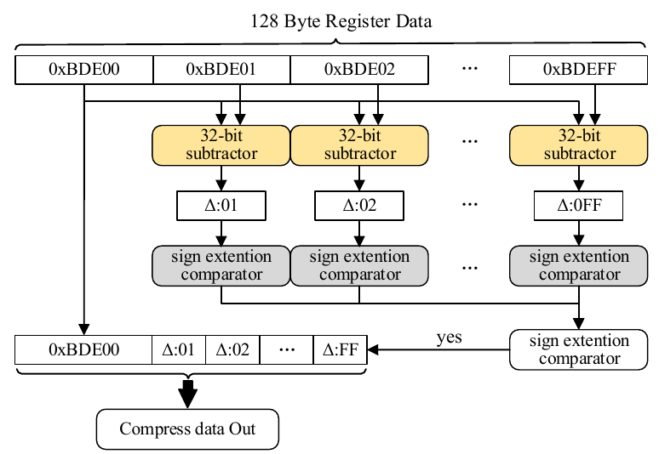
A lightweight compression framework
Base-Delta-Intermediate (BDI) compression
lightweight: 1 cycle compress/decompression
high compression ratio: when data are similar
Value similarity on SIMT architecture
If a data word can be compressed
Base: first data chunk
Delta: difference with base
Intermediate

Slide 11
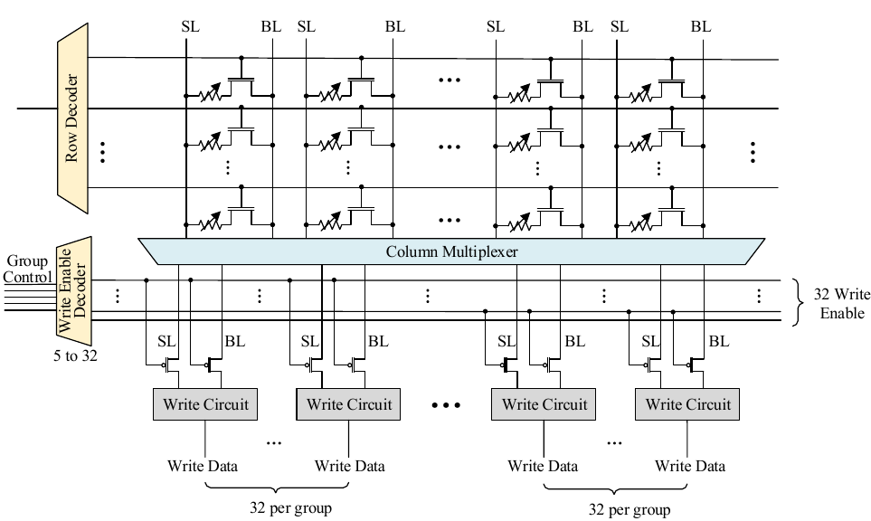
Write driver enhancement
Fine Grained Write Driver Control
32 groups for 1024-bit register entry
Enable signals from the compression engine
Notes:
1. The write driver is redesigned to enable a fine-grained access control on how many of STT-RAM bits can be read/write at the same time.
2. To minimize the control complexity, a bits group of 32-bit is controlled together as a unit.
3. The signals from the compression engine are fed in as the control enabler.

Slide 12
Centralized Write Buffer
Prior SRAM buffer design
Each bank has its own write buffer
Under utilization
Register Requests
B
Bank1
Conflict!
A
A
Bank1
Buffer1
Buffer2
Buffer2
Bank1
Bank2
Bank3

Slide 13
Centralized Write Buffer
Our proposed design
A centralized write buffer shared by banks
Register Requests
B
Bank1
Buffer
A
Bank1
Buffer1
Buffer2
Buffer2
Bank1
Bank2
Bank3

Slide 14
Centralized Write Buffer
Our proposed design
A centralized write buffer shared by banks
Register Requests
B
Bank1
Buffer
A
B
Buffer
A
Bank1
A
Buffer
Bank1
Bank2
Bank3
Centralized writer buffer
Better utilization
Smaller total capacity (SRAM)

Slide 15
Relaxed retention time STT-RAM cells
Retention Time
Operating Point
Write current goes down with reduction in retention time
Retention Time of STT-RAM | Write Latency @ 700Hz
10 Years | 5.5 cycles
1 second | 3 cycles
10 millisecond | 1.5 cycles
10ms retention time equals 7000000 cycles on GPUs and is far more than 789 cycles (inter-access distance)

Slide 16
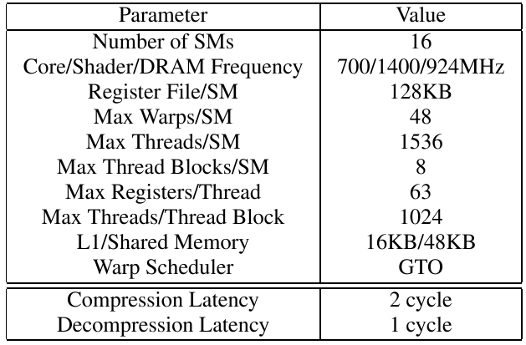
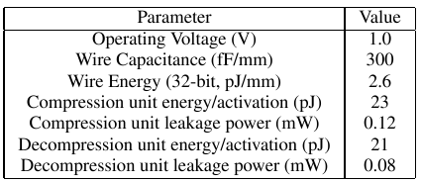
Experimental Evaluation
Hardware Setup
GPGPUSim simulator
Nvsim
NVIDIA GTX 480 architecture

Slide 17
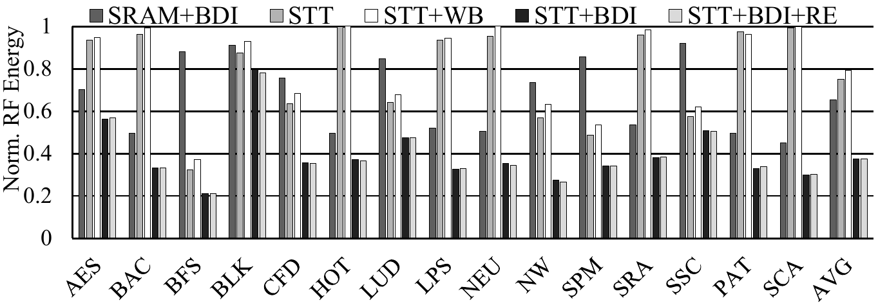
Evaluation: Register File Energy
Our proposed design consume only 37.4 % register file energy compared to the baseline on average.

Slide 18
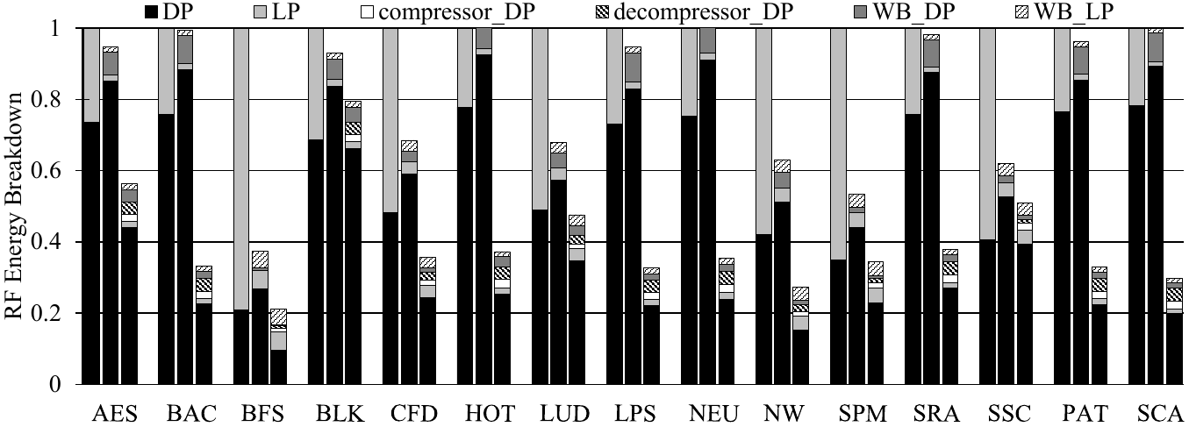
Energy Breakdown
Bar 1 is Base, Bar 2 is WB, Bar 3 is STT+BDI
1.STT-RAM can effectively cut off leakage energy
2. Compression is good at reducing dynamic energy

Slide 19
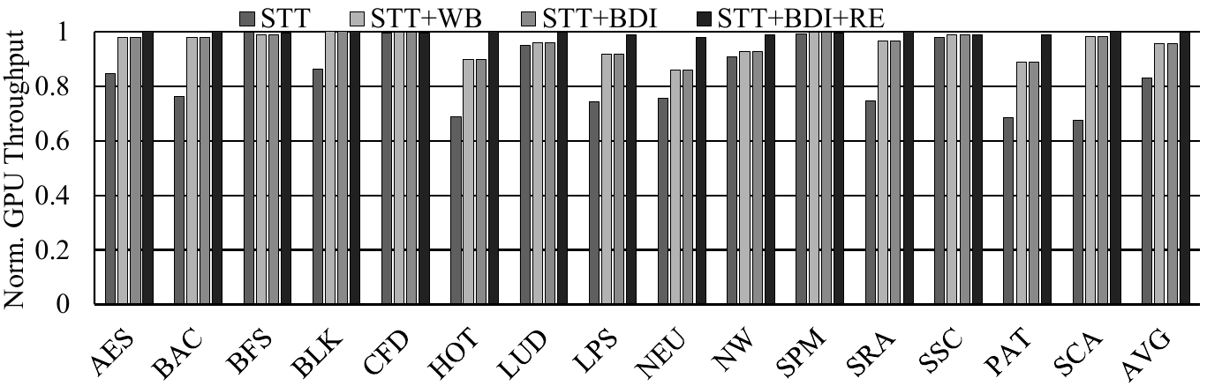
GPU Performance
Our scheme can achieve near 99% performance of the SRAM baseline

Slide 20
Conclusion
Register files on GPU becomes the key design consideration for future GPU architecture.
STT-RAM is a promising candidate for building GPU register files, if write operations are optimized well.
The value similarity makes the delta compression effective to reduce the dynamic energy overheads associated with STT-RAM write.
Centralized write buffer design can better utilize the SRAM write buffer.
Our proposed design can achieve 37.4% energy consumption of the SRAM based design, with negligible performance overheads.

Slide 21
Thank you!

