Slide 1






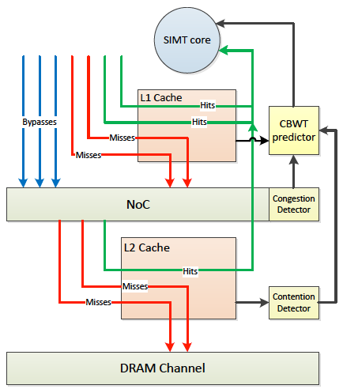

Adaptive Cache Management for Energy-efficient GPU Computing
Xuhao Chen^{1,2,3}, Li-Wen Chang³, Chris Rodrigues³, Jie Lv³, Zhiying Wang^{1,2}, Wen-Mei Hwu³
[1] State Key Laboratory of High Performance Computing, National University of Defense Technology, Changsha, China
[2] School of Computer, National University of Defense Technology, Changsha, China
[3] Department of Electrical and Computer Engineering, University of Illinois at Urbana-Champaign, Urbana, USA
1. Cache Contention and Resource Congestion
3.2. Maximum Active Warps Prediction
Many cache sensitive GPU applications have cache contention → low cache efficiency → poor performance
Smaller L1 cache capacity per thread
Cache contention information is collected by the L2 cache
Used by predictor to enable/disable bypassing and throttling
Bypass ratio is used to quickly estimate the optimal MAW
Bypass ratio denotes cache bypass as a fraction of accesses
L1D $ size=
A 2.68x speedup on average (harmonic mean) for highly cache sensitive (HCS) benchmarks
We propose Coordinated Bypassing and Warp Throttling (CBWT) to improve GPU cache efficiency
Reduce cache contention rate and NoC latency
NoC latency feedback controls multithreading
Adjust MAW to keep the network in a busy but low-congestion range
MAW=
Better than simply combining bypass and warp throttling
Feedback-driven control on NoC utilization
Lower hardware overhead
High Contention Rate for HCS benchmarks
NoC latency increases when Maximum Active Warps (MAW) increases
4. Experimental Results
2. Cache Management Schemes
Cache bypassing retains useful cache lines instead of replacing upon cache miss
Retain useful data → fewer cache misses per thread
Many active threads → many misses → high demand on NoC to serve misses, i.e. congestion
Cores may be underutilized due to NoC congestion
Bypassing still cannot avoid locality loss
Warp throttling temporarily deactivates some threads
Fewer threads sharing the cache → more cache per thread → fewer cache misses
Few active threads → cannot hide latency through multithreading
Cores may be underutilized due to low thread parallelism
Resource (e.g. NoC bandwidth) under-utilization
PDP-S: pure cache bypassing Best-SWL: pure warp throttling
CBWT achieves an average of 74% (maximum 661%) IPC improvement on HCS benchmarks over baseline
Significantly outperforms PDP bypass (42%) and Best-SWL (52%)
Due to a sharp reduction in cache misses
1.46x (SWL)
1.84x (SWL+bypass)
1.38x (bypass)
CBWT outperforms the baseline with an average of 58.6% Perf/Watt improvement
On average, PDP bypassing can reduce 16.5% of DRAM traffic,
CBWT reduces DRAM traffic by 54.9%
CBWT is still beneficial when advanced warp schedulers or larger L1 caches are applied (see paper)
PDP (Protection Distance Prediction) bypass policy on GPU achieves
an HCS speedup of 1.57x
SWL: Static Wavefront Limiting (warp throttling)
3.1. CBWT Design Overview
5. Conclusion
Extra sampling modules (yellow blocks) are added to monitor contention and congestion
CBWT components:
Contention detector
Congestion detector
CBWT predictor
The victim bits records the access history from a particular L1 cache before the line's eviction
CBWT enables GPGPU for irregular applications from memory hierarchy’s point of view
CBWT significantly outperforms existing management schemes in terms of performance and energy efficiency
The cost-effective CBWT design is more practical to implement in real hardware
A novel cache contention detection mechanism (leveraging L2 cache’s tag array)
Come to Session 4A in Main Auditorium on Dec. 16 (Tuesday) at 11:10 AM for more details
Proposed L2 cache line

