Slide 1





Adaptive Cache Management for Energy-efficient GPU Computing
Xuhao Chen^{1,2,3}, Li-Wen Chang³, Chris Rodrigues³, Jie Lv³, Zhiying Wang^{1,2}, Wen-Mei Hwu³
[1] State Key Laboratory of High Performance Computing, National University of Defense Technology, Changsha, China
[2] School of Computer, National University of Defense Technology, Changsha, China
[3] Department of Electrical and Computer Engineering, University of Illinois at Urbana-Champaign, Urbana, USA
Notes:
Good morning everyone. Thanks for coming. My talk is xxx. My name is Xuhao Chen. I am from National University of Defense Technology.
This work was done when I was visiting UIUC.

Slide 2
Overview
Our focus: cache management scheme for GPGPUs
Enable GPUs for Irregular applications that is highly cache sensitive
Could be very inefficient due to massive multithreading
Cache contention & resource congestion
Existing management schemes have limitations
Cache bypassing (retain some useful lines instead of always replacing)
Warp throttling (adjust thread counts to avoid over-saturating resources)
We propose coordinated bypassing and warp throttling (CBWT)
Take full advantage of cache capacity & other on-chip resources
Improve GPU performance and energy efficiency
Notes:
Our work focuses on cache management scheme for GPGPUs.
We aim to enable GPUs for accelerating irregular applications that could potentially benefit from caches.
Executed in the massive multithreading environment, these applications could be …
The main problems are …
Existing management schemes include xxx and xxx.
They can alleviate contention and resource congestion, but they both have limitations.
We propose … to … and therefore improve …

Slide 3
Outline
Introduction
Existing Work
CBWT Design
Evaluation
Conclusion
Notes:
This talk will be organized in this way.
First I will briefly introduce the background.
Then the existing approaches will be discussed.
Based on that, I will introduce our proposal, the CBWT design.
And then I will show some experimental results, and finally concludes.

Slide 4
Design Trade-offs in GPGPUs
Massive Multithreading
SIMT execution
Warp interleaving to hide memory latency
Throughput-oriented cache hierarchy in GPUs
Memory coalescing
Private L1 data cache (write-through, non-cohenrent)
Shared L2 cache (non-inclusive)
The baseline GPU architecture
Similar to NVIDIA Fermi GPU
Poor cache efficiency for irregular applications
Cache thrashing, a.k.a cache contention
Worse due to massive multithreading (few resources per thread)
Notes:
The figure shows the baseline GPU architecture, similar to NVIDIA Fermi GPU.
With SIMT execution model, GPUs are good at dealing with data-parallel kernels with regular memory access behavior.
And GPUs can hide memory latency through massive multithreading.
To support applications with irregular memory access patterns, cache hierarchy has been introduced to the GPU architecture to mitigate the effect of irregular accesses.
However, GPU caches exhibit poor efficiency due to the mismatch of the high thread counts and limited on-chip resources, which limits system performance and energy-efficiency.

Slide 5
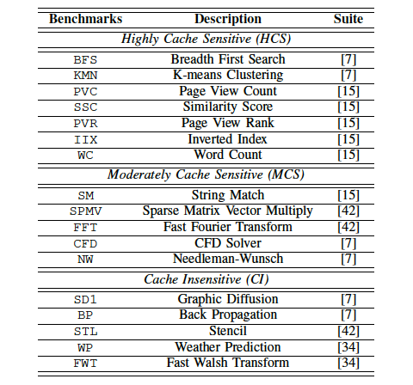
Benchmarks
[7] Rodinia
[15] Mars
[34] CUDA SDK
[42] Parboil
HCS (Highly Cache Sensitive)
MCS (Moderately Cache Sensitive)
CI (Cache Insensitive)
GPGPU benchmarks
Categorized by their cache sensitivity
Notes:
To evaluate the GPU system, we selected 17 memory intensive GPU benchmarks.
We categorize the benchmarks into highly cache sensitive (HCS), moderately cache sensitive (MCS) and cache insensitive (CI) ones.
HCS benchmarks are the ones we mostly care about.

Slide 6
GPU Cache Inefficiency
Nearly 80% inserted cache lines are never reused before eviction
reuse count =
L1 Cache Reuse Count Distribution for a GPU with 32KB L1 caches
Most of the L1 cache lines are zero-reuse lines
Cache reuse count is the number of times cache lines are reused during their lifetimes, throughout the entire program execution
Cache inefficiency may degrade the system performance and energy-efficiency
Notes:
In order to illustrate the cache inefficiency,
we measured the reuse count distribution for a GPU with 32KB L1 caches. As the figure shows,
most of the cache lines inserted into the L1 caches are never reused (see the zero reuse count).
Take BFS as an example, …
This cache inefficiency problem may lead to poor system performance and energy-efficiency.
The zero-reuse cache lines are either streaming accesses or victims of early eviction.

Slide 7
A 2.68x speedup on average (harmonic mean) for highly cache sensitive (HCS) benchmarks
Cache Contention
L1$ size=
Perf. speedup when increasing L1 cache size
L1 Cache Contention Rate
Many cache sensitive GPU applications have severe cache contention → low cache efficiency → poor performance
Smaller L1 cache capacity per thread
High contention rate for HCS benchmarks
num_repeated_accesses / num_accesses to L2 cache
Notes:
To illustrate how contention affects the performance of HCS applications,
The figure shows the performance speedup of HCS benchmarks with increasing L1 cache size (from 32KB to 512KB).
For these benchmarks, larger L1 caches reduce contention and improve performance.
We can observe a 2.68 speedup on average for HCS benchmarks.
The figure on the right presents the L1 contention rate detected by the L2 cache.
Contention rate is calculated as the number of repeated accesses (from a particular L1 cache) divided by the total number of accesses to the L2 cache.
It shows very high contention rates for HCS benchmarks.

Slide 8
Resource Congestion
MAW=
Average NoC latency under different MAWs (Maximum Active Warps)
NoC latency: number of cycles that a packet takes to walk through the network
[HPCA ‘14] Memory Request Prioritization Buffer – MRPB
Cache blocks, MSHR, miss queues are not available
Average NoC latency increases when MAW increases
Over-saturated when too many active warps
Underutilized when too few active warps
Notes:
The massive amount of memory requests may also cause resource congestion as observed in the HPCA’14 paper.
In our work, we focus on network congestion.
This figure shows that the average NoC latencies of HCS benchmarks increase as their Maximum Active Warps (MAWs) increase from 1 to 24.
MAW here is a runtime tunable hardware parameter that is used to control warp concurrency.
When there are too many active warps, they might over-saturate the network.
But, if too few active warps, it might lead to NoC bandwidth underutilization.
The NoC latency becomes dramatically high when MAW is larger than 5 for most of the benchmarks,
because more concurrent warps generate more requests and quickly saturate the network.

Slide 9
Outline
Introduction
Existing Work
CBWT Design
Evaluation
Conclusion
Notes:
There are basically tow types of existing management schemes that can alleviate contention and improve GPU performance.

Slide 10
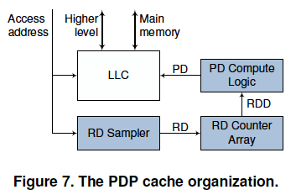
Cache Bypassing
The PDP Cache Organization
[MICRO ‘12] Protection Distance Prediction (PDP)
Each cache line is assigned a protection distance (PD) (>0)
Decrement PD for each access to the set
Bypass an incoming request when no PD=0 line found
SPDP-B and Dynamic PDP (PDs are estimated at runtime by sampling)
Notes:
The first one is cache bypassing. The state-of-the-art bypass policy is called protection distance prediction (a.k.a. PDP),
Each line is assigned a counter called protection distance to indicate how many accesses this line will be protected from.
The counter is decremented for each access to the target set. A line is protected only if this counter is larger than 0.
An unprotected line can be replaced by the incoming requests. The cache is bypassed if no unprotected lines are found.
Two schemes are introduced: static PDP bypass (SPDP-B) and dynamic PDP. SPDP-B uses a statically determined PD.
Dynamic PDP predicts reuse distance (RD) by hardware sampling, and periodically estimates the optimal PD (which maximizes the hit rate) based on the sampling.

Slide 11
Bypassing in GPUs
HCS Performance of Static PDP bypass (SPDP-B) for GPU L1 caches (PD=4~64)
The first to implement and evaluate PDP bypass policy in GPUs (both static and dynamic PDP policies)
PDP bypass policy is beneficial for GPUs
It achieves an average speedup of 1.57x for HCS benchmarks
Notes:
Our work is the first implementation and evaluation of PDP cache on GPU.
The figure shows the performance of SPDP-B for GPU L1 caches in response to different PDs
In this static study, we enumerate the PD from 4 to 64 (i.e. associativity to maximum PD).
We can observe that the optimal PD (if we can predict them accurately)
can lead to significant speedups, which is an average speedup of 1.57 times for HCS benchmarks.
However, the curves are flatter than those observed in CPUs [11].
This is because GPU warp interleaving makes the memory behavior much less predictable,
and thus the RD is relatively unstable in such a massive multithreading environment.
But the RD-based protection mechanism is still beneficial for GPUs,
because statistically, GPU memory behavior is still predictable [3].
The relatively flat curve implies that a suboptimal prediction may not lose too much benefit,
which is an opportunity to reduce hardware overhead.
Note that STL and SD1 have short RDs, and thus need small PDs.
A large PD leads to poor performance for them because it protects some cache lines beyond their lifetime, delaying their replacement with useful data.

Slide 12
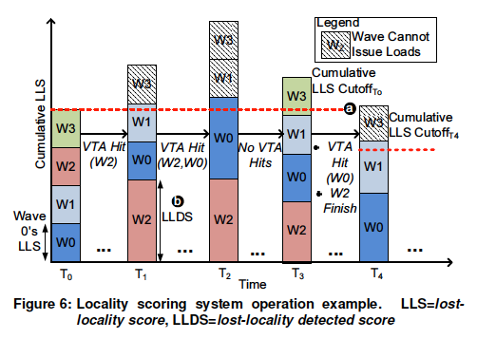
Warp Throttling
[MICRO’ 12] Cache Conscious Wavefront Scheduling (CCWS)
Aims to alleviate inter-warp cache contention and improve cache hit rate
Basic idea: suspend warps when severe contention is detected
Static and dynamic CCWS (calculates Lost Locality Score at runtime)
Notes:
The second management scheme is warp throttling.
Cache-conscious wavefront scheduling (a.k.a. CCWS) as been proposed to alleviate inter-warp contention and improve the L1 cache hit rate in GPUs.
Its basic idea is: when severe cache contention is detected (some warps lose too much locality),
the scheduler suspends some of the warps (not allowed to issue requests and stalled) to avoid inter-warp contention.
Two schemes have been proposed: static scheme uses statically determined maximum active warps (MAW) on each warp scheduler,
And dynamic scheme calculates Lost Locality Score at runtime to control warp concurrency.

Slide 13
Approaches to GPU Cache Management
Cache bypassing retains useful cache lines instead of replacing upon cache miss
Retain useful data → fewer cache misses per thread
Still cannot avoid locality loss (unable to control the working set)
Many active threads → many misses → high demand on NoC to serve misses, i.e. congestion
Cores may be underutilized due to NoC congestion
Warp throttling temporarily deactivates some threads
Fewer threads sharing the cache → more cache per thread → fewer cache misses
Resource (e.g. NoC bandwidth) under-utilization
Few active threads → cannot hide latency through multithreading
Cores may be underutilized due to low thread parallelism
Notes:
Both techniques can alleviate contention and improve performance.But they also have their own limitations.
Pure cache bypassing cannot avoid locality loss, since it is unable to control the working set.
It may also generate too many bypassed requests that cause congestion in the lower level memory subsystem.
pure warp throttling may cause the n-chip network to be underutilized.
Also, it may leads to too few warps and therefore cannot hide memory access latency through multithreading

Slide 14
A Complementary Approach
1.84x (warp throttling+bypassing)
1.46x (warp throttling)
1.38x (bypassing)
Performance of BFS under two schemes: static warp throttling with bypass-disabled (red line) and bypass-enabled (green line).
SWL: Static Warp Limiting (Throttling)
3
7
Pure bypassing or pure warp throttling may not be optimal
Cooperatively combining two techniques could outperform either of them
Warp throttling can help bypassing to control the working set
Bypassing can enable more active warps with trivial cache performance loss
Optimal MAW is increased (from 3 to 7) when bypassing is enabled
Notes:
Given the limitations, we find a possible complementary approach by static study.
This experiment shows the …, we change the MAW from 1 to 24.
The figure illustrates that bypassing improves system performance for any MAW that is larger than 2.
We can also observe that pure bypassing achieves 1.38 times speedup, pure warp throttling get 1.46,
however when we combine bypassing and warp throttling together, we can get up to 1.84 times speedup.
This implies that cooperatively combining these two techniques could outperform either of them.
Because on one hand, …, on the other hand, …
Compared to SWL with bypassing disabled, we find that the optimal MAW is increased when bypassing is enabled (from 3 to 7).
This is because when bypassing is enabled, it is possible to issue more warps without degrading cache performance, since caches are protected by the bypass policy.
The extra warps can take advantage of the underutilized NoC and/or DRAM bandwidth, which can potentially improve system performance.
Optimal MAW is different for different benchmarks and inputs, which means a dynamic approach is required.
BFS has memory divergence because its access behavior depends on input data, and can not be well coalesced at programming or compile time.

Slide 15
Outline
Introduction
Existing Work
CBWT Design
Evaluation
Conclusion
Notes:
We propose coordinated bypassing and warp throttling, which cooperatively combines cache bypassing and warp throttling.

Slide 16
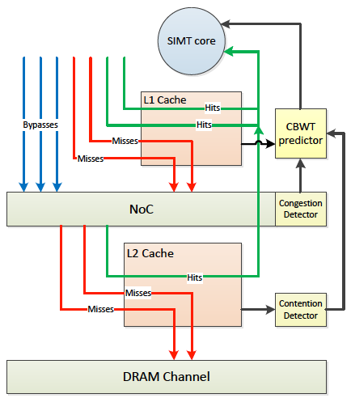
Architecture Overview
Extra sampling modules (yellow boxes) are added to monitor contention and congestion
CBWT components:
Contention detector
Congestion detector
CBWT predictor
The victim bits records the access history from a particular L1 cache before the line's eviction
Proposed L2 cache line
CBWT Overview
Notes:
The figure shows the CBWT architecture overview.
Extra sampling modules (yellow blocks) are added to monitor contention and congestion.
The CBWT design basically contains three components:…
For contention detection , we proposed a novel mechanism, the victim bits.
They records the access history from a particular L1 cache before the line's eviction.
Based on this the L2 cache can detect L1 cache contention.
Memory requests consist of hits, misses and bypasses. Caches are protected by the PDP bypass policy.
The feedback paths are illustrated in the figure.
To overcome the limitations of bypassing, CBWT adaptively controls the number of active warps to take full advantage of the cache capacity and other on-chip resources.

Slide 17
Runtime MAW Prediction
NoC latency feedback controls multithreading
Adjust MAW to keep the network in a busy but low-congestion range
Dynamic MAW Prediction Algorithm
Cache contention information is collected by the L2 cache
Used by predictor to enable/disable bypassing and throttling
Notes:
Our proposed method for dynamic CBWT uses the runtime observed L1 cache bypass rate, NoC congestion, and L1 contention to adjust the maximum active warps (MAW) to avoid overburdening the memory system.
Cache contention information is collected by the L2 cache, and is used by predictor to enable/disable bypassing and throttling.
NoC latency feedback controls multithreading. It adjusts MAW to keep the network in a busy but low-congestion range.

Slide 18
Implementation Details
Bypass ratio is used to quickly estimate the optimal MAW
Bypass ratio denotes cache bypass as a fraction of accesses
Better than simply combining bypass and warp throttling
Feedback-driven control on NoC utilization
Lower hardware overhead
Contention detection overhead
Victim bits in the L2 cache (no extra tag arrays): 256B for a 16-way 1MB L2 cache in a 16-core GPU
Victim Tag Array (VTA) in CCWS: 40 bits/entry x 16 entries/warp x 48 warps/core x 16 cores = 60 KB
Notes:
In the runtime MAW prediction algorithm, we use bypass ratio to quickly estimate the optimal MAW.
Our design is better than … because, first we put feedback-driven control on NoC utilization, and second we proposed a low-overhead hardware design.
Thinking about the contention detection overhead,
for a 16-core GPU with a 16-way 1MB L2 cache, CBWT requires 256B extra storage, while CCWS requires 60KB on-chip storage.
NoC latency sampler, the predictor, the PDP components

Slide 19
Outline
Introduction
Existing Work
CBWT Design
Evaluation
Conclusion
Notes:
We use GPGPU-Sim to model the baseline architecture which mimics a generic NVIDIA Fermi GPU.

Slide 20
IPC and Miss Rates
1.74x Speedup
CBWT achieves an average of 74% (maximum 661%) IPC improvement on HCS benchmarks over baseline
Also significantly outperforms PDP bypass (42%)
Due to a sharp reduction in cache misses
Notes:
The figure above illustrates normalized performance (IPC) improvement of PDP-S, CBWT and Best-CBWT on all benchmarks, with respect to baseline.
Best-CBWT is the best static warp throttling (SWL) with PDP bypassing enabled.
The figure shows that CBWT achieves an average of 74% IPC improvement on HCS benchmarks over baseline,
which significantly outperforms PDP bypassing (42% improvement over baseline).
This is mainly because CBWT reduces MAWs when contention and congestion are detected.
Compared to Best-CBWT, CBWT only loses 9% performance for HCS benchmarks on average.
This indicates that our prediction is effective enough to capture the most of the performance benefit.
The lower figure illustrates that the reason for the performance improvement for PDP bypassing and CBWT on HCS benchmarks is a sharp reduction in cache misses.
For HCS benchmarks, CBWT reduces 18.3% of the average NoC latency compared to PDP-S.

Slide 21
DRAM and Energy-efficiency
59% Energy-efficiency
improvement
55% Reduction
DRAM traffic of baseline, PDP and CBWT
Energy-efficiency (Perf/Watt)
CBWT outperforms the baseline with an average of 59% Perf/Watt improvement
On average, PDP bypassing can reduce 17% of DRAM traffic,
CBWT reduces DRAM traffic by 55% (14% DRAM power reduction)
CBWT is still beneficial when larger L1 caches are applied (see paper)
Notes:
We also evaluated the system energy efficiency.
The left figure shows DRAM requests generated by HCS benchmarks.
On average, PDP bypassing can reduce 17% of DRAM traffic, while CBWT reduces DRAM traffic by 55%.
This DRAM traffic reduction leads to 14% DRAM power reduction, and overall the system energy efficiency is improved by 59%.
The dramatic reduction of DRAM traffic leads to an average DRAM power reduction of 14.4%.
Fig. 16 shows the system energy efficiency (Perf/Watt) for HCS benchmarks.
Overall, CBWT outperforms the baseline GPU with an average of 59% system energy efficiency improvement in terms of Perf/Watt.
For all evaluated benchmarks, including HCS, MCS and CI benchmarks, CBWT has an average of 25.4% system energy efficiency improvement over the baseline.
Considering only the effect on DRAM energy efficiency, although not shown in the figure, CBWT provides an average of 111% (2.11 ) Perf/Watt improvement over the baseline.
Overall, CBWT gives an average of 76.7% DRAM energy efficiency improvement.

Slide 22
CBWT vs. CCWS & MRPB
Comparing CBWT with CCWS and MRPB
Effect of warp scheduling policies
CBWT shows an average IPC improvement of 1.74, which outperforms Best-SWL and MRPB (1.52 and 1.57 respectively)
Best-SWL : optimal static warp throttling
Normalized to Best-SWL, CBWT improves performance by 17% and 38% with LRR and GTO scheduler respectively
GTO (Greedy Then Old) which runs a single warp until it stalls then picks the oldest ready warp
Notes:
Comparing CBWT with CCWS and MRPB, we can see in the figure that CBWT also outperforms CCWS and MRPB.
This is due to the benefit of bypass policy and the heuristic control on NoC utilization.
When we change the warp scheduling policy from LRR to GTO, it shows increased performance benefit (from 17% to 38%).
CBWT provides more improvement when GTO is applied because GTO shrinks the performance benefit of Best-SWL and MRPB, since they both only focus on cache performance.
However CBWT monitors NoC congestion and properly controls the request flow through bypassing and throttling, thus it is still beneficial even if GTO improves the cache behavior.
LRR Loose round-robin scheduling. Wavefronts are prioritized for scheduling in round-robin order. However, if a wavefront cannot issue during its turn, the next wavefront in round-robin order is given the chance to issue.
GTO A greedy-then-oldest scheduler. GTO runs a single wavefront until it stalls then picks the oldest ready wavefront. The age of a wavefront is determined by the time it is assigned to the core. For wavefronts that are assigned to a core at the same time (i.e. they are in the same workgroup), wavefronts with the smallest threads IDs are prioritized. Other greedy schemes (such as greedy-then-round-robin and oldest-first) were implemented and GTO scheduling had the best results.

Slide 23
Outline
Introduction
Existing Work
CBWT Design
Evaluation
Conclusion

Slide 24
Conclusion
This work aims to enable GPGPUs for irregular applications from memory hierarchy’s point of view
Evaluation and analysis on the current GPU cache design and state-of-the-art management schemes
Further understanding memory access behavior of GPU applications
Understanding the limitations of existing approaches
CBWT significantly outperforms existing management schemes in terms of performance and energy efficiency
Demonstrating the benefit of cooperatively combining two techniques
The cost-effective CBWT design is more practical to implement in real hardware
A novel cache contention detection mechanism (leveraging the L2 cache)

Slide 25

Thanks!
Q & A

Slide 26
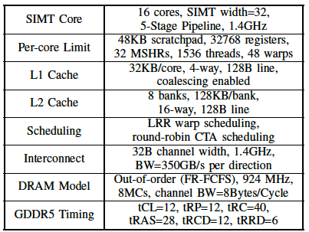
Evaluation
GPGPU-Sim v3.2.0
NVIDIA Fermi GPU
GPUWattch
Power model
Simulation configuration
Notes:
We use GPGPU-Sim to model the baseline architecture which mimics a generic NVIDIA Fermi GPU.
GPUWattch is used to estimate the power consumption.
The table lists the major configuration parameters.
The baseline architecture uses a detailed GDDR5 DRAM model.
NoC traffic in each direction between the SIMT cores and the memory partitions are serviced by two separate networks
which can transfer a 32-byte flit per interconnect cycle to/from each memory partition.

Slide 27
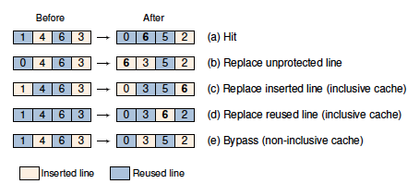
CPU Bypassing – Protection Distance Prediction
Example of the PDP cache operation
Notes:
Example of the PDP cache operation
Bypass MSHR: lose locality and cause NoC congestion
Not bypass MSHR: lose locality and cause MSHR congestion (need to be implemented)

Slide 28
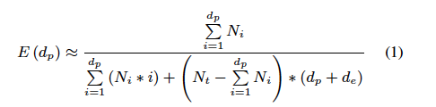
PDP Hit Rate Model
E(d_{p}) = HR(d_{p})/W. HR(d_{p}) is the hit rate. W is the set associativity.
d_{p} is a value of the PD
N_{i} is the hit count for reuse distance i.
N_{t} is the total number of cache accesses.
d_{e} is a function of cache associativity and program behavior.
It has been experimentally determined that it can be set to a constant equal to W

Slide 29
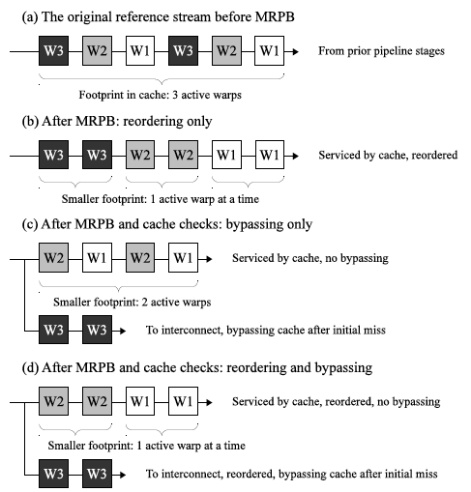
Memory Request Prioritization Buffer - MRPB
Reordering and bypassing are two request prioritization techniques that reduce cache footprints of active warps.
A box’s color and the number after W both indicate which warp a request comes from
Reordering can not avoid locality loss in some cases (e.g. KMN) with a reasonable number of request buffers
Reordering has no control on NoC traffic
MRPB bypassing only deals with resource (cache blocks etc.) congestion
Notes:
Reordering and bypassing are two request prioritization techniques that reduce cache footprints of active warps. A box’s color and the number after W both indicate which warp a request comes from.

Slide 30
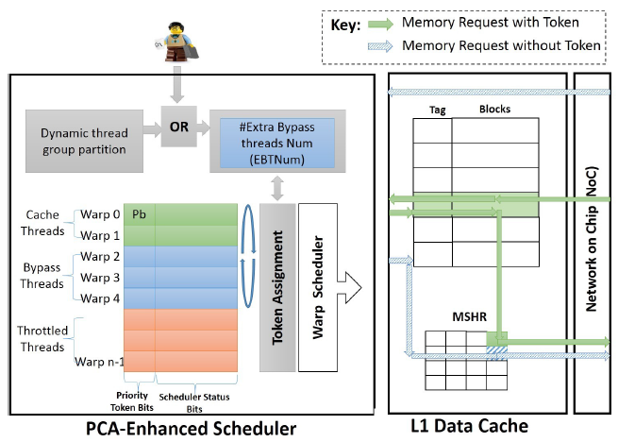
Priority-based Cache Allocation - PCAL
The PCAL Architecture Overview.
Paths potentially effected by token priorities are shown
Warp-level bypassing: PCAL bypasses all the requests issued by the warps with lower priority
Based on CCWS: requires all the CCWS components
Notes:
The PCAL Architecture Overview. Paths potentially effected by token priorities are shown

Slide 31
Pure SWL (without bypassing)
SWL without bypassing

Slide 32
NoC Latency
Average NoC latencies of different schemes
Cache bypassing may cause NoC congestion
Warp throttling may cause NoC under-utilization
CBWT controls the NoC traffic in a busy but low-congestion range
Notes:
Average NoC latencies of different schemes

Slide 33
Static Warp Throttling + Bypassing
MAW=
Performance under different MAWs when bypassing is enabled
Optimal MAWs for HCS benchmarks are always smaller than 24
Performance is not satisfactory when MAW is too small
Optimal MAW is increased when bypassing is enabled
Optimal MAW is different for different benchmarks and inputs
Notes:
When bypassing is enabled together with SWL, there is an opportunity to further improve performance
because pure warp throttling may lead to under-utilization of on-chip resources, but cache bypassing can enable more multithreading without degrading cache performance.
Figure shows the speedups over baseline on HCS benchmarks as the MAW increases, when PDP bypassing is enabled for L1 caches.
The scheme that picks the optimal MAW is called Best-CBWT in Section VI.
In the figure, we observe that the optimal MAWs for HCS benchmarks are always smaller than 24, because too many concurrent warps cause contention and congestion.
However, the performance is also not satisfactory when MAW is too small, due to resource under-utilization.
Compared to SWL with bypassing disabled (not shown in the figure), for most of the HCS benchmarks, we find that the optimal MAW is increased when bypassing is enabled.
This is because when bypassing is enabled, it is possible to issue more warps without degrading cache performance, since caches are protected by the bypass policy.
The extra warps can take advantage of the underutilized NoC and/or DRAM bandwidth, which can potentially improve system performance.
Likewise, the new optimal MAW is different for different benchmarks and inputs. This motivates us to find the optimal MAW dynamically.

Slide 34
Hardware Extension
The victim bits are bitmasks where each bit records the access history from a particular L1 cache before the line's eviction
Contentions in L1 caches is detected when the L1 cache sends a second request to the line that was requested before
Notes:
The victim bits are added to record the lost locality. They are bit masks associated with a cache line where each bit records the access history from a particular L1 cache before the line’s eviction. The bit is set when the L2 cache fulfills a request from the corresponding L1 cache, and reset when the line is evicted from L2 cache. Using the victim bits, early eviction in an L1 cache can be detected when the L1 cache sends a second request for a cache line that was requested recently. In this case, the LLS is incremented to indicate that a reuse opportunity is lost. When the LLS rate (LLS over total number of accesses) is high enough, the L2 cache notifies the L1 cache indicating that contention is detected.

Slide 35
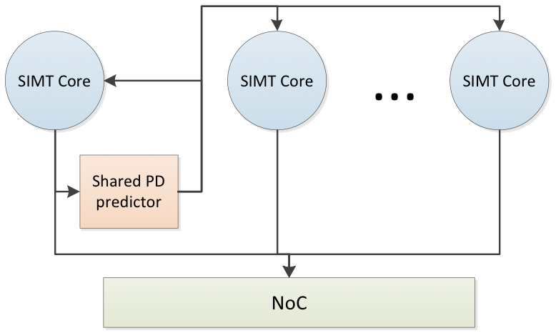
Hardware Overhead
Contention Detection
LLS sampling in the L2 cache: 256B for a 16-way 1MB L2 cache in a 16-core GPU
Victim Tag Array (VTA) in CCWS: 40 bits/entry x 16 entries/warp x 48 warps/core x 16 cores = 60 KB
NoC latency sampler
The predictor
PDP components
Minimized with the PDP-Share design

Slide 36
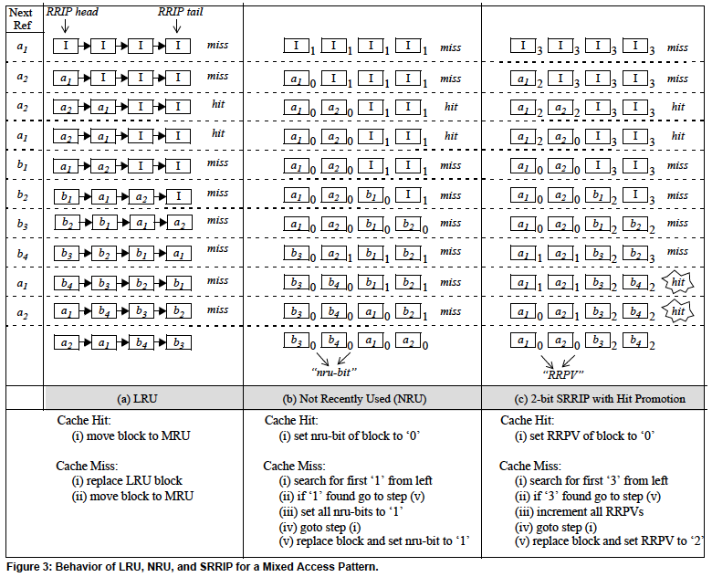
Re-Reference Interval Prediction - RRIP
Behavior of LRU, NRU, and SRRIP for a Mixed Access Pattern
Notes:
Behavior of LRU, NRU, and SRRIP for a Mixed Access Pattern.

