Slide 1

Architecting Energy-efficient STT-RAM Based Register File on GPGPUs via Delta Compression
Hang Zhang¹, Xuhao Chen¹, Nong Xiao^{1,2}, Fang Liu¹
¹State Key Laboratory of High Performance Computing, College of Computer,
National University of Defense Technology, China
²School of Data and Computer Science, Sun Yat-sen University

Slide 2
Overview
Background
GPGPU, STT-RAM
Motivation
Register value similarity on SIMT
Design Details
delta compression engine
centralized write buffer
relaxed retention time
Experimental Evaluation
performance and energy consumption
Conclusion

Slide 3
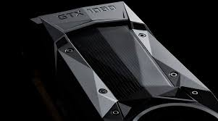

The Processing Engine in Big Data Era
GPGPUs (General Purpose Graphic Processing Unit) have been widely employed
Deep Learning
Datacenter
Supercomputer
However, energy-efficiency of GPUs becomes critical
NVIDIA Tesla P100, 300W
Intel Core i7-980X Extreme Edition, 130W
“We also implemented a distributed version of AlphaGo that exploited multiple machines, 40 search threads, 1,202 CPUs and 176 GPUs” – Nature, 2016
Notes:
The GPGPU have been widely employed in computing system, thanks to its high throughput and high energy-efficiency for Watt per float point operations,
including deep learning, datacenter, and supercomputer.
2. Google have used 176 GPUs to train the AlphaGO algorithm to beat human GO players.
2. The energy-efficiency of GPU becomes critical for future computing system
.

Slide 4
GPU Architecture
SIMT architecture: Single Instruction Multiple Threads
thousands of threads running together
threads operates on different data
hiding long memory access latency
high throughput can be achieved
Register file with large capacity
save the contexts of threads
512KB per SM (streaming multiprocessor) on NVIDIA K80 GPU
constrain how many threads concurrently running
A register read/write operation from a warp
32 threads / warp
32 * 32 bit = 1024 bit

Slide 5
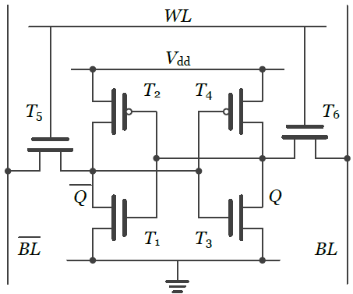
SRAM becomes the energy bottleneck
High leakage SRAM cell
high leakage power consumption
escalated leakage power as technology scales
low density, e.g. 137F²
Energy-efficiency of the register file
conventionally built with high leakage SRAM
consume a great portion of GPU total power, 15-20%
impediment for scaling up GPUs in future generation
6T SRAM

Slide 6
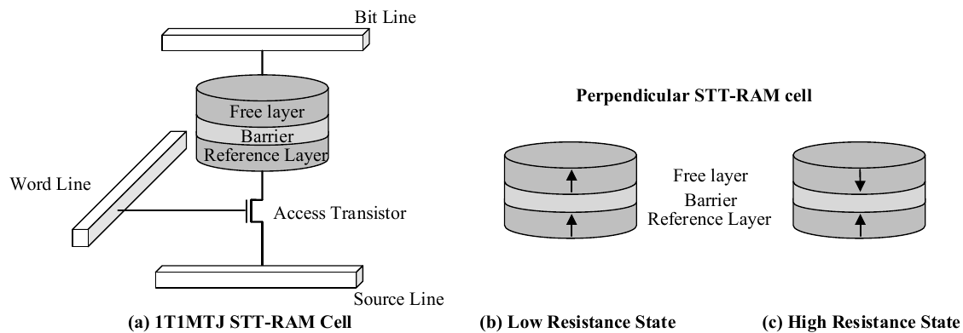
To combat SRAM leakage
STT-RAM (Spin Transfer Torque magnetic RAM)
near zero leakage power
high density, 6-37 F²
good scalability, 1x nm
good endurance, 10^15
Building STT-RAM GPU Register File
R.F. and shared memory [HPCA’13], distributed buffer[DAC’15] , MLC STT-RAM [ASP-DAC’15]
Goal: make use of near-zero leakage
However, now writing STT-RAM cells becomes a problem
high write energy consumption
long write latency

Slide 7
Our Design Goal
Prior proposals still suffer from
performance degradation
high dynamic energy consumption
Our solution
leverage value similarity in SIMT architecture
propose a lightweight compression framework to mitigate STT-RAM writes
redesign a centralized write buffer for better utilization

Slide 8
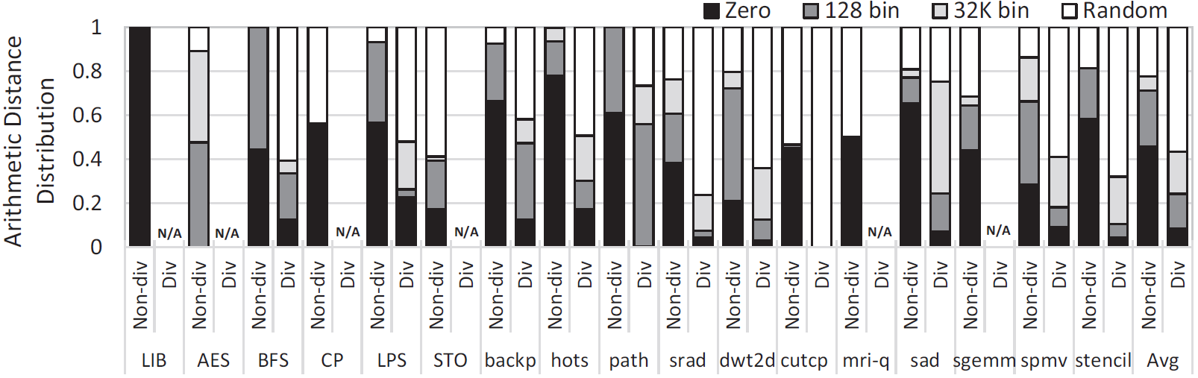
Motivation: Register Value Similarity
Value similarity between successive register requests
many thread-specific local variables, threadID
some local variables are assigned similar
input data arrays has a very narrow dynamic range
Register value similarity profiling
1. 79% of the registers are categorized as not random
during non-divergent execution phase
2. Similarity-aware compression algorithm will be effective

Slide 9
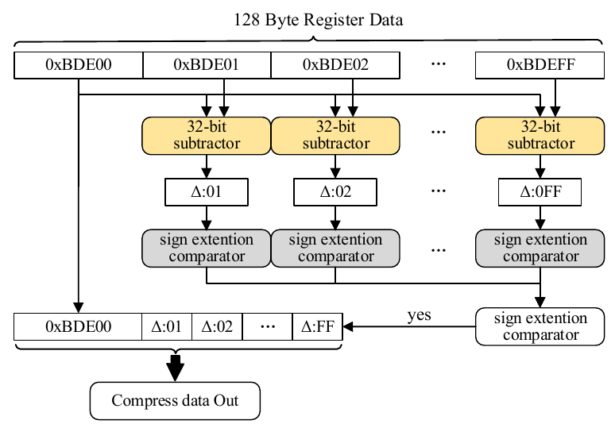
A lightweight compression framework
Base-Delta-Intermediate (BDI) compression
lightweight: 1 cycle compress/decompression latency
high compression ratio: when data are similar
Value similarity on SIMT architecture
The compressed process
A register value is divided into chunks
Base: first data chunk
Delta: difference with base
Intermediate: chunk data width (2, 4, 8)
STT-RAM writes is reduced
the number of writes is reduced,
when data is compressed

Slide 10
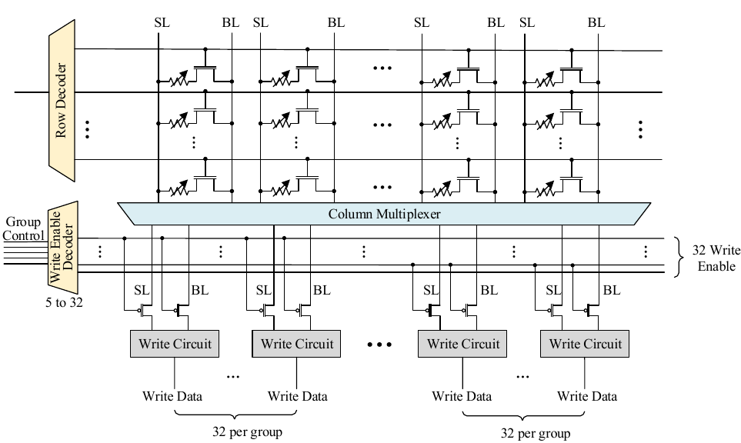
Write driver enhancement
Fine grained write driver control
32 groups for 1024-bit register entry
32-bits per group are controlled together
enable signals are from the compression engine
control which part of the groups are read/write
Notes:
1. The write driver is redesigned to enable a fine-grained access control on how many of STT-RAM bits can be read/write at the same time.
2. To minimize the control complexity, a bits group of 32-bit is controlled together as a unit.
3. The signals from the compression engine are fed in as the control enabler.

Slide 11
Centralized Write Buffer
Prior SRAM buffer design
Each bank has its own write buffer
Under utilization
Register Requests
B
Bank1
Conflict!
A
A
Bank1
Buffer1
Buffer2
Buffer3
Bank1
Bank2
Bank3

Slide 12
Centralized Write Buffer
Our proposed design
A centralized write buffer shared by banks
Register Requests
B
Bank1
Buffer
A
Bank1
Buffer1
Buffer2
Buffer2
Bank1
Bank2
Bank3

Slide 13
Centralized Write Buffer
Our proposed design
A centralized write buffer shared by banks
Register Requests
B
Bank1
Buffer
A
B
Buffer
A
Bank1
A
Buffer
Bank1
Bank2
Bank3
Centralized writer buffer
better utilization
smaller total capacity (SRAM)

Slide 14
Relaxed retention time STT-RAM cells
Retention Time
Write current goes down with reduction in retention time
Retention Time of STT-RAM | Write Latency @ 700Hz
10 Years | 5.5 cycles
1 second | 3 cycles
10 millisecond | 1.5 cycles
10ms retention time equals 7,000,000 cycles on GPUs and is far more than 789 cycles (the average inter-access distance)

Slide 15
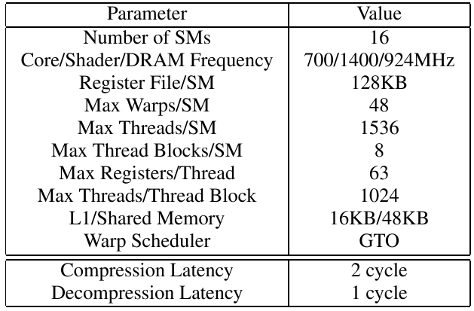
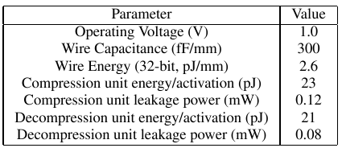
Experimental Evaluation
Hardware Setup
GPGPUSim simulator
Nvsim: model STT-RAM
NVIDIA GTX 480 architecture (Fermi)

Slide 16
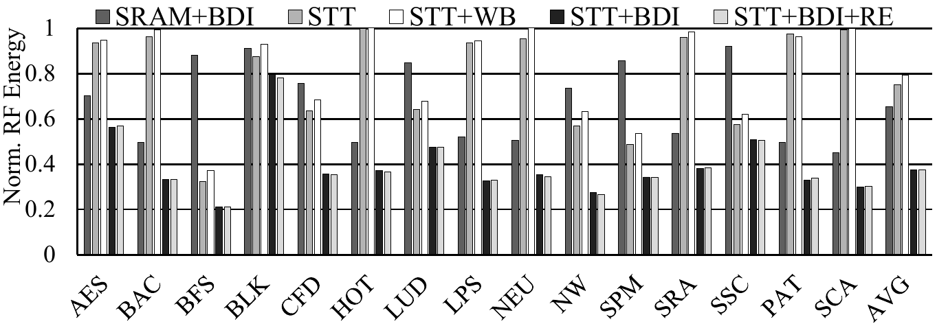
Register File Energy Consumption
Our proposed design consumes only 37.4% register file energy compared to the baseline on average.

Slide 17
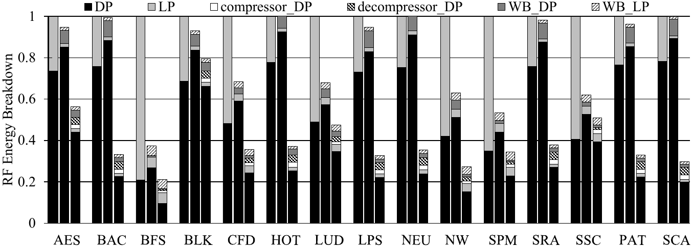
Energy Breakdown
Bar 1 is Base, Bar 2 is WB, Bar 3 is STT+BDI
1.STT-RAM can effectively cut off leakage energy
2. delta compression is good at reducing dynamic energy

Slide 18
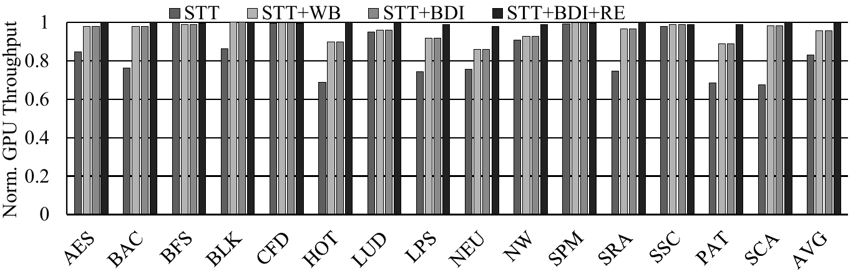
GPU Performance
Our scheme can achieve near 99% performance of the SRAM baseline

Slide 19
Conclusion
The energy-efficiency of the register file plays a vital role for GPGPU architecture
Leakage problem can be solved by STT-RAM, however, the dynamic energy consumption should be minimized
Delta compression is effective to optimize dynamic energy consumption of STT-RAM based register file.
Centralized write buffer design can improve the utilization of SRAM buffer.
The STT-RAM based register file is promising for future GPU architectures.

Slide 20
Thank you!
Q&A

Slide 21
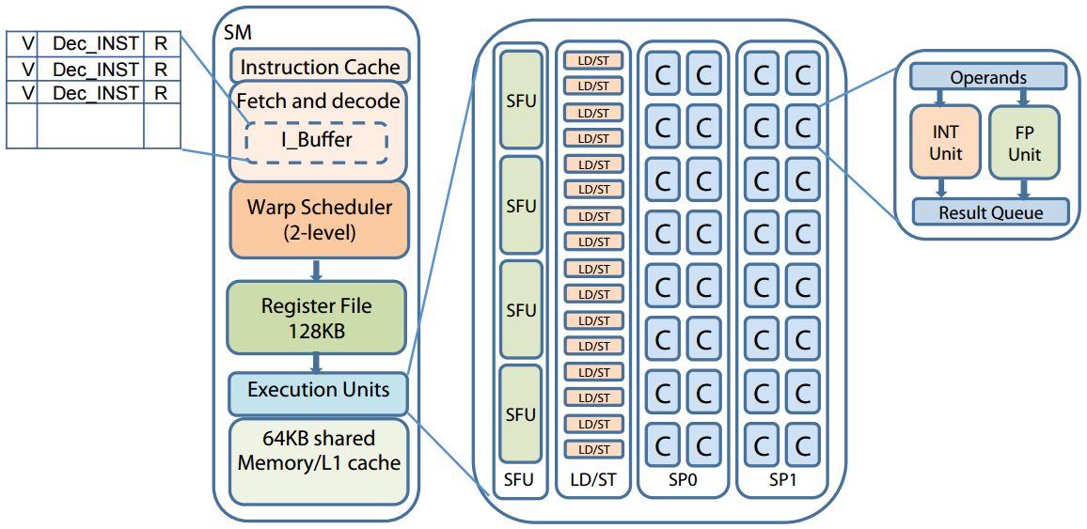
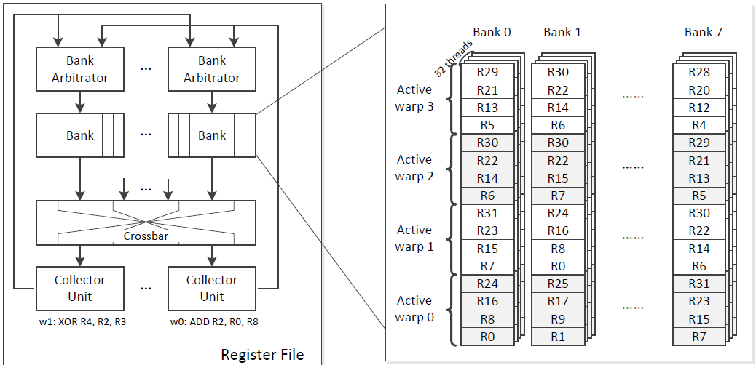
GPGPU Architecture (GTX 480)
ISCA’15 Warped-compression: enabling power efficient GPUs through register compression

