Slide 1

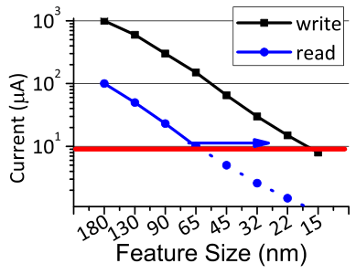
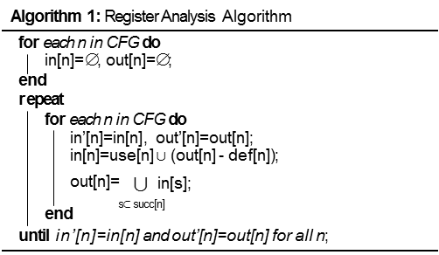
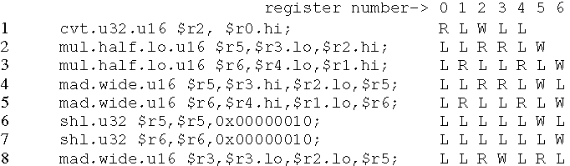
Red-Shield: Shielding Read Disturbance for STT-RAM Based Register Files on GPUs
Hang Zhang, Xuhao Chen, Nong Xiao, Fang Liu, Zhiguang Chen
College of Computer, National University of Defense Technology
Abstraction
RED-Shield Design
To address the high energy consumption issue of SRAM on GPUs, emerging Spin-Transfer Torque (STT-RAM) memory technology has been intensively studied to build GPU register files for better energy-efficiency, thanks to its benefits of low leakage power, high density, and good scalability. However, STT-RAM suffers
from a reliability issue, read disturbance, which stems from the fact that the voltage difference between read current and write current becomes smaller as technology scales. The read disturbance leads to high error rates for read operations, which cannot be effectively protected by SECDEC ECC on large-capacity register files of GPUs.
Prior schemes (e.g. read-restore) to mitigate the read disturbance usually incur either non-trivial performance loss or excessive energy overheads, thus not applicable for the GPU register file design which aims to achieve both high performance and energy-efficiency.
2. Read Buffer Promotion
3. Adaptive Restore Design
A reference tracking algorithm to record register reference count information, and exploit register access locality.
a small SRAM read buffer to hold register values with high temporal locality
direct restore is fast but consumes more energy.
selective restore is slow but consumes less energy.
adaptive restore: adaptively choose restore schemes, according to the busy status of the accessed register bank.
Motivation
Figure 4: The overall architecture of our proposed design.
STT-RAM read operations have the same operating mechanism as write operations but with smaller voltage.
As technology scales, the read current becomes close to write current. Read operations may change the store value, referred as read disturbance.
The line error rate is so high that cannot be protected by the SECDEC code (Table 1).
Both direct restore scheme and selective restore scheme will incur unacceptable performance loss and energy overheads.
Figure 5: A conceptual comparison between the direct restore operation and the selective restore.
Experiment Evaluation
Figure 1: The scaling of read and write currents^{[2]}.
base: the baseline register file built with SRAM; WB: the STT-RAM based register file with a SRAM write buffer. RD: the STT-RAM based register file design with the selective restore scheme. CO: configured similar with RD, but with the dead read identification technique. CORB: configured similar with CO, but with the read buffer promotion design. CORBAR: Configured similar with CORB, but with the adaptive restore scheme.
Performance: Our proposed dead read identification scheme (CO) can effectively improve throughput and achieve 90.6% of the baseline performance. Finally, CORBAR achieves 93.1% of the baseline performance on average.
Energy Consumption: Our proposed CO scheme can effectively mitigate the restore energy consumption on average and achieve 78.7% energy consumption of the baseline, even under read disturbance.
CORB consumes 79.8% of the baseline energy on average. CORBAR consumes 81.2% of the baseline energy on average. Though CORBAR consumes a little bit higher energy than CORB, the energy-efficiency of the register file is not sacrificed thanks to the low leakage power of STT-RAM.
Table 1. Read Disturbance Error Rate for a 1024-bit GPU register entry. BER: Raw bit error rate.
LER: Line error rate. SECDEC: Line error rate under the SECDEC ECC protection
Tech(nm) | 45 | 32 | 22 | 15 | 11
BER | 1.38E-08 | 3.38E-07 | 3.07E-06 | 2.16E-05 | 1.20E-04
LER | 1.42E-05 | 3.50E-04 | 3.17E-03 | 2.21E-02 | 1.17E-01
SECDEC | 1.02-10 | 6.12E-08 | 5.04E-06 | 2.46E-04 | 7.11E-03
RED-Shield Design
The Red-Disturbance Shield design
Dead Read Identification
Observation: on average, nearly 49.3% of generated register values are referenced (read) only once, while nearly 27.9% and 11.6% of them are referenced twice and three times, respectively. (Fig. 2)
Figure 6: GPU throughput comparison between different configurations.
Policy: identify dead read
a) Do not need to restore
register values that will not be
re-referenced in the future.
b) For a register value that will be re-referenced several times, the last reference does not need to be restored.
Figure 2: Register read access count distribution.
Figure 7: Energy consumption comparison between different configurations.
Conclusions
Implementation:
Goal: identify dead reads and avoid unnecessary restore operations.
Solution: standard register analysis algorithm to analyze register
liveness coverage.
The read disturbance issue of STT-RAM imposes great challenges for GPU register file design as technology further scales. We present a novel design, Red-shield, to employ complier optimization to filter out short-lifetime reads so as to mitigate the performance and energy overhead incurred by the read-restore operations. Coupled with the read buffer promotion design as well as the optimized read-restore scheme, Red-shield can effectively alleviate pipeline stalls caused by read disturbance and improve the energy efficiency. Our design can promote STT-RAM based GPU register files to become a feasible and effective solution for future GPU architectures.
Figure 3: A snippet of the PTX source code for the backprop benchmark.
R: read operation. W: write operation. L: register is alive.
Contact
References
Hang Zhang
College of Computer, National University of Defense Technology
Email: hangzhang@nudt.edu.cn
Z. Sun, H. Li, and W. Wu, “A dual-mode architecture for fast-switching STT-RAM,” in ISLPED, 2012.
R. Wang, L. Jiang, Y. Zhang et al., “Selective restore: an energy efficient read disturbance mitigation scheme for future STT-MRAM,” in DAC, 2015.
X. Liu, M. Mao, X. Bi et al., “An efficient STT-RAM-based register file in GPU architectures,” in ASP-DAC, 2015.
G. Li, X. Chen, G. Sun et al., “A STT-RAM-based low-power hybrid register file for GPGPUs,” in DAC, 2015.

