Slide 1



Adaptive Cache Bypass and Insertion for Many-core Accelerators
Xuhao Chen, Shengzhao Wu, Li-Wen Chang, Wei-Sheng Huang, Carl Pearson, Zhiying Wang, Wen-mei Hwu
Department of Electrical and Computer Engineering, University of Illinois at Urbana-Champaign
School of Computer, National University of Defense Technology
June 15, 2014
Notes:
Good morning everyone. My name is Xuhao Chen. I am glad to be here to present our work about ….

Slide 2
Data Parallel Accelerators - GPGPUs
Massive Multithreading
Warp interleaving
Hiding memory latency
Cache Hierarchy in GPUs
Private L1 data cache for each SIMT core
Shared L2 cache for reducing off-chip traffic
Poor Cache Efficiency
Thrashing, streaming, and resource congestion
Due to massive multithreading
Notes:
GPUs are widely used as data parallel accelerators to speed up general purpose compute kernels.
GPU architecture is evolving to support more general purpose applications.
Cache hierarchy is introduced to GPU architecture to capture input data sharing and mitigate the effect of irregular accesses.
However, high miss rate is commonly observed in GPU caches. The poor cache efficiency is caused by thrashing, streaming and resource congestion.
We focus on thrashing problem in this talk. Thrashing is also known as cache contention.
These problems are even worse in GPUs because of massive multithreading.
Take thrashing as an example, it occurs when the working set is larger than cache space.
Since GPUs have hundreds and thousands of threads running concurrently,
The working set is much larger than that is in CPUs.
Therefore thrashing happens much more commonly in GPUs.

Slide 3
Cache Efficiency
L1 Cache Reuse Count Distribution.
Cache reuse count is the number of times cache lines are reused during their lifetimes, throughout the entire program execution.
Notes:
To illustrate the cache efficiency of current GPUs, we did this experiment.
The figure shows the cache reuse count distribution.
Whenever a cache line is never reused it is effectively wasting cache space.

Slide 4
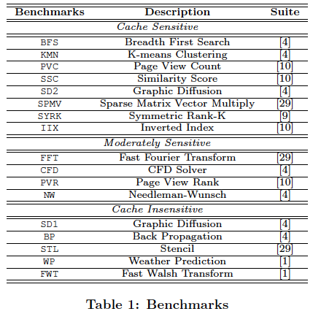
Experiment - Benchmarks

Slide 5
Motivation
Many cache sensitive GPU applications have severe contention
L1 cache performance is critical to system performance for these applications

Slide 6
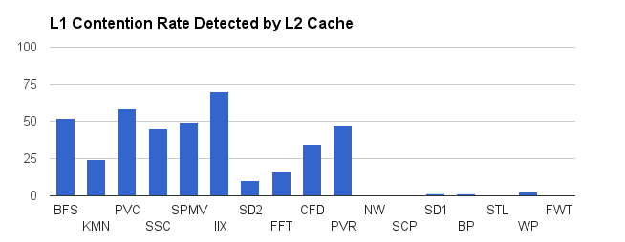
Cache Contention
Contention Rate
num_repeated_accesses / num_accesses to L2 cache
Thrashing-resistant: “important” (hot) cache lines need protection!
Notes:
This figure shows the L1 data cache contention detected by L2 cache

Slide 7
G-Cache Design
Built on top of 3-bit SRRIP (Jaleel et. al., ISCA’2010)
State-of-the-art CPU replacement policy (without bypassing)
Static Re-Reference Interval Prediction
Re-Reference Prediction Value (RRPV)
Detect cache contention at run time
A novel mechanism to detect L1 cache contention using L2 cache
Enable cache bypassing when contention detected
Proposed bypass policy: protect hot lines
Bypass incoming requests when all the existing lines in the target set are hot
Cost-effective design
cheaper hardware extension compared to state-of-the-art CPU bypass policy

Slide 8
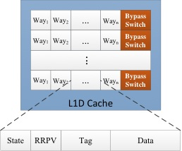
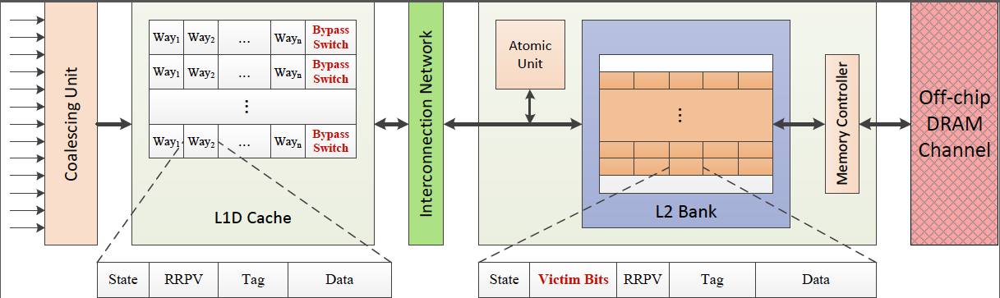
Hardware Extension
For each L2 cache line
Notes:
Each L1 cache set adds one bit \bypass switch" (Figure 5) to control bypass, i.e. \0" means bypass disabled, and \1"means bypass enabled.
The victim bits are added to control bypass decisions. They are bitmasks where each bit records the access history from a particular L1 cache before the line's eviction. The bit is set when L2 cache fulfills the request from the corresponding L1 cache, and reset when the line is evicted from L2 cache. Using the victim bits, contentions in L1 caches can be detected when the L1 cache sends a second request to the cache line that was requested recently. When contention is detected, L1 cache can enable bypass to mitigate it.

Slide 9
Bypass Example

Slide 10
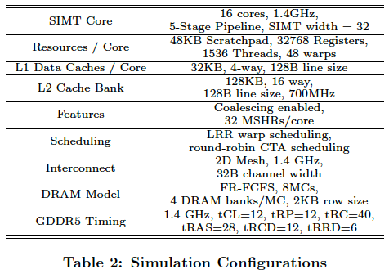
Experiment - Simulation
GPGPU-Sim v3.1.2

Slide 11
Comparison of Cache Management Policies
BS-S: 3-bit SRRIP (First GPU implementation)
No bypassing
Jaleel et. al., ISCA-2010
PDP: dynamic PDP bypass (First GPU implementation)
Protection Distance Prediction: dynamically predict reuse distance
Nam Duong et. al. MICRO-2012
3-bit (PDP-3) and 8-bit (PDP-8) to represent PD
GC: G-Cache
Proposed design
SPDP-B: static PDP bypass (First GPU implementation)
Statically pick the best PD

Slide 12
Results (1/2)

Slide 13
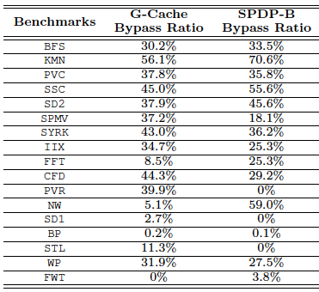
Results (2/2)
Performance speedup over baseline architecture. All designs have 64KB L1 caches.
Comparison on bypass aggressiveness of G-Cache and SPDP-B with 32KB 4-way associative L1 cache.
Notes:
cache bypass as a fraction of accesses. GC bypassed more accesses than SPDP-B for SPMV, while KMN and NW have much more accesses bypassed in SPDP-B than GC. This is consistent with the performance and miss rate results.
In the future, manufactures may enlarge L1 cache size to satisfy performance requirement of more emerging applications. We also evaluate our design with larger L1 caches.
Figure 10 shows G-Cache can improve system performance even when 64 KB L1 caches are applied to baseline and G-Cache. Even if larger caches are applied, the contention cannot be eliminated. Thus, the bypass policy can still help alleviate contention and improve performance. On average,
G-Cache can provide 35.7% performance improvement for cache sensitive benchmarks and 16.1% overall, which is also very close to those of SPDP-B (40.1% and 19.5%).

Slide 14
Conclusion
First implementation of state-of-the-art CPU cache management policies in GPU
RRIP replacement policy and PDP bypass policy
The cost-effective G-Cache design
Add bypassing on top of RRIP
A novel cache contention detection mechanism (using L2 cache)
Performance evaluation and analysis on both the existing and proposed policies
First demonstration of the necessity and benefit of GPU bypass
Bypassing can alleviate cache contention and improve GPU performance

Slide 15
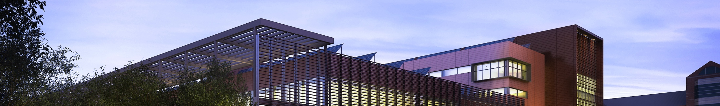
Thanks!
Q & A

Slide 16
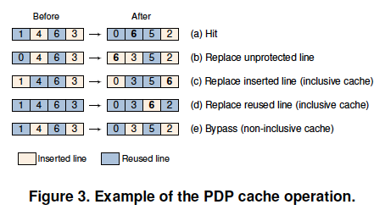
CPU Bypass – PDP Cache

Slide 17
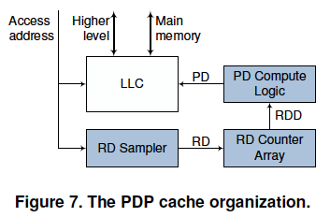
Dynamic PDP Bypassing

Slide 18
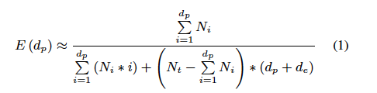
PDP Hit Rate Model
E(d_{p}) = HR(d_{p})/W. HR(d_{p}) is the hit rate. W is the set associativity.
d_{p} is a value of the PD
N_{i} is the hit count for reuse distance i.
N_{t} is the total number of cache accesses.
d_{e} is a function of cache associativity and program behavior.
It has been experimentally determined that it can be set to a constant equal to W

Slide 19
SPDP-B

Slide 20
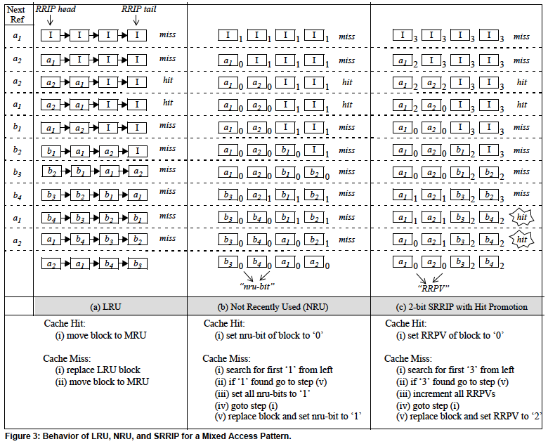
Re-Reference Interval Prediction - RRIP

Slide 21
Prediction Accuracy - BFS

Slide 22
Bypass-on-miss v.s. Bypass-on-fill
Bypass on miss
L1
Bypass on fill
L2
DRAM

