Slide 1


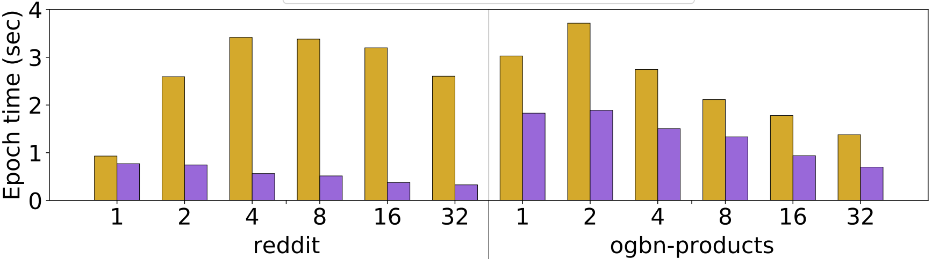

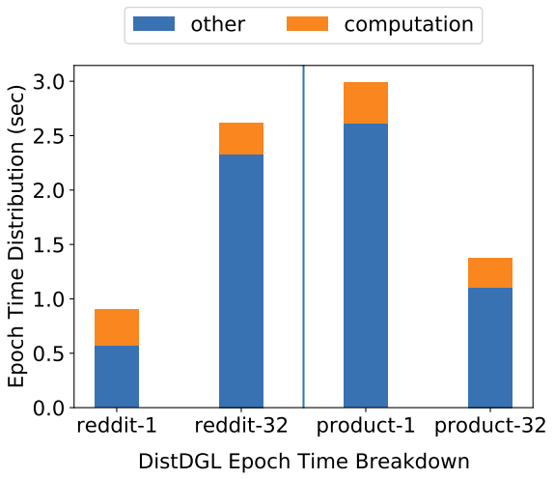
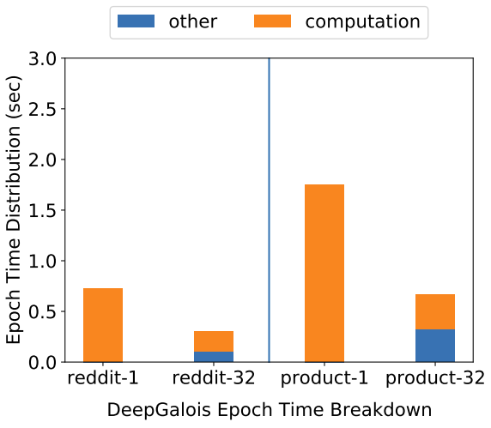
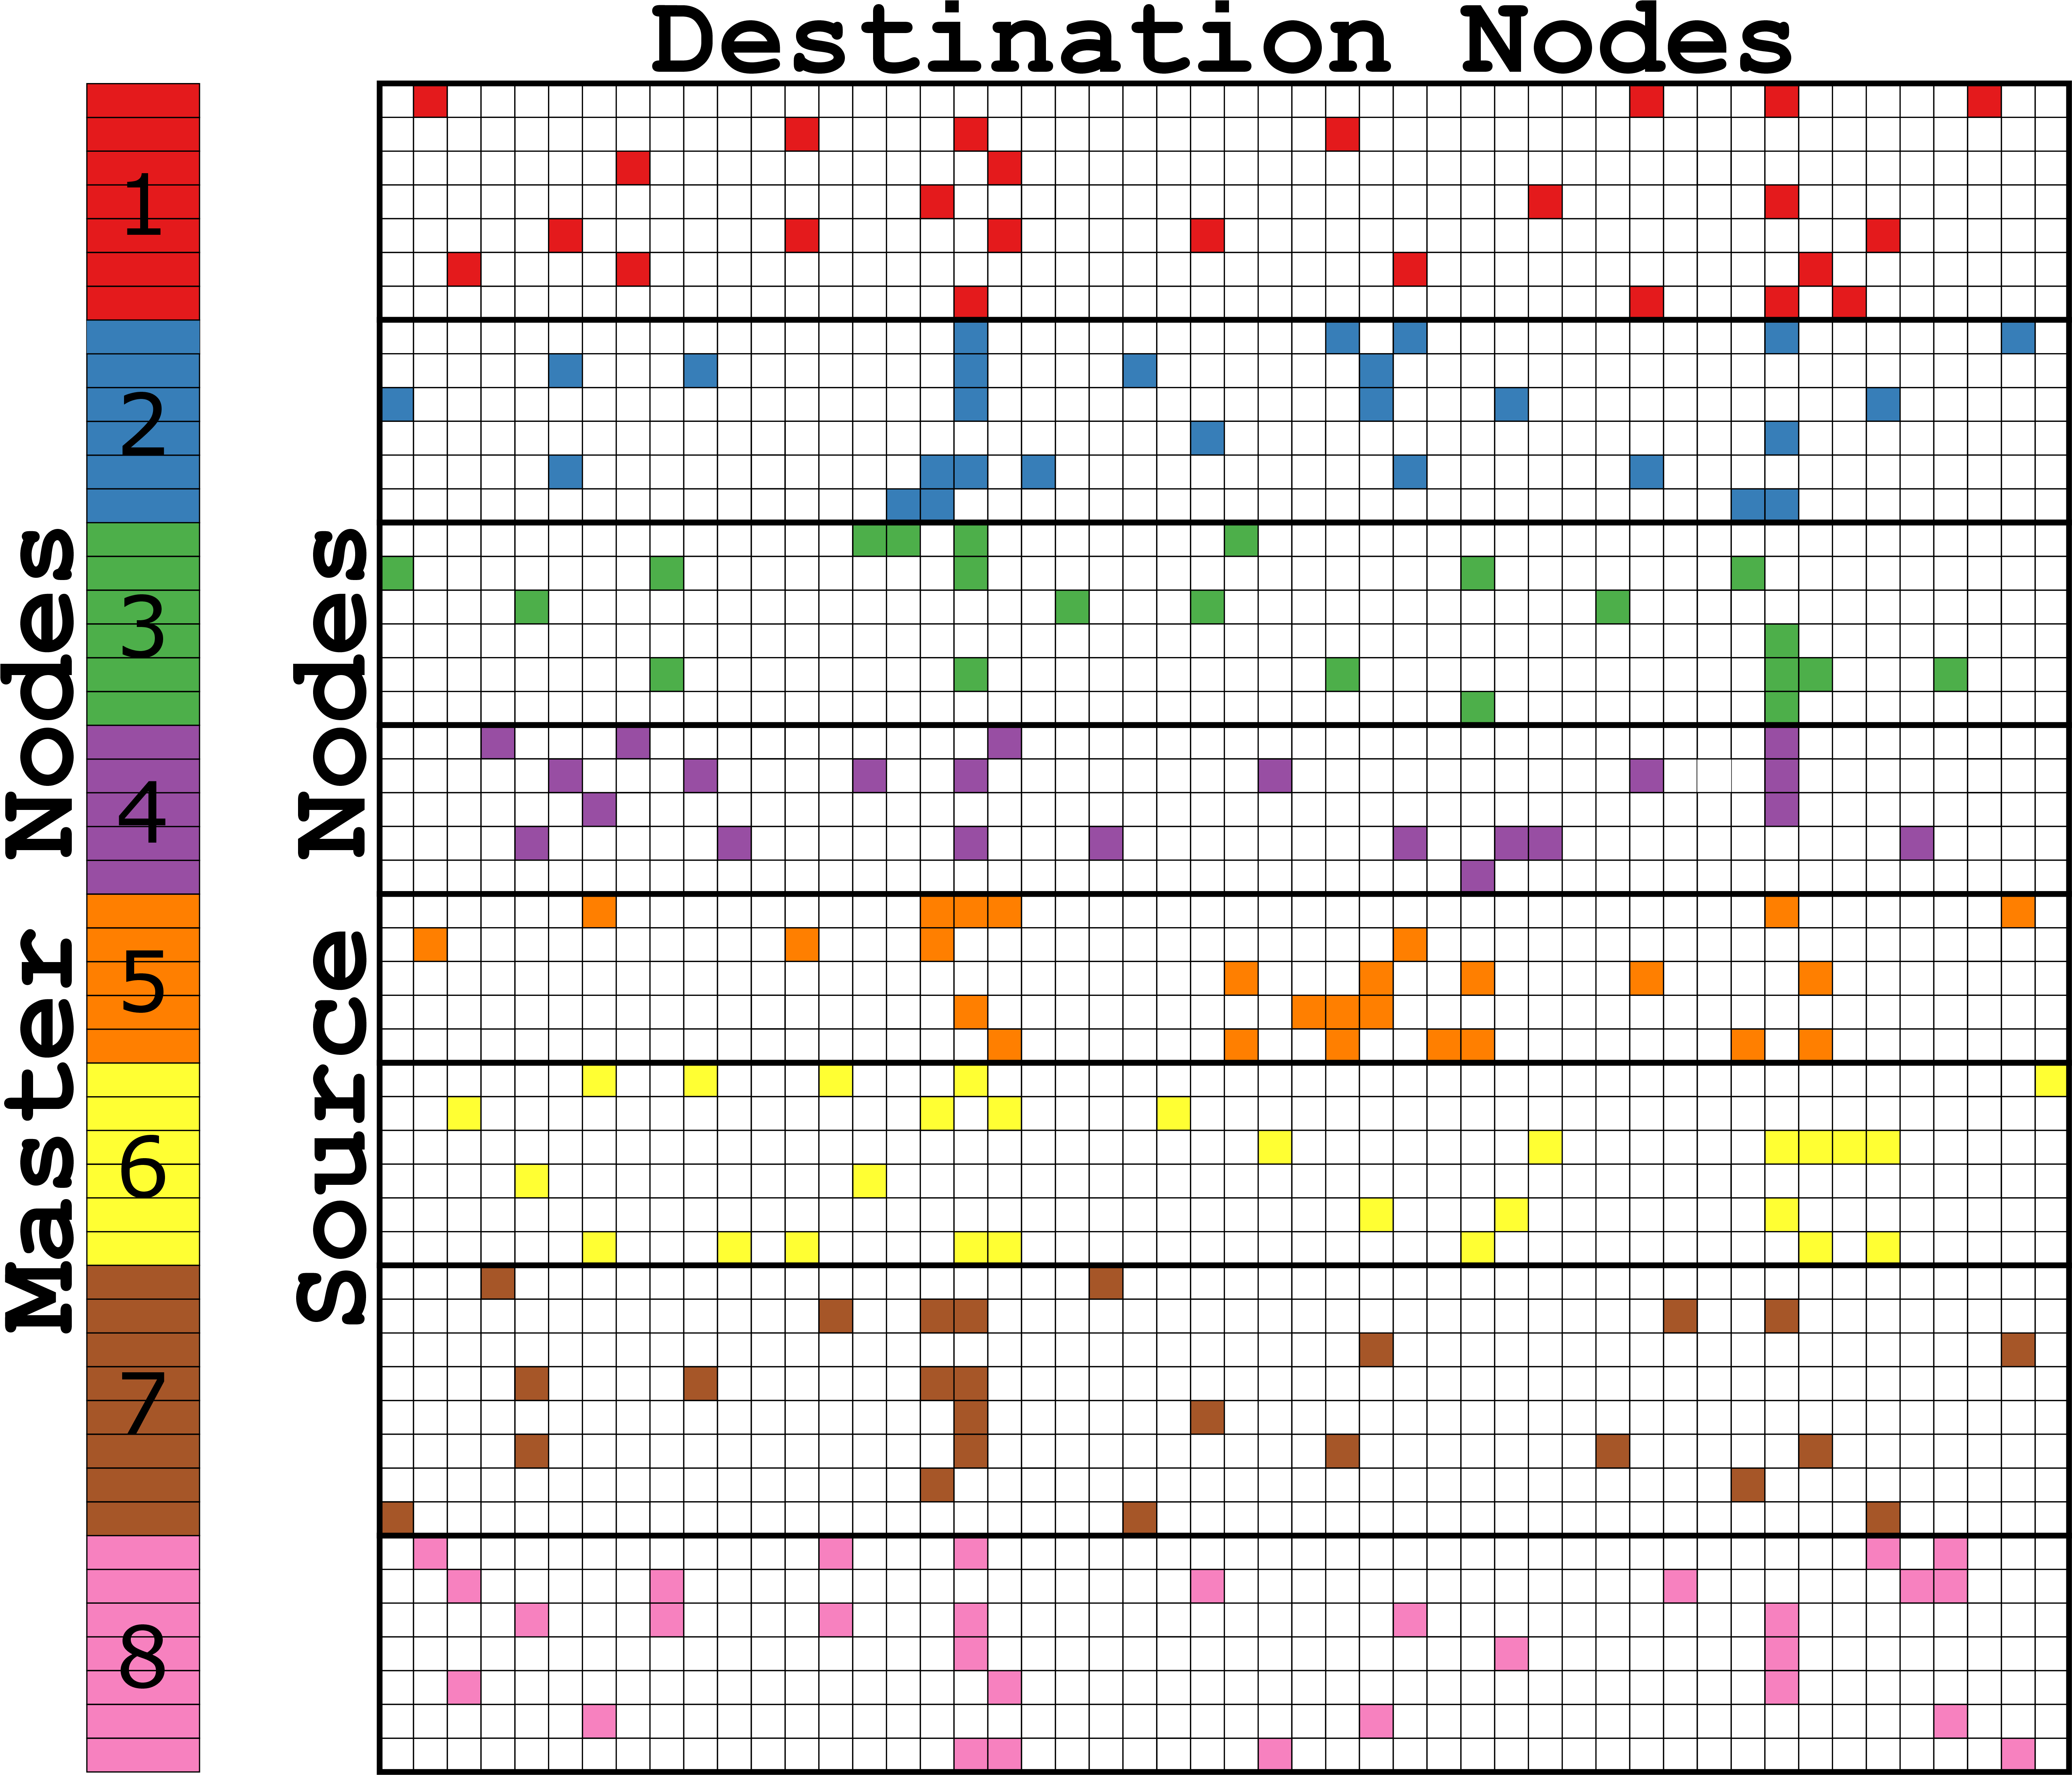
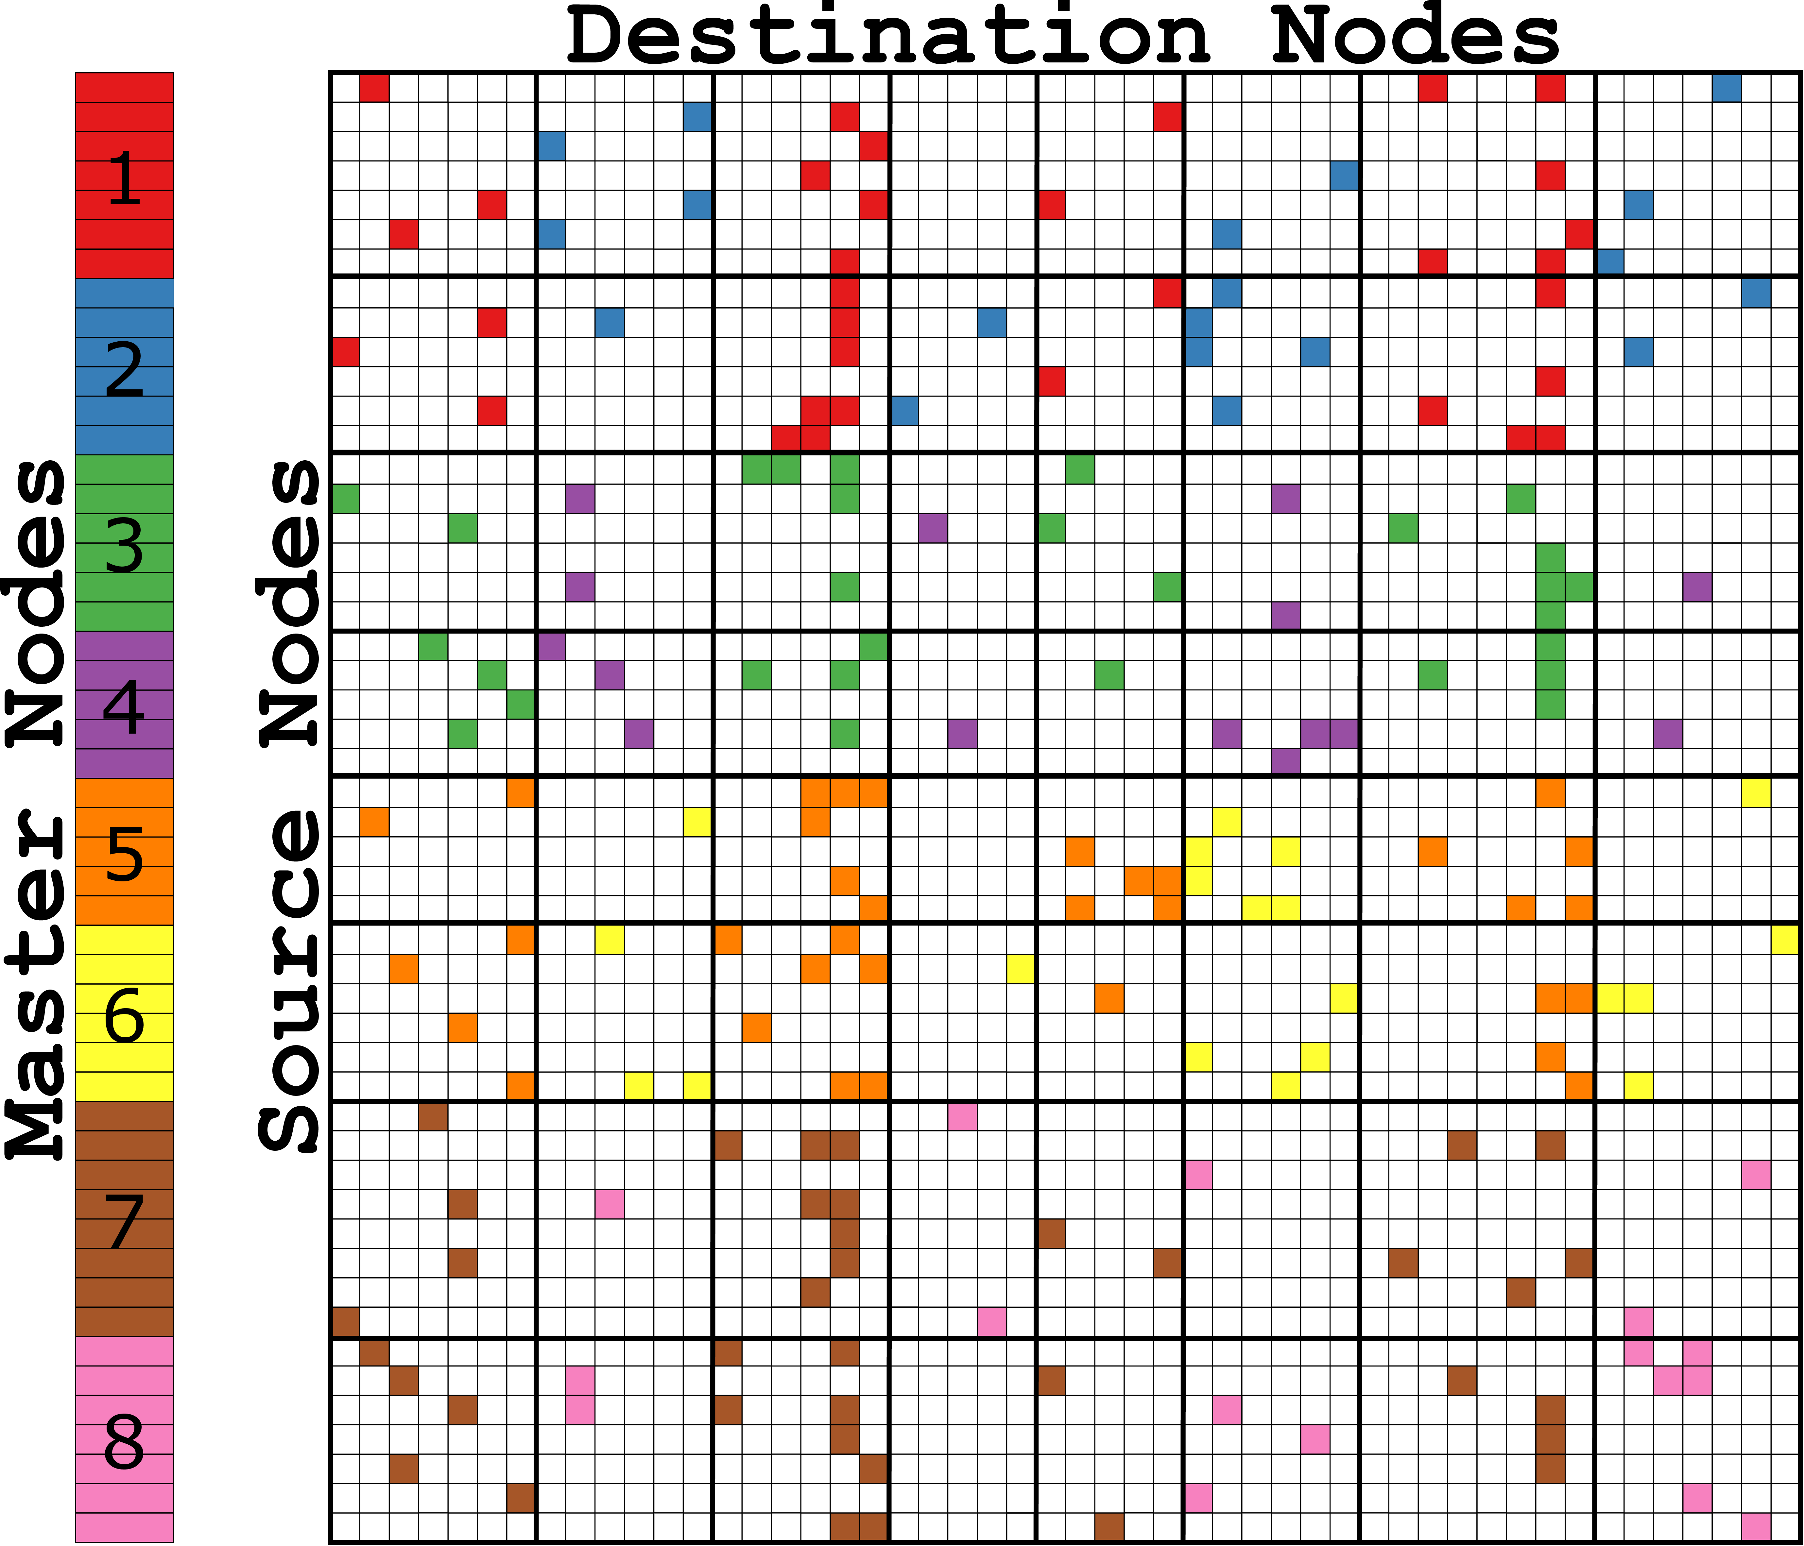
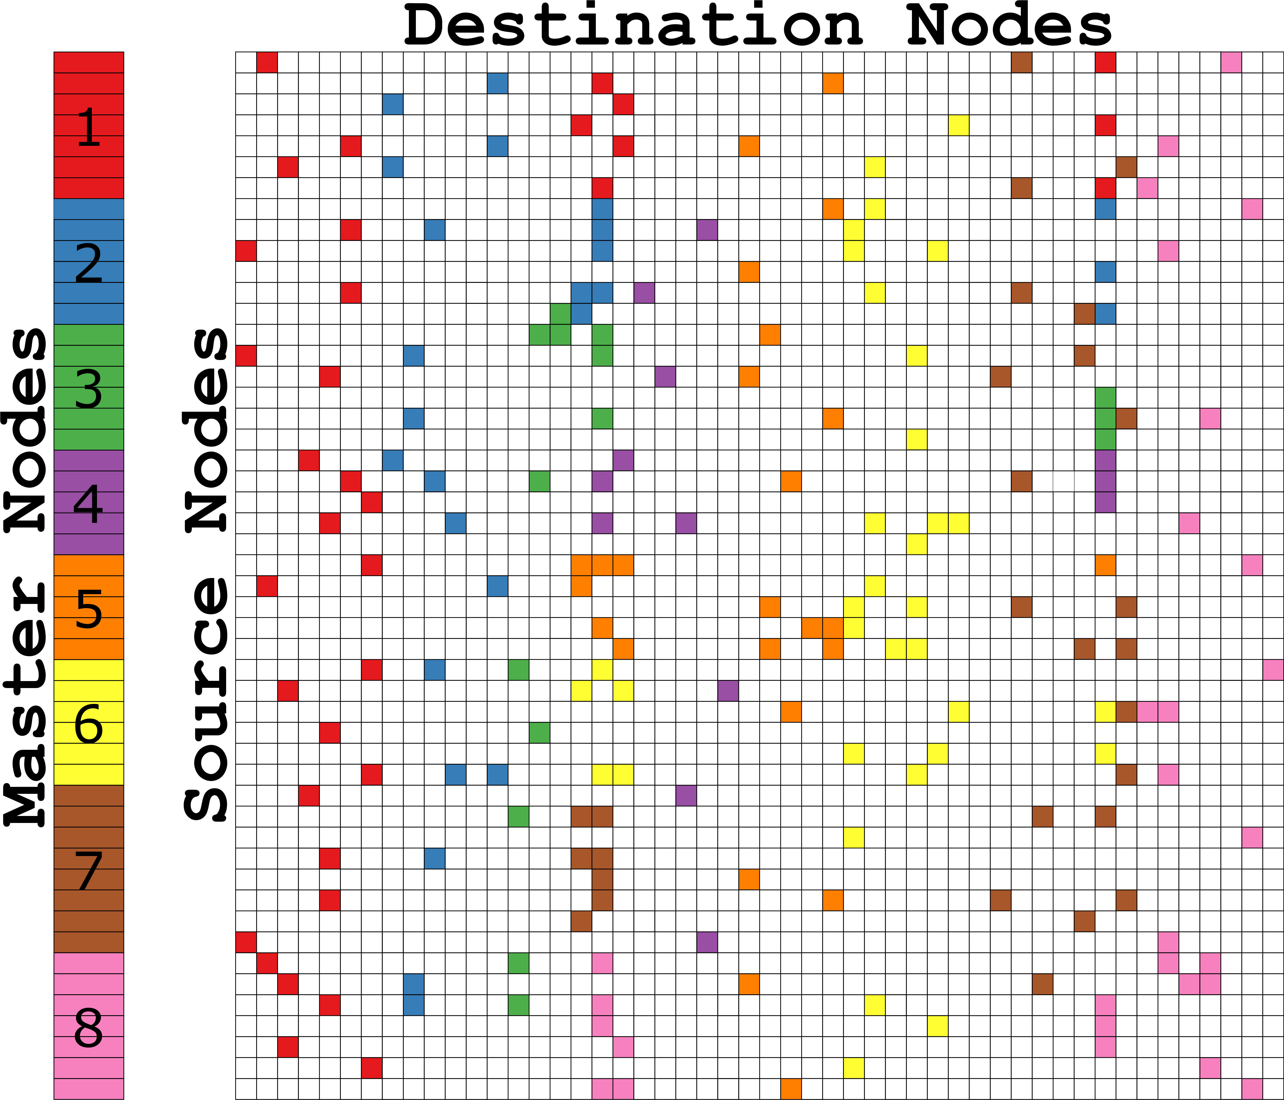
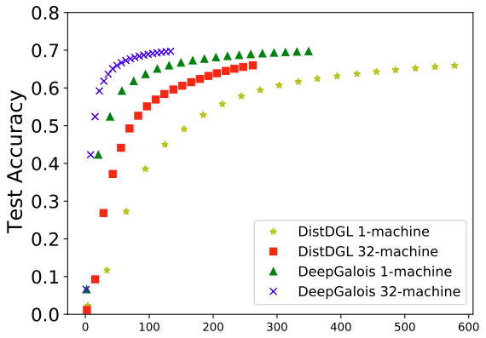
Efficient Distribution for Deep Learning on Large Graphs Loc Hoang¹, Xuhao Chen², Hochan Lee¹, Roshan Dathathri³, Gurbinder Gill³, and Keshav Pingali^{1,3} ¹The University of Texas at Austin ²Massachusetts Institute of Technology ³Katana Graph
DeepGalois Overview
Synchronization
Evaluation
Scalable distributed GNN framework
Generalize GNN to vertex programming model
Topology driven: All vertices are active
Operators
Aggregate features from 1-hop neighbors
Local linear transformation
Termination condition: number of layers
Distributed Graph Engine
CuSP [1]: Graph partitioner
Gluon [2]: Communication substrate
Galois [3]: Computation engine
Outperform the state-of-the art
4x speedup over DistDGL [4]
Support arbitrary use-defined partitioning policy
Optimize communication based on the partitioning policy
GraphSAGE average epoch time
DeepGalois 4x faster than DistDGL
32 hosts vs 1 host for reddit
DeepGalois: 2.4x speedup
DistDGL: 2.8x slowdown
Epoch time breakdown
Speed of Convergence
A
B
C
Graph Partitioner [CuSP]
D
E
F
OEC
MPI P2P
: Synchronize Aggregated Features or Feature Gradient
[Original Graph]
<Host 1>
<Host 2>
A
B
C
C
F
Number of Hosts
D
E
B
D
E
...
Layer 1
Layer 2
...
...
Layer 1
Layer 2
...
:Master
:Mirror
MPI All-Reduce Synchronize Weight Gradients
Graph Partitioning
Edges are uniquely assigned among hosts
Proxies for end points
One proxy is designated the master proxy
Different policies have different edge/master assignment
Policies trade-off
Computation load-balance
Communication overhead
Each vertex proxy has feature vectors
Hosts share weight matrices for layers
No accuracy loss
[Partitioning Policy Examples]
<Outgoing Edge-Cut>
<Cartesian Vertex-Cut>
<Hybrid Vertex-Cut>
References
[1] “Cusp: A customizable streaming edge partitioner for distributed graph analytics” Loc Hoang, et el. In International Parallel and Distributed Processing Symposium (IPDPS), 2019
[2] “Gluon: A communication optimizing framework for distributed heterogeneous graph analytics” Roshan Dathathri, et el. In Proceedings of ACM SIGPLAN Conference on Programming Language Design and Implementation, PLDI 2018
[3] “A lightweight infrastructure for graph analytics” Donald Nguyen, et el. In Proceedings of ACM Symposium on Operating Systems Principles, SOSP 2013
[4] “DistDGL: Distributed Graph Neural Network Training for Billion-Scale Graphs” Da Zheng, et el. In arXiv 2020
Time in Seconds

