Slide 1
OSGi™ 入门与实践
陈绪绍
11/07/26

Slide 2
内容
介绍OSGi
OSGi基础概念
Services
开发OSGi
Blueprint
总结

Slide 3
Section I – 介绍OSGi

Slide 4
模块化
模块化的例子
  计算机硬件独立生产，主板，内存，显卡，CPU，只需要定义好接口
  USB支持热插拔、可以升级内存、更换显卡…
  Winamp播放器的皮肤插件
  Eclipse的插件机制
软件里面的模块
  软件 “模块” 由一个接口和该接口的一个或多个实现组成。接口定义了该类与外部世界的关系。
  Java中的jar包、第三方组件
  业务系统中的逻辑划分，如收货模块，验收模块
  …….

Slide 5
模块化的考量
合约
  该模块与其它模块的关系？与其客户端之间签订了什么样的合约？它们如何访问它，它们期望的行为是什么，等等。在软件开发中，开发人员编写的代码通常取决于某个函数的未归档的行为，例如期望发生某个未归档的附作用。
可见性
  任何模块都有可能包含大量有用的内部类、方法和工具，它们用于提供模块接口（或合约），但是模块并不将它们视为外部的。通常，在使用由供应商提供的模块时，很难分辨出哪些是内部的，哪些是外部的。最终结果是如果使用了某个内部模块，那么客户端第一次找到它时是在出现编译故障或运行时故障时，因为方法签名被修改了。
共存
  任何系统都可以包含一组模块，其中每个模块都依赖于其他模块。这些模块需要能够一起运行，而不会彼此造成问题。如类的版本管理。
可替换性
  定义了合约或接口后，您需要能够替换模块而不影响系统。回想一下前面的显卡例子：您可以替换（或升级）显卡，而不需要担心这会对整个系统产生影响。

Slide 6
Java语言有模块化解决方案吗？
能控制包、类不被访问吗？
能控制版本吗？
热部署？

Slide 7
Java模块化的考量
合约
  该模块与其它模块的关系？依靠文档制约。
可见性
  通过public、protected、private等修饰符来限制
共存
  类路径下的两个模块存在相同名称的类时，引用该相同名称类时，将出错。
可替换性
  可替换性有两个方面：冷替换（允许 JVM 重启）和热替换（无需 JVM 重启）。冷替换是可实现的，但是需要知道类路径上的哪些 JAR 文件需要移除并替换。这听起来简单，但是在实践中会非常复杂。Java 没有提供热替换。

Slide 8
OSGi模块化的考量
合约
  OSGi 很好地匹配了合约要求。一个模块声明了它提供给客户端模块的功能，以及它需要从其他模块获得的有关包的功能。。
可见性
  OSGi 采用两种方式确保可见性。首先，模块只看到声明存在依赖关系的包。其次，模块声明要公开哪些包，因此没有公开的包是私有的。这意味着可以很明显地确定哪些包是私有的，OSGi 实现了这一点。
共存
  通过包版本化获得支持。每个模块可以定义它所提供和需要的包的版本。这使得系统中可以存在两个使用不同包版本的模块。
可替换性
  OSGi 允许在运行时停止某个模块并替换它。这对系统的影响取决于所做的更改以及应用程序的编写方式。一些更改将引起严重的问题，而其他更改的影响则很微小。

Slide 9
什么是OSGi?
是一套规范
  Java语言模块化的解决方案、是事实上的标准
可成看作是容器
  OSGi可以被看作是bundle生存的容器
Open Services Gateway initiative
  这是OSGi最初的名字
  目标是建立家庭网关，并通过互联网向家庭网络提供各种服务
Dynamic Module System For Java
  这是OSGi现在的定义
  意味着基于OSGi就可以模块化的开发、部署Java应用；
  最重要的一点是可以动态的管理模块
Universal Middleware
  这是OSGi近年来新取的名词，目标是让OSGi脱离语言限制，成为所有语言的统一模型

Slide 10
OSGi的发展轨迹
1999年3月，OSGi（Open Services Gateway initiative）联盟(非盈利性质)成立
  目标 ：建立家庭网关，并通过互联网向家庭网络提供各种服务。以支持嵌入式装置为主的家庭网关软件。(例如通过web页面控制咖啡机等)；
2000年至2003年，是OSGI规范发展的初级阶段，一共发布了三个版本。这个阶段其主要关注点是在移动和嵌入式设备上的Java模块化应用。
2000年5月发布OSGI Release 1(R1)
2001年10月发布OSGI Release2(R2)
2003年3月发布OSGI Release 3(R3)
2004年 Eclipse 3.x核心改用OSGi, 开始有大量的开源团体投入研究
R4的目标从“在移动和嵌入式设备上的Java模块化应用”发展为“Java模块化”，这意味着OSGI开始脱离嵌入式的约束，向Java其他领域进军。
2005年10月发布V 4.0、 2007年5月发布V 4.1、2010年3月发布V4.2、2011年4月发布V4.3
R5
改进和增强的核心规范，企业级支持更多。
OSGi In Cloud(Bundle仓库)

Slide 11
OSGi带来了哪些可能?
OSGi为Java 程序模块化和重用提供了可能
OSGi是当前Java领域唯一的模块化解决方案。
热插拔――梦想中的“即插即用”，可动态的安装卸载 bundle
OSGi 使得热插拔技术在软件界成为现实。 基于OSGi的系统，可通过安装新的 Bundle、更新或停止现有的Bundle来实现系统功能的插拔。
为构建更稳定、高效的系统提供了可能
基于OSGi 的系统采用的是微核机制，微核机制保证了系统的稳定性，只要微核是稳定运行的，那么系统就不会崩溃，也就是说基于OSGi的系统不会受到运行在其中的 Bundle的影响，不会因为某个Bundle的崩溃而导致整个系统的崩溃。
规范的、可积累的模块
可以将常用的模块划分为不同bundle，积累成bundle库，以方便后续开发重用。

Slide 12
OSGi应用场景
  嵌入式领域
    服务网关
    汽车
    工业自动化
    建筑物自动化
    PDA网格计算
  Mobile（移动终端） android-osgi
  IDE
  服务器
    JBoss
    GlassFish
  WEB APP

Slide 13
OSGi商业开源应用
IBM WAS V6.1、 Websphere、Eclipse
BMW汽车控制系统
WebLogic
JBoss AS 5.0
Glassfish V3
基于Eclipse RCP的NASA火星探测系统
基于Eclipse RCP思维脑图软件XMind

Slide 14
OSGi在国内的应用
普元
中电普华
一些金融行业的前端
淘宝，阿里
R1Studio

Slide 15
OSGi框架
Equinox：与Eclipse完美结合，使用最为广泛
http://www.eclipse.org/equinox/
Knopflerfish：孤独前行者
http://www.knopflerfish.org/
Apache Felix：一个较新的框架。
http://felix.apache.org/
Spring DM：畸形的需求产物(实际上它并不算是一个OSGi框架，最初它只是为了将OSGi与Spring进行整合，Spring-DM早已不再更新，2009年被捐献给了Eclipse社区，如今叫gemini)
http://www.springsource.org/OSGi

Slide 16
OSGi运行环境
Apache Karaf
Eclipse Virgo
Apache Geronimo
……

Slide 17
他们也支持OSGi
应用服务器：WebLogic、Jboss……
Apache CXF、EclipseLink(JPA)、Hibernate(最新版本)
一些类库：Gson、HttpClient官方直接提供了bundle供下载
Fuse ESB[被Redhat收购，如今叫Red Hat JBoss Fuse ] 、ServiceMix

Slide 18
OSGi现状
OSGi发展了12年，已经成了Java模块化的实际技术标准JSR-232,JSR-291,彻底取代了Sun原来自己定义的JSR-277
一百多个联盟成员,各大IT巨头，IBM,Google，Oracle…
各种应用纷纷转向OSGi，Jboss，Weblocig，GlassFish…
OSGi在嵌入式和桌面领域取得了较大成就，企业级应用还有待加强。
OSGi 技术在国外关注率很高，但目前国内目前采用的还不多，大多还只是停留在了解的层次。但其发展前景很大。
OSGi不可能解决Java开发中所有组件的管理问题，这些问题主要靠对应用系统模块的架构划分来解决。
对原有J2EE投资的重用并不优雅，上手曲线也较陡峭

Slide 19
OSGi规范
OSGi Core
OSGi企业级规范
OSGi标准服务

Slide 20
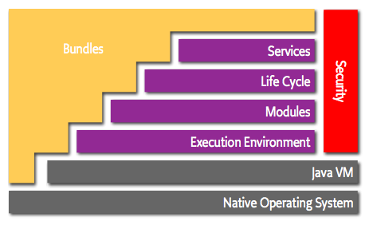
OSGi架构图
Everythign is Bundle

Slide 21
Layering
Services
Life Cycle
Security
Applications
Module
Execution Environment

Slide 22
什么是OSGi Bundle
是最小的部署单元，是服务等的载体。
MANIFEST.MF文件的介绍
META-INF和OSGI-INF

Slide 23
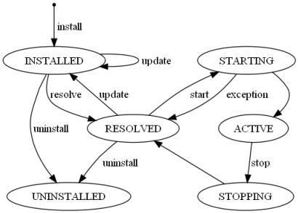
OSGi Bundle的生命周期

Slide 24
OSGi的类加载架构
父类加载器
Bundle类加载器
其它类加载器
类加载顺序

Slide 25
OSGi规范
OSGi Bundle的组织和依赖
导入导出package
约束规则和示例
检验bundle的有效性

Slide 26
Execution Environment
OSGi APIs only use a subset of J2SE and J2ME CDC
  OSGi Minimum EE
Matches most profiles
Implementations can use more than the OSGi Minimum EE
Security is not mandatory
CLDC is possible if class loaders are added in a device specific way
CLDC/
MIDP
J2SE
CDC/FP
OSGi
Min.

Slide 27
Module Layer
Packaging of applications and libraries in Bundles
  Raw Java has significant deployment issues
Class Loading modularization
  Raw Java provides the Class Path as an ordered search list, which makes it hard to control multiple applications
Protection
  Raw Java can not protect certain packages and classes
Versioning
  Raw Java can not handle multiple versions of the same package
bundle
bundle
bundle
bundle
bundle
bundle
bundle

Slide 28
Life Cycle Layer
System Bundle represents the OSGi Framework
Provides an API for managing bundles
  Install
  Resolve
  Start
  Stop
  Refresh
  Update
  Uninstall
Based on the module layer
System
bundle
bundle
M
Bundle
X
Bundle
X-v2
Bundle
B
Bundle
A

Slide 29
Life Cycle Layer
Bundle is started by the Bundle Activator class
Header in Manifest refers to this class
Interface has 2 methods
  Start: Initialize and return immediate
  Stop: Cleanup
The Activator gets a Bundle Context that provides access to the Framework functions
Framework provides Start Level service to control the start/stop of groups of applications
INSTALLED
STARTING
start
RESOLVED
ACTIVE
stop
UNINSTALLED
STOPPING

Slide 30
Service Layer
Provides an in-VM service model
  Discover (and get notified about) services based on their interface or properties
  Bind to one or more services by
    program control,
    default rules, or
    deployment configuration
SOA Confusion
  Web services bind and discover over the net
  The OSGi Service Platform binds and discovers inside a Java VM
The OSGi Alliance provides many standardized services

Slide 31
Section II – Eclipse/Equinox

Slide 32
使用Eclipse开发OSGi
An open source community focused on OSGi Technology
  Develop OSGi specification implementations
  Prototype ideas related to OSGi
An OSGi Framework implementation
  Core of the Eclipse runtime
  Provides the base for Eclipse plug-in collaboration
  Fully compatible with the OSGi R4 specification
New for Eclipse 3.2 – Other specification implementations
  Device Manager, Declarative Services, Event Admin, HTTP Service, Log Service, Metatype Service, Preferences Service, User Admin, Wire Admin – More on the way!!

Slide 33
The Equinox Target Environment
Bundle A
{}
Eclipse makes it easy to develop for OSGi Service Platforms
A target platform
  Contains a set of bundles
  Defines runtime parameters
To Define the Target Platform, goto:
  Preferences ->Plug-in Development ->Target Platform
  Select the target project in your workspace as location
Install
Target
OSGi Framework
(Equinox)
Bundle c
{}
Bundle B
{}
Bundled
{}
Bundle F
{}
BundleG
{}
Bundle E
{}

Slide 34
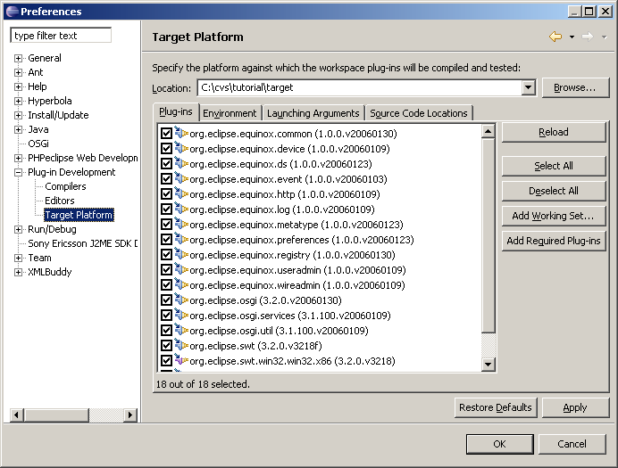
Setting up the Target Platform

Slide 35
Section III – OSGi基础概念

Slide 36
Framework Entities
OSGi Framework
Bundle A
{}
Bundle B
{}
Bundle C
{}
= service, java interface

Slide 37
Bundles
A bundle is the deliverable application
  Like a Windows EXE file
  Content is a JAR file
A bundle registers zero or more services
  A service is specified in a Java interface and may be implemented by multiple bundles
  Services are bound to the bundle life-cycle
Searches can be used to find services registered by other bundles
  Query language

Slide 38
什么是OSGi Bundle
A Bundle contains (normally in a JAR file):
  Manifest
  Code
  Resources
The Framework:
  Reads the bundle’s manifest
  Installs the code and resources
  Resolves dependencies
During Runtime:
  Calls the Bundle Activator to start the bundle
  Manages java classpath
  Handles the service dependencies
  Calls the Bundle Activator to stop the bundle
Bundle A
{}

Slide 39
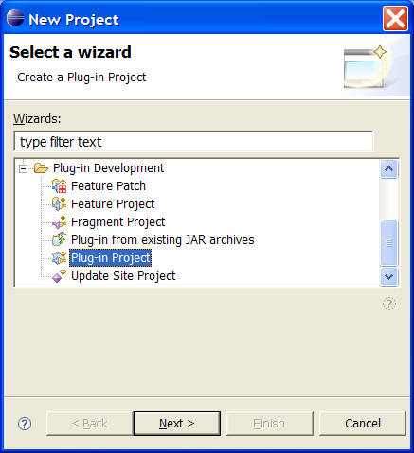
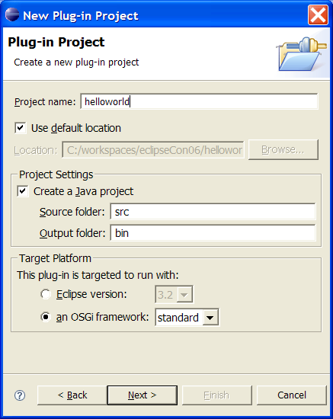
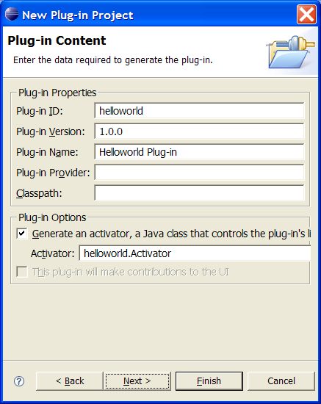
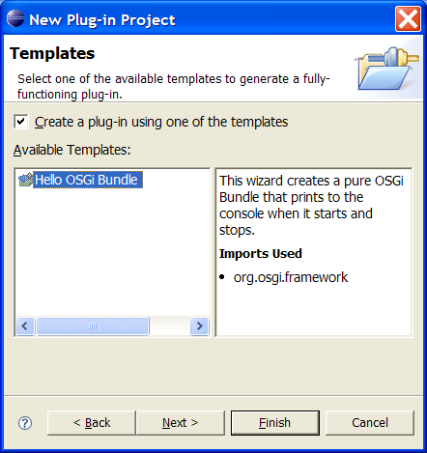
Create the Hello World bundle
_{Step 1.}
_{Create new plug-in project}
_{Step 2}
_{Project name: helloworld}
_{an OSGi framework: standard}
_{Step 3}
_{Generate an activator}
_{Step 4}
Use the Hello OSGi Bundle template

Slide 40
Real code! Hello World (and Goodbye)
The wizard has generated the code on the left
This class implements the BundleActivator so that the Framework can start/stop the class
The activator is referenced in the manifest
HelloWorld.java
package helloworld
public class HelloWorld
implements BundleActivator {
public void start(
BundleContext context)
throws Exception{
System.out.println(
"Hello world!!");
}
public void stop(
BundleContext context)
throws Exception {
System.out.println(
"Goodbye world!!");
}
}

Slide 41
Real code! Hello World (and Goodbye)
The Manifest (in META-INF/MANIFEST.MF) is also generated by the wizard
Eclipse provides convenient editors for the manifest
  For the source: click on MANIEST.MF
Notice:
  Bundle-Activator (used to notify the bundle of lifecycle changes)
  Import-Package (dependencies)
META-INF/MANIFEST.MF
Manifest-Version: 1.0
Bundle-ManifestVersion: 2
Bundle-Name: Helloworld Plug-in
Bundle-SymbolicName: helloworld
Bundle-Version: 1.0.0
Bundle-Localization: plugin
Bundle-Activator: helloworld.Activator
Import-Package:
org.osgi.framework;version="1.3.0"

Slide 42
Eclipse Launch Configuration
The Launch Configuration is prepared for you
  Run -> Run … -> EclipseTutorial
Deselect “Target Platform” checkbox
  This removes all possible bundles from the launch configuration
Select “Add Required Plug-ins”
  This calculates from the dependency information, which bundles are required to run our helloworld example
Press Run
The Framework is a console application

Slide 43
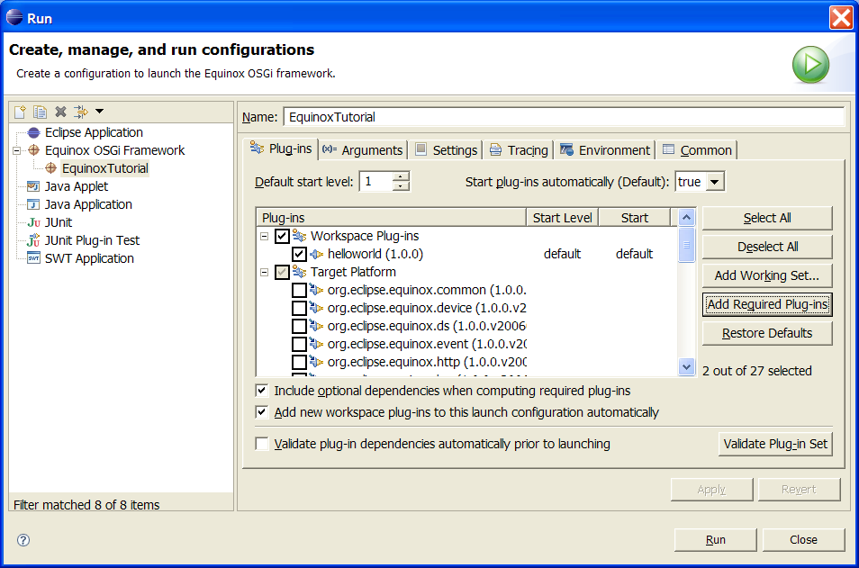
Equinox Launch Configuration

Slide 44
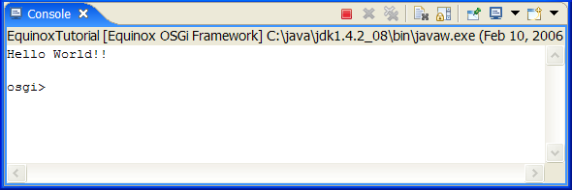
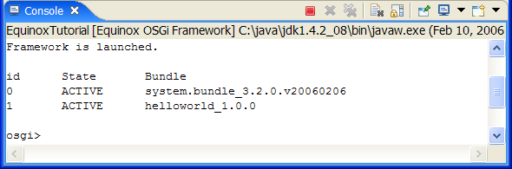
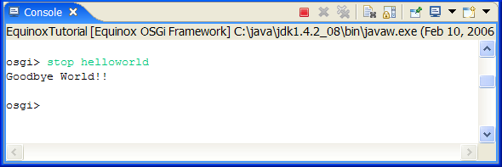
Run the Hello World bundle
The Framework now runs the helloworld example
  See the printed text
It also runs a Framework console
  Equinox specific
Type “ss” (show status)
  Look at the active bundles
  Notice the number for the helloworld bundle. This is the bundle id.
Type “stop <symbolic-name>”

Slide 45
Self-Hosting Bundle Projects
JAR file layout
Normally, a bundle is packaged in a JAR file
  The traditional edit-compile-debug cycle.
Self-Hosting Allows for quick debugging of bundle code
  No packaging steps
  No deployment steps
  Just code/save/run
Some changes require update of the bundle in the Framework
  Console:
  update <symbolic-name>
META-INF/MANIFEST.MF
helloworld/HelloWorld.class
file:c;/…
Target Platform
Project Layout
META-INF/MANIFEST.MF
.project
.classpath
src/helloworld/HelloWorld.java
bin/helloworld/HelloWorld.class
reference:file:C:/…
Complied into bin directory, non java files copied
bin dir content automatically added to root

Slide 46
Creating deployable bundles – how it works
The build.properties file specifies the content of the bundle jar
  Specifies the source and output folders of the different libraries
  source.. – The source directory of the project. Used for compilation and resources.
  output.. – The output directory where class files and resources are copied to
  bin.includes – What is included in the JAR from the project directory
Export the content of a project into a bundle jar
  Bundle jars can be installed across multiple OSGi Framework implementations
  The Deployable plug-ins and fragments wizard can be used to generate a bundle jar from a project.
  File -> Export -> Deployable plug-ins and fragments
build.properties
source.. = src/
output.. = bin/
bin.includes = META-INF/,\
.

Slide 47
Section IV – Component interaction and collaboration

Slide 48
Collaborative model
OSGi is more than an Applet, MIDlet, Xlet runner
Bundles can collaborate through:
  service objects
  package sharing
A dynamic registry allows a bundle to find and track service objects
Framework fully manages this collaboration
  Dependencies, security

Slide 49
Collaborative model
OSGi Framework
Bundle
Service
registry
Bundle
packages
packages
JAVA
Operating System
Hardware

Slide 50
Collaborative model
Java Application Manager
No management bundles
Service
registry
Midlet,
Xlet,
or
Applet
Midlet,
Xlet,
or
Applet
No collaboration
packages
No package management
(versions!)
packages
JAVA
Operating System
No native code
Hardware

Slide 51
Classpath issues
Java applications consists of classes placed in packages
Java searches for a package or class in different jar files and directories
  These are usually specified in the CLASSPATH environment variable
An OSGi Framework is a network of class loaders.
  Parameterized by the Manifest headers
Any dependencies between bundles are resolved by the Framework
It is possible to fetch bundles on demand
Complicated – But an OSGi Framework makes it painless to use
q
q-1.0
p
r
p
q
q-2.0
Bundle
Wire
Exported package
Constraint
Exported package

Slide 52
OSGi dependency resolution
Framework
org.osgi.framework
org.osgi.service.http
Bundle A
Export org.osgi.service.log
com.ibm.service.log
com.ibm.j9
Import org.osgi.service.http
javax.servlet.http
A resolved
Bundle B
Export ericsson.osgi
javax.servlet
javax.servlet.http
org.osgi.service.log
Import org.osgi.service.http
org.osgi.service.log
B resolved

Slide 53
Package or Bundle Dependencies?
The OSGi Specifications supports both Require-Bundle and Import-Package
Require-Bundle creates a dependency on a complete bundle
  Simple to use
  Imports packages that are not used
Import-Package creates a dependency on just a package
  Creates less brittle bundles because of substitutability
  More cumbersome to use (Tools!)
In almost all cases, Import-Package is recommended because it eases deployment and version migration
The specifications detail a number of additional problems with Require-Bundle
p
q
Import-Package
r
r
s
Require-Bundle
r

Slide 54
Service Specifics
discover
bind
service
register
A service is an object registered with the Framework by a bundle to be used by other bundles
The semantics and syntax of a service are specified in a Java interface
A bundle can register a service.
A bundle can use a service (bind to)
  1..1
  0..1
  0..n
A service can be discovered dynamically
Services can go away at any time!
package org.osgi.service.log;
import org.osgi.framework.ServiceReference;
public interface LogService {
public static final intLOG_ERROR= 1;
public static final intLOG_WARNING= 2;
public static final intLOG_INFO= 3;
public static final intLOG_DEBUG= 4;
public void log(int level,
String message);
public void log(int level,
String message, Throwable exception);
public void log(ServiceReference sr,
int level, String message);
public void log(ServiceReference sr,
int level, String message,
Throwable exception);
}

Slide 55
Services continued
The Framework Service Registry is available to all bundles to collaborate with other bundles
Different bundles (from different vendors) can implement the same interface
  Implementation is not visible to users
  Allows operator to replace implementations without disrupting service
OSGi defines a standard set of services
  Other organizations can define more (AMI-C)
Extensive notifications for services life cycles
Services have a unique id
Services require permission
  Under Operator control
Services are associated with properties
  Query language to find appropriate service
  Bundles can update the properties

Slide 56
Manipulating Services
The BundleContext provides the methods to manipulate the service registry
Services registrations are handled by ServiceRegistration objects
  They can be used to unregister a service or modify its properties
Service References give access to the service as well as to the service’s properties
Access to service objects is through the getService method. These services should be returned with the ungetService method
ServiceRegistration registerService(
String clss,
Object srvc,
Dictionary prprts)
ServiceReference[]
getServiceReferences(
String clss,
String fltr)
Object getService(
ServiceReference reference)
boolean ungetService(
ServiceReference rfrnc);

Slide 57
What Did We Learn
The OSGi Service Platform provides a collaboration model that is based on
  Services
  Package sharing
Sharing is complicated, but the well defined specifications make it quit painless for bundle developers
Services provide a very powerful dynamic programming model

Slide 58
Section V – Service Components

Slide 59
Components Simplify Service Programming
The dynamic nature of services make programming more complicated
The declarative service model simplifies handling these dynamics
  Dependencies are defined in an XML file
Declarative Services:
  Optionally Depend on one or more services
  Optionally Provide a service
  Optionally lazy initialized
  Configurable
Example shows a hello world bundle that logs Hello and Goodbye
First add dependencies by selecting MANIFEST.MF, on the Dependencies tab
  Add the component and log package
META-INF/MANIFEST.MF
Manifest-Version: 1.0
…
Import-Package: org.osgi.framework;version="1.3.0“,
org.osgi.service.component,
org.osgi.service.log
Service-Component:
OSGI-INF/component.xml
OSGI-INF/component.xml
<?xml version="1.0" encoding="UTF-8"?>
<component name="hello.component.log">
<implementation
class="hello.Component"/>
<reference name="LOG”
interface=
"org.osgi.service.log.LogService"/>
</component>

Slide 60
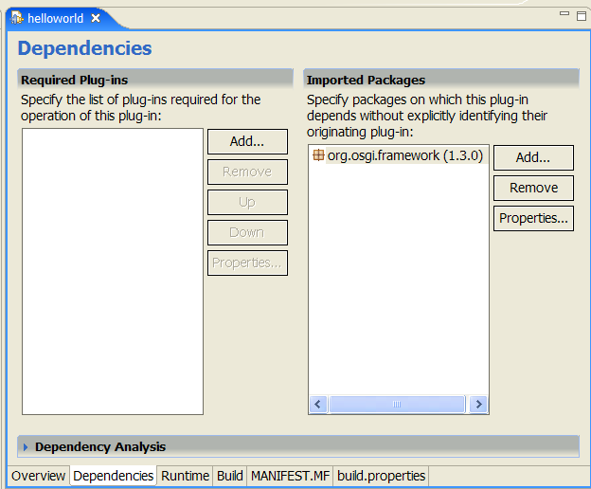
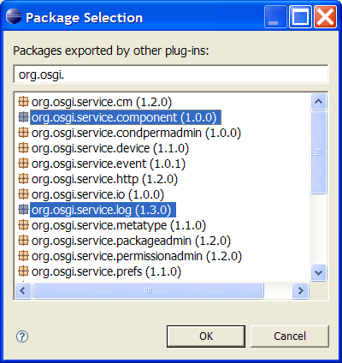
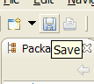
Import the necessary packages
Step 1 – Add new Imported Packages
Step 2 – Select the necessary packages
Step 3 – Save the bundle manifest

Slide 61
The Login Component Source Code
OSGI-INF/component.xml
A component can be any class
  No specific interface
The activate and deactivate methods are called when the component is activated/deactivated
  Dependencies must be resolved: Log Service
The ComponentContext class provides access to the referenced services
  The locateService methods finds a reference
The component instance can be sure that at any moment in time between activate and deactivate there is a valid Log Service
<?xml version="1.0" encoding="UTF-8"?>
<component name="hello.component.log">
<implementation
class="hello.Component"/>
<reference name="LOG"
interface=
"org.osgi.service.log.LogService"/>
</component>
Component.java
package hello;
import org.osgi.service.component.*;
import org.osgi.service.log.*;
public class Component {
LogService log;
protected void activate( ComponentContext context){
log = (LogService)
context.locateService("LOG");
log.log(LogService.LOG_INFO,
"Hello World"); }
protected void deactivate(
ComponentContext context) {
log.log(LogService.LOG_INFO,
"Goodbye World");}}

Slide 62
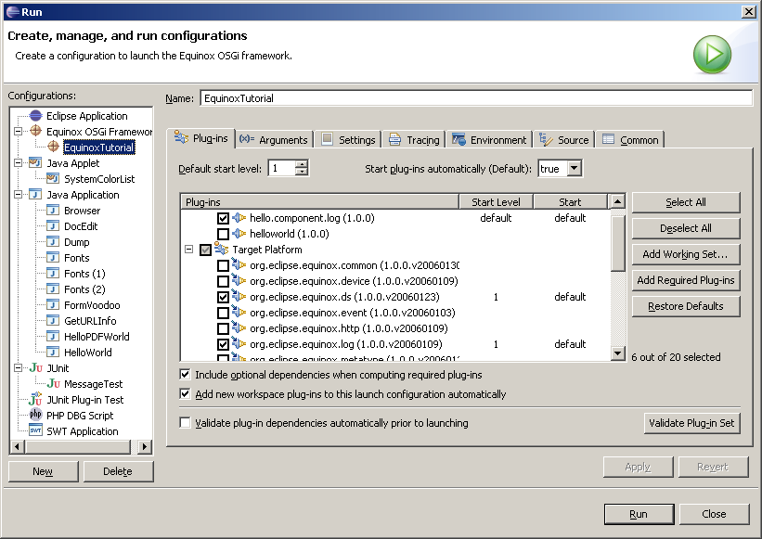
Add Declarative Services, Log, and Component

Slide 63
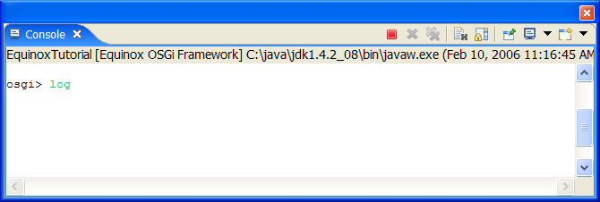
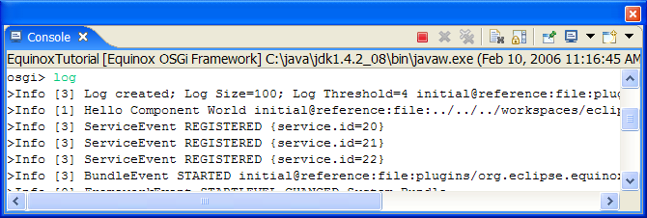
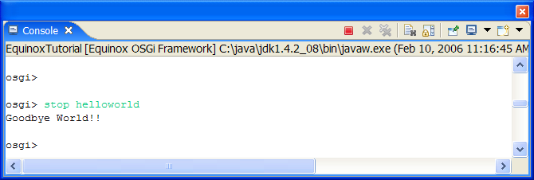
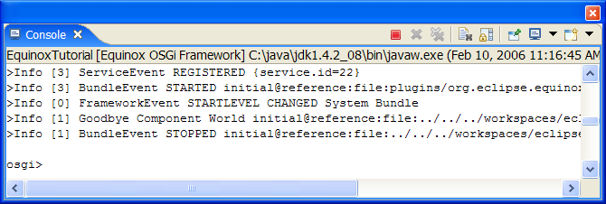
Launching
Launch the EquinoxTutorial launch configuration
You can look in the log with the log command
  Last event is at bottom
Stop the bundle
  Stop <symbolic-name>
Run log again

Slide 64
Section VII – Service Tracking

Slide 65
The Case for the ServiceTracker
Finding services for each message is kind of expensive.
The ServiceTracker in org.osgi.util.tracker package is intended to simplify this task
A service tracker maintains a list of services based on:
  A filter
  A specific class
It reports any existing or new services as well as any services that become unregistered
  Object addingService
  void modifiedService
  void removedService
The service tracker is used to track channels and store them in a Map

Slide 66
ServiceTracker: create
Framework
Bundle
A
Bundle
B
Bundle
C

Slide 67
ServiceTracker: open
Framework
Bundle
A
addServiceListener
Bundle
B
Bundle
C
Object addingService(ServiceReference r){…}
Object addingService(ServiceReference r){…}

Slide 68
ServiceTracker: adding
Framework
Bundle
A
addServiceListener
Bundle
B
Bundle
C
Object addingService(ServiceReference r){…}

Slide 69
ServiceTracker: removing
Framework
Bundle
A
addServiceListener
Bundle
B
Bundle
C
void removedService(ServiceReference r,Objecto){…}

Slide 70
ServiceTracker: modified
Framework
Bundle
A
addServiceListener
Bundle
B
Bundle
C
void modifiedService(ServiceReference r, Object o){…}

Slide 71
What We Did Not Learn
Security Architecture
Permission Management
Signed Bundles
Package Management
Bundle Life Cycle Management
Configuration Management and Preferences
Servlet Support/Web Server
Device Access
Event Manager
UPnP
User Admin
Wire Admin
Application Model
Deployment Admin and Autoconf
Device Management Tree
Initial Provisioning
Position, Measurement, State
MetaType
And much, much, more

Slide 72
Conclusion
The OSGi R4 Specifications consists of considerable more details than elucidated in this tutorial
There are many independent OSGi implementations on the market, both commercial and open source
  Apache Felix, Atinav, Eclipse Equinox, Espial, IBM SMF, Knopflerfish/Ubiserv of Gatespace, ProSyst, …
The OSGi specification are today running on mobile phones, PDAs, embedded computers, desktops, and mainframes
Both in managed and unmanaged configurations
The OSGi specifications solve real world problems
The OSGi Alliance is working on making the OSGi specifications the standard for portable applications. Join us!

Slide 73
The End
要关注的网站
http://www.osgi.org/Main/HomePage
OSGi is a trademark of the OSGi Alliance in the United States, other countries, or both.
Java and all Java-based trademarks are trademarks of Sun Microsystems, Inc. in the United States, other countries, or both.

Slide 74
The End
Further reading:
http://www.osgi.org
http://bundles.osgi.org
http://www.eclipse.org/osgi
http://www.aqute.biz
OSGi is a trademark of the OSGi Alliance in the United States, other countries, or both.
Java and all Java-based trademarks are trademarks of Sun Microsystems, Inc. in the United States, other countries, or both.

