Slide 1
Analog IC Design
Cadence Tutorial
ECSE 4030

Slide 2
To run cadence, you must connect to the ECSE teaching servers via VPN
For more information about ECS servers: https://wiki.ecse.rpi.edu/servers/teaching
using RPI VPN: https://itssc.rpi.edu/hc/en-us/articles/360008783172-VPN-Installation-and-Connection

Slide 3
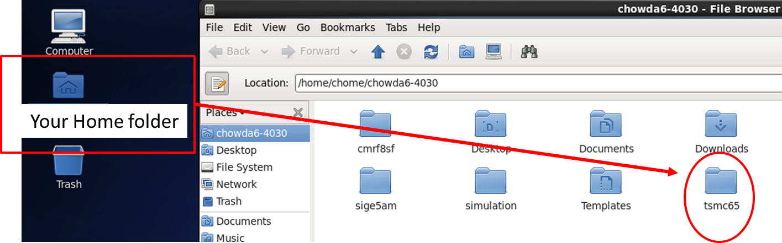
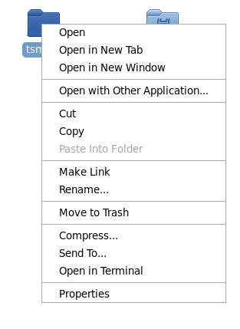
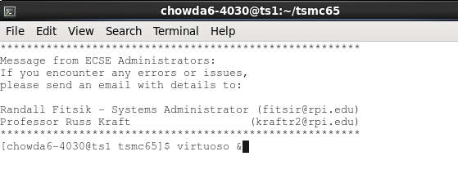
Starting Cadence
After log into your account
open your home folder YOUR_RIN-4030
Right click tsmc65 and select open in terminal
Right click
After that, - Type: “virtuoso &” in terminal and hit “Enter”.

Slide 4
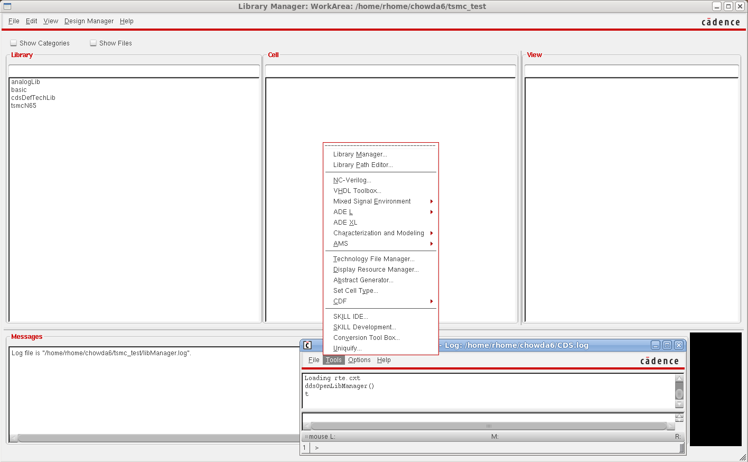
Library setup
Click Tools
→ Library Manager

Slide 5
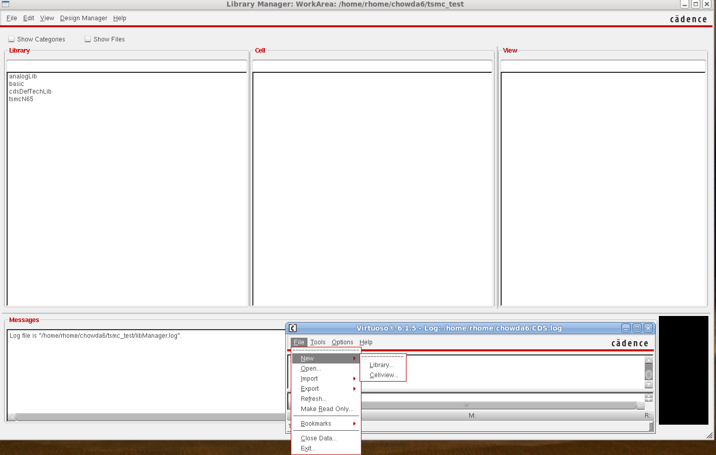
Then build new library
Create new library

Slide 6
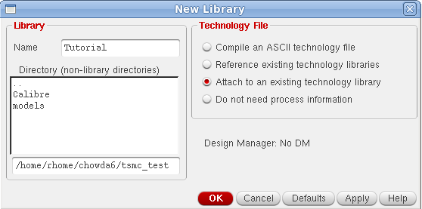
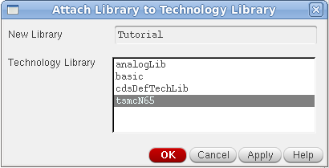
Choose
a name
Select, then
OK
The new library
will appears in
Library Manager
Select, then
OK

Slide 7
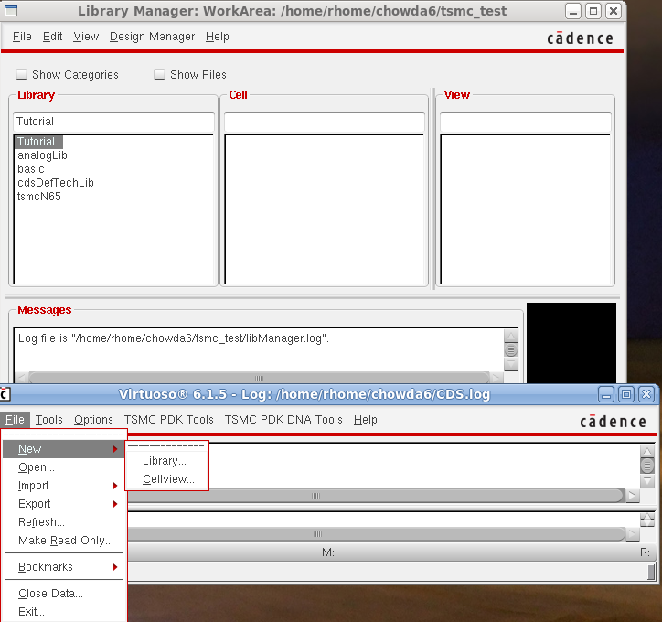
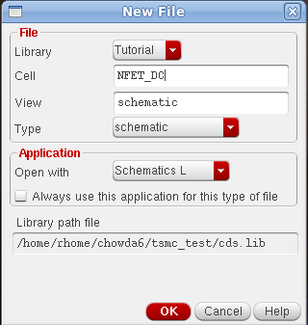
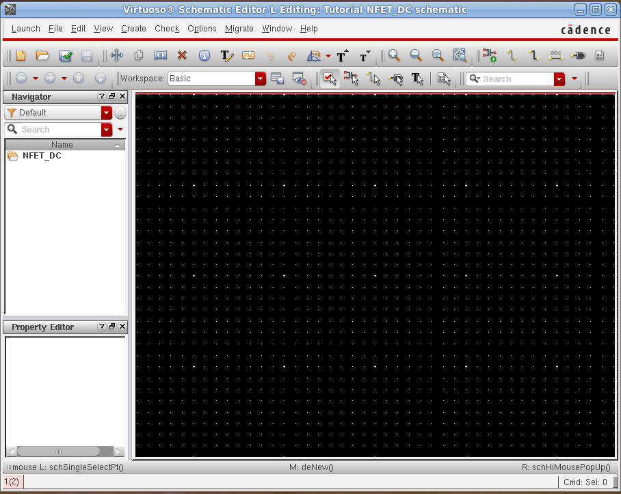
Select the new library
Then select Cell View
Choose a name, then OK

Slide 8
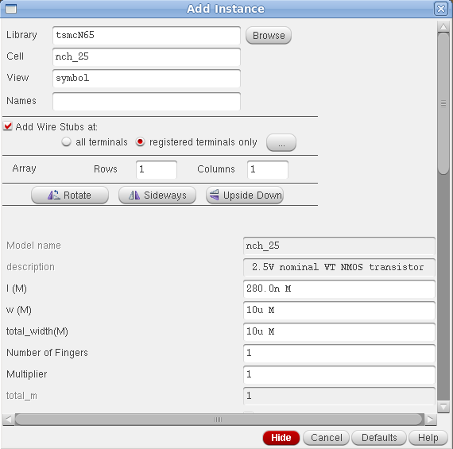
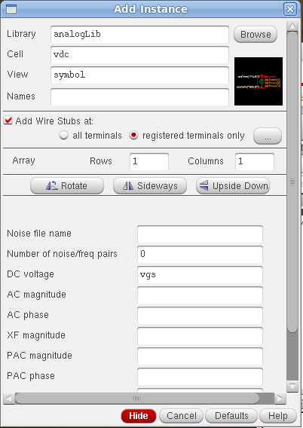
In schematic window, press i to insert instance,
Select a nch_25, view is symbol, change the width
to whatever value you want, then Hide.
Follow the same process, to insert DC supply and
gnd from Library analogLib, cell name is vdc, gnd
Set the DC voltage as vgs, then DC supply connect to
the drain as vds, as shown in next slide

Slide 9
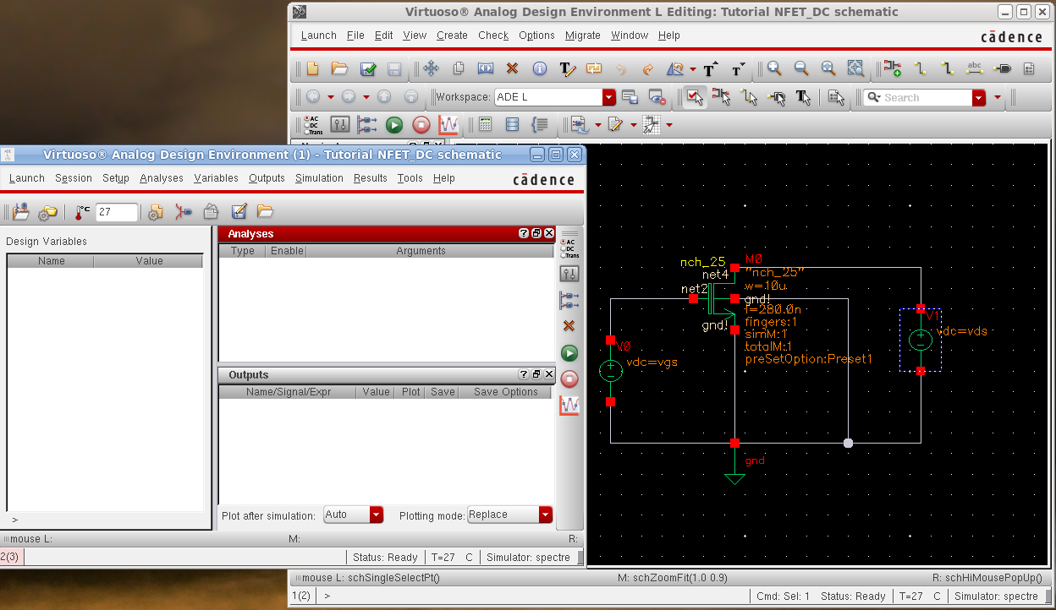
Then click check & save, go to Launch → ADE L, as shown

Slide 10
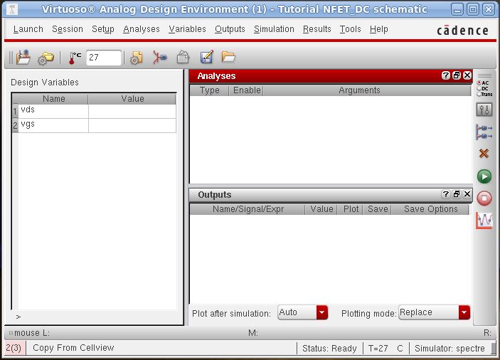
In analog design environment, go to variables → copy from cellview, to get all design parameters in the schematic
Choose
Analyese
Variables appear
here, double click
To give an initial
value
Edit variables

Slide 11
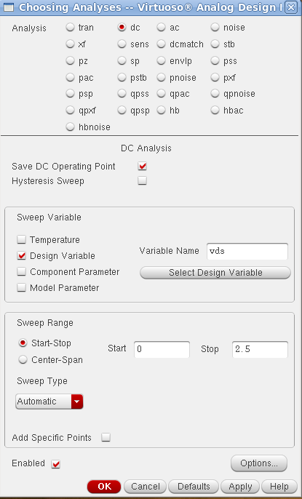
Setup DC
simulation
Click choose
analyses, set
DC analysis as
shown

Slide 12
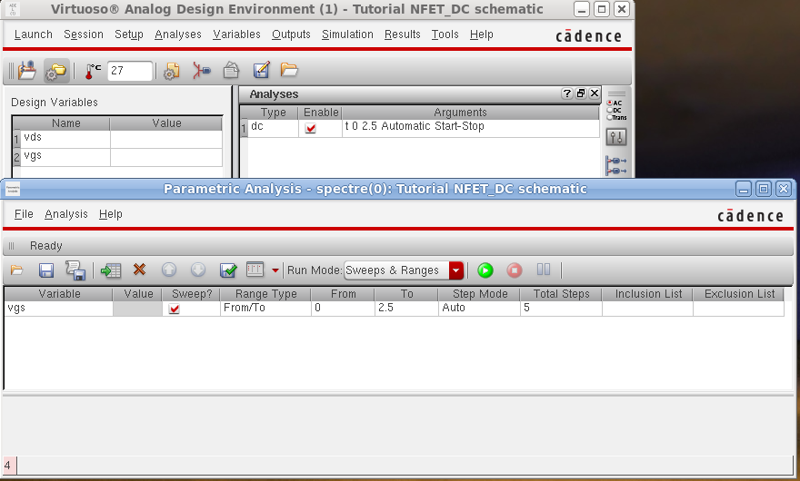
Setup parametric analyses, go to Tools → Parametric Analysis

Slide 13
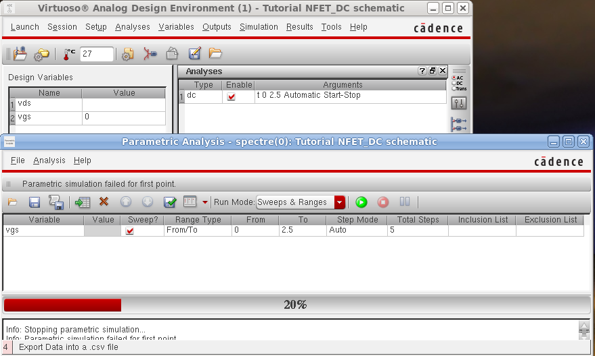
Run Parametric analysis
Initial value
Click to run
Simulation status

Slide 14
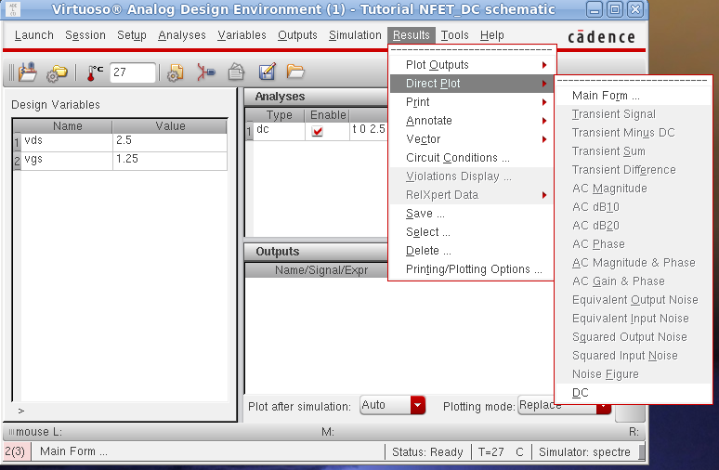
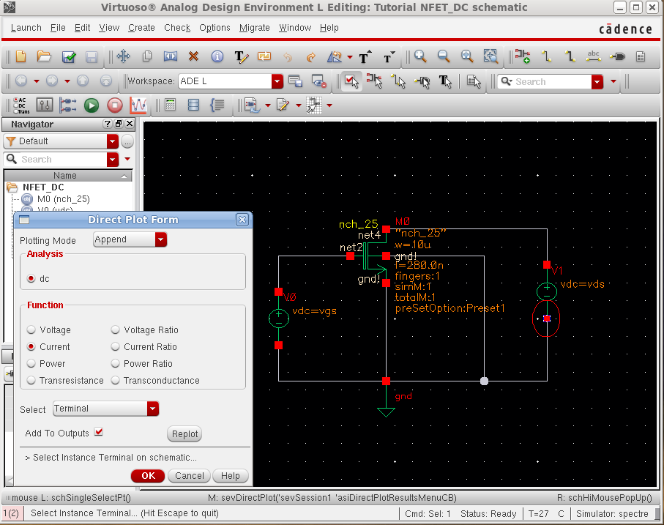
Plot I-V curve
Select the
negative node
of “V1”

Slide 15
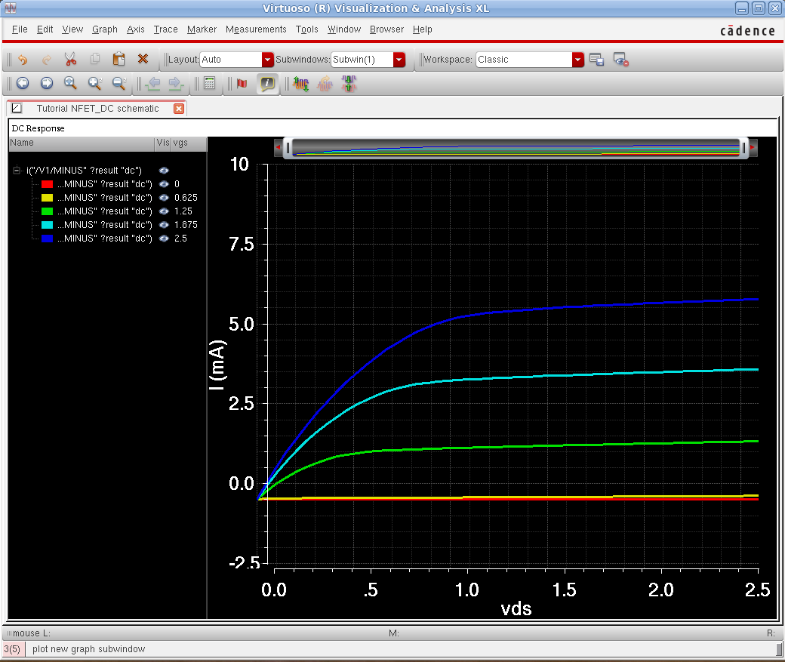
Plot

