Slide 1
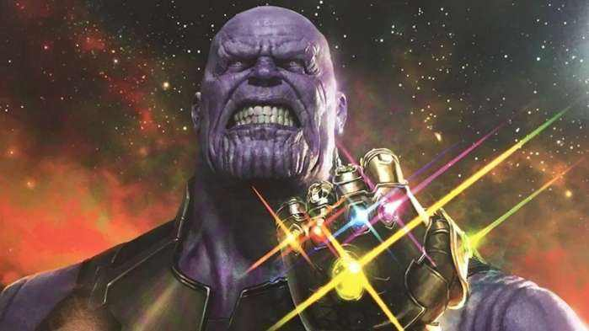
灭霸来了
Thanos is coming
group 9

Slide 2
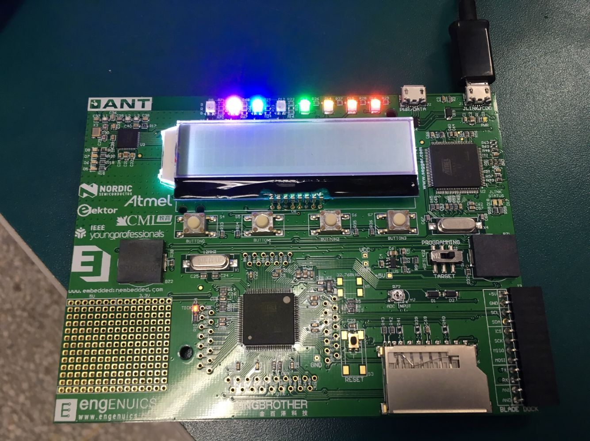
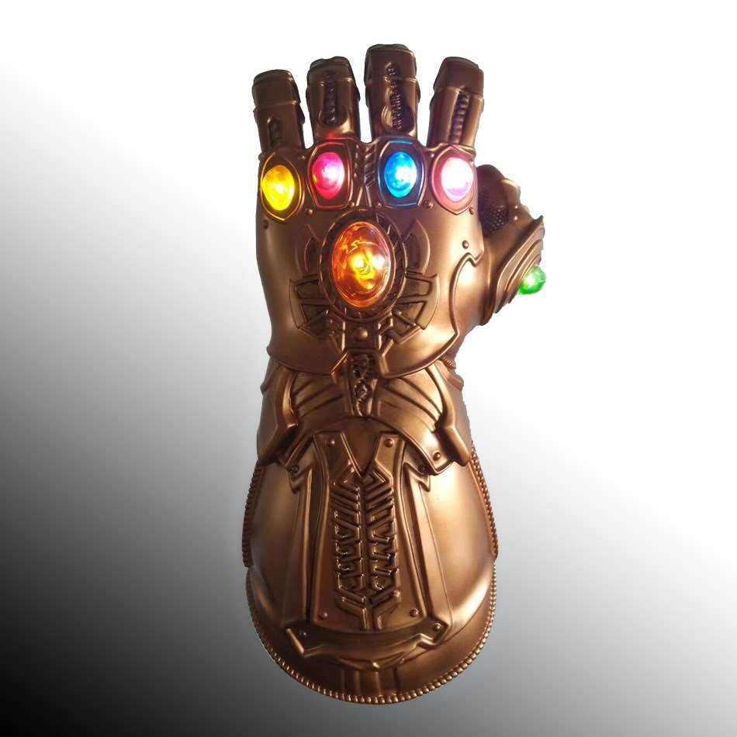
Step 1
When the light representing six infinity stones blinks, It means Thanos is coming.

Slide 3
Step 2
Thanos is hurting a lot of people, We should call 120 for ambulance.

Slide 4
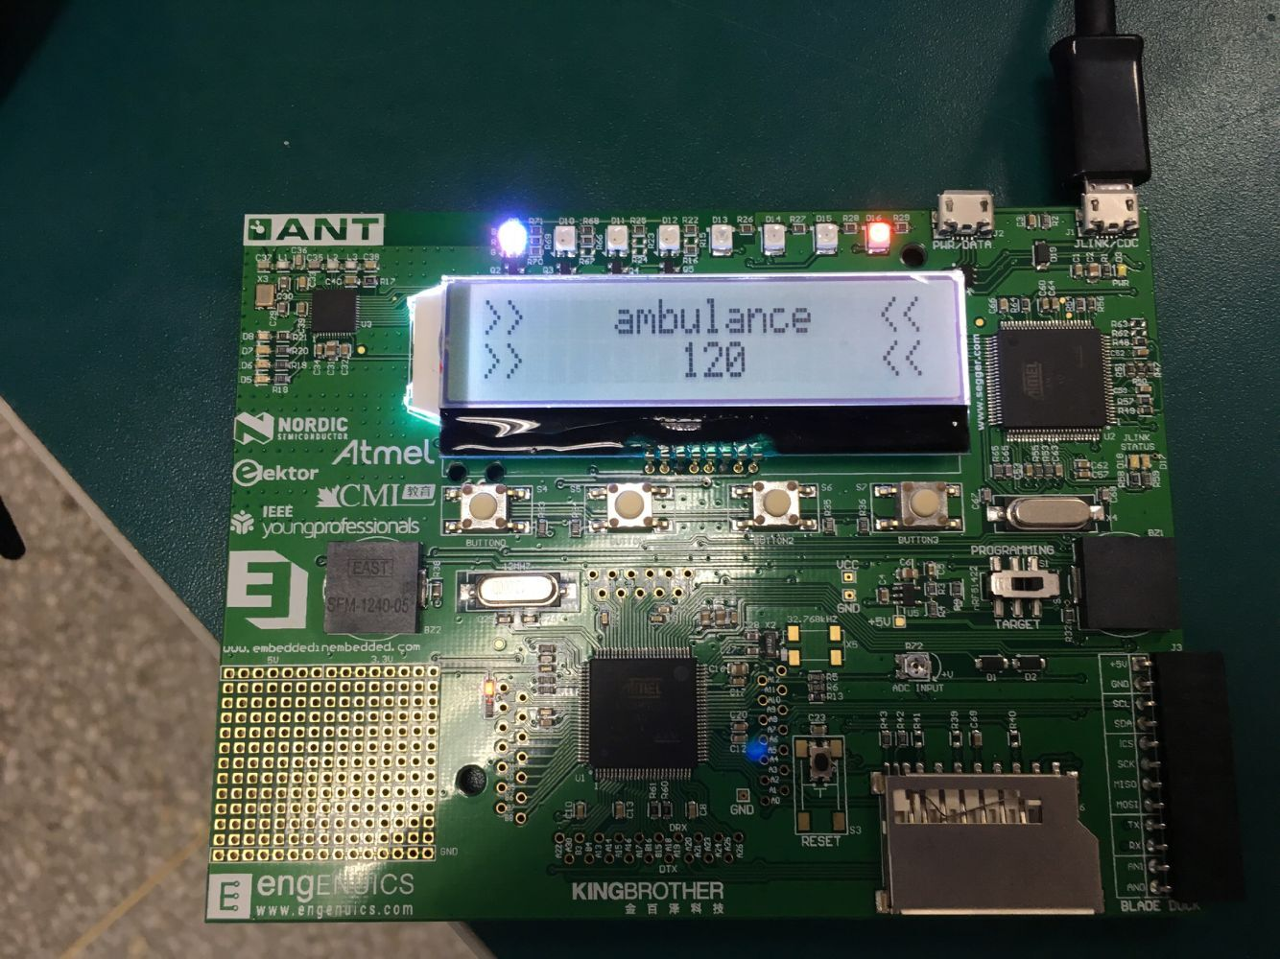
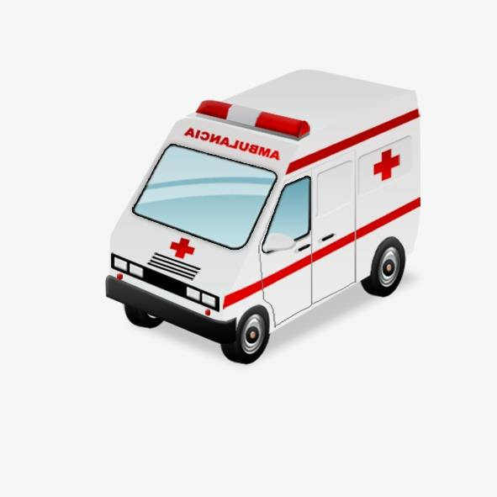
Step 3
The ambulance siren sounds and the light of red an white blinks, Means the ambulance is coming to save us.

Slide 5
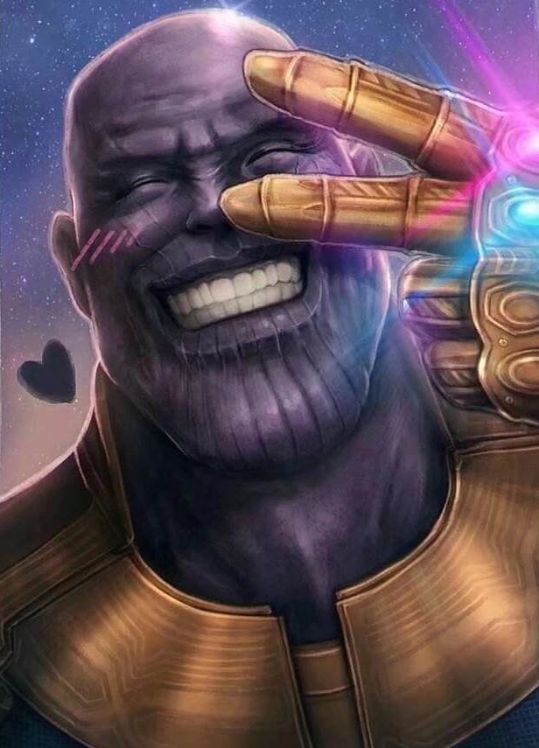
Thank you

