Slide 1
credit-g: a clean but mixed dataset
A · HU Zhongyuan · data and business cost
1,000
13
7
loan records
nominal attributes
numeric attributes
700 good (70%)
300 bad (30%)
No missing values · bad is the positive class · missing a bad loan costs 5× more
01
Notes:
Thanks, zyj — yes, the cleaner one first. credit-g: one thousand loan applications from a German bank. 1,000 rows, 21 columns — thirteen categorical, seven numeric, plus the class. Zero missing values, zero duplicates. The class is 700 good versus 300 bad — 70 to 30. We treat bad as the positive class, and the official cost matrix says missing a bad loan costs five times more than rejecting a good one.

Slide 2
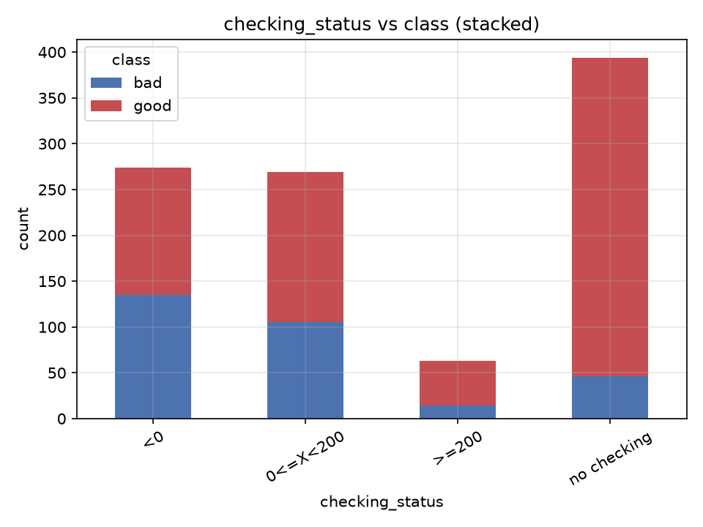
Checking status: the clearest signal
A · HU Zhongyuan · exploration
49%
default rate — account below zero (<0)
12%
default rate — no checking account
overall average: 30% — in between
Less money in the account, more risk — a top-3 feature in the random forest too.
02
Notes:
One thing stands out: checking status. The four groups are sorted by default rate, and it goes down step by step — an account below zero: 49% default. No checking account at all: only 12%. The average, 30%, sits right in the middle.

Slide 3
Encoding changes the Logistic result
A · HU Zhongyuan · own A6 experiment
One-hot
Ordinal
F1(bad) = 0.531
F1(bad) = 0.406
AUC 0.785 · 61 columns
AUC 0.738 · 20 columns
+0.125 F1, +0.047 AUC — both significant (paired t: p = 0.021 / 0.008)
Why: nominal categories have no natural rank; ordinal codes impose one.
Apriori echo: all three RF top-3 features reappear among the 6 retained rules → zyj
Targeted A6 comparison; not the full 32-configuration ranking.
03
Notes:
Now, my experiment. Mixed data — numbers and categories — so does encoding matter? Same logistic regression, two versions of the same data: one-hot plus scaling, 61 columns; or categories as plain numbers, 20 columns. Same model, same folds, same seed — only the encoding changes.
F1 jumps from 0.41 to 0.53, and AUC rises as well — both gains are statistically significant, and the gap comes from the encoding, not the scaling. So on mixed data, encoding decides which linear model wins — that's our answer to research question three. And it's not only the models: the Apriori rules echo the same fields — all three of the forest's top features reappear among the six retained rules — zyj will come back to this. Encoding and rules point to the same key fields. Next, the harder side — Ling will take you into sick.

