Slide 1
SYSTEM RECOMMENDATION
Professor: Tian Zheng
GROUP 9:
1. Chen, Yanzhu yc3511@columbia.edu 2. Lal, Sagar sl3946@columbia.edu 3. Lu, Haotian hl3089@columbia.edu 4. Wang, Yakun yw3211@columbia.edu 5. Xu, Yizhen yx2470@columbia.edu

Slide 2
01
ALS+Regularization(magnitude+bias)
02
Post processing(knn+krr)
CONTENT
03
Linear regression
04
conclusion

Slide 3
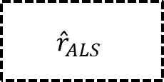
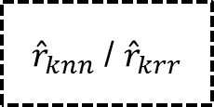
cv
Knn/Krr
Train/test data
②
ALS+biases
①
$${\hat{r}}_{ALS}$$
${\hat{r}}_{knn}$ / ${\hat{r}}_{krr}$
③
Linear Regression

Slide 4
1
PART ONE
ALS with Regularization

Slide 5
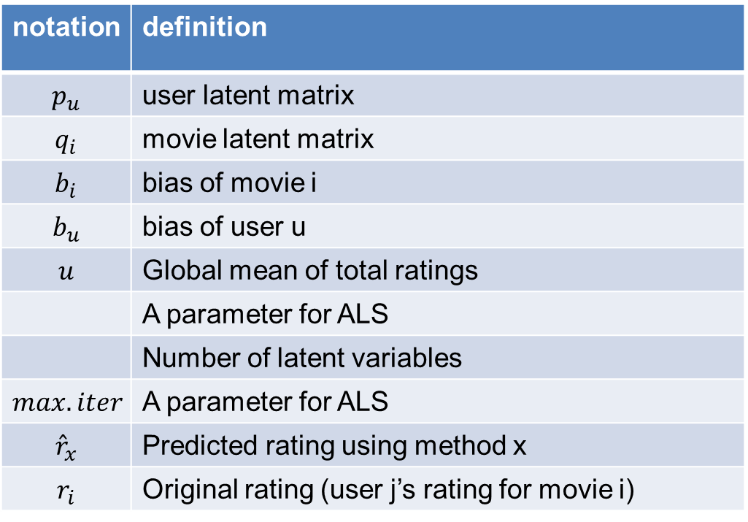
ALS with biases
notation | definition
$$p_{u}$$ | user latent matrix
$$q_{i}$$ | movie latent matrix
$$b_{i}$$ | bias of movie i
$$b_{u}$$ | bias of user u
$$u$$ | Global mean of total ratings
 | A parameter for ALS
 | Number of latent variables
$$max.iter$$ | A parameter for ALS
$${\hat{r}}_{x}$$ | Predicted rating using method x
$$r_{i}$$ | Original rating (user j’s rating for movie i)

Slide 6
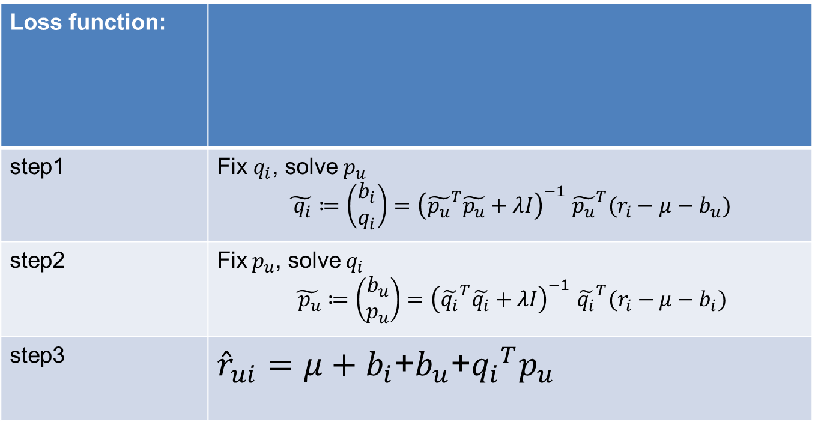
ALS with biases
Loss function:
step1 | Fix $q_{i}$, solve${ p}_{u}$ $$\tilde{{ q}_{i}}≔\left(\begin{aligned}b_{i} \\ q_{i}\end{aligned}\right){=\left({\tilde{p_{u}}}^{T}\tilde{p_{u}}+λI\right)}^{−1}{\tilde{p_{u}}}^{T}(r_{i}−μ−b_{u})$$
step2 | Fix${ p}_{u}$, solve${ q}_{i}$ $$\tilde{{ p}_{u}}≔\left(\begin{aligned}b_{u} \\ p_{u}\end{aligned}\right){=\left({\tilde{q_{i}}}^{T}\tilde{q_{i}}+λI\right)}^{−1}{\tilde{q_{i}}}^{T}(r_{i}−μ−b_{i})$$
step3 | ${\hat{r}}_{ui}=μ+b_{i}$+$b_{u}$+${q_{i}}^{T}p_{u}$

Slide 7
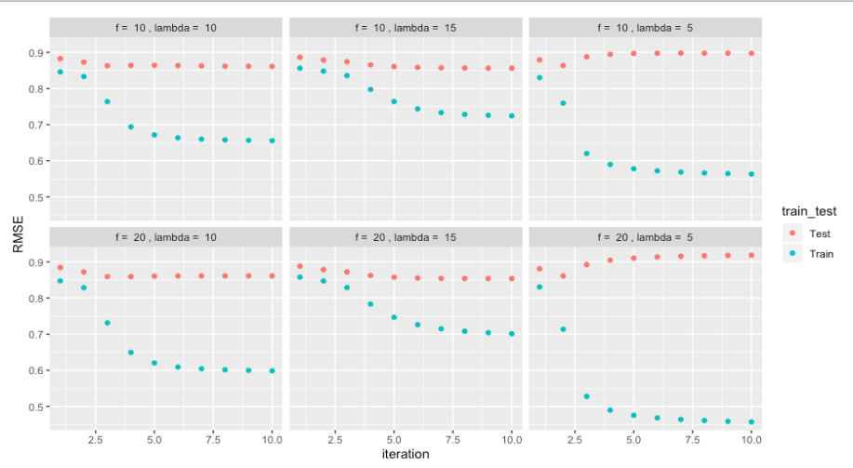
ALS with biases
Lambda=10,f=10,max.iter=3

Slide 8
Evaluation
RMSE | Train data | Test data
ALS | 0.7665 | 0.8576
Accuracy of high rating | Train data | Test data
ALS | 96.87% | 93.88%
$$accuracy of high ratings=\frac{P(true rating≥4|predict rating≥4.5)}{P(predict rating≥4.5)}$$

Slide 9
2
PART TWO
Post processing

Slide 10
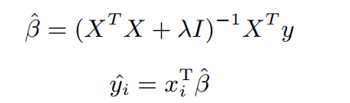


Post processing
Average rating of the most similar movie
krr
knn
25
610 times

Slide 11
Evaluation
RMSE | Train data | Test data
ALS | 0.7665 | 0.8576
KNN | 1.1134 | 1.1485
Krr | 0.6100 | 0.8609
Accuracy for high ratings | Train data | Test data
ALS | 96.87% | 93.88%
KNN | 62.56% | 54.17%
Krr | 99.00% | 94.35%

Slide 12
3
PART THREE
Linear Regression

Slide 13
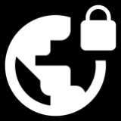
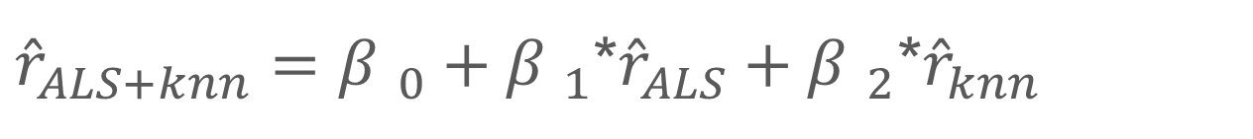
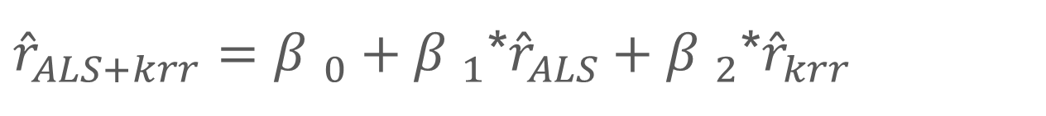
Linear Regression
kkk
ALS+KNN
①
${\hat{r}}_{ALS+knn}={β }_{0}+{β }_{1}$*${\hat{r}}_{ALS}+{β }_{2}\text{∗}{\hat{r}}_{knn}$
ALS+KRR
②
${\hat{r}}_{ALS+krr}={β }_{0}+{β }_{1}$*${\hat{r}}_{ALS}+{β }_{2}\text{∗}{\hat{r}}_{krr}$

Slide 14
Evaluation
RMSE | Train data | Test data
ALS | 0.7665 | 0.8576
KNN | 1.1134 | 1.1485
KRR | 0.6100 | 0.8609
LR(ALS+KNN) | 0.7462 | 0.8635
LR(ALS+KRR) | 0.5935 | 0.8779

Slide 15
Evaluation
Accuracy for high ratings | Train data | Test data
ALS | 96.87% | 93.88%
KNN | 62.56% | 54.17%
KRR | 99.00% | 94.35%
LR(ALS+KNN) | 93.50% | 90.88%
LR(ALS+KRR) | 98.44% | 90.48%

Slide 16
4
PART FOUR
Conclusion

Slide 17
Conlusion
Knn is a better predictor than Krr.
ALS works best.
Further step: CV for post processing

Slide 18
THANKS FOR YOUR WATCHING

