Slide 1
Analysis of FIFA 24 Capability Values for Football Players from Four Countries
Yida Chen: yic192@pitt.edu
Final Report

Slide 2
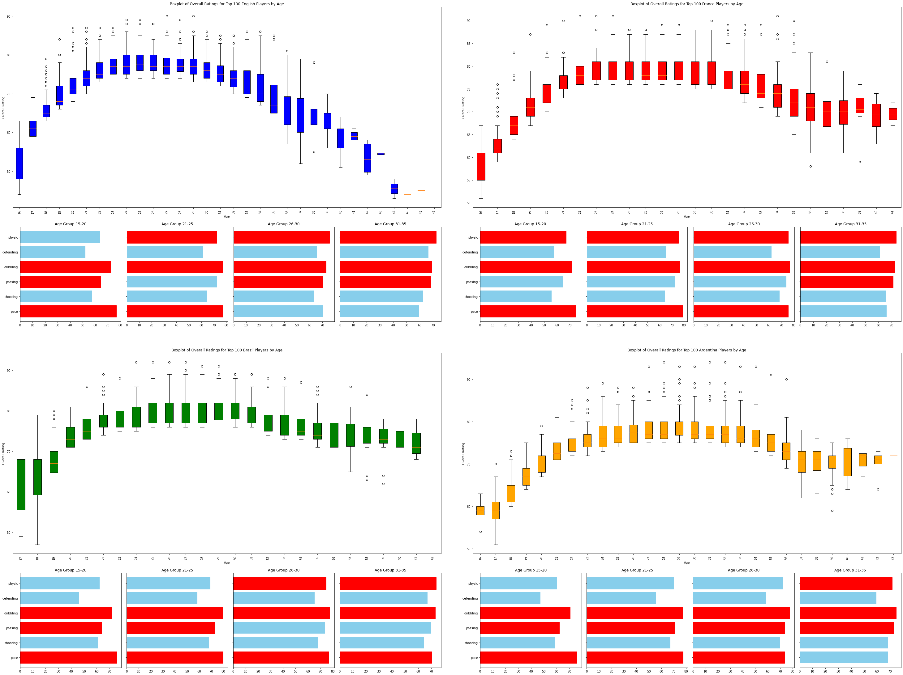
Distribution chart of the top 100 athletes' ability values across all age groups from four countries
Players’ abilities improve with age, typically peaking between 26 to 32 years old.
Players from different countries exhibit significant preferences in certain skills.
The "prime time" age range of players differs by country.

Slide 3
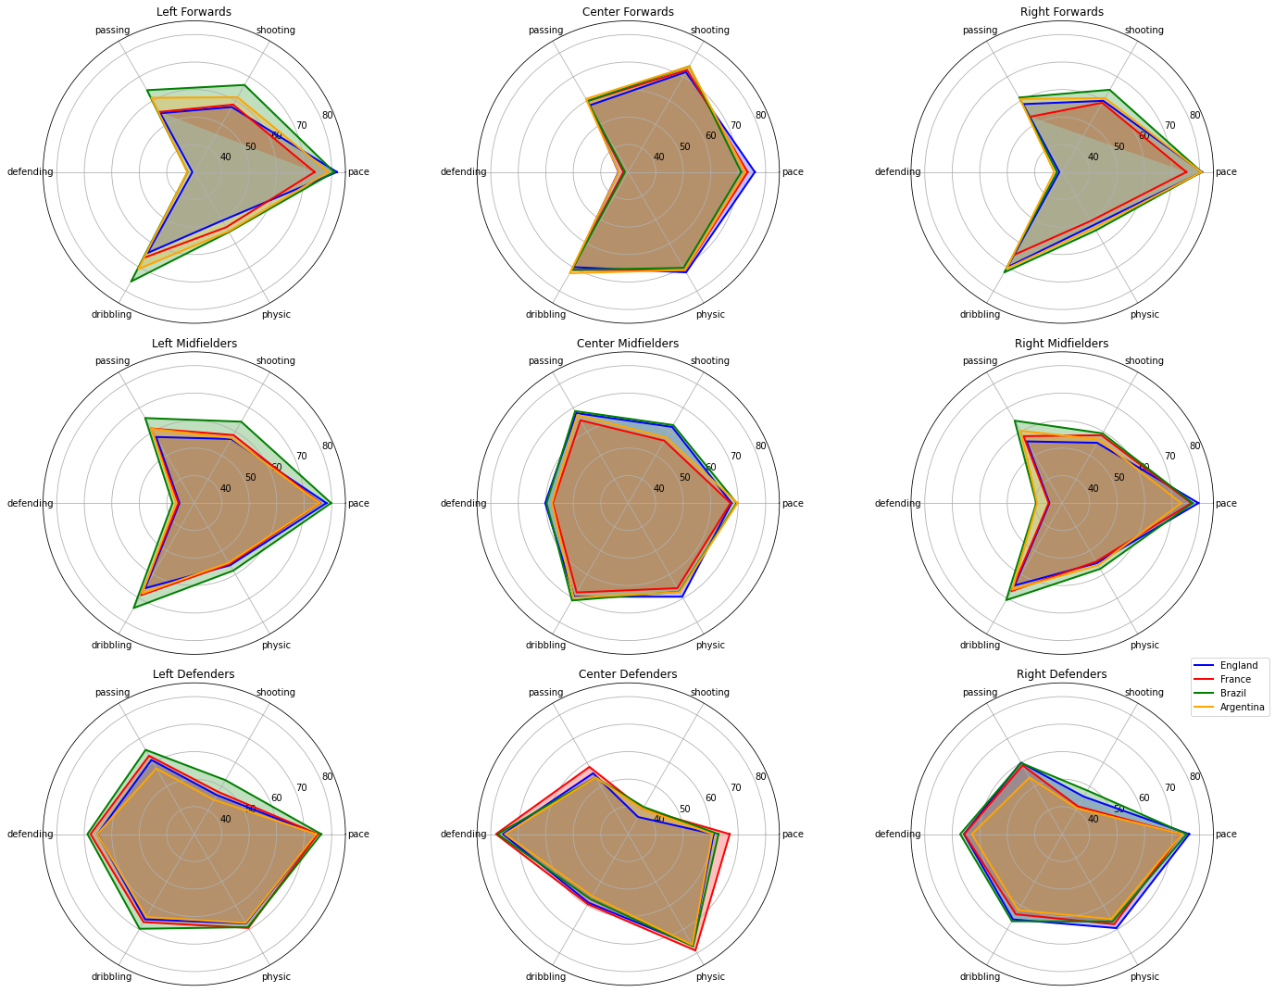
Comparison of capability values at each position
Each country has distinct areas of strength and weakness
Brazilian teams, particularly between the ages of 20 to 28, excel in attributes related to speed and skill.
The England team, within the same age range, is characterized by a strong midfield, which excels in game control attributes.

Slide 4
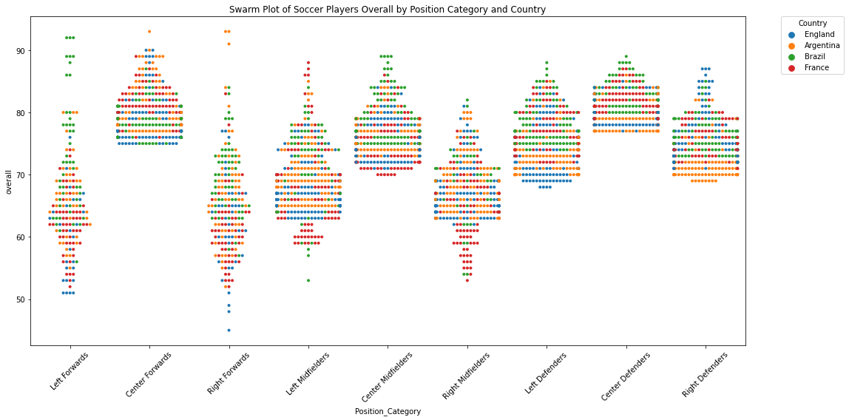
Distribution of capacity values in four countries by position
Brazil excels in producing talented left forwards within a broad age range, highlighting a strong development in that position.
Argentina showcases exceptional right midfielders and forwards, suggesting targeted development and strategic emphasis in these roles.
England's concentrated talent in center forward and right-wing positions indicates specialized training for scoring and offensive support roles.
France's dominance in left midfield and center forward reflects effective nurturing of players in these positions, likely enhancing their offensive play.

Slide 5
End of Presentation. Thank you.

